Slide 1
Cognitive Robotics 06. Non-Parametric Filters: Discrete Filter, Particle Filter, Monte Carlo Localization
AbdElMoniem Bayoumi, PhD
Fall 2022

Slide 2
Acknowledgment
These slides have been created by Wolfram Burgard, Dieter Fox, Cyrill Stachniss and Maren Bennewitz

Slide 3
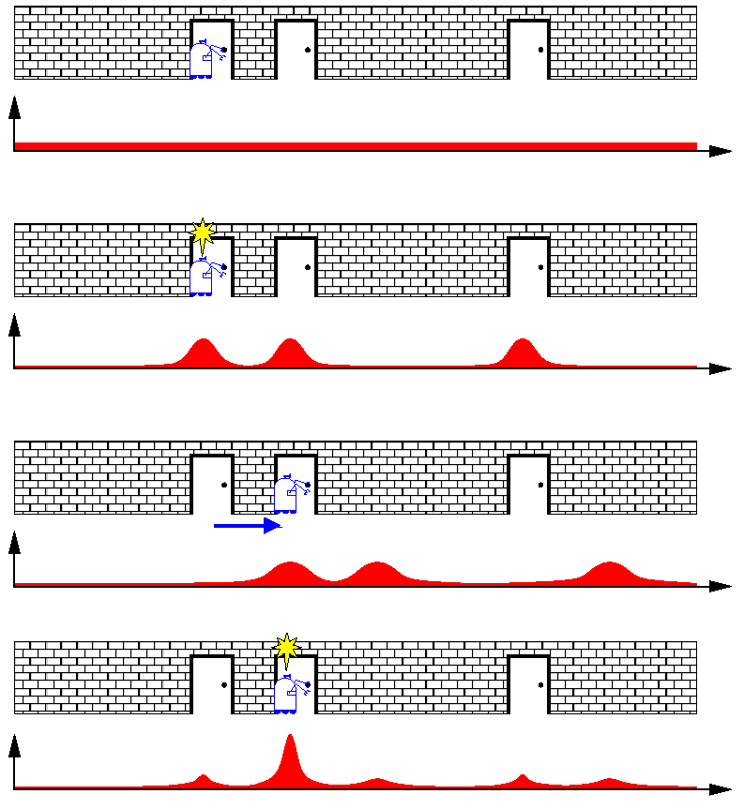
Probabilistic Localization
Notes:
click: formula
running example to compare performance of different filter impl.
1D state space, only move forward, backward. 1: uniform prior.
2: one obs. direct product: obs model with prior.
3: normally actions make the robot uncertain. convol of prior with mm.
4: further obs: multiply prior with obs model.
distr. we would like to obtain. consistent with both obs.
how can we repr. the post. and eff. update it?

Slide 4
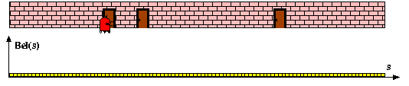
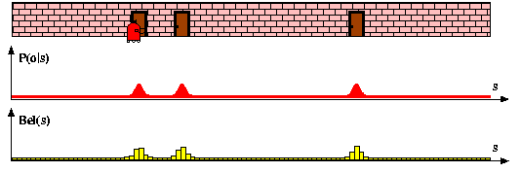
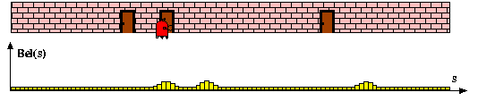
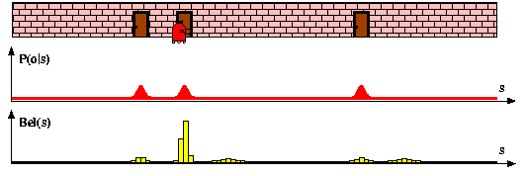
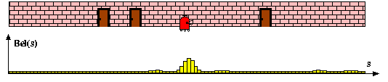
Discrete Filter: Piecewise Constant
Notes:
one possible solution. histograms.
approximate belief by a number of bins. size of the bins = accuracy
1: ini: unif. distr. over all bins. 2: likelihood fct, multiply with prior. normalize.
3: convolve with mm: uncertainty. 4. obs: multiply with likelihood. normalize. consistent with… 5: convolve with mm.
in general: 3D pose, x,y,theta (or more), more complex

Slide 5
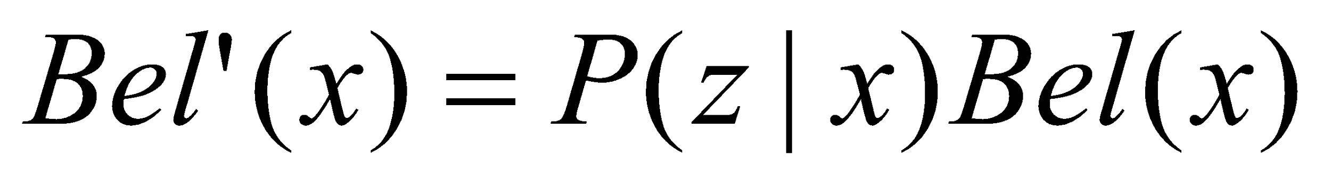
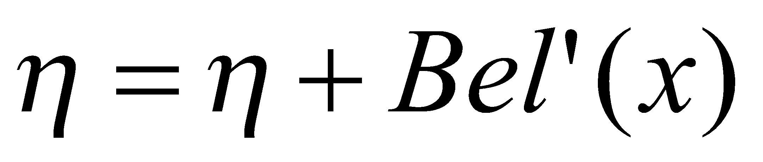
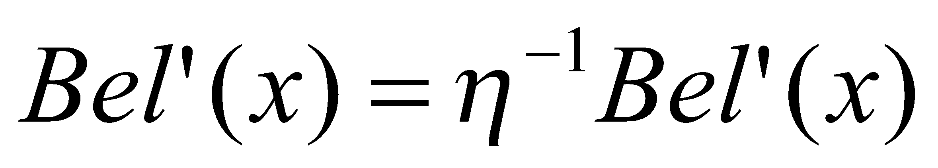
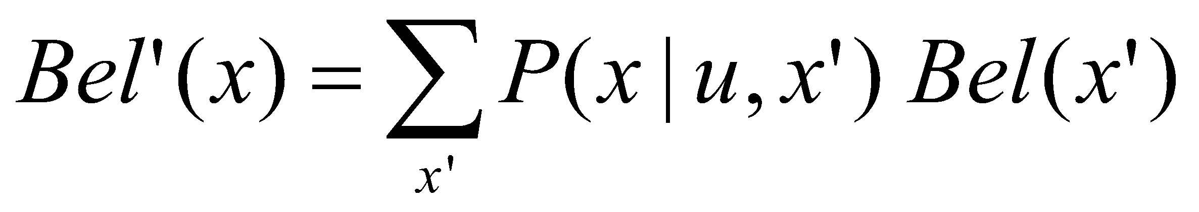
Bayes Filter Algorithm
Algorithm Bayes_filter( Bel(x),d ):
η=0
If d is a perceptual data item z then
For all x do
For all x do
Else if d is an action data item u then
For all x do
Return Bel’(x)
sum over all discrete states
motion model, Ch. 4
Notes:
BF as def. in Ch 2 but now for the discrete case.
for all states repr. as bins. L5: multiply belief with obs likelihood.
Add up prob, L6/8: normalize, over all histogram entries sum up to 1.
L11: integral -> sum over all states. consider prob. of ending up in state x.
closed form calc of posterior.
quadr. complexity (unless certain states can be excluded)

Slide 6
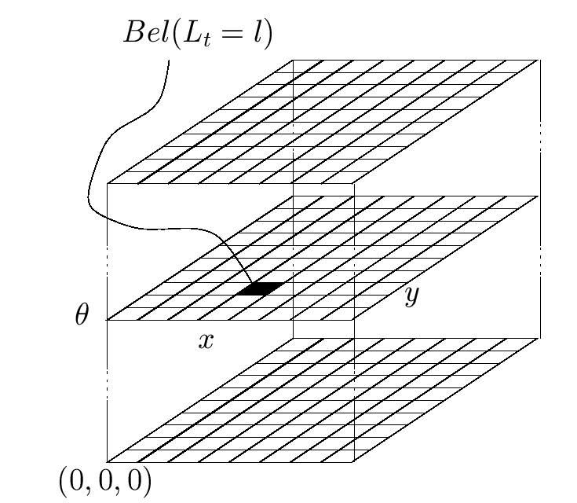
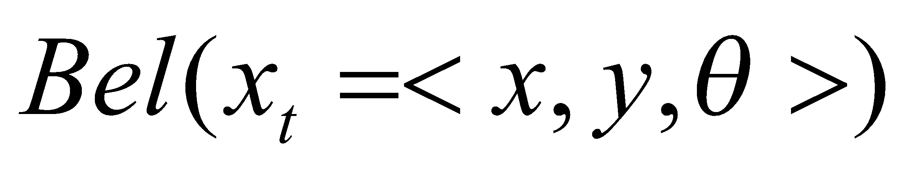
Piecewise Constant Representation
Notes:
3D grid structure. 1 layer for each poss. discretized orientation.
same loc, diff orientation.
not memory efficient for a reasonable res. e.g. 15 cm, 1-2 deg.
Problem: access+update. hard to update in real time for large maps.
Possibly cannot integrate all obs. since too slow.

Slide 7
Implementation
To update the belief, one has to iterate over all cells of the grid
When the belief is peaked, one wants to avoid updating irrelevant aspects of the state space
Monitor whether the robot is de-localized or not
Consider the likelihood of the observation in the relevant components of the state space
Assume a bounded Gaussian for the motion uncertainty
Notes:
1: Mio of multiplications.
2: Typically after some time unimodal distr., no update in areas where prob < thresh, leave min value
3: attention: de-loc! tele-ported
4: if obs likelihood < thresh consider all states again.
5: Shift the data in the grid acc. to measured motion, convolve with a Gaussian kernel. instead of quadratic, linear update complexity

Slide 8
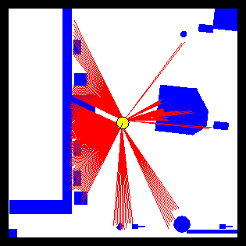
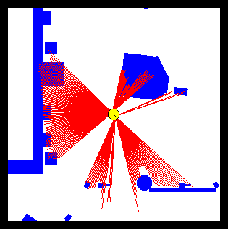
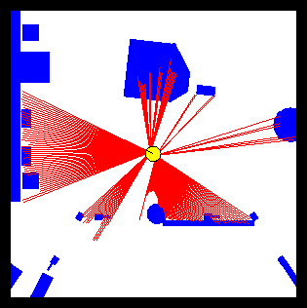
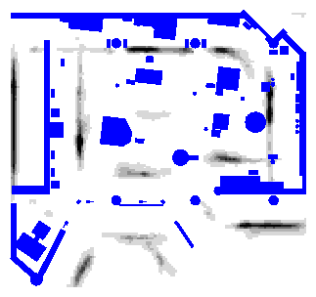
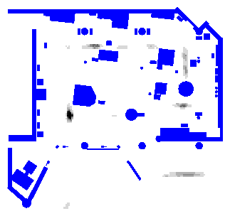
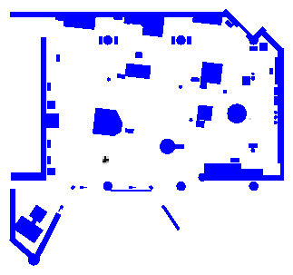
Grid-Based Localization
Notes:
discrete BF applied to loc. some noisy reflections, in general fits well.
3D grid: 15 cm, 2 deg angular res., 80MB
2D repr. of 3D histo. max of diff. layers of orient.
wall on the right. the darker, the higher the likeliood. multi-modal
<click><click>
after integration of 3 measurements: 1 single peak

Slide 9
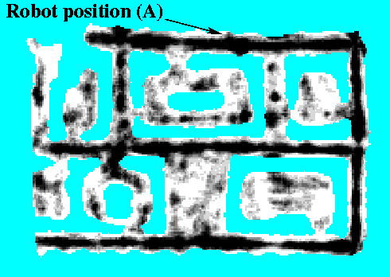
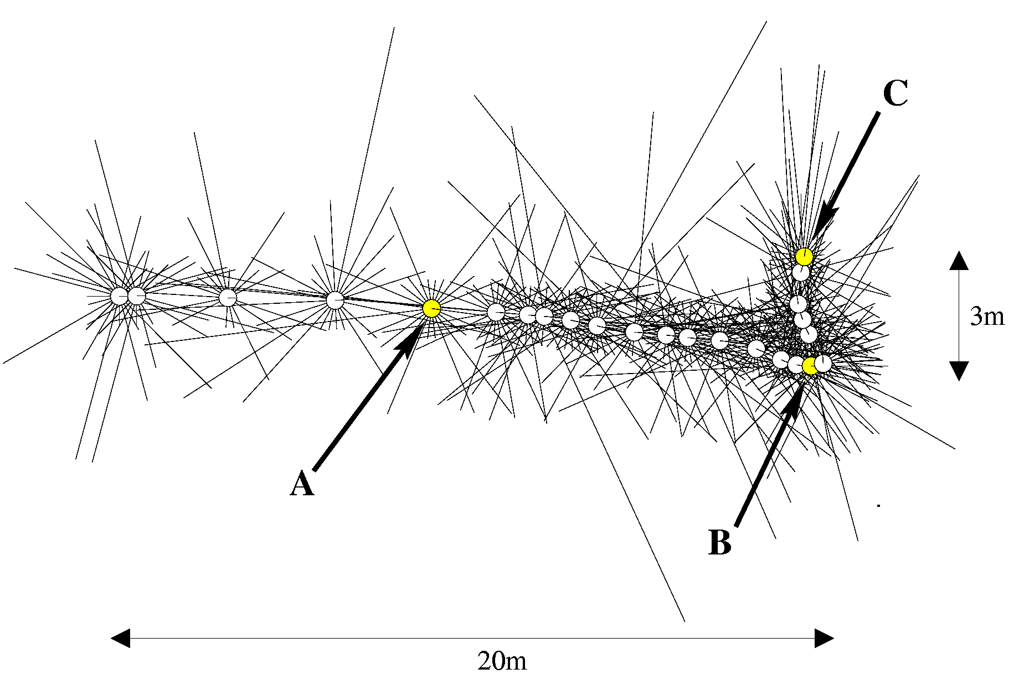
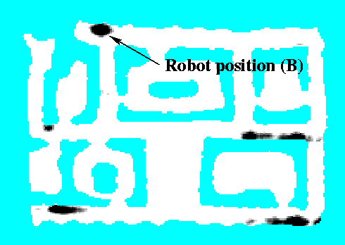

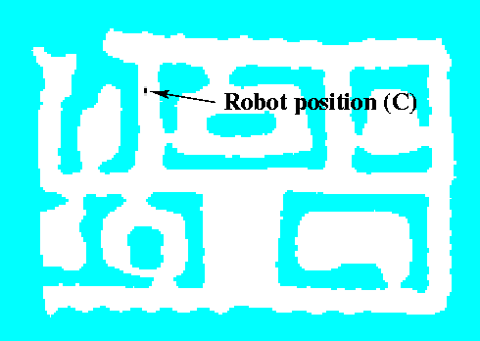
Sonars and Occupancy Grid Map
A
B
C
Notes:
odo, 24 sonar readings. where is the robot?
must be at the end of a long corridor. [click]
based on relatively noisy obs. robot can figure out where it is.

Slide 10
Summary: Discrete Filters
Discrete filters are an alternative way for implementing the Bayes Filter
Histograms for representing the density
Can represent multi-modal beliefs and recover from localization errors
Huge memory and processing requirements
Accuracy depends on the resolution of the grid
In practice: approximations needed
Notes:
2: piece-wise constant fct used for appr.
6: update only in relevant parts, bounded Gaussian for mm

Slide 11
Motivation: Particle Filter
Discrete filter
High memory complexity
In general: fixed resolution
Particle filters are a way to efficiently represent non-Gaussian distributions
Basic principle
Set of state hypotheses (“particles”)
Survival-of-the-fittest
Notes:
1.2: variants such as octrees can adapt to the belief distrib.. but more complex to implement.
Appr. of the cont. space by piecewise constant fct, more efficient: set of particles instead of 3D grid. sub-resolution accuracy.
3: guess about pos+orient. propagate hyp. according to motion model, evaluate based on obs. model. how well p. can explain obs.

Slide 12
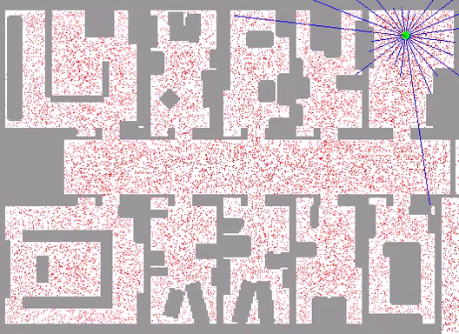
Example: Sample-Based Localization (Sonar)
‹#›
Notes:
beams shown from particle with highest obs. likelihood
symmetric corridor.
has to acquire data in room to be able to localize.

Slide 13
Motivation
Goal: approach for dealing with arbitrary distributions

Slide 14
Key Idea: Samples
Use a set of weighted samples to represent arbitrary distributions
samples

Slide 15
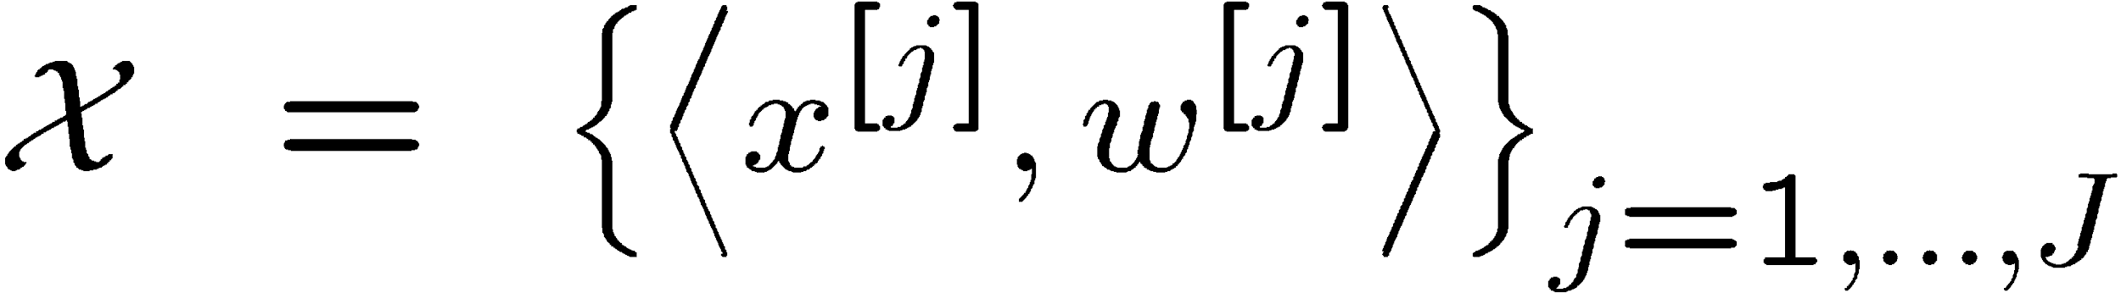
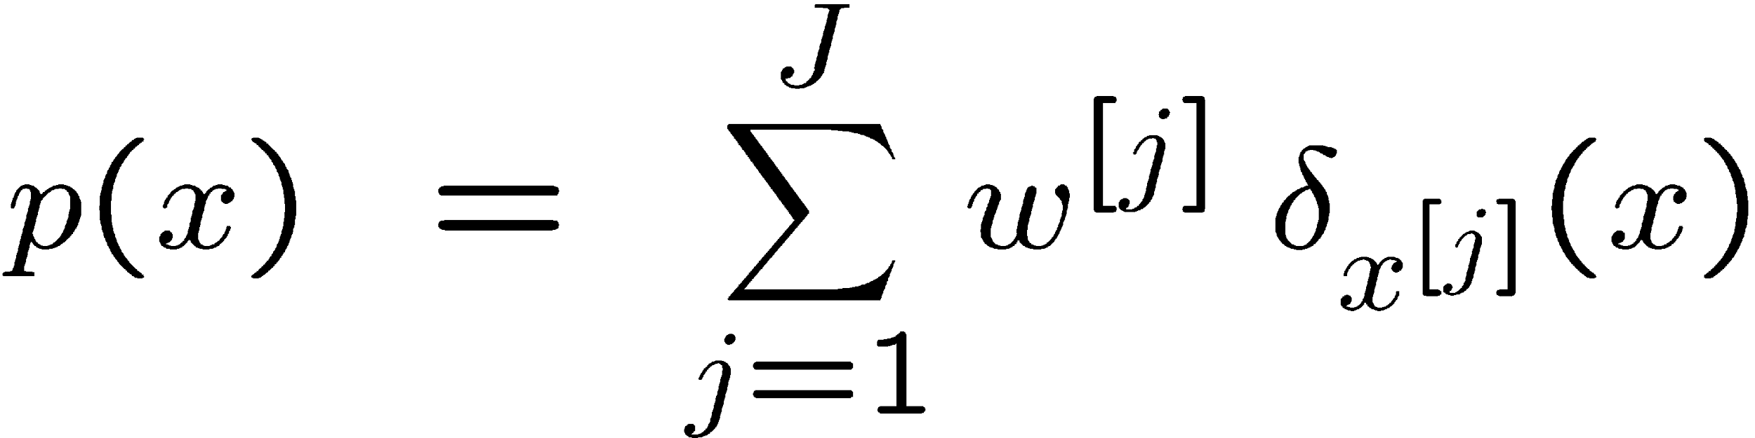
Particle Set
Set of weighted samples
The samples represent the posterior
state hypothesis
importance weight
Notes:
1: J samples/particles x, y, theta
later: how to calc. weights, how to update state hypot. based on mm, obs model
2: math. descrip. posterior = weighted sum of p. states.
dirac delta: infinite, zero, integral = 1.

Slide 16
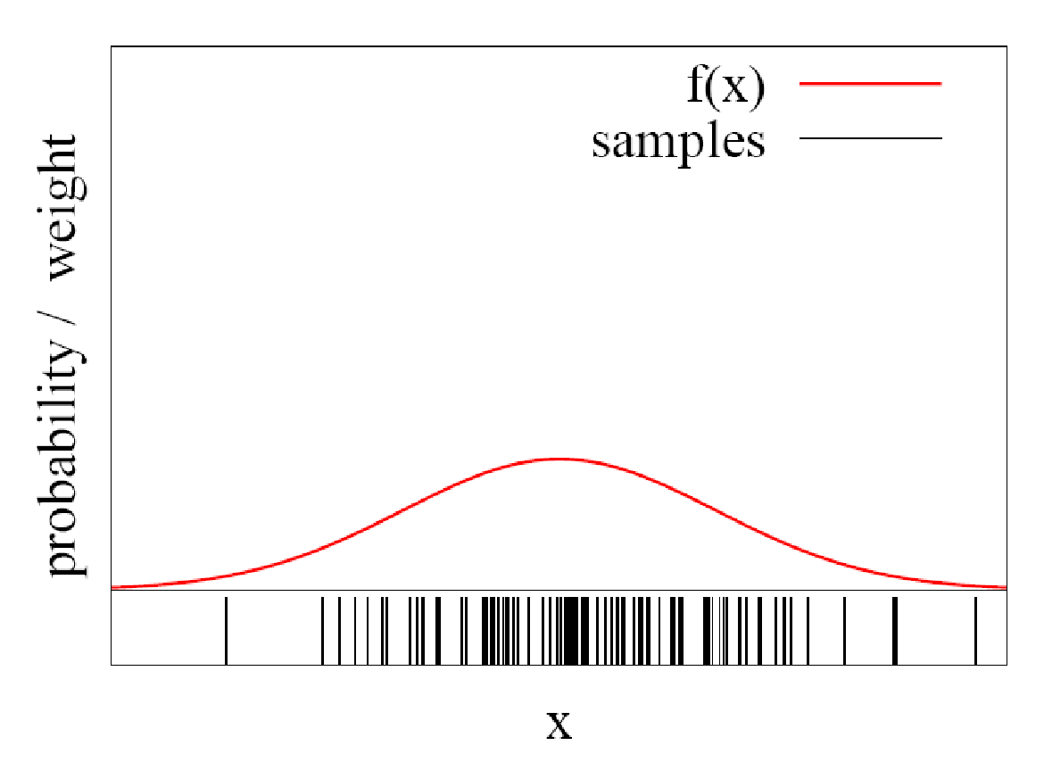
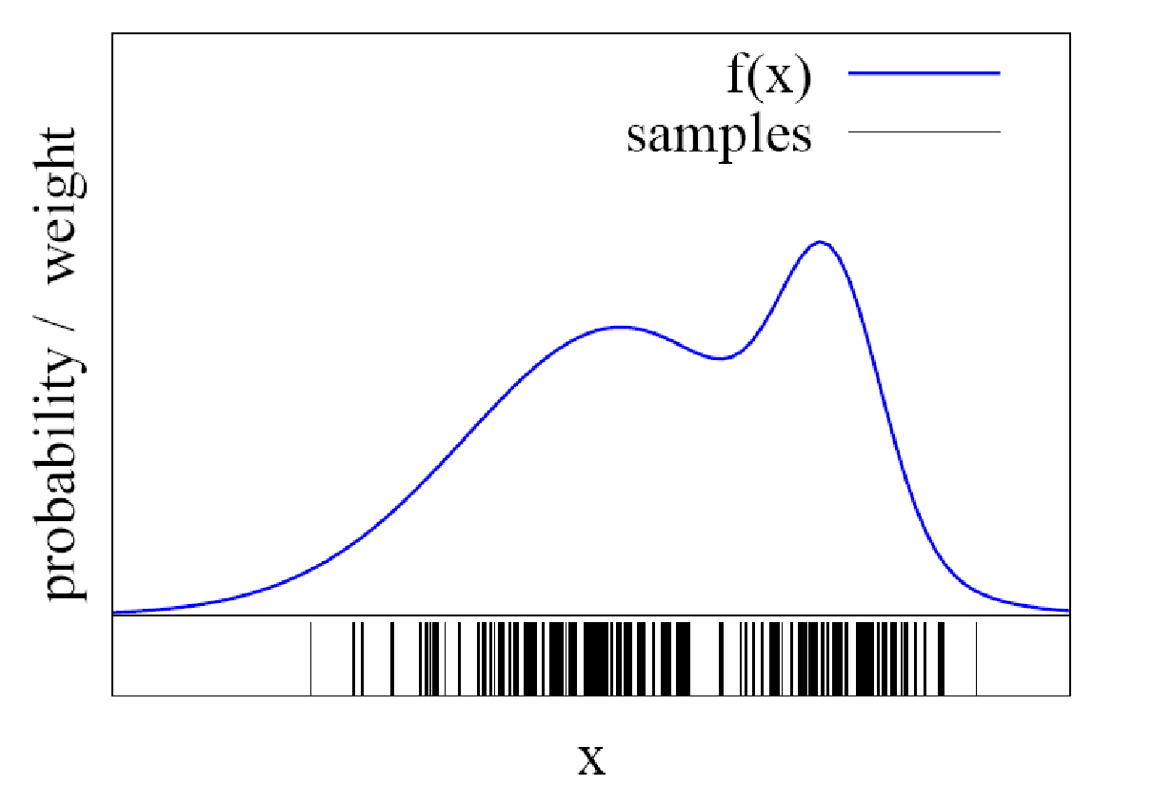
Particles for Approximation
Particles for function approximation
The more particles fall into a region, the higher the probability of the region
How to obtain such samples?
Notes:
basic idea
2: the higher the fct value

Slide 17
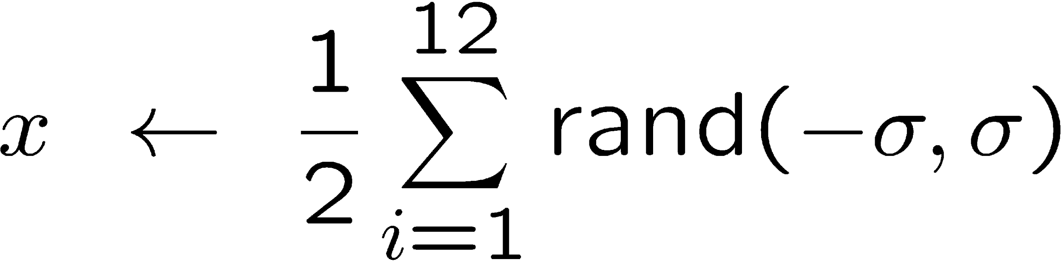
Closed Form Sampling is Only Possible for Few Distributions
Example: Gaussian
How to sample from other distributions?
Notes:
as discussed in Ch4.
2: rejection sampling as in Ch4. Uniform sampling comp. with f value. Not very efficient.

Slide 18

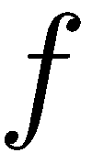
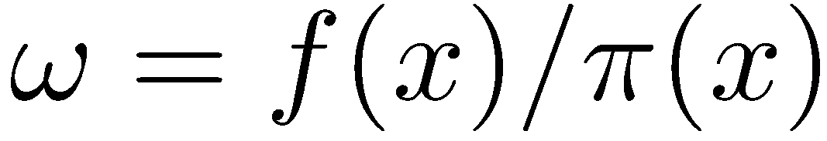
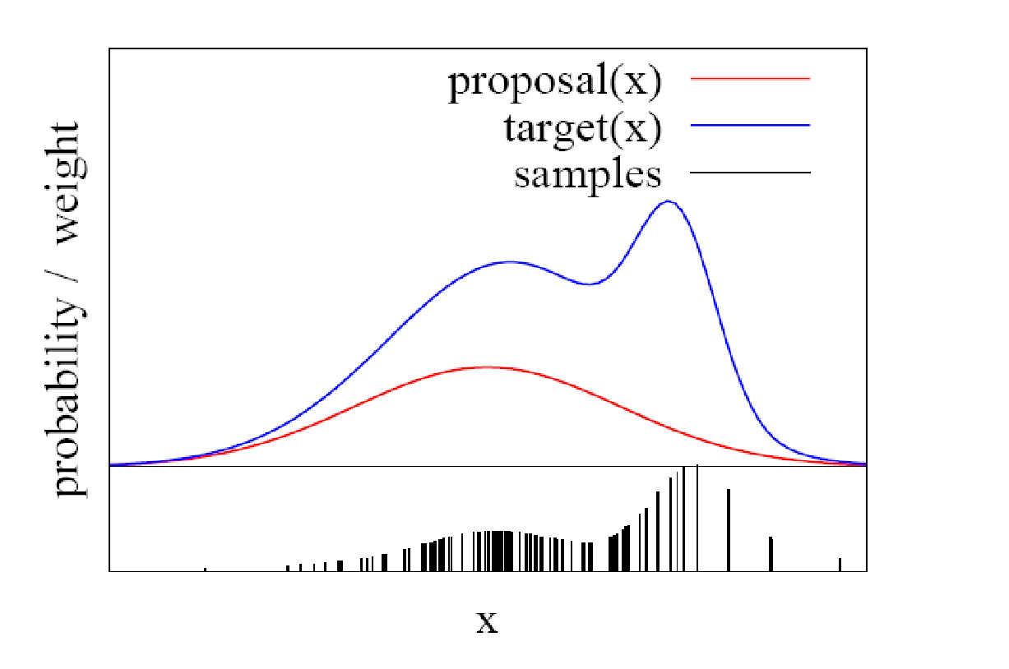
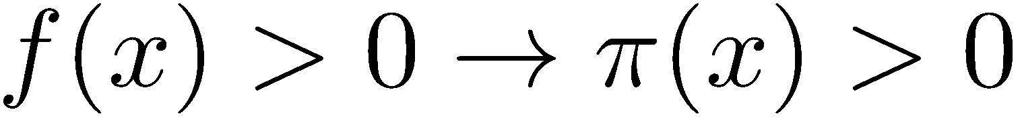
Importance Sampling Principle
We can use a different distribution to generate samples from
Account for the “differences between and ” using a weight
target
proposal
Pre-condition:
‹#›
Notes:
1: use weighted particles to approx. arbitrary functions.
blue = f = target: we want to represent with a set of weighted particles.
red = g = proposal: sample from.
2: weight of the p. acc to the ratio of t/p to account for diff.
set of weighted p. approx. blue target. we can use any distrib. to sample from.

Slide 19
Particle Filter
Recursive Bayes filter
Non-parametric approach
Models the distribution by weighted samples
Prediction: draw from the proposal
Correction: weigh particles by the ratio of target and proposal
The more samples we use, the better is the estimate!
Notes:
6: the better is the approximation

Slide 20
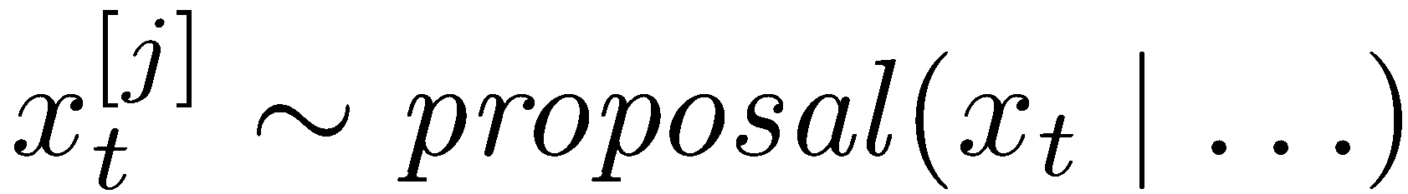
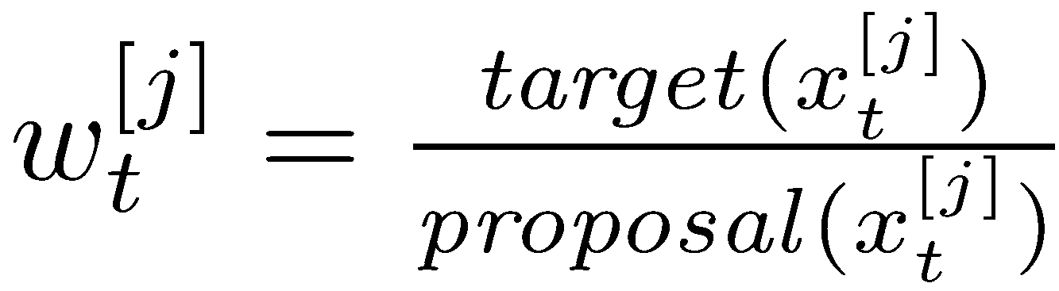

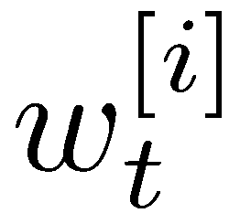

Particle Filter Algorithm
Sample the particles using the proposal distribution
Compute the importance weights
Resampling: Draw sample with probability and repeat times
Notes:
2. to account for the diff between target and proposal
How to use PF for localization?

Slide 21
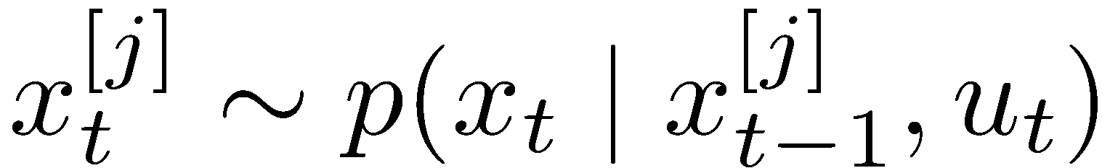
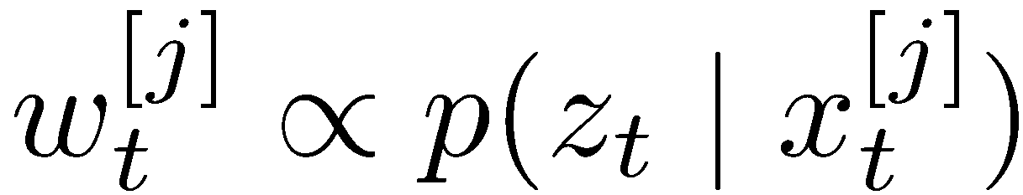
Monte Carlo Localization
Each particle is a pose hypothesis
Prediction: For each particle, sample a new pose from the the motion model
Correction: Weigh samples according to the observation model
Resampling: Draw sample with probability and repeat times
Notes:
2: acc to Ch4: Sample Odometry Motion Model
3: weight has to be chosen in exactly that way if the samples are drawn from the motion model (see ex on Sheet 5)
4: good ones survive, are repeatedly sampled, others die out
# particles stays constant!

Slide 22
Reminder: Odometry Motion Model
end pose
start pose
According to the estimated motion
‹#›
Notes:
odometry: relative movement from wheel encoders

Slide 23
Reminder: Odometry Motion Model
rotation
translation
rotation
Decompose the motion into
Traveled distance
Start rotation
End rotation
‹#›
Notes:
decompose into 3 components

Slide 24
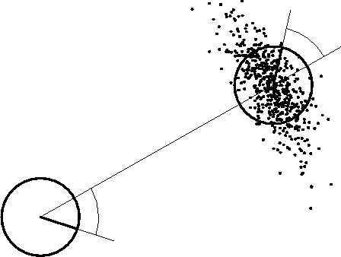
Reminder: Odometry Motion Model
Uncertainty in the translation of the robot: Gaussian over the traveled distance
Uncertainty in the rotation of the robot: Gaussians over start and end rotation
For each particle, draw a new pose by sampling from three normal distributions
‹#›
Notes:
we have noise!
for each particle we draw a new pose based on 3 Gaussians.
ex: 500 particles

Slide 25



Reminder: Odometry Motion Model
Noise in odometry
Example: Gaussian noise
‹#›
Notes:
Ch 4: sample odometry mm

Slide 26
Reminder: Proximity Sensor Model
expected distance
measured distance
‹#›
Notes:
example sensor models to evaluate the particles: weighted sum of 4 fct
expected measured distance according to ppose and map.
distrib. over the measured dist.
evaluate the diff. between distance that should be measured from p.pose and the actual measured one.
Alternative: endpoint model

Slide 27
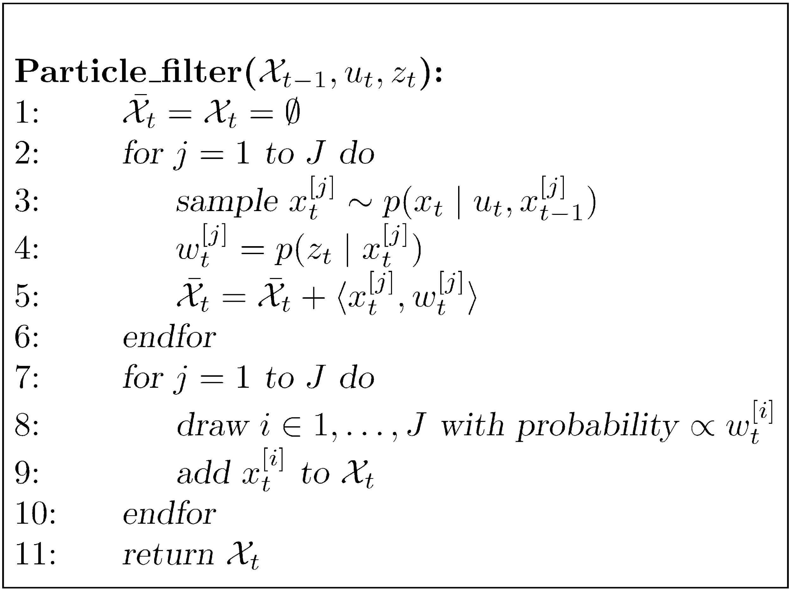
Particle Filter for Localization
Notes:
input: … output: new sample set
take orig. state of hypot., sample new state acc to mm
weight of new state hypot., add to particle set.
Resampling is needed: only a finite number of samples. Without resampling: most particles would represent states with a low likelihood after some time and the filter would loose track of the “good” hypotheses.
proposal, weight: exercise on Sheet 5
left out: normalization

Slide 28
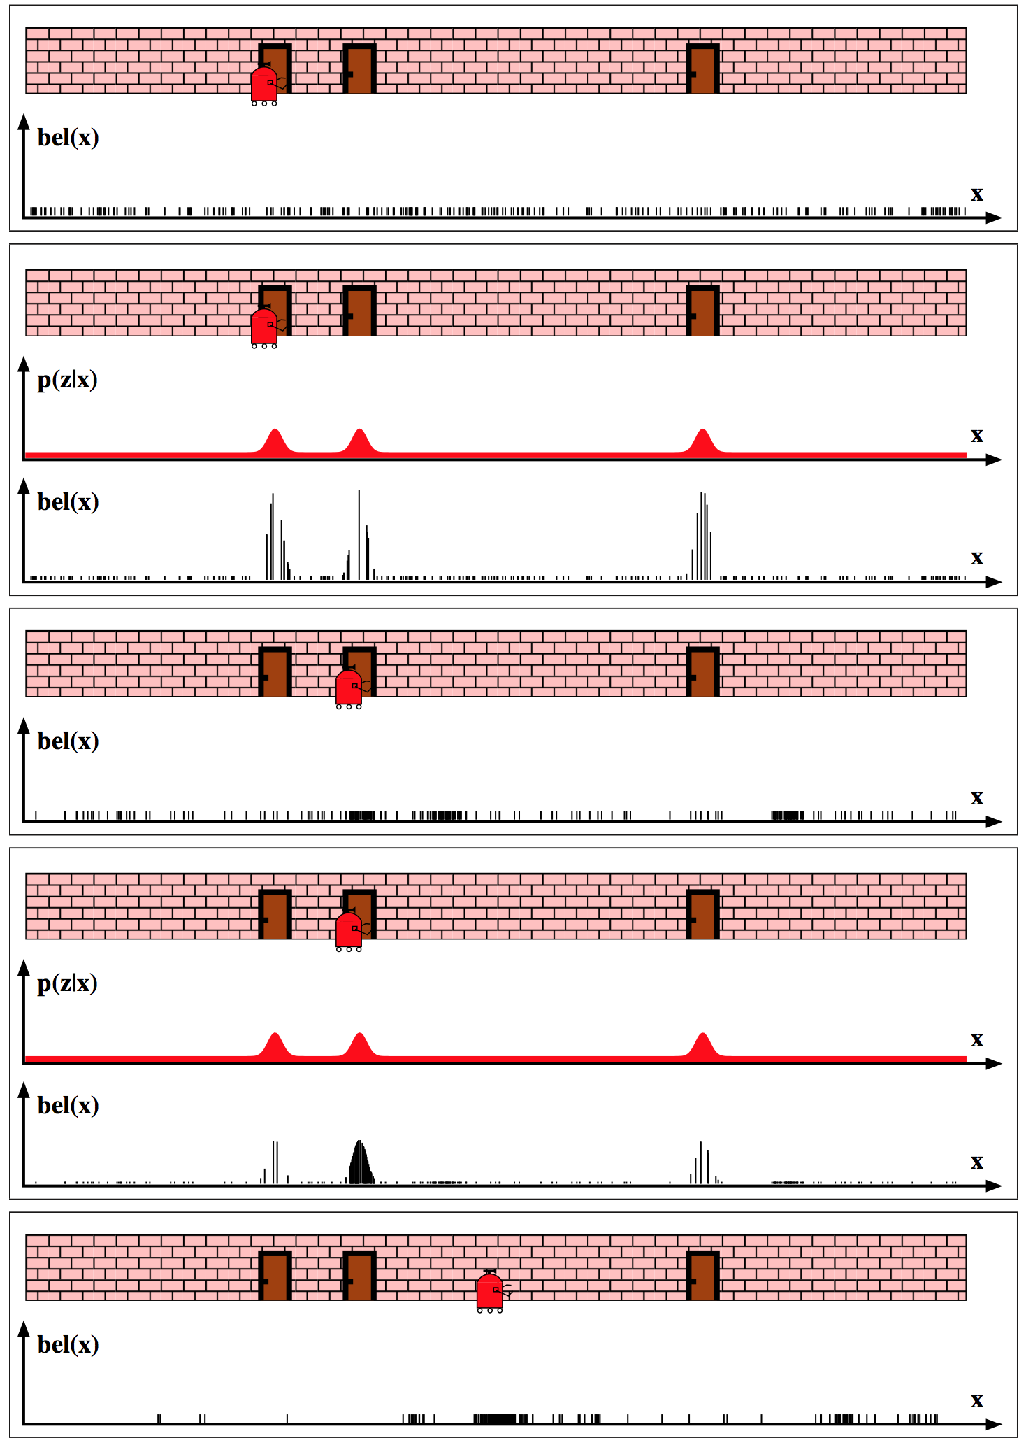
MCL – Correction Step
Image Courtesy: S. Thrun, W. Burgard, D. Fox
Notes:
1D
sensor: in front of door
init: sample state hypot. uniformely.
door detection.
w: obs likelihood. weighted particles.
sensor obs uncertain: still some weight between the doors

Slide 29
MCL – Prediction Step
Image Courtesy: S. Thrun, W. Burgard, D. Fox
Notes:
resampling, prediction acc. to mm (in one step)
propagate particles according to mm: sample for each particle a new pose.
draw new set of hypot. from old set acc to weights with replacements (put particle back).
3 clusters of particles. drawn repeatedly.

Slide 30
MCL – Correction Step
Image Courtesy: S. Thrun, W. Burgard, D. Fox
Notes:
again sensor: in front of door
weight particles acc to obs model.
next: resampling acc to weights. and mm.

Slide 31
MCL – Prediction Step
Image Courtesy: S. Thrun, W. Burgard, D. Fox
Notes:
draw new set of hypot. from old set acc to weights with replacements.
again pass through motion model. sample new pose for each particle.
one main cluster. concentrate on true pose, but still....

Slide 32
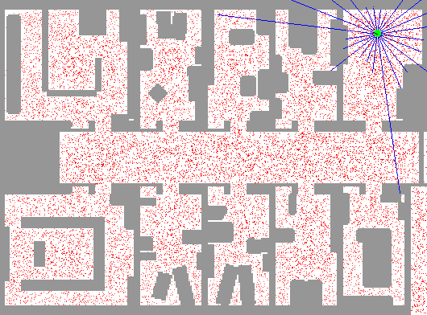
Example: Sample-Based Localization (Sonar)
‹#›
Notes:
beams shown from particle with highest obs. likelihood

Slide 33
Resampling
Repeat times: Draw sample with probability
Informally: “Replace unlikely samples by more likely ones”
Survival-of-the-fittest principle
“Trick” to avoid that many samples cover unlikely states
Needed as we have a limited number of samples
Notes:
5: Without resampling: The filter is likely to loose track of the “good” hypotheses.
In each prediction step, a large number of samples will end up in wrong states. (still approximation of the posterior)
Resampling ensures that particles stay in the meaningful area of the state space.

Slide 34
Resampling
Assumption: normalized weights
initial value between 0 and 1/J
“roulette wheel”
step size = 1/J
w_{n}
w₁
w_{n}
w₁
w₂
w₂
W_{n-1}
W_{n-1}
w₃
w₃
Draw randomly between 0 and 1
Binary search
Repeat J times
O(J log J)
Systematic resampling
Low variance resampl.
O(J)
Also called “stochastic universal resampling”
Notes:
size of holes proportional to weights, ball ends up with prob.<click>
array of length J, cumulative sum of weights, draw rand number between 0 and sum of weights = 1, search array entry (binary search).
draw rand. ini value: 1/J, take particle, move in the array with a step size of 1/N.
Adv: array traversed just once, more systematic
Qu: what happens if all particles have the same weight. makes sense. if all have the same weight, all should survive!
in contrast to roulette wheel.

Slide 35
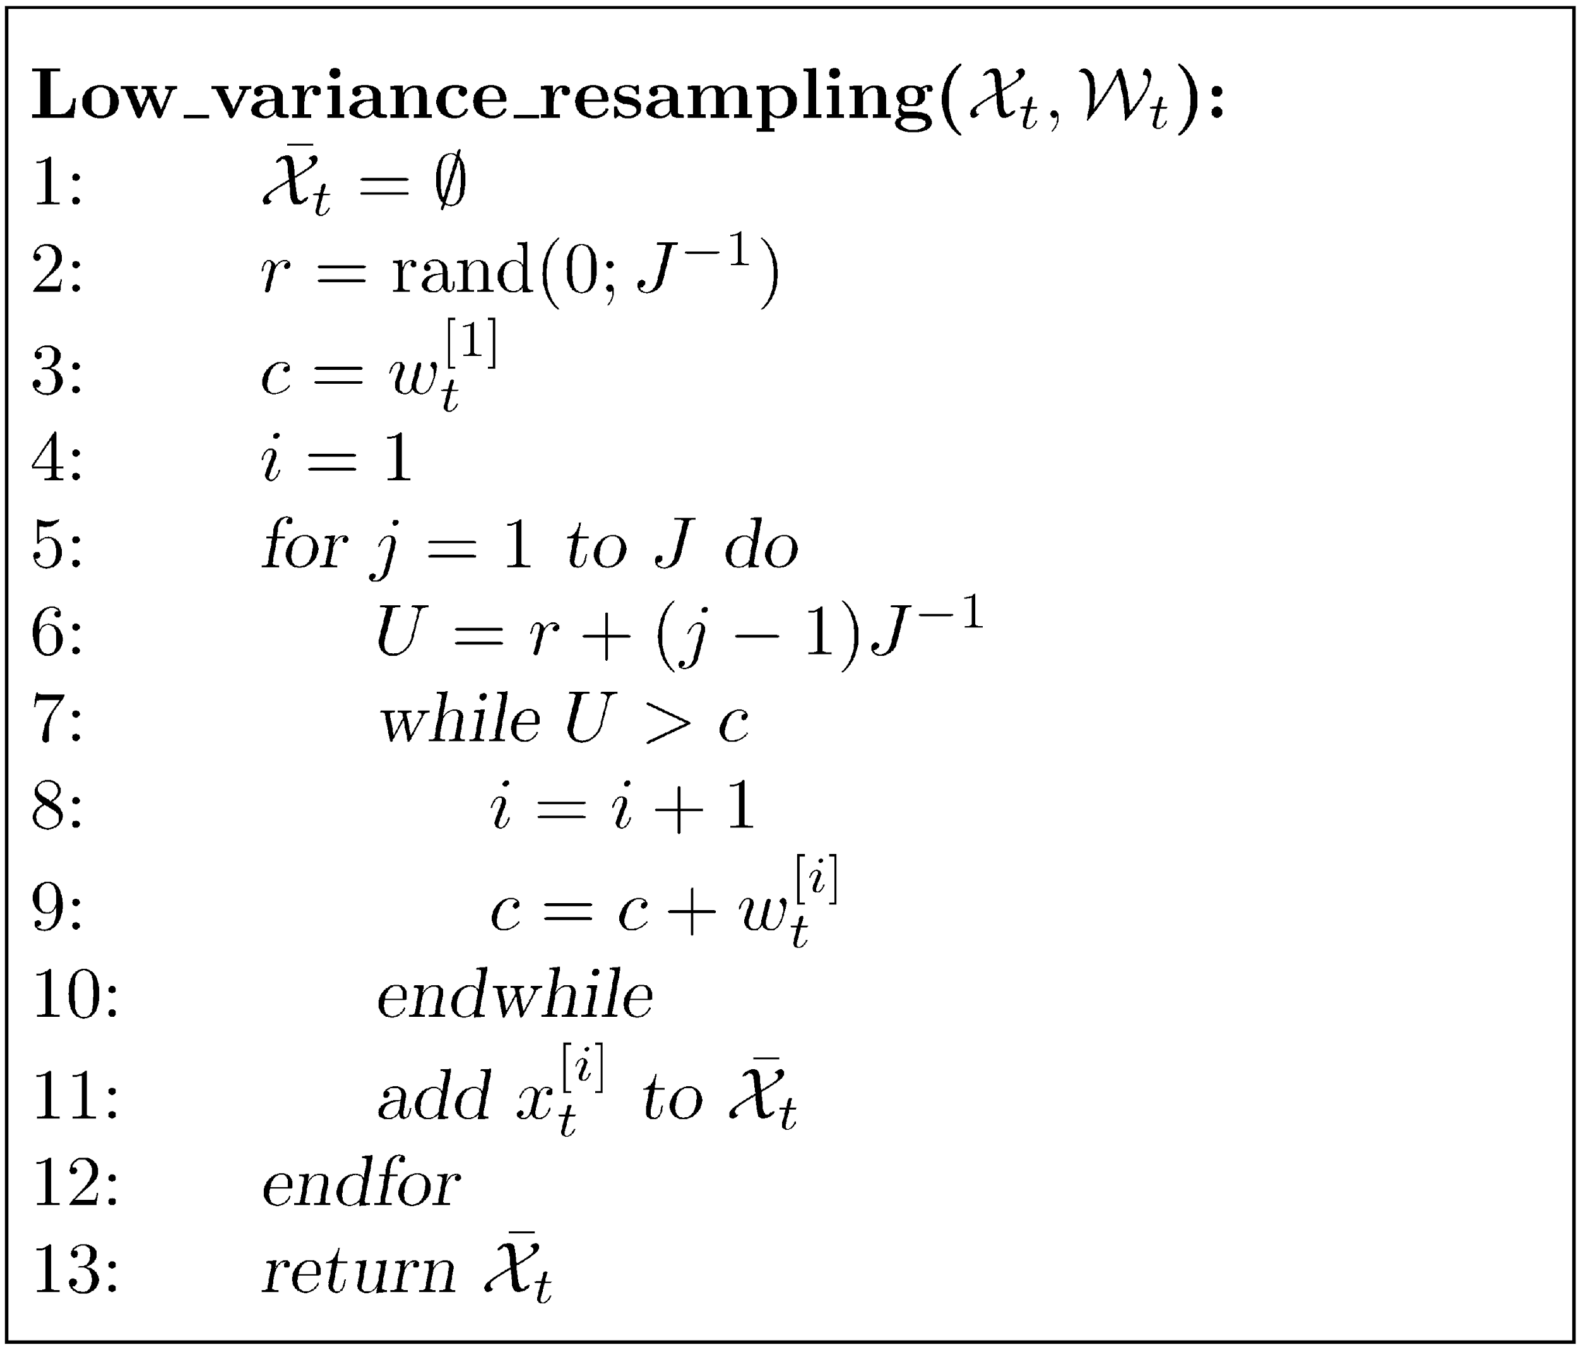
Low Variance Resampling
initialization
cumulative sum of weights
J = #particles
step size = 1/J
decide whether or not to take particle i
Notes:
take particle
step size 1/J

Slide 36
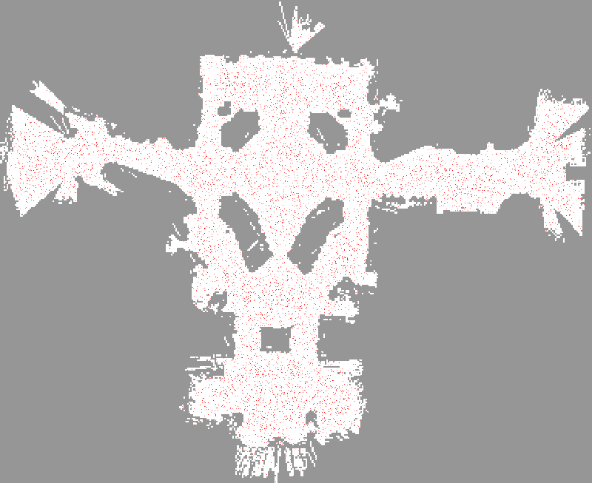
initialization
Courtesy: Thrun, Burgard, Fox
Notes:
example: 2 LRF, 120 range measurements integr.
ini

Slide 37
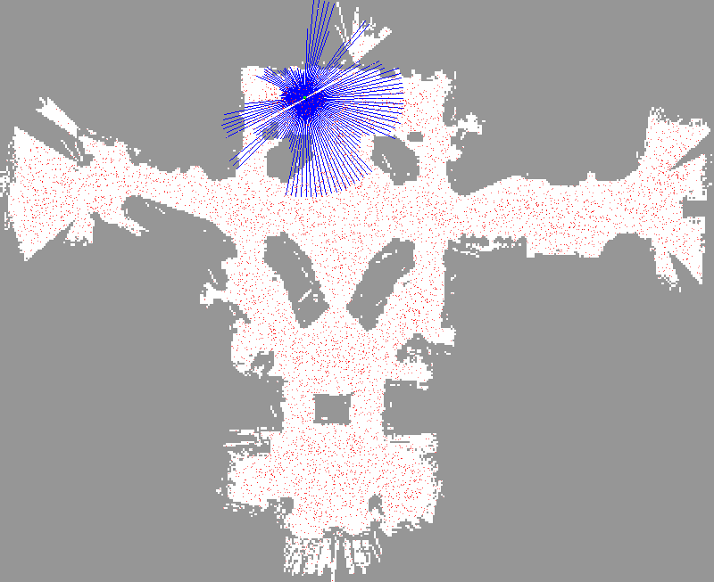
observation
Courtesy: Thrun, Burgard, Fox
Notes:
beams for pose with highest obs likelihood

Slide 38
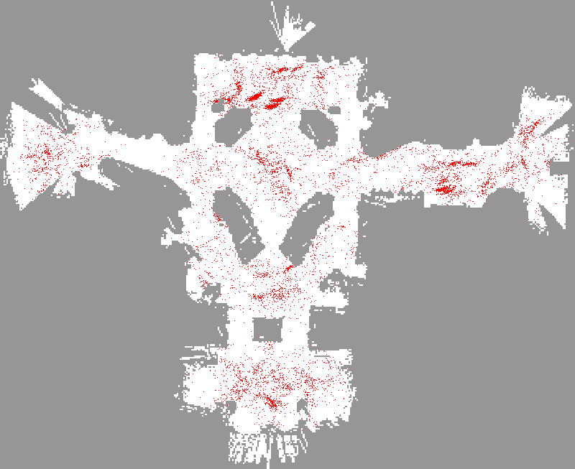
weight update, resampling, motion update
Courtesy: Thrun, Burgard, Fox

Slide 39
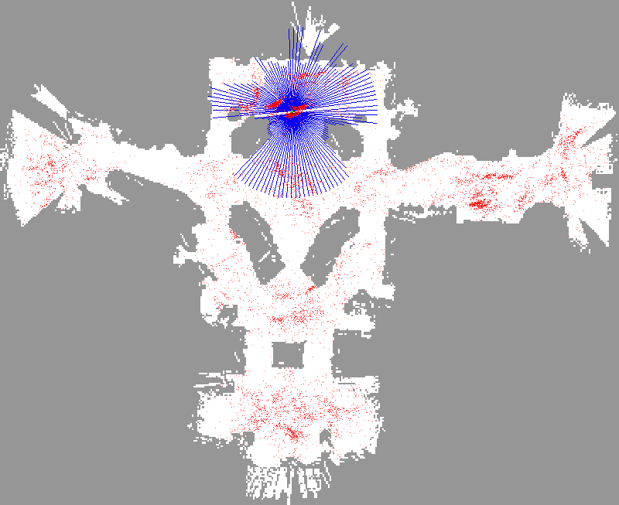
observation
Courtesy: Thrun, Burgard, Fox
Notes:
observation at the particle with the highest likelihood/weight.
particle which best matches the measurements.

Slide 40
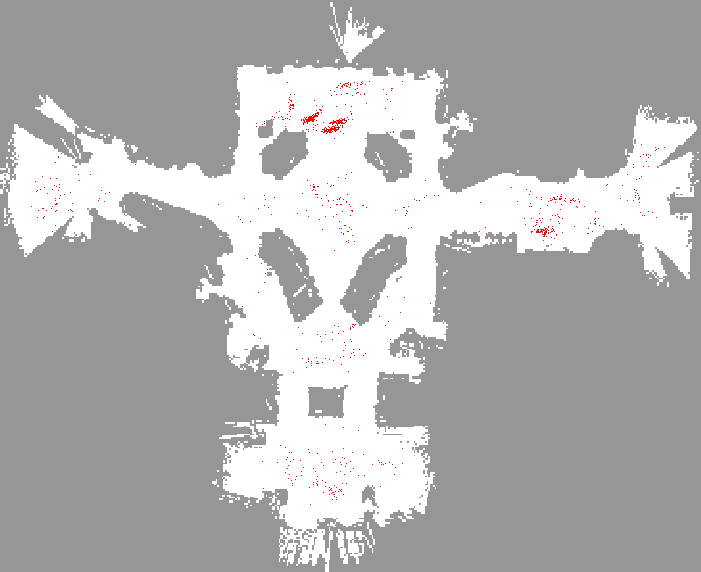
weight update,
resampling
Courtesy: Thrun, Burgard, Fox
Notes:
unlikely particle die out

Slide 41
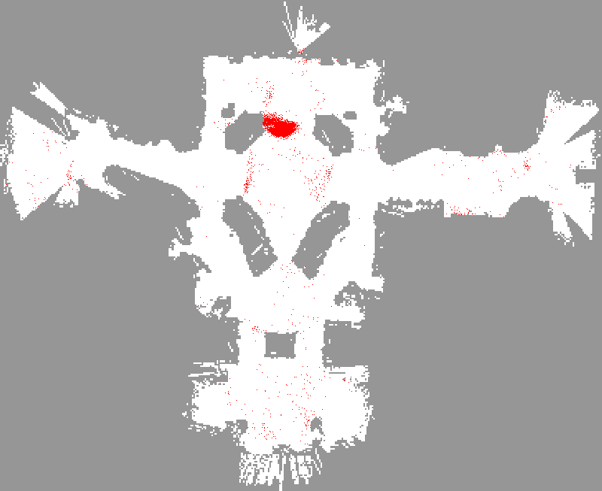
motion update
Courtesy: Thrun, Burgard, Fox

Slide 42
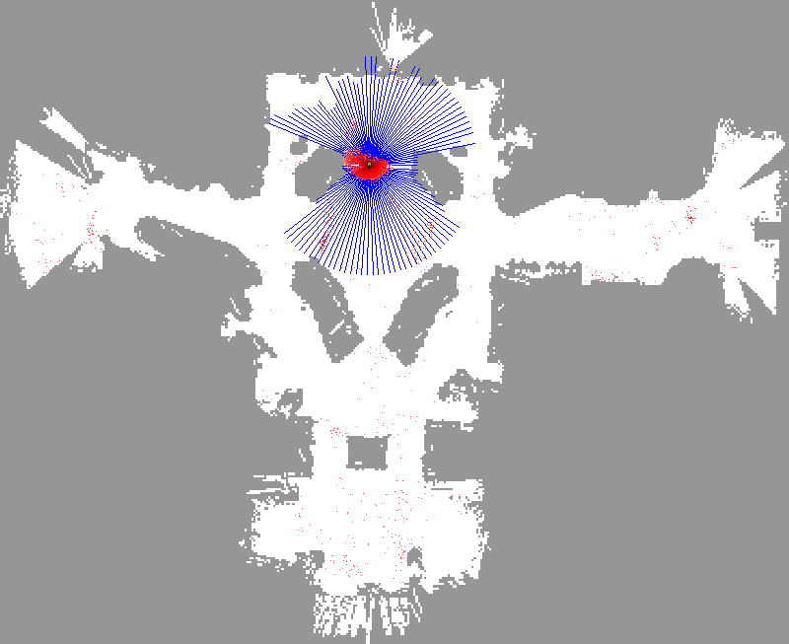
observation
Courtesy: Thrun, Burgard, Fox

Slide 43
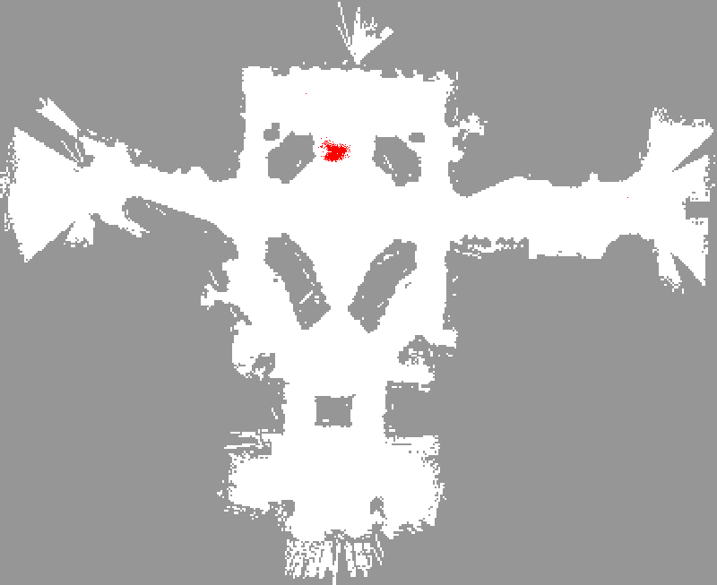
weight update,
resampling
Courtesy: Thrun, Burgard, Fox
Notes:
unlikely die out, concentrated belief

Slide 44

motion update
Courtesy: Thrun, Burgard, Fox
Notes:
more uncertainty since motion commands are exec. inacc.

Slide 45

observation
Courtesy: Thrun, Burgard, Fox

Slide 46

weight update,
resampling
Courtesy: Thrun, Burgard, Fox
Notes:
even more concentrated.

Slide 47

motion update
Courtesy: Thrun, Burgard, Fox
Notes:
more uncertain again. open space

Slide 48

observation
Courtesy: Thrun, Burgard, Fox

Slide 49


Using Ceiling Maps for Localization
[Dellaert et al. 99]
‹#›
Notes:
further sensor model. not based on dist. measurements.
laser measurements were affected by people, not many valid range measurements.
camera pointing to ceiling.
mosaic learned from from b+w images. basically lights on the ceiling.

Slide 50

Vision-Based Localization
P(z|x)
z
h(x)
‹#›
Notes:
captured image.
consider center area, 10x10 pixels. determine avg intensity value.
idea: compare avg intensity value for particle pose on learned ceiling map with currently observed value.
[Click] Gaussian fct to evaluate the diff betw. exp. and measured intensity value

Slide 51


Under a Light
Measurement z:
P(z|x):
‹#›
Notes:
10x10 center area.
which poses can explain the obs best.
all poses under a light have high values. the darker the better.

Slide 52


Next to a Light
Measurement z:
P(z|x):
‹#›
Notes:
light not completely in the center of the image.
poses in a certain distance to the lights have highest obs likelihood.

Slide 53


Elsewhere
Measurement z:
P(z|x):
‹#›
Notes:
no light at all.

Slide 54

Global Localization Using Vision
Notes:
global localization + tracking using this observation model.
10.000 particles. true path.
uncertain in the center: when no lights. point cloud spreads.
concentrates again where lights are.

Slide 55
How to deal with localization errors?
The approach described so far is able
to track the pose of a mobile robot and
to globally localize the robot
How can we deal with localization errors (i.e., the kidnapped robot problem)?
Notes:
2: or concentrated at wrong pose. how to recover?

Slide 56
Approaches
At each time step, randomly insert a fixed number of samples
Alternatively, insert random samples proportional to the average likelihood of the particles
Notes:
1: e.g. draw particles from a uniform distribution (and weight them according to the current obs).
2: when the current particles cannot explain the obs well. then the robot is likely to be at a diff. pose.
without randomly sampling the robot cannot recover.
rather unlikely that particles get close to the correct pose by chance.

Slide 57
Summary – Particle Filters
Particle filters are non-parametric Bayes filters
Belief represented by a set of weighted samples
Proposal distribution to draw the samples for the next time step
Particle weight to account for the differences between the proposal and the target
Re-sampling: Draw new particles with a probability proportional to the weight
Notes:
1: can represent non-Gaussian distributions, multi-modal beliefs
3: prediction
4: correction
5: needed since we have only a limited #particles

Slide 58
Summary – PF Localization
Particles are propagated according to the motion model
Particles are weighted according to the likelihood of the observation
Called: Monte-Carlo localization (MCL)
Used in many practical localization systems
The art is to design appropriate motion and sensor models
Notes:
2: Re-sampling: Draw new particles with a probability proportional to the likelihood of the observation

Slide 59
Acknowledgment
These slides have been created by Wolfram Burgard, Dieter Fox, Cyrill Stachniss and Maren Bennewitz

