Slide 1

Cairo University
1
Faculty of Engineering
Computer Engineering Department
WEB BUILDING
CMPN 425-Fall 2022

Slide 2
PHP Advanced-cont
2

Slide 3
AJAX
4
AJAX = Asynchronous JavaScript and XML.
a technique for creating fast and dynamic web pages.
AJAX allows web pages to be updated asynchronously by exchanging small amounts of data with the server behind the scenes. This means that it is possible to update parts of a web page, without reloading the whole page.
Classic web pages, (which do not use AJAX) must reload the entire page if the content should change.
Examples of applications using AJAX: Google Search, Google Maps, Gmail, Youtube, and Facebook tabs.
Notes:
With traditional form submissions, the entire page must reload to submit the form and display the results. AJAX allows you to send requests to the server and update parts of a web page without reloading the whole page.

Slide 4
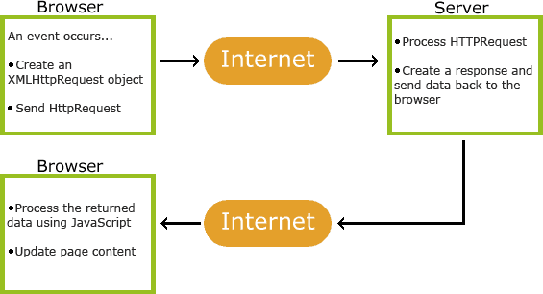
How AJAX Works?

Slide 5
Create an XMLHttpRequest Object
6
All modern browsers (IE7+, Firefox, Chrome, Safari, and Opera) have a built-in XMLHttpRequest object.
xmlhttp=new XMLHttpRequest();
Old versions of Internet Explorer (IE5 and IE6) uses an ActiveX Object:
xmlhttp=new ActiveXObject("Microsoft.XMLHTTP");
Notes:
To send multiple requests, it’s better to use multiple objects:
// Create the first XMLHttpRequest object
var xmlhttp1 = new XMLHttpRequest();
xmlhttp1.onreadystatechange = handleResponse1;
xmlhttp1.open("GET", "endpoint1.php", true);
xmlhttp1.send();
// Create the second XMLHttpRequest object
var xmlhttp2 = new XMLHttpRequest();
xmlhttp2.onreadystatechange = handleResponse2;
xmlhttp2.open("GET", "endpoint2.php", true);
xmlhttp2.send();

Slide 6
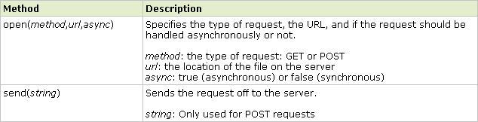
Send a Request To a Server
To send a request to a server, we use the open() and send()
methods of the XMLHttpRequest object:
xmlhttp.open("GET","ajax_info.txt",true); xmlhttp.send();
Notes:
When set to true, the request is made asynchronously, meaning that the rest of the code will continue to execute without waiting for the request to complete. The script will not freeze and the user can continue to interact with the web page.
For GET Requests: Generally, the send method does not require any parameters because the data is sent in the URL. If you pass a string, it will be ignored.
For POST Requests That Send Data: You can pass data to the send method, and this data will be included in the request body.

Slide 7
Server Response
The responseText property returns the response as a string, and you can use it
xmlhttp.responseText;
This property contains the server's response as a text string. The server can return plain text or a string format, including JSON, HTML, CSV, etc.

Slide 8
When to ensure that the Server Response is ready?
The onreadystatechange event handler:
When a request to a server is sent, we want to perform some actions based on the response.
It's designed to be a function that will be called every time the readyState property of the XMLHttpRequest changes.

Slide 9
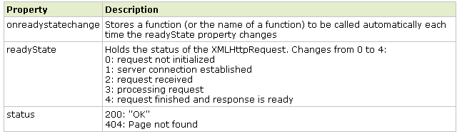
When to ensure that the Server Response is ready?
The onreadystatechange event handler:
Three important properties of the XMLHttpRequest object:
When readyState is 4 and status is 200, the response is ready.

Slide 10
When to ensure that the Server Response is ready?
xmlhttp.onreadystatechange=function()
{
if (xmlhttp.readyState==4 && xmlhttp.status==200)
{
document.getElementById("myDiv").innerHTML=xmlhttp.responseText;
}
}
Note: onreadystatechange is triggered four times, one time for each change in readyState.
Notes:
Example:
The browser can send something like this: var xmlhttp = new XMLHttpRequest();
xmlhttp.open("POST", "process_request.php", true);
xmlhttp.onreadystatechange = function() {
if (this.readyState == 4 && this.status == 200) {
// Handle the response
console.log(this.responseText);
}
};
// Data to be sent to the server
var requestData = "key1=value1&key2=value2";
xmlhttp.send(requestData);
The PHP file would be something like this:
<?php
// Check if the keys 'key1' and 'key2' exist in the POST request
if (isset($_POST['key1']) && isset($_POST['key2'])) {
// Retrieve the values of 'key1' and 'key2' from the POST data
$value1 = $_POST['key1'];
$value2 = $_POST['key2'];
// Now you can use $value1 and $value2 to do whatever you need to do
// For example, you could save them to a database, perform calculations, etc.
// Then you can send a response back
echo "Received values: Key1 is {$value1} and Key2 is {$value2}";
} else {
// If the expected POST data is not there, send an error message back
echo "Error: Missing data";
}
?>

Slide 11
AJAX and PHP Example – HTML
<html>
<head>
<script>
function showHint(str) { if (str.length == 0) {
document.getElementById("txtHint").innerHTML = ""; return;
} else {
var xmlhttp = new XMLHttpRequest(); xmlhttp.onreadystatechange = function() {
if (this.readyState == 4 && this.status == 200) { document.getElementById("txtHint").innerHTML =
this.responseText;
}
};
xmlhttp.open("GET", "ajaxPHP.php?q=" + str, true); xmlhttp.send();
}
}
12
Page
</script>
</head>
<body>
<p><b>Start typing a name in the input field below:</b></p>
<form>
First name: <input type="text" onkeyup="showHint(this.value)">
</form>
<p>Suggestions: <span id="txtHint"></span></p>
</body>
</html>
Notes:
Registration: When you assign a function to the onreadystatechange event handler of an XMLHttpRequest object, you're registering an event listener. This listener is set up to respond to changes in the readyState property of the XMLHttpRequest object.
Asynchronous Execution: The send method of XMLHttpRequest initiates an asynchronous operation. JavaScript does not wait for this operation to complete; instead, it continues to execute the next lines of code.
Function Scope Ends: The function that set up the XMLHttpRequest and its onreadystatechange event handler (showHint) completes its execution and exits. However, the event listener remains registered with the browser's event loop.
Event Loop: JavaScript has an event loop that continuously checks for events that have occurred and calls the corresponding event handlers. Even though showHint has finished, the event loop is still aware of the onreadystatechange event handler that was registered.
Handling Events: When the server responds to the HTTP request, the readyState property of the XMLHttpRequest object changes. This change is an event that the event loop detects. The loop then calls the onreadystatechange event handler function associated with that XMLHttpRequest object.
Event Handler Execution: The onreadystatechange function runs in its own scope, independent of the original showHint function scope. It has access to the XMLHttpRequest object and can react to the response from the server.

Slide 12
AJAX and PHP Example – HTML Page
13
If the input field is empty (str.length==0), the function clears the content of the txtHint placeholder and exits the function.
If the input field is not empty, the showHint() function executes the following:
Create an XMLHttpRequest object
Create the function to be executed when the server response is ready
Send the request off to a file on the server
Notice that a parameter (q) is added to the URL (with the
content of the input field)
Notes:
NOTE 1:
If you were to call send() before setting the onreadystatechange, there might be a race condition where the response from the server could return before the event handler is set up, meaning you would miss the response. This is particularly true for synchronous requests (which you should avoid), but is also a good practice for asynchronous requests to ensure that your event handler is in place before the response could possibly arrive.
NOTE 2:
The onkeyup event attribute is set to call the showHint() function every time the user releases a key after typing in the input field. The this.value part passes the current value of the input field to the showHint() function.
NOTE 3:
when using JavaScript to create an XMLHttpRequest and manually calling the open method, you need to construct the query string yourself. The XMLHttpRequest does not automatically append input values to the URL; you have to explicitly set them. That's why in the showHint function, you concatenate the input value to the query string using q=.
NOTE 4:
Handling Multiple Responses: Because each request is independent, each onreadystatechange event handler will handle its own response. When the server sends a response to a particular request, the corresponding event handler will be invoked.
NOTE 5:
Response Timing: If the server is fast and the network latency is low, responses to these requests may come back quickly, and the onreadystatechange function will update the page with the new information in a timely manner.
NOTE 6:
Potential Overlap: If you trigger showHint rapidly, such as by typing quickly, multiple requests will be sent out nearly simultaneously. Their responses may come back out of order or overlap. This can cause a flickering effect in the suggestions or display out-of-order suggestions.
NOTE 7: To manage multiple consecutive AJAX requests properly, especially when a new request might be triggered before the previous one completes, you can implement one of the following strategies:
- Abort the previous request: Before starting a new request, you can call the abort() method on the existing XMLHttpRequest object to cancel it:
if (xmlhttp) {
xmlhttp.abort(); // Abort the previous request
}
xmlhttp = new XMLHttpRequest();
// ... rest of your AJAX setup and send request
- Debounce the input: Wait for a short pause in typing before sending the request, reducing the number of requests sent:
var timeout = null;
function showHint(str) {
clearTimeout(timeout); // Clear the previous timeout
timeout = setTimeout(function() {
// AJAX request setup and send
}, 300); // Wait for 300ms of no typing before sending the request
}
-Ignore responses from older requests: Use a flag or counter to track the latest request and ignore responses from any requests that are not the most recent

Slide 13
AJAX and PHP Example – PHP file
14
<?php
// get the q parameter from URL
// Array with names
$a[ ] = "anna";
$a[ ] = "brittany";
$a[ ] = "cinderella";
$a[ ] = "diana";
$a[ ] = "eva";
$a[ ] = "fiona";
$a[ ] = “gunda";
$a[ ] = "gege";
$a[ ] = "inga";
$a[ ] = "johanna";
$a[ ] = "kitty";
$a[ ] = "linda";
$a[ ] = "mina";
$a[ ] = "ophelia";
$a[ ] = "petunia";
$q = $_REQUEST["q"];
$hint = "";
// lookup all hints from array if $q is different from ""
if ($q !== "") {
$q = strtolower($q);
$len = strlen($q);
foreach ($a as $name) {
if (substr($name, 0, $len) === $q))) {
if ($hint === "") {
$hint = $name;
} else {
$hint .= ", $name";
}
}
}
}
// Output "no suggestion" if no hint was found or output correct values
echo $hint === "" ? "no suggestion" : $hint;
?>
Notes:
In PHP, when you use $array[] = value;, you are appending a new value to the end of the array. You don't need to specify a key because PHP automatically uses the next integer index.
The behavior of echo depends on the context in which the PHP script is running:
Direct Webpage Content: When a PHP script generates an HTML page, everything echoed by the script is sent to the browser as part of the HTTP response. This content is then rendered directly by the browser. For example, if you have a PHP script that generates an entire webpage, each echo statement contributes to the HTML that the user sees.
AJAX Response: When PHP is used as the server-side component of an AJAX operation (PHP script is called via AJAX), echo outputs the response data, which is sent back to the JavaScript XMLHttpRequest or fetch API that made the AJAX call. The JavaScript then handles the response and can insert it into the DOM, update elements, or perform other actions based on the received data.
You can use echo multiple times in an AJAX called script, just like you would in a non-AJAX called one. The response is concatenated.

