Slide 1
Computer Networks
Chapter one

Slide 2
Layering principle
“Software implementing layer n at the destination receives exactly the message sent by software implementing layer n at the source”

Slide 3
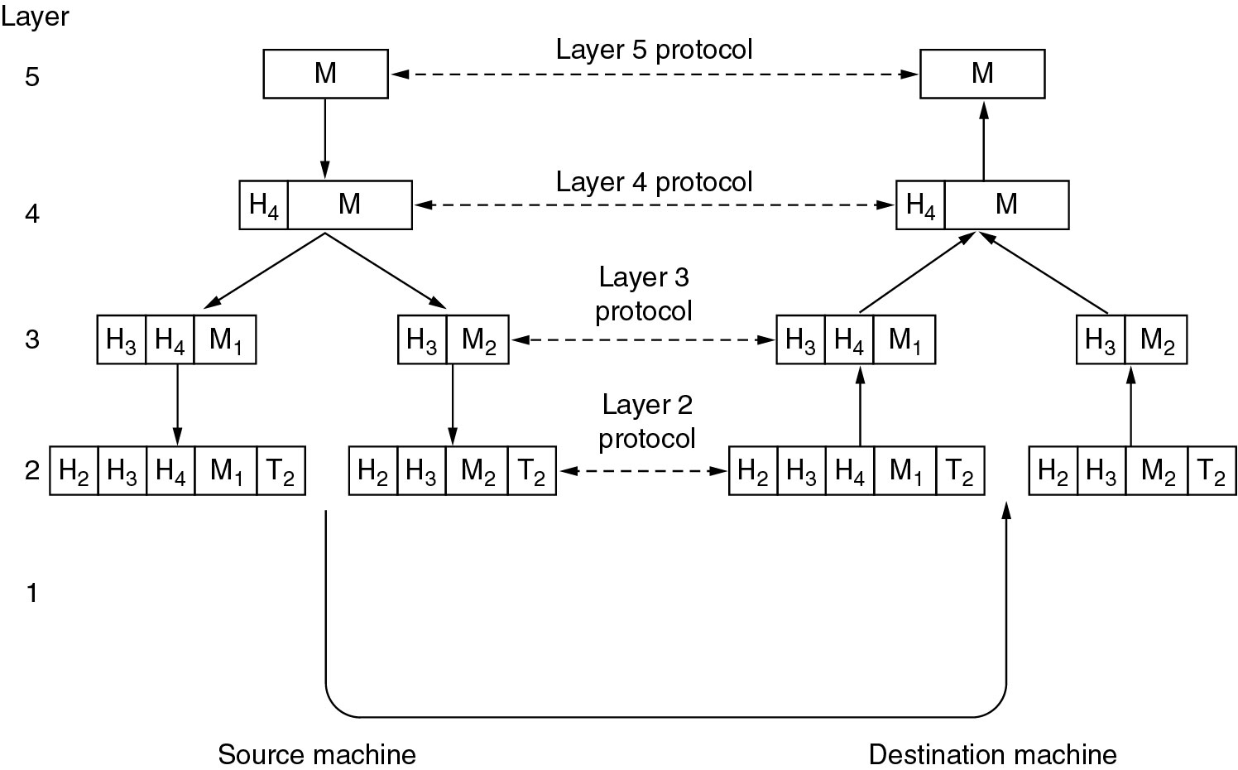
Protocol hierarchies

Slide 4
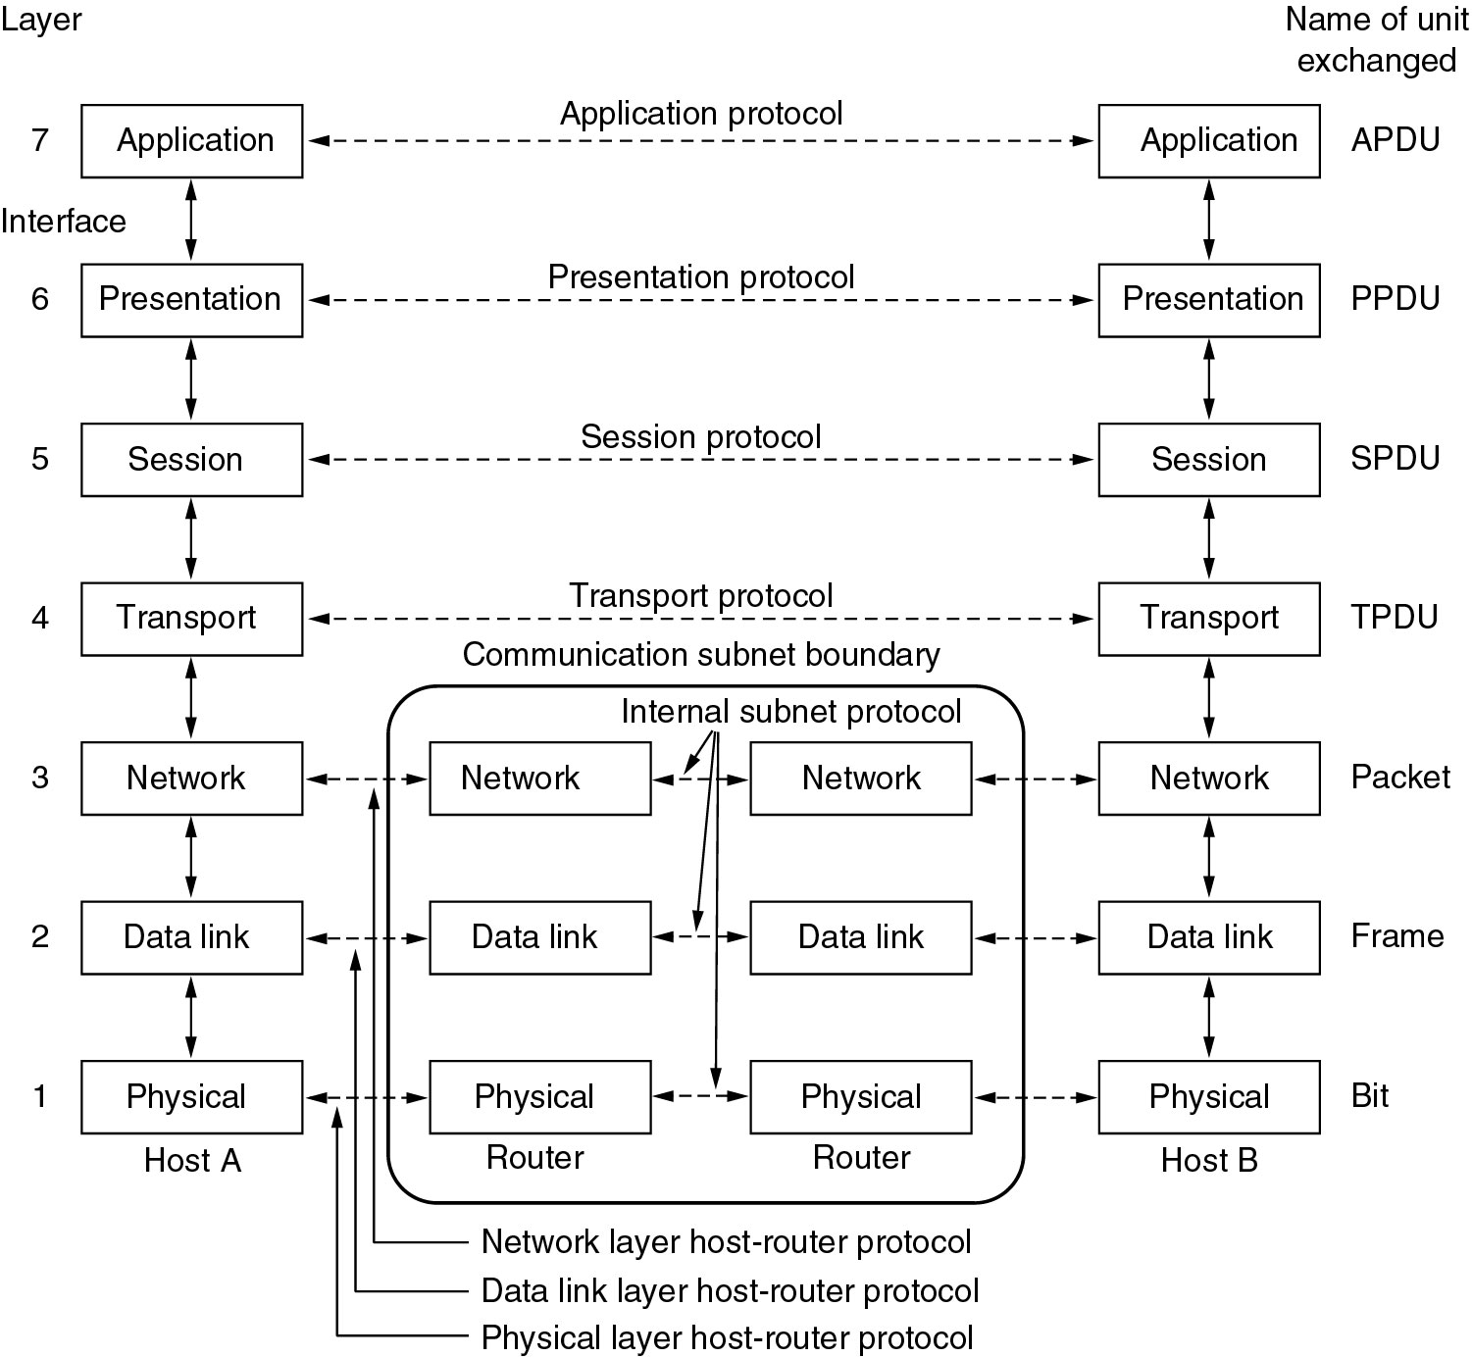
OSI reference model

Slide 5
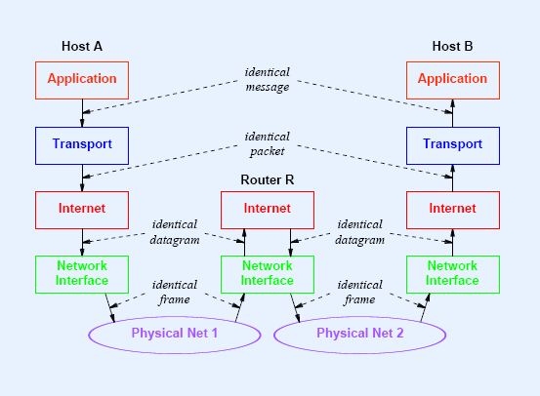
TCP/IP reference model

Slide 6
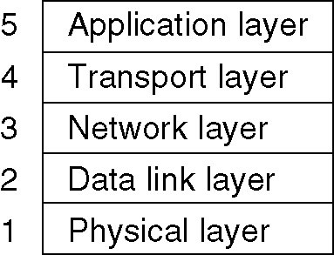
Hybrid Model
Most of the industry adopt and follow this model

Slide 7
1) physical layer
Sends bits (0’s and 1’s) physically
through any mean of transportation.
Examples: digital modulator, demodulator
and hubs .

Slide 8
2) Data Link layer
Supports local addressing,
framing, error detection and check sum .
Example: switch and bridge .
Ethernet / WIFI

Slide 9
3) Network Layer
Responsible for routing between sub-networks
and global addressing .
Example: routers , protocols ( ipv4 , ipv6, CLNP ).

Slide 10
4) Transport layer
Provides end-to-end ( from source to destination )
communication .
May be connection oriented or connectionless
like TCP , UDP

Slide 11
5)Session, presentation and application layer
Responsible for session management , syntax ,human interaction and every thing else .
like MAIL , FTTP, HTTP.

Slide 12
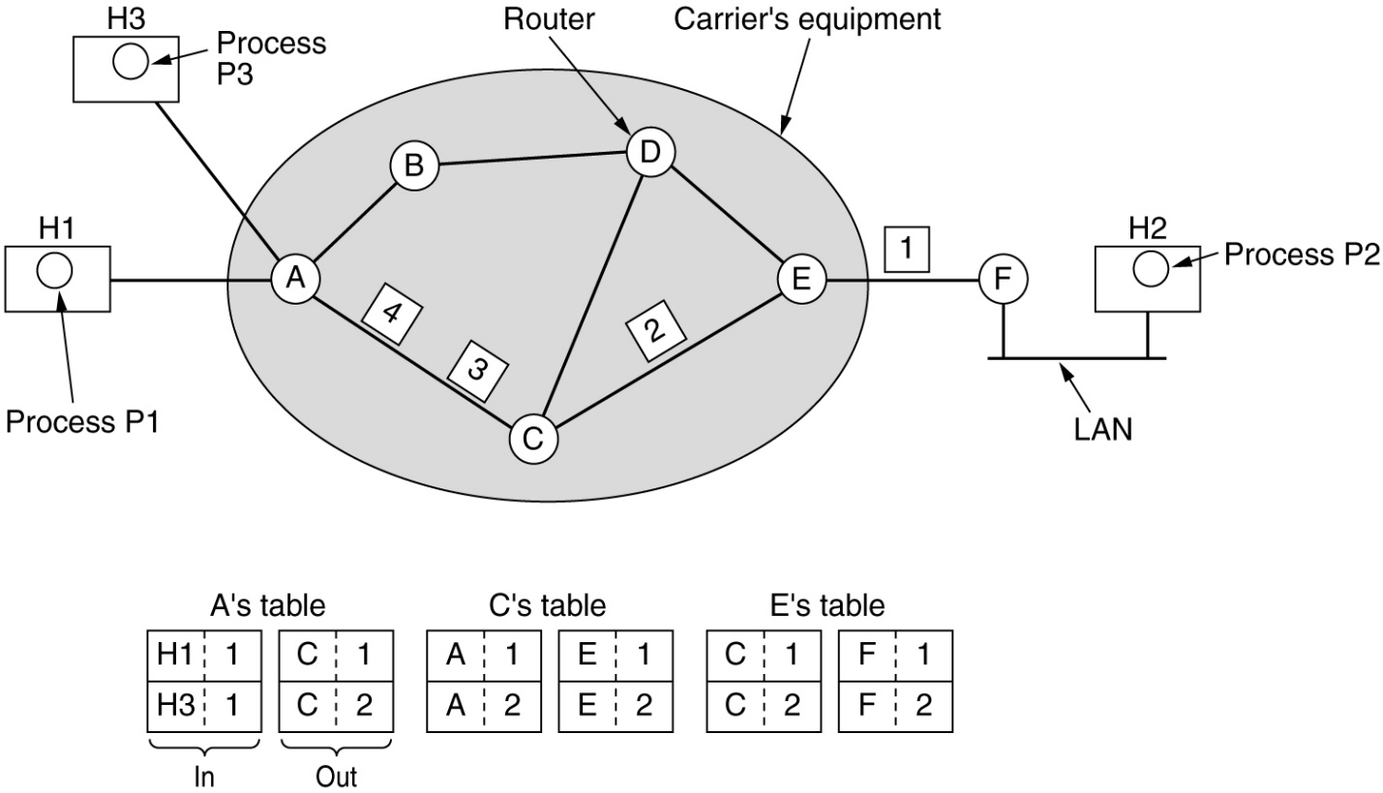
Connection Oriented protocols
A Vritual Path between source and destination is pre-established
Usually called virtual circuit (VC)
Advantage: More QOS and
in order delivery.
Disadvantage:
more time before establishment
more severe effects in case of
routers failures .
Examples: ATM ,TCP and FTB.

Slide 13
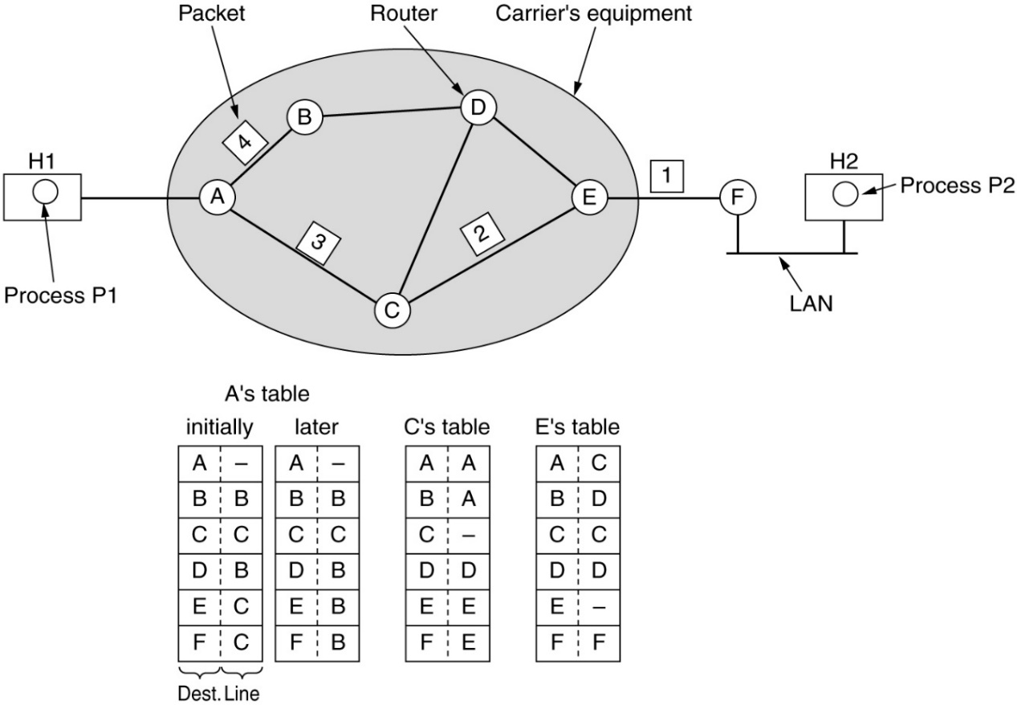
Connection less protocols
No path pre-established
Each packet is sent and routed independently
Each packet carries enough information
to be forwarded to the destination.
Advantage: faster and
Less failures effects.
Disadvantage:
Less QOS.
Example : UDP ( online games )
and video conferences

Slide 14
Mention three differences between a service and a protocol.
 | Service | Protocol
Concerned with | layers | peers within the same layer.
What are they? | Set of operations provided by a layer to an upper layer. | Set of rules for message exchange between peers within a layer
Definition or Implementation | Define operations, not how an operation is implemented | Related to the way the service is implemented.
Example | Error detection in layer 2 | CRC used in Ethernet

Slide 15
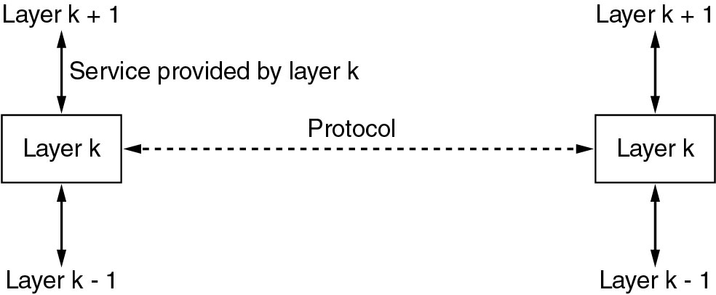
Mention three differences between a service and a protocol.

Slide 16
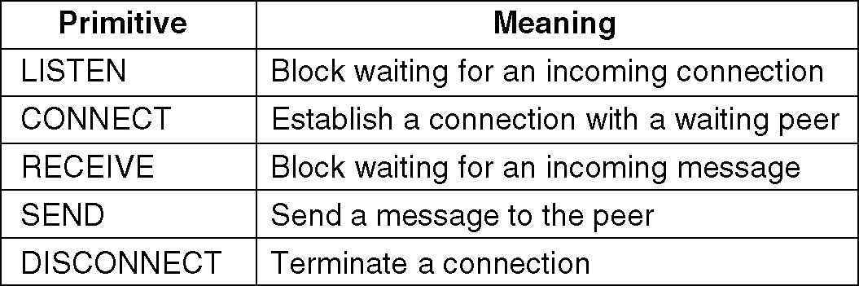
Service Primitives Connection Oriented
A service is defined by:
“the set of primitives that the service makes available to the upper layer “

Slide 17
Give two advantages for using layered protocols.
Layered protocol provide abstraction of layers:
As The purpose of each layer is to offer certain services to the higher layers while shielding those layers from the details of how the offered services are actually implemented.
Flexibility
by Replacing of layers with a completely different protocol or implementation:
Maintainability and Scalability
Reduce complexity
Trouble-shooting

Slide 18
Mention the names of bottom 4 layers of the OSI model and mention a real-life example for each layer.
Physical Layer.
Data link Layer.
Network Layer.
Transport Layer.
Could you provide examples?!
Notes:
cables, repeaters, optical fibers, multiplexers, de-multiplexers.
Switches, Bridges.
Routers.
TCP and UDP Protocols.

Slide 19
Mention the names of the OSI layers which are similar to those of TCP/IP model.
Application Layer.
Transport Layer.
Network Layer.

Slide 20
Which OSI layer handles each of the following?
Delivers raw bits from one peer to the other.
Provides end-to-end communication.
Divide the raw bit stream into units of transmission.
Determine the route from source to destination.
Notes:
Physical layer.
Transport layer and above.
Data link layer.
Network layer.

Slide 21
Provide a real example protocol for each of the following:
Connection oriented protocol
Data link layer
Connectionless protocol
Transport layer
Notes:
TCP
Ethernet/ WiFi
UDP
TCP/UDP

Slide 22
True or False?
An implementation of a connectionless service may contain two primitives only.
In the OSI model, a protocol specifies the rules governing information exchange between adjacent layers.
CLNP is a layer 3 protocol.
A file system provides a connection oriented service.
IPv6 is a layer 3 protocol.
Notes:
All is true except second point (corresponding layers not adjacent layers).

Slide 23
“For Extra Knowledge”

Slide 24
Critical Thinking Questions!
Which OSI layer functionality can be often neglected or even non-existent in broadcast networks? Why?
When do we need a service to be reliable? Does there exist a case when we may not mind an unreliable service?
Does every layer in the OSI model necessarily add a header to the message?
Notes:
1- Network layer is often neglected in broadcast networks, because routing is not a main issue so it is often thin or non-existent in most broadcast networks.
2- Reliable service is needed, for example, in file transfer. The owner of the file wants to be sure that all the bits arrive correctly and in the same order they were sent.
Yes, in some cases the transit delays introduced by acknowledgements are unacceptable. One such application is digitized voice traffic for voice over IP. It
is less disruptive for telephone users to hear a bit of noise on the line from time to time than to experience a delay waiting for acknowledgements.
3- This may be true for all layers, but definitely not the physical layer.

