Slide 1
Desig
noder
One designoder a day keeps coders away

Slide 2

Cairo University
Faculty of Engineering
Department of Computer Engineering
Faculty of Engineering, Cairo University
in Partial Fulfillment of the requirements of the degree
of
Bachelor of Science in Computer Engineering.
Supervised By
Dr. Khalid El-Suradi
Summer 2023
All rights reserved. This report may not be reproduced in whole or in part, by photocopying or other means, without the permission of the authors/department.

Slide 3
Team 1
Ahmed Khaled Mahmoud
Ahmed Mahmoud Hafez
Hazem Abdo
Nour Aldin Mostafa

Slide 4
Agenda
Motivation
Problem definition
System Design
Implementation
demo
Project Modules

Slide 5
Motivation
In Agile-based environments, the process of building early stages prototypes is very iterative, costly, time-consuming, and error-prone so making it a one-team-centered process will overcome these challenges.

Slide 6
Problem definition
Automating the process of converting sketches(low fidelity wireframes) to web-based prototypes that closely resemble the sketch's visuals and hierarchy.

Slide 7
System Design
Project Block Diagram
Computer vision Block Diagram
Machine learning Block Diagram
NLP Block Diagram

Slide 8
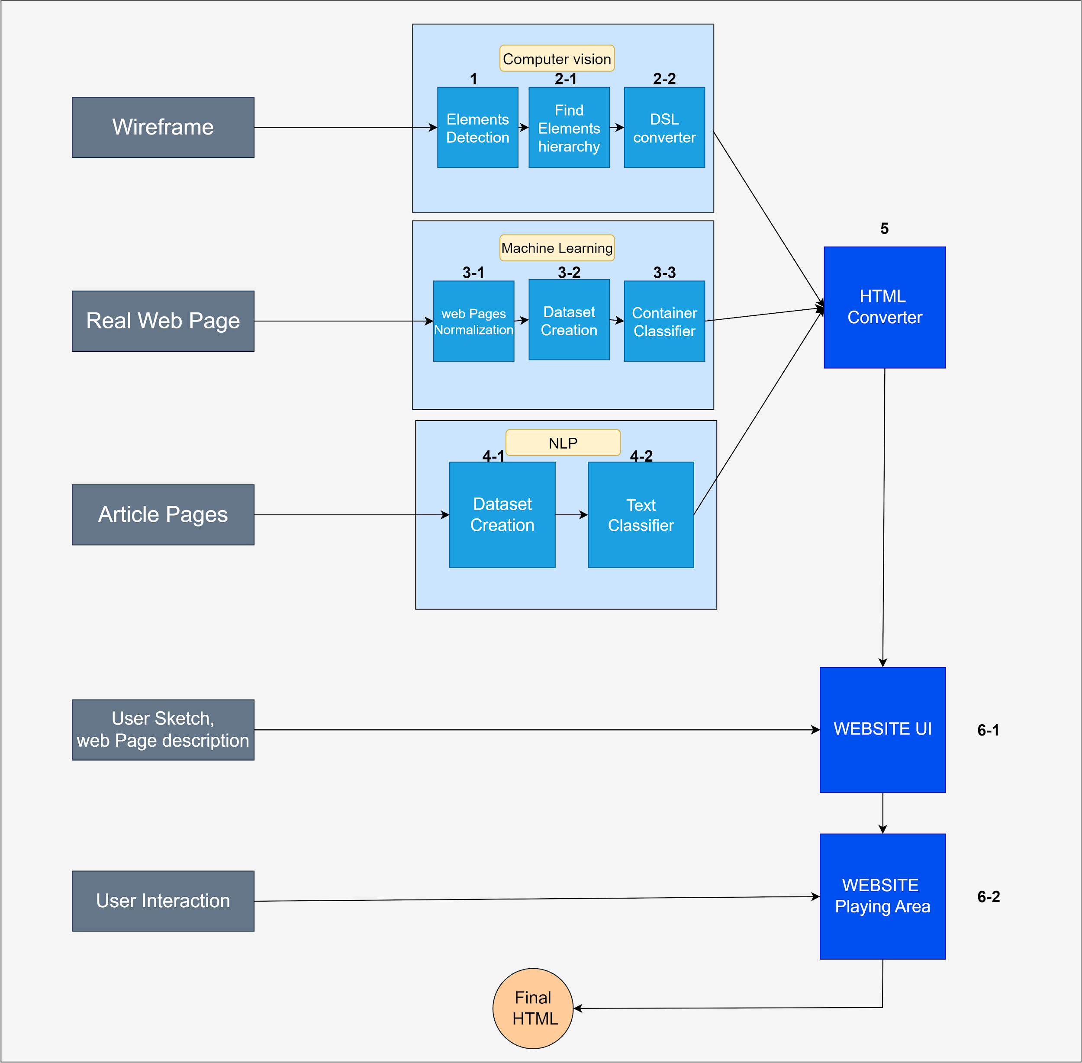

Slide 9
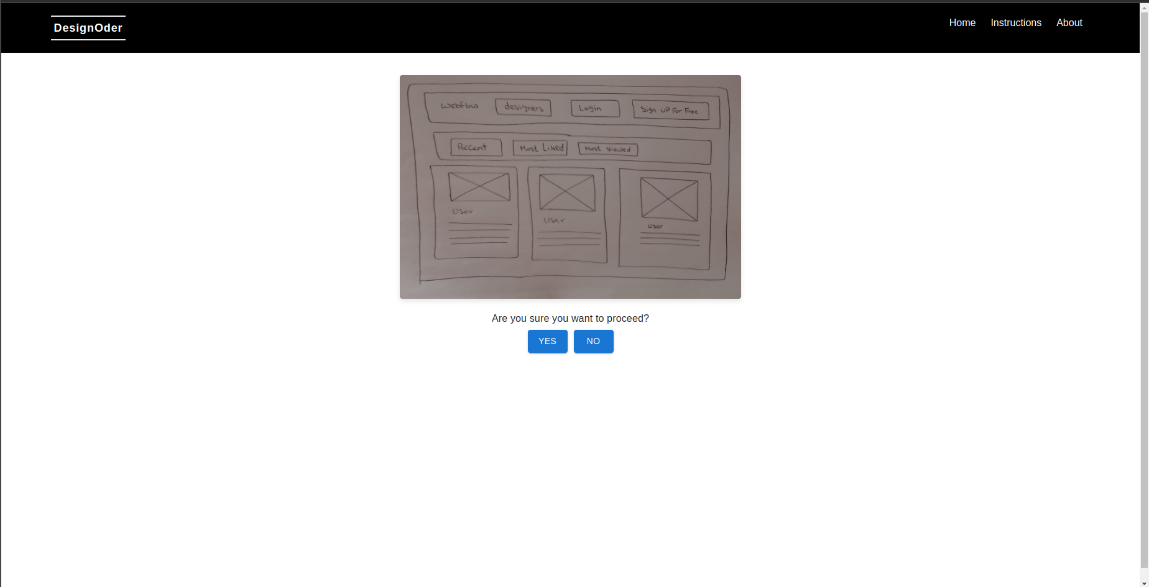

Slide 10
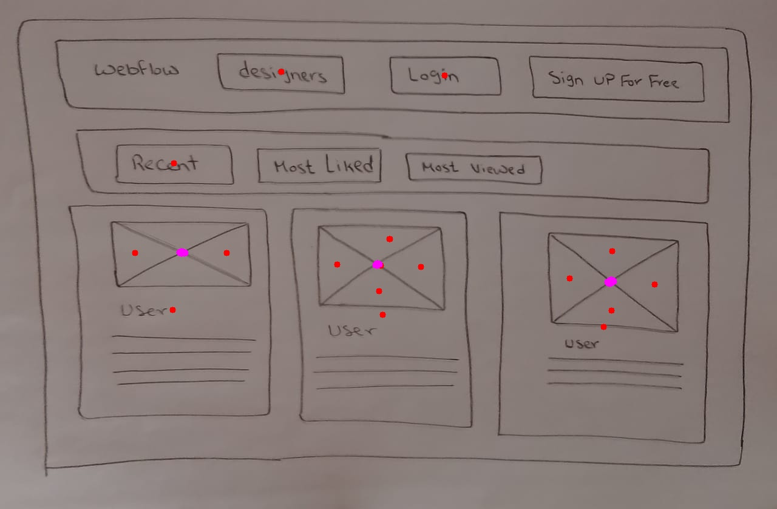

Slide 11
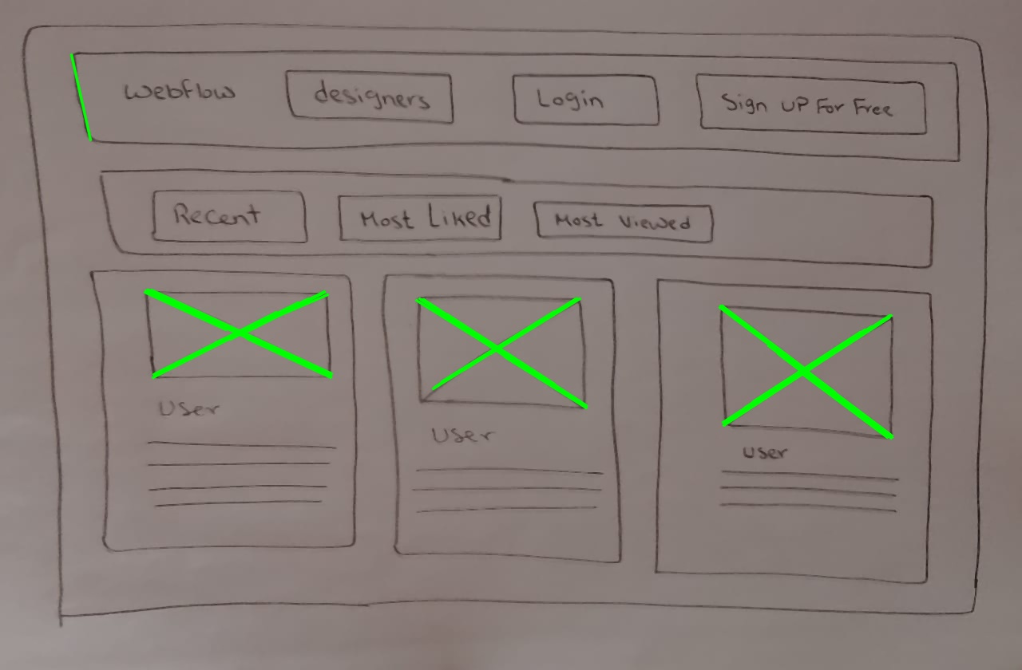

Slide 12
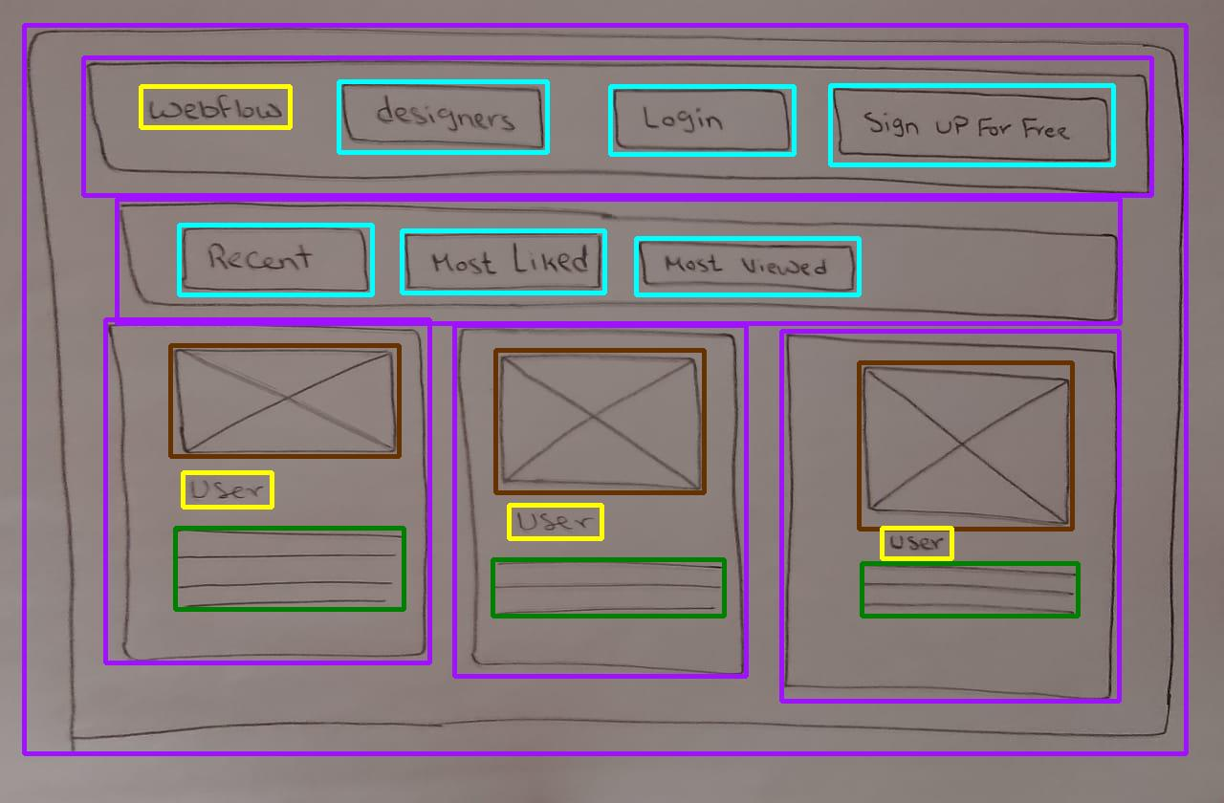

Slide 13

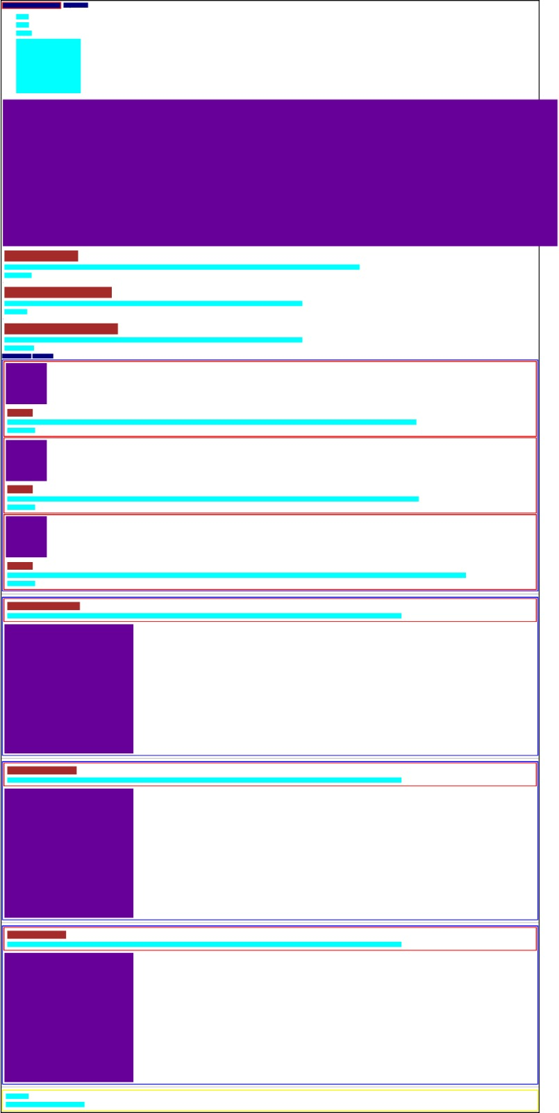

Slide 14
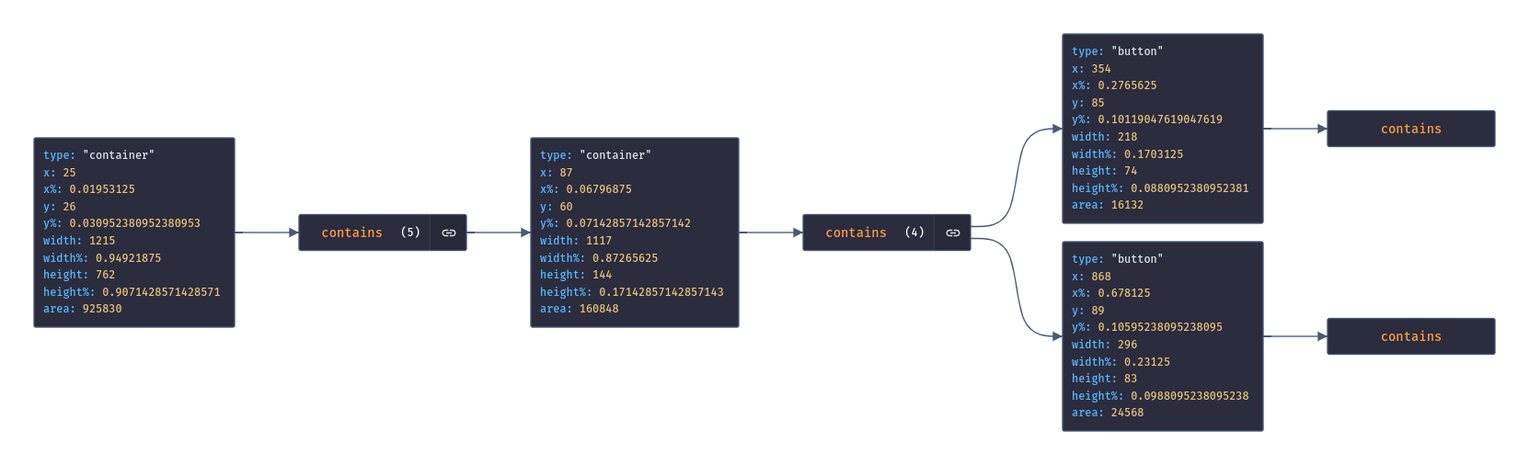

Slide 15
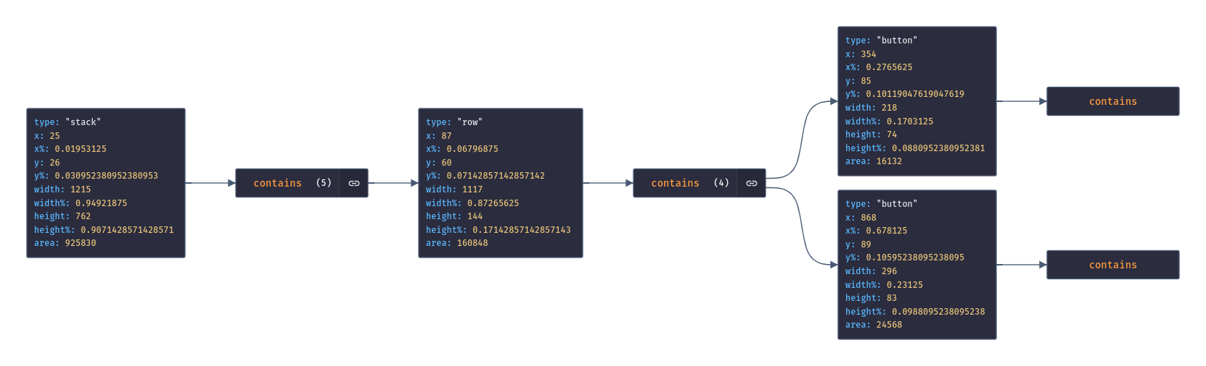

Slide 16
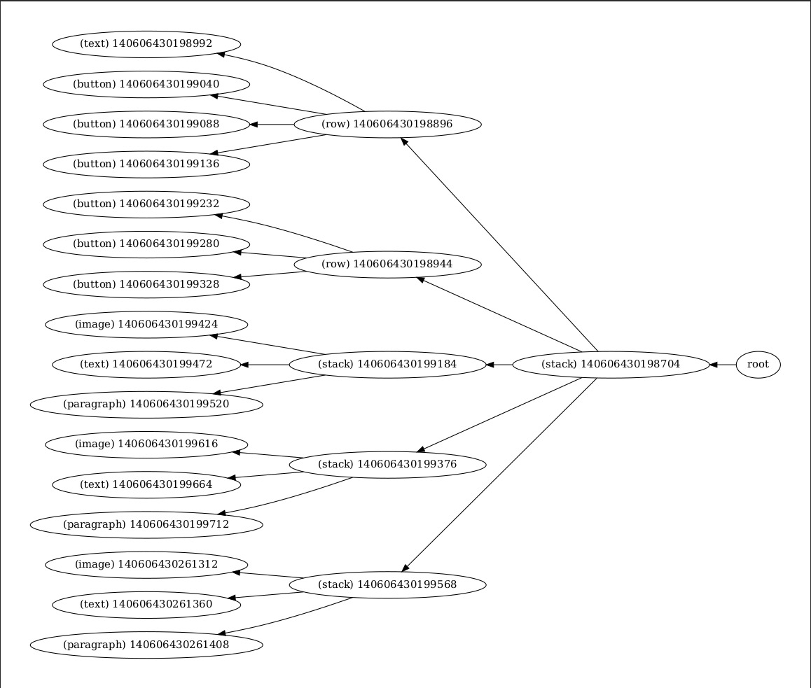

Slide 17
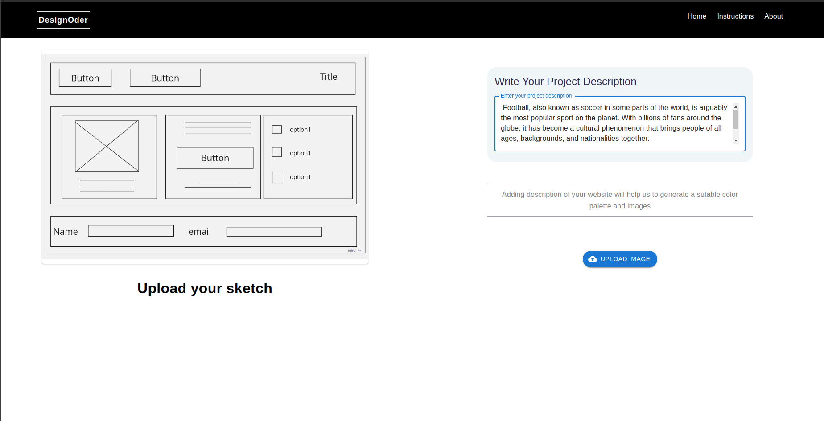

Slide 18
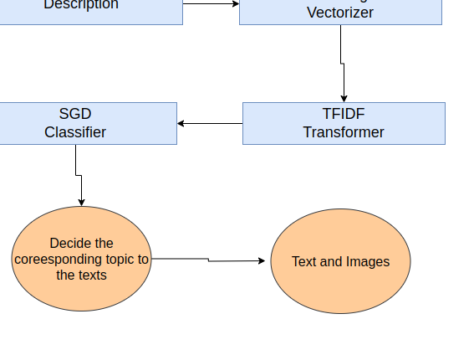

Slide 19
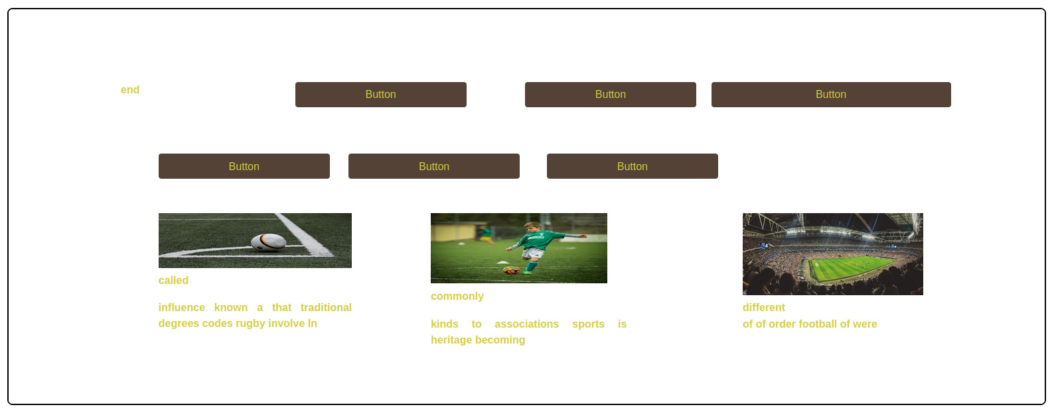

Slide 20
Project Modules
 | Ahmed Khaled | Ahmed Hafez | Hazem Abdo | Nour Aldin Mostafa | Ready-made %
Dataset creation | 0% | 0% | 0% | 90% | 10%
CV | 40% | 40% | 0% | 0% | 20%
Container classifier | 0% | 0% | 80% | 0% | 20%
Topic classifier | 0% | 0% | 70% | 0% | 30%
UI and playing area | 0% | 40% | 0% | 50% | 10%
HTML Converter | 90% | 0% | 0% | 0% | 10%
DSL Generation | 0% | 0% | 0% | 90% | 10%

Slide 21
Thank You

