Slide 1
OLxPBench
Real-time, Semantically Consistent, and Domain specific Benchmark, Designing, and Implementing hybrid transactional analytical processing (HTAP) Systems
Presented By:
Presented to:
Abdelaziz Salah Mohammed
DR/ Samir Shahien

Slide 2
Introduction
What is HTAP?
Hybrid (OLTP & OLAP).
Transactional.
Analytical.
Processing.
Can you guess the topic?
Correct! Databases <3

Slide 3
Throughput VS Latency
THROUGHPUT
Measures the volume of the data that passes through a network in a given period.
It impacts how much data you can transmit in a period of time.
LATENCY
Measures the time delay when sending data.
A higher latency causes a network delay.

Slide 4
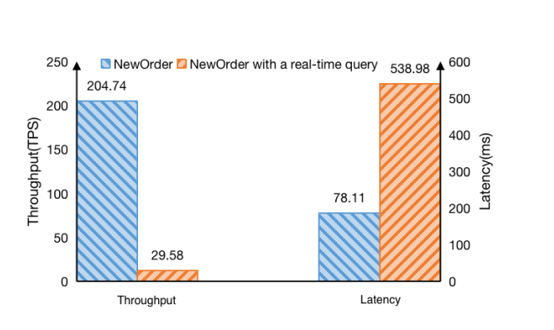
Why to consider?
This figure reveals the impact of a hybrid workload – performing a real-time query in-between an online transaction on the performance of TiDB – a state-of-the-art HTAP system against that of only an online transaction.

Slide 5
Methodology
Solutions:
Separate DBMSs
Lambda Architecture
Single STAP DBMS
Benchmarks
Subenchmark (Generic)
Fibenchmark (Banks – Domain specific)
Tabenchmark (Telecoms – Domain specific)
We compare the tradeoffs of these solutions.

Slide 6
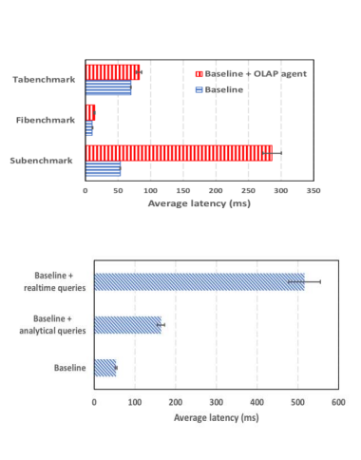
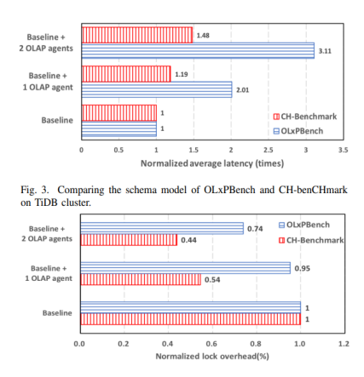
Sample Results

Slide 7
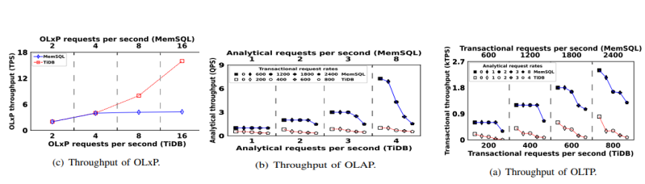
Sample results

Slide 8

Conclusion
This paper quantitatively discloses that the previous HTAP benchmarks provide misleading information in evaluating, designing, and implementing HTAP systems. We design and implement an extensible HTAP benchmarking framework named OLxPBench. OLxPBench proposes the abstraction of a hybrid transaction to model the widely-observed behavior pattern – making a quick decision while consulting real-time analysis; a semantically consistent schema to express the relationships between OLTP and OLAP schemas; the combination of domain-specific and general benchmarks to characterize diverse application scenarios with varying resource demands. Extensive experiments demonstrate its merit and pinpoint the bottlenecks of the mainstream distributed HTAP DBMSs.

Slide 9

THE END
DATABASE

