Slide 1
Lecture 2: The Learning Theory
Dina Elreedy
CMP402B-Spring 2022

Slide 2
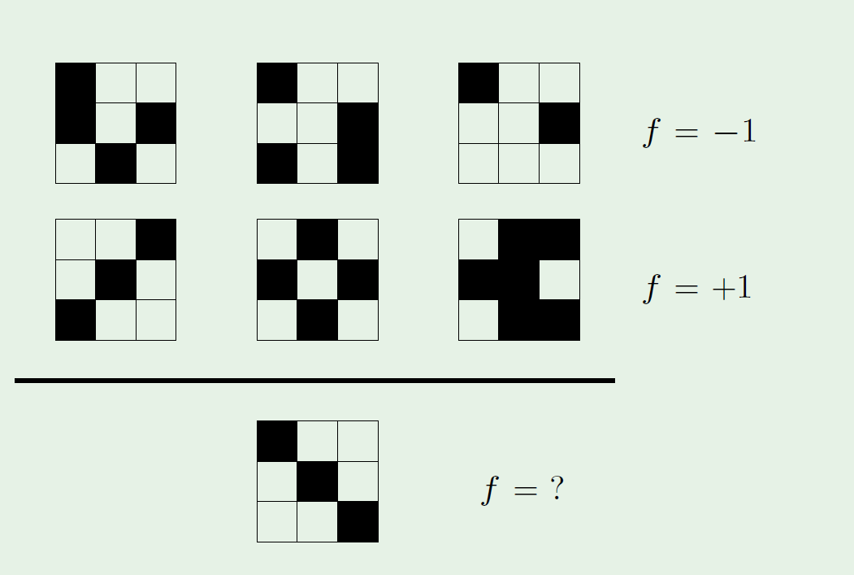
Learning Puzzle

Slide 3
Is learning feasible?-Example
X={0,1}³
Y={0,1}
Hypothesis set H:All Boolean functions X→Y
|H|=?
|H|=2⁸=256
f: Target function

Slide 4
Is learning feasible?-Example
x | y | g | f1 | f2 | f3 | f4 | f5 | f6 | f7 | f8
0 0 0 | 0 | 0 | 0 | 0 | 0 | 0 | 0 | 0 | 0 | 0
0 0 1 | 1 | 1 | 1 | 1 | 1 | 1 | 1 | 1 | 1 | 1
0 1 0 | 1 | 1 | 1 | 1 | 1 | 1 | 1 | 1 | 1 | 1
0 1 1 | 0 | 0 | 0 | 0 | 0 | 0 | 0 | 0 | 0 | 0
100 | 1 | 1 | 1 | 1 | 1 | 1 | 1 | 1 | 1 | 1
101 | ? | ? | 0 | 1 | 0 | 1 | 0 | 1 | 0 | 1
110 | ? | ? | 0 | 0 | 1 | 1 | 0 | 0 | 1 | 1
111 | ? | ? | 0 | 0 | 0 | 0 | 1 | 1 | 1 | 1
Observed Training data
Same values
Testing data
Nothing to tell us which f is the true function??

Slide 5
Is learning feasible?
Can we generalize to unseen data?
Yes, it is feasible to learn the unknown function f in a probabilistic way.

Slide 6
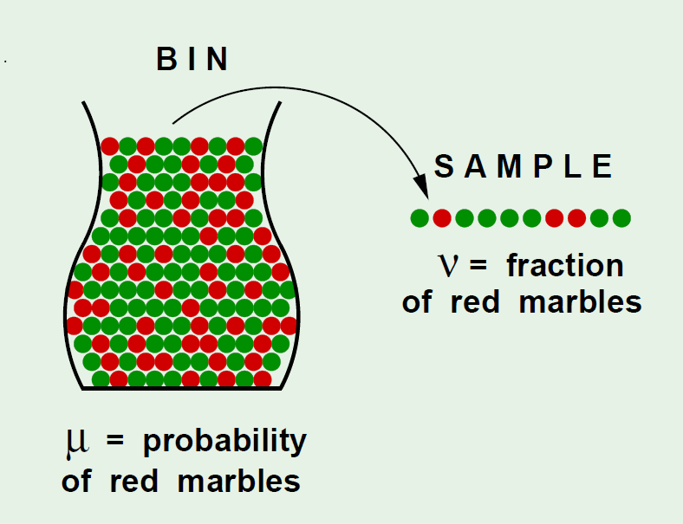
Analogy
Assume we have a bin of infinitely many red
and green marbles.
Assume we pick a random sample of N
marbles out of the bin.
μ=ν??
Can ν say anything about μ?

Slide 7
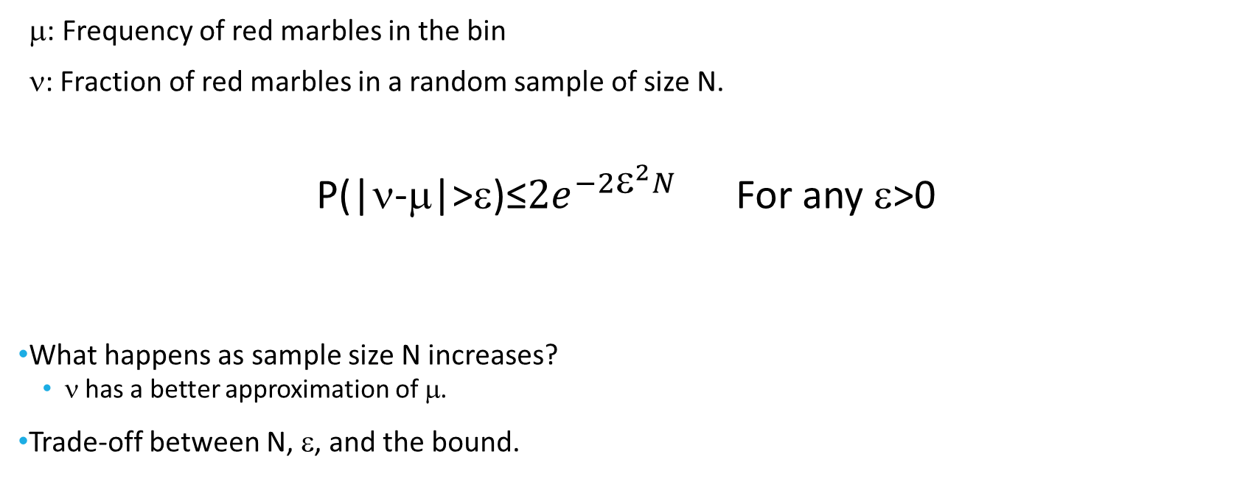
Hoeffdeing’s Inequality
μ: Frequency of red marbles in the bin
ν: Fraction of red marbles in a random sample of size N.
P(|ν-μ|>ε)≤${2e}^{−2{\text{ε}}^{2}N}$ For any $\text{}$>0
What happens as sample size N increases?
ν has a better approximation of μ.
Trade-off between N, ε, and the bound.

Slide 8
Analogy to the learning problem
Bin: Input space X
Sample:(Observed) Training set D
Each marble is a point x that belongs to the input space X
Red marbles: Misclassified points by hypothesis h h(x)≠f(x)
Green marbles: Correctly classified points by hypothesis h (h(x)=f(x))
ν: Fraction of misclassified data points by hypothesis h in traning data. (Ein(h))
ν is the in-sample error of the hypothesis h (Ein(h))
μ: Fraction of misclassified data points by hypothesis h in the input space. (Eout(h))
μ is the out-of-sample error of the hypothesis h (Eout(h))

Slide 9

In-sample versus Out-of sample error
$Ein\left(h\right)=fraction of D where f and h disagree$
=$\frac{1}{N}\sum_{n=1}^{N}{⟦h(xn)≠f(xn)⟧}$
$Eout\left(h\right)=P[h(xn)≠f(xn)]$

Slide 10
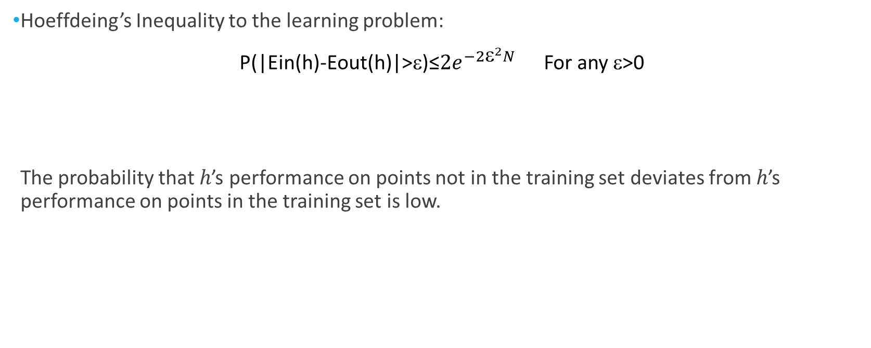
Hoeffdeing’s Inequality
Hoeffdeing’s Inequality to the learning problem:
P(|Ein(h)-Eout(h)|>ε)≤${2e}^{−2{\text{ε}}^{2}N}$ For any $\text{}$>0
The probability that ℎ’s performance on points not in the training set deviates from ℎ’s performance on points in the training set is low.

Slide 11
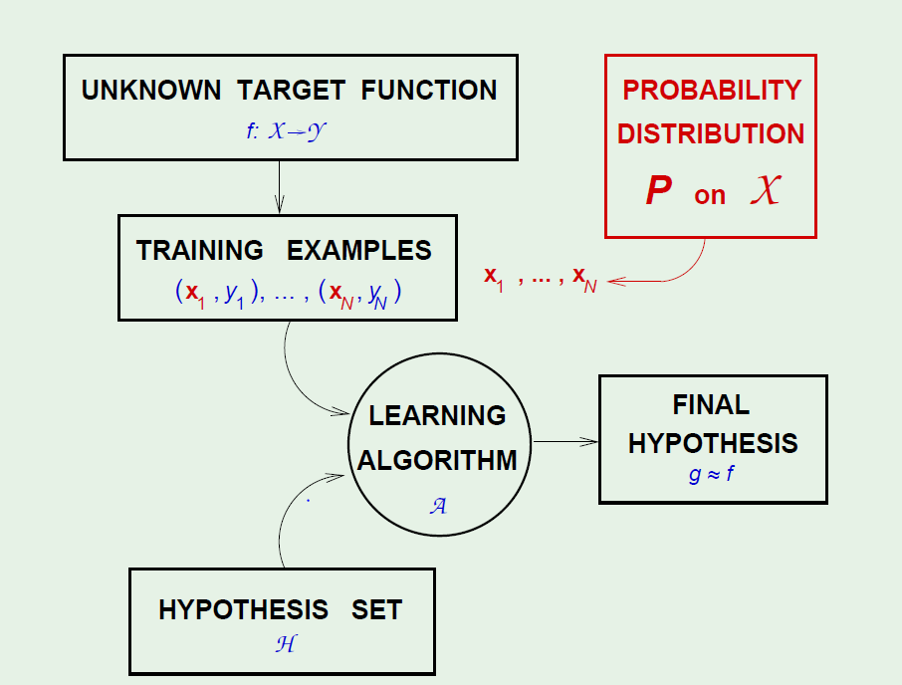
Learning Setup-updated
Important Note:
A fundamental assumption made
in this analysis is that the sample
is taken randomly and training and
testing data have the same distribution.
Source: Learning from data book

Slide 12
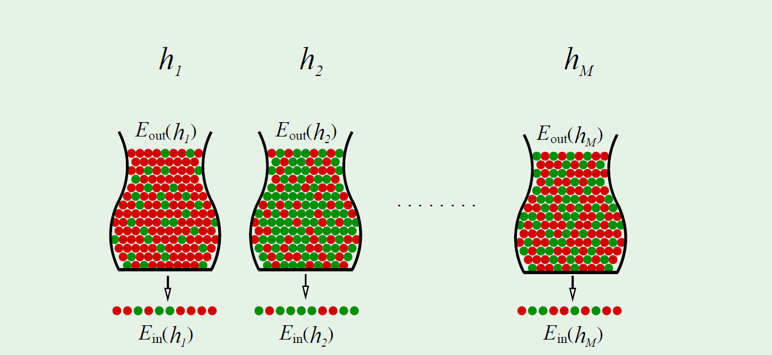
Multiple Hypotheses
In learning, we have multiple hypotheses to pick from.
Finite Hypothesis set H={h₁,h₂,…h_{M}}
H is analogous to multiple bins.
The final hypothesis g is selected
by the learning algorithm.

Slide 13
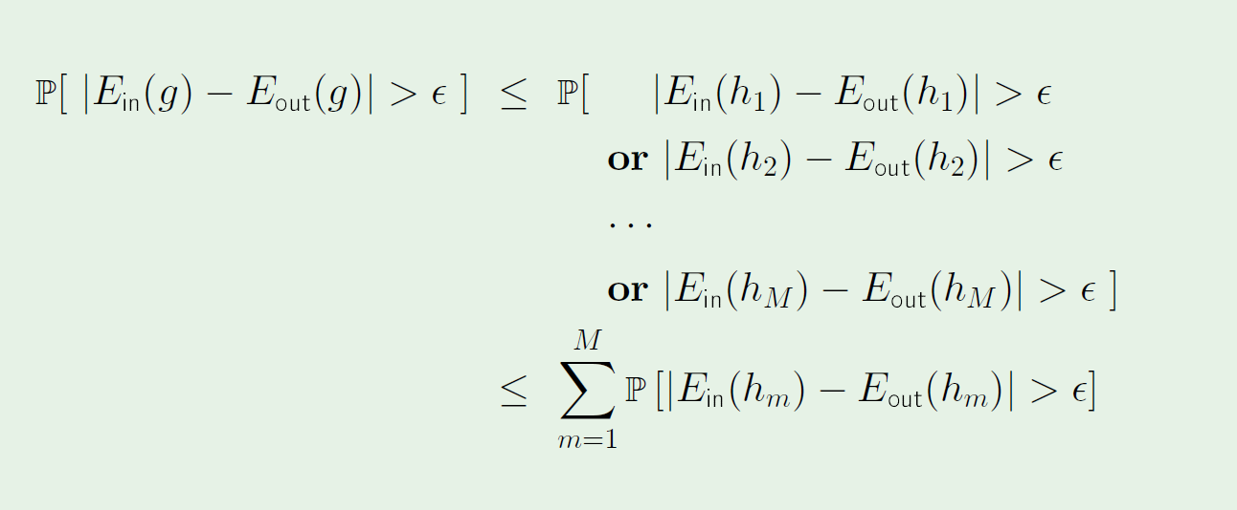
Hoeffdeing’s Inequality for final hypothesis g
Notes:
Why we cannot simply apply hoeffding’s inequality for g?
As g is affected by the data. The basic assumption when applying hoeffding inequality is that the hypothesis is fixed before generating the data.
The best performing hypothesis g is affected by the data.

Slide 14
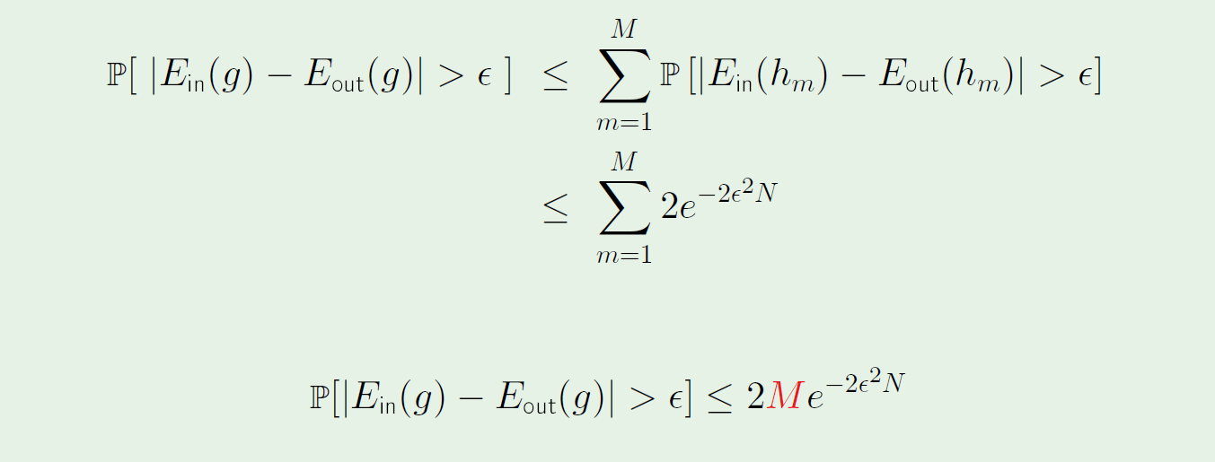
Hoeffdeing’s Inequality for final hypothesis g
As M (the hypothesis set size) increases, the bound gets looser.

Slide 15
Feasibility of Learning
Two main questions:
Can we make sure that Eout(g) is close enough to Ein(g)? Hoeffdeing’s Inequality.
Can we make Ein(g) small?
Learning models

