Slide 1
Learning Theory-Infinite Hypothesis sets
Dina Elreedy

Slide 2
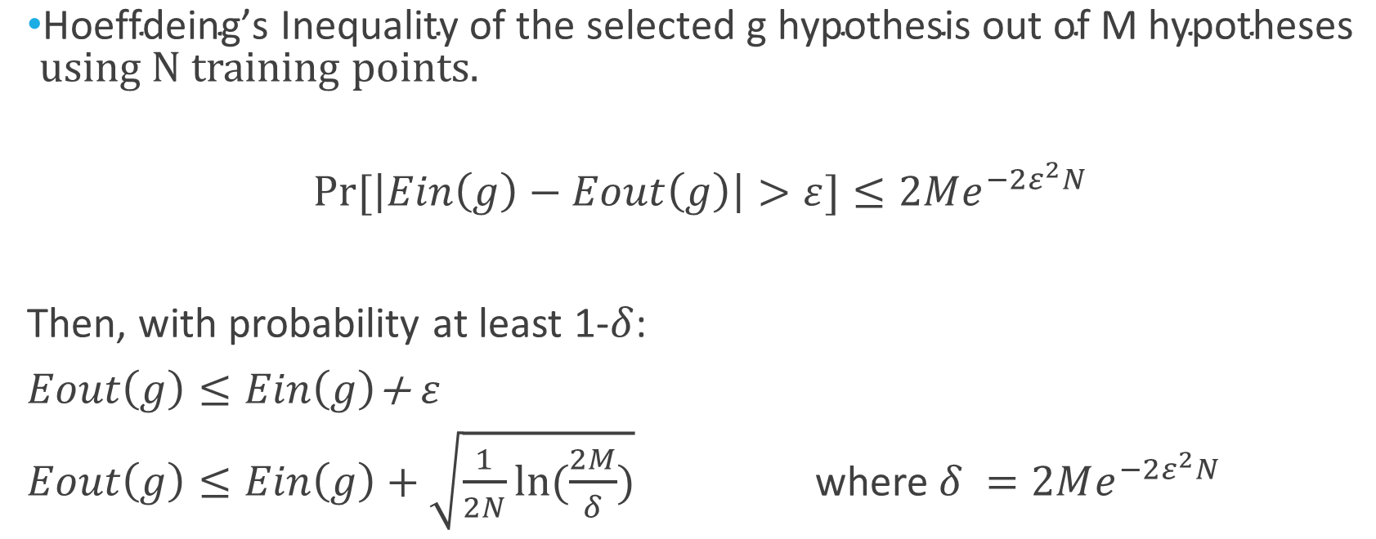

Generalization bound ($\text{M} \text{hypotheses}\text{)}$
$\text{Hoeffdeing}\text{’}\text{s} \text{Inequality} \text{of} \text{the} \text{selected} \text{g} \text{hypothesis} \text{out} \text{of} \text{M} \text{hypotheses}$ using N training points.
$$Pr⁡[\left|Ein\left(g\right)−Eout\left(g\right)\right|>ε]≤2Me^{−2ε^{2}N}$$
Then, with probability at least 1-$δ$:
$Eout\left(g\right)≤Ein\left(g\right)$+ $ε$
$Eout\left(g\right)≤Ein\left(g\right)+\sqrt{\frac{1}{2N}ln⁡(\frac{2M}{δ})}$ where $δ =2Me^{−2ε^{2}N}$

Slide 3
Generalization bound
What if we have an infinite set of hypotheses?
Example: the perceptron learning algorithm.
Can we derive a generalization bound?

Slide 4
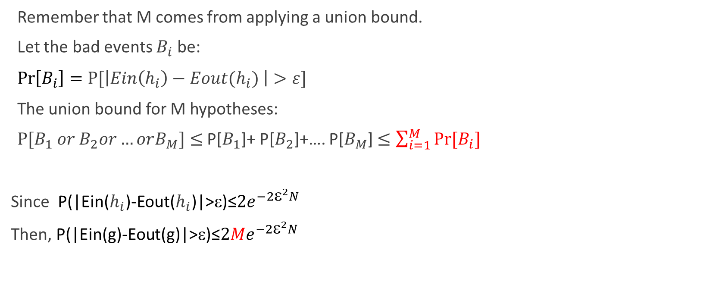

Review: Union bound of M$\text{hypotheses}$
Remember that M comes from applying a union bound.
Let the bad events $B_{i}$ be:
$\operatorname{Pr}\left[B_{i}\right]=P[\left|Ein\left(h_{i}\right)−Eout(h_{i}) \right|>ε]$
The union bound for M hypotheses:
$P[B_{1} or B_{2}or…orB_{M}]≤$ P[$B_{1}$]+ P[$B_{2}$]+…. P[$B_{M}$] $≤\sum_{i=1}^{M}{Pr⁡[B_{i}]}$
Since P(|Ein($h_{i}$)-Eout($h_{i}$)|>ε)≤${2e}^{−2{\text{ε}}^{2}N}$
Then, P(|Ein(g)-Eout(g)|>ε)≤${2Me}^{−2{\text{ε}}^{2}N}$
M terms

Slide 5
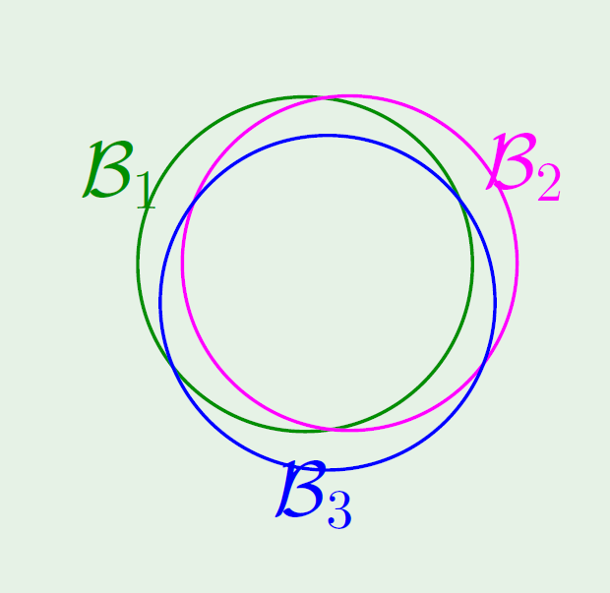
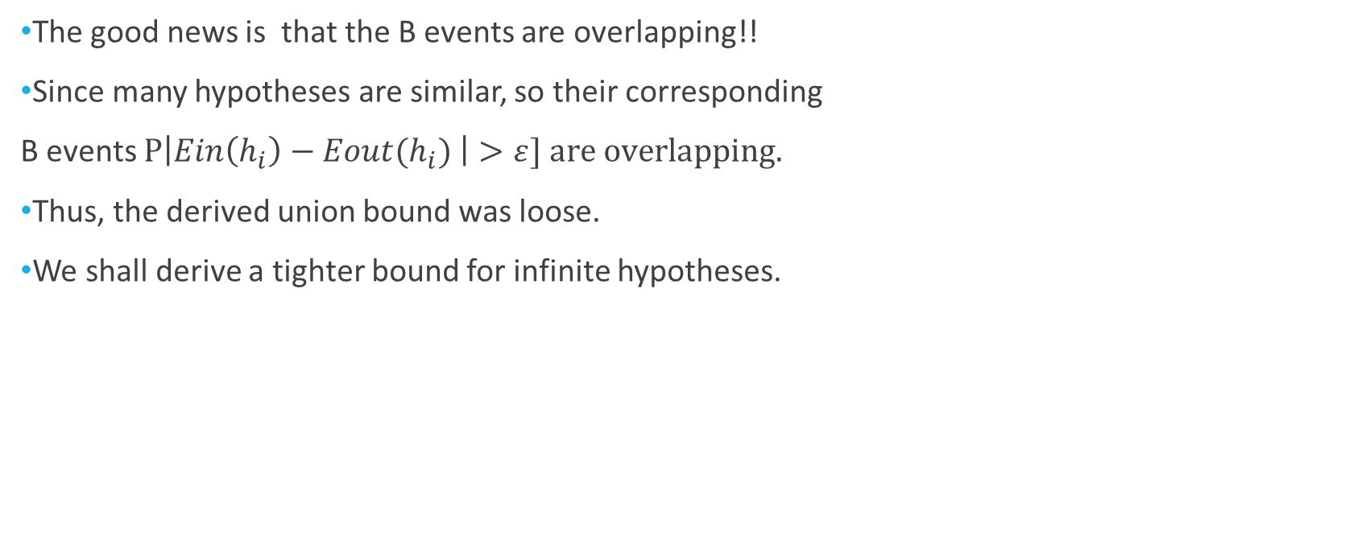

Union bound of M$\text{hypotheses}$
The good news is that the B events are overlapping!!
Since many hypotheses are similar, so their corresponding
B events $P\left|Ein\left(h_{i}\right)−Eout(h_{i}) \right|>ε] are overlapping.$
Thus, the derived union bound was loose.
We shall derive a tighter bound for infinite hypotheses.

Slide 6
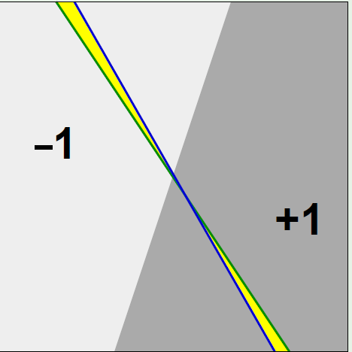
Example- linear classifiers

Slide 7
Dichotomies
For a binary classification problem:
A hypothesis h: X -> {+1,-1}.
Apply a hypothesis h to a finite sample of input points not the whole input space.
Assume we have N sample points {x₁, x₂,…x_{N}}
Apply h ∈H to the N points, we get a dichotomy which is an N-tuple of (h(x₁), h(x₂),…h(x_{N})) .

Slide 8
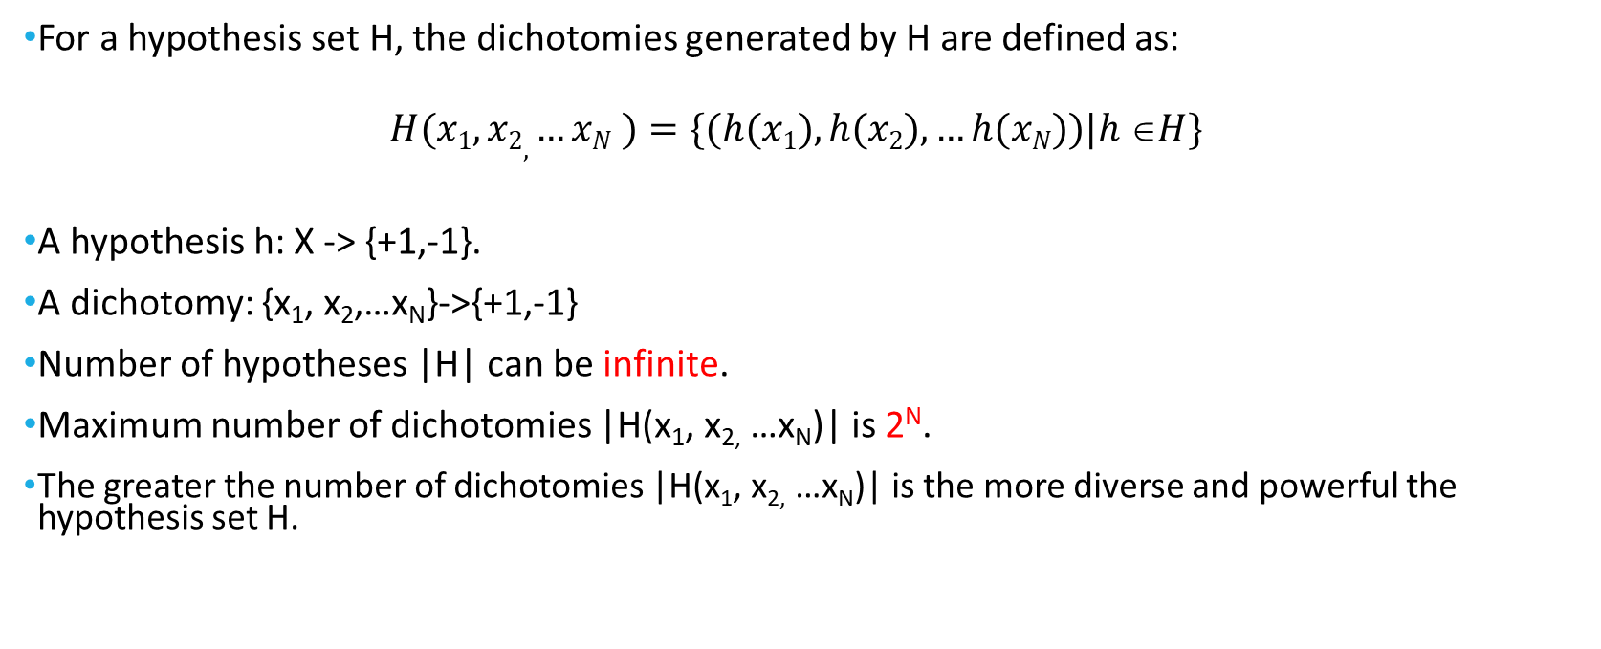
Dichotomies (cont.)
For a hypothesis set H, the dichotomies generated by H are defined as:
$$H(x1, x2, …xN )=\{(h(x1), h(x2),…h(xN))|h H\}$$
A hypothesis h: X -> {+1,-1}.
A dichotomy: {x₁, x₂,…x_{N}}->{+1,-1}
Number of hypotheses |H| can be infinite.
Maximum number of dichotomies |H(x₁, x_{2,} …x_{N})| is 2^{N}.
The greater the number of dichotomies |H(x₁, x_{2,} …x_{N})| is the more diverse and powerful the hypothesis set H.

Slide 9
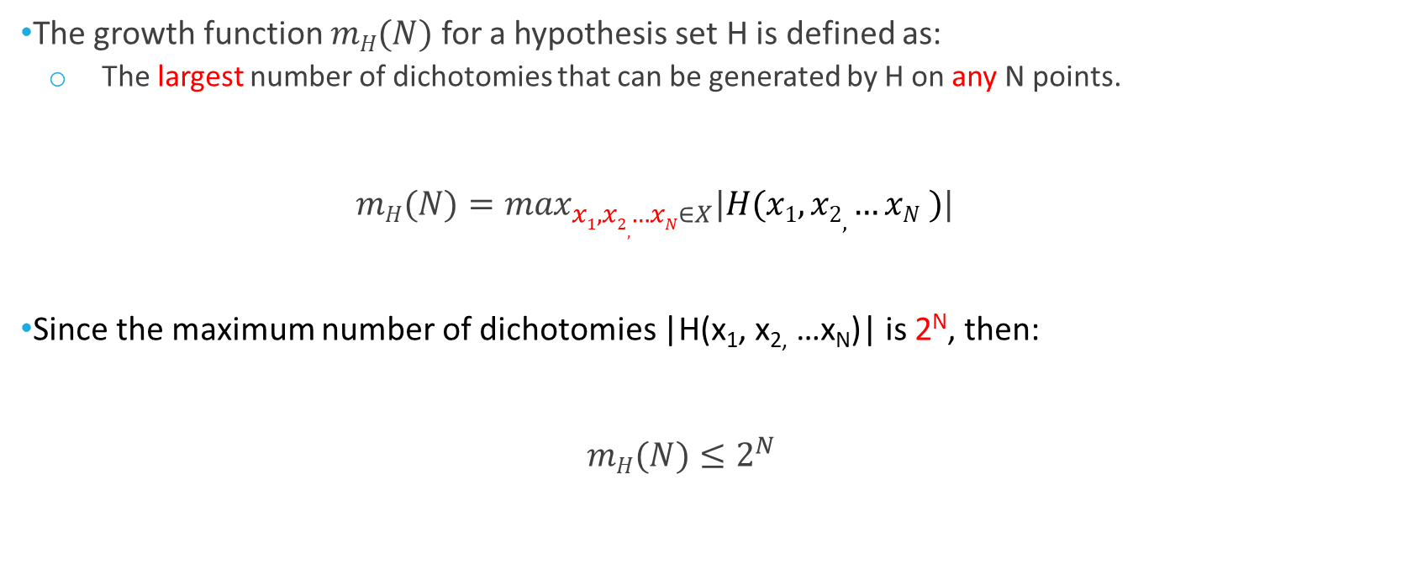
Growth Function
The growth function $mH(N)$ for a hypothesis set H is defined as:
The largest number of dichotomies that can be generated by H on any N points.
$mH(N)=\max_{x1, x2, …xN∈X}|H(x1, x2, …xN )|$
Since the maximum number of dichotomies |H(x₁, x_{2,} …x_{N})| is 2^{N}, then:
$mH(N)≤2^{N}$

Slide 10

Growth Function (cont.)
Given H, if H can generate all possible dichotomies on data points $(x1, x2, …xN$) such that |H($x1, x2, …xN$)|=2^{N} then H shatters $(x1, x2, …xN$).

Slide 11
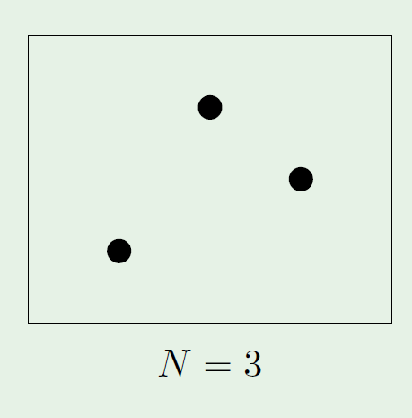

Growth function-Perceptron
N=3
$mH\left(3\right)=8$

Slide 12
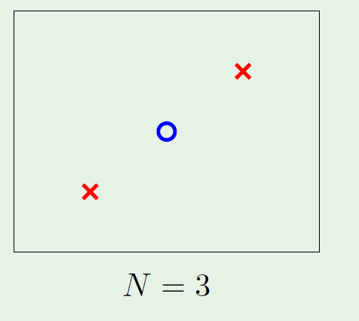
Growth function-Perceptron
N=3 (co-linear points)

Slide 13
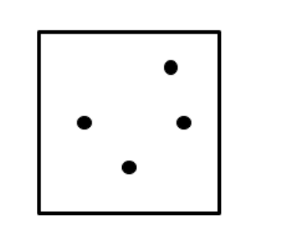
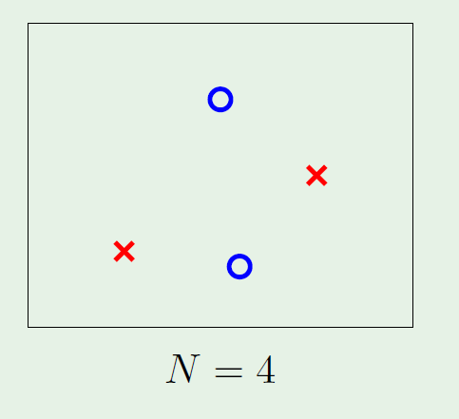

Growth function-Perceptron
$mH\left(4\right)=14$

Slide 14
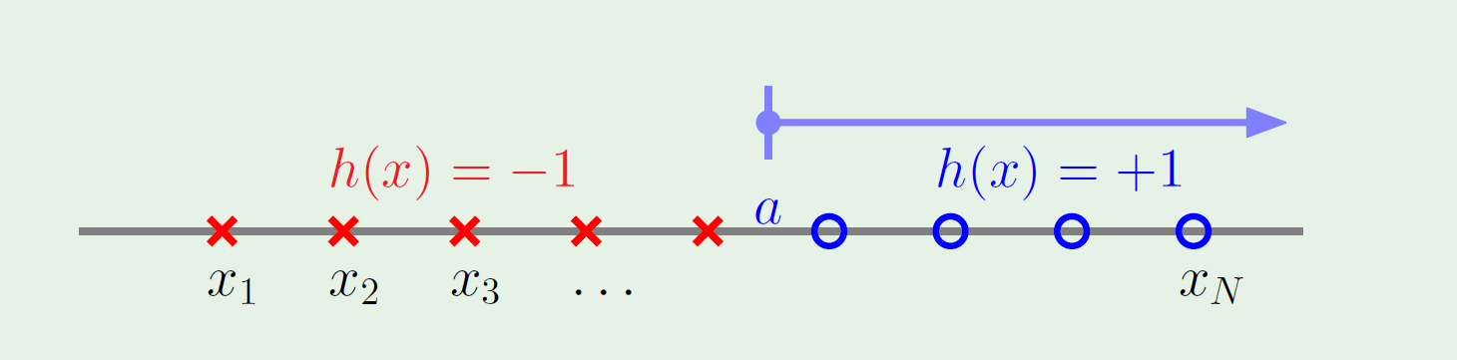

Growth function- Positive rays
H consists of all hypotheses h of the form: h(x)=sign(x-a)
$mH\left(N\right)=N+1$

Slide 15
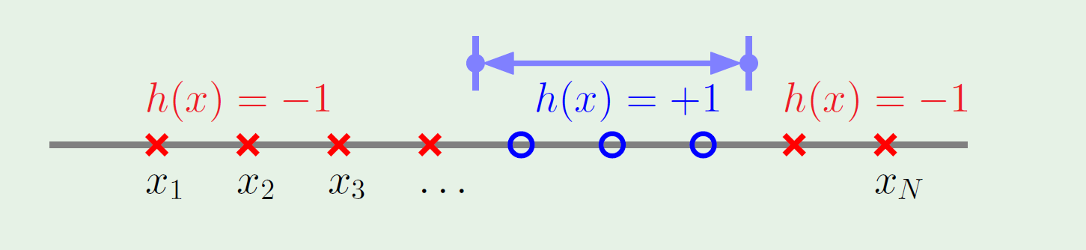

Growth function- Positive intervals
H consists of all hypotheses in one dimension that returns +1 within some interval and -1 otherwise.
Each hypothesis is specified by the two end values of the interval (a,b).
$mH\left(N\right)=$ +1=$\frac{1}{2}N^{2}+\frac{1}{2}N+1$

Slide 16
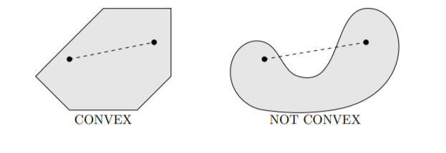
Convex sets
A set is convex if the line between any two points in the set entirely lies within the set.
Image source: https://faculty.math.illinois.edu/~mlavrov/docs/484-spring-2019/ch2lec1.pdf

Slide 17
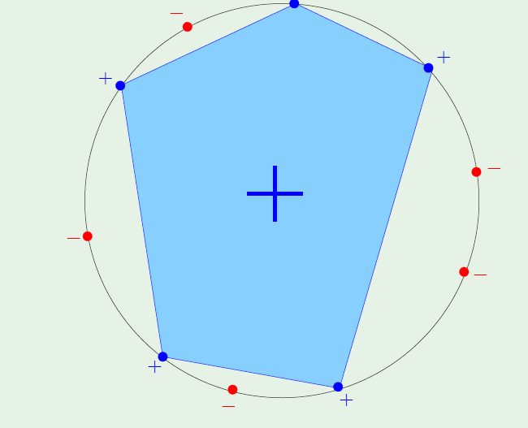
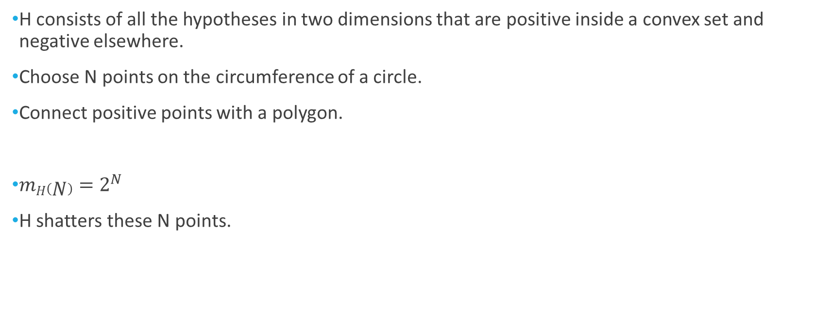
Growth function- Convex sets
H consists of all the hypotheses in two dimensions that are positive inside a convex set and negative elsewhere.
Choose N points on the circumference of a circle.
Connect positive points with a polygon.
$mH\left(N\right)=2^{N}$
H shatters these N points.
Notes:
If N<3 the convex set would be line, point, or empty set.

Slide 18

Breakpoint
If no data set of size k can be shattered by H, then k is said to be a breakpoint for H.
If k is a breakpoint then:
$mH\left(k\right)<2^{k}$

Slide 19


Breakpoint Examples
For 2D perceptron:
k=4
For the 1D positive rays:
k=2
For the 1D positive interval:
k=3
For the convex sets:
k=∞

Slide 20

The VC Dimension
The VC dimension of a hypothesis set H denoted by $dvc(H)$is the largest value of $N$ for which $mH\left(N\right)=2^{N}.$
$dvc\left(H\right)=k−$1
If there is no break point for the hypothesis set H, $mH\left(N\right)=2^{N} ∀N$, then $dvc(H)$=$∞.$

Slide 21

VC dimension-examples
The VC dimension for 2D perceptron is $dvc\left(H\right)=$3.
The VC dimension for d-dimension perceptron is $dvc\left(H\right)=$d+1.

Slide 22

VC dimension-examples (cont.)
The VC dimension for positive rays $dvc\left(H\right)=$1.
The VC dimension for positive intervals $dvc\left(H\right)=2$.
VC dimension can be interpreted as the effective number of parameters (degrees of freedom).

Slide 23

Theorem
If H has a break point, then $mH\left(N\right)$ is bounded by a polynomial in N.
$mH\left(N\right)≤\sum_{i=0}^{k−1}{\left({N \atop i}\right)}$
$mH\left(N\right)≤\sum_{i=0}^{dvc(H)}{\left({N \atop i}\right)}$

Slide 24

VC-Generalization bound for Infinite hypothesis set
The VC inequality using the growth function instead of M:
$Pr⁡[\left|Ein\left(g\right)−Eout\left(g\right)\right|>ε]≤4mH\left(2N\right)e^{−\frac{1}{8}ε^{2}N}$

Slide 25
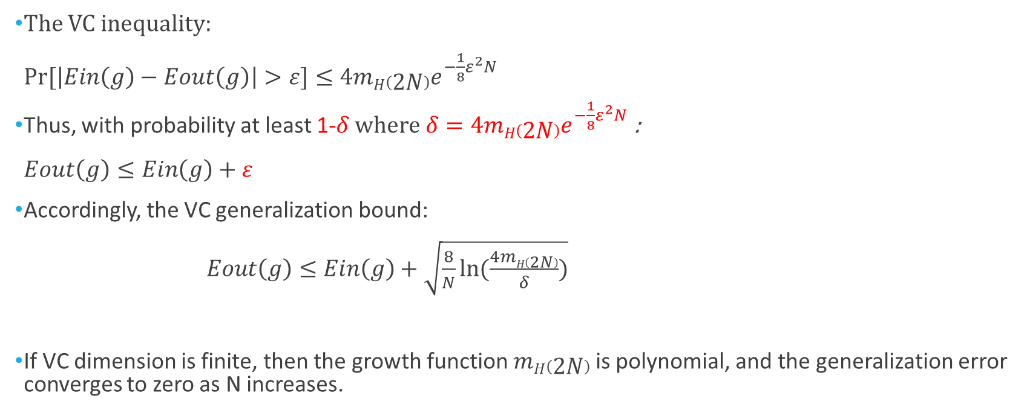
VC Generalization bound
The VC inequality:
$Pr⁡[\left|Ein\left(g\right)−Eout\left(g\right)\right|>ε]≤4mH\left(2N\right)e^{−\frac{1}{8}ε^{2}N}$
Thus, with probability at least 1-$δ where δ=4mH\left(2N\right)e^{−\frac{1}{8}ε^{2}N}$ :
$Eout\left(g\right)≤Ein\left(g\right)+ε$
Accordingly, the VC generalization bound:
$Eout\left(g\right)≤Ein\left(g\right)+\sqrt{\frac{8}{N}ln⁡(\frac{4mH\left(2N\right)}{δ})}$
If VC dimension is finite, then the growth function $mH\left(2N\right)$ is polynomial, and the generalization error converges to zero as N increases.
Notes:
The VC bound is loose.

Slide 26
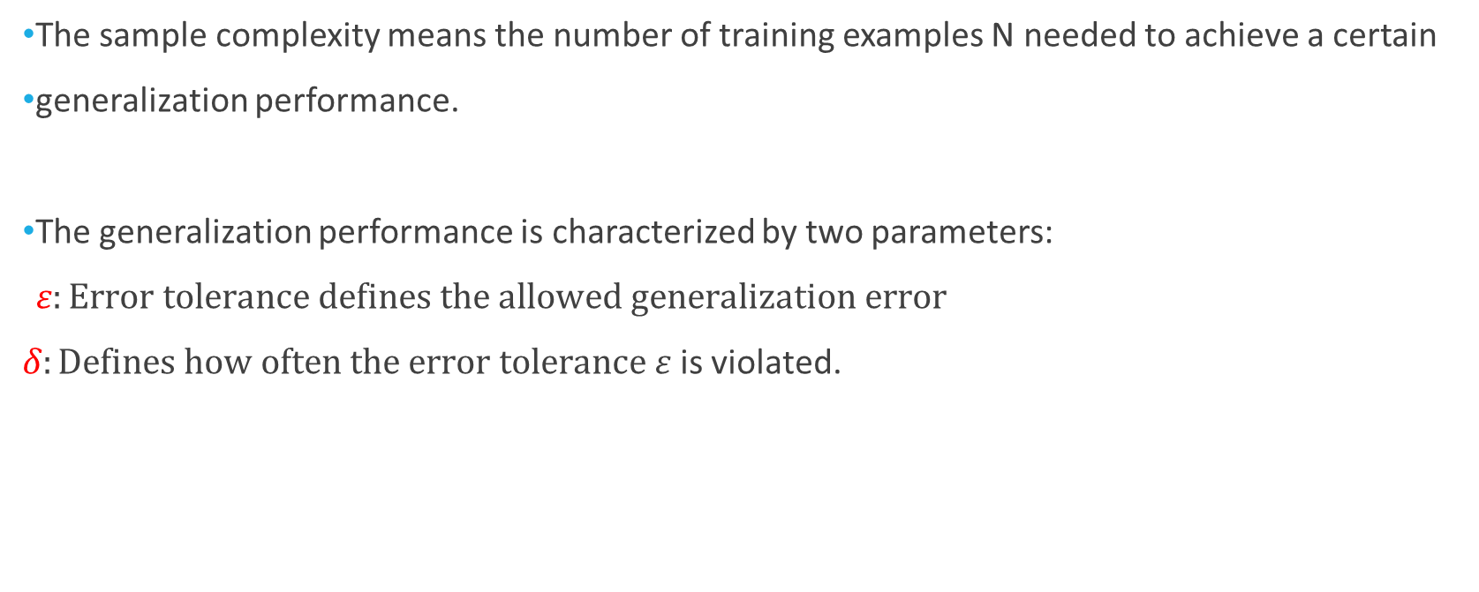
Sample Complexity
The sample complexity means the number of training examples N needed to achieve a certain
generalization performance.
The generalization performance is characterized by two parameters:
$ε:Error tolerance defines the allowed generalization error$
$δ:Defines how often the error tolerance$ $ε$ is violated.

Slide 27
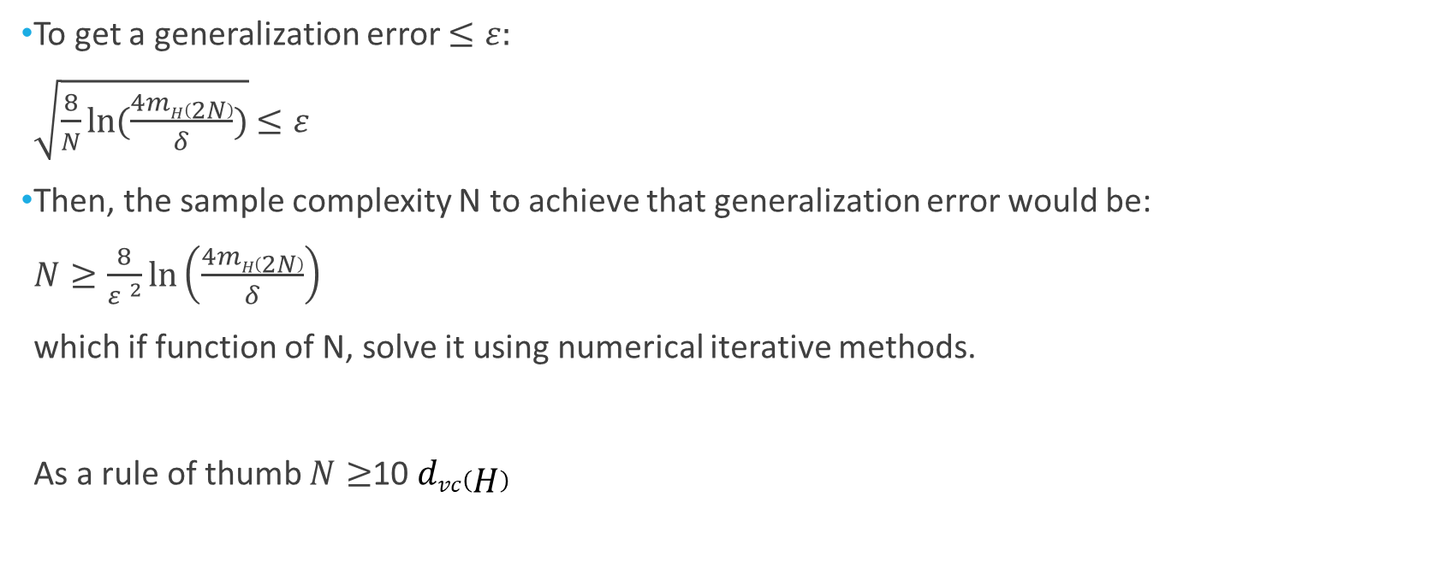
Sample Complexity (cont.)
To get a generalization error $≤ε:$
$\sqrt{\frac{8}{N}ln⁡(\frac{4mH\left(2N\right)}{δ})}$ $≤ε$
Then, the sample complexity N to achieve that generalization error would be:
$N≥\frac{8}{{ε }^{2}}ln⁡\left(\frac{4mH\left(2N\right)}{δ}\right)$
which if function of N, solve it using numerical iterative methods.
As a rule of thumb $N≥$10 $dvc\left(H\right)$

Slide 28
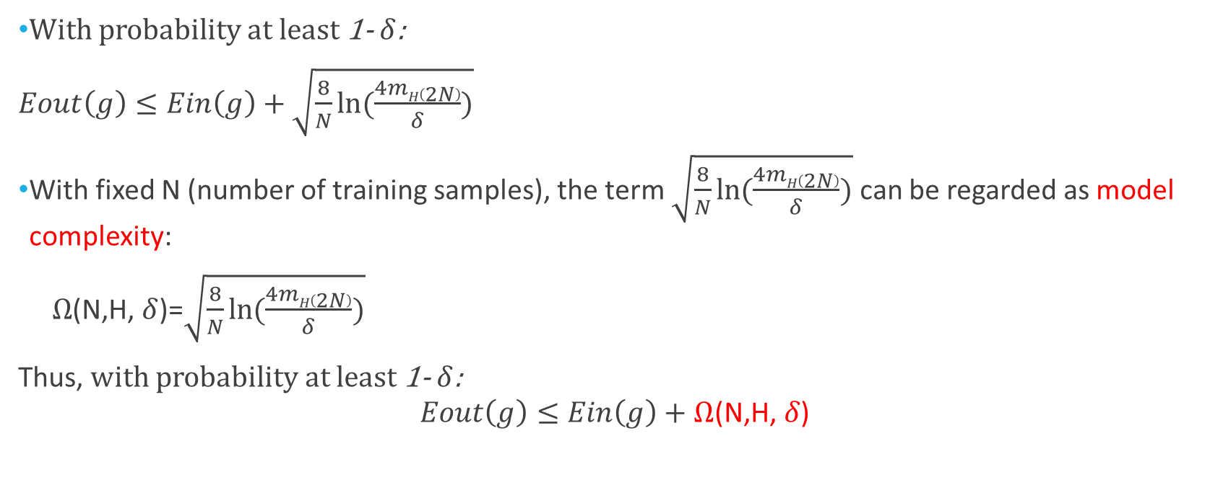
Model Complexity
With probability at least 1- $δ$:
$Eout\left(g\right)≤Ein\left(g\right)+\sqrt{\frac{8}{N}ln⁡(\frac{4mH\left(2N\right)}{δ})}$
With fixed N (number of training samples), the term $\sqrt{\frac{8}{N}ln⁡(\frac{4mH\left(2N\right)}{δ})}$ can be regarded as model complexity:
$Ω$(N,H, $δ$)=$\sqrt{\frac{8}{N}ln⁡(\frac{4mH\left(2N\right)}{δ})}$
Thus, with probability at least 1- $δ$:
$$Eout\left(g\right)≤Ein\left(g\right)+Ω\text{(}\text{N}\text{,}\text{H}\text{, }δ\text{)}$$

Slide 29
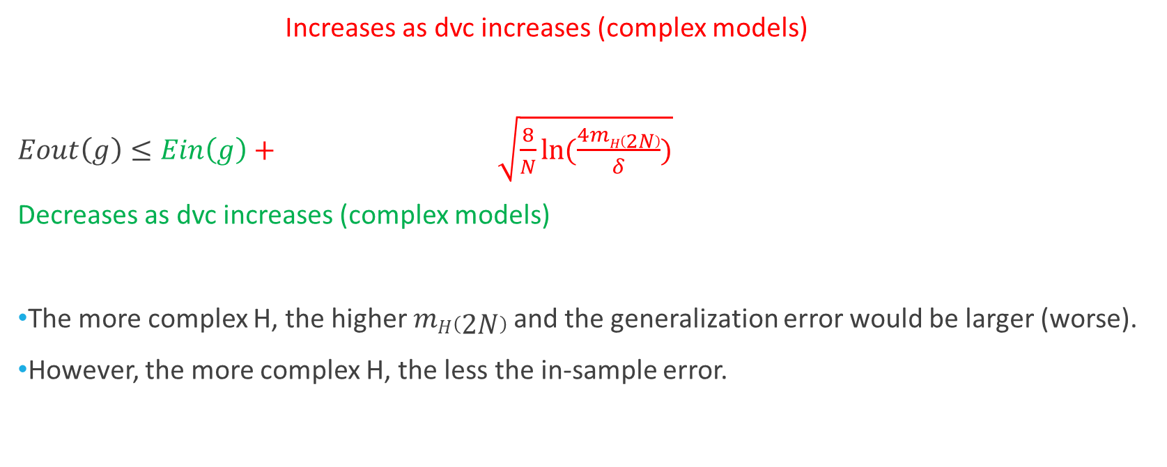
Model complexity vs. generalization error Trade-off
Increases as dvc increases (complex models)
$Eout\left(g\right)≤Ein\left(g\right)+ \sqrt{\frac{8}{N}ln⁡(\frac{4mH\left(2N\right)}{δ})}$
Decreases as dvc increases (complex models)
The more complex H, the higher $mH\left(2N\right)$ and the generalization error would be larger (worse).
However, the more complex H, the less the in-sample error.

Slide 30
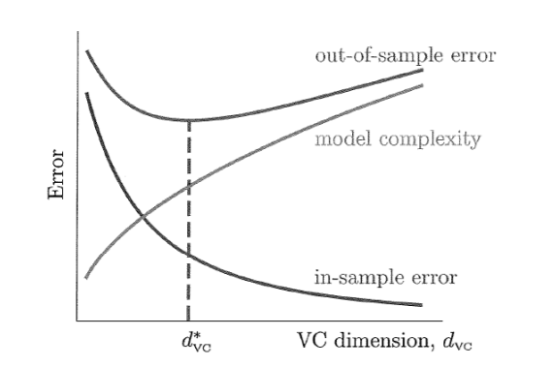

Generalization Error
A very simple model with low $dvc$, will
not fit the training data well and will have a high
in-sample error.
A more complex learning model with
higher $dvc$ would fit the training data better,
resulting in a lower in-sample error, but
the generalization will be worse.
Some intermediate $d∗vc$represents a
trade-off between the two errors.

Slide 31
Ein vs. Eout
Ein is the error on the training data. (in-sample error)
Eout is the error over the entire input space X. (out of sample error)
To estimate Eout, we should use new test points that are never used for training.

Slide 32
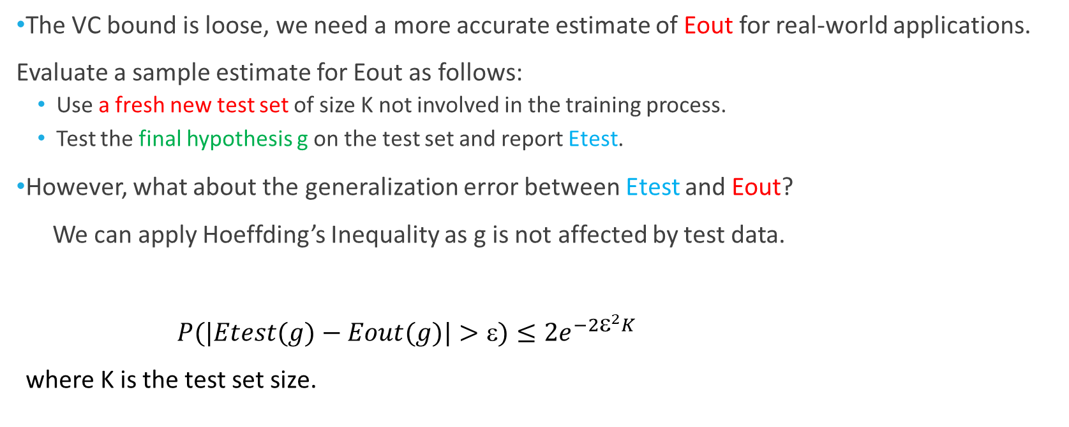
Estimating Eout in practice
The VC bound is loose, we need a more accurate estimate of Eout for real-world applications.
Evaluate a sample estimate for Eout as follows:
Use a fresh new test set of size K not involved in the training process.
Test the final hypothesis g on the test set and report Etest.
However, what about the generalization error between Etest and Eout?
We can apply Hoeffding’s Inequality as g is not affected by test data.
$P(|Etest(g)−Eout(g)|>)≤{2e}^{−2^{2}K}$
where K is the test set size.

Slide 33
Summary
Dichotomies
Growth function
Breakpoint
VC dimension
VC generalization bound for infinite hypotheses
Sample complexity
Model Complexity and trade-off between in-sample and generalization error
Estimate Eout in practice

