Slide 1

Toward-High-interactive Honeypots
Bullet points

Slide 2

Main purpose
They purpose a design of a virtual, high-interactive, and server-based ICS to satisfy these properties:
        Cost-Effective
        Realistic
        Maintainable
They mimic water treatment testbed
They target Ethernet/IP protocol

Slide 3
Main components
Their honeypot can be managed with Software defined network controller:
- it is a component which dynamically manage the network behaviour by directly controlling network devices such as switches and routers
They are using MiniCPS framework to emulate network topology and simulate the physical processes

Slide 4

MiniCPS
- It is a toolkit for security research on ICS
- Built over the lightweight Linux network emulator called MiniNet
- Mininet allows to emulate a collection of end-hosts, switches, routers, and links with high-fidelity
It also enables rapid prototyping of large network setups.
So MiniCPS combines network emulation, physical process simulation, and ICS devices to build a real-time ICS simulation in Box.

Slide 5
Emulation vs Simulation
- Emulation means that components that are emulated will behave (in real-time) exactly at their real-world counterparts
- Simulation mean that we try to mimic the real-world scenario, but it is not necessary to have the exact same properties as in the real world,
- In other words, the simulated components, may run slower or faster than the real-world components.
- That's why they say that they can simulate physical processes, by which they mean that this is an assumption how the system will work if there is a real-world physical process, but it is not gurenteed to have the same results in real-world scenario

Slide 6
How to simulate the physical processes
MiniCPS components are merely implementing a subset of PLC functionality, so it is not so reliable.
what they are mentioning, that they don't represent the whole physical system, with all its complexities, but they provide very simple simulation API such as set and get functions which works as if there is an underneath physical process -> big limitation
And they perform this simulation using set of files, from which they read and write the values
(Section 3.4 in MiniCPS paper)
But we can add some physics simulators to interact with it (I think here is where pandapower will play a role)
Notes:
constant

Slide 7
Attacker Model
- The attacker can access their system either via SSH or vulnerable VPN, and gets root access.
He can perform MITM attack, DOS, and send malformed packets and unauthorized commands to the system
Notes:
If something missing, refer to the excel sheet, it is more detailed.

Slide 8

Attacker knowledge
They Assume that attacker has knowledge about:
  Not-well documented industrial protocols such as Ethernet/IP (basic knowledge)
  The documented ones such as Modbus (extensive knowledge)
  He is familiar with the underlying physical process and the control logic
  The attacker can only connect via the 2 provided interfaces.

Slide 9
What are possible actions of the attacker
VPN and gateway gives him access to the internal network
There is a virtual switch responsible for distributing Ethernet/IP traffic in the internal network
Thus, attacker can perform the following attacks:
  ARP Poisoning
  Packets sniffing
  Malicious command delivery

Slide 10
What else can be compromised?
Implementing the honeypot with MiniCPS can allow us to set 3 different levels of security ( low, medium, and high)
Low/Medium can be considered as:
        Adding old vulnerable versions of SSH server
        Using unpatched services
        Simple admin credentials
For hard, we can make more complex honeynet, by combining many honeypots together.
Everything inside the network is transparent, so the critical part is to get access to the internal network.

Slide 11
Attacker prevention for getting root access
The attacker is chrooted to protect the honeypot file system and running processes
Implementing high interactive honeypot usually provide the risk of allowing the attacker to escalate his privileges inside the honeypot, and if done, the honeypot is considered useless because the attacker may send false values to the data collection subsystem
Notes:
(page 6, directly before section 5) => privilege escalation issue ( marked in blue )

Slide 12
Typical methods to prevent root access
Chroot method
Sandbox Containers or VMs
Alerting and Auto-shutdown
But all of these approaches does not prevent attacker to get root access to the honeypot itself, then remove all the logs from the honeypot, or send false data to the data collection modules
Notes:
Chroot Jails (Change Root)
Limits the attacker to a fake root directory.
Even if they gain "root", it's inside a confined fake file system.
Prevents access to system binaries like /bin/bash, /etc/passwd, etc., from the real OS.
Containers or Virtual Machines (VM Isolation)
The honeypot runs in a Docker container, QEMU VM, or KVM-based guest.
Even if the attacker escapes chroot or escalates privileges, they’re still in a sandboxed environment.
If a breach happens, the damage is isolated.
Alerting & Auto-Shutdown
Some honeypots trigger alerts or auto-shutdown if suspicious behavior is detected (e.g., privilege escalation attempts).

Slide 13
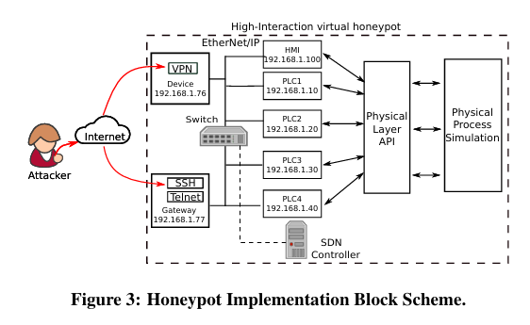
Implementation
The system consists of the following components:
1. Vulnerable VPN Endpoint
2. Vulnerable Gateway device
3. Network Emulation
3.1. Virtual switch
4.Physical process and devices simulation
5. Data collection subsystem

Slide 14
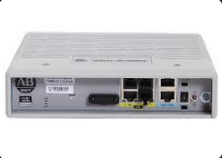
1. Vulnerable VPN
They simulate Allen-Bradley Stratix 5900 router with firewall capabilities, with weak credentials:
U:admin P:admin

Slide 15
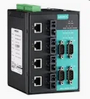
2. Vulnerable Gateway
They simulate also Moxa OnCell IP gateway, with two open ports, 22 running ssh, and 23 running telnet
both with weak credentials U:admin P:admin
they use sshd, and telnetd which are deamons (background processes, allows them to run these services on the honeypots)
Notes:
Double check, what do thez mean by simulating Moxa OnCell IP
And how does the ssh looks when they connect to it.

Slide 16

3. Network Emulation
They use MiniNet to emulate the network

Slide 17
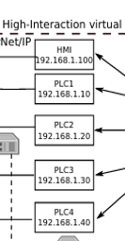
4. Physical Process
They simulate a water treatment physical process,
- One HMI
- 4 PLCs
These physical processes are simulated using python scripts.

Slide 18
Implementation benefits and risks
Good implementation yields to additional benefits.
MiniCPS allows to define the security level of the honeypot
Security level means the amount of intentional vulnerabilities exists in the system
For research -> old ssh version -> low/medium level
For production -> latest version -> high level
This setup helps security teams observe basic attacks on research honeypots, and discover advanced zero-days or new techniques on production honeypots.

Slide 19
Evaluation
They performed their evaluation in context of jeopardy CTF

Slide 20
Setup
Each participating team has one configured honeypot simulating water treatment system.
Each one simulates 4 PLCs, 1 HMI, 2 Water tanks, 1 vulnerable gateway ( no VPN ), and all devices are connected in star-topology
There are 5 main tasks during the CTF

Slide 21
Task1: Passive MITM
Teams should read what does PLC2 is saying to PLC3

Slide 22
Task2: Understanding Ethernet/IP
Teams should read a file called README:2 tag.
So, attacker should understand what is Ethernet/IP server
This can be done using python module called cpppo.
cpppo is short for Communications Protocol Python Parser and Originator, it is a python-based library and toolset designed for interacting with Industrial protocols, particulary those used in ICS/SCADA networks
It allows to Query/Scan, Write to, Monitor CIP tags like the README:2 tag mentioned in task2, emulate Ethernet/IP server devices
Scapy is low level packet crafting, sniffing, and manipulation library, but it is general purpose, while cpppo is special library for handling Ethernet/IP protocol packets especially used in ICS systems
cpppo describe elements in form of statemachines which change the state in response to input events, collecting data, and producing output data artifacts.
Notes:
Go more in details what are the benefits of using cpppo and what are the implecation, and why it is possible to use cpppo than scapy.

Slide 23
Task3: Active MITM
Teams should overflow Raw water tank
Attacker should understand the water treatment industrial control system, and know that PLC1 is the controller of the of the raw water tank
And PLC1 controls input valve, and output pump, and he must send malicious commands, in order to overflow the water tank

Slide 24
Task4: DOS HMI
PLC3 is constantly sending keep alive value:2 to HMI
So, attacker should disrupt this communication, then write to the HMI value:3

Slide 25
Task5: Advanced Overflow
PLC4 is controlling water level, and also controls another input valve, and output pump
He can not use the same technique used in Task3, and it was not mentioned how he can handle this, but he should use better technique.

Slide 26
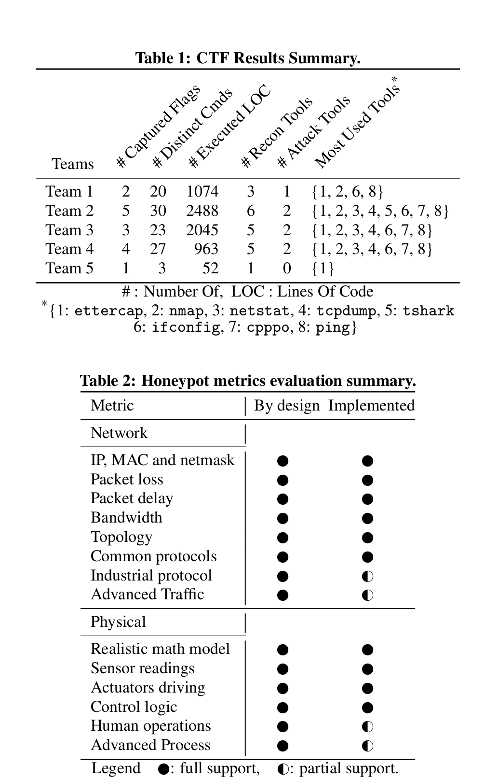
Results

Slide 27
Limitations
The physical process is not so accurate, and has a limited APIs to link to external physical process
It does not support many current ICS protocols like Modbus, it only support one protocol which is Ethernet/IP
Evaluation scope is narrow and not so clear, the CTF does not show how real world attackers can act on the system
Since the physical process is not so accurate, the real attackers will easily detect that this is a honeypot.
No Fault Tolerance / Resilience ( this is important )
Lack of post processing
Fully Virtual, so it limits the realism
They mentioned that there can be side channel attacks on their system
No integration with detection systems, everything later is done manually.
They does not consider internal threats like insider attacker or USB Malware (Stuxnet)
Does not Capture Malwares for further analysis
Notes:
No fault tolerance -> During CTF the system crashed, and they spent 3 hours to get it back to work

