Slide 1

Towards High-Interaction Virtual ICS Honeypots-in-a-Box
Brief Presentation explaining the paper, and how to build a honeypot especially for ICS
Abdelaziz Neamatallah

Slide 2

Problem Statement
They address the problem of designing ICS honeypot with the following requirements:
  Realistic with multiple services supported
  Low cost, in terms of hardware, software, and deployment time
  Reconfigurable, to allow extensibility, scalability, and secure maintenance
  Targeting the ICS domain, dealing with physical processes, physical devices, industrial protocols, time, and determinism constraints
  Usable both for research, and production

Slide 3
Objective
Cost-effective
01
Realistic
02
Maintainable
03
Deterministic
04

Slide 4
Key contributions of the paper
Introduces the first academic virtual high-interactive ICS honeypot supporting the EtherNet/IP protocol
Uses MiniCPS (built on Mininet) to simulate
ICS network topologies
PLC Logic
Physical processes
Provides high interaction without relying on full virtualization such as a network of virtual machines.
Integrates with a Software Defined Network (SDN) for flexible control

Slide 5
MiniCPS Framework
It is a framework for security research on ICS.
It is used as a core platform in the paper to build and run the high-interactive ICS honeypot
It is built on Mininet
  Mininet is a lightweight network emulator commonly used for prototyping Software defined networks
It allows realistic emulation
  ICS network topology, PLCs, HMIs, and physical processes
It has modular Python APIs
  Set/get (sensor/actuator values)
  Send/receive (network communication)
It provides In-Box simulation
  Everything runs within a single Linux kernel using lightweight container-based virtualization, making it cost-effective and portable
It is used in the paper to:
  Build a virtual honeypot that mimics a water treatment plant
  Simulate attacks like DoS, MITM, and control manipulation
  Emulate a real ICS environment with high fidelity but low resource cost

Slide 6

Components Needed to Build High-interactive ICS Honeypot
Usually, the architecture is logically divided into three layers
  Physical Process Layer
  ICS Device Layer (Control Logic & Hardware Simulation)
  Network Layer
There may be additional Cross-layer Elements:
  Data Collection system
  Isolation & Security
  Configuration & Deployment

Slide 7
Physical Process Layer
Goal:
Simulate the real-world physical system (e.g., water treatment, power distribution)
Key Components:
1. Process Simulation engine: Models dynamics (e.g., tank levels, flow rates)
2. Mathematical models: Physics-based (e.g., Bernoulli’s law, continuity eqution)
3. Real-time behavior: With tunable simulation time steps (< 1 sec for realism)

Slide 8
ICS Device Layer
Goal:
Emulate control devices and their logic realistically
Key Components:
1. Simulated PLCs: Execute logic to read sensors & control actuators
2. Simulated HMIs: Allow operator interactions (e.g., via HTTP)
3. Tag-based variable system: Like LIT101, MV101 for sensor/actuator data
4. Control interlocks: Dependencies between PLCs or states
Notes:
Tag-based means that we represent each component with a certain tag, so if we have a valve for example we say it is VLV1, VLV2 and so on.
Control interlock means that there are some components depending on other components, so for example the system should not open pump 1 if valve one is on, this is an interlock example.

Slide 9
Network Layer
Goal:
Emulate the ICS communication network with realistic traffic and vulnerabilities
Key Components:
1. Virtual hosts: PLCs, HMIs, VPNs, gateways in isolated containers
2. Switching & Routing: Simulated using Mininet/SDN
3. Protocol support: EtherNet/IP, Modbus/TCP, ARP, DHCP
4. Vulnerable services: SSH, Telnet, VPN with weak/default credentials
5. Attack surface: Configured to expose real services on standard ports
6. Link shipping: Customizable delay, bandwidth, packet loss

Slide 10
Paper Topology Layers
On the lowest layer :
Controller devices are connected to sensors and actuators
Or to remote input/output (RIO) devices, capable of converting raw sensors and actuators signals into Ethernet-based packets
The next layer :
Connects the controller devices, and the additional devices such as HMIs, engineering workstations, and historian server

Slide 11
Types of Honeypots
Real honeypots
Uses real physical devices to replicate the target system
The most realistic solution
Their deployment is so expensive (money, maintenance, and space)
Virtual honeypots
Utilizes virtualization technologies, such as PLC emulators, to reproduce a system
They offer a compact, and low-cost solution
Hybrid honeypots
Include a mixture of virtual and real devices
They might be interesting cost-effective solution

Slide 12
Types of Honeypots
Server-based
Expose, over an insecure channel, a number of vulnerable services, that are passively listen to well-known ports
It is passively waiting to be attacked
Client-based honeypot
Act as vulnerable client application, such as a web-browser
It actively looks for an attack from a malicious webserver
Notes:
Client-based honeypot acts as a week browser which try to open malicious links for example, and check it the webserver will try to redirect it to malicious link, or perform any malicious activity, so it simulates the client visiting a vulnerable web app.

Slide 13
Types of Honeypots
Low Interactive
Simulate only specific systems services (such as telnet daemon)
Provide a narrow attack surface
Easy to develop, configure, but easy to be detected
High Interactive
Use real services running on real OS
Provides realistic environment for the attacker
Trickey to implement

Slide 14
Types of Honeypots
Research honeypots
Implement well-known vulnerabilities to lure attackers, and to study their behaviours.
Usually used for security training purposes
Production Honeypots
Supposed to be more secure
Deployed to defend the system against attackers
In best case, will prevent the attacker
In average case it will slow down the attacker
In worst case it will help the attacker to complete his job

Slide 15
Additional requirements of ICS honeypot
It is important to emphasize that ICS honeypots present additional requirements compared to traditional ones
Time and Determinism constraints ( the most important two )
ICS devices have to complete a sequence of tasks within a critical time interval, and in precise order, that’s why it uses a Real Time OS with a deterministic scheduler.
In the same manner, ICS packets are sent over the network with a specific order, and they had to reach their destinations within a time period, that’s why industrial protocols, such as Ethernet/IP, are extended with special application layer features to address these requirements
If these constraints are not satisfied, the attacker can easily detect the honeypot with simple tests.

Slide 16
Attacker Model
Attacker reaches honeypot via internet
01
Can perform active and passive reconnaissance
02
Can try DoS, MITM, and logic manipulation attacks
03
Limited to network-based access through intentionally exposed services
04

Slide 17
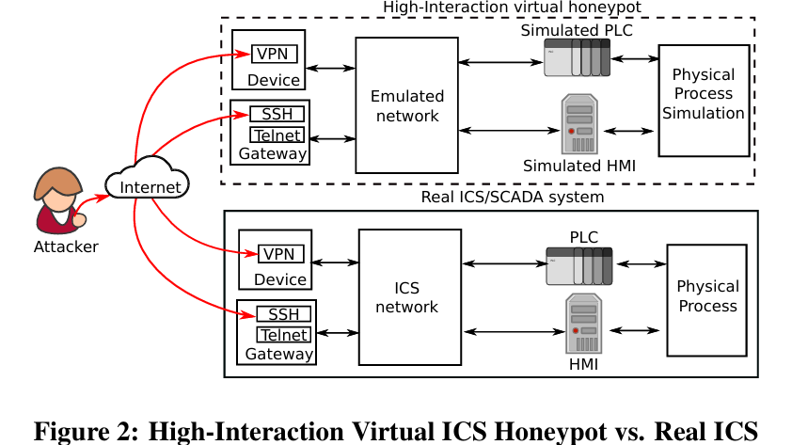
High-level comparison between presented honeypot architecture, and real ICS architecture
The attacker comes over the internet
He can access the fake internal network via:
  VPN ( gives access to the honeypot over the network)
  Vulnerable interfaces (SSH), gives a command line interface on an ICS device connected to the internal network
Emulated network enables to reproduce the same network topology as the real ICS
A set of simulated devices reproduces the control logic of the ICS system
A physical process simulation mimics the real physical process
The ICS block is represented with dashed lines, to underline the fact that the proposed design physically separate the honeypot network from the real ICS one, this provides additional layer of security, in contrast to the traditional honeypots which are deployed inside the internal network.
Notes:
El rasma el fo2, btwrena ezay homa 3mlo replication le real ICS system, fa el fo2 hya el honeypot

Slide 18

Architecture
Server-based, high-interaction virtual honeypot
Exposes real services (SSH, Telnet, or HTTP)
Simulates PLCs, HMIs, and physical processes using Python and MiniCPS.
Allows attacker access through:
  Vulnerable VPN (openConnect)
  Vulnerable gateway device (Telnet with default credentials)
Network emulation includes ARP poisoning, packet loss, latency shaing

Slide 19
Qualitative Metrics
Network Parameters:
IP, MAC, and netmask addresses
Link Shaping:
Average packet loss, delay, and bandwidth
Infrastructure:
The network topology
Protocols:
Communication between devices
Advanced traffic properties
Perfect sequence of messages, and delay
Process:
The physical process simulation
Devices:
Real time simulation for sensors and actuators
Human operator:
Simulation of human interactions
How to measure realism
Notes:
These metrics should be similar to the real system to be able to convince the attacker that he is dealing with real system not a honeypot

Slide 20
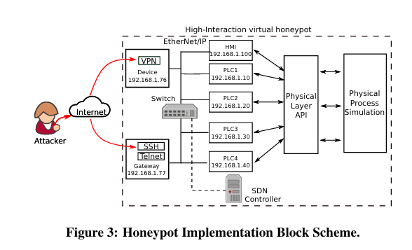
Implementation
Their implementation is based on MiniCPS, and it is the first academic work targeting Ethernet/IP
It is the first ICS honeypot that can be managed with a Software-Defined Network controller
The vulnerable intern-facing devices are connected to the internal network, and they are the attacker’s biats.
There is a virtual switch distributing Ethernet/IP traffic in the internal network, enabling ARP poisoning attacks, packet sniffing, and malicious command delivery.
Every simulated host is connected to the virtual network, and it is exposing real services
  PLC1 for example may expose the Ethernet/IP server for explicit messaging, listening on standard tCP port 44818 that is addressable with realistic tag names

Slide 21

Implementation (cont’d)
The implementation relies on 5 main pillars:
  Vulnerable VPN endpoint
  Vulnerable Gateway Device
  Network Emulation
  Physical process and devices simulation
  Data collection Subsystem

Slide 22

Vulnerable VPN Endpoint
VPN is widely used in ICS network to establish a secure channel between a host located outside the control network and a network interface inside the control network
Their target hardware platform is Allen-Bradley Stratix 5900 Router, with firewall capabilities.
  It runs an IPv4 OpenConnect (Cisco VPN server), reachable from the internet with weak credentials (U:admin, P:admin)
There is a dedicated firewall host with IP 192.168.1.76 that is listening on default port 443

Slide 23
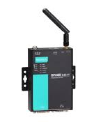
Vulnerable Gateway Device
Gateway devices are used in ICS control network to translate industrial protocols, such as back and forth from Modbus to Modbus/TCP, and extend the inter-device communication capabilities of the whole ICS (similar to NAT)
Their target hardware platform is Moxa OnCell IP gateway, that is able to connect to the testbed over cellular networks using different technologies such as GPRS, EDGE, UMTS, and HSDPA
  It has 2 ports open, telnet server listening on port 23, and ssh server listening on port 22, and the ssh also has weak credentials (U:admin, P:admin)
  While the Telnet shows the plaintext without encryption, with the same weak credentials
  They use sshd (demon) and telnetd on IP 192.168.1.77 ports 22,23
Notes:
الـ Gateway في شبكات التحكم الصناعي (ICS) هو جهاز أو برنامج وظيفته إنه يربط بين أجهزة مختلفة بتتكلم لغات (بروتوكولات) مختلفة.
هو شبه المترجم اللي بيفهم لغتين، ويربط بين جهازين مش فاهمين بعض.

Slide 24

Network Emulation
The network emulation and virtual network hosts isolation is implemented by Mininet using a low-level feature of the Linux kernel, called container-based virtualization.
It is a collection of processes, and has a complete virtualized Linux network stack associated.
Each container interface is connected to the software switch’s virtual interface through a virtual ethernet link called veth
The link shaping feature is implemented using another low level Linux kernel functionality that can be accessed through the tc program
Notes:
Link shaping means that we control the bandwidth of the network, the delay of messages, and the percentage of the packetloss
TC is a Traffic control tool in Linux, which can control each interface in the network

Slide 25
Physical Process and Devices Simulation
The honeypot is simulating using python scripts:
Water treatment physical process
HMI and four PLCs
The interlock between components is also simulated
PLC1 logic depends upon values stored in PLC2, and PLC3
They are using real Tagging names
The physical process simulates the hydraulic part of the system, in real-time ( following some physics equation described in testbed )

Slide 26

Data Collection Subsystem
It involves different types of data acquisition
  For SSH -> standard shell logging techniques which is a log file storing:
    Timestamp
    Username
    Issued commands
    Files are periodically copied to a safe location outside the honeypot.
  For VPN -> standard network traffic logging techniques which are multiple tcpdump deamons attached to the vulnerable network which generates pcap capture files which can be analyzed with tools like wireshark
Additionally, the honeypot includes a software keylogger program, which generate a log file with all the entered keystrokes.

Slide 27
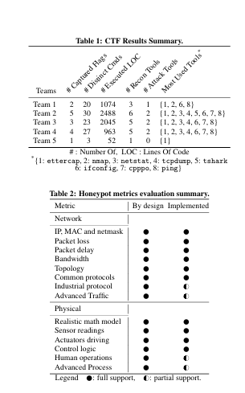
Evaluaiton process
They evaluated the system in a CTF and they got these results
I did not focused on the results so much, but I can do this later.

