Slide 1

HoneyPLC
Next Generation Honeypot for ICS
CCS '20, November 9–13, 2020, Virtual Event, USA

Slide 2
What is HoneyPLC
High Interaction, extensible, and malware collecting honeypot supporting a broad spectrum of PLCs models and vendors.

Slide 3

Why is it difficult to have High interaction ICS honeypot
  Common Limitation of literature honeypots are their
    low-interaction nature
    Inadequate Simulations Can Be Detected
    Proprietary ICS Protocols Like S7comm Are Hard to Emulate
    Diversity and Customization of Real PLCs Is a Challenge
Notes:
Inadequate Simulations Can Be Detected
"Inadequate simulations complicate concealing the true nature of honeypots..."
Poor or incomplete simulations of ICS devices or processes can make it obvious to attackers that they are interacting with a honeypot, not a real ICS.
For example, unrealistic sensor data, simplistic control logic, or poor timing behavior can tip off attackers.
"Up to the point accurate and valuable data... can be retrieved"
If the honeypot is not realistic enough, attackers may avoid using their actual malicious payloads (e.g., crafted ladder logic for PLCs), which reduces the honeypot’s value for research.
On the other hand, a good honeypot might trick them into revealing real attack code, which is valuable for defenders to analyze.
Proprietary ICS Protocols Like S7comm Are Hard to Emulate
"Several network protocols... are proprietary"
Many widely used ICS protocols, like S7comm (used by Siemens PLCs), are not publicly documented.
That makes it hard for honeypot designers to implement accurate protocol emulation.
"Hidden configuration parameters and undocumented assumptions..."
Proprietary protocols may contain implicit behaviors (e.g., how retries or errors are handled, timing quirks) that are only known through reverse engineering or vendor documentation.
If the honeypot doesn't behave exactly as a real device would, an attacker might easily detect that it's fake.
Diversity and Customization of Real PLCs Is a Challenge
"Existing PLCs vary in configuration, supported protocols, customization..."
PLCs differ across brands and models—not only in the protocols they support but in:
How they configure I/O
Memory layout
Startup routines
Firmware capabilities
"Creating a general framework... is a non-trivial challenge"
It’s very hard to create a one-size-fits-all honeypot framework that can simulate all this variation accurately.
Most current honeypots either:
Use manual configuration (which is time-consuming and error-prone),
Or only support a narrow subset of devices/protocols.

Slide 4
Protocols Simulation
They simulate some protocols such as
  TCP/IP -> using fingerprint reversing allows accurate modeling of TCP, ICMP, and UDP probes at runtime.
  S7Comm -> this is core PLC communication protocol to be used by tools like Siemens Step7 Manager, which is the tool used for programming and configuring Siemens PLCs, and S7Comm is the communication protocol used to exchange the data, but it is undocumented.
    Reading and writing Ladder logic from PLCs
Notes:
Step7 is Siemens' engineering software used to program and configure PLCs.
S7comm is the communication protocol used by Step7 to talk to the PLCs over the network (usually via TCP port 102).
🧠 So: Step7 uses the S7comm protocol to read/write memory, upload/download ladder logic, and perform diagnostics on PLCs like the S7-300, S7-400, and others.

Slide 5
Main Contribution
1. Limitations of existing state-of-the-art honeypots
2. HoneyPLC which solves many of the limitations
3. PLC profiler tool, which allows effective simulation of many different PLCs
4. Experimental evidence showing that the honeypot is effective.

Slide 6
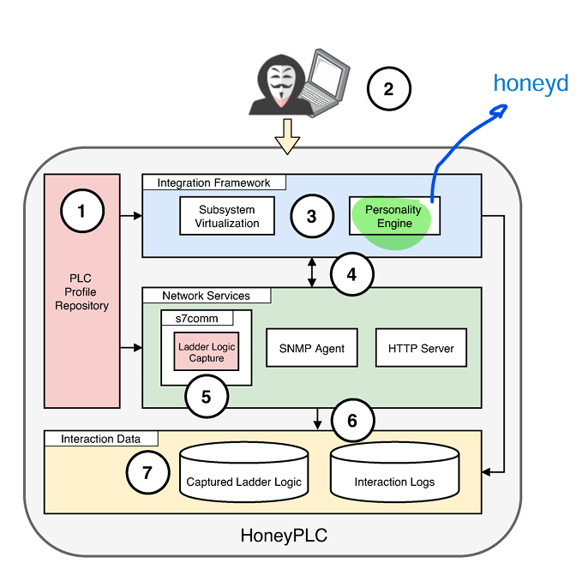
HoneyPLC Architecture
Notes:
Subsystem virtualization is a method used by honeyd, to facilitate the integration of the different HoneyPLC components, so that honeyd launch real services or scripts behind fake IPs and ports
Like when we define ip 192.168.16.1 port 111 runs http service for example on the honeypot, this is done by subsystem virtualization.

Slide 7
They provide Extensibility
PLC Profiles module:
  It is a repo contains all the required data to simulate a given PLC.
  It consists of 3 main modules:
    SNMP MIB
    Nmap fingerprint
    Management Website
HoneyPLC profiler tool automates the creation of new HoneyPLC Profile.
  It interfaces with three different applications:
    Nmap Snmpwalk Wget
    To obtain the profile for a target PLC, HoneyPLC Profiler requires the IP address of the PLC device as the only input.
    Then the profiler obtains the three discrete sets of data -> SNMP MIB, nmap fingerprints, and management website
Notes:
First, snmpwalk is used for reading all the available Object IDs (OIDs) from the public community string, creating an identical MIB to the one used by the PLC. OIDs may include, among other important configuration settings, the unique identifier of the PLC, as well as its base IP address. Second, Nmap’s OSdetection is used to get the TCP/IP stack fingerprint of the target PLC, in a process that includes scanning all well-known TCP and UDP ports. This fingerprint will be later leveraged by HoneyPLC’s Integration Framework to provide meaningful TCP/IP interactions

Slide 8
Illustrative Use Case Scenario
The first step in using HoneyPLC is to choose the PLC profile which is required to be simulated.
When Attacker try to contact the honeypot, he will first start with fingerprinting the system, so all TCP/IP requests will be handled by the HoneyPLC personality Engine, which returns the fingerprint results of the simulated PLC (Honeyd).
Attacker will try to use S7Comm connection to check what PLC memory blocks are available, which is a very important step to be able to modify the inner ladder logic code of PLC
  Also A tool like PLCScan is used to scan all available PLC devices in the network, and which PLCs implement S7comm protocol, and list all PLC information including basic hardware, serial number, name of PLC and version
This attempt is handled by S7Comm module server, which later replies with the requested information.
Then S7Comm server is logging all the interactions, including the attacker IP address and memory block requests made to PLC
At this point, when the attacker identifies the PLC memory block suitable for injection, he will use S7Comm application like PLCinject to load ladder logic code into the PLC, effectively overwriting any pre-existing code and introducing a custom-made malicious payload.
S7Comm server will write the code into the dedicated HoneyPLC repo, which is manged by the Interaction Data module, which will store the Ladder Logic, and all the interaction logs. ( but what is the tool used for capturing the ladder logic ? )
Notes:
Prerequists:
What is Personality Engine: module using Honeyd to be able to simulate any device using a file contains its fingerprint, and how this device should response, in order to fool reconisence tools to feel like it is communicating with the real device.
S7Comm: It is Siemens industrial protocol used for communication with Siemens PLCs such as S7-300, S7-400, S7-1200, S7-1500, it allows memory reads/writes, which can extract or modify the Ladder logic of PLCs, the main problem, is that S7Comm is not well documented, so it is difficult to understand correctly how it works.
Lader logic: This is the programming language of the PLC, which instructs the PLC what should it exactly perform.

Slide 9
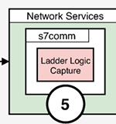
S7Comm Server Module
It provides a sophisticated simulation of the Siemens proprietary protocol.
It simulates a real Siemens PLC and exploses several memory blocks via TCP port 102.
Siemens had not released the specifications of S7comm protocol and the information that is avail able has been collected by third parties like the Snap7 project [27] and the Wireshark Wiki [1].
They leveraged the Snap7 framework [27, 32] to write an S7comm server application in C++.
They modified and recompiled the source code of the main Snap7 library to add thier own features. These include logging the S7comm interactions, ladder logic capture, and PLC firmware specifications for all three Siemens PLC models. For example, CPU model, serial number, PLC name label, copyright among others.

Slide 10
Tools Implementing S7Comm
Tool / Library | Purpose / Features | Language / Platform
Snap7 | Client/server library to communicate with Siemens S7 PLCs. | C++, Python, Java, etc.
PLCInject | Offensive tool to inject S7Comm commands into Siemens PLCs over the network. | Python (Scapy-based)
Scapy + S7Comm ext | Scapy extension for crafting and sending raw S7Comm packets. | Python
s7comm Wireshark | Wireshark dissector plugin for decoding S7Comm packets. | Wireshark plugin
S7comm-plus plugin | Extends Wireshark dissector to support S7-1500 and S7Comm+ | Wireshark plugin (open src)
PLCscan | Scanner to identify S7Comm-enabled PLCs and gather metadata. | Python / Nmap NSE
Siemens PLCSIM | Siemens official emulator for S7 PLCs (mostly for engineering, not attack). | Windows / Siemens TIA
Rogue7 | PoC tool for injecting rogue logic blocks into Siemens PLCs. | Python / C++

Slide 11
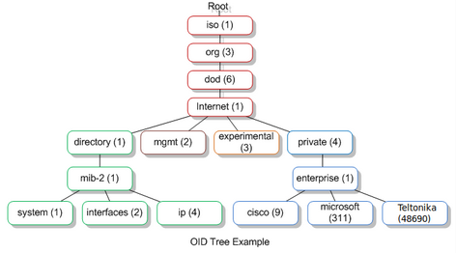
SNMP Server
They implemented advanced simulation of SNMP Server with believable MIB data, allowing the honeypot to reply to any external SNMP server query
SNMP is used to monitor network connected devices and listens to requests over UDP port 161
Real PLCs implements SNMP server, so honeypot should also Implements it.
It uses Management Information Base (MIB) as its data structure, which defines the structure of the information that a network device can report or be configured with using SNMP.
  Each element is defined as object, and it reports what data can be queried or set on a device.
  It is in form of Hierarchical tree of object identifers (OIDs)
Notes:
Explain it to the professor from this link better.
Read this for better understanding: https://www.geeksforgeeks.org/computer-networks/simple-network-management-protocol-snmp/
SNMP => Simple network management protocol, it is an application layer protocol used to manage and monitor network devices.
It allows network administrators to gather information about the status and performance of devices like routers, switches, and servers
MIB contains information about the resources managed by the SNMP in the network, and their hierarchy and how they are connected.
In the context of Industrial Control System (ICS) honeypots :
SNMP simulates device behavior by exposing fake or container-based SNMP services.
Emulating OIDs allows attackers to query fake PLCs for device info (e.g., using tools like snmpwalk).
Example: If the honeypot fakes a Teltonika device, it might expose OIDs under .1.3.6.1.4.1.48690.
So attacker will see this OIDs and from which he can ensure the type of the PLC device used, and the expected behaviour of it, and also more information such as the crafting organization because each device should have unique path for OIDs.

Slide 12
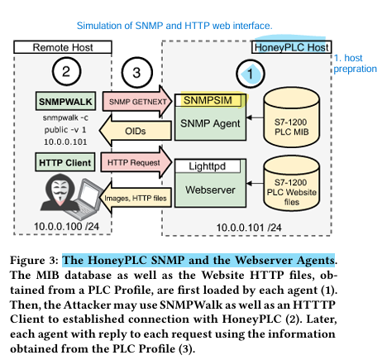
How SNMP/HTTP server works
SNMP Setup includes a Manager as well as Agent module
  Manager continually queries the Agent for up-to-date data
  Agent exposes a set of data known as MIB
    They simulate this process using python app called snmpsim
When SNMP request is received by HoneyPLC
  Agent replies with an OID as real PLC would do.
HTTP Server provides an advanced simulation of the HTTP server of Real PLCs websites found in real PLCs
  Most Siemens PLCs include an optional HTTP service to manage some of its internal configuration features.
  They implemented it with lighttpd, because it is very lightweight and good for serving static files, so it acts as the backend server.
Notes:
Lighttpd: https://www.lighttpd.net/
It is a secure, fast, very flexible web server, similar to Apache, nginx and so on.

Slide 13
Ladder Logic Collection
They write any ladder logic program that attacker uploads.
They implemented this feature using C++ in similar fashon to S7Comm Server, and modified Snap7 Framework main libraries to integrate this feature
So, the captured ladder logic is written into HoneyPLC filesystem with the corresponding timestamp
  Then Later it can be analyzed manually at the byte level to expose the ladder logic instructions and extract the new attack patterns.

Slide 14
Interaction Logs capturer
They log all logs produced by S7comm servers, SNMP agent.
  They include IP address of originating host, timestamp, memory Block ID in case of reading and writing, OIDs
Also, they log all the ladder logic programs that get injected via the S7comm server.
Finally, lighttpd logs which shows the interactions with the HTTP server.

Slide 15
Evaluation
They started their evaluation by asking 3 main experimental questions, which are based on the limitations of the previous existing approaches.
Can HoneyPLC support Different real PLCs.
Can HoneyPLC conceal/hide its honeypot nature from attackers.
Can HoneyPLC effectively capture Ladder Logic Code ?
And Their Evaluation shows that the answer for the three questions is yes.

Slide 16
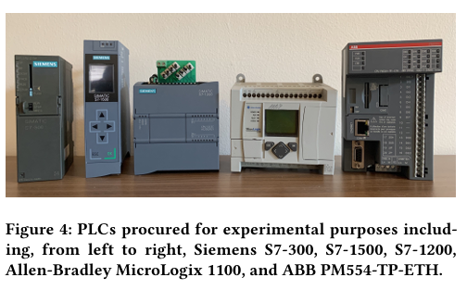
Q1: Support different real PLCS ? YES
They managed to simulate 3 Siemens PLCs with the PLC profile module, it took around 5 mins to create each profile of them.
  S7-300 S7-1200 S7-1500
They also managed to simulate 2 non-Siemens PLCs, which provides some generality
  Allen-Bradley MicroLogix 1100 ABB PM554-TP-ETH
Notes:
How they created the profiles, are explained briefly in the paper in section 5.2 and 5.3

Slide 17
Recommendations for non-Siemens PLCs
It is necessary to identify the network services they provide, because different vendors may implement a variety of protocols on different ports.
Both non-Siemens PLCs failed to support SNMP services, which prevents the HoneyPLC from retrieving MIB database
Allen-Bradley MicroLogix implements Ethernet/IP on port 2222 for configuration purposes, which is different from Siemens models that use the S7comm protocol, which will affect the retrieved profiles and may need to be processed manually case-by-case.
Siemens uses S7Comm to load Ladder logic, while Allen-Bradley MicroLogix 1100 uses the EthernNet/IP protocol, while ABB uses Nucleus Sand DB, so they need to manually modify Honeyd templates to simulate the ABB and Allen PLCs, but this results in not having true emulation.

Slide 18
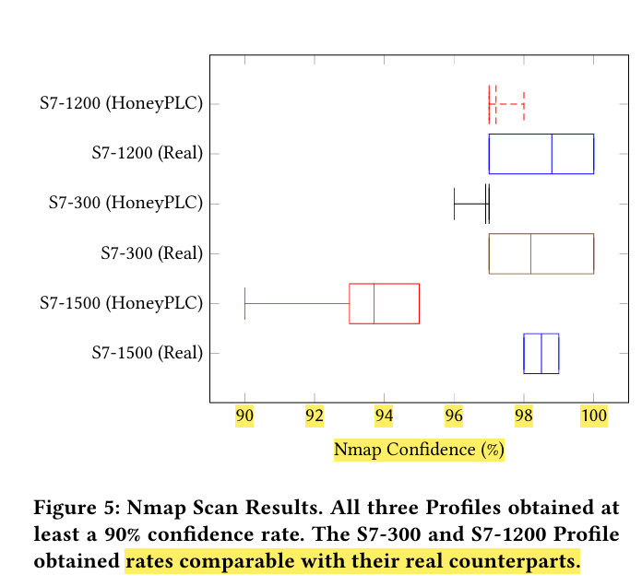
Q2: Resilience to Reconnaissance - YES
They tested it against NMAP and PLCSCAN
They used the following components:
  Desktop running Ubuntu 18.04, Honeyd v1.6d, lighttpd v1.4.45, snmpsim v0.4.7 and all its dependencies
  Laptop including Nmap 7.80, and three Siemens PLC fingerprints in nmap-os-db, and the latest version of PLCScan from github, and connected the two hosts (desktop, and laptop) via Ethernet cable.
They performed the scan with OS detection feature, and each PLC model was scanned 10 times, and they also scanned HoneyPLC, and the results shows that they were so close to the real (except for S7-1500)
But methods like Conpot was identified 100% confidence that they are linux kernels

Slide 19
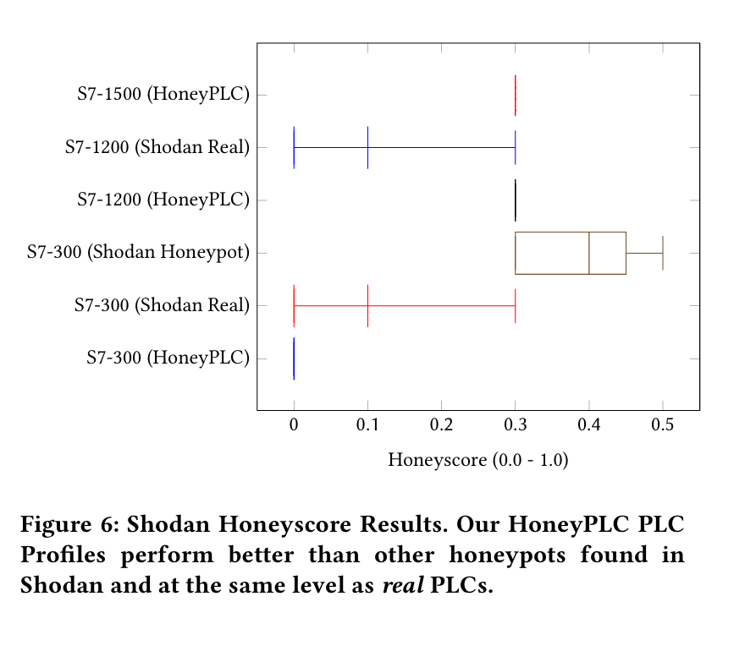
Shodan Test
They deployed three AWS EC2 instances accessible from the Internet with the following specs:
  2 vCPUs, 4GB Ram, Ubuntu 18.04, exposing TCP ports 80, 102 and UDP port 161, and deployed HoneyPLC on each of them with the three Siemens profiles
It took one week by Shodan to provide the results:
  S7-300 shows 0.0 Honey score -> totally not a honeypot
    That is why this is used in ICSPot.
  S7-1200, S7-1500 shows 0.3 Honey score comparable with the real PLCs
Conpot was indexed by Shodan, and was assigned 0.3 Honey score

Slide 20
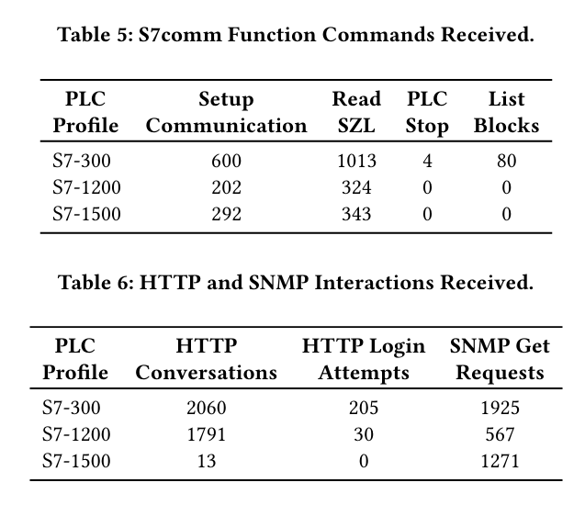
Internet Interaction Experiment
They exposed the EC2 instance to the internet for 5 months period
They logged more than 5GB recorded data
Notes:
4 PLC Stop -> means that somebody was trying to stop the process working on the PLC
Table 6 shows thousands of HTTP converations

Slide 21

S7Comm Connections Received by Geolocations
It can be noted that countries with most connections have historically been either the target or the initiators of attacks against ICS
At the time of writing the paper they did not record any attempt to upload ladder logic.

Slide 22
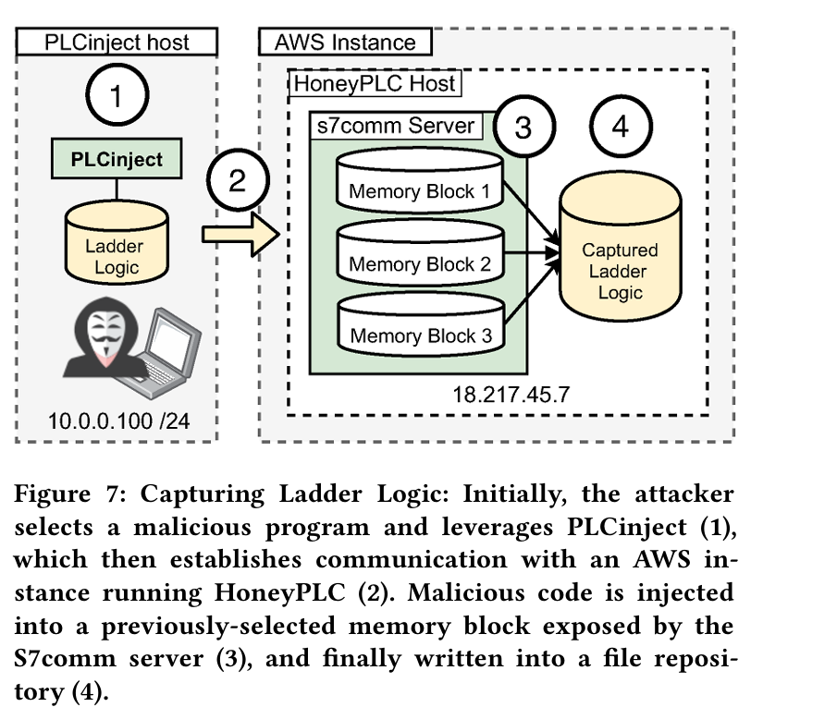
Injecting Ladder Logic
Their experiments were successful as they were able to inject a sample ladder logic program into HoneyPLC using both, PL Cinject and the Step7 Manager. After the injection was completed, they logged into their honeypot file system and found the ladder logic file with its corresponding timestamp, which matched the contents of the blocks previously updated to PLCinject

Slide 23
Limitations – from the paper
HoneyPLC does not provide support for modeling physical interactions as depicted by PLCs in practice -> This is solved via ICS-POT
Second, despite numerous attempts, they were unable to test HoneyPLC against Stuxnet, so it is not fully tested against real malware
They does not support various communication protocols such as Modbus, and does not simulate for ICS system, they just create honeypot for PLCs
They does not perform malware analysis on the captured malwares, this must be performed manually.

Slide 24
More Limitations - Concluded
They focus only on PLC, and does not provide the full system simulation by integerating HMIs for example
They do not integrate or simulate physical processes.
Manual configuration is still required to customize devices profiles ( especially for those non-Siemens PLCs)
Does not contain IDS or any defensive mechanisms, so it may be easy to be detected by attacker.

