Slide 1

ICSPOT paper summary
The first ICS high interactive honeypot
Abdelaziz Neamatallah

Slide 2
Extension for HoneyPLC
They built over HoneyPLC
Extended its framework with additional services and interaction with MiniCPS-based physical process together with interactive HMI representing the physical process evolution.
They chose to simulate S7-300 because of low honey score (0).
ICSPOT main contribution is to integrate physical process simulation and possibility of interacting with it to HoneyPLC.
    This is achieved by running MiniCPS simulation in the host machine.
  Then they extended HoneyPLC also in Logging by adding Honeyd-Viz, and Honeyd2MYSQL

Slide 3

Background
ICS Systems are mainly designed to operate in Air-Gapped environments
Air-Gapped environments means that the system is completely isolated, no internet, no external network.
This is done for security, to prevent cyberattacks
Therefore, security practices such as Encryption and Authentication were not considered.
However, due to the increasing Digitalization and Smartification of the processes
ICSs have been Integrated with internet connections to allow remote control and diagnosis.
75.6 % of the industrial protocols implemented to communicate over the internet do not implement any security features

Slide 4
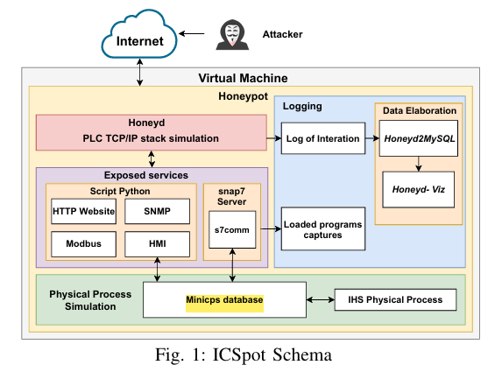
Structure and Architecture
Honeypot main components are:
  VM
  HoneyD
  Logging
  Exposed Services
  Physical Process Simulation
They consider that attacker can access the system via Internet

Slide 5
HoneyD
It communicates with the Logging and the Exposed services
It is the core tool used to simulates the PLC TCP/IP stack
It listens for requests addressed to the honeypots, simulates, and responds by imitating a list of services.
Packets sent by Honeyd are modified by its personality engine
A component that allows simulating the behavior of a predefined OS or a device chosen from the list of Nmap fingerprints
A configuration file lists the parameters defining the machine to be simulated, such as its MAC address, IP address, operating system, and services.
Thanks to these features, Honeyd allows configuring and simulating complex honeypots without exposing the host machine to risks.

Slide 6
Physical Process Simulation
They simulate S7-300 from the many PLCs offered by HoneyPLC, and this choice is motivated by the lower Honey Score obtained from the HoneyPLC paper
Their main contribution is that they integrated interactive physical process simulation and the possibility of interacting with it.
This is achieved via MiniCPS simulation in the host machine, and they simulate water treatment process
They also integrated the possibility of using S7comm protocol to write and read data in the MiniCPS database, so the attacker can modify the states of the valves controlling the water flwo.
Notes:
The Shodan Honey Score is a mechanism that flags a device as a honeypot with a confidentiality score
The score is calculated by analyzing features such as open network ports, or default known honeypot settings

Slide 7
Services and Interactions
Web interface
Reporting data about simulated physical process
Summary of the services:
Http
SNMP
Modbus
S7comm

Slide 8

HTTP
A copy of the Siemens Simatic S7-300 website on port 80.
On port 8000, an HMI interface that shows the tank water level, the status of the two valves, and the water ingoing and outgoing volume.

Slide 9
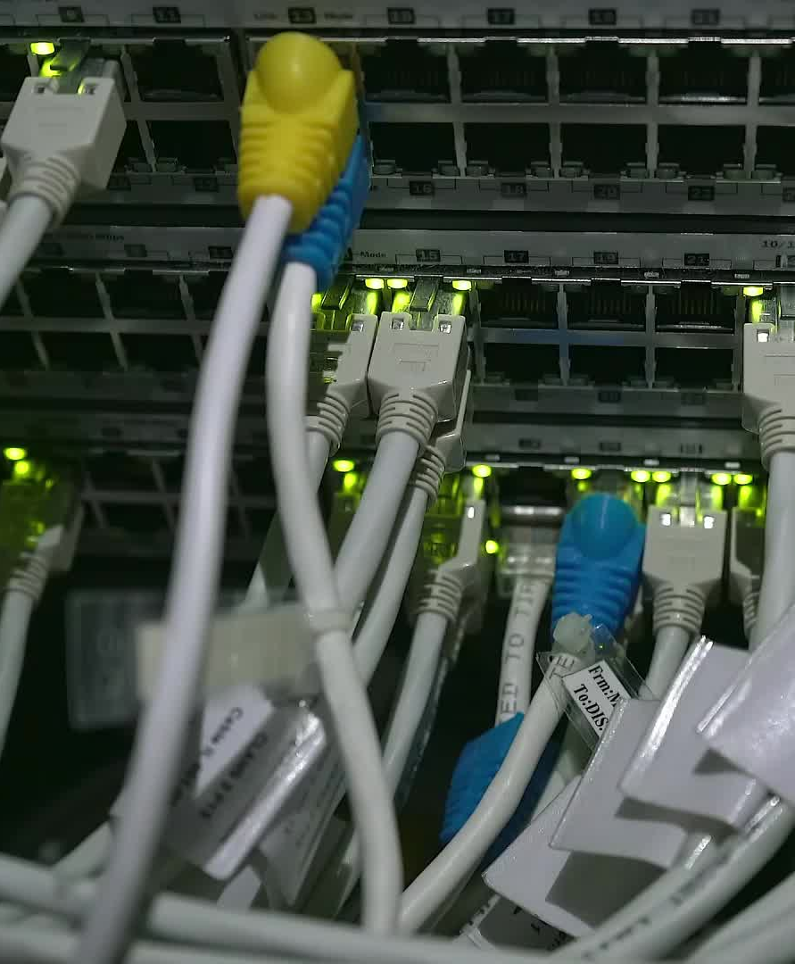
SNMP
The SNMP protocol, used to monitor devices connected to the network, is listening on port 161 UDP.
The SNMP agent, when queried, responds with the Management Information Base (MIB), which reports information related to the PLC.
This protocol is implemented with a python script from the SCADA Honeynet project and contains the MIB data of a real Simatic S7-300 PLC.
Notes:
SNMP stands for Simple Network Management Protocol.
It is a network protocol used to monitor and manage devices like routers, switches, servers, and in the context of ICS — PLCs (Programmable Logic Controllers) and other industrial devices.

Slide 10
Modbus
Modbus/TCP protocol enables the communication between industrial devices and supervisor computers in a master-slave paradigm.
01
ICSpot implements Modbus/TCP using a python script from the SCADA Honeynet project.
02
This implementation is considered low-interaction but allows connecting to the honeypot, which takes the role of slave, and reading and writing data, exactly as with a real PLC.
03

Slide 11
S7Comm
Siemens does not release the official documentation. That is why it is difficult to implement it. However they did the same as HoneyPLC paper
Following the example of HoneyPLC, they employed the snap7 library to implement an S7comm server listening on port 102 TCP.
Based on HoneyPLC implementation, the S7comm server enables different functions.
    First, it simulates a Siemens Simatic S7-300 PLC, offering the possibility to read and write PLC memory blocks.
    Second, the S7comm server allows the honeypot to fool the Siemens Step7 Manager proprietary software.
    Since this proprietary software cannot detect the honeypot, it is reasonable to assume that no other application which can connect to it through the S7comm protocol can do it.
    Third, the S7comm server allows storing the programs injected by attackers in the virtual machine file system on which the honeypot is installed.
    This allows an accurate analysis of potential malware.
  These three functionalities derive from the HoneyPLC server implementation.
  Finally, they innovate the implementation of the S7comm server by offering the attacker data related to the physical process.
  The attacker can read the value of the volume of water present in the simulated tank by accessing the data blocks.
  The attacker can also modify the state of the valves in the process.
  This interaction allows the attacker to communicate with the physical process through the S7comm protocol.
  The S7comm server runs locally and is connected to the honeypot via the Honeyd configuration file.
Notes:
HoneyPLC paper describes better how they managed to simulate S7Comm even though Siemens did not reveal the official documentation
I am going to read HoneyPLC this week

Slide 12
Log Data Visualization
They used open-source tools for that
    Honeyd2MySQL
    Honeyd-viz
  Honeyd2MySQL :
    Extract all the information from the Honeyd log and import them into a MySQL database
  Honeyd-Viz:
    Exploits the database created to create a web interface showing useful statistics related to the collected data
    Collected data such as:
      Number of connections divided by ports
      IP addresses of the main attackers
      Attackers origins
      Connections established per day

Slide 13
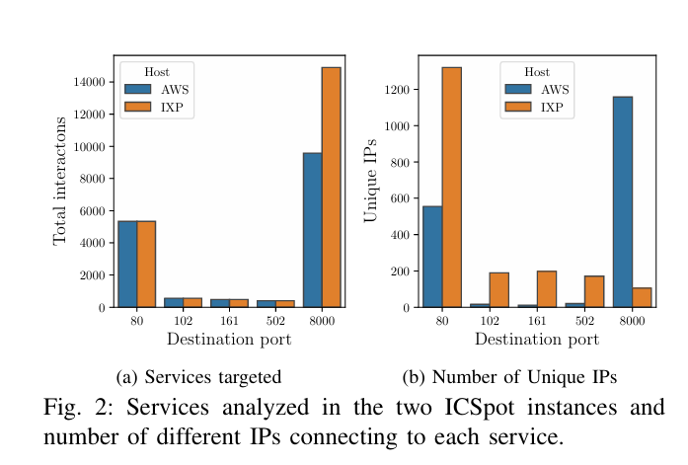
Results
They installed two instances of ICSpot in two different environments
    AWS EC2 virtual machine
    Virtual machine in a network segment owned by VSIX IXP
    VSIX is a local IXP that manages the traffic circulating in the North-East of Italy
  They registered 2185 different IPs interacting with the port 8000 running the HMI in AWS and 105 in the VSIX.
  For port 80 running the website, 555 unique IPs in AWS and 1321 in VSIX
  This high requests in port 8000 confirms the effectiveness of the HMI in attracting and increasing the attacker’s engagement
Notes:
Veneto Smart Internet eXchange (VSIX),
and it is an Internet Exchange Point (IXP) located in Padua, Italy.

