Slide 1
HoneyICS
High-interactive ICS-honeypot

Slide 2
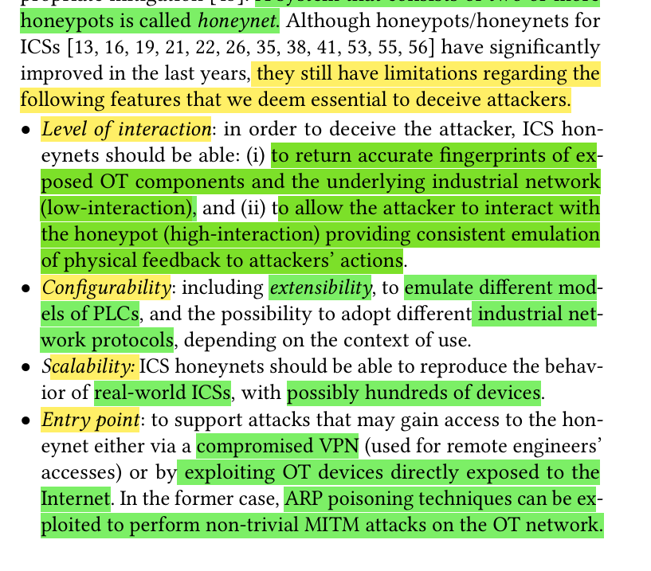
Limitations of previous ICS honeypots
Level of interaction
Configurability
Scalability
Entry point
Attack Monitoring
Notes:
But I think HoneyPLC and ICSPot for example does not face the configurability issue, and they provide the same Entrypoints, and do the same Attacking monitoring as this paper.

Slide 3
Paper Contribution
Provide honeynet that is:
  High-interactive
  Physics aware
Emulate OT network of and ICS
Support network of PLCs and HMI rather than just single PLC ( same is in THI ICS )
High extensibility to emulate different brands of PLCs and ICS protocols. ( HoneyPLC & ICSPOT )
Attacker can modify the value of PLC registers (ICSPOT).
Attacker can gain full control of the network connecting PLCs and HMIs to munt non-trivial MITM attacks that can be monitored by the administrator of the honeypot
Focus on Modbus communication protocol
The only difference I can see that they constructed a full network of devices instead of only PLCs and they say that we can integerate physical plcs, but they implemented virtual ones.

Slide 4
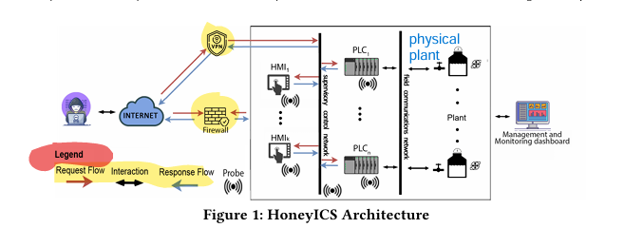
Architecture
They simulate a full Honeynet.
Notes:
The system can be compromised either via VPN or by exposing some devices (PLCs or HMIs) on the Internet directly.

Slide 5
Components
PLC
HMI
Physical Plants
Management and Monitoring System
Supervisory
Field communication

Slide 6
PLC
can integerate both physical and software PLCs
for the Software PLCS, they support low and high interaction levels
for Low-level they return the accurate fingerprints
while for High-level they emulates ICS protocols supporting specific commands to modify PLCs registers
This allows the attacker to affect the physical process by reading/writing the values of PLC registers
Notes:
They have 5 possible programming languages: https://d1.amobbs.com/bbs_upload782111/files_31/ourdev_569653.pdf

Slide 7
HMIs
their presence allows HoneyICS to support attacks
where the attacker gain access over the HMIs via password brute-force Or Via phishing.
And sends actuator commands directly through them

Slide 8
Physical Plant
Physical Plant: they assume the presence of underlying physical processes to realize physics-awareness
such plants can either be real physical systems, or can be simulated using classical tools
Notes:
physics-awareness is a crucial ingredient to realize convincing and deceiving ICS honeypots; this means the attacker should receive consistent feedback from a (possibly simulated) manipulated physical process.

Slide 9

Communication Network
Allow the communication between the previous components
Divided into 2 main parts:
  Supervisory: connect PLCs together and with HMIs
  Field communication: connecting PLCs with physical plants ( the attacker can not see this communication part, sec 3.2)

Slide 10

Monitoring System
To collect and track the activities performed by attackers or malware once they break into the honeypots
Used for understanding the behaviour of the attackers and their techniques and methods used to get into the system.
It requires existing of specialized software called probe, which is a special software acts like hidden observer and monitors all the activities
In their solution, the probe collect data involving access to each device PLC or HMI and the supervisory control network, and the data collected by the probes is stored and sent to the management and monitoring dashboard for further processing

Slide 11

Management & Monitoring Dashboard
Which controls the whole Honeynet to simplify its configuration, deployment, and monitoring. allows monitor to see what are the currently running components, add new components, stop running ones, and analyze the data received from the probes.
It is a web dashboard, enables operator to see what honeynets are currently running, and allow adding or removing components, and analyze the data received from the probe.
It can also monitor what is displayed by HMI and the real process, so it can detect if there was MITM attack which manipulated the HMI to show different results than the physical process (such as what happened in Stuxnet).

Slide 12
Attack Model
Attacker can access either via VPN or compromising directly connected device exposed to internet
Internet:
  Gain full control over the supervision control network
  Can fingerprint the system using NMAP and find PLC models, open, filtered ports, what services running and so on
  Can attempt to read and write PLC memory registers and upload and execute a malicious PLC user-program
  Can observe the effect of the program execution either by examining the value of PLC register or via a compromised HMI.
VPN:
  Sniff network traffic on the supervisory control network
  Setup MITM attacks between two PLCs, or between a PLC and the associated HMI
  Perform two-fold objective by manipulating the PLC register values, and send different values to the associated HMI ( Stuxnet method ).
In no case the attacker can get access to the Field communication network

Slide 13
Implementation
They did not used any hardware, it was only a simulation process
They rely on existing simulation frameworks:
- HoneyD
- HoneyPLC
- OpenPLC
- ScadaBR
- Simulink
-Modbus
Each Component was docker container running either Ubuntu 18.04 or NGINX base
They used HoneyD to simulate TCP/IP stack of a target devices such as PLCs to respond to Nmap fingerprint request
They use HoneyPLC project to support multiple PLC models, by integerating into HoneyD the PLC profiles provided by HoneyPLC
Notes:
ScadaBR: emulates a realistic web-based HMI for the attacker to interact with.
Simulink: Simulates underlying physical process ( watertanks, pumps, and valves ).

Slide 14

Prototype implementation
💧 System Design: 3 PLCs simulate a secure water treatment plant
🛢️ Tank Configuration: T-201 (80 gal), T-202 (20 gal), T-203 (1 gal)
⚙️ Flow Mechanics: Pump P-101, valve MV-301, pump P-102
🔁 Filtration Path: T-201 → filtration → T-202 → reverse osmosis
🚰 Backwash Loop: Water can flow to T-203 and loop back via P-102
🔍 Design Constraint: T-202 can hold full T-203 content at any time

Slide 15
Prototype implementation
⚙️ Control Logic: Pump P-101, valve MV-301, pump P-102
  PLC-1: Manages T-201: opens pump at low level, stops at high level
  PLC-2: Requests PLC-1 to open/close valve for T-201 -> T-202 flow
  PLC-3: Monitors T-203; opens valve to drain into T-202 at high level
📡 Protocol: PLCs communicate via Modbus
🖥️ HMI Interface: Displays tank levels (T-201, T-202, T-203), valve states,
and pump statuses
🔐 Design Constraint: Coordination required to prevent overflow at T-202 during transfers

Slide 16
Network Layer
The network layer of OpenPLC is responsible for establishing and maintaining network
connections over Modbus by accessing the I/O image tables, i.e., the PLC registers storing, for instance, the current state of inputs (sensor measurements) and outputs (actuator commands)

Slide 17
Implementation Details
Honeyd:
  Simulate the TCP/IP stack of a target device such as PLCs to respond to Nmap scans.
  integrated HoneyPLC profiles to support multiple PLC models (the five mentioned in HoneyPLC paper).
OpenPLC: implement high-interaction physics aware honeypot which is an open-source solution for PLC virtualization
  The network layer of OpenPLC is responsible for establishing and maintaining network connections over Modbus.
  So, requests from scanning tools are handled by Honeyd, while requests received via ICS network protocols (such as register manipulation), and handled by OpenPLC.
  OpenPLC is integrated into the subsystem virtualization component provided by Honeyd
ScadaBR: implement HMI components.
  The credentials for HMI is so weak: admin/admin
Simulink is used to emulate simplified water treatment plant.

Slide 18
More implementation details
Each component is implemented in a dedicated docker container
  PLC containers
  HMI containers
  Physical plant container
  Supervisory Control Network
  Management & Monitoring Dashboard

Slide 19
PLC containers
They implemented 3 software PLCs
Each container running both low-interaction ( relies of Honeyd which simulates the TCP/IP stack) and high-interaction ( relies on OpenPLC by establishing and maintaining network over Modbus by accessing the I/O image tables and PLC registers. )
Also, They support multiple PLC models by integrating HoneyPLC finderprints into Honeyd fingerprint database.
Notice that they integrated OpenPLC into honeyd using the subsystem virtualization provided by HoenyD, which allows honeyD to run scripts acting like real services.
They deployed in each PLC a broker to connect PLCs with each other
  PLC-HMI connections is already supported by OpenPLC, and ScadaBR)
  When a PLC requires to transmit a message to another PLC, it writes the message in a dedicated register in its memory; the broker copies the value in this register into an associated register of the receiving PLC

Slide 20
HMI containers
They created a container and installed on it ScadaBR which allows drag-and-drop SCADA interface and can interact with several PLC brands
ScadaBR get the data by connecting them to the software PLCs using Modbus protocol, which are used to fill data sources and data points in ScadaBR, then it shows them in its interface.
Attacker can access the web-interface hosted on TCP port 9090, and the authentication is with weak credentials (admin/admin)
Communication in HMIs are built-in and does not need dedicated broker as in PLCs.
They installed a version 1.0CE which is exposed to a known vulnerability (CVE-2021-26828) which allows authenticated attacker to execute arbitrary code on the targeted system by uploading malicious .jsp file through view_edit.shtm page
containers are equipped with a probe built on security forensics tool called Aquasecurity.

Slide 21
Physical Plant Container
They emulate simplified water treatment plant using Simulink
Simulink is a widely adopted framework that simulate, and analyze ICS.
They run it inside Debian-based Docker container, which includes MatLab and the needed toolboxes.
They also implemented another broker to simulate the field communications network connecting the physical plant with the PLCs, using C++ script called Simlink which is part of OpenPLC environment.

Slide 22
Supervisory Control Network
When attacker gain access to the honeynet, there are two main challenges
  Transparent Redirection:
    The attacker might try to interact with the PLCs or HMIs. The honeynet must make sure that this traffic is redirected correctly to the actual containers without revealing that these are virtualize components.
  Lateral Movement Isolation ( prevent pivoting )
    If the Attacker compromises one PLC, they should not be able to directly hack into other containers.
    The system should prevent uncontrollable lateral movement within the network.
In order to achieve this:
  Each PLC is placed in its own isolation network called Docker macvlan (virtual network interface) alongside each PLC is a proxy container
  The Proxy has two main jobs:
    Reverse Proxy: listens to traffic from the internet or supervisory control network, and forwards that traffic to the corresponding PLC container
    Gateway: for outgoing connections from the PLC, it rewrites the source address using the iptables so responses look real, which prevents attacker from easily seeing the container structure or origin.
Notes:
🏭 In the context of ICS honeypots:
If an attacker compromises one PLC container, and can directly access:
Another PLC
The HMI
Or even the physical simulation backend (like Simulink)
👉 that would be lateral movement — and it’s dangerous.

Slide 23
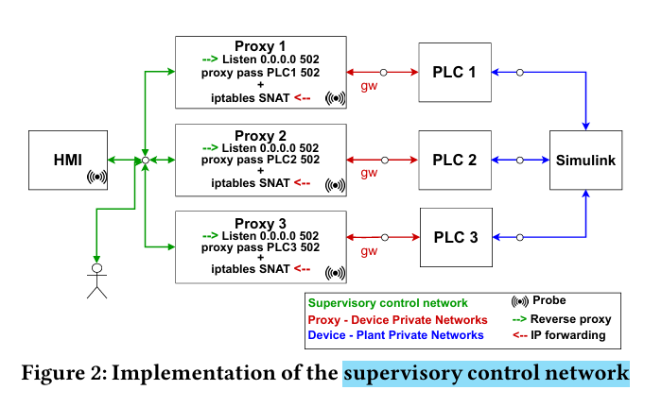
Supervisory Control Network
Notes:
🧠 أول حاجة نفهم الفكرة العامة:
الهدف من التصميم ده هو إن المهاجم لما يدخل الشبكة، يحس إنه دخل شبكة حقيقية بتاعة ICS، يقدر يعمل فيها MITM ويشوف PLCs بتكلم بعضها، لكن في الحقيقة كل حاجة ماشية في بيئة وهمية متراقبة كويس، ومفيش حاجة حقيقية ممكن تتأذي.
🧱 شرح كل جزء في الصورة:
🔲 PLCs (PLC 1, PLC 2, PLC 3)
دول أجهزة تحكم منطقية Programmable Logic Controllers، بس هنا معمولة داخل Docker Containers (يعني برامج بتشتغل كأنها أجهزة حقيقية).
🔁 Proxies (Proxy 1, Proxy 2, Proxy 3)
لكل PLC فيه قدامه Proxy Container، وده بيشتغل كالتالي:
بيستقبل أي ترافيك داخل من الإنترنت أو من أي جهاز تاني في الشبكة.
يبعت الترافيك ده للـPLC الحقيقي جوه الكونتينر.
وكمان لو الـPLC حب يبعت ترافيك، البروكسي بيغير عنوانه (IP & MAC) عشان يبان كأن الترافيك طالع من PLC حقيقي.
➕ البروكسي معمول باستخدام NGINX + iptables SNAT.
🔌 macvlan network
كل PLC والبروكسي بتاعه في شبكة خاصة (macvlan) لوحدهم.
البروكسيهات بس هما اللي يقدروا يكلموا بعض عن طريق شبكة تانية مشتركة بينهم.
يعني لو فيه مهاجم سيطر على PLC، مش هيقدر يعدي منه مباشرة لغيره من غير ما يعدي على البروكسي اللي قدامه.
🧪 Probe
كل بروكسي فيه Probe (أداة مراقبة) بتسجل كل حاجة بتحصل: الترافيك، الأوامر، المودباص، حتى لو فيه فايل

Slide 24
Management & Monitoring Dashboard
It is used to facilitate the deployment, configuration, and runtime monitoring of HoneyICS
It is a web dashboard that allows visualization of the utilized honeynets’ components
Each device can be managed via device page
It also allows adding new devices to the honeynet, either via docker image or selecing pre-existing one.
It also shows all logs performed by the attacker and the captured logs.
Notes:
🏭 In the context of ICS honeypots:
If an attacker compromises one PLC container, and can directly access:
Another PLC
The HMI
Or even the physical simulation backend (like Simulink)
👉 that would be lateral movement — and it’s dangerous.

Slide 25
Evaluation - Setup
They deployed it on Dell PowerEdge T620 server with Inter Xeon E5-2640v2 with 16 CPUs, 128 GB RAM running Vmware ESXi.
Three VMs were created
  Runs Docker with both the PLCs, HMI, and proxy containers and equipped with 4vCPUs, 8GB RAB, 200 GB diskm 5 Network adapters.
  Runs Docker with Matlab Simulink container, has 4vCPUs, 8 GB Ram, 200GB disk, and 1 adapter net
  Runs Management and monitoring dashboard, features 4vCPUs, 12GB RAM, 500GB disk, 1 adapter

Slide 26
Evaluation – Fingerprinting experiment
The main goal was to test the emulation effectiveness.
They scanned the IP addresses of the eposed devices.
They are connected to the honeynet via a VPN and used two tools, NMAP and PLCScan
As result, Nmap showed that the honeynet devices are actual PLCs not virtual with accuracy 98%, and detected HMI port 9090 as open running Apache engine.
PLCScan gets two modbus units on port 502 and identified by their IDs.

Slide 27
Evaluation – Attack Simulation Experminet
They simulated 3 attacks
  Assume that both PLCs and HMIs are exposed to the internet, so they want to perform DOS on pumps to achieve tank overflow, this can be done using a script that keeps transmitting a Modbus packets on port 502/TCP
  Assume HMI is exposed to internet, the attacker exploit the vulnerability CVE-2021-26828 and gain complete control of the HMI and carry out a MITM attack to get the physical system into a deadlock and giving the attacker a webshell on the container allowing him to perform remote command execution
  Assuming compromised VPN
    Simulating a stealthy DoS attack on pumps, by sending commands to HMI showing that pump is off, and sending commands to the pumps to keep it on and overflow the system, something similar to what happened in Stuxnet.

Slide 28
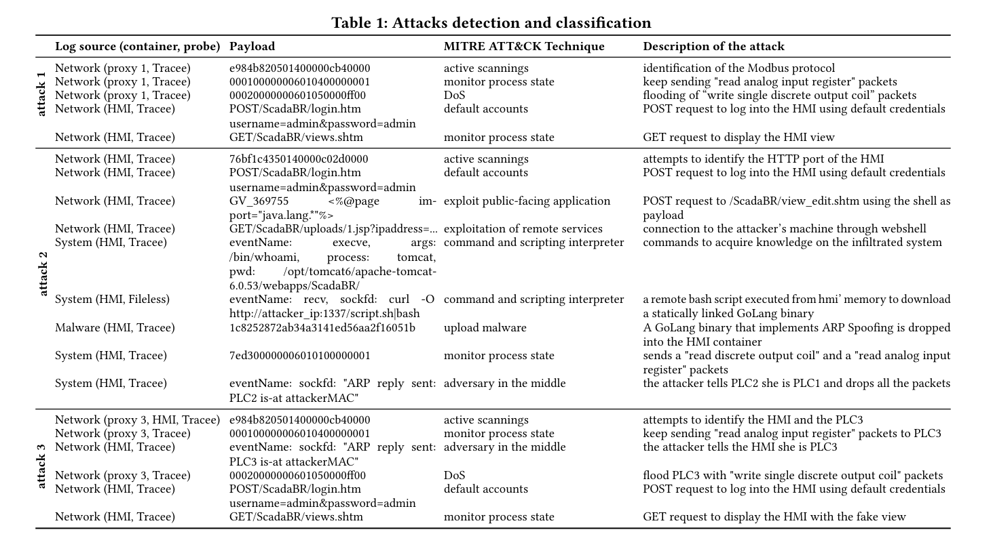

Slide 29
