Slide 1
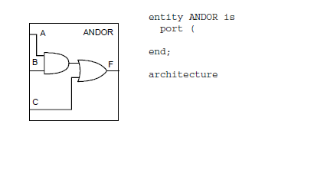
Lab1 (15 mins)
Write a simple entity named “testbench.vhd” that contains:
Use EDAPLAYGROUND as your editor
Or try link

Slide 2
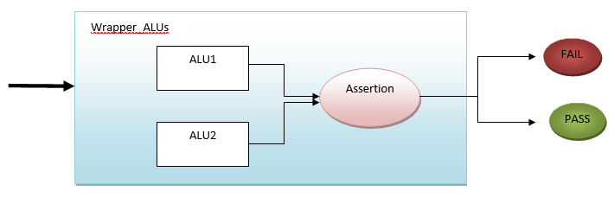
Lab2 (30mins)
Overview:
In this assignment you will build a combinational model for an 8-bit ALU in VHDL. Your 8-bit ALU will support the following operations: and, or, nand, nor, addition, division, subtraction, zero flag.
You are required to build your design with two different styles:
1-level design
Multiple-level design
Description:
Specification of the ALU:
Provide support for: and, or, nand, nor, addition, subtraction, zero flag.
Operands are 8 bits signed (each)
Output is 8 bit signed
Output of the Zero flag
The control signals must be 4 bits std_logic_vector
What to do:
1-level design (ALU1)
Create a description for the ALU model using ONLY 1 level.
Multiple-level design (ALU2)
Create a description for the ALU model using multiple levels such as:
  A top level module that instantiates the leaf modules
  Leaf modules to describe each operation of the ALU.
Verification
Perform an equivalence checking between both design styles
  Create a wrapper module that instantiates both ALU1 and ALU2
  Inject assertion within the wrapper module as to ensure that the output of both ALUs are the same whenever their inputs are similar

