Slide 1
Adversarial Machine Learning Use of Reverse Engineering for Anomaly Detection in Industrial Control Systems
Study Project
Presenters: Abdelaziz Neamatallah, B.Sc.
Coauthor: Anna Dembowski, B.Sc.

Slide 2
Agenda
Motivation and Problem Statement
Datasets
Methodology
Experimental Procedure Overview
Dataset Preprocessing
Reverse Engineering
Feature Extraction (SDA)
Anomaly Detection Methods
Evaluation Strategy
Results
Summary & Conclusion

Slide 3
Motivation and problem statement
Industrial Control Systems (ICS) monitor and control critical infrastructure (e.g. power grids, water systems, and chemical plants).
Intrusion detection in ICS is challenging due to:
Proprietary and non-standardized industrial protocols.
Lack of protocol specifications for deep packet inspection.
Main Question:
Can anomaly detection methods be designed to operate without relying on protocol knowledge and achieve good performance on reverse engineered traffic?

Slide 4
Motivation and problem statement
What?
Statistical analysis.
Reverse engineer packets to obtain protocol chunks.
Train ML and DL classifiers.
Why?
Enable anomaly detection for ICS without access to protocol specifications.
Notes:
What ?
Perfrom statistical analysis on the datasets to understand how they looks like
Implement and evaluate different approaches to extract expressive patterns network traffic collected in the OT area using everse engineering methods to derive specific chunks from the observed network packets.
Train different machine learning and deep learning methods to train a classifier with the reverse engineered chunks
Why ?
The main idea is to be able to create an anomaly detection for ICS even if we do not have the used protocol as open-source.

Slide 5
Datasets
 | Electra S7Comm¹ | 2017QUTS7Comm²
Publisher | University of Murcia (UM), Spain | Queensland University of Technology
Generation | Collected From Realistic Testbeds | Generated in Controlled Laboratory Environment
Size | 387.098.466 packets (~30 GB) | 5.830.642 packets (~1,5 GB)
Compoisition | 31,7% Attack 63,3% Benign | 85,1% Attack 14,9% Benign
Format | CSV (preprocessed) | PCAP Files
Primary use in Project | Initial Analysis | Initial Analysis, Reverse Engineering & Execution of Experiments
Protocols | Only s7Comm | Different Protocols (mainly S7Comm)
Notes:
-we were provided with 2 dfferent datasets that we analyzed in the beginning of the project
-one is .... [read table]
-both s7Comm
-electra -> realistic testbeds, QUT -> controlled laboratory environment
Therefore more normal then attack data in electra
-electra was only used in the beginning for initial analysis and comparison to the QUT datasaet
-QUT was used for all further steps in the projects
More suitable for reverse engineering tasks since it contains the raw packets in pcap files
--------------------------------------------------------------------------
(attacks in electra:
-reconnaissance, false data injection, replay)

Slide 6
Datasets
QUTS7Comm(2017) Class and Attack Distribution
99,8% of traffic belongs to S7Comm protocol (minor background traffic includes DHCPv6, NTP, mDNS)
Notes:
-QUT is highly imbalanced with attack packets accounting for the vast majority of the traffic
-within the attack traffic there is a diversity of present attack types
But it is strongly dominated by flooding attacks of different types
-there are three kinds of non-flooding attacks inside the dataset which only form a small fraction below 0,01%
namely: EmergencyStop,. GlobalReset and ConveyorBeltReset
-majority of traffic generated by S7Comm

Slide 7
Methodology

Slide 8
Experimental Procedure overview
One-class SVM
Local Outlier Factor
Elliptic Envelope
Ensemble
Classifier
(One-class/ Multiclass)
QUTS7Comm
(2017)
Dataset Preprocessing
Feature
Extraction (SDA)
Raw
RE5
RE10
RE15
KNN
Binary SVM
Random Forest
Traditional ML Detection
Dataset Preprocessing & Reverse Engineering
RE
concatination
of bytes
Other anomaly detection methods
SDA
N-Gram
GAN
Deep learning classifiers
CNN
ResNet
= Trained on benign/control data only
K-Fold cross-validation with (k=5) on different evaluation scenarios:
Scenario 1
Scenario 2
Scenario 3
= Trained on benign/control and attack data
Notes:
-we started by applying dataset preprocessing and reverse engineering to create 4 different dataset representation types (out of QUT)
-on the one hand: RAW datset representation
-> 3 differnt Reverse Engineered Representations
-from those representation we extracted features using a SDA which we implemented
-those were then used with the traditional ML classifiers
There we had on the one hand the outlier detectors (namely ...) which were trained on normal packets only and the multilass classifiers (namely ...) trained on attack and normal packets
Those traditional ML classifiers were then combined into an ensemble classifiers which could either operate on the one class / multiclass classifiers
-we also implemented DL classifiers (CNN, ResNet)
-and other anomaly detection methods (SDA, N-Gram based detection, GAN)
-the evaluation was performed using K-Fold-Crossvalidation
-using 3 different evaluation scenarios
-------------------------------------------------------------------------------------------------------------------------
-first of all we implemented dataset preprocessing to create one preprocessed dataset cotaining all of the Raw bytes of the given QUT dataset
-we also implemented a reverse engineering strategy to identify meaningful chunks of the bytes inside the given QUTdataset
This then resulted in the RE dataset -> which was further processed by concatinating a byte sequence of a certain length into smaller dataset representations RE5,RE10 and RE15
-we implemented and evaluated many different models for the Anomaly Detection
On the one hand we used standard ML classifiers, including outlier detectors and standard multiclass classifiers
Then we had 3 other anomaly detection methods and two deep learning models which we implemented
3 different evaluation scenarios were used to evaluate the differernt models
Scenario 1 suitable for all methods trained only on attack data and scenario 2 and 3 suitable for al models trained normal and attack data
->that were then evaluated using K-Fold in different evaluation scenarios

Slide 9
Methodology
Dataset Preprocessing

Slide 10
Dataset Preprocessing
Provided
Metadata
Labels
Raw Dataset Representation
Extract all packets
Extract entire byte sequence (Ethernet, IP, TCP/UDP headers)
RE Dataset Representation
Filter S7Comm packets
Extract S7Comm payload starting at keyword
PCAP files
Timestamps
IP Address
Port Number
Benign/Attack type
Keyword identified
through reverse engineering
Notes:
to preprocess the dataset we started by extracting attack labels from the folder structure
-then we processed the pcap files and extracted the metadata for each packets (includingtimestamps , ip addresses, port numbers)
-for the creation of our Raw dataset:
RAW:
-used all kinds of packets (also the ones without application layer and the ones not being s7comm
-used raw bytes (the entire packet including the IP, Ethernet and TCP header)
RE:
-use only application data
-filter s7comm by verifying:
-tcp layer exists
-protocol no (102 in srcport or dstport)
-min length for TPKT (4)+ COTP(3) + S7(12)
=> cut part of s7comm tht starts after the (position which we identified for the key word during the reverse engineering process

Slide 11
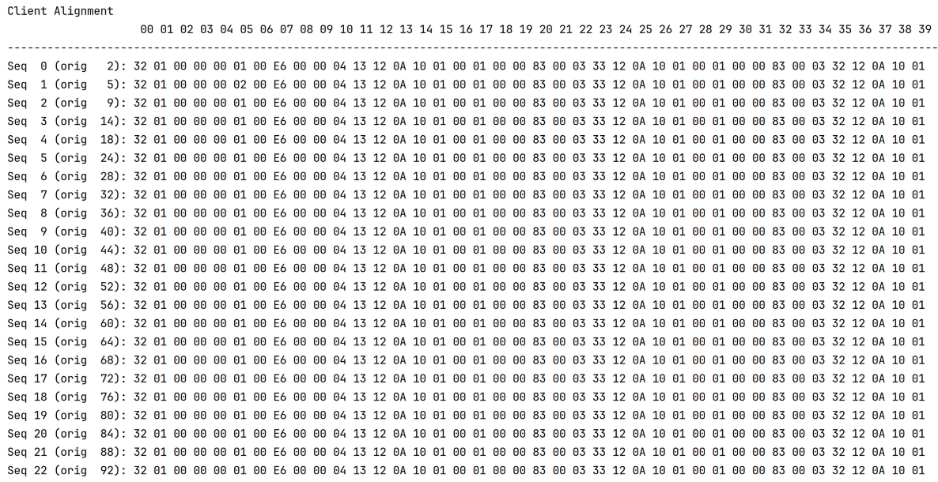
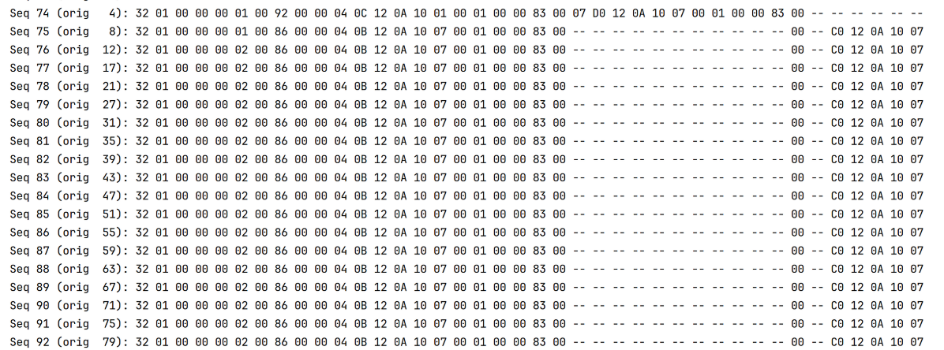
Reverse Engineering
– Identify candidate payload fields
Goal:
Identify payload regions that most likely contain physical readings.
Group into communication sessions (based on session ID and inter-arrival time)
Perform sequence alignment (for client-to-server and server-to-client traffic over all sessions)
Identify static vs. dynamic byte positions and merge static fields across alignments
Cluster dynamic fields from keyword candidates
...
keyword candidate
Notes:
-the objective of the reverse engineering was to identify the keyword after which the physical readings are most likely to start
0. Divide the traffic into communication sessions (using IP –address + port number and a time window based on the inter arrival time)
-> this would also separate traffic of different communication directions
Perform progressive sequence alignment
From the sequence alignment define static fields as those that don’t change among the messages and dynamics as those that change
The static unit fields are then merged together
For each remaining dynamic field – value based clusters are created out of the remaining frame (behind the keyword candidate)
Finally the similarity between clusters is measured in order to identify most likely keyword candidates
-here you can see what the sequence alignment can look like
-in this case the first 40 bytes of the alignment for the communication from Client to Server in one Session
-------------------------------------------------------------------------------------------------------
-communication session split based on IAT:
TODO: HOW DID WE PERFORM SEQUENCE ALIGNMENT – BACKUP
Our approach is inspired by progressive alignment (like ClustalW), but we use a simpler greedy guide strategy instead of a full guide tree and profile–profile alignment.
Most similar messages are aligned first – remaining messages are added progressively

Slide 12

Reverse Engineering
– Clustering and best candidate detection
Define constrains to filter out keyword candidates
Our constraints:
Max keyword length
For the remaining candidates, we compute the following as probabilities:
Message similarity (Pm).
Remote coupling (Pr).
Structure coherence (Ps)
Compute the joint probability:
Pt = (Pm * Pr * Ps)
Assuming that these probabilities are independent.
Best keyword should be the one with the highest joint probability.
Notes:
We defined some constraints on which we can filter out some candidates, because not every candidate keyword is a legitimate keyword
Max keyword length: if we found a candidate longer than certain length, it should be excluded.
For the remaining candidates, we compute the following as probabilities:
Message similarity (Pm): messages within the same cluster should have high number of identical bytes
Remote coupling (Pr): client request should determine the server response.
Structure coherence (Ps): messages within the same cluster should share the same field structure.
Message similarity: Between every message pair, we should compute # identical bytes divided by total number of bytes
This gives a matrix of similarity.
This similarity should be divided into:
- intrascore: within the same cluster how much of them are similar to each other.
- interscore: between different cluster how much of them are similar to each other.
We should define certain threshold t and compute the accuracy as Pm = 1 – (FMR + FNMR) / 2
FMR is False matching rate = (# interscores > threshold) / total inter score
In other words, it defines how many of the packets within different cluster are similar to each other.
(e.g. they are in the same cluster, but they are not similar to each other)
FNMR is False non matching rate = ( # intrascore < threshold ) / total intra score
In other words it defines how many of packets within different clusters are similar to each other.
(e.g. they are in different clusters, but they are similar to each other).
High pm -> good keyword, Low pm -> bad keyword.
Remote coupling: This evaluate how well client clusters corresponds to server clusters
The process goes as follow:
1. We cluster client-to-server messages.
2. We cluster server-to-client messages.
3. then we pair messages by TCP session order.
Then for each client cluster:
N: number of client messages in this cluster
M: largest # of corresponding server messages that fall into same server cluster
Then we compute remote coupling:
Pr = M / N
So Pr evaluate what Is the probability that this cluster shows good cluster, because all client messages should have the same server response.
Then high Pr means good keyword candidate, because cliend request should determine server response.
3. Structure coherence:
- The main idea is that messages of the same type should have similar aligned structure.
The process is as follow:
- For each cluster
- re-align messages inside the cluster
- count the number of gaps per message
- compute Ps = 1 – (average gaps / aligned length)
High Ps means good keyword candidate.

Slide 13
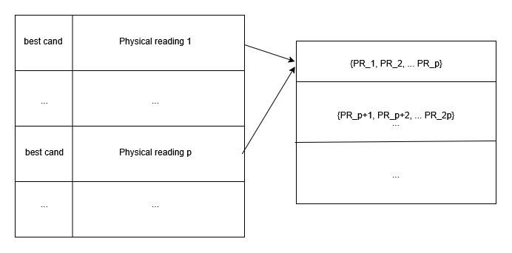
Reverse engineering
– Concatination of physical reading data
Raw data
Concatenation of physical reading sequence
Extraction of the physical reading directly after the best candidate.
Define parameter p.
Concatenation of the physical readings of every p consecutive packets into one packet.
Goals:
Focus only on physical readings as features.
Reconstruct context of physical readings.
Evaluate the impact of different values of p.
RE data
Notes:
Appending of physical reading sequence
After we managed to extract the best candidate keyword, we extracted the physical reading sequence after each byte.
It was asked for the reverse engineering packets for a given value of p, to concatenate physical reading bytes for p consecutive packets into one single packet.
The main goal is to focus on the extracted physical readings as the main features instead of the full packets, and to evaluate how aggregating multiple consecutive readings (p = 5, 10, 15) captures temporal behavior relevant to anomaly detection.

Slide 14

S7comm Protocol structure
Best candidate

Slide 15
Methodology
Feature Extraction

Slide 16
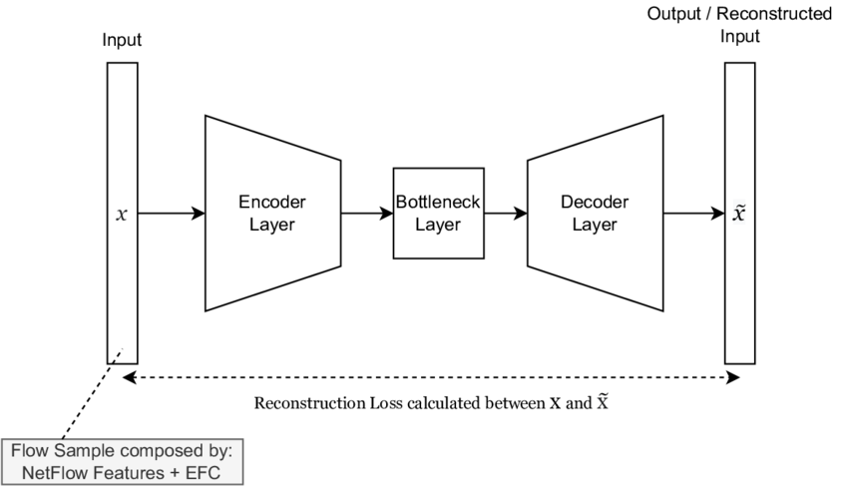
Feature Extraction
Autoencoder architecture:
Input: Byte-vectors from Raw/RE representations (RE5/RE10/RE15)
Pad/Truncate to length M
Normalize byte values to [0/1]
SDA* (trained on benign samples)
Encoder (bottleneck layer)
Output: Latent feature vector (e.g. 32 features)
Image taken from: https://www.researchgate.net/figure/Deep-Autoencoder-architecture-composed-by-input-x-encoder-layer-bottleneck-layer_fig1_367193919
Notes:
-for our project we implemented a SDA
-one use case for the SDA was to extract features from the byte-vectors inside the preprocessed dataset representations
(which were then used as input for all the traditional ML based detection methods)
0. prepare the input for the autoencoder:
-each byte-vector (inside representation) was padded with zeros/truncated to a fixed length $M$ and normalized (to values between 0/1)
(For the experiments we set M to the length of the longest packet in the representation)
Trained the Autoencoder on benigne (bä-nein) data of the different representations
Used it to Encode all byte-vectors from the corresponding representations
For this we made a prediction and extracted the results from the bottleneck layer
(output: fature vector with 32 elements per input byte-vector)
-----------------------------------------------------
Tranform each packet to a fixed length vector M (pad/truncate) and normalize values to [0,1]
Train SDA on the training split (normal packets only)
Use the trained encoder to transform all packets into latent vectors
Extract the latent feature vectors from the bottleneck (encoding) layer

Slide 17
Methodology
Anomaly Detection Methods
Ensemble Classifier
Autoencoder Reconstruction-Error
N-gram
Generative Adversarial Network
ResNet

Slide 18
Detection methods
Ensemble Classifier
Training
Final prediction
Classifier 1
Ensemble Classifier
Classifier 2
Evaluation
Data
Classifier 3
Operational Modes:
One-class
One-class SVM
Local Outlier Factor
Elliptic Envelope
Multiclass
Binary SVM
KNN
Random Forest
Prediction Modes:
Random – randomly select one of the predictions
Majority – select the majority of equal predictions
All – classify as attack, if all classifiers predict it as attack
Notes:
-for our project we implemented multiple traditional ML detection methods using the SKIT-Ih – learn library
=> They were (otoh) evaluated seperately and also combined into an Ensemble Classifier with 3 different modes
-(as illustrated here) it was implemented by training all 3 involved classifiers seperately and letting them predict individual results (for each datapoint)
-then the ensemble classifier would make a decision by combining all 3 predictions (for each datapoint) while applying one of the three modes
Prediction Modes:
Random – randomly select one of the predictions
Majority – select the majority of equal predictions
All –classify as attack, if all classifiers predict it as attack
-given that we had 6 traditional ML detection methods with 3 of them operating as outlier detectors and 3 as binary classifiers
We implemented two different operational modes for the ensemble classifier
One where it operates on the 3 outlier detectors (in one class mode)
One where it operates on the 3 bianry classifiers

Slide 19
Anomaly Detection methods
Autoencoder-based anomaly detection
Idea:
An autoencoder is trained on benign data to learn compact representation. Since attack data deviate from this learned representation, they typically result in a higher reconstruction error.
Approach:
Define threshold based on average reconstruction error over all benign data points
If the reconstruction error for a data point in test crosses that threshold it will be classified as attack
Notes:
-the second use case for the SDA was to implement a reconstruction error based anomaly detection method
Idea:
-autoencoder is trained on all normal packets
=> Will achieve an observably higher reconstruction - error when processing an attack packet
-in order to use it as a classifier we firstly computed the MSE which the trained autoencoder achieved over all normal packets
-then we defined a threshold based on that result
-when the error which the autoencoder computes for a packet will be higher than that threshold it will be classified as attack

Slide 20
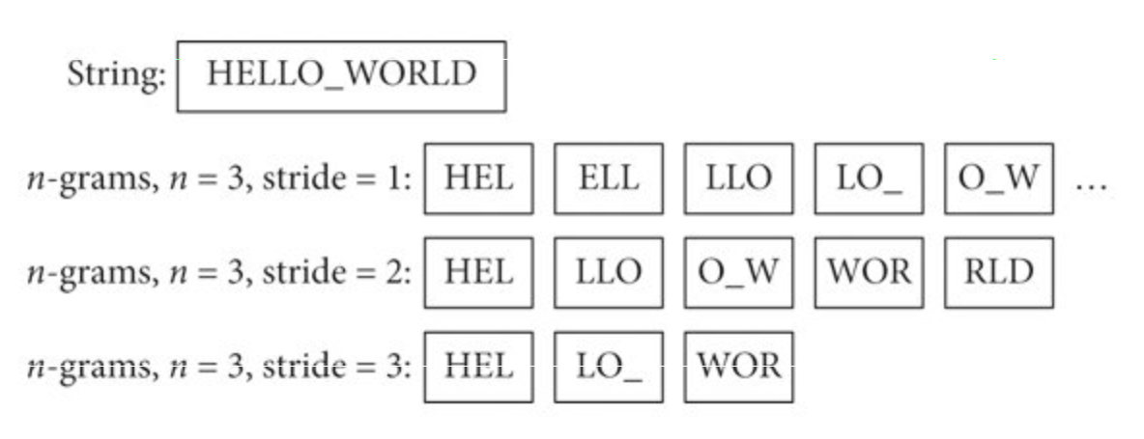

Anomaly Detection methods
N-gram-based Anomaly Detection
What is n-gram?
How n-gram model network packet?
Training phase
Detection phase (Testing):
Anomaly score:
Score = $\frac{1}{T}\sum_{i=1}^{T}{wi ∗Seeni}$
Low score means attack packet
Decision rule:
Packet is malicious if score < threshold
Notes:
What is n-gram?
It is a contiguous sequence of n bytes
Extracted by sliding a window over packet bytes
How n-gram model network packet?
Each packet is represented as a set of bytes
Normal traffic produces repetitive and stable n-gram patterns
Attacks introduce unseen or rare n-grams
Training phase:
Observe all distinct n-grams in training packets
Store seen n-grams in a Bloom filter (space-efficient)
Count how often each n-gram appears
Compute normalized weights based on frequency.
Detection Phase (Testing):
For each packet
Count how many n-grams were seen during testing
Compute anomaly score
Score = $\frac{1}{T}\sum_{i=1}^{T}{wi ∗N_seeni}$
Low score means attack packet
Decision Rule:
Packet is malicious if Score < threshold

Slide 21
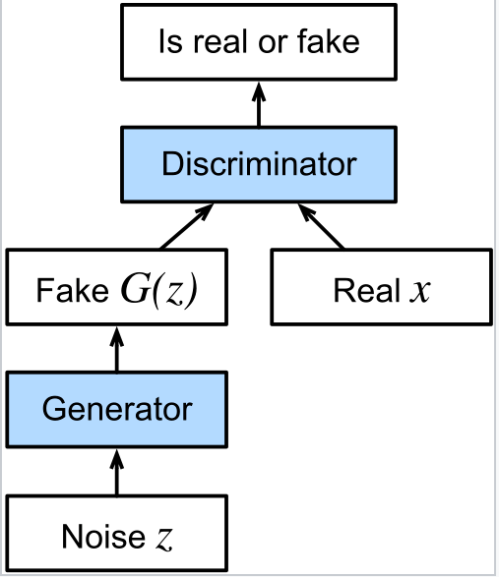
Anomaly Detection methods
Generative Adversarial Network
What Is GAN?
How can GAN be used for anomaly detection?
During testing:
Abnormal packets differ from learned distribution
Key Idea:
Only benign data can be generated or recognized
Notes:
What is GAN?
Deep learning model with two competing networks.
Learns the distribution of normal network packets.
How GAN is used for anomaly detection?
Trained mainly on benign traffic.
Learns what normal packets look like.
During testing:
Abnormal packets differ from learned distribution
Detected using either
Discriminator
Generator
Key idea:
We can learn to recognize or generate the normal data, but we can not do the same for anomalies, and this is how we can use them as classifiers.

Slide 22
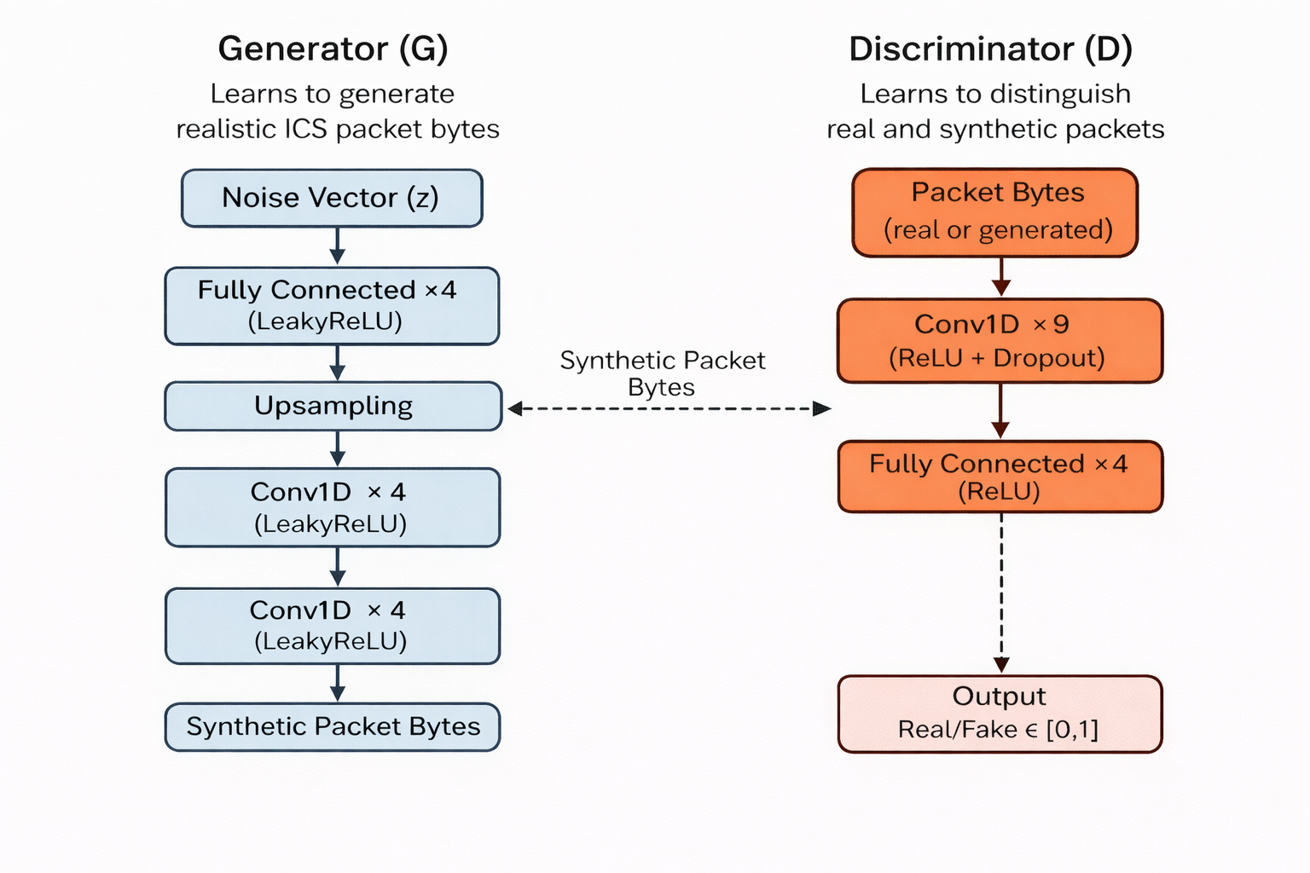
Anomaly Detection methods
Generative Adversarial Network
Discriminator & Generator
Notes:
What is the discriminator?
A CNN-based binary classifier
Distinguishes between:
Real packets from the dataset
Fake packets generated by the generator
What is Generator?
Generates fake network packets
Input:
Random noise vector
Output:
Synthetic packet bytes that resemble real traffic
Using the generator as classifer happens in that way:
- The generator is trained to model normal ICS traffic.
- So during inference:
- if the input packet is well reconstructed or well matched, then this should be normal
- if it is poorly reconstructed, then it is anomaly.
- we use mean square distance function to measure how similar are these two packets.
Using Discriminator as classifier:
- This is normal, because Discriminator is already binary classifier which is trained to differentiate between benign traffic, and generated traffic.
What does upsampling mean?
- it means increasing in the size or resolution of data so that is has more points than before.
- So in generator its main goal is to increase the length of the feature representation so the model can turn a small, compressed noise vector into a full-length sequence of realistic ICS packet bytes; so after the fully connected layer produces a short, dense feature map, upsampling extends it, giving the following Conv1D layers enough detail from a tiny vector.
- Without upsampling, generator would struggle to produce packets with realistic size and structure.
LeakyReLU usually is used to not give 0 value for –ve points, which roughly helps the neuron not to be completely excluded.

Slide 23
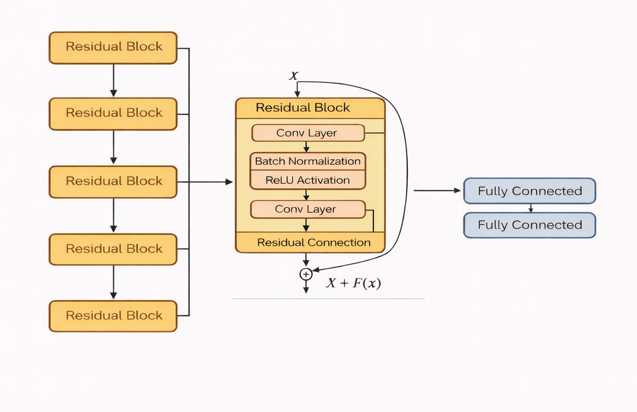
Anomaly Detection Method
ResNet
Architecture
Notes:
Our final method was ResNet:
Its core idea is to learn changes to the input instead of relearning everything from scratch.
Each residual block takes an input x, passes it through two convolutional layers with batch normalization and relu activation function, and it learns function f(x)
Then the residual connection adds the original input to the learned features x + F(X)
This shortcut allows information and gradients to flow directly through the network, preventing vanishing gradients and enabling much deeper models.
Then at the end of the 4 stages, we pass the output to two fully connected layers, and then uses these high-level features to perform the classification.
Residual connection is skip connection, so it means that the layer learns a correction on top of its input, so instead of learning H(x), it learns f(x) = H(x) – x, and at the end it produces x + F(X)
Difference between CONV layers, and FCL?
Conv layers look at small local patterns and reuse the same filter everywhere.
Fully layers connect every input to every output, so they do not care about local structures, instead they combine all extracted features.

Slide 24



Anomaly Detection Method
ResNet
Learns discriminative patterns from the packet bytes.
Normal and attack traffic produce different deep feature activations
Final output:
Sigmoid decision:
1 is attack
0 is normal

Slide 25
Methodology
Evaluation Strategy

Slide 26
Evaluation Strategy
Sceneraios
1 Test set: benign data + all attack types
Training set: benign data only
2 Test set: benign data + all attack types
Training set: benign data + N-2 attack types
Scenario
3 Test set: benign data + all attack types
Training set: benign datas + 1 attack type
Notes:
-besides performing hyperparameter tuning for each detection method / modeel
-we also worked with 3 different evaluation scenarios
In all scenarios the test data includes all attack types and normal data but the training data differs
-in scenario 1 it only contains normal data
Making it suitable only for the outlier detectors of the classic ML models we used – as well as the autoencoder detection and Gan detection method
-scenarios 2 and 3 can be used to evaluate the ML classsifiers that are trained based on normal data and the two deep learning classifiers CNN and ResNet
-scneraio 2: 2 of the attack types are removed for the training
-and in scenario 3 only one attack type is included in the training data

Slide 27
Evaluation Strategy
K-Folds cross-validation
(k=5)
Benign data:
Test set:
all N attack types
...
Training set scenario 1:
For each attack type:
N-2 attack types
Training set scenario 2:
...
Training set scenario 3:
1 attack type
Notes:
-the training and test splits were created using K-Folds with 5 iterations
HOW DOES IT WORK in general?
Divide the dataset into K equal sized folds
Train the model on K-1 folds and test on the remaining fold.
Repeat K times, using a different fold as the test set each time.
For the evaluations it computes the average performance across all K runs.
-> How did we implement it in order to create the specific data for each scenario:
>for the experiments we always used k fold with runs (k=5)
K-fold splits are computed separately for benign (control) data and for each attack type. For each run, the test set consists of the validation folds of benign data and all attack types. The training set always includes all benign training folds and only the training folds of the attack types specified by the respective scenario.
------------------------------------------------------------------------------------
Attributes:
Each data point appears EXACTLY ONCE in a test set across all k folds. * All folds are disjoint (no index appears in more than one fold). * The union of all folds contains every data point exactly once.

Slide 28
Results

Slide 29
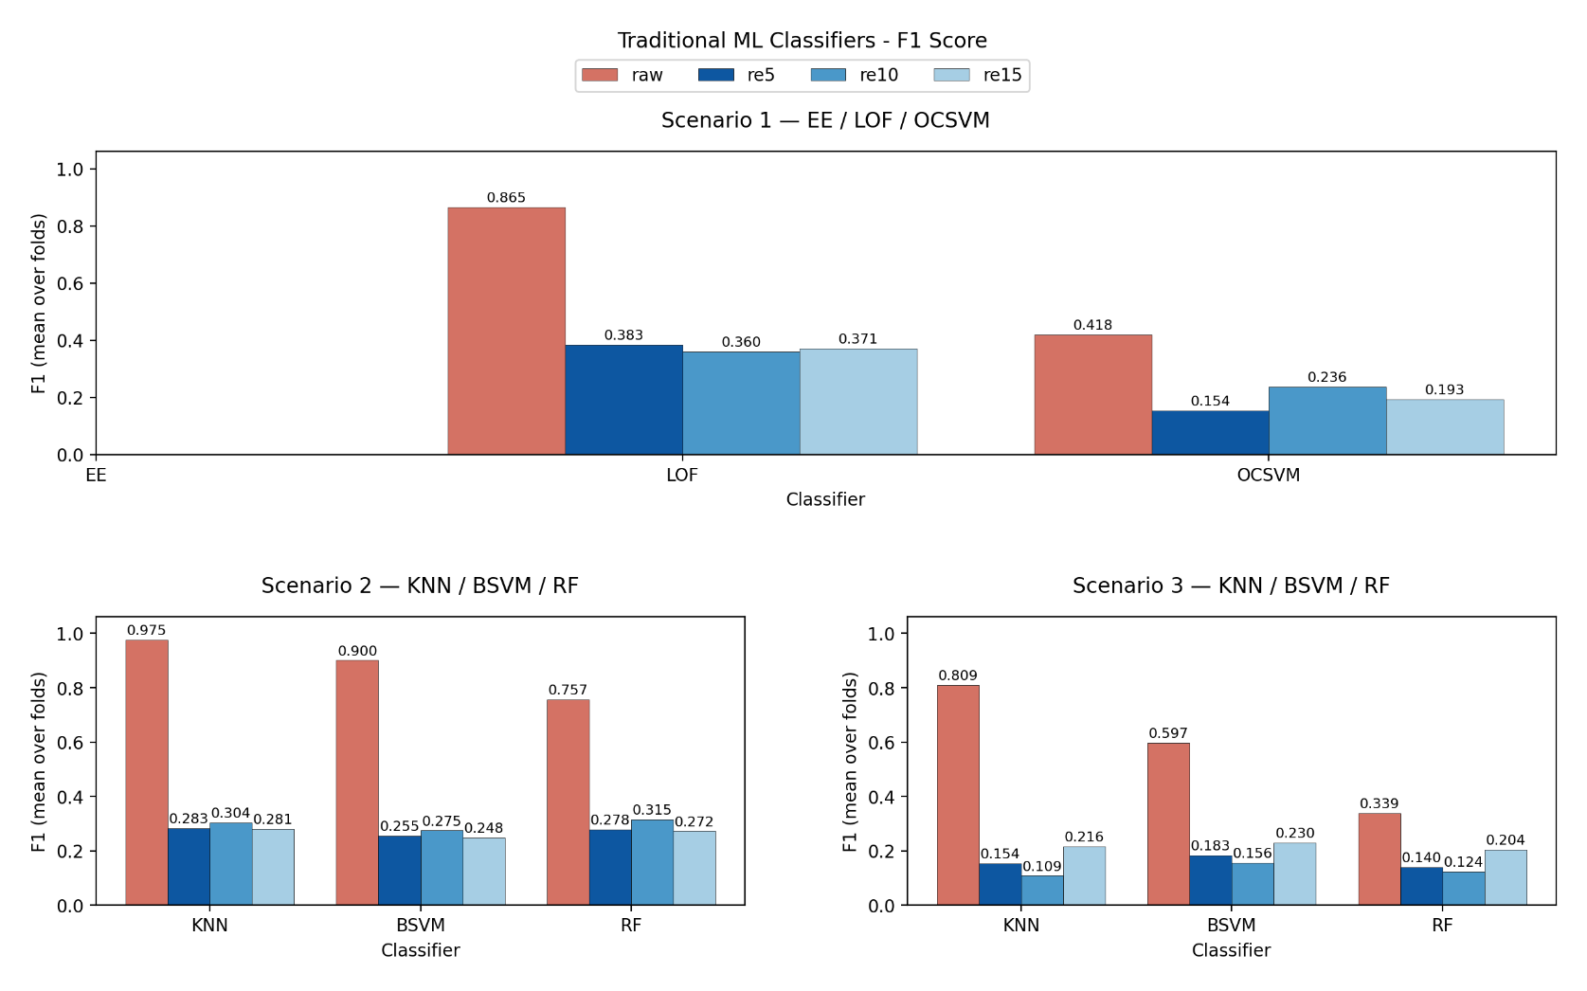
Results
Traditional ML Classifiers – F1-Score
Notes:
-here you can see the results for the standard ML classifiers
-Raw presentation outperformed the reverse engineered representation for each classifier
-kNN and BSVM performed best (in scenario 2)
-kNN best overall
-ee only predicted one class => result 0
-evaluation scenario 2 seems to work best, were the models have been traiined on multiple attack data

Slide 30
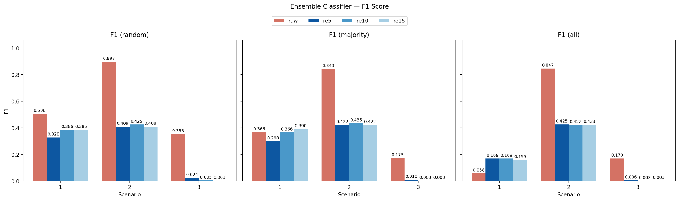
Results
Ensemble classifiers – F1-Score
Notes:
-best results for raw (one exception)
-consistent results between modes for evaluation scenario 2
-always bad results for scenario 3n are outstandingly bad (posibly because of lack of attack data)
-F1-score drops for the outlier detectors in scenario 1
=> Indicating that one of the coutlier detectors perform bad (which is the case for EE)
COINCIDEN

Slide 31
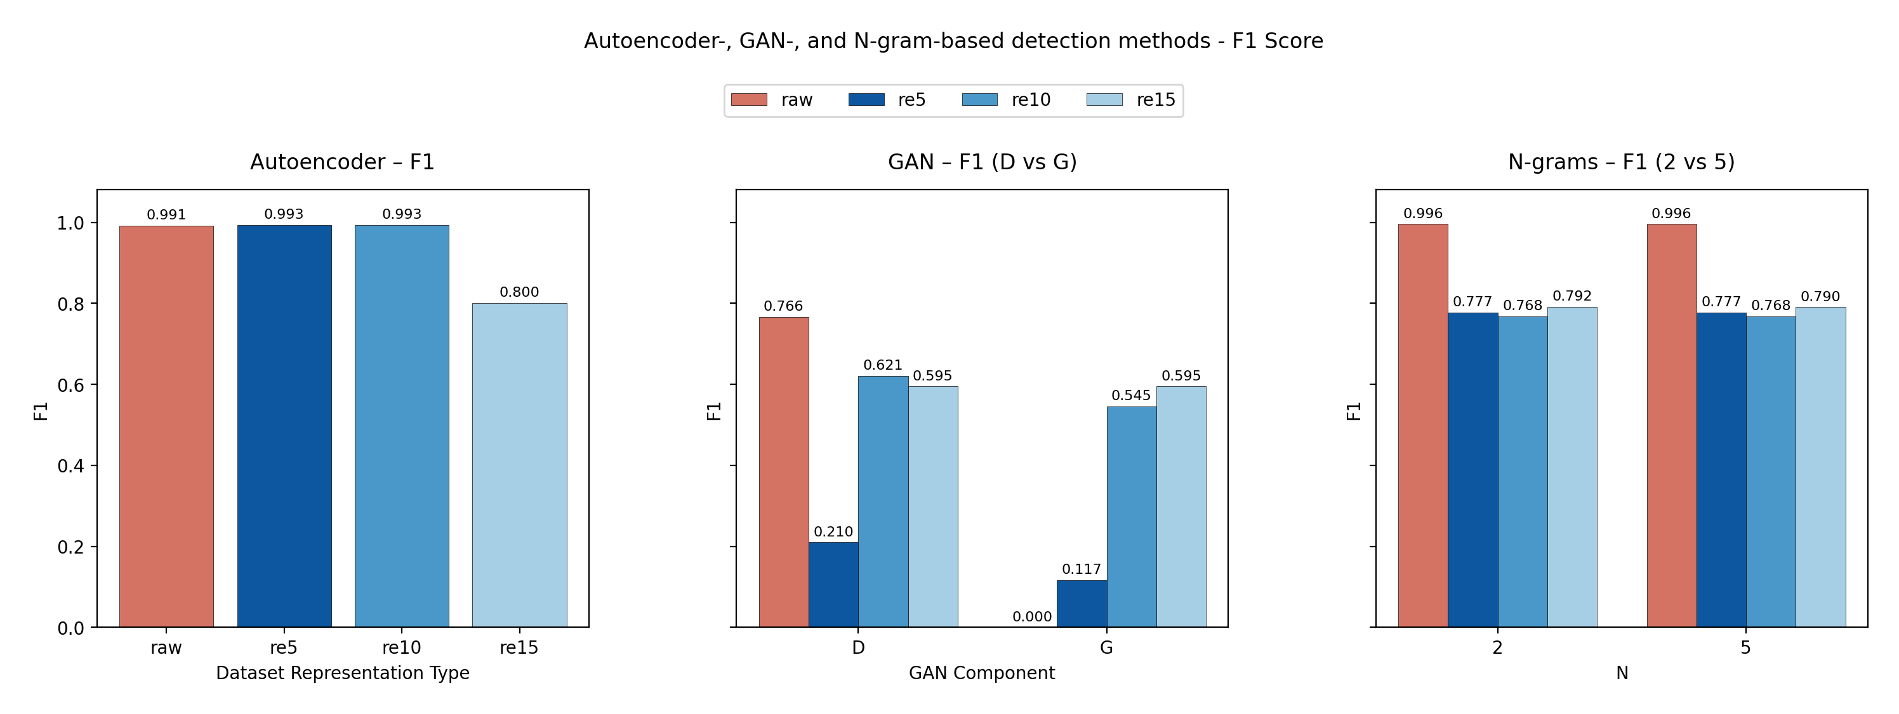
Results
N-Gram, GAN, and SDA - F1-Score
Notes:
Autoencoder / SDA
Very strong performance on raw packets (F1 ≈ 0.99).
Performance remains high for re5 and re10, showing that reverse-engineered physical readings still preserve most discriminative information.
Noticeable drop at re15, indicating that too much temporal aggregation can dilute anomalies.
Interpretation: Autoencoders are effective because they model normal system behavior directly via reconstruction error.
GAN (Discriminator vs Generator)
GAN performance is unstable and clearly lower than other methods.
The discriminator performs better than the generator, but still poorly compared to SDA and N-grams.
Generator-based detection struggles, especially on raw data, and we assume that is because of the difficulty of constructing valid raw packet from noise input.
Interpretation: The generator fails because raw network packets are too strict and detailed, making it hard for the GAN to learn and recreate them correctly.
Strict means that data must follow very precise and fixed rules.
N-grams (N = 2 vs 5)
Excellent performance on raw packets (F1 ≈ 0.996).
F1 drops after reverse engineering but remains stable across p = 5, 10, 15.
Similar performance for 2-gram and 5-gram, suggesting limited sensitivity to N.
Interpretation: N-grams capture local byte patterns effectively, but lose discriminative power when only physical readings are available.
Key takeaways (one-liner)
“Autoencoders are the most robust method, N-grams are strong but rely on raw packet structure, and GANs are not well-suited for reliable anomaly detection in ICS byte-level data.”
SDA is used as a classifier by computing the construction error, if we managed to reconstruct the packet properly, then it is considered as normal, otherwise it is considered as attack, and this can be computed using distance function.

Slide 32
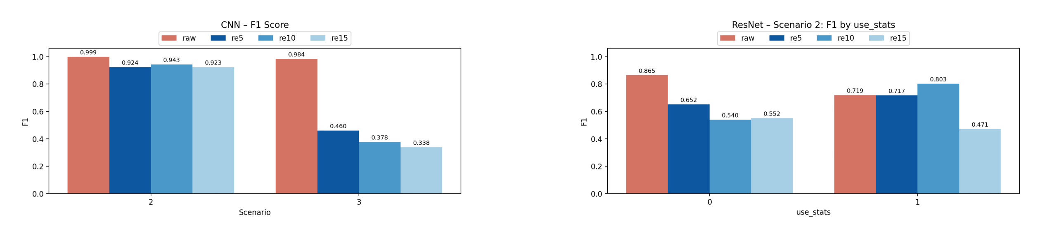
results
CNN and ResNet – F1-Score
Notes:
CNN vs ResNet – F1 Score Analysis
CNN performs extremely well on raw packets, especially in Scenario 2 (F1 ≈ 0.99), showing that convolutional models can directly exploit low-level byte patterns.
CNN performance drops significantly in Scenario 3, particularly after reverse engineering, indicating that CNNs are sensitive to distribution shifts and reduced packet context, and also difficulty of detecting previously unseen attacking packets.
ResNet is more stable than CNN when using reverse-engineered data, especially when statistical features are included.
Adding statistical features (use_stats = 1) clearly improves ResNet performance, reaching its best F1 when combined with re10 / re15.
This shows that ResNet benefits from residual connections and auxiliary features, making it better suited for more challenging and realistic scenarios.

Slide 33
Summary & Conclusion

Slide 34
Summary & Conclusion
Key Findings:
Overall best performance: SDA, N-Gram, and CNN
Overall worst performance: GAN and traditional ML classifiers
Best data respresentation: Raw packet data
Worst data representation: RE15 (smallest aggregation representation)
Impact of reverse engineering (compared to raw):
Comparable performance for CNN, autoencoder and ResNet
Moderate performance loss for GAN and N-gram-based detection
Severe performance loss for traditional ML methods (only approach relying on explicit feature extraction)
Evaluation scenario impact: Scenario 3 results in the lowest overall performance
Notes:
N-gram:
Effective and efficient classifiers especially when combined with Bloom filters.
Performance is insensitive to the choice of N.
SDA:
Achieves near-perfect F1-scores for raw, re5, and re10.
Indicating that it is successfully learns a compact representations
Can reliably identify deviations as anomalies.
GAN:
Poor classification performance (low average F1-Score).
Highly inconsistent results across experiments.
ResNet:
Performs reasonably on raw bytes (F1 ≈ 80%).
Reverse engineering provides limited benefit when trained on both normal and attack data.
Fails without attack samples, which means not suitable for detecting unseen attacks.
----------------------------original slide:
N-gram:
Effective and efficient classifiers especially when combined with Bloom filters.
Performance is insensitive to the choice of N.
SDA:
Achieves near-perfect F1-scores for raw, re5, and re10.
Indicating that it is successfully learns a compact representations
Can reliably identify deviations as anomalies.
GAN:
Poor classification performance (low average F1-Score).
Highly inconsistent results across experiments.
ResNet:
Performs reasonably on raw bytes (F1 ≈ 80%).
Reverse engineering provides limited benefit when trained on both normal and attack data.
Fails without attack samples, which means not suitable for detecting unseen attacks.

Slide 35
Summary & Conclusion
Main Question:
Can anomaly detection methods be designed to operate without relying on protocol knowledge and achieve good performance on reverse engineered traffic?
Anomaly detection without protocol knowledge is feasible using raw packets
Reverse engineering compresses packet data by extracting key features and concatenating packets
The resulting runtime gains during training come with method dependent performance trade-offs
Notes:
We suggest that it is because of having smallest number of samples after aggregation

Slide 36
Summary & Conclusion
Future Work:
Analyse performance of reverse-engineered representation without concatination
Evaluate alternative feature extraction methods for traditional ML
Evaluate the approach on datasets from realistic testbeds with less repetitive attack patterns
Notes:
We suggest that it is because of having smallest number of samples after aggregation
Other alternative features can be:
Request-response ratio, n-gram frequency, physical responses sizes, session lengths, frequent bytes.

Slide 37
Q&A

Slide 38
Thank you!

Slide 39
Datasets
2017QUTS7Comm – Statistical Analysis
Protocols Discovered: 99,8% of traffic is S7Comm
(other application-layer protocols: DHCPv6, NBDS, NBNS, NTP, llmnr, mDNS)
Longest Packet in Dataset: 466 Bytes
Inter Arrival Time (in one communication Session)
S7Comm:
Frame Length S7Comm:
 | Mean | Std | Median
Normal | 139 | 88 | 85
Attack | 92 | 43 | 83
 | Mean | Std | Median
Normal | 0,0762 | 0,2472 | 0,0005
Attack | 0,0217 | 4,8411 | 0,0013
Notes:
-99,8% of the traffic we found inside the electra pcpa files belonged to the S7Comm protocol (according to the port number and header signature we found )
-other protocols found were mainly responsible for background network traffic (eg NTP for time control and DHCP for management of IP addresses)
-> We also had non-application protocol ere we didnt analyse the protocol
-we also measured the packet length and found out that the lognest packet overall was 466 bytes long (ncluding the header)
-the analysis of the frame length (for s7Comm!) exposed some differences between the normal and the attack traffic
-the normal traffic seems to contain some longer outliers compared to the attack traffic (since the median is similar but the mean fram length and standard derivation is higher for the normal packets)
-differences also showed in the inter arrival time were the average was slightly higher in the normal traffic
-also the inter arrival time is way more inconsistent for the attack packets
-IAT was measured within one communication session
Grouping by each IP address belonging together
-normal traffic has some longer outliers
Normal:
10.10.10.10__10.10.10.20 s7comm 0.076238 0.247161 0.000498
Attack:
10.10.10.10__10.10.10.20 s7comm 0.075641 0.245002 0.000505
10.10.10
.10__10.10.10.66 s7comm 0.021749 4.841117 0.001307

Slide 40
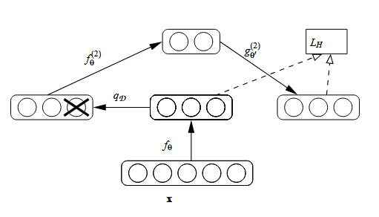
Stacked Denoising Autoencoder
What is autoencoder?
Neural network trained to reconstruct its input.
Consist of:
Encoder compresses the input into latent features
Decoder reconstructs the original input from those features.
Trained using reconstruction error
What is Denoising Autoencoder?
Input is intentionally corrupted with noise
Model learns to reconstruct the clean original input
Forces the network to learn robust and meaningful patters.
Stacked means multiple denoising autoencoders stacked
layer by layer to create deeper hierarchical feature representations
Image taken from https://www.jmlr.org/papers/volume11/vincent10a/vincent10a.pdf
40
Notes:
Read about this image from page 13 in the SDA paper: https://www.jmlr.org/papers/volume11/vincent10a/vincent10a.pdf?source=post_page
Latent features are the final compressed internal representation of the input learned by the encoder.
We can think of it as what the network believes really matters in the input.

Slide 41
Detection Methods
CNN
Input
Architecture
ConvolutionalLayer
BatchNormalization
Activation Function
DropoutLayer
ConvolutionalLayer
BatchNormalization
Activation Function
DropoutLayer
PoolingLayer
Dense Layer
DenseLayer
Output
Notes:
-the CNN (Convolutional Neural nettwork) was implemented using tensorflow
-it takes the preprocessed datasets as an input (not the features)
-as for the autoencoder, all features need to be provided with the same length – so the packet bytes are being cut/padded again to a length of M
-for the experiments we set M again to the length of the longest packet
(Input Shape)
Architecture:
-Input shape (M,1)
-each of the first 4 blocks consists of
-> two convolustion layers
=> essential building block as they löearn patterns from the input data (by applying trainable filters across the sequence)
-> two Batch Normalization layeres
=> normalize the output of the convolutional layer
-> two acitvation fucntions
=> introduce non-linearity to the output
-> two Dropout Layers
=> randomly zeros a fraction of input units to reduce overfitting
-downsampling is applied between blocks (either MaxPooling after each block or stride-2 at the first convolution of bloks 2-4)
(main job of the first for blocks is feature detection/extraction)
**((=> Output Shape (M,L) – L is channel dimension of conv layer (reduced by downsampling)))
-after passing the first 4 blocks a Global Average pooling layer is applied
(it reduces the multidimensional output of the 4 blocks into the expectd 1D shape of the dense layer)
-then 2 fully connected (dens) layers are applied
(main job -> integrate features into predictions)
-the model uses adam optimizer and categorial cross entropy as loss functions
-for the other parameters (as eg the activation function and the downsampling strategy, globalavergae pooling method or the kernel size and regulators for the conv layer) have been determined using grid search

Slide 42
Detection Methods
ResNet
Statistical Features Added to ResNet
Why add statistical features?
Raw bytes capture local structure
Statistical features capture global packet characteristics
Complement deep CNN features
Features:
Total number of bytes:
Packet length before padding or trimming
Helps detect:
Abnormal packet sizes
Flooding or malformed packets
Occurrences of the most and second most frequent bytes
Useful for detecting repetitive payloads and protocol misuse and adds robustness beyond single dominant value.
Byte entropy
Measures randomness of packet bytes
Attacks often show:
Unusually high or low entropy
Ratio of padded bytes
Tells the model how much of the input is artificial.

Slide 43
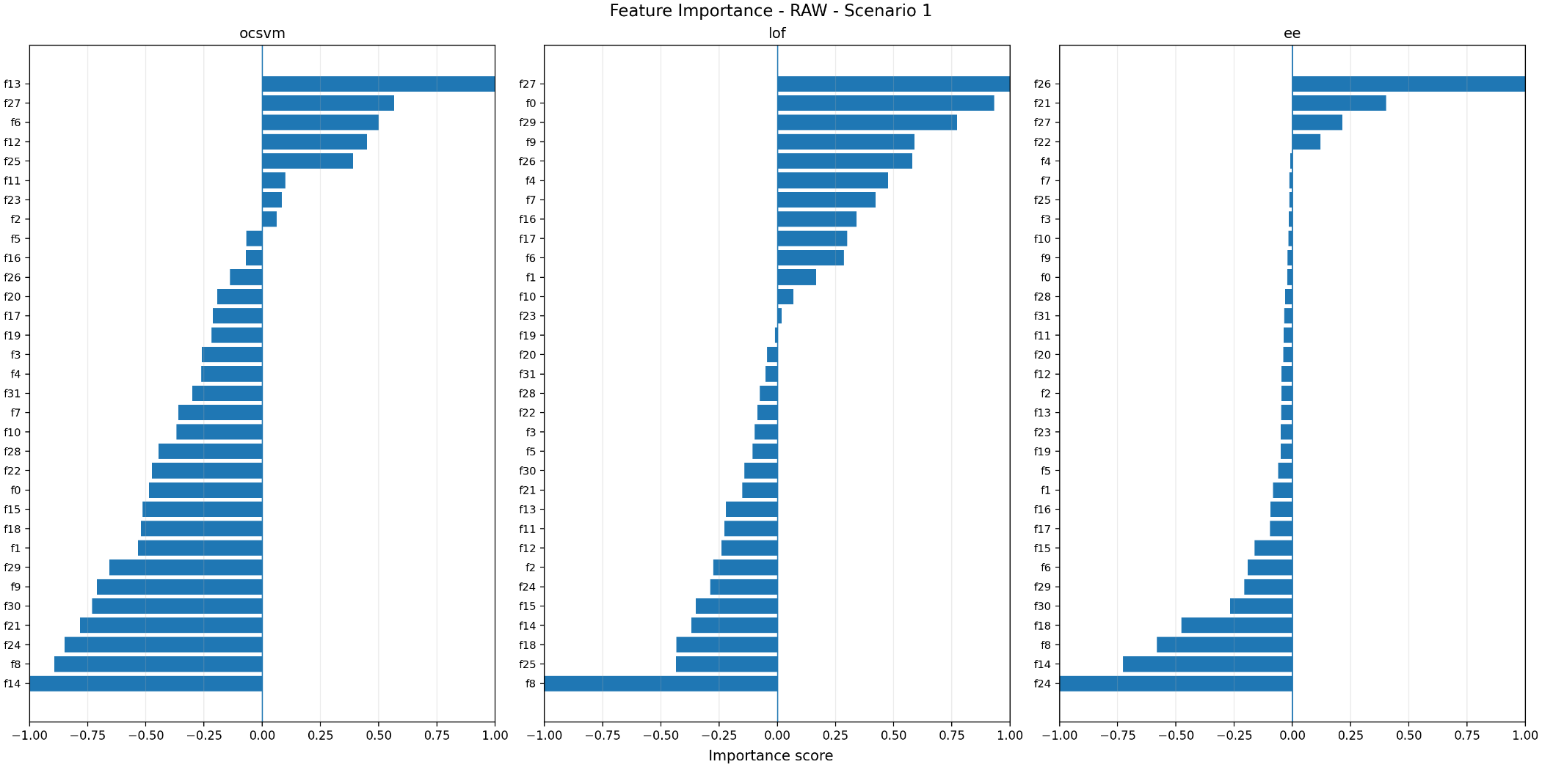
Results
Traditional ML Models
Feature Importance Scenario 1
Notes:
-one feature = one byte of the encoded output packet
-shows the most important features, measured with permutation importance
-negative values => feature hurts the performance

Slide 44
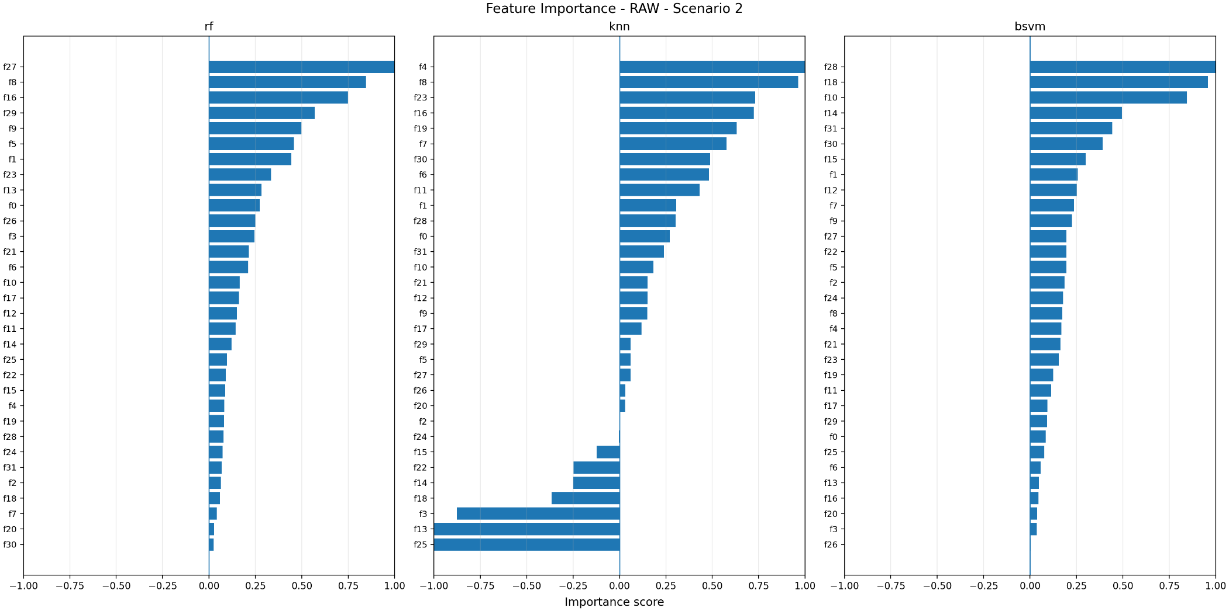
Results
Traditional ML Models
Feature Importance Scenario 2

Slide 45
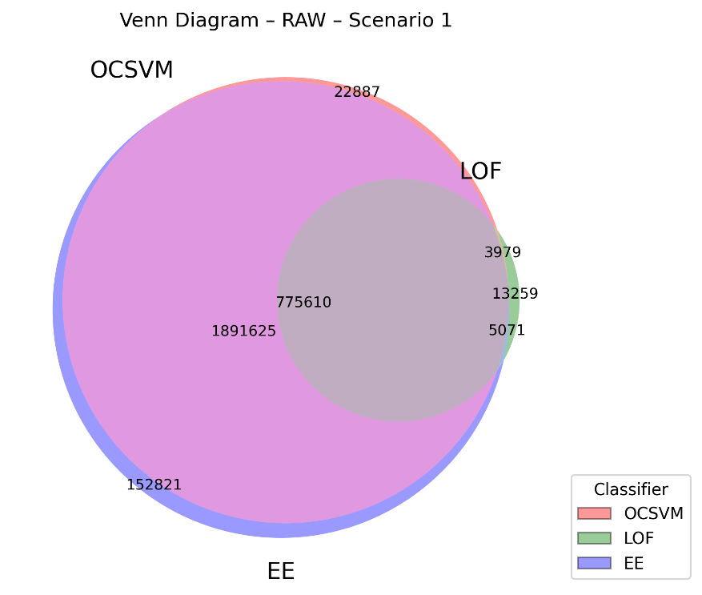
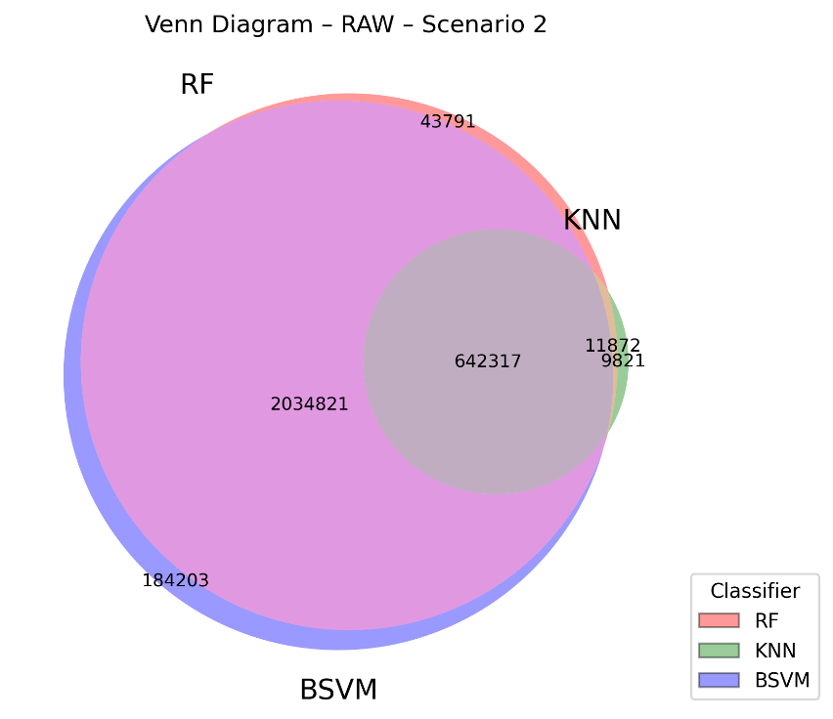
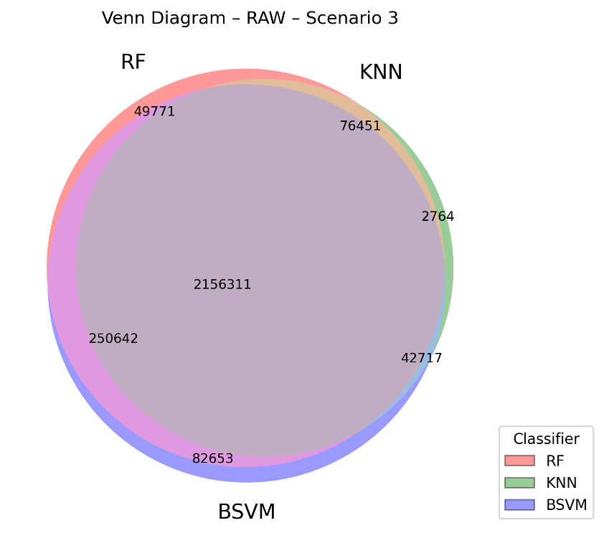
Results
Traditional ML Models
Error Overlaps (Raw)
Notes:
-s1: overlaps mostly for EE and LOF
-s2: overlaps mostly for RF and BSVM
-.S3: most errors happen for all the 3 classifiers

Slide 46
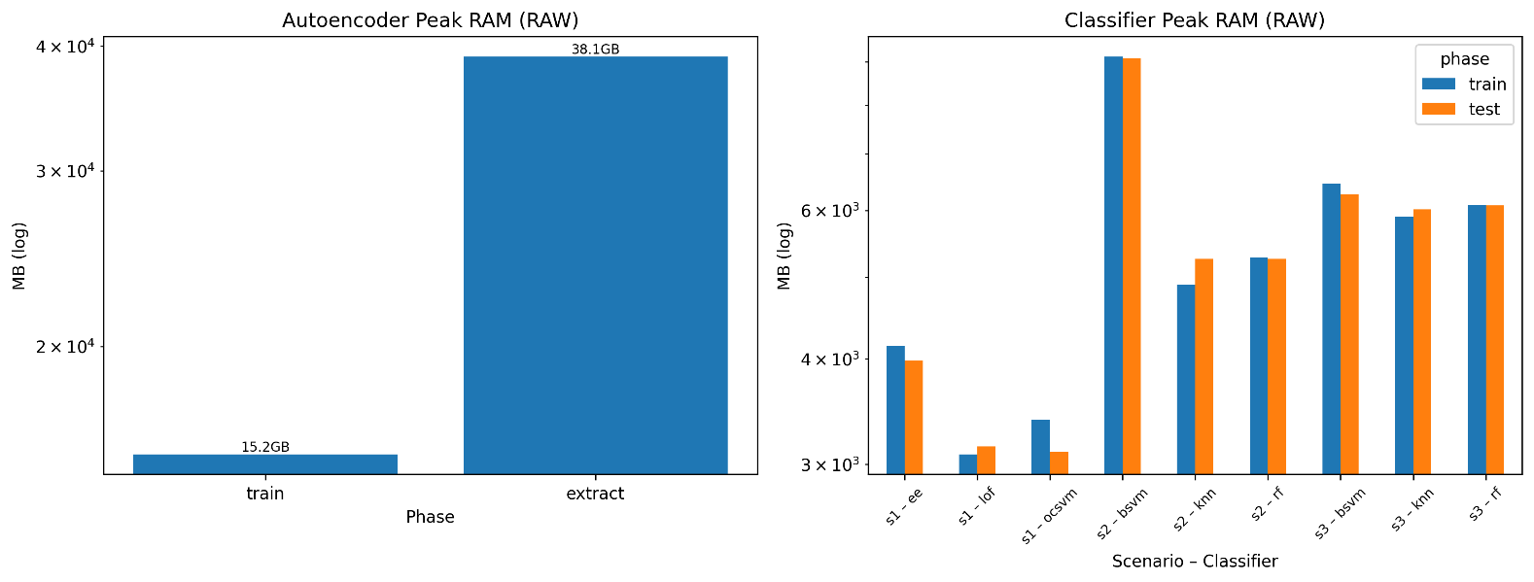
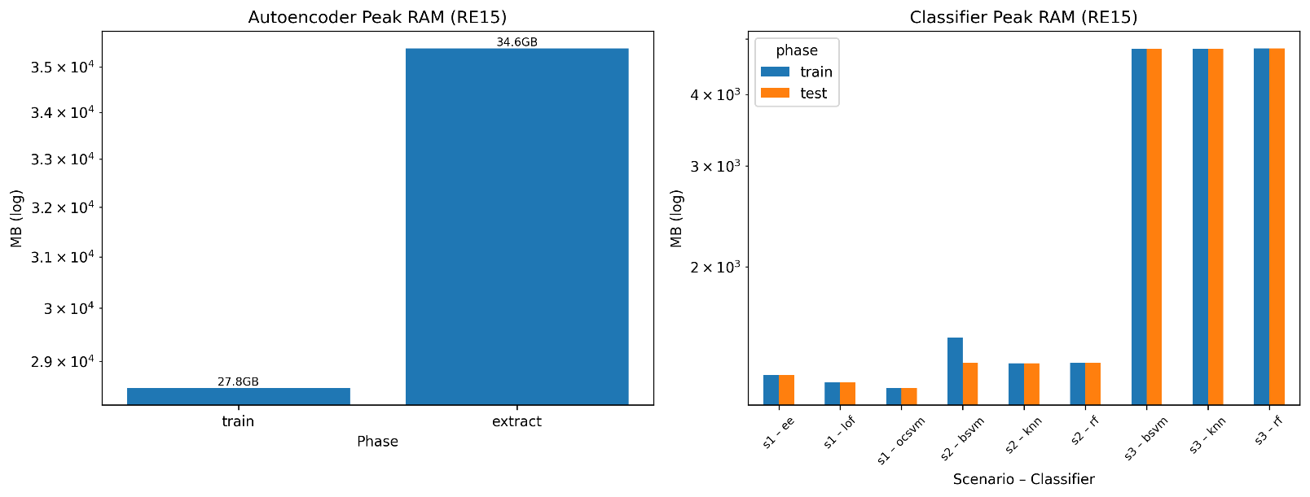
Results
Traditional ML Models
Memory Usage

Slide 47
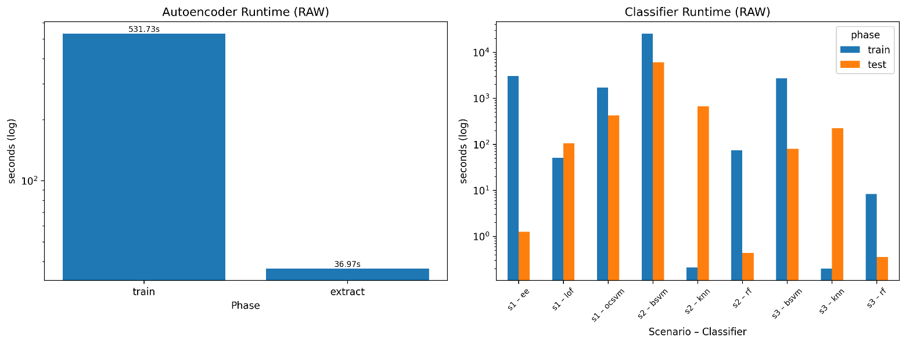
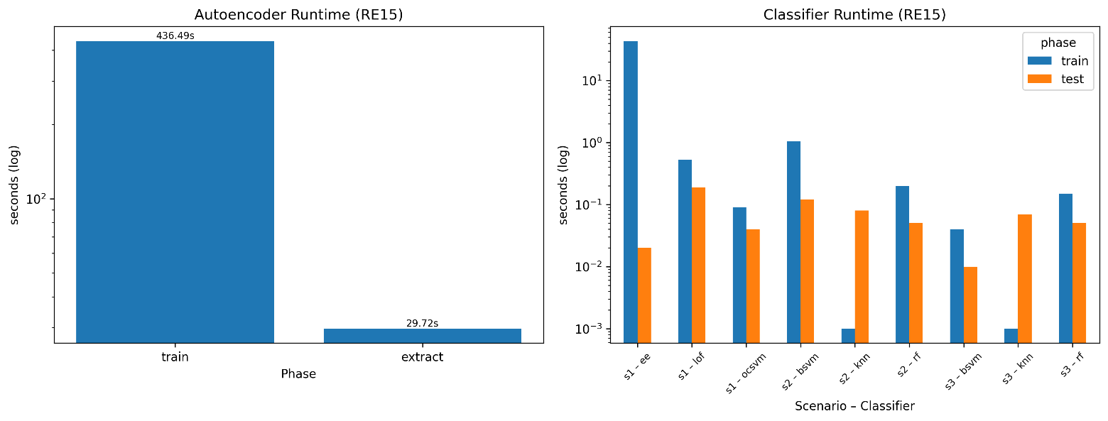
Results
Traditional ML Models
Runtime

Slide 48
Probabilities computation
Message Similarity
Message similarity: Between every message pair, we should compute # identical bytes divided by total number of bytes
This gives a matrix of similarity.
This similarity should be divided into:
- intrascore: within the same cluster how much of them are similar to each other.
- interscore: between different cluster how much of them are similar to each other.
We should define certain threshold t and compute the accuracy as Pm = 1 – (FMR + FNMR) / 2
FMR is False matching rate = (# interscores > threshold) / total inter score
In other words, it defines how many of the packets within different cluster are similar to each other.
(e.g. they are in the same cluster, but they are not similar to each other)
FNMR is False non matching rate = ( # intrascore < threshold ) / total intra score
In other words it defines how many of packets within different clusters are similar to each other.
(e.g. they are in different clusters, but they are similar to each other).
High pm -> good keyword, Low pm -> bad keyword.

Slide 49
Probabilities computation
Remote coupling
Remote coupling: This evaluate how well client clusters corresponds to server clusters
The process goes as follow:
1. We cluster client-to-server messages.
2. We cluster server-to-client messages.
3. then we pair messages by TCP session order.
Then for each client cluster:
N: number of client messages in this cluster
M: largest # of corresponding server messages that fall into same server cluster
Then we compute remote coupling:
Pr = M / N
So Pr evaluate what Is the probability that this cluster shows good cluster, because all client messages should have the same server response.
Then high Pr means good keyword candidate, because cliend request should determine server response.

Slide 50
Probabilities computation
Structure Coherence
3. Structure coherence:
- The main idea is that messages of the same type should have similar aligned structure.
The process is as follow:
- For each cluster
- re-align messages inside the cluster
- count the number of gaps per message
- compute Ps = 1 – (average gaps / aligned length)
High Ps means good keyword candidate.

Slide 51
Resnet Statistical features
We should have 5 features
Total number of bytes before padding or truncation
Most frequent byte
Second most frequent byte
Entropy
Length of padded data

