Slide 1



EJADA Summer Internship Program for 2023
Microsoft Dynamics CRM
Day (4)
Date: 12 July, 2023

Slide 2



Sales Cycle
CRM Overview

Slide 3
How Sales Cycle begins?
1- following a post(containing the website of the company) in social media.
2- Marketing Campaign (list of lead records imported into system in Bulk(excel sheet, Comma separated files).
3- Call Center Member made an activity with existing client(phone call, appointment, email,…).
4- Non existing client asks for services and products that organization present.
CRM Overview

Slide 4
Lead Creation
-Once the client express his interests about the products or services that company presents(Customer Needs), Call Center member(User) creates him as a lead(potential customer) in dynamics 365 system.
-If the client was contacted very well and there were interactions between the user and the client (it appears in time line of lead record) and he shows that he would to open an opportunity to buy the product or use the service , the user converts the lead to an opportunity by Qualifying it(press Qualify button), if the lead was company it converted to Account record but if it was an individual person the lead converted to a contact record.
-If the client was not interested, not contacted, shows that he would not open an opportunity . The user Disqualifying it(press Disqualify button) and choose the reason of Disqualifying { Lost, Cancelled, No Longer Interested, …).
CRM Overview

Slide 5
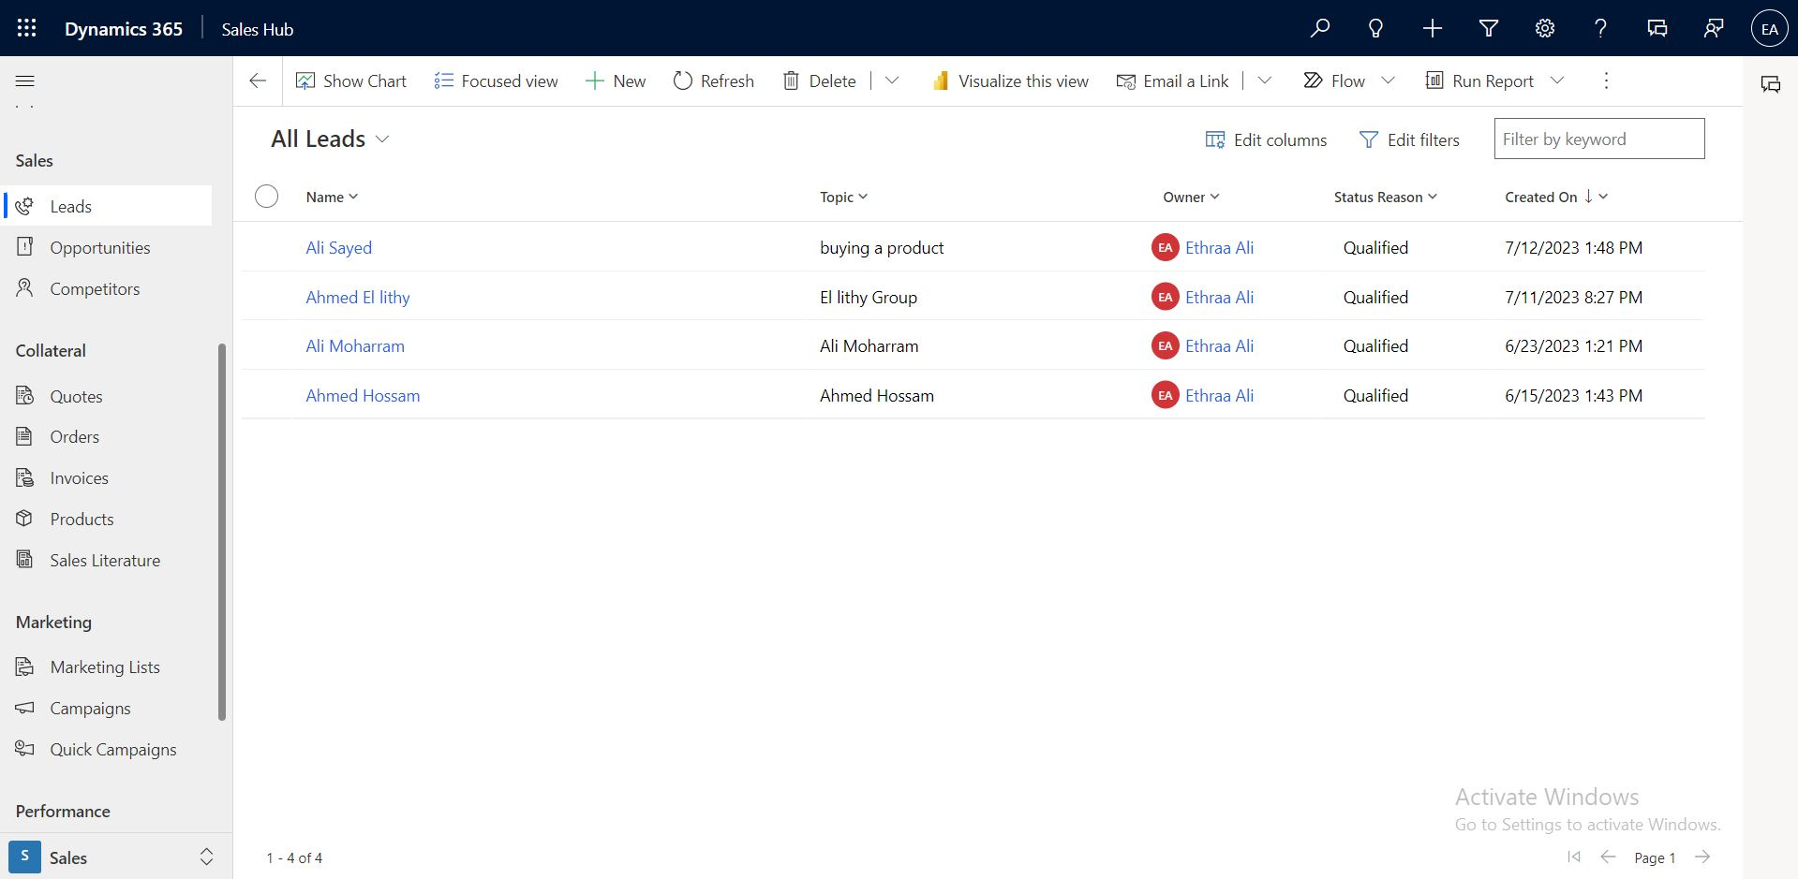
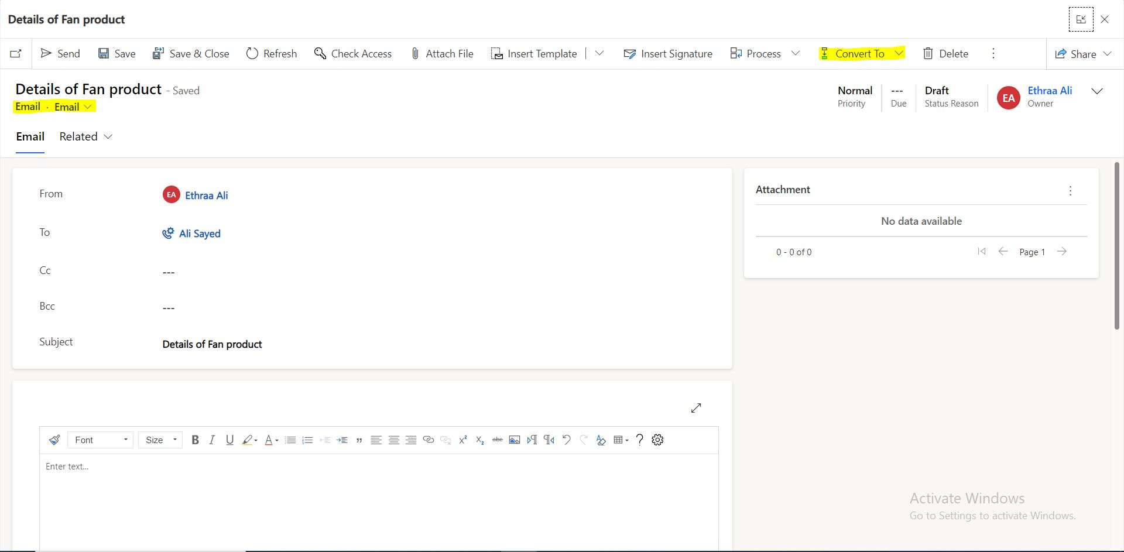
Ways to create a lead:
1-Convert an activity(email) to a lead.
2-Manually from site map (on premise or on cloud ) press New button.
CRM Overview

Slide 6
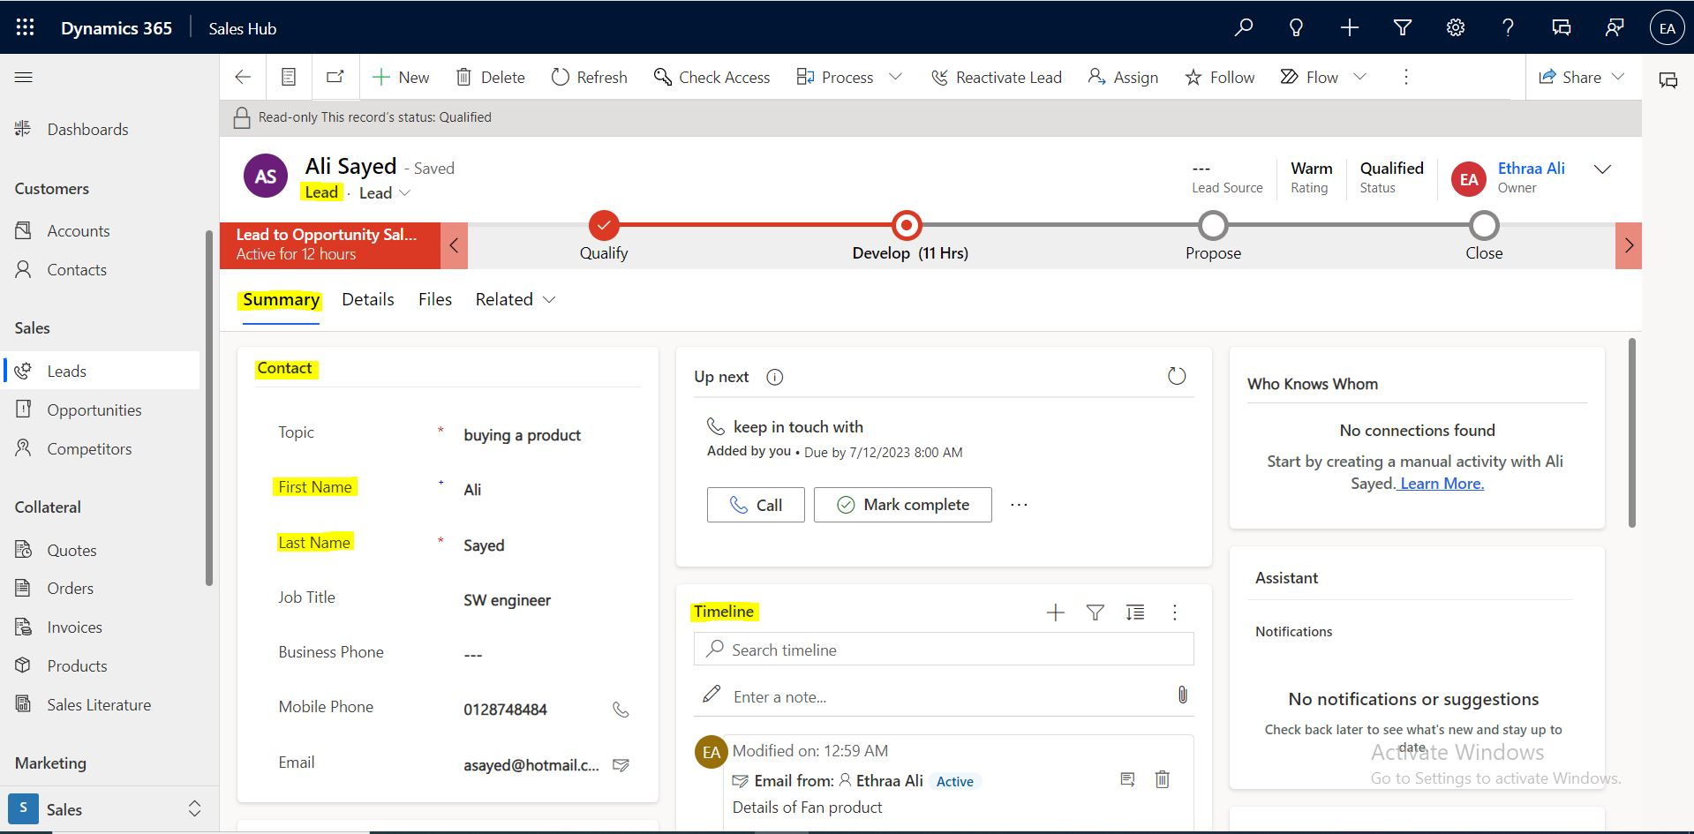
Lead record contains:
-info about the client.
-time line sub grid(interactions between user and client on opportunity record).
-stakeholder, competitors sub grid.
-additional info.
CRM Overview

Slide 7
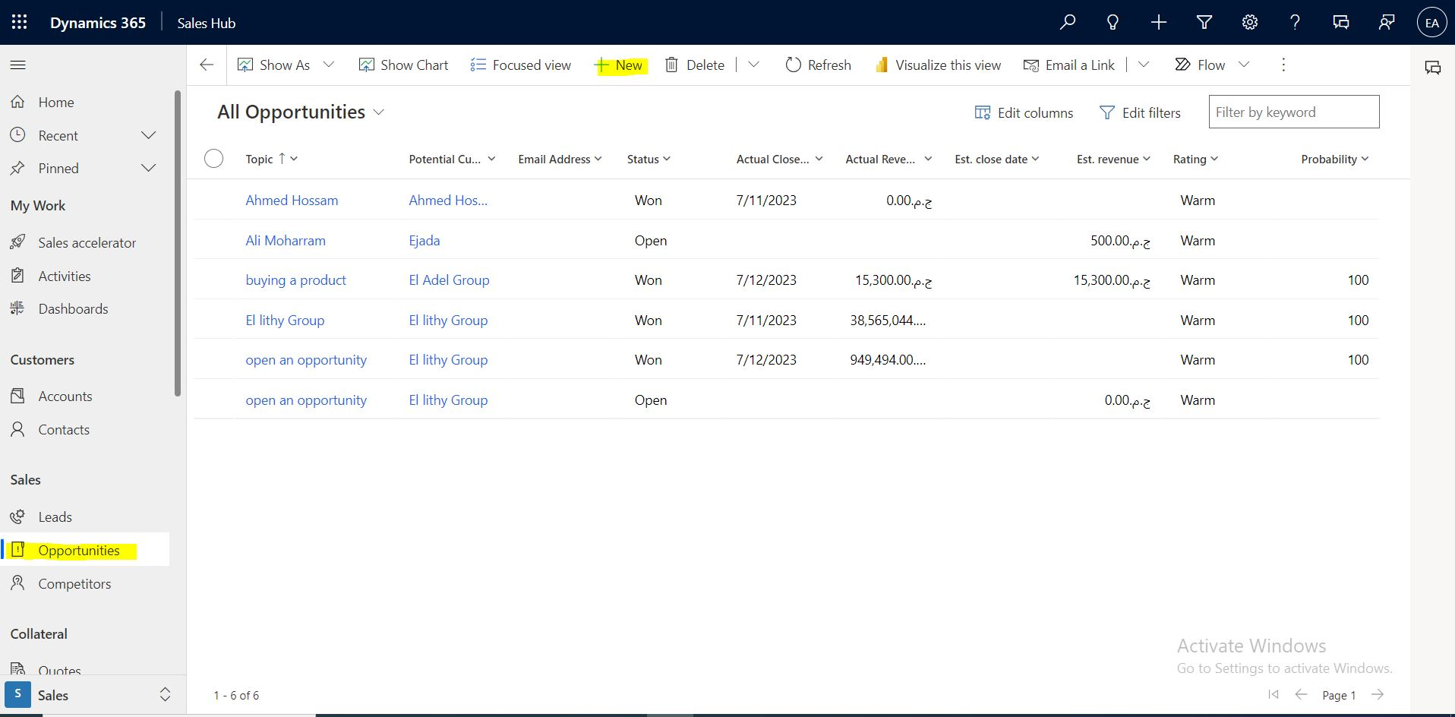
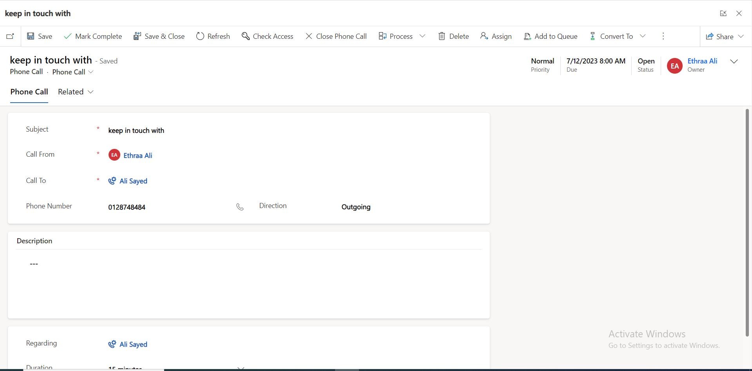
Ways to create an Opportunity:
1-Convert an activity(Task, Phone Call, appointment) to an opportunity.
2-Manually from site map (on premise or on cloud ) press New button.
3-convert Lead to Opportunity by Qualifying the lead(press Qualify button).
CRM Overview

Slide 8
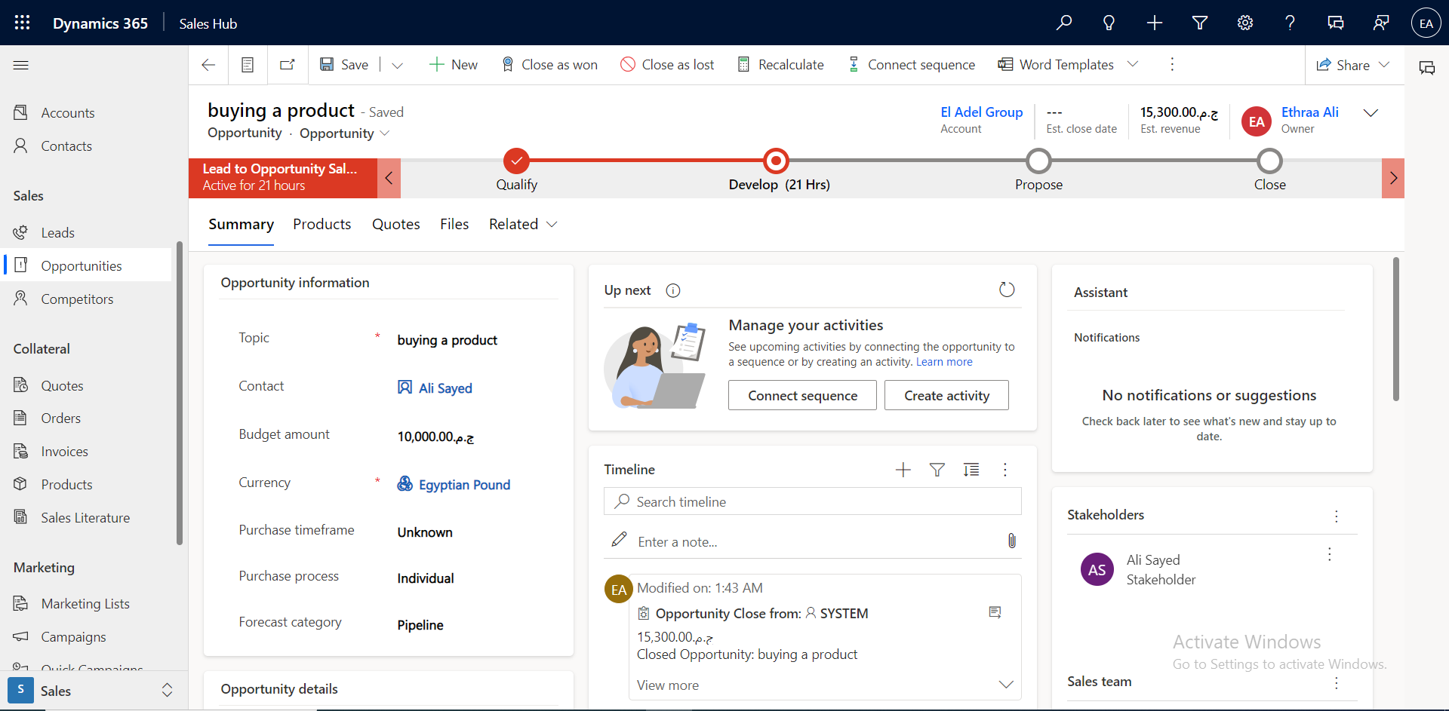
opportunity record contains:
-info has been mapped from lead to opportunity.
-time line sub grid(interactions between user and client on opportunity record).
-stakeholder, competitors sub grid.
-additional info.
- Products ,Quotes Taps.
CRM Overview

Slide 9
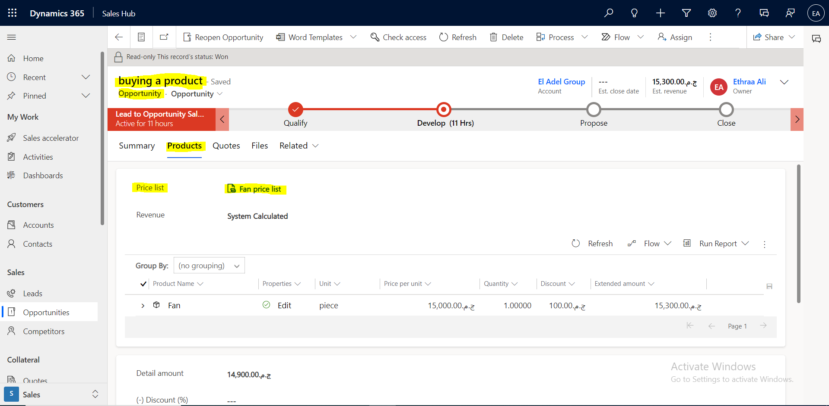
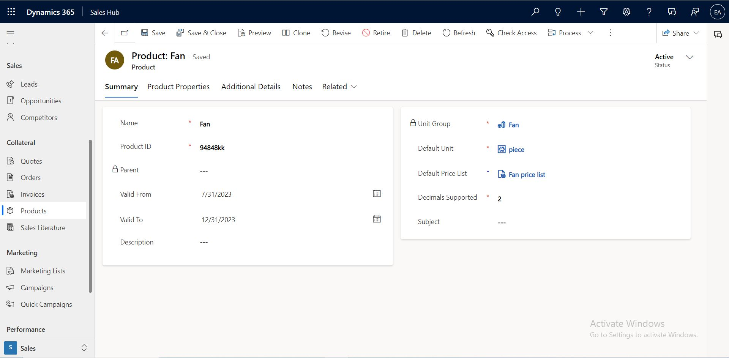
Products Section Contains:
1-Price list : set of prices that are charged for products under circumstances.
a -Price list divided into 3 types shows in (Quantity selling option field):
-Retail
-Whole sale
-Distributer
b- price list can be created from Opportunity as new , or from product.
C- Price list record contains “Discount list” : which lets organization offer products at different prices depending on the quantity.
CRM Overview

Slide 10
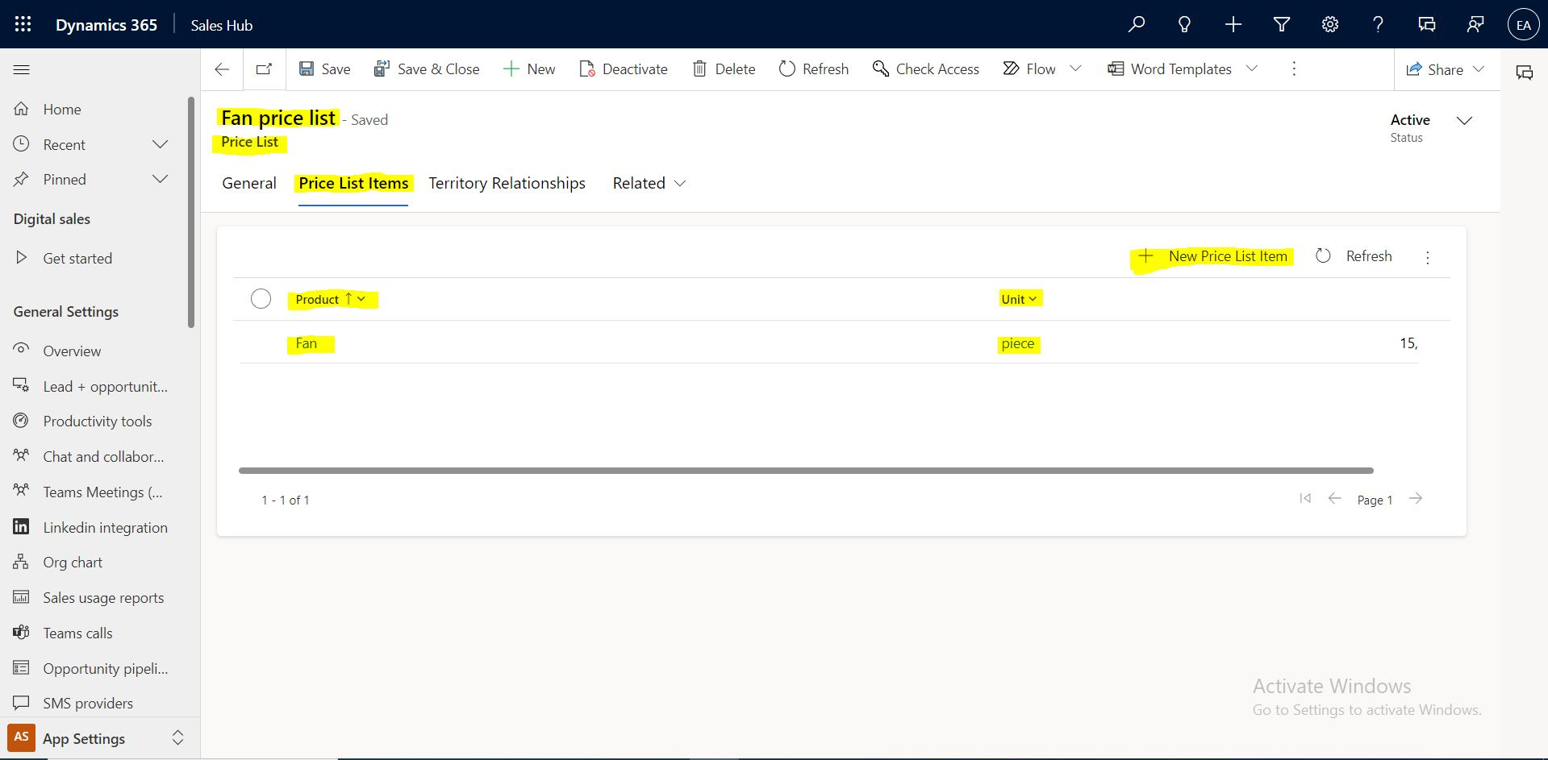
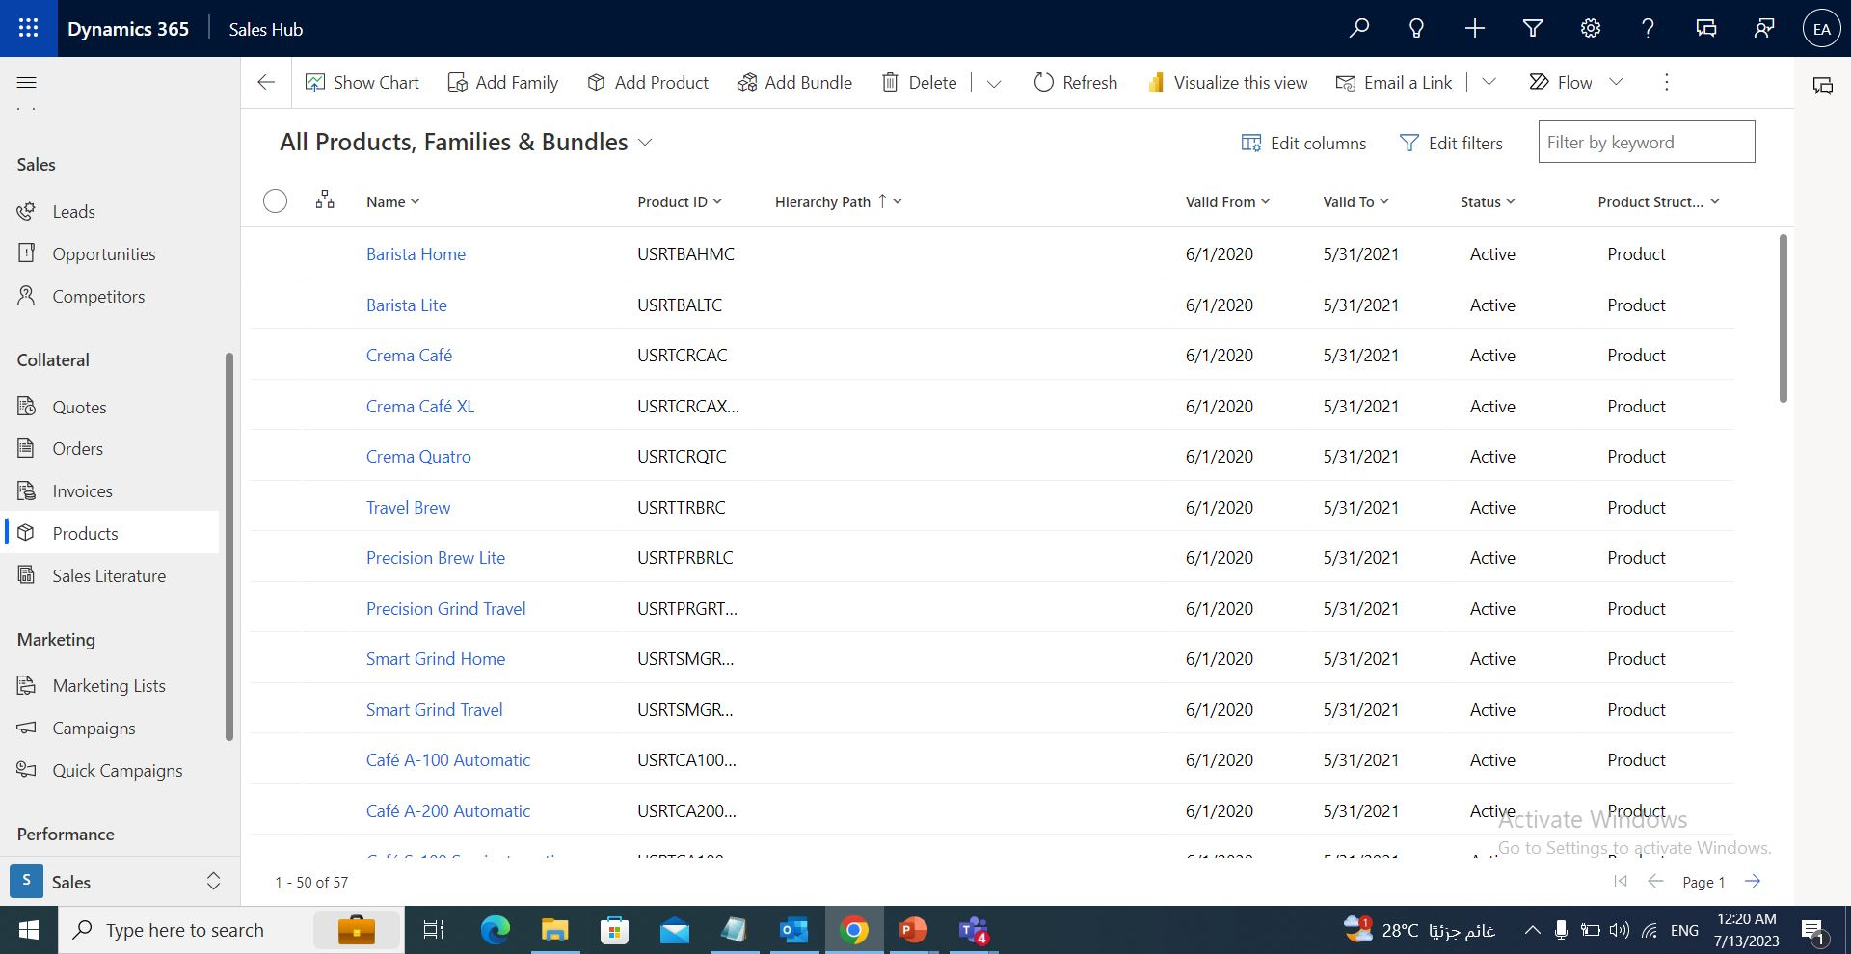
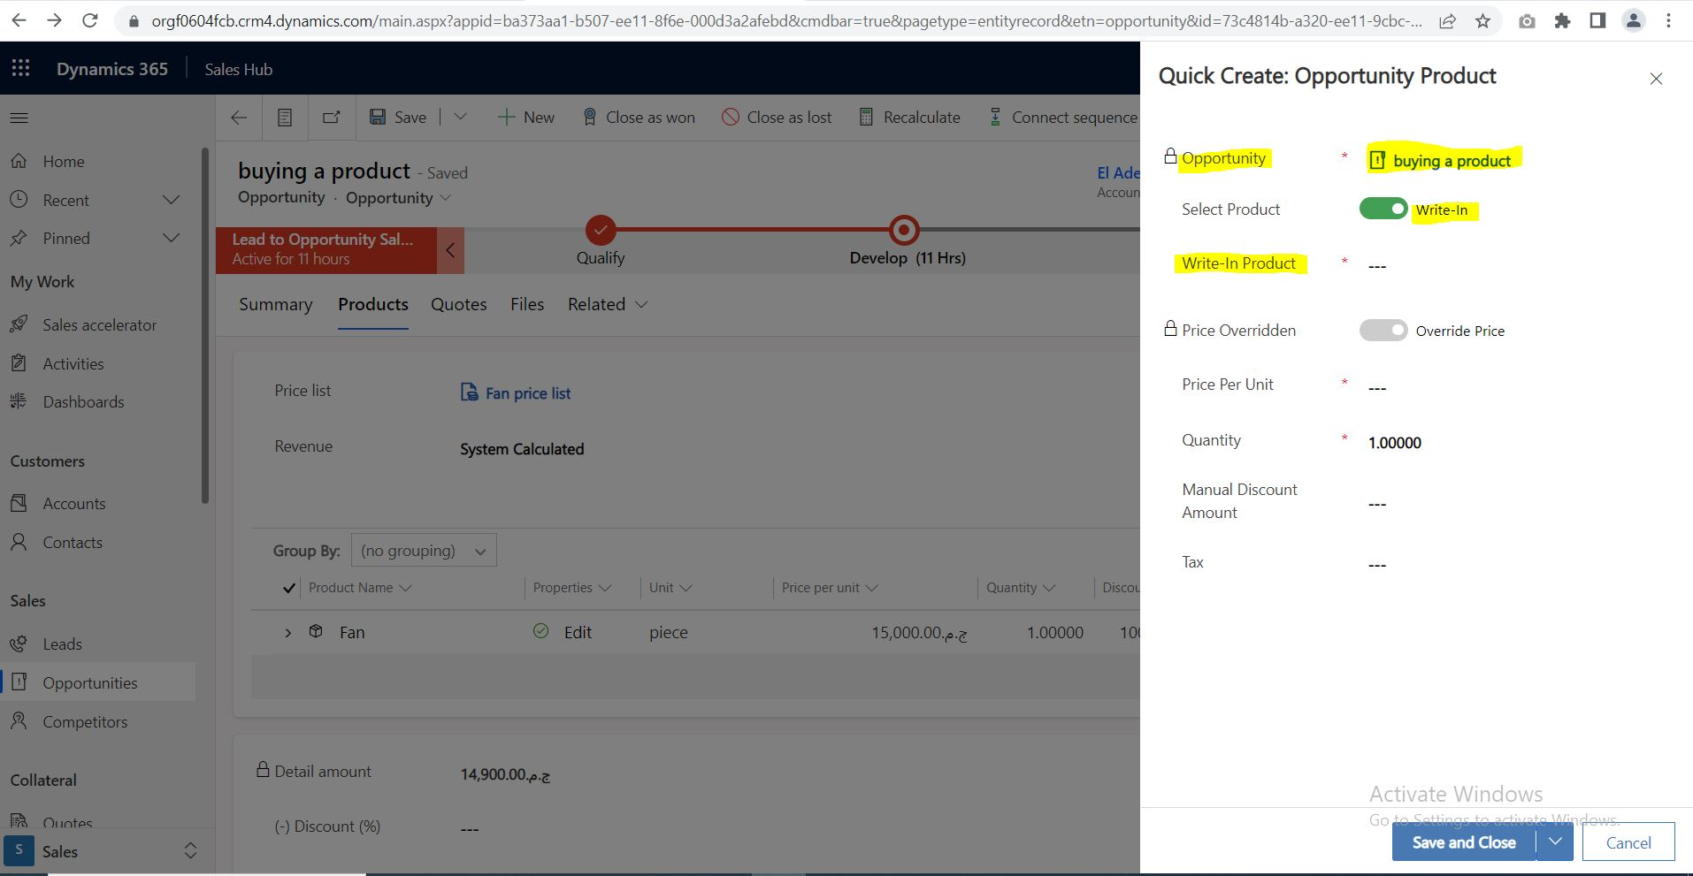
2-product :
a- product divided into 2 types:
- Existing Product: products included in the product catalog.
-Write in Product : products not included in the product catalog.
b- Products can be :
-Individual product.
-bundle product(2 products as package).
-Family product(parent and child product , the child product can be individual product or bundle or Family Product).
c- product can be created from price list(from opportunity) or from site map or from opportunity as (write in product).
CRM Overview

Slide 11
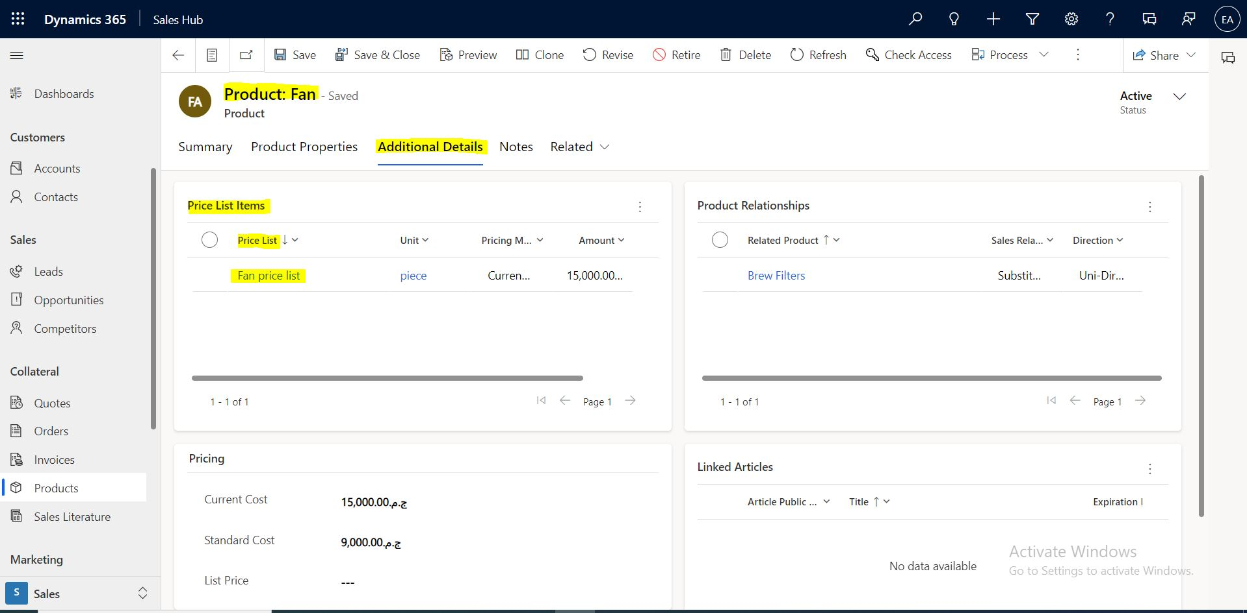
Product record Contains:
-Unit Group: defines how the product is purchased or it is the measure.
-Default Unit: unit is a single unit of measure, and multiple units can be grouped into unit groups.
-Default Price list: created inside the product record then add this product to this price list.
-Additional Info
CRM Overview

Slide 12
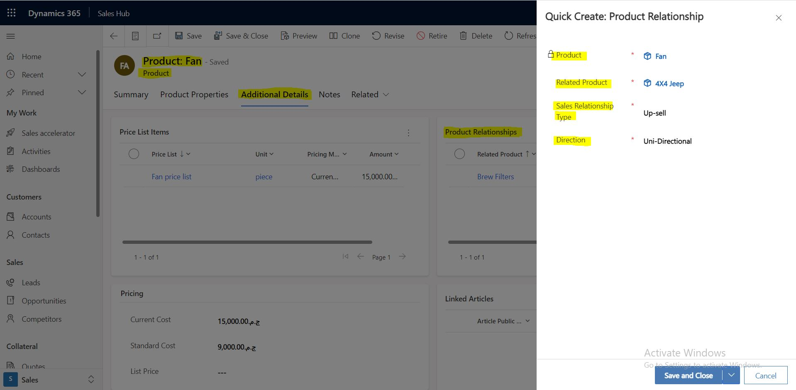
Ways to Bundle Product:
1-through the product record ,open “Additional Details” Tap the Quick Create from “Product Relationships”.
2-from site map choose “Product” then press “ADD Bundle” button.
CRM Overview

Slide 13
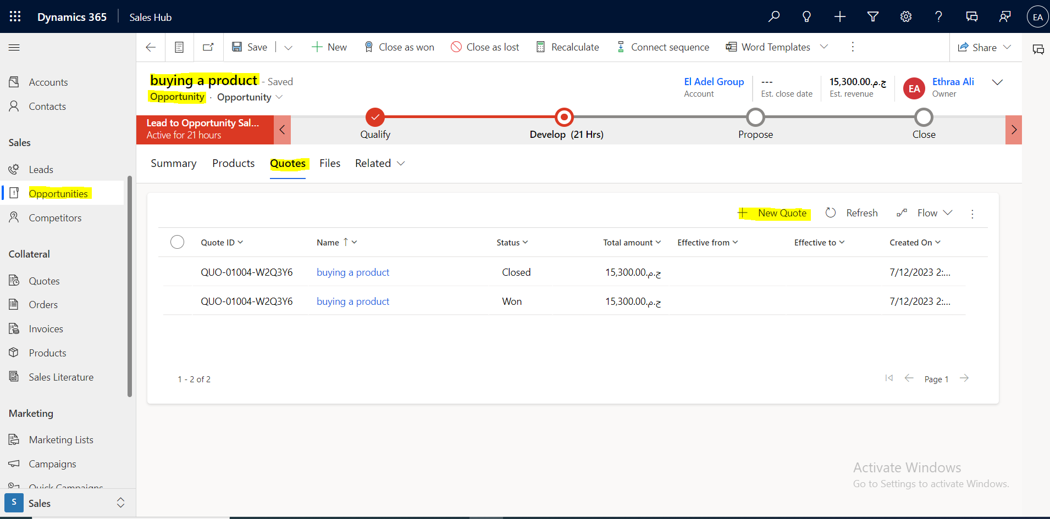
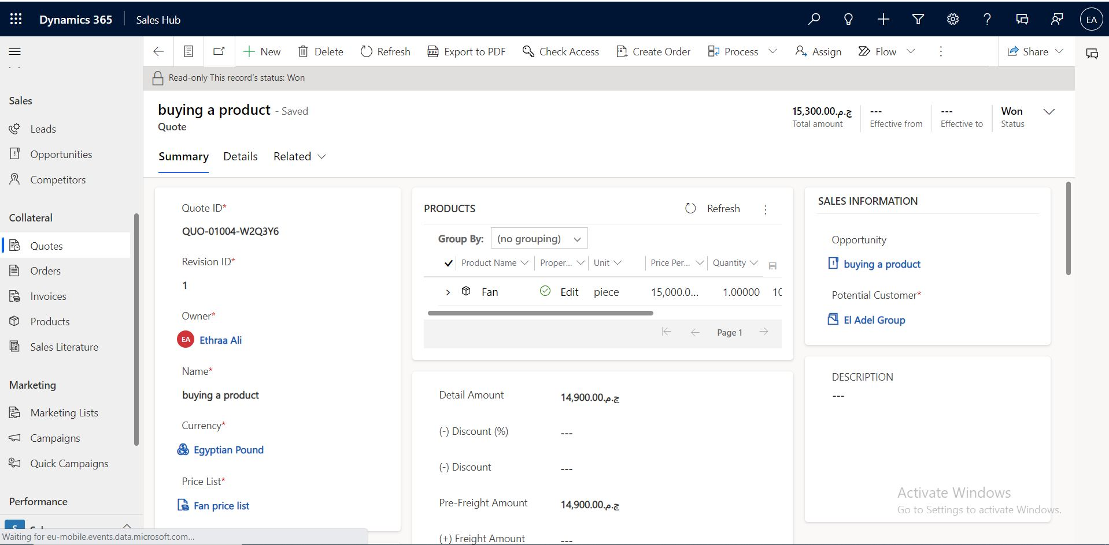
Create a Quote:
-after adding info about price list and product in products section , go to quotes section to create a quote :
1-Quote: Formal offer for products or services proposed at specific prices.
-when Quote is accepted from the Client , press (Activate Quote button) to be activated.
-when Quote needs to be edited ,press (Revise button) with status “Draft” and field “Revision Id” Updated as new copy of the previous quote.
CRM Overview

Slide 14
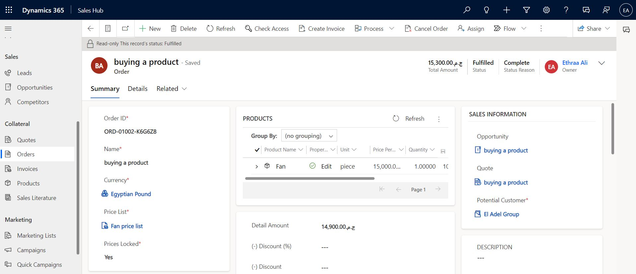
Create Order:
-Order: Confirmed request of delivery goods and services based on specific terms or a quote that has been accepted by a customer.
-from Quote record press button (create order).
-complete additional info then press (fulfill button) to show that order will be delivered partially or completely.
CRM Overview

Slide 15
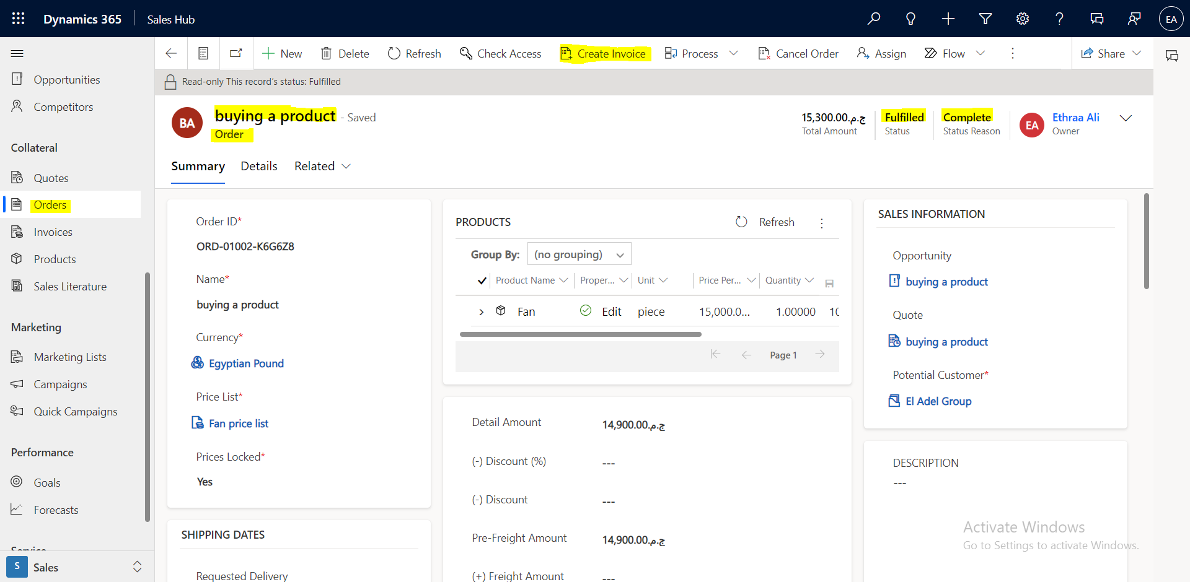
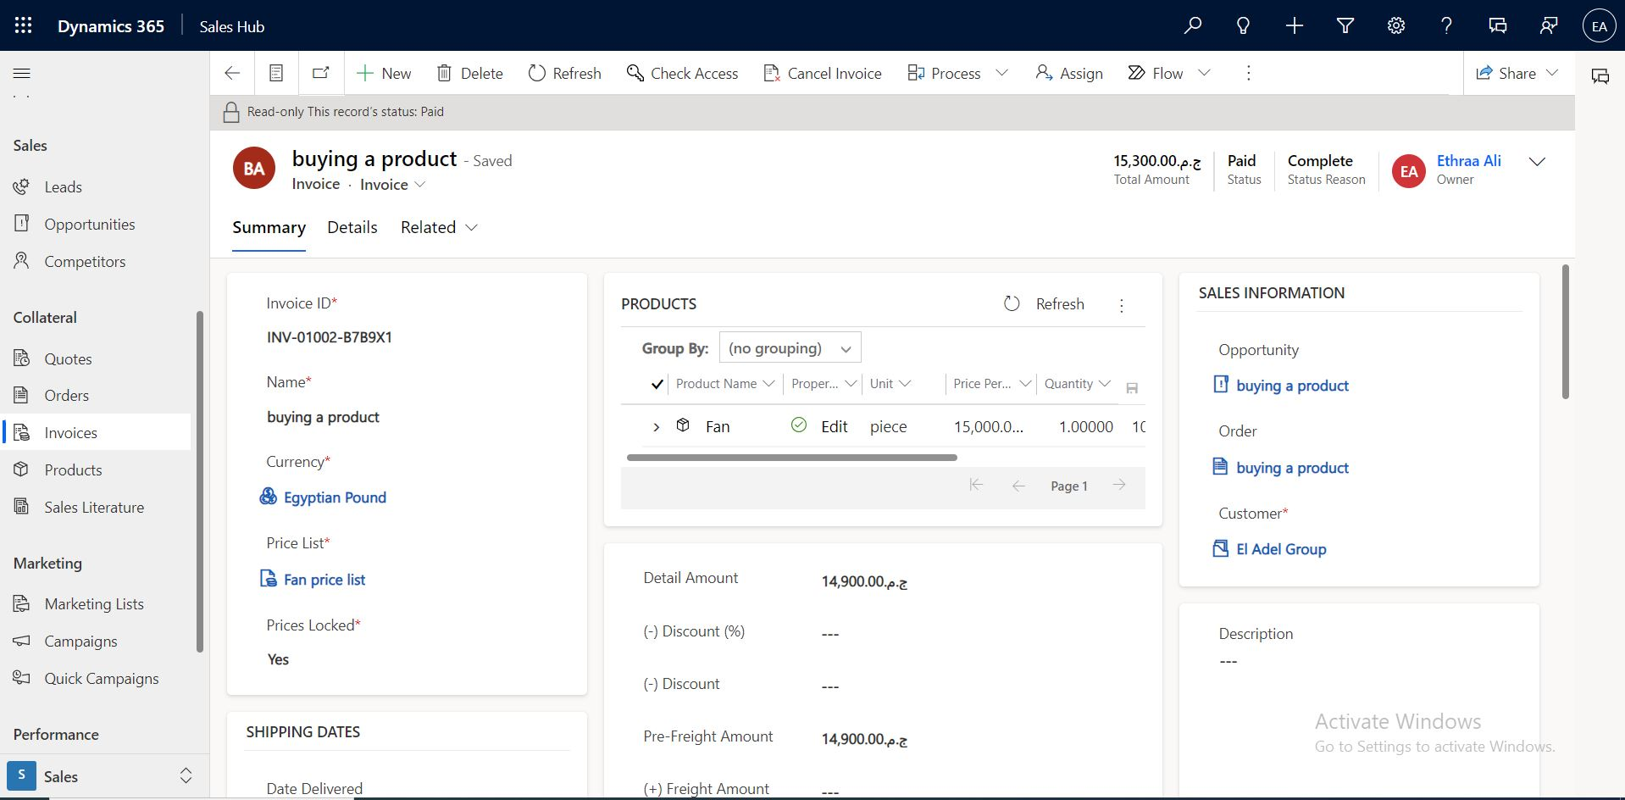
Create Invoice:
-Invoice: record of sales including details about products or services purchased that has been billed to the Customer.
-from order record press (create invoice) button.
-complete additional info then press (paid invoice) to show that invoice will be paid partially or completely.
CRM Overview

Slide 16
Thank You

