Slide 1
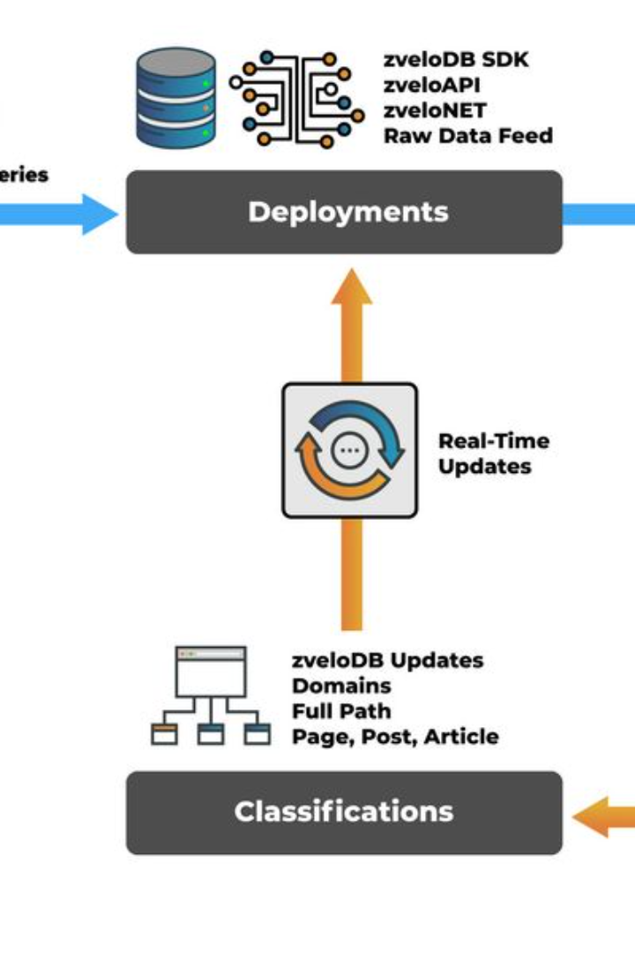

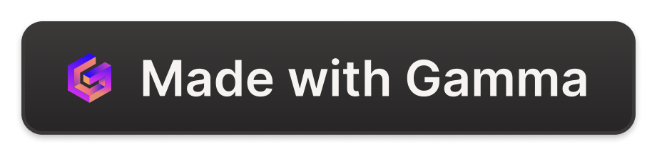
Introduction to Web Categorization
A web categorizer organizes web information into a hierarchical structure, creating spaces, categories, and subcategories. It provides a systematic approach to managing and accessing diverse online content.
by Khaled Abdelbar

Slide 2
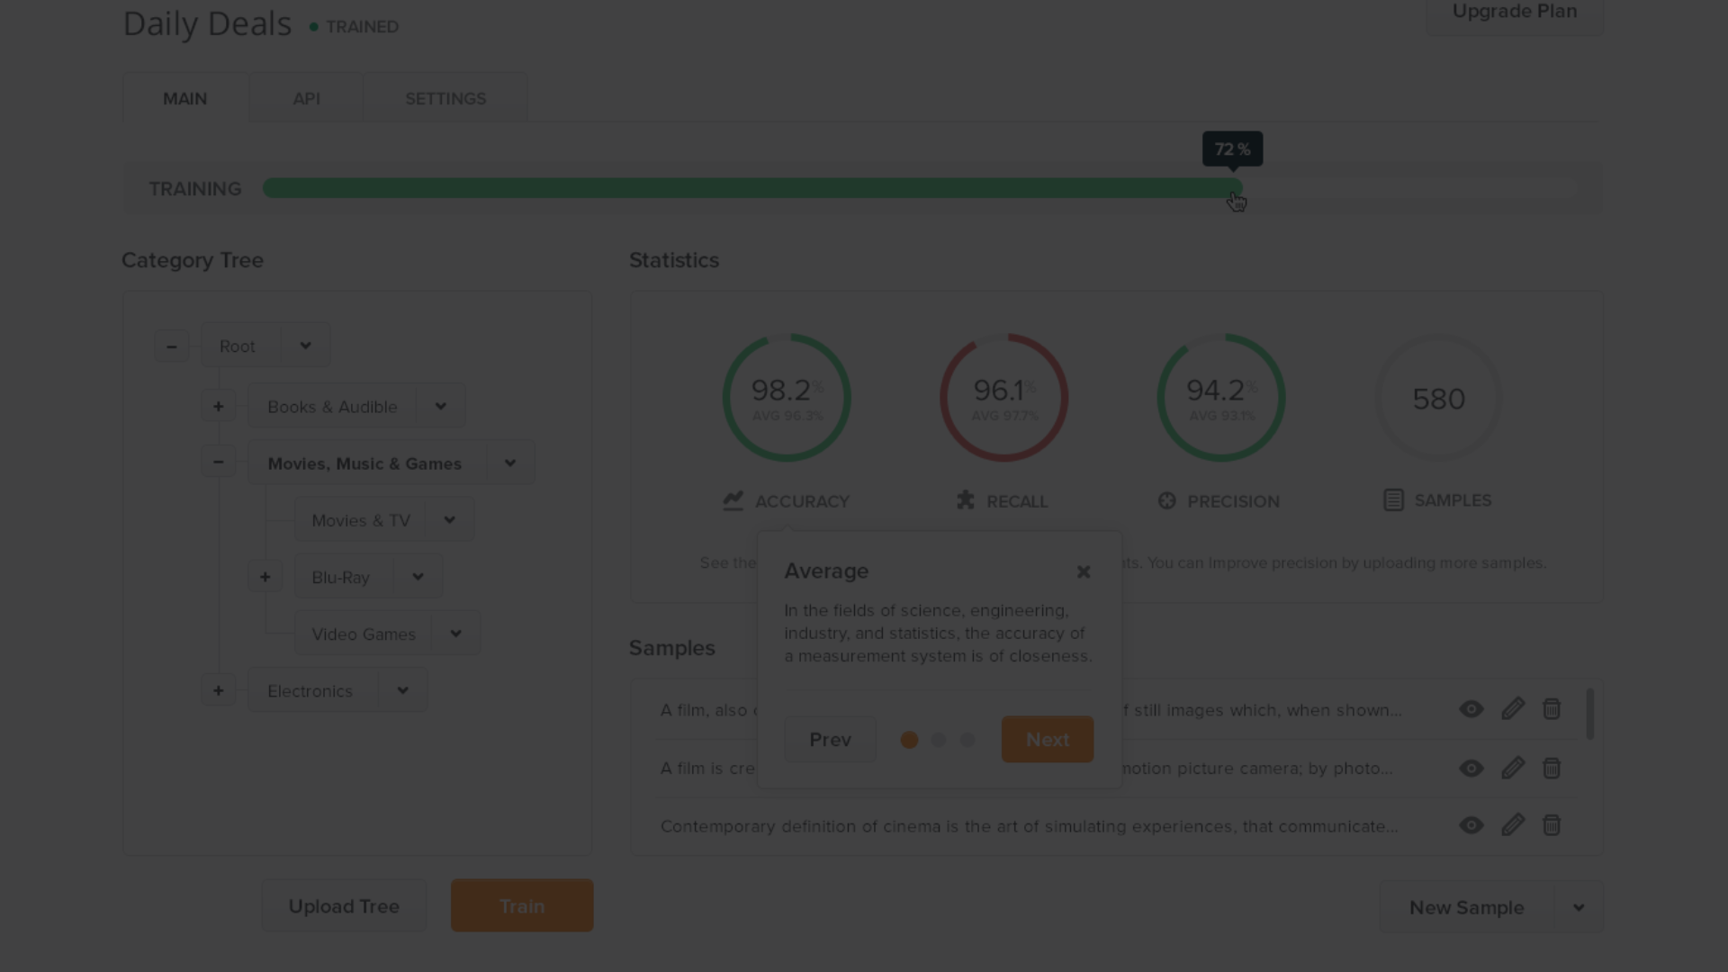



How does a Web Categorizer Work?
Data Collection
Categorization Algorithm
Hierarchical Organization
Gathers information from various sources.
Uses algorithms to classify content into categories.
Structures data into spaces, categories, and subcategories.

Slide 3
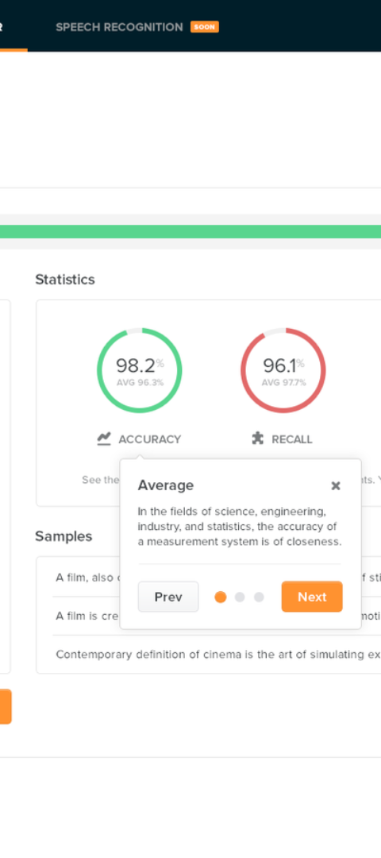
Benefits of Using a Web Categorizer
1
Efficient Information Retrieval
2
Enhanced User Experience
Enables quick and accurate access to relevant content.
Improves navigation and content discovery for users.
3
Structured Knowledge Organization
Helps in creating a systematic and organized information repository.

Slide 4



Examples of Popular Web Categorizers
Google
Yahoo Directory
DMOZ Open Directory Project
Utilizes advanced algorithms for web indexing.
Organizes websites into various categories and subcategories.
Community-curated directory of the web.

Slide 5
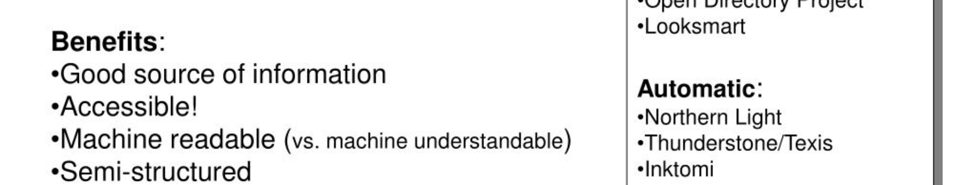
Challenges in Web Categorization
Noisy Data
Scalability
Multilingual Content
Dealing with irrelevant or inconsistent information.
Managing large volumes of rapidly changing web content.
Handling web information in different languages effectively.

Slide 6
Best Practices for Web Categorization
Data Quality Management
Continuous Evaluation
Ensuring accuracy, consistency, and relevance of data.
Regularly assessing and refining categorization algorithms.
Usability Testing
Metadata Utilization
Evaluating the user-friendliness of category structures.
Effectively utilizing metadata for precise categorization.

Slide 7

Future of Web Categorization
1
AI Integration
Advanced AI for automatic content categorization.
2
Enhanced Personalization
Customized categorization based on user preferences.
3
Improved Semantic Search
Utilizing semantics to enhance web content retrieval.

Slide 8
Conclusion and Key Takeaways
1
Crucial Organizational Tool
2
Continual Evolution
3
User-Centric Approach
The field of web categorization is continually evolving with technological advancements.
Focusing on improving user experience and content accessibility.
Web categorization plays a vital role in information management.

