Slide 1
AI-driven, flight-proven threat scenarios for air defense
CHESS — OPUS AEROSPACE · CAID 2026
Each suborbital flight calibrates the tool; an adaptive onboard AI flies the threat.
[Presenter] · [Date] · [Classification marking]
Notes:
Title says the whole story: scenarios are AI-driven AND flight-proven. One sentence of context: Opus Aerospace builds and flies suborbital vehicles; CHESS is the software loop built around those flights.

Slide 2
Why “CHESS” — decisions against the clock
The name is not about playing games: deciding under time pressure, from validated moves only
 | In chess | In CHESS
Calibration | Engine tuned on real games | The tool is calibrated on every flight
Preparation | Opening book before the game | Mission decision tree uplinked before the flight
Decision | Best move from the position | Onboard AI selects the next branch from sensor data
Clock | Each move played in time | Bounded compute (WCET)
One difference: CHESS only plays moves that were validated on the ground.
Queen
King
Pawn
Every threat in a CHESS salvo plays a piece’s role — the doctrine comes in part 1.
CHESS · Introduction
Notes:
One minute only on the name. Orally: chess AI went from hand-written rules (Deep Blue) to self-play (AlphaZero) — but every engine still decides against the clock, and that is the point: search, evaluation, time. The banner line is the trust message of the whole talk — say it slowly; it answers the qualification question before anyone asks it.

Slide 3
Agenda
Four questions, one learning loop
Use cases
1
What do today's synthetic threats miss, and what does air defense need?
Technical approach
2
What runs today, and how does each flight calibrate the tool?
On-board AI
3
How does the threat adapt in flight while staying bounded?
Maturity & evaluation
4
Where do we stand, and how will results be measured?
CHESS · Introduction
Notes:
Point 4 is new versus a classic pitch: we will state plainly what exists, what is in development, and how success will be measured.

Slide 4
Limits of synthetic threats
Today's threats rest on models, not flights
 | Synthetic threats today | Flight-proven threats (CHESS)
Trajectory | Modelled from assumed aerodynamics and propulsion | 6-DOF reconstruction of real flights, ground and onboard sensors
Signatures | RCS and IR predicted, rarely validated | Measured on a jet-like threat profile
Uncertainty | Error bars unknown | Dispersion statistics, quantified residual error
Behaviour | Scripted, cannot react | Onboard AI adapts in flight, within a validated decision tree
This is the gap CHESS is built to close: threat scenarios whose physics carry known error bars.
CHESS · 1. Use cases
Notes:
The operational pain: scenario realism is asserted, not measured. CHESS replaces assumptions with measured data and quantified uncertainty.

Slide 5
Value for air defense
Every scenario is anchored in measured flight data, not assumptions
C2 evaluation bench
Operator training
GBAD planning
Assess C2 chains against raids whose trajectories and signatures were measured.
Train crews on threat behaviour that has actually flown, including in-flight adaptation.
Plan ground-based air defense on doctrinal and achievable scenarios.
A live exercise: months of preparation for a single pass. In CHESS: a scenario replays in minutes, without engaging any real asset.
Your operational needs feed directly into the definition of the next flight.
CHESS · 1. Use cases
Notes:
Three user groups, one promise: measured realism. The cost line anchors the Defense interest required by the CAID brief.

Slide 6



The CHESS doctrine — every threat plays a role
The salvo is a plan, not a script
King — the real threat
Queen — the premium decoy
Pawns — saturation
The real trajectory, complete. The one that must be detected early enough to engage.
Replays the King's flight, rotated — a larger signature, built to steal the track.
Own physics, short burn, launched in numbers — to drown the King in noise.
The salvo plays against the operator: a composition designed to exploit the weaknesses of the defense layout. Crews train against an adversary — not against a script.
CHESS · 1. Use cases
Notes:
Saturation raids are the defining problem of current air defense. The Pawns are exactly that — and the doctrine makes every exercise adversarial by construction.

Slide 7
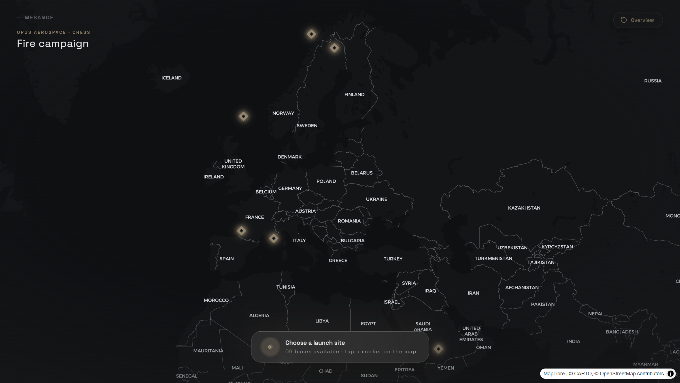
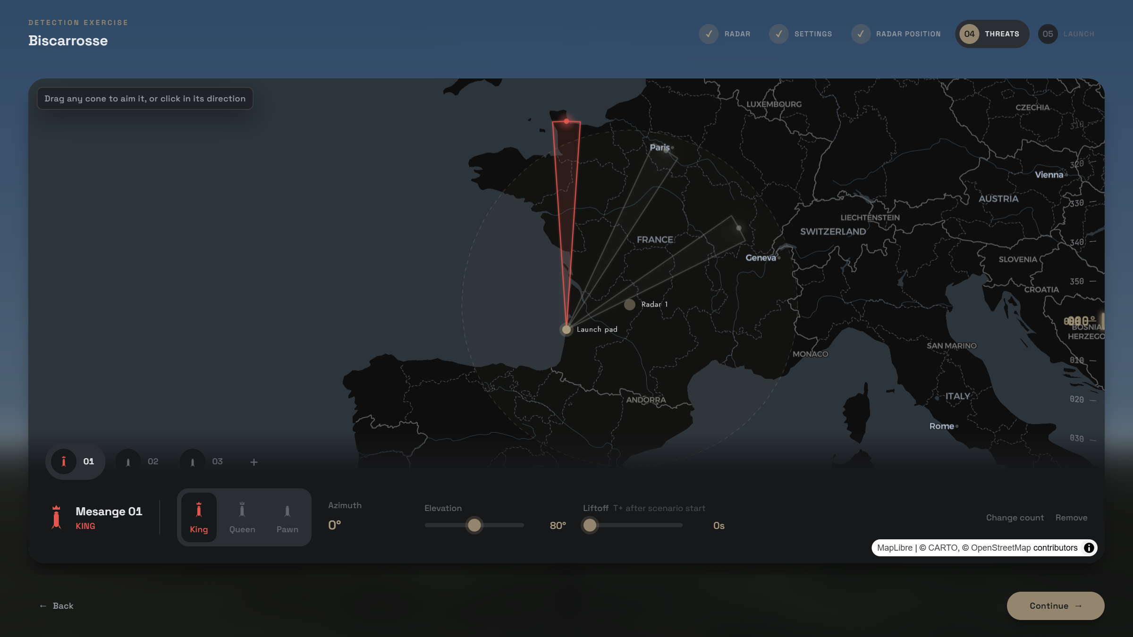
What runs today — the simulator
A complete exercise flow, operational now
Launch-site selection. Six real European bases — site weather and elevation feed the simulation.
Salvo composition. 1-5 threats, azimuth and elevation per threat, roles assigned by the doctrine.
Running today: the physics simulation core and the full exercise flow. The AI layers are being built on top of it.
CHESS · 2. Technical approach
Notes:
Honesty first: what the audience sees here runs today. Make clear the AI layers come on top of this working core.

Slide 8
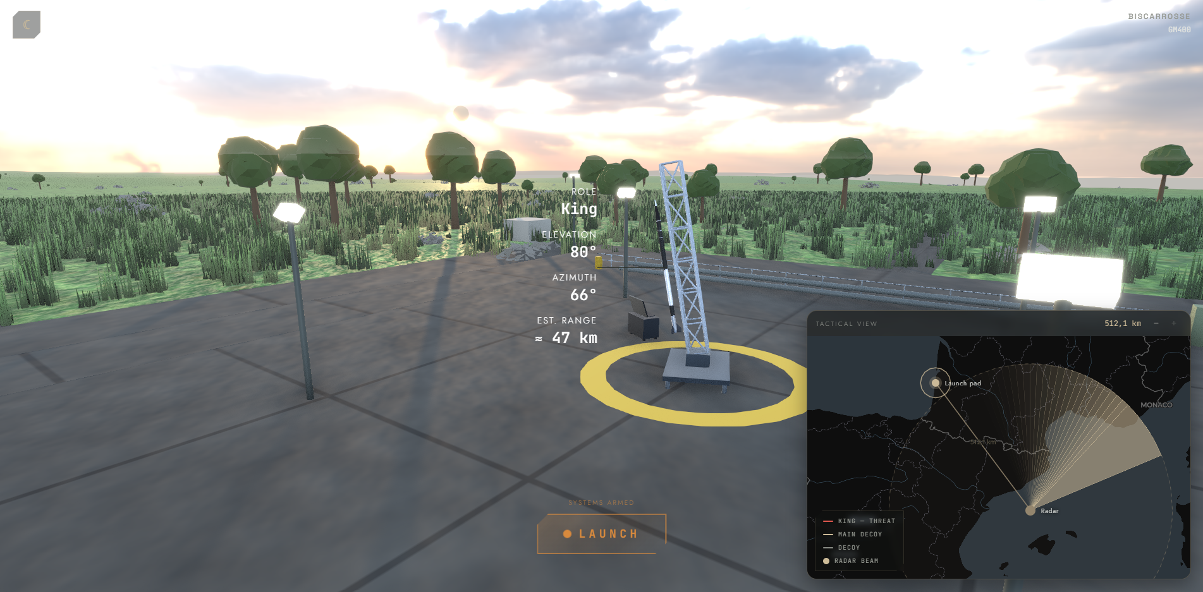
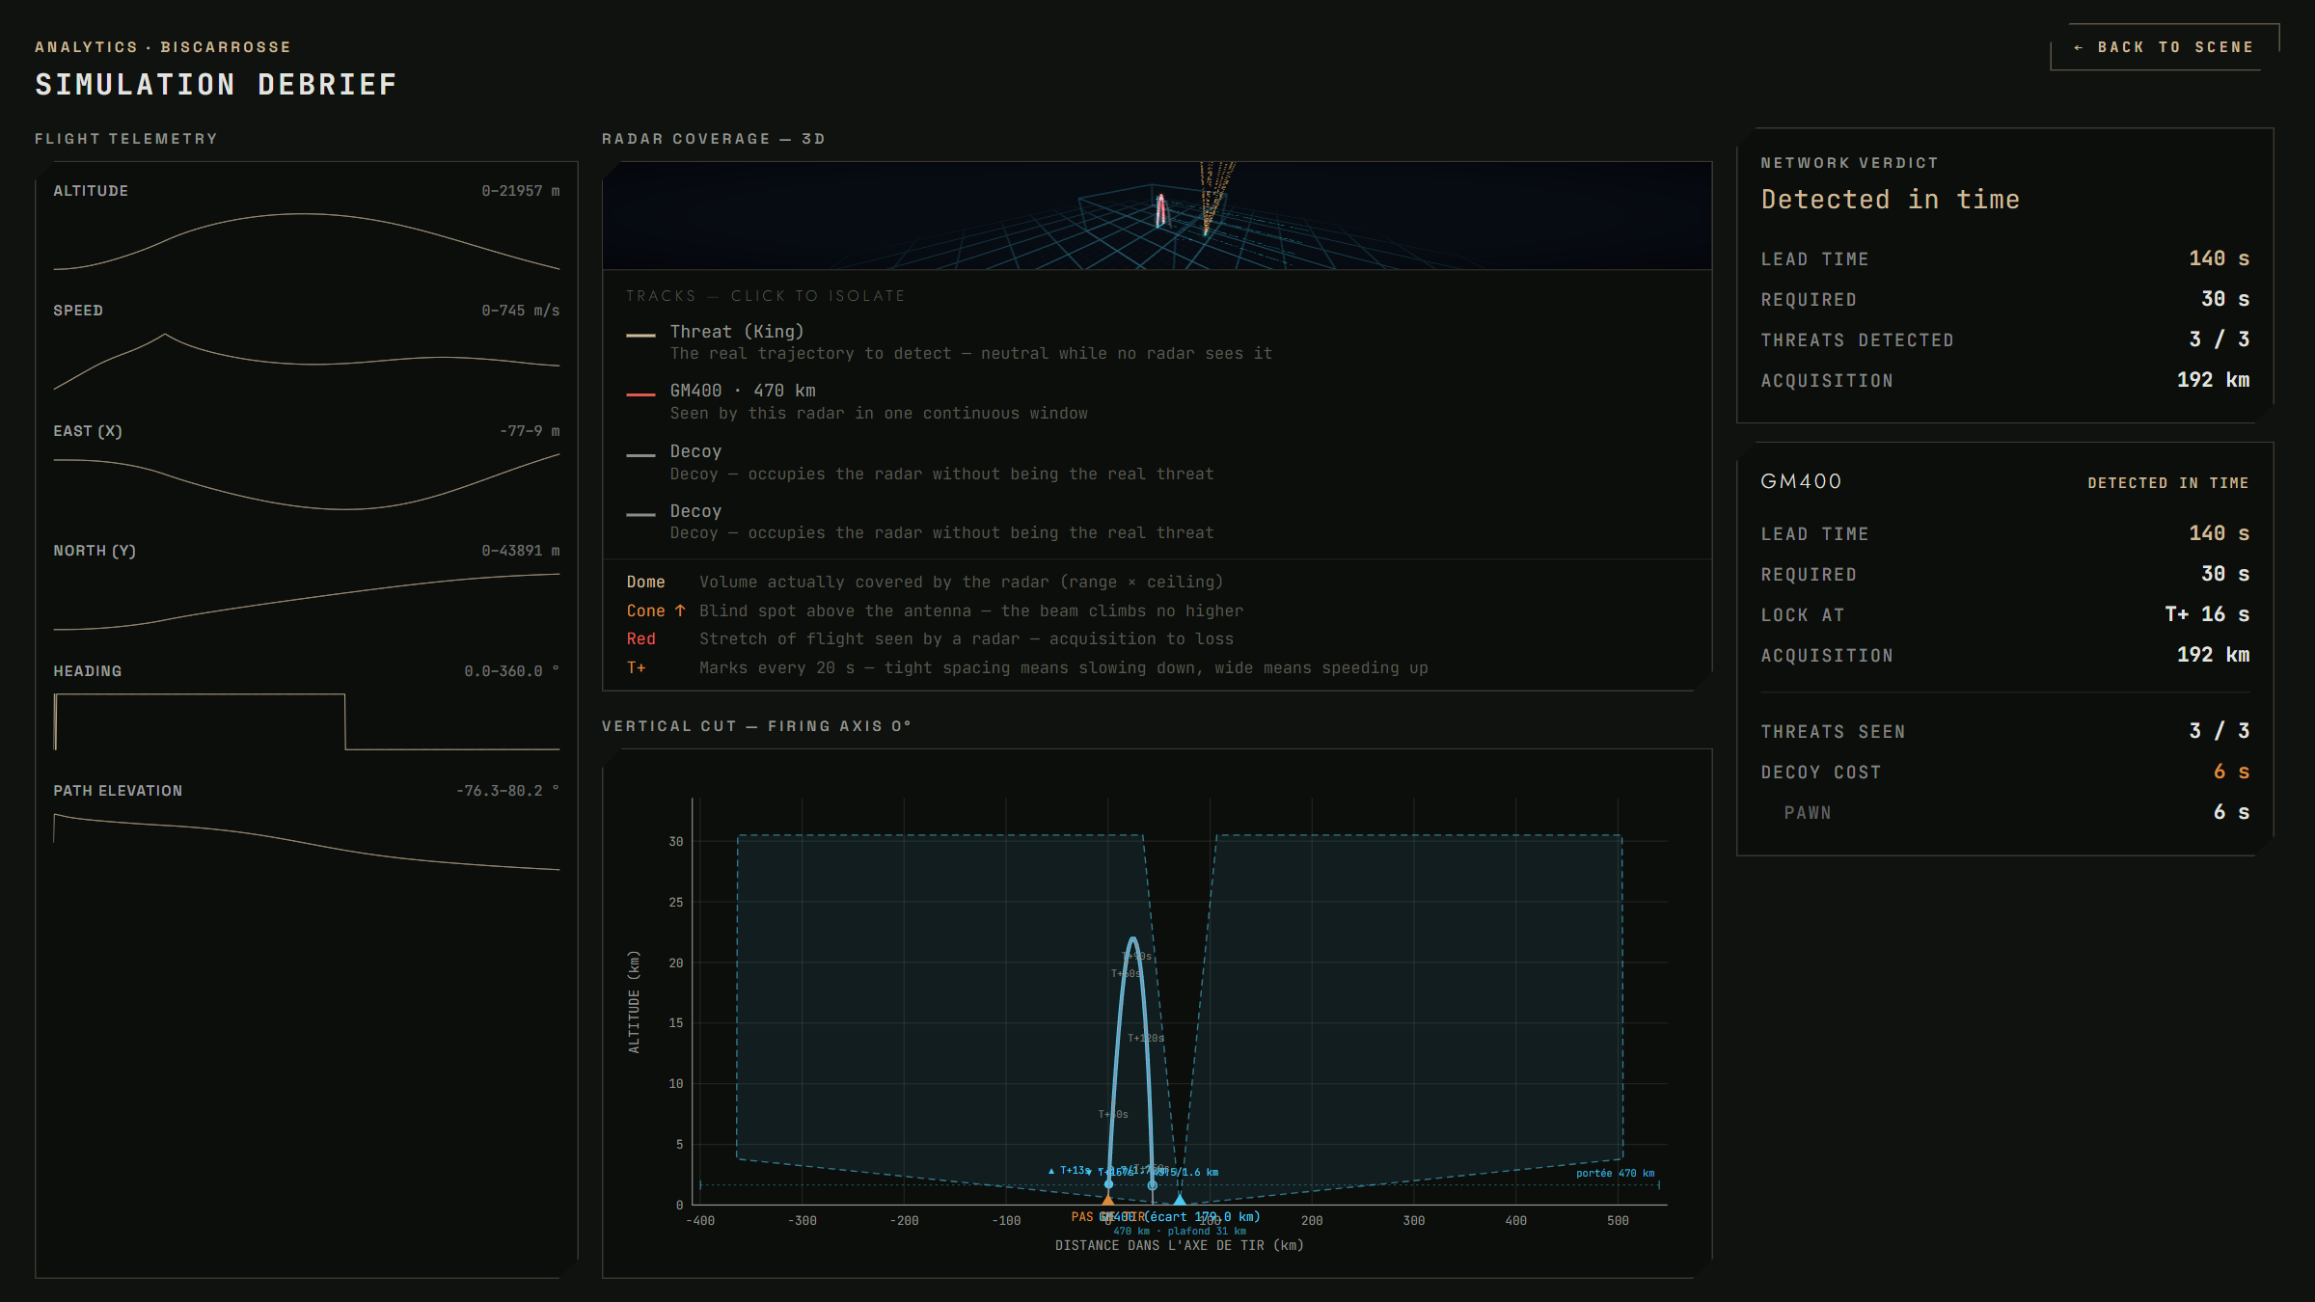
What runs today — flight & debrief
Physics-based detection, not a distance check
Real-time 3D flight. Tactical map, radar beam, live detection status of the King.
Post-flight debrief. Coverage volume, vertical cut, network verdict, per-radar analysis.
Radar horizon (4/3 refraction) · radar equation (4th-root RCS) · aspect RCS: ~0.08 m² nose-on vs ~1.2 m² broadside · ceiling & scan rate
CHESS · 2. Technical approach
Notes:
Optional live demo moment (30-60 s screen capture): one flight, one verdict. The physics strip explains why blind spots exist — which is what makes the exercise instructive.

Slide 9
The iterative loop — one cycle per flight
Fly, measure, calibrate, refine
next flight: refined parameters & mission decision tree uplinked to the onboard AI
0
Initiation flight
1
Instrumented flight
2
Ground processing
3
Scenario study
4
Parameter refinement
First real dataset
Ballistic profile (V1)
Seeds the models
Suborbital carrier
6-DOF reconstruction
RCS & IR signatures
Post-flight reconstruction
Prediction vs observation
Residual error quantified
Raids generated under calibrated models
Doctrinal AND achievable
Shortlist of best raids
Gaps in the envelope
Next signatures to measure
Mission decision tree
5
Users — Air defense
C2 evaluation bench · operator training · GBAD planning
Each flight calibrates the tool: models sharpen, scenarios tighten, the decision tree improves.
CHESS · 2. Technical approach
Notes:
The system innovation: a learning loop with one cycle per flight. Exercises consume the scenarios at every turn of the loop — users do not wait for the loop to finish.

Slide 10
Calibrated tool, adaptive AI
Calibrated on the ground, adaptive in flight
Ground · calibrated tool
Onboard · adaptive AI
Models calibrated on reconstructed flight data
Receives the refined tree before each flight
Raid generation constrained by the calibrated models
Processes onboard sensor data in real time
uplink
Optimization shortlists doctrinal and achievable raids
Adapts its choices to what it perceives, like a chess move
Outputs the mission decision tree
Adapts the trajectory within bounded compute (WCET)
Flights calibrate the tool; the onboard AI adapts in flight.
CHESS · 2. Technical approach
Notes:
Division of labour: everything heavy and learned happens on the ground; the air segment executes a validated, bounded policy.

Slide 11
On-board AI
The threat adapts in flight, like a chess player
Onboard sensors
Sensor processing
'Chess' branch selection
Trajectory adaptation
Bounded compute (WCET): predictable worst-case timing at every step
Adaptive, never unbounded
Each move is chosen in flight from the uplinked mission decision tree. Every branch was defined and refined on the ground.
CHESS · 3. On-board AI
Notes:
The tree graphic: grey branches are prepared alternatives, navy is the path actually flown. Adaptation means choosing among validated branches — never improvising outside them.

Slide 12
Where exactly is the AI?
Three components, one deliberate design choice
Learned layer — scenario generation
Onboard perception
Bounded decision policy
Candidate raids are generated and scored under models calibrated on flight data. The learned layer constrains what is doctrinal AND achievable.
Real-time processing of onboard sensor data, to recognise the situation among the prepared branches of the tree.
The uplinked mission decision tree. Every branch validated on the ground, every step within proven time bounds — a qualifiability choice, not a limitation.
IN DEV
IN DEV
IN DEV
Frugal, bounded, qualifiable — by design.
We chose a bounded policy before building the AI: in this domain, an explainable decision beats an impressive one.
CHESS · 3. On-board AI
Notes:
Pre-empt the "is a decision tree AI?" question: the learning is in the ground layer (calibrated models, raid optimization); the airborne policy is deliberately bounded for qualification. Own this as a position.

Slide 13
Where we stand today
An early-stage project — stated plainly
RUNNING TODAY
IN DEVELOPMENT
PLANNED
Physics simulation core
Full exercise flow: sites, radars, salvo, 3D flight, debrief
Detection physics with per-radar verdicts
Configuration advisor (search over the simulator)
Raid generation & optimization — the learned layer
Onboard policy prototype (bounded branch selection)
First instrumented flights
First calibration cycle on measured data
Adversary evaluation campaign vs scripted baseline
No claimed results, no demo magic: this page is the contract we intend to be measured against.
CHESS · 4. Maturity & evaluation
Notes:
This slide buys trust. Everything in column 1 was shown live two slides ago; columns 2 and 3 are commitments, not claims.

Slide 14
How we will measure success
The evaluation protocol exists before the AI
Adversary value
Calibration quality
Bounded execution
Baseline: scripted salvos.
Metrics: blind-spot discovery rate, reduction of defender lead time at equal raid budget.
Residual error between prediction and observation, quantified after each flight — published per cycle.
Measured worst-case execution time on the target compute — every branch, every step, every time.
Results will be measured, not claimed.
CHESS · 4. Maturity & evaluation
Notes:
For the technical half of the room: the baselines and metrics are defined now, before the AI exists — that is what makes next year's curves meaningful.

Slide 15
Hard problems we are working on
Named now, so they don't surprise us later
Sim-to-real gap
In-flight signature measurement
Real-time guarantees
How far does a model calibrated on N flights remain valid outside the measured envelope? Extrapolation must carry explicit error bars.
Instrumenting RCS & IR on a suborbital carrier is hard: sensor choice, geometry, and reconciliation with ground measurements are open work.
Keeping every decision step within proven worst-case bounds (WCET) on embedded hardware, as the tree grows richer.
If you have fought one of these problems, we want to talk to you.
CHESS · 4. Maturity & evaluation
Notes:
Naming the hard problems converts hostile questions into conversations — and signals engineering maturity despite the early stage.

Slide 16
Conclusion
Closing the loop between flight and air defense
01
02
03
Measured, not modelled
Calibrated with every flight
Adaptive, yet bounded
Reconstructed trajectories and measured signatures, with known error bars.
Each flight calibrates the tool and closes a gap in the envelope.
The onboard AI adapts in flight within a validated decision tree and bounded compute.
What we are looking for: operational feedback on the use cases · experimentation partners · flight-test opportunities
[Contact name] · [email]
CHESS · Conclusion
Notes:
End on the ask, not on a sale: feedback on the use cases, experimentation partners, flight-test opportunities. That is what a community conference is for.

Slide 17

Thank you
Questions?
[Contact name] · [email] · [phone]

Slide 18
Annex · Roadmap
Next developments of the tool
Phase 0
Initiation flight
[Q_ 20__]
Ballistic profile (V1): first real dataset, seeds the models
Phase 1
First instrumented flights
[Q_ 20__]
6-DOF reconstruction, RCS & IR signatures, dispersion: first calibration of the tool
Phase 2
Scenario generation for users
[Q_ 20__]
Raids generated under calibrated models, shortlists for C2 bench, training and GBAD
Phase 3
Adaptive onboard AI in flight
[Q_ 20__]
Real-time branch selection within the uplinked tree, bounded compute (WCET)
Phase 4
Operational loop
[Q_ 20__]
One cycle per flight, operational needs drive each next flight definition
CHESS · Annex
Notes:
Annex — show only if asked about timeline. Quarters intentionally left as placeholders until the flight manifest is confirmed.

