Slide 1
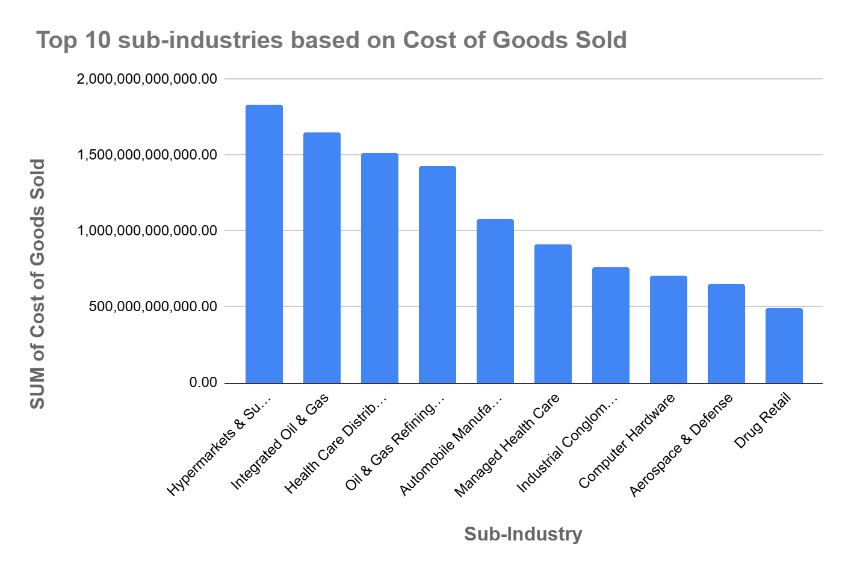
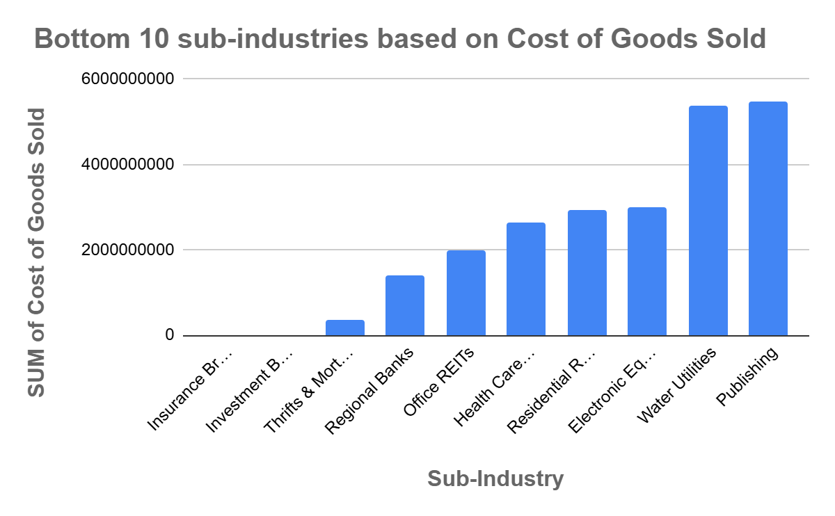
What is the relationship between the 'GICS Sub Industry' and the 'Cost of Goods Sold' among different companies?
The Top 10 sub-industries by Cost of Goods Sold include sectors like Hypermarkets & Super Centers and Integrated Oil & Gas, with costs over $1.8 trillion, reflecting high production and procurement expenses. In contrast, the Bottom 10 sub-industries, such as Publishing and Water Utilities, have costs below $6 billion.
The mean cost across all sub-industries is $12.87 billion, with a median of $4 billion, indicating a right-skewed distribution due to a few high-cost outliers. The high standard deviation ($30.93 billion) further highlights variability. Only 20.35% of sub-industries are above the mean, while 79.65% are below, underscoring the skewed cost structure across sectors.

