Slide 1






Shared Living Expense Manager
Marrakesh, Morocco
CS50’s Introduction to Programming with Python Final Project
abdelghaniabb
Presented by
abdelghani_98
Abdelghani Ait Ben Braim

Slide 2
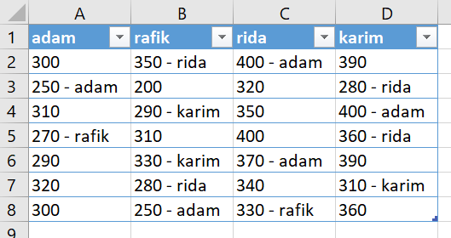

adam : - 38.33
rafik : - 425.00
rida : 298.33
karim : 165.00

