Slide 1
TASKFLOW
END-TO-END DEVOPS PIPELINE FOR MICROSERVICES
AUTOMATED INFRASTRUCTURE & DEPLOYMENT ON AWS EKS
PRESENTED BY: ABDELHADY ELSAYED GOMAA
https://github.com/abdelhadyi/taskflow-project.git

Slide 2
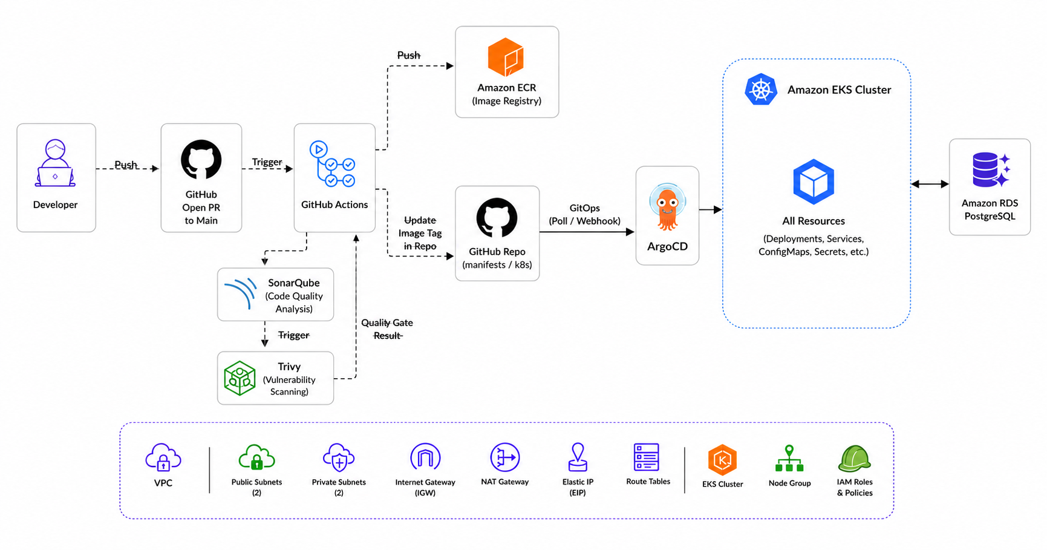
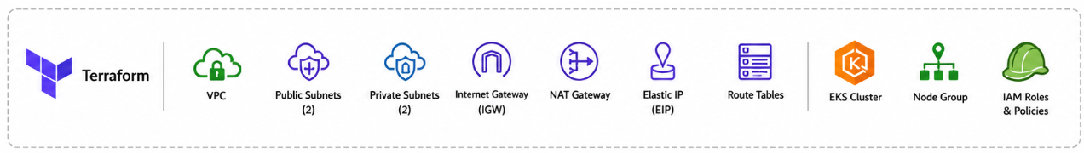
HIGH-LEVEL ARCHTICTURE
https://github.com/abdelhadyi/taskflow-project.git

Slide 3
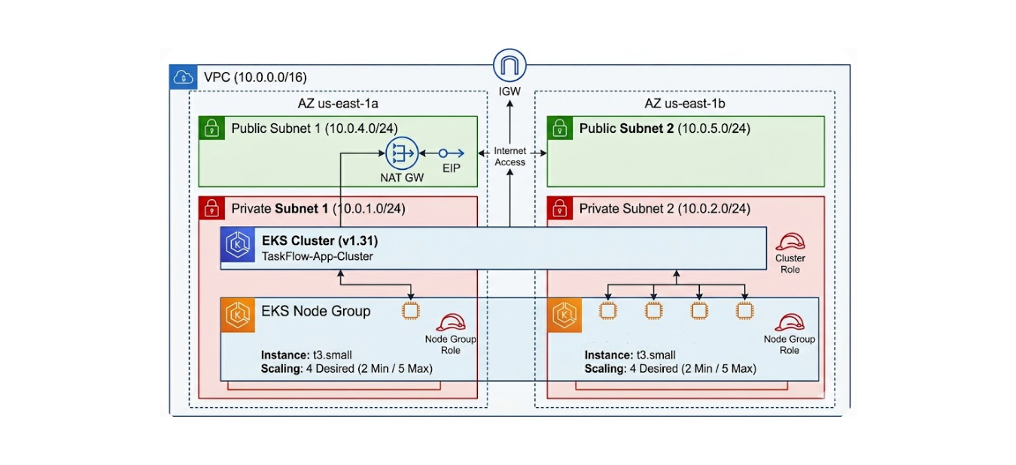
INFRASTRUCTURE AS CODE (TERRAFORM)
  MODULAR INFRASTRUCTURE PROVISIONING
  STATE FILE SECURITY & CONCURRENCY:
      BACKEND: AWS S3
      STATE LOCKING: AWS DYNAMODB (LOCKID)
https://github.com/abdelhadyi/taskflow-project.git

Slide 4
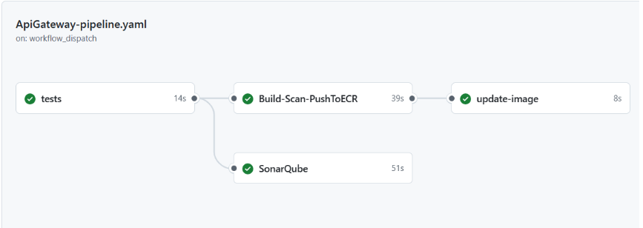
CONTINUOUS INTEGRATION (GITHUB ACTIONS)
  TRIGGERS: DYNAMIC PATH-BASED TRIGGERS PER MICROSERVICE DIRECTORY.
  PIPELINE STAGES:
    LINTING & FORMATTING CHECK ⟶ UNIT TESTING
    QULAITY GATE (SONARQUBE)
    DOCKER BUILD ⟶ IMAGE SCAN (TRIVY) ⟶ PUSH IMAGE TO AWS ECR
    UPDATE KUBERNETES DEPLOYMENT WITH THE UPDATED IMAGE
https://github.com/abdelhadyi/taskflow-project.git

Slide 5
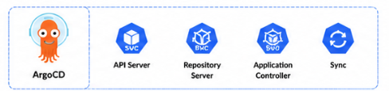
CONTINUOUS DELIVERY & GITOPS (ARGOCD)
  WHY ARGOCD?
  PUSH-BASED VS. PULL-BASED DEPLOYMENT
  CORE MECHANICS:
    DECLARATIVE DESIRED STATE - GIT AS SOURCE OF TRUTH
    AUTOMATED RECONCILIATION LOOP
    SELF-HEALING & ELIMINATING CONFIGURATION DRIFT
https://github.com/abdelhadyi/taskflow-project.git

Slide 6
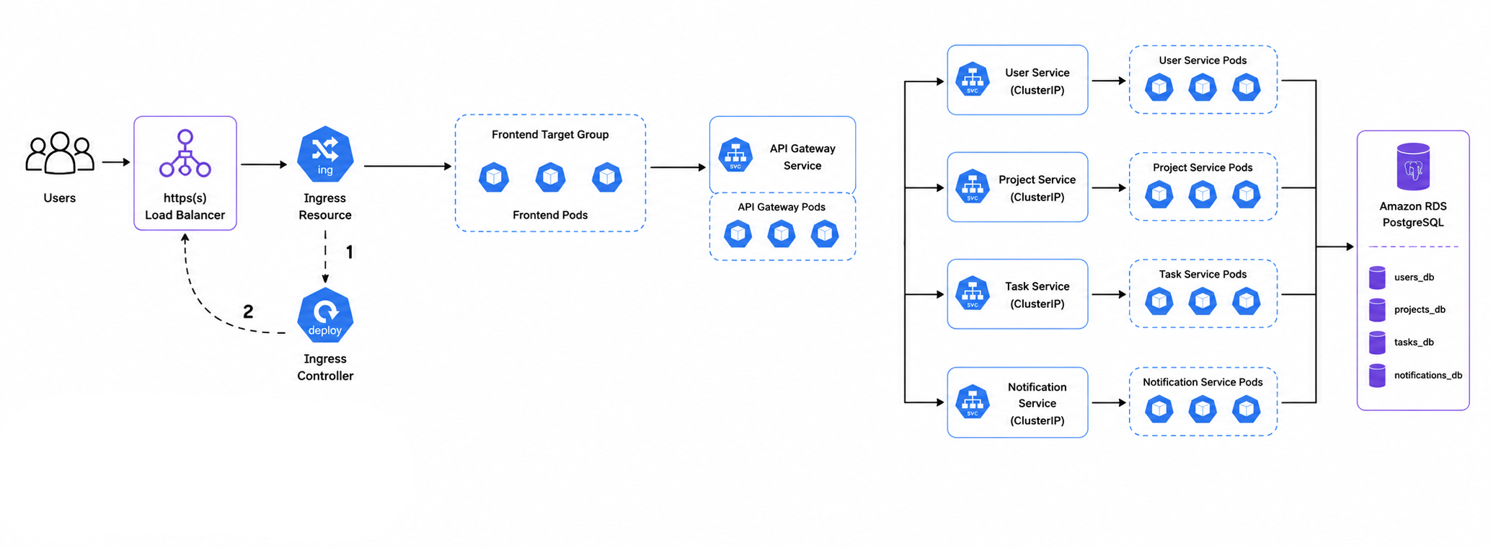
EKS CLUSTER ARCHTICTURE
  CORE KUBERNETES OBJECTS USED
    DEPLOYMENTS, SERVICES, INGRESS, CONFIGMAPS, SECRETS AND JOBS
https://github.com/abdelhadyi/taskflow-project.git

Slide 7
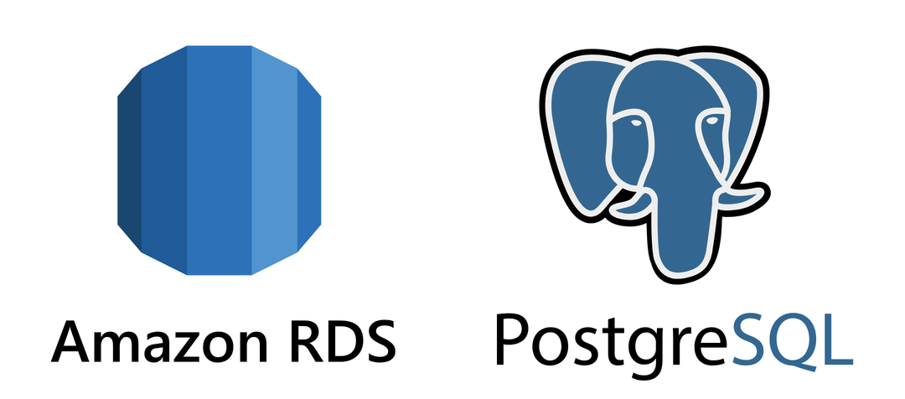
DATABASE ARCHITECTURE (AWS RDS)
  WHY AWS RDS?
  ARCHITECTURAL TRADE-OFF:
    AWS RDS POSTGRESQL VS. K8S STATEFULSETS
  DATABASE-PER-SERVICE PATTERN:
    USERS_DB || PROJECTS_DB || TASKS_DB || NOTIFICATIONS_DB
  DATABASE INITIALIZATION VIA KUBERNETES JOB AND CONFIGMAP.
https://github.com/abdelhadyi/taskflow-project.git

Slide 8
CHALLENGES & TROUBLESHOOTING
  EKS NODE GROUP RESOURCES REMEDIATION
  DATABASE CONNECTION HANDSHAKE (SSL/TLS ENFORCEMENT)
  AWS LOAD BALANCER CONTROLLER TARGET-TYPE MISMATCH
https://github.com/abdelhadyi/taskflow-project.git

Slide 9
FUTURE ROADMAP —KNOWN GAPS & NEXT STEPS
  OBSERVABILITY STACK (PROMETHEUS, GRAFANA)
    TODAY ⟶ ONLY KUBECTL LOGS AVAILABLE
    GAP ⟶ NO METRICS, TRACING, OR ALERTING
  HORIZONTAL POD AUTOSCALING
    TODAY ⟶ REPLICA COUNTS ARE SET MANUALLY
    GAP ⟶ WASTE AT LOW LOAD, RISK AT TRAFFIC SPIKES
  AWS SECRETS MANAGER INTEGRATION
    TODAY ⟶ USING NATIVE, BASE64-ENCODED KUBERNETES SECRETS
    GAP ⟶ LACK OF DYNAMIC SECRET ROTATION, ENCRYPTION-AT-REST GOVERNANCE, AND CENTRALIZED AUDITING
https://github.com/abdelhadyi/taskflow-project.git

Slide 10
Q&A
THANK YOU FOR YOUR TIME!
https://github.com/abdelhadyi/taskflow-project.git

