Slide 1

Unicycle
Andriy Sarabakha
31/03/2022

Slide 2








Unicycle
$$\left\{\begin{aligned}\dot{x}=v\cos{θ} \\ \dot{y}=v\sin{θ} \\ \dot{θ}=w \\ \dot{v}=\frac{R}{I_{y}}τ_{y} \\ \dot{w}=\frac{1}{I_{z}}τ_{z}\end{aligned}\right.$$
$$τ_{z}$$
$$R$$
$$τ_{y}$$
$$y$$
$$x$$
$$θ$$

Slide 3




Controller
Controller
$$\left[\begin{matrix}x^{∗} & y^{∗}\end{matrix}\right]$$
Position Controller
Velocity Controller
$$\left[\begin{matrix}v^{∗} & w^{∗}\end{matrix}\right]$$
$$\left[\begin{matrix}τ_{y} & τ_{z}\end{matrix}\right]$$
Unicycle
$$\left[\begin{matrix}x & y & θ\end{matrix}\right]$$

Slide 4
Implementation
main.py
pid.py
Controller
$$\left[\begin{matrix}x^{∗} & y^{∗}\end{matrix}\right]$$
Position Controller
Velocity Controller
$$\left[\begin{matrix}v^{∗} & w^{∗}\end{matrix}\right]$$
$$\left[\begin{matrix}τ_{y} & τ_{z}\end{matrix}\right]$$
unicycle.py
Unicycle
$$\left[\begin{matrix}x & y & θ\end{matrix}\right]$$

Slide 5
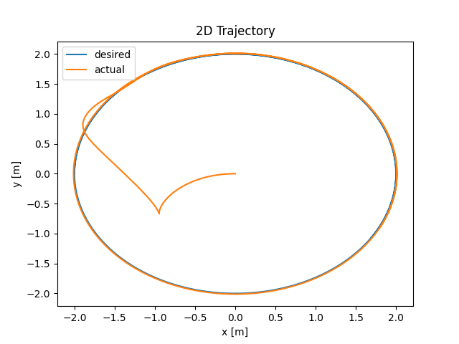
Tracking

Slide 6



DNN-based Controller
main.py
dnn.py
Controller
$$\left[\begin{matrix}x^{∗}(t+2) & y^{∗}(t+2)\end{matrix}\right]$$
$$\left[\begin{matrix}τ_{y}\left(t\right) & τ_{z}\end{matrix}(t)\right]$$
unicycle.py
Unicycle
$$\left[\begin{matrix}x(t) & y(t) & θ(t)\end{matrix}\right]$$

Slide 7
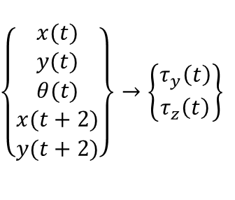
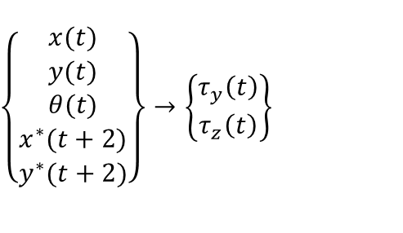



Controller
$$\left\{\begin{matrix}x(t) \\ y(t) \\ θ(t) \\ x^{∗}(t+2) \\ y^{∗}(t+2)\end{matrix}\right\}→\left\{\begin{matrix}τ_{y}\left(t\right) \\ τ_{z}\left(t\right)\end{matrix}\right\}$$
Unicycle
$$\left[\begin{matrix}τ_{y}\left(t\right) & τ_{z}\end{matrix}(t)\right]$$
$$\left[\begin{matrix}x(t+2) & y(t+2)\end{matrix}\right]$$
$$\left[\begin{matrix}x(t) & y(t) & θ(t)\end{matrix}\right]$$
$$\left\{\begin{matrix}x(t) \\ y(t) \\ θ(t) \\ x(t+2) \\ y(t+2)\end{matrix}\right\}→\left\{\begin{matrix}τ_{y}\left(t\right) \\ τ_{z}\left(t\right)\end{matrix}\right\}$$
$$∀t \left\{\begin{matrix}τ_{y}\left(t−2\right) & τ_{z}\left(t−2\right) & x(t−2) & y(t−2) & θ(t−2) & x(t) & y(t)\end{matrix}\right\}$$

Slide 8
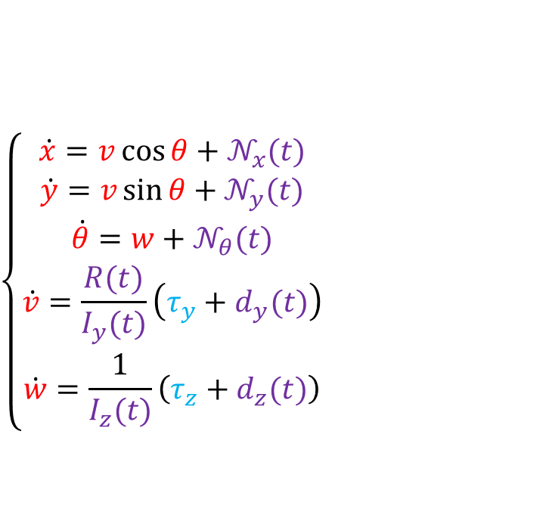
Unicycle
$$\left\{\begin{aligned}\dot{x}=v\cos{θ}+𝒩_{x}(t) \\ \dot{y}=v\sin{θ}+𝒩_{y}(t) \\ \dot{θ}=w+𝒩_{θ}(t) \\ \dot{v}=\frac{R(t)}{I_{y}(t)}\left(τ_{y}+d_{y}(t)\right) \\ \dot{w}=\frac{1}{I_{z}(t)}\left(τ_{z}+d_{z}(t)\right)\end{aligned}\right.$$
$$τ_{z}$$
$$R$$
$$τ_{y}$$
$$y$$
$$x$$
$$θ$$

