Slide 1
Just relax and add some slacks
Dynamic Collision Avoidance using RTI-MPC
Philipp Bordne, Ahmet Selim Canakci, Abdelhakim Khaled Amer

Slide 2
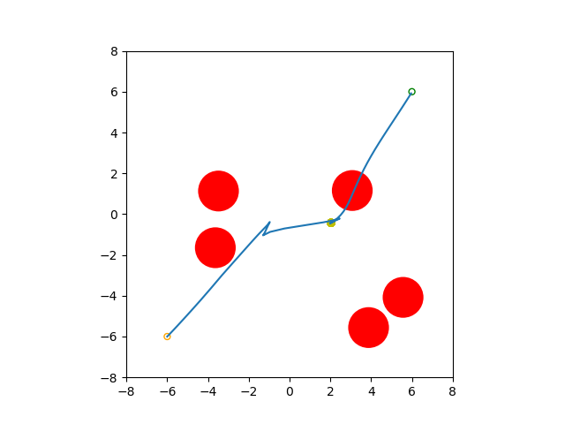
Problem description
Robot needs to cross square with circular obstacles moving around (perturbed by noise) without colliding with them:

Slide 3
General continuous time formulation
Adapted from B. Brito, M. Everett, J. P. How and J. Alonso-Mora: “Where to go next: Learning a Subgoal Recommendation Policy for Navigation in Dynamic Environments”, 2021

Slide 4
Formulation as RTI problem
Again based on B. Brito, M. Everett, J. P. How and J. Alonso-Mora: “Where to go next: Learning a Subgoal Recommendation Policy for Navigation in Dynamic Environments”, 2021
Real Time Iteration (RTI) stopped as soon lies within some margin
Least squares formulation as in Acados documentation

Slide 5
Detailed look on variables and dynamics model
Dynamics taken from B. Brito, M. Everett, J. P. How and J. Alonso-Mora: “Where to go next: Learning a Subgoal Recommendation Policy for Navigation in Dynamic Environments”, 2021
: implicit Runge-Kutta integrator
with discount for constraint violations at later stages
no penalty on orientation of robot
: no limit on angular velocity

Slide 6
Implementation in Acados
RTI with solving for N=20 prediction steps
parameterized model for obstacle positions per iteration:
h += [(model.x[0] - model.p[2*i])**2 + (model.x[1] - model.p[2*i+1])**2 - (R_OBST + R_ROBOT + MARGIN)**2]
slack variables:
even when running „full“ SQP solver hard to solve for N > 10
scaling according to current robot position :
compensate that L2 penalty on robot position will be higher when further away from the goal
adding margin on constraints:
gets us into steep region of L2-loss as soon as we really would hit obstacle
initialization strategy:
set controls to 0 and state to current

Slide 7
Demo

Slide 8
Results
For M=5 obstacles, radius=1, max_v=2
vs robot radius=0.2, max_v=10
Noisy obstacle movements (10% of current obstacle velocity):
Scenario RANDOM: collision in 18% of cases
Scenario EDGE: collision in 38% of cases
No noise on obstacles:
Scenario RANDOM: collision in 19% of cases
Scenario EDGE: collision in 10% of cases
Further data to be evaluated (goals reached, leaving admissable square)

Slide 9
Synergies high level RL could provide
RL agent proposes subgoals for the MPC controller
as proposed by B. Brito et al (current understanding, need to look in more detail):
→ better long term anticipation of unsolvable configurations
→ better dealing with sochasticity
→ shorter overall paths to goal
for our specific solution proposal:
→ alleviate need for adaptation of slack penalty

Slide 10
Challenges tuning MPC-controller
trade-off margin to obstacles vs.:
  „available space“ on the map
  reach the goal while agent is close

Slide 11
Acknowledgements
B. Brito, M. Everett, J. P. How and J. Alonso-Mora: “Where to go next: Learning a Subgoal Recommendation Policy for Navigation in Dynamic Environments”, 2021
R. Verschueren, G. Frison, D. Kouzoupis, J. Frey, N. van Duijkeren, A. Zanelli, B. Novoselnik, T. Albin, R. Quirynen and Moritz Diehl: “acados -- a modular open-source framework for fast embedded optimal control”, 2021

