Slide 1
Part 1, graph_1

Slide 2
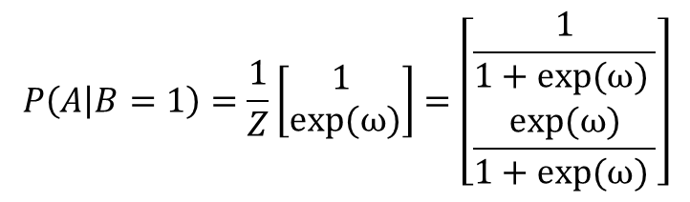

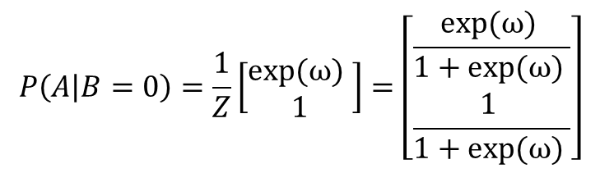

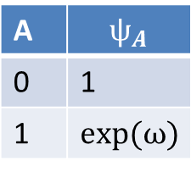
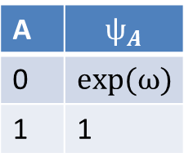
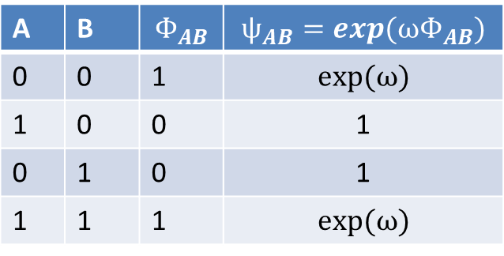
graph_1
A
A
B is observed
$$ѱ_{AB}(A,B)$$
$$ѱ_{A}(A)$$
B
B=0
B=1
A | B | $$Φ_{AB}$$ | $$ѱ_{AB}=exp(ωΦ_{AB})$$
0 | 0 | 1 | $$exp⁡(ω)$$
1 | 0 | 0 | 1
0 | 1 | 0 | 1
1 | 1 | 1 | $$exp⁡(ω)$$
A | $$ѱ_{A}$$
0 | $$exp⁡(ω)$$
1 | 1
A | $$ѱ_{A}$$
0 | 1
1 | $$exp⁡(ω)$$
$$P\left(A | B=0\right)=\frac{1}{Z}\left[\begin{matrix}exp⁡(ω) \\ 1\end{matrix}\right]=\left[\begin{matrix}\frac{exp⁡(ω) }{1+exp⁡(ω) } \\ \frac{1 }{1+exp⁡(ω) }\end{matrix}\right]$$
$$P\left(A | B=1\right)=\frac{1}{Z}\left[\begin{matrix}1 \\ exp⁡(ω)\end{matrix}\right]=\left[\begin{matrix}\frac{1}{1+exp⁡(ω) } \\ \frac{exp⁡(ω)}{1+exp⁡(ω) }\end{matrix}\right]$$

Slide 3
Part 2, graph_2

Slide 4

C
C is observed
$$ѱ_{BC}(B,C)$$
$$ѱ_{B}(B)$$
B
B
$$ѱ_{AB}(A,B)$$
$$τ_{B→A}(A)$$
$$ѱ_{AB}(A,B)$$
$$τ_{A→B}(B)$$
A
A
A | B | $$Φ_{AB}$$ | $$ѱ_{AB}=exp(βΦ_{AB})$$
0 | 0 | 1 | $$exp⁡(β)$$
1 | 0 | 0 | 1
0 | 1 | 0 | 1
1 | 1 | 1 | $$exp⁡(β)$$
B | C | $$Φ_{BC}$$ | $$ѱ_{BC}=exp(αΦ_{BC})$$
0 | 0 | 1 | $$exp⁡(α)$$
1 | 0 | 0 | 1
0 | 1 | 0 | 1
1 | 1 | 1 | $$exp⁡(α)$$

Slide 5

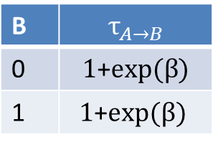




$$ѱ_{B}(B)$$
B
$$τ_{B→A}(A)$$
$$ѱ_{AB}(A,B)$$
$$τ_{A→B}(B)$$
A
A | B | $$Φ_{AB}$$ | $$ѱ_{AB}=exp(βΦ_{AB})$$
0 | 0 | 1 | $$exp⁡(β)$$
1 | 0 | 0 | 1
0 | 1 | 0 | 1
1 | 1 | 1 | $$exp⁡(β)$$
B | $$τ_{A→B}$$
0 | $1$+$exp⁡(β)$
1 | $$1\text{+}exp⁡(β)$$

Slide 6
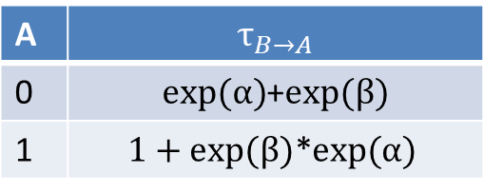
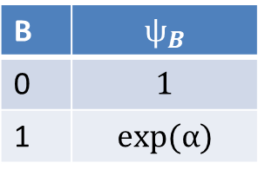
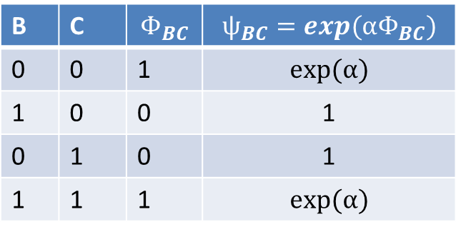

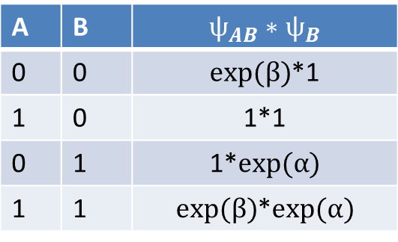
$$ѱ_{B}(B)$$
A | B | $$Φ_{AB}$$ | $$ѱ_{AB}=exp(βΦ_{AB})$$
0 | 0 | 1 | $$exp⁡(β)$$
1 | 0 | 0 | 1
0 | 1 | 0 | 1
1 | 1 | 1 | $$exp⁡(β)$$
B
$$τ_{B→A}(A)$$
$$ѱ_{AB}(A,B)$$
$$τ_{A→B}(B)$$
A
B | $$ѱ_{B}$$
0 | $$1$$
1 | $$exp⁡(α)$$
C = 1
B | C | $$Φ_{BC}$$ | $$ѱ_{BC}=exp(αΦ_{BC})$$
0 | 0 | 1 | $$exp⁡(α)$$
1 | 0 | 0 | 1
0 | 1 | 0 | 1
1 | 1 | 1 | $$exp⁡(α)$$
A | B | $$ѱ_{AB}∗ѱ_{B}$$
0 | 0 | $exp⁡(β)$*1
1 | 0 | 1*1
0 | 1 | 1*$exp⁡(α)$
1 | 1 | $exp⁡(β)$*$exp⁡(α)$
A | $$τ_{B→A}$$
0 | $exp⁡(α)$+$exp⁡(β)$
1 | $$1+exp⁡(β)\text{∗}exp⁡(α)$$

Slide 7
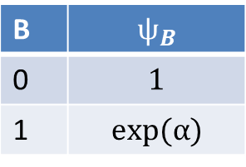
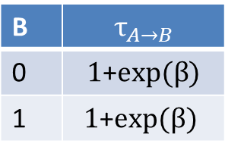
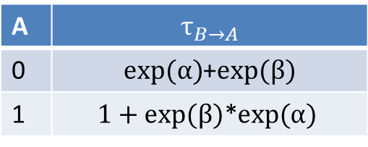
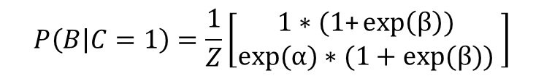

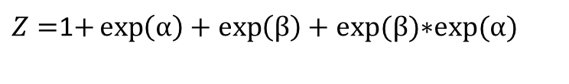
$$ѱ_{B}(B)$$
B
$Z=$1$+\exp\left(α\right)+\exp\left(β\right)+exp⁡(β)\text{∗}exp⁡(α)$
$$τ_{B→A}(A)$$
$$ѱ_{AB}(A,B)$$
$$τ_{A→B}(B)$$
A
A | $$τ_{B→A}$$
0 | $exp⁡(α)$+$exp⁡(β)$
1 | $$1+exp⁡(β)\text{∗}exp⁡(α)$$
B | $$ѱ_{B}$$
0 | $$1$$
1 | $$exp⁡(α)$$
B | $$τ_{A→B}$$
0 | $1$+$exp⁡(β)$
1 | $$1\text{+}exp⁡(β)$$
$$P\left(A | C=1\right)=\frac{1}{Z}\left[\begin{matrix}exp⁡(α)\text{+}exp⁡(β) \\ 1+exp⁡(β)\text{∗}exp⁡(α) \end{matrix}\right]$$
$$P\left(B | C=1\right)=\frac{1}{Z}\left[\begin{matrix}1∗(1\text{+}\exp\left(β\right)) \\ exp⁡(α)∗(1+exp⁡(β)\text{)} \end{matrix}\right]$$

Slide 8
Part 3

Slide 9


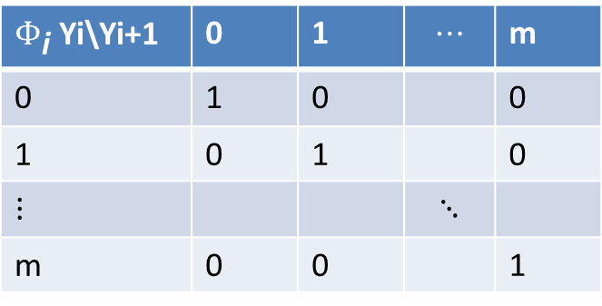

Y0
Y0 is observed, evaluate the
marginal distribution of Yn
$$P\left(Yn | Y0=0\right)$$
$$ѱ_{1}$$
Y1
$$ѱ_{2}$$
$Φ_{\text{i}}$ Yi\Yi+1 | 0 | 1 | $$⋯$$ | m
0 | 1 | 0 |  | 0
1 | 0 | 1 |  | 0
$$⋮$$ |  |  | $$⋱$$
m | 0 | 0 |  | 1
Y2
$$ѱ_{i}=exp⁡(Φ_{i}∗ w)$$
$$ѱ_{n}$$
Yn

