Slide 1
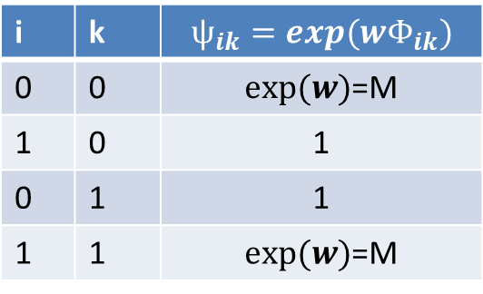
i | k | $$ѱ_{ik}=exp(wΦ_{ik})$$
0 | 0 | $exp⁡(w)$=M
1 | 0 | 1
0 | 1 | 1
1 | 1 | $exp⁡(w)$=M
V_i
V_k

Slide 2
Observed value
C columns
v0
v1
vC-1
VC
vC+1
R rows

