Slide 1
Part 1, graph_1

Slide 2
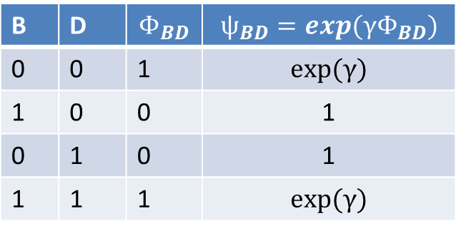
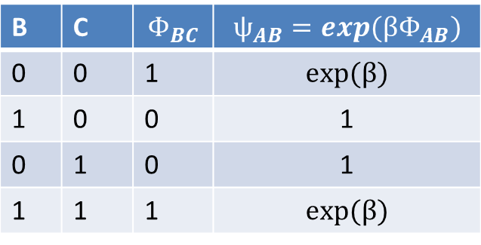

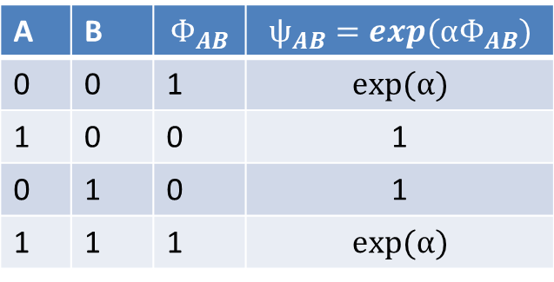



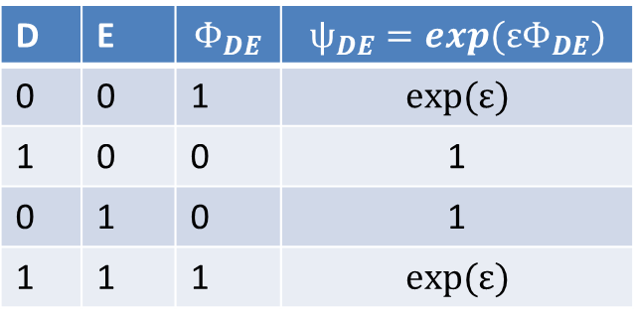
A
$$ѱ_{AB}(A,B)$$
B
D
E
$$ѱ_{BD}(B,D)$$
$$ѱ_{DE}(D,E)$$
C
$$ѱ_{BC}(B,C)$$
A | B | $$Φ_{AB}$$ | $$ѱ_{AB}=exp(αΦ_{AB})$$
0 | 0 | 1 | $$exp⁡(α)$$
1 | 0 | 0 | 1
0 | 1 | 0 | 1
1 | 1 | 1 | $$exp⁡(α)$$
B | C | $$Φ_{BC}$$ | $$ѱ_{AB}=exp(βΦ_{AB})$$
0 | 0 | 1 | $$exp⁡(β)$$
1 | 0 | 0 | 1
0 | 1 | 0 | 1
1 | 1 | 1 | $$exp⁡(β)$$
B | D | $$Φ_{BD}$$ | $$ѱ_{BD}=exp(γΦ_{BD})$$
0 | 0 | 1 | $$exp⁡(γ)$$
1 | 0 | 0 | 1
0 | 1 | 0 | 1
1 | 1 | 1 | $$exp⁡(γ)$$
D | E | $$Φ_{DE}$$ | $$ѱ_{DE}=exp(εΦ_{DE})$$
0 | 0 | 1 | $$exp⁡(ε)$$
1 | 0 | 0 | 1
0 | 1 | 0 | 1
1 | 1 | 1 | $$exp⁡(ε)$$

Slide 3
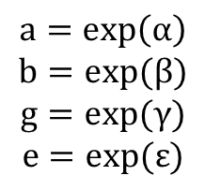



A
Observed variable
$$ѱ_{AB}(A,B)$$
B
D
E
$$ѱ_{BD}(B,D)$$
$$ѱ_{DE}(D,E)$$
$$ѱ_{BC}(B,C)$$
E=1
C
A
$$ѱ_{AB}(A,B)$$
$$a=\exp\left(α\right)$$
$$b=exp⁡(β)$$
$$g=exp⁡(γ)$$
$$e=exp⁡(ε)$$
B
D
$$ѱ_{BD}(B,D)$$
C
$$ѱ_{BC}(B,C)$$
$$Ψ_{D}=\left[\begin{matrix}1 \\ e\end{matrix}\right]$$

Slide 4



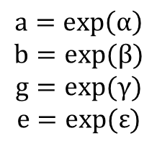
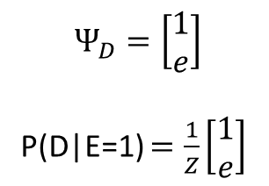



$$a=\exp\left(α\right)$$
$$b=exp⁡(β)$$
$$g=exp⁡(γ)$$
$$e=exp⁡(ε)$$
Irrelevant!
$$τ_{A→B}=\left[\begin{matrix}0.5 \\ 0.5\end{matrix}\right]$$
A
$$ѱ_{AB}$$
$$τ_{B→D}=\left[\begin{matrix}0.5 \\ 0.5\end{matrix}\right]$$
B
D
$$τ_{C→B}=\left[\begin{matrix}0.5 \\ 0.5\end{matrix}\right]$$
$$ѱ_{BD}(B,D)$$
C
$$ѱ_{BC}(B,C)$$
$$Ψ_{D}=\left[\begin{matrix}1 \\ e\end{matrix}\right]$$
P(D|E=1) $=\frac{1}{Z}\left[\begin{matrix}1 \\ e\end{matrix}\right]$

Slide 5
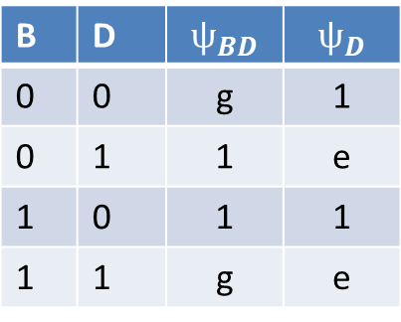




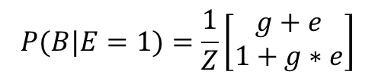


A
$$τ_{D→B}(B)$$
$$ѱ_{AB}$$
$$a=\exp\left(α\right)$$
$$b=exp⁡(β)$$
$$g=exp⁡(γ)$$
$$e=exp⁡(ε)$$
B
D
$$ѱ_{BD}$$
C
$$ѱ_{BC}$$
$$Ψ_{D}=\left[\begin{matrix}1 \\ e\end{matrix}\right]$$
B | D | $$ѱ_{BD}$$ | $$ѱ_{D}$$
0 | 0 | g | 1
0 | 1 | 1 | e
1 | 0 | 1 | 1
1 | 1 | g | e
$$τ_{D→B}\left(B\right)=\left[\begin{matrix}g+e \\ 1+g∗e\end{matrix}\right]$$
$$P(B|E=1)=\frac{1}{Z}\left[\begin{matrix}g+e \\ 1+g∗e\end{matrix}\right]$$

Slide 6
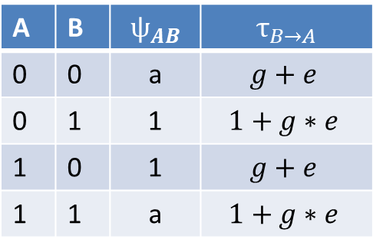
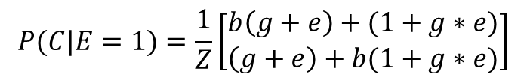



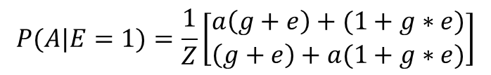
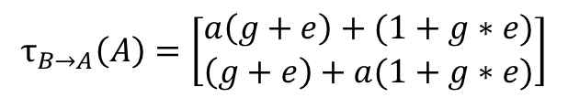
A
$$τ_{B→A}(A)$$
$$ѱ_{AB}$$
$$τ_{D→B}(B)$$
$$a=\exp\left(α\right)$$
$$b=exp⁡(β)$$
$$g=exp⁡(γ)$$
$$e=exp⁡(ε)$$
B
D
$$ѱ_{BD}$$
C
$$ѱ_{BC}$$
$$τ_{B→C}(C)$$
$$Ψ_{D}=\left[\begin{matrix}1 \\ e\end{matrix}\right]$$
A | B | $$ѱ_{AB}$$ | $$τ_{B→A}$$
0 | 0 | a | $$g+e$$
0 | 1 | 1 | $$1+g∗e$$
1 | 0 | 1 | $$g+e$$
1 | 1 | a | $$1+g∗e$$
$$P(C|E=1)=\frac{1}{Z}\left[\begin{matrix}b\left(g+e\right)+(1+g∗e) \\ \left(g+e\right)+b(1+g∗e)\end{matrix}\right]$$
$$τ_{B→A}\left(A\right)=\left[\begin{matrix}a\left(g+e\right)+(1+g∗e) \\ \left(g+e\right)+a(1+g∗e)\end{matrix}\right]$$
$$P(A|E=1)=\frac{1}{Z}\left[\begin{matrix}a\left(g+e\right)+(1+g∗e) \\ \left(g+e\right)+a(1+g∗e)\end{matrix}\right]$$

Slide 7




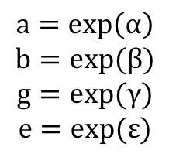

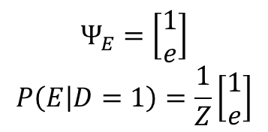


A
Observed variable
$$ѱ_{AB}$$
B
D
E
$$ѱ_{BD}$$
$$ѱ_{DE}$$
C
$$ѱ_{BC}$$
D=1
$$a=\exp\left(α\right)$$
$$b=exp⁡(β)$$
$$g=exp⁡(γ)$$
$$e=exp⁡(ε)$$
A
$$ѱ_{AB}(A,B)$$
E
B
C
$$ѱ_{BC}(B,C)$$
$$Ψ_{B}=\left[\begin{matrix}1 \\ g\end{matrix}\right]$$
$$Ψ_{E}=\left[\begin{matrix}1 \\ e\end{matrix}\right]$$
$$P\left(E | D=1\right)=\frac{1}{Z}\left[\begin{matrix}1 \\ e\end{matrix}\right]$$

Slide 8


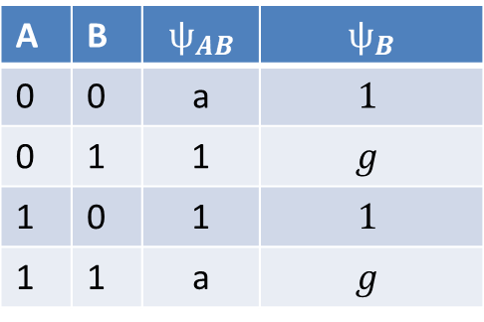



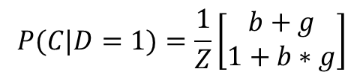

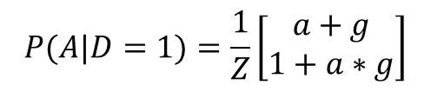
A
$$τ_{B→A}(A)$$
$$ѱ_{AB}$$
B
C
$$ѱ_{BC}$$
$$Ψ_{B}=\left[\begin{matrix}1 \\ g\end{matrix}\right]$$
$$τ_{B→C}(C)$$
$$P(C|D=1)=\frac{1}{Z}\left[\begin{matrix}b+g \\ 1+b∗g\end{matrix}\right]$$
A | B | $$ѱ_{AB}$$ | $$ѱ_{B}$$
0 | 0 | a | $$1$$
0 | 1 | 1 | $$g$$
1 | 0 | 1 | $$1$$
1 | 1 | a | $$g$$
$$τ_{B→A}\left(A\right)=\left[\begin{matrix}a+g \\ 1+a∗g\end{matrix}\right]$$
$$P(A|D=1)=\frac{1}{Z}\left[\begin{matrix}a+g \\ 1+a∗g\end{matrix}\right]$$

Slide 9
Part 2, graph_2

Slide 10
i | k | $$ѱ_{ik}=exp(wΦ_{ik})$$
0 | 0 | $$exp⁡(w)$$
1 | 0 | 1
0 | 1 | 1
1 | 1 | $$exp⁡(w)$$
V_i
V_k

Slide 11
v1
v2
v3
observations
v4
v5
v6
v7
v8
v9
v10
v11
v12
v13

Slide 12
Part 3, graph_3

Slide 13
i | k | $$ѱ_{ik}=exp(wΦ_{ik})$$
0 | 0 | $exp⁡(w)$=M
1 | 0 | 1
0 | 1 | 1
1 | 1 | $exp⁡(w)$=M
V_i
V_k

Slide 14
A
B
D
E
Observed variable
C

Slide 15


E=1
A
B
D
$$Ψ_{D}=\left[\begin{matrix}1 \\ M\end{matrix}\right]$$
C
AB
BCD
$$Ψ_{D}$$
$$Ψ_{AB}$$
$$Ψ_{BCD}$$

Slide 16

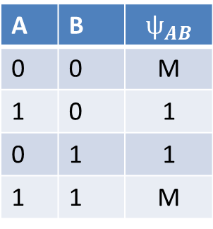


$$τ_{II→I}(B)$$
AB:I
BCD:II
$$τ_{I→II}(B)$$
$$Ψ_{D}$$
$$Ψ_{AB}$$
$$Ψ_{BCD}$$
A | B | $$ѱ_{AB}$$
0 | 0 | M
1 | 0 | 1
0 | 1 | 1
1 | 1 | M
$$τ_{I→II}\left(B\right)=\left[\begin{matrix}1+M \\ 1+M\end{matrix}\right]$$
Ininfluente!

Slide 17

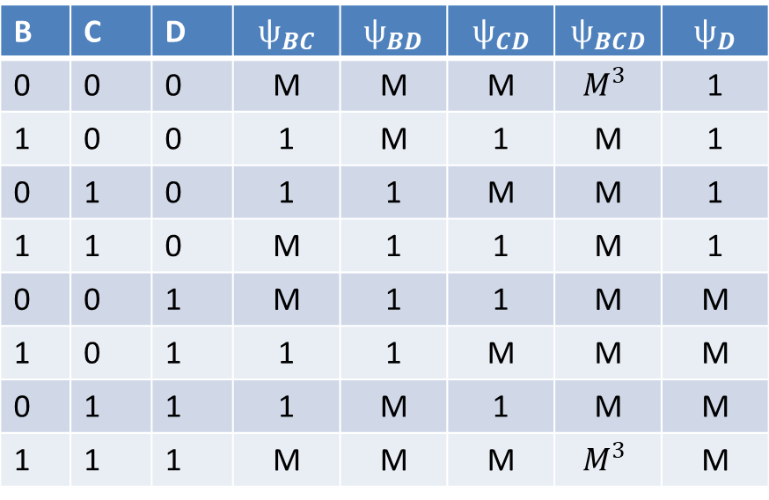
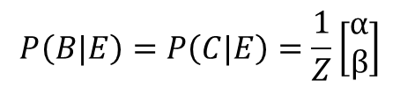
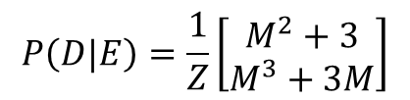
$$τ_{II→I}(B)$$
AB:I
BCD:II
$$τ_{II→I}\left(B\right)=\left[\begin{matrix}M^{3}+M+2M^{2} \\ M^{4}+M^{2}+2M\end{matrix}\right]=\left[\begin{matrix}α \\ β\end{matrix}\right]$$
$$τ_{I→II}(B)$$
$$Ψ_{D}$$
$$Ψ_{AB}$$
$$P\left(D|E\right)=\frac{1}{Z}\left[\begin{matrix}M^{2}+3 \\ M^{3}+3M\end{matrix}\right]$$
$$Ψ_{BCD}$$
B | C | D | $$ѱ_{BC}$$ | $$ѱ_{BD}$$ | $$ѱ_{CD}$$ | $$ѱ_{BCD}$$ | $$ѱ_{D}$$
0 | 0 | 0 | M | M | M | $$M^{3}$$ | 1
1 | 0 | 0 | 1 | M | 1 | M | 1
0 | 1 | 0 | 1 | 1 | M | M | 1
1 | 1 | 0 | M | 1 | 1 | M | 1
0 | 0 | 1 | M | 1 | 1 | M | M
1 | 0 | 1 | 1 | 1 | M | M | M
0 | 1 | 1 | 1 | M | 1 | M | M
1 | 1 | 1 | M | M | M | $$M^{3}$$ | M
$$P\left(B|E\right)=P\left(C|E\right)=\frac{1}{Z}\left[\begin{matrix}α \\ β\end{matrix}\right]$$

Slide 18
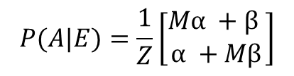
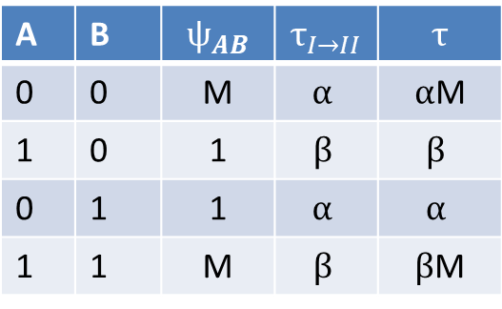
$$τ_{II→I}(B)$$
AB:I
BCD:II
$$τ_{I→II}(B)$$
$$Ψ_{D}$$
$$Ψ_{AB}$$
$$Ψ_{BCD}$$
A | B | $$ѱ_{AB}$$ | $$τ_{I→II}$$ | $$τ$$
0 | 0 | M | $$α$$ | $α$M
1 | 0 | 1 | $$β$$ | $$β$$
0 | 1 | 1 | $$α$$ | $$α$$
1 | 1 | M | $$β$$ | $β$M
$$P(A|E)=\frac{1}{Z}\left[\begin{matrix}Mα +β \\ α +Mβ\end{matrix}\right]$$

Slide 19
Part 4, graph_4

Slide 20
v4
v6
v1
v2
v5
v7
Observed variable
v3
v8

