Slide 1
Part 1, graph_1

Slide 2

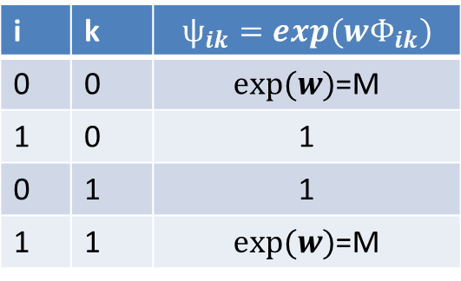
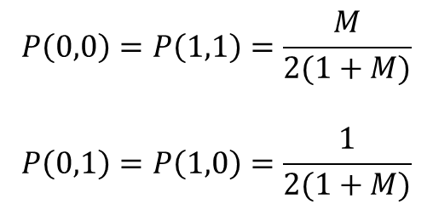
A
i | k | $$ѱ_{ik}=exp(wΦ_{ik})$$
0 | 0 | $exp⁡(w)$=M
1 | 0 | 1
0 | 1 | 1
1 | 1 | $exp⁡(w)$=M
B
$$Z=2∗(1+M)$$
$$P\left(0,0\right)=P\left(1,1\right)=\frac{M}{2(1+M)}$$
$$P\left(0,1\right)=P\left(1,0\right)=\frac{1}{2(1+M)}$$

Slide 3
Part 2, graph_2

Slide 4
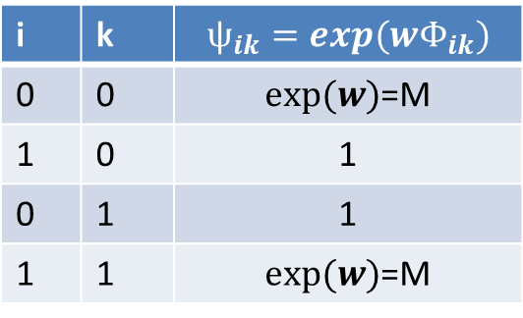
i | k | $$ѱ_{ik}=exp(wΦ_{ik})$$
0 | 0 | $exp⁡(w)$=M
1 | 0 | 1
0 | 1 | 1
1 | 1 | $exp⁡(w)$=M
V_i
V_k

Slide 5

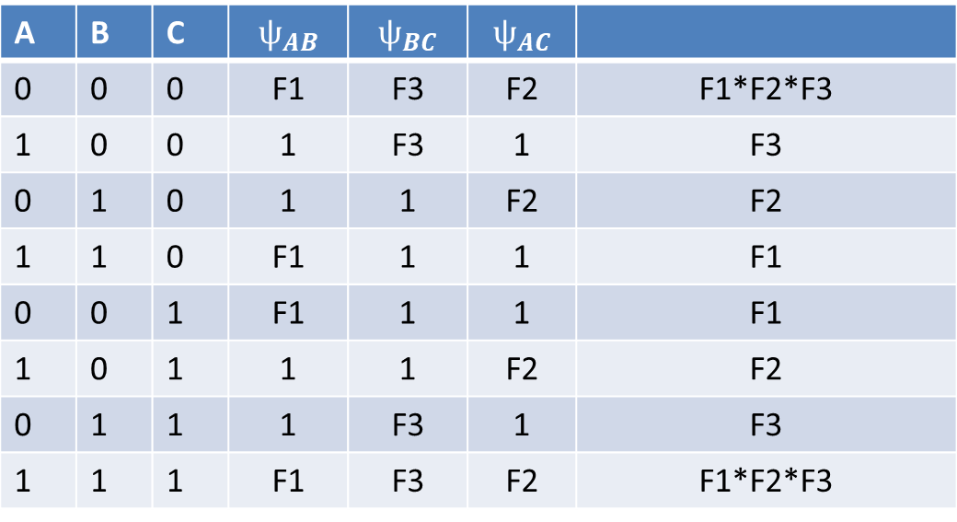
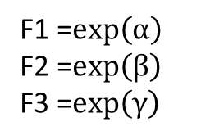


$$αΦ$$
A
B
$Z=2(exp\left(α\right)+exp\left(β\right)+exp\left(γ\right)+exp\left(α\right)∗exp\left(β\right)∗exp\left(γ\right))$
$$βΦ$$
$$γΦ$$
C
F1 =$exp\left(α\right)$
F2 =$exp\left(β\right)$
F3 =$exp\left(γ\right)$
A | B | C | $$ѱ_{AB}$$ | $$ѱ_{BC}$$ | $$ѱ_{AC}$$
0 | 0 | 0 | F1 | F3 | F2 | F1*F2*F3
1 | 0 | 0 | 1 | F3 | 1 | F3
0 | 1 | 0 | 1 | 1 | F2 | F2
1 | 1 | 0 | F1 | 1 | 1 | F1
0 | 0 | 1 | F1 | 1 | 1 | F1
1 | 0 | 1 | 1 | 1 | F2 | F2
0 | 1 | 1 | 1 | F3 | 1 | F3
1 | 1 | 1 | F1 | F3 | F2 | F1*F2*F3

Slide 6
Part 3, graph_3

Slide 7

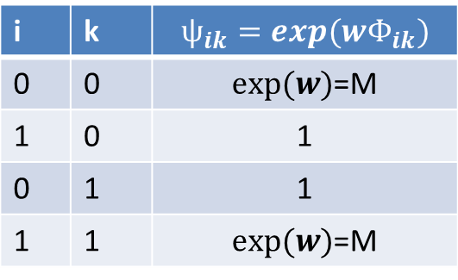


i | k | $$ѱ_{ik}=exp(wΦ_{ik})$$
0 | 0 | $exp⁡(w)$=M
1 | 0 | 1
0 | 1 | 1
1 | 1 | $exp⁡(w)$=M
A
$$αΦ$$
$$βΦ$$
B
C
$α$ is known and constant while $β$ must be tuned through learning

Slide 8
Part 4, graph_4

Slide 9









v4
$$exp⁡(2Φ)$$
v6
$$exp⁡(Φ)$$
$$exp⁡(Φ)$$
$$exp⁡(2Φ)$$
v1
v2
v5
v7
$$exp⁡(2Φ)$$
$$exp⁡(Φ)$$
$$exp⁡(0.2Φ)$$
$$exp⁡(0.2Φ)$$
v3
$$exp⁡(2Φ)$$
v8

Slide 10
Part 5, graph_5

Slide 11





Y1
$$exp⁡(α Φ_{1})$$
Y2
$$exp⁡(α Φ_{1})$$
Y3
$$exp⁡(βΦ_{2})$$
$$exp⁡(βΦ_{2})$$
$$exp⁡(βΦ_{2})$$
X1
X2
X3

