Slide 1
Y1
Y2
Yn
X1
X1
Xn

Slide 2
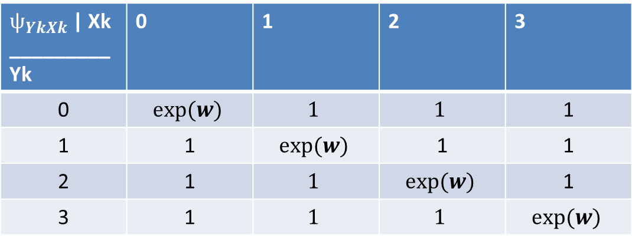
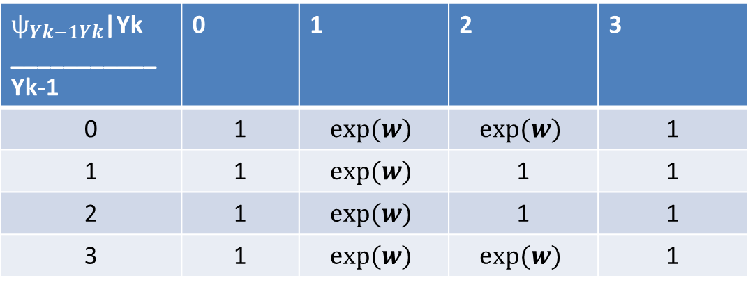
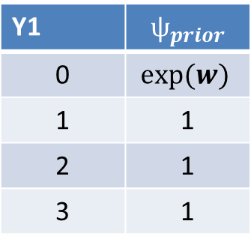
Yk
$ѱ_{YkXk}$ | Xk _________ Yk | 0 | 1 | 2 | 3
0 | $$exp⁡(w)$$ | $$1$$ | $$1$$ | 1
1 | 1 | $$exp⁡(w)$$ | 1 | 1
2 | 1 | $$1$$ | $$exp⁡(w)$$ | 1
3 | 1 | $$1$$ | $$1$$ | $$exp⁡(w)$$
Xk
$ѱ_{Yk−1Yk}$|Yk ___________ Yk-1 | 0 | 1 | 2 | 3
0 | 1 | $$exp⁡(w)$$ | $$exp⁡(w)$$ | 1
1 | 1 | $$exp⁡(w)$$ | 1 | 1
2 | 1 | $$exp⁡(w)$$ | 1 | 1
3 | 1 | $$exp⁡(w)$$ | $$exp⁡(w)$$ | 1
Yk-1
Yk
Y1 | $$ѱ_{prior}$$
0 | $$exp⁡(w)$$
1 | 1
2 | 1
3 | 1
Y1

