Slide 1
Part 1, graph_1

Slide 2
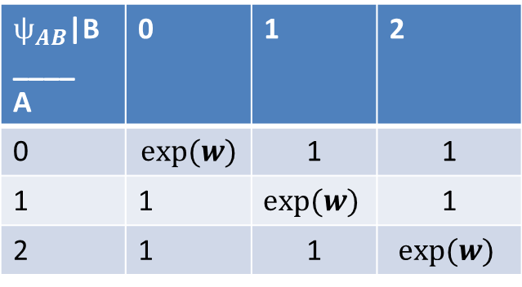
A
$ѱ_{AB}$|B ____ A | 0 | 1 | 2
0 | $$exp⁡(w)$$ | 1 | 1
1 | 1 | $$exp⁡(w)$$ | 1
2 | 1 | 1 | $$exp⁡(w)$$
B

Slide 3
Conditional_graph
X1
Y1
Y5
X2
Y2
X3
Y6
X4
Y3
Y4
Evidences

