Slide 1


Digital Freelancer:
Managing Freelancing Projects
Project: Working with a Mock Client

Slide 2
Part 1
Project Listing

Slide 3
Sample Project Listing #1: Web Development
Web application development support needed for healthcare application.
Posted 2 hours ago
Hourly: $35.00 - $65.00 Based on experience.
Project Time: 3 months, 25 hours a week.
Project Description:
We are a web development company working with a healthcare client looking to connect patients directly with their doctors. We need someone to be able to take PSD mockup files from our designer and convert them into custom code using HTML, CSS, and JavaScript. We have not decided on which JavaScript library to use, but will be open to working with the one you’re most familiar with. We have the designs for 10 pages and will need them to be completed in 3 months. We are open to working with all levels of experience, but the pay will be adjusted based on your experience.

Slide 4
Part 2
Expression of Interest

Slide 5
Expression of Interest (Provided)
Answer: Web Development
Expression of Interest:
Dear Sir,
Greetings,,,
I have found your job announcement for the healthcare application development and I am glad to apply for this job and work with your company as I am sure it will be a great chance for both sides. As I had a previous working experience with a similar application to your project.
I am a web developer with 5 years experiences. I have worked with many companies and a lot of projects (i.e. e-commerce, booking and portfolio websites) and I have a fair enough experience with the healthcare applications for example I developed a website for well-known hospital in Egypt which helps the patient to create an account to have an access to his medical history, payments and bills, and information about the doctors who are treating him.
Secondly I prefer to work with Angular Js because of these specific points:
Easy to work with.
Time saving.
Promotes code re-usability.
Faster in application development, testing and maintenance.
If you are more interested about the healthcare application that I have worked on and see its features that can help you to determine your decision you can download it from play store and app store the application name is (Cleopatra Hospital).
At the end I hope all of these knowledge and working experience are good enough to have your interest and trust to work with me.
Waiting for your feedback soon.
Thanks and best regards,

Slide 6
Part 3
Project Management Process

Slide 7
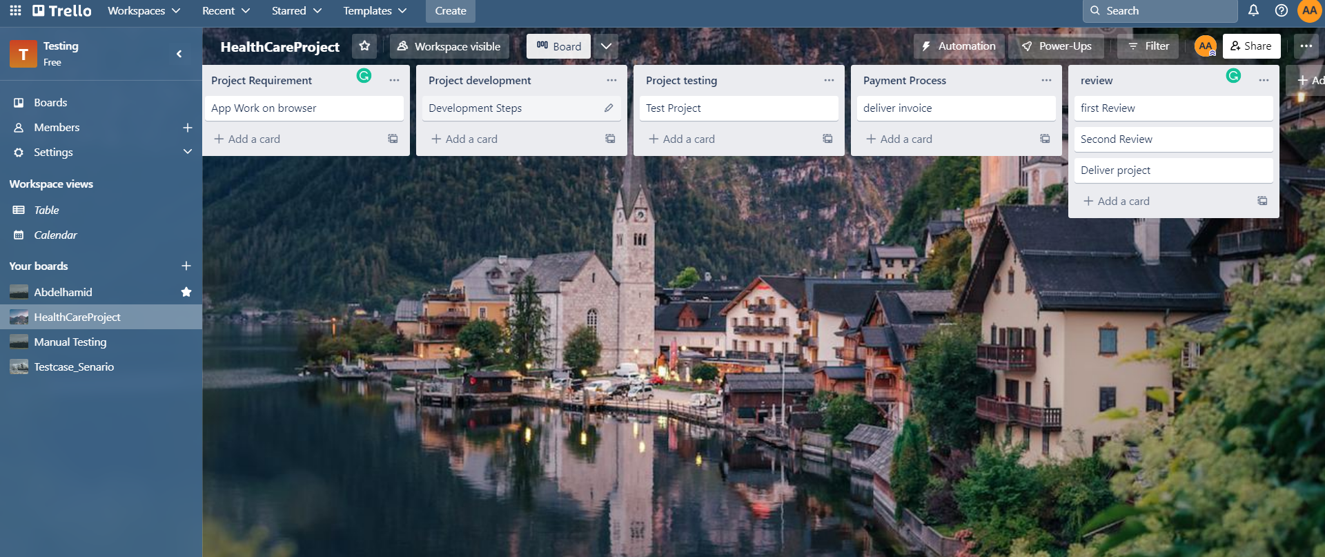
Trello Board
Please include the following information for your Trello board:
A link to your public Trello board should be provided here:
https://trello.com/b/kvX98Kk1/healthcareproject

Slide 8
Part 4
Invoice and Payment Options

Slide 9
[Abdelhamid Awwad]
[Zagazig city, Egypt]
Invoice
Recipient:
[ATA for websites developments]
[Cairo, Egypt]
Invoice #: [1]
Date issued: [11/3/2023]
Date due: [a week from invoice receiving]
Services Rendered (Continue on next page)
Service | Description of Work Done | Hours Spent | Amount Per Hour | Total
[Development] | [Break the PSD into parts] | [10] | [$50] | (Hours spent) x (Amount per hour) = [$500]
[Development] | [Generate Directories] | [10] | [$50] | (Hours spent) x (Amount per hour) = [$500]
[Development] | [Create HTML Code] | [60] | [$50] | (Hours spent) x (Amount per hour) = [$3000]
[Development] | [Generate Style Files] | [15] | [$50] | (Hours spent) x (Amount per hour) = [$750]

Slide 10
[Abdelhamid Awwad]
[Zagazig city, Egypt]
Invoice
Services Rendered (continued)
Service | Description of Work Done | Hours Spent | Amount Per Hour | Total
[Development] | [Web Design Set Arrangement] | [10] | [$50] | (Hours spent) x (Amount per hour) = [$500]
[Development] | [Java Script Interaction] | [40] | [$50] | (Hours spent) x (Amount per hour) = [$2000]
[Development] | [Add Extra Responsive Features] | [5] | [$50] | (Hours spent) x (Amount per hour) = [$250]
[Test the project] | [test all features inside this project] | [30] | [$50] | (Hours spent) x (Amount per hour) = [$1500]
Total Payment Due: [$ 9000]
Payment Options:
PayPal Acc: Abdelhamidawwad@paypal.com
Bank Transfer
QNB: Qatar National Bank
Account Number: 1000231312xbc

