Slide 1
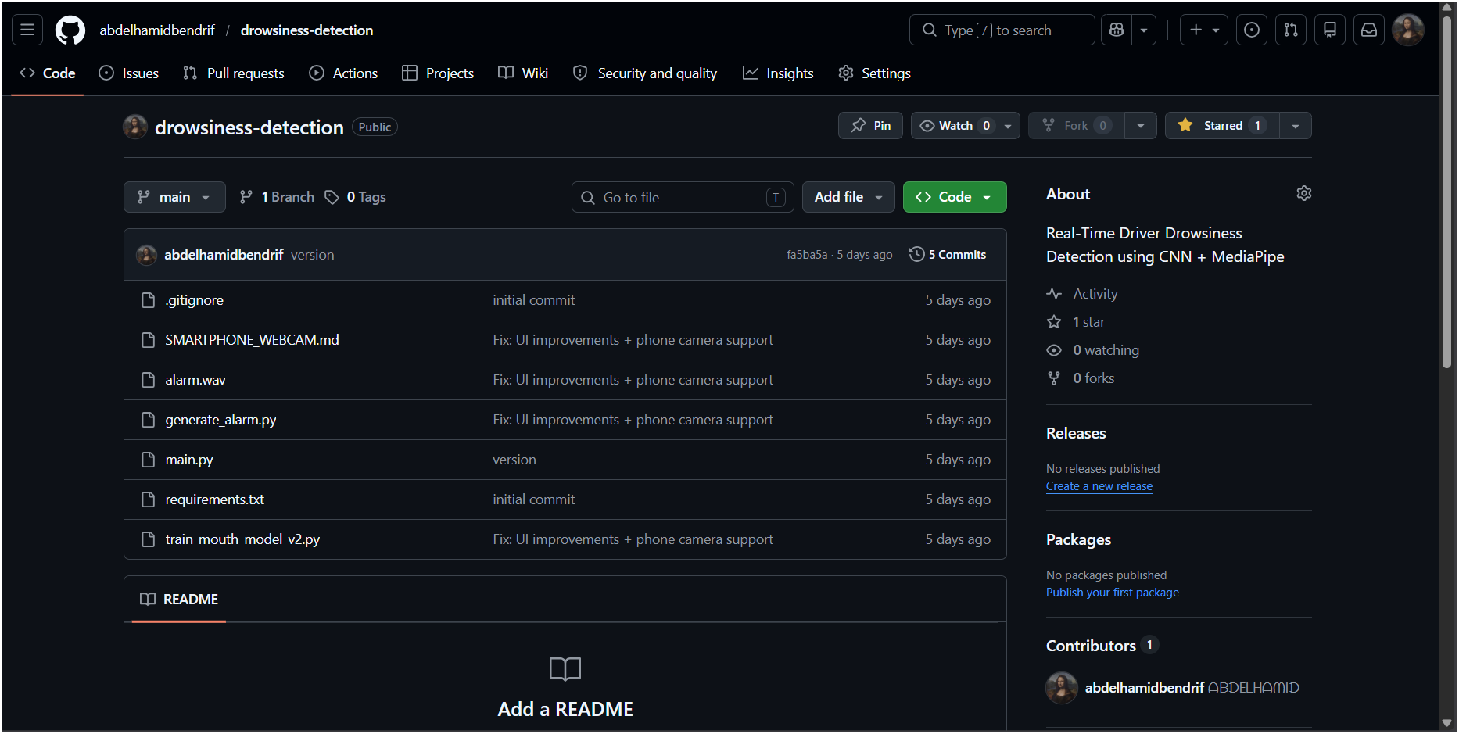

Slide 2
Presentation Outline
From problem definition to real-time deployment
- Motivation and problem statement
- Objectives and scientific contribution
- Datasets and transfer learning strategy
- Real-time system architecture
- Multimodal fusion and temporal decision logic
- Dashboard, alerts, validation and perspectives
Core idea
A driver-fatigue prototype should not rely on one cue only. DriveGuard combines eye appearance, mouth/yawn evidence, head posture, calibration and time consistency.

Slide 3
Motivation
Driver drowsiness is a multimodal safety problem
Why it matters
Challenge
Our answer
Fatigue reduces attention, reaction time and lane control. Visual symptoms appear gradually and may combine weak cues before a clear dangerous event.
Lighting, glasses, camera angle, face shape, network latency and low-quality webcams make single-threshold systems unstable.
Use multimodal deep learning and facial geometry, then stabilize the decision through calibration and temporal logic.

Slide 4
Problem Statement
Detect fatigue from a regular camera in real time
Given a live video stream of a driver's face, estimate whether the driver state is NORMAL, WARNING or DANGER.
- Input: webcam, virtual phone camera, Android IP stream or generic video URL.
- Output: fatigue score, safety state, alert evidence and live dashboard state.
- Constraints: real-time behavior, low-cost hardware and interpretable signals.

Slide 5
Objectives and Contributions
What was implemented
Detection
Decision
Deployment
Two MobileNetV2 classifiers estimate sleepy eyes and yawning. MediaPipe provides facial landmarks for EAR, MAR, iris position and head pose.
CNN probabilities and geometric risks are fused, calibrated per driver, smoothed over time and classified into three safety levels.
The system includes alarm, screenshots, incident videos, CSV logs, optional Telegram notification and a zero-rerun live dashboard.

Slide 6
Global System Architecture
End-to-end operational workflow
Camera
MediaPipe
CNNs
Fusion
Decision
Outputs
>
>
>
>
>
Webcam / phone stream
Face landmarks
Eye and mouth models
Multimodal fatigue score
Normal / warning / danger
Alarm, logs, dashboard
- The detector and the dashboard are decoupled through an atomic JSON state file.
- The dashboard displays live values without forcing the inference pipeline to wait.

Slide 7
Datasets and Training Strategy
Transfer learning with MobileNetV2
Eye model - MRL Eye Dataset
Mouth model - Yawn dataset
Train: 50,937 images
Validation: 16,980 images
Test: 16,981 images
Classes: awake = 0, sleepy = 1
Recorded test accuracy: 98.91%
Recorded test AUC: 99.86%
Train: 1,233 images
Validation/test folder: 215 images
Classes: no_yawn = 0, yawn = 1
Original best validation accuracy: 83.72%
Important: independent mouth test split is future work.

Slide 8
CNN Model Design
Lightweight binary classifiers for real-time inference
- Backbone: MobileNetV2 with ImageNet initialization.
- Input size: 64 x 64 x 3.
- Last 40 layers unfrozen for fine-tuning.
- Global average pooling, batch normalization, dense layers and dropout.
- Output: one sigmoid probability per model.
Eye model
Mouth model
2,624,065 total parameters
2,045,057 trainable
2,435,393 total parameters
1,856,385 trainable
Why MobileNetV2?
Good compromise between accuracy, CPU speed and model size for a real-time student prototype.

Slide 9
Facial Geometry Features
MediaPipe landmarks make the decision interpretable
EAR
MAR
Head pose
Eye Aspect Ratio estimates whether the eyes are closing using distances between eye landmarks.
Mouth Aspect Ratio estimates mouth opening and supports yawn detection.
Approximate roll and pitch highlight abnormal head posture or loss of frontal attention.

Slide 10
Multimodal Fusion
Combining learned and geometric evidence
Eye, mouth and head evidence are normalized to risks, then merged into one fatigue score.
Eye risk
Mouth risk
0.70 x Eye CNN + 0.30 x EAR risk
0.50 x Mouth CNN + 0.50 x MAR risk
Final score
0.50 x Eye risk + 0.30 x Mouth risk + 0.20 x Head-pose risk
The weights reflect the importance of prolonged eye closure while preserving confirmation from yawning and head posture.

Slide 11
Calibration and Temporal Reliability
Reducing false alarms in real-time conditions
Personal calibration
Time-based events
Stability
At session start, EAR and MAR samples are collected while the driver looks forward. Thresholds are adapted to the current face and camera angle.
Blink, prolonged closure, yawn, danger confirmation and danger release are measured in seconds, not frame counts.
A 1.5-second smoothing window, hysteresis and pre-alert cooldown prevent visible flicker and alert spam.

Slide 12
Decision Logic and Alerts
From score to safety action
NORMAL
WARNING
DANGER
Fatigue score below 28%.
Continue monitoring.
Score between 28% and 58%.
Break recommended.
Score at 58% or higher for 1.5 seconds.
Alarm and evidence capture.
- Danger requires calibration and sustained evidence.
- Safe release also requires a stable period to avoid alarm flickering.
- Pre-alerts are generated when the warning score is rising over time.

Slide 13
Evidence and Notification Pipeline
What happens during a confirmed danger event
Step 1
Step 2
Step 3
Alarm sound
Danger screenshot
Incident video
Step 4
Step 5
Step 6
CSV session log
Dashboard event
Optional Telegram
The system already generated screenshots, videos, CSV logs and live JSON states during testing.

Slide 14
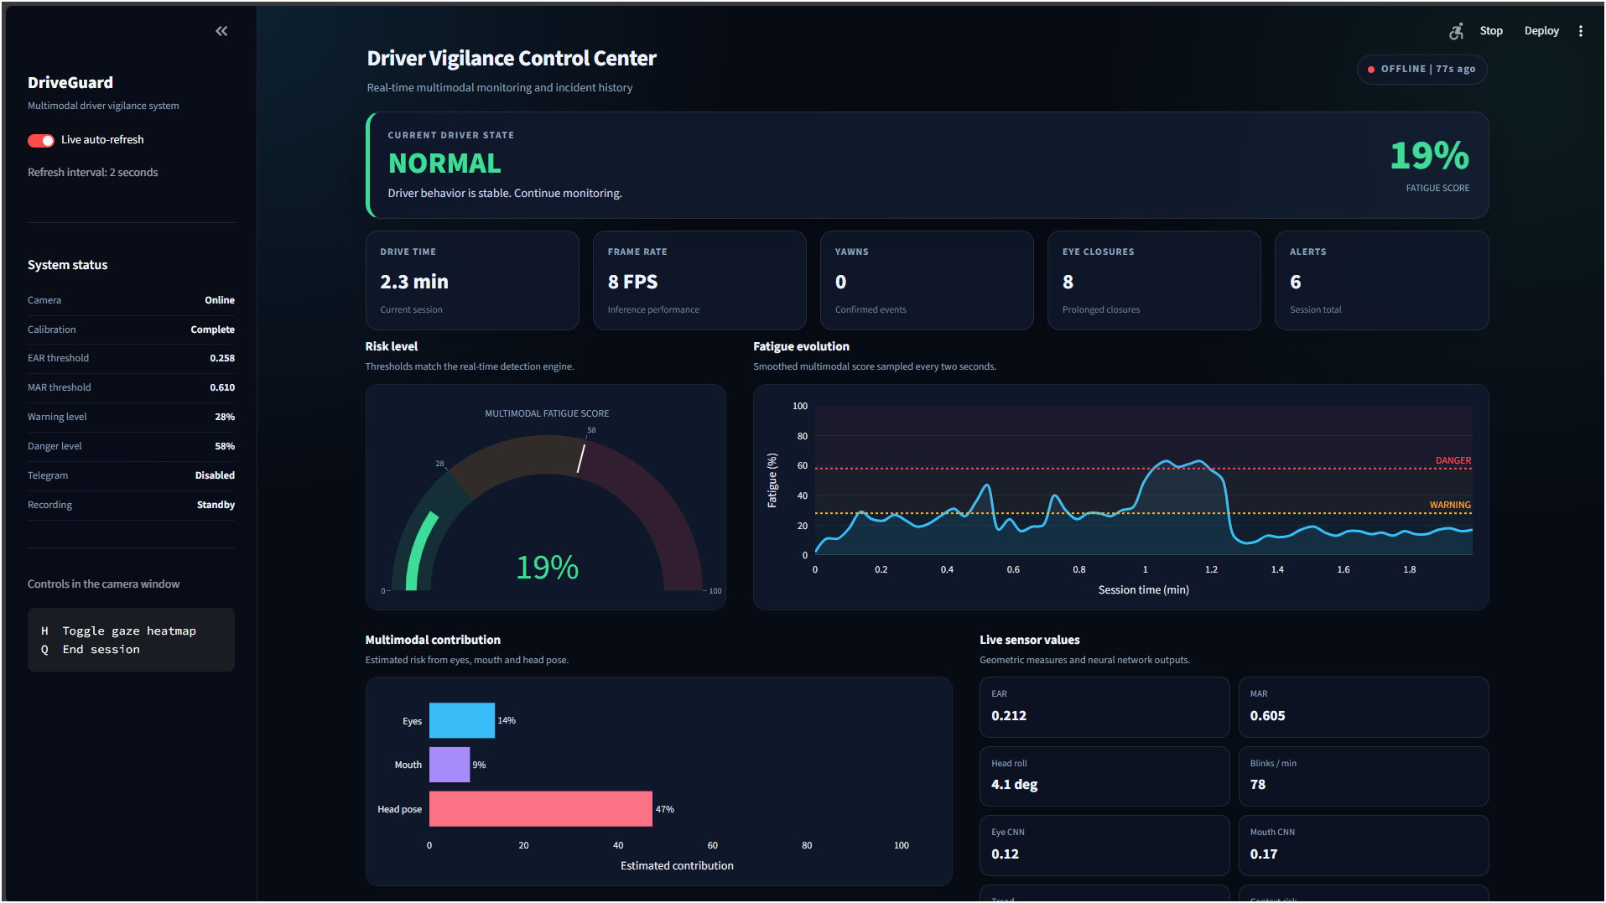
Real-Time Dashboard
Monitoring interface for the final demonstration
Final dashboard: stable HTML view, JavaScript polling every 200 ms, no Streamlit reruns during live monitoring.

Slide 15
Implementation Details
Main files and responsibilities
main.py
dashboard.py + HTML
training files
Camera capture
MediaPipe landmarks
CNN inference
Fusion and temporal logic
Alerts, recording and logs
Stable Streamlit shell
Local state endpoint
Zero-rerun browser dashboard
SVG/CSS live charts
deep-learning.ipynb
train_mouth_model_v2.py
requirements files
trained Keras models

Slide 16
Validation and Final Checks
What was verified before submission
- Python syntax verified for detector, dashboard and training script.
- Dependency consistency checked with pip check.
- Both Keras models loaded successfully.
- Dashboard shell rendered with one stable iframe and zero exceptions.
- JavaScript dashboard engine passed syntax and endpoint checks.
- GitHub repository contains code, documentation, notebook and both trained models.

Slide 17
Limitations
Honest scientific discussion
Mouth validation
Real-world robustness
Temporal model
The mouth dataset needs a fully independent untouched test split before strong final accuracy claims.
Lighting, glasses, blur, camera angle and phone-network quality can still affect performance.
The implemented system uses temporal smoothing, not a recurrent LSTM. CNN-LSTM remains future work.

Slide 18
Future Work
How to improve the research quality
- Create subject-independent train, validation and test splits.
- Evaluate the full system with labeled real driving or simulated sessions.
- Report precision, recall, F1-score, false alarms per hour and alert delay.
- Optimize fusion weights on a multimodal validation dataset.
- Add a true temporal architecture: CNN-LSTM, temporal convolution or transformer.
- Export TensorFlow Lite models for embedded or low-power deployment.

Slide 19
Demonstration Scenario
Recommended order for the oral presentation
- Start the Streamlit dashboard.
- Start the detector with webcam or phone camera.
- Complete personal calibration.
- Show normal monitoring values.
- Demonstrate a yawn and prolonged eye closure.
- Show the warning or danger state, dashboard history and generated evidence.

Slide 20
Conclusion
A complete academic prototype
DriveGuard demonstrates a complete pipeline from deep learning models to a real-time driver-vigilance interface.
Scientific value
Engineering value
Academic honesty
Hybrid fusion of CNN predictions and interpretable facial geometry.
Real-time alerts, evidence capture, phone-camera support and dashboard.
Clear limitations and realistic future work toward stronger validation.
Thank you

