Slide 1


Chouaib Doukkali University
National School of Applied Sciences of El Jadida
Master Data Science and Artificial Intelligence
Module: Natural Language Processing
IMDb Movie Review Sentiment Analysis
Presented by:
Supervised by:
BEN DRIF ABDELHAMID
BELFROUH Sanae
Academic Year:
2025/2026
Notes:
Target timing: 15 seconds.
Hello everyone. My name is Ben Drif Abdelhamid.
Today, I will present my project about movie review sentiment analysis.
The main goal is to predict whether a movie review is positive or negative.
For this project, I compared two machine learning approaches: SVM and CNN.
Sources:
imdb-sentiment-analysis-executed.ipynb, cells 0 and 42

Slide 2
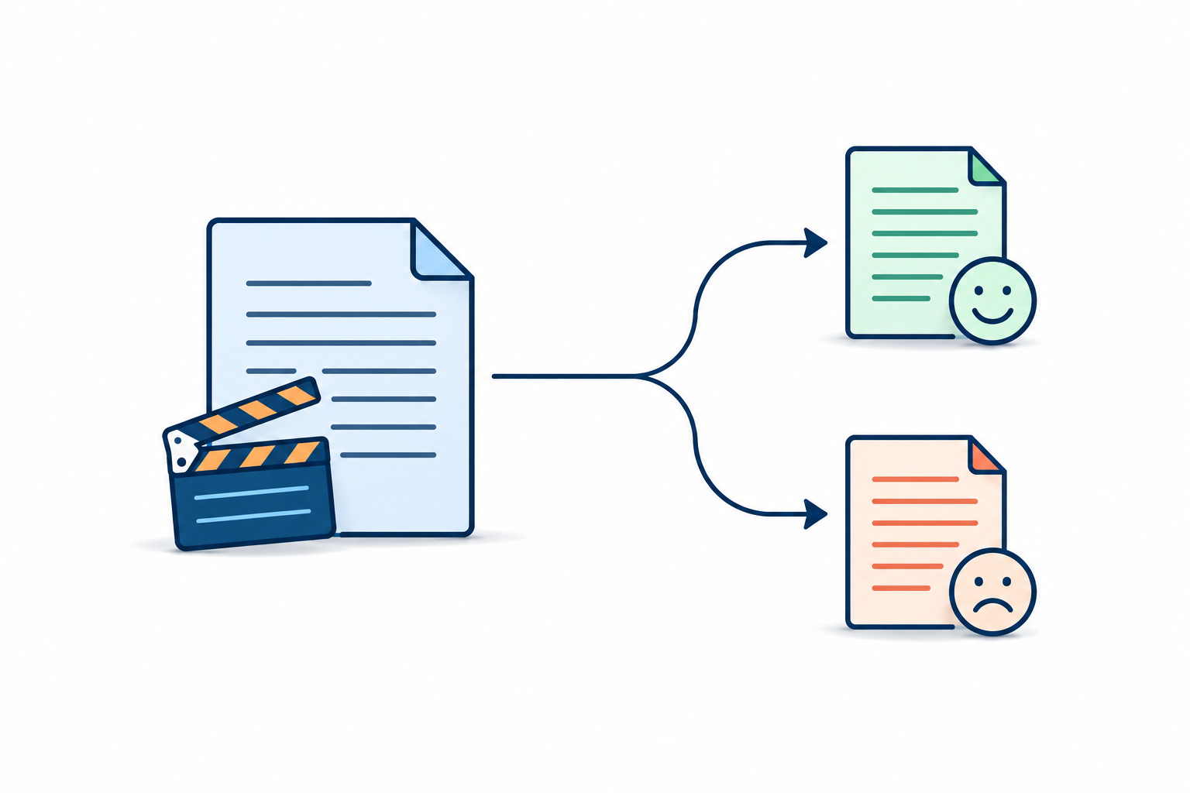
Presentation outline
01
Introduction and problem
Binary sentiment classification
02
Dataset and acquisition
03
Preprocessing and representation
04
Modeling: SVM and CNN
05
Evaluation and critical analysis
06
Application and demonstration
07
Conclusion and future work
Each review receives one sentiment label
1. Introduction and problem
02 / 14
Notes:
Target timing: 15 seconds.
Here is the plan of my presentation.
First, I will introduce the dataset and explain how I prepared the text.
Then, I will present the two models, compare their results, and discuss their limitations.
Finally, I will show you the application and conclude with possible improvements.
Sources:
The supplied SDIA NLP mini-project presentation structure.
Conceptual illustration recolored with the built-in image generation tool. Prompts: output/presentation/assets/color-illustration-notes.md.

Slide 3
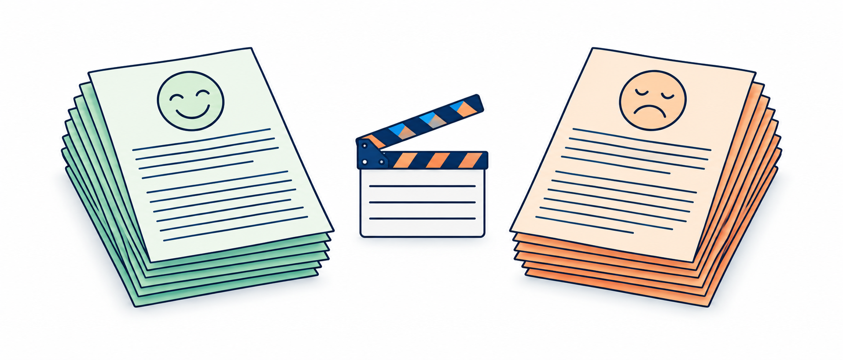
Dataset and experimental split
50,000 reviews
Split | Reviews | Purpose
Train | 39,662 | Fit models
Validation | 4,958 | Select checkpoint
Test | 4,958 | Final evaluation
English movie reviews
25,000 positive / 25,000 negative
80% / 10% / 10%
418 exact duplicates + 4 after cleaning
49,578 unique reviews remain
No missing or blank reviews
Stratified by sentiment, random seed 42
2. Dataset and acquisition
03 / 14
Notes:
Target timing: 30 seconds.
Let's start with the dataset.
I used the IMDb dataset from Kaggle, which contains 50,000 English movie reviews.
Half of them are positive, and the other half are negative.
After removing 422 duplicates, I divided the data into three parts: 80% for training, 10% for validation, and 10% for testing.
We use training data to learn, validation data to select the model, and test data for the final evaluation.
Sources:
imdb-sentiment-analysis-executed.ipynb, cells 1-13
https://www.kaggle.com/datasets/lakshmi25npathi/imdb-dataset-of-50k-movie-reviews
https://nlp.stanford.edu/~amaas/data/sentiment/index.html
Conceptual illustration recolored with the built-in image generation tool. Prompts: output/presentation/assets/color-illustration-notes.md.

Slide 4
Preprocessing
Cleaning
Remove HTML
Lowercase
Negation
didn't becomes
did not
Tokenization
Split text
into words
Lemmatization
Simplify forms
movies: movie
Original
THE movies weren't boring.<br />
Processed
the movie be not boring
Keep negation: "good" and "not good" have different meanings.
3. Preprocessing and representation
04 / 14
Notes:
Target timing: 45 seconds.
Before training the models, I needed to clean the text.
First, I removed HTML tags and converted the text to lowercase.
Then, I handled negation. For example, "didn't" becomes "did not".
I also used tokenization to split sentences into words, and lemmatization to simplify words. For example, "movies" becomes "movie".
An important point is that I kept negation words like "not", because "good" and "not good" have different meanings.
Sources:
imdb-sentiment-analysis-executed.ipynb, cells 7 and 14-22
preprocessing.py

Slide 5
Text representation
TF-IDF
GloVe embeddings
Weights for words and word pairs
Dense word vectors with 100 values
50,000 features
Individual words and pairs of words
Example: "not recommend"
Up to 20,000 vocabulary entries
Maximum 450 tokens per review
100 numbers per word
Efficient representation for SVM
Pretrained word information for CNN
Both vocabularies use training reviews only
3. Preprocessing and representation
05 / 14
Notes:
Target timing: 45 seconds.
After cleaning the text, we need to convert it into numbers that the models can understand.
For the SVM, I used TF-IDF, which gives importance to words and pairs of words.
For the CNN, I used GloVe embeddings, which represent each word as a vector of 100 numbers.
The CNN also uses up to 20,000 vocabulary entries and a maximum of 450 tokens per review.
Both vocabularies were built using training reviews only.
Sources:
imdb-sentiment-analysis-executed.ipynb, cells 23 and 30-32
https://nlp.stanford.edu/projects/glove/

Slide 6
TF-IDF with SVM
Support Vector Machine
Feature | Learned weight
excellent | +3.42
great | +3.23
awful | -4.60
bad | -4.58
not recommend | -3.53
Input: TF-IDF features
Output: positive or negative
Model: linear SVM
Separates positive and negative reviews
Efficient for text classification
Word weights help explain predictions
Positive weights favor positive sentiment.
Negative weights favor negative sentiment.
4. Modeling
06 / 14
Notes:
Target timing: 45 seconds.
The first model is Support Vector Machine, or SVM.
It learns to separate positive reviews from negative reviews using TF-IDF features.
I chose SVM because it is efficient and works well with text classification.
We can also understand some of its decisions by looking at word weights.
For example, "excellent" has a positive weight, while "awful" has a negative weight.
Sources:
imdb-sentiment-analysis-executed.ipynb, cells 23-25 and 28
Technical settings: LinearSVC, C=1.0, max_iter=5000, random_state=42.

Slide 7
GloVe with CNN
450 tokens per review
GloVe
Embedding
450 × 100
Conv1D
128 filters
kernel 5
ReLU
Global max
pooling
128 values
Dense
64 units
ReLU
Dropout
rate = 0.5
training only
Dense
1 sigmoid
threshold 0.5
Pattern detector
Dropout: 0.5
Early stopping on validation loss
Frozen GloVe embeddings
Looks at five tokens at a time
Combines patterns across the review
4. Modeling
07 / 14
Notes:
Target timing: 45 seconds.
The second model is a Convolutional Neural Network, or CNN.
It uses GloVe embeddings to represent words.
Then, a convolutional layer with 128 filters looks for patterns in groups of five words.
Global max pooling keeps the most important patterns, and the final layers predict the sentiment.
I also used dropout and early stopping to help reduce overfitting.
Sources:
imdb-sentiment-analysis-executed.ipynb, cells 30-37
https://aclanthology.org/D14-1181/
Technical settings: 72,449 trainable parameters, 2,000,000 frozen embedding values. Adam 0.001, binary cross-entropy, batch 64, maximum 10 epochs, early-stopping patience 2.

Slide 8
Test results
Metric | SVM | CNN
Accuracy | 0.9086 | 0.8711
Macro precision | 0.9089 | 0.8711
Macro recall | 0.9086 | 0.8711
Macro F1 | 0.9086 | 0.8711
ROC-AUC | 0.9682 | 0.9426
90.86% vs 87.11% accuracy
4,958 test reviews. SVM leads by 3.75 percentage points for these configurations.
5. Evaluation and critical analysis
08 / 14
Notes:
Target timing: 50 seconds.
Now, let's compare the results.
Both models were evaluated on the same test set of 4,958 reviews.
The SVM achieved 90.86% accuracy, while the CNN achieved 87.11%.
The SVM also performed better in F1-score and ROC-AUC.
So, based on these results, we can say that SVM performed better than CNN in this experiment.
Sources:
imdb-sentiment-analysis-executed.ipynb, cells 39-40
output/model_verification.json

Slide 9
Confusion matrices
TF-IDF + SVM
GloVe + CNN
Predicted label
Predicted label
Actual label | Negative | Positive
Negative | 2211 | 259
Positive | 194 | 2294
Actual label | Negative | Positive
Negative | 2142 | 328
Positive | 311 | 2177
453 errors
639 errors
False positive: negative predicted as positive. False negative: positive predicted as negative.
5. Evaluation and critical analysis
09 / 14
Notes:
Target timing: 40 seconds.
To better understand these results, I analyzed the confusion matrices.
They show correct predictions and classification errors.
A false positive happens when a negative review is predicted as positive.
A false negative is the opposite.
As we can see, SVM made 453 errors, while CNN made 639 errors.
This confirms the better performance of SVM.
Sources:
imdb-sentiment-analysis-executed.ipynb, cell 41
output/model_verification.json

Slide 10
CNN overfitting
Accuracy
Binary cross-entropy loss
Selected checkpoint: epoch 4
Minimum validation loss = 0.3040. Training stops at epoch 6 and restores the best weights.
5. Evaluation and critical analysis
10 / 14
Notes:
Target timing: 45 seconds.
Now, let's look at the CNN training curves.
We can see that training accuracy continues to increase, but validation performance stops improving.
This means the model is learning the training data better, without improving on new data.
This problem is called overfitting.
To reduce it, I used early stopping.
Training stopped after six epochs and restored epoch four, which had the lowest validation loss.
Sources:
imdb-sentiment-analysis-executed.ipynb, cells 35-38; recorded training log

Slide 11
Error analysis and limitations
“The film was decent, but I didn’t like the way it ended;
I believe there should have been a different, more logical conclusion.”
SVM: Positive
CNN: Negative
Mixed opinions
Limits of the experiment
Praise: "The film was decent"
Criticism: "I didn't like the way it ended"
English movie reviews only
Two sentiment classes
More testing needed for generalization
No official label for this example. Disagreement alone does not tell us which model is correct.
5. Evaluation and critical analysis
11 / 14
Notes:
Target timing: 45 seconds.
However, both models have limitations.
For example, this review contains both positive and negative opinions.
The SVM predicts positive, while the CNN predicts negative.
This illustrates a challenge with mixed opinions. This example has no official label, so disagreement alone does not tell us which model is correct.
Also, this experiment focuses only on English movie reviews and two sentiment classes.
So, more testing is needed to evaluate generalization.
Sources:
imdb-sentiment-analysis-executed.ipynb, cells 43-44
models/reference_predictions.json
output/model_verification.json

Slide 12
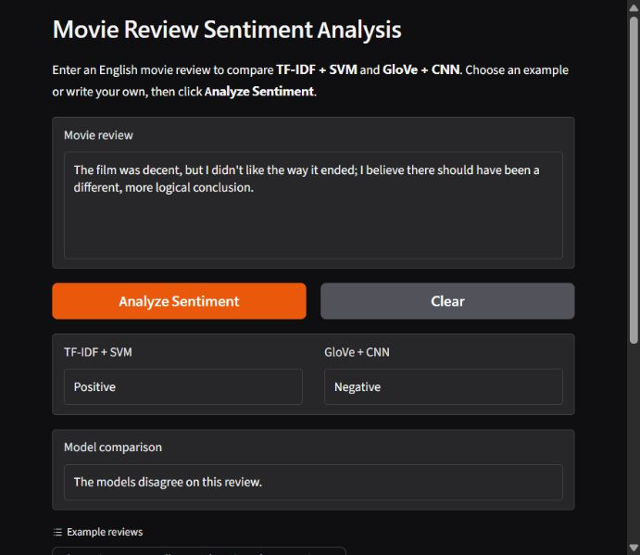
Application demonstration
Live demo
1 Enter an English review
2 Click Analyze Sentiment
3 Compare both predictions
Train on Kaggle
Predict locally on the CPU
Saved models and identical preprocessing
Original Keras weights via NumPy
6. Application and demonstration
12 / 14
Notes:
Target timing: 30 seconds.
Finally, I developed a local application to test both models.
The user enters an English movie review and clicks "Analyze Sentiment".
The application displays the predictions from SVM and CNN and shows whether they agree.
[Enter a review, click the button, and show the predictions.]
As you can see, we can easily compare both models using this interface.
Sources:
app.py
inference.py
keras_numpy.py
output/interface-demo.jpg
output/model_verification.json

Slide 13
Conclusion and future work
TF-IDF + SVM is the stronger model
in this experiment
90.86% test accuracy with a working local demo
Future work
Improve the CNN
Test different configurations using validation data
Evaluate on other datasets
7. Conclusion and perspectives
13 / 14
Notes:
Target timing: 25 seconds.
To conclude, this project covers the complete NLP pipeline, from data preprocessing to model training and application development.
The main result is that TF-IDF with SVM performed better than GloVe with CNN in this experiment.
For future work, I would like to improve the CNN, test different configurations, and evaluate the models on other datasets.
Sources:
imdb-sentiment-analysis-executed.ipynb
output/model_verification.json

Slide 14
Thank you
for your attention
Questions?
BEN DRIF ABDELHAMID
Notes:
Target timing: 5 seconds.
Thank you for your attention.
I am ready for your questions.
Sources:
Closing remarks.

Slide 15
Evaluation metrics
Metric | Meaning
Accuracy | Correct predictions / all reviews
Precision (+) | TP / (TP + FP)
Recall (+) | TP / (TP + FN)
F1 (+) | 2 × precision × recall / (precision + recall)
Macro average | Compute per class, then average equally
ROC-AUC | Quality of score ranking across thresholds
Positive class = positive sentiment. SVM AUC uses margins. CNN labels use threshold 0.5.
Appendix A. Questions
Appendix 1
Notes:
Backup slide for questions. Positive means positive sentiment. Precision asks how many positive predictions are correct. Recall asks how many actual positives are found. F1 balances precision and recall. Macro averaging computes a metric separately for each class and averages the two values equally. ROC-AUC evaluates the ranking of positive examples above negative examples across thresholds. Accuracy is useful here because the classes are almost balanced, but the confusion matrix still reveals different error types. CNN sigmoid scores are not demonstrated to be calibrated probabilities. SVM margins are not probabilities.
Sources:
imdb-sentiment-analysis-executed.ipynb, cells 25, 37 and 40
output/model_verification.json

Slide 16
Experimental controls and limitations
Control or limitation | What this experiment does
Data separation | Remove basic-cleaned exact duplicates before splitting
Fitted representations | Fit TF-IDF and CNN vocabulary on training reviews only
Model selection | Select CNN checkpoint by validation loss
Transfer verification | 4 reference reviews + 4,958 saved test rows match
Comparison limits | Different vocabularies, truncation and pretrained vectors
Generalization limits | New CSV split, one run, no external-domain evaluation
Further tuning uses validation data. A fresh external test is stronger for future redesigns.
Appendix B. Questions
Appendix 2
Notes:
Backup answers. Why no transformer? The project compares a classical baseline with a compact deep model under a limited resource budget. A pretrained transformer could be a future comparison, but was not evaluated. Is the comparison perfectly controlled? Both models use the same cleaned split, but the representations differ in vocabulary size, sequence length, and pretraining, so individual causes cannot be isolated. Why not use the original IMDb benchmark split? This Kaggle CSV experiment uses a new stratified split. Its results are not directly comparable to published benchmark scores. Why not improve using the test results? Further model selection must use validation data. Since the final test has been examined, a fresh external test would be stronger for evaluating future redesigns. What prevents leakage? Basic-cleaned exact duplicates were removed before splitting and vocabularies were fitted only on training text. This does not establish that every near-duplicate or shared movie has been excluded. Why keep frozen random vectors for missing GloVe words? That was the selected setup, but it limits adaptation. A controlled fine-tuning experiment could test an improvement. Is the difference statistically significant? No paired significance test or confidence interval was computed. The reported gap is descriptive for one split.
Sources:
imdb-sentiment-analysis-executed.ipynb, cells 11-12, 23 and 30-40
models/training_metadata.json
output/model_verification.json

Slide 17
Sources and project evidence
Project evidence
Executed training notebook and output/model_verification.json
Dataset access
Kaggle: lakshmi25npathi / IMDb Dataset of 50K Movie Reviews
IMDb benchmark background
Maas et al. (2011), Learning Word Vectors for Sentiment Analysis
nlp.stanford.edu/~amaas/data/sentiment/
Word embeddings
Pennington, Socher & Manning (2014), GloVe
nlp.stanford.edu/projects/glove/
CNN background
Kim (2014), Convolutional Neural Networks for Sentence Classification
aclanthology.org/D14-1181/
Appendix C. References
Appendix 3
Notes:
Sources. The numerical results and architecture come from the executed project notebook and local verification report. Dataset access: Kaggle, lakshmi25npathi, IMDb Dataset of 50K Movie Reviews. Dataset background: Maas and colleagues, Learning Word Vectors for Sentiment Analysis, ACL 2011. Word vectors: Pennington, Socher and Manning, GloVe: Global Vectors for Word Representation, EMNLP 2014. CNN background: Yoon Kim, Convolutional Neural Networks for Sentence Classification, EMNLP 2014. This project uses its own compact single-kernel CNN rather than claiming an exact reproduction of Kim's architecture. The previous group's PDF served as a presentation reference only. Its names, models, and results were not reused.
Sources:
https://www.kaggle.com/datasets/lakshmi25npathi/imdb-dataset-of-50k-movie-reviews
https://nlp.stanford.edu/~amaas/data/sentiment/index.html
https://nlp.stanford.edu/projects/glove/
https://aclanthology.org/D14-1181/
imdb-sentiment-analysis-executed.ipynb
output/model_verification.json

