Slide 1
[ University Logo ]
[Module Name] — Data Engineering
Real-Time Trending Topics Detection Pipeline
A Data Engineering Pipeline on the Bluesky Firehose
AUTHORS
DATE
[Author Name 1]
[Author Name 2]
June 2026
1

Slide 2
AGENDA
Plan of the Presentation
1
Context & Problem
2
Objectives & Key Decisions
3
System Architecture
4
Real-Time Pipeline & Cleaning
5
Storage, Serving & Dashboard
6
Search & Exploration
7
Results, Engineering Rigor & Conclusion
2

Slide 3
INTRODUCTION
The Problem We Solve
Social platforms produce a continuous, unbounded stream of public posts
“Frequent” is not “trending”: common words are stable, not interesting
We need acceleration: a term's rise versus its own recent baseline, not raw counts
Spam, bots, and noisy/clock-skewed clients must not be mistaken for real spikes
All of this must happen continuously and at low latency, not as a nightly batch job
3

Slide 4
INTRODUCTION
Objectives & Key Decisions
End-to-end pipeline: ingest → clean → score → store → serve → visualize
Source: Bluesky Jetstream firehose — public, real-time, no authentication
Trend score: ratio to the term's own trailing baseline (acceleration, not frequency)
Window: 5-minute sliding window, 1-minute slide, 2-minute watermark
HBase for low-latency serving; Elasticsearch/Kibana added for full-text exploration
Every component is its own Docker service, cleanly separated, configured by env files
4

Slide 5
01
Architecture
How the system is put together
5

Slide 6
ARCHITECTURE
Global System Architecture
Jetstream
wss firehose
Producer
Python
Kafka
bluesky-posts
Spark
Structured Streaming
HBase
REST :8080
API
FastAPI
Dashboard
Next.js
Trending pipeline
Indexer
Python
Elasticsearch
single-node 8.15
Kibana
web UI :5601
Search & exploration (additive)
One Kafka topic, two independent downstream readers — neither blocks the other
Trending pipeline (teal): scores and ranks terms, served by HBase + the API
Search branch (cyan): indexes raw posts for full-text search, additive only
6

Slide 7
ARCHITECTURE
Technology Stack
Python
Producer, Indexer
Apache Kafka
Ingestion & buffering (KRaft)
Apache Spark
Structured Streaming
Apache HBase
Low-latency serving store
FastAPI
REST API
Next.js
Dashboard UI
Elasticsearch
Full-text search index
Kibana
Exploration UI
Docker Compose
9 containers, 1 network
7

Slide 8
02
Real-Time Pipeline
Ingestion, cleaning, windowing, and scoring
8

Slide 9
REAL-TIME PIPELINE
Ingestion: Firehose to Kafka
Producer opens a WebSocket to the Bluesky Jetstream firehose (no auth required)
Keeps only post-creation events, filtered to English language
Reconnects automatically with exponential backoff, resuming from its last cursor
Publishes each surviving post as a small JSON record to Kafka topic bluesky-posts
9

Slide 10
REAL-TIME PIPELINE
Real-Time Cleaning Pipeline
Raw post text
from Kafka
Lowercase +
strip URLs/mentions
regex
Extract hashtags
#word -> term
Strip punctuation
& apostrophes
don't -> dont
Filter stopwords
& short words
len >= 3
Terms
hashtags + words
One shared, pure-Python module — reused as-is by 3 independent services
10

Slide 11
REAL-TIME PIPELINE
Cleaning in Action
BEFORE · RAW TEXT
AFTER · CLEANED TEXT
Just published my research on #DataEngineering 🚀 Check it out at https://example.com/article cc @johndoe isn't this exciting??
just published my research on check it out at cc isnt this exciting
#dataengineering
published
research
check
exciting
Same input → same output on spark-processor, api, and indexer — by construction
11

Slide 12
REAL-TIME PIPELINE
Windowing & Trend Scoring
window 1
window 2
window 3
5-minute window · 1-minute slide · 2-minute watermark
score = count / (baseline_avg + smoothing)
Ratio to the term's own trailing baseline (EMA) - acceleration, not raw frequency
12

Slide 13
03
Storage, Serving & Dashboard
From ranked terms to a live UI
13

Slide 14
STORAGE
HBase Schema
Table | Row key | Columns | Written by | Read by
trends | bucket#rank | rank, term, count, score, distinct_authors | spark-processor | api
term_history | term#bucket | count, score | spark-processor | api
term_baseline | t#term | avg | spark-processor | spark-processor
pipeline_meta | latest_bucket | value, updated_at | spark-processor | api
TTL on trends/term_history enforces 24h retention automatically — no cleanup job
14

Slide 15
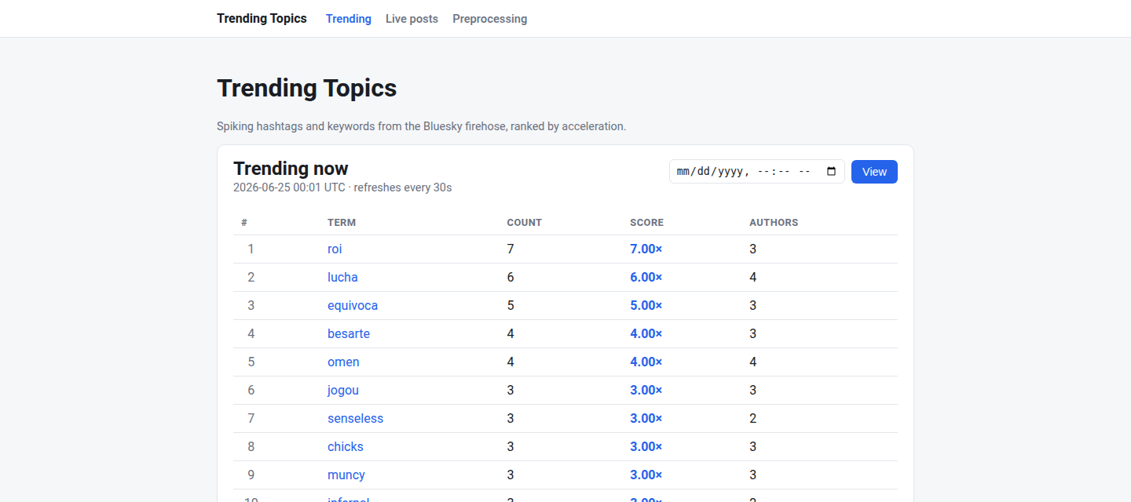
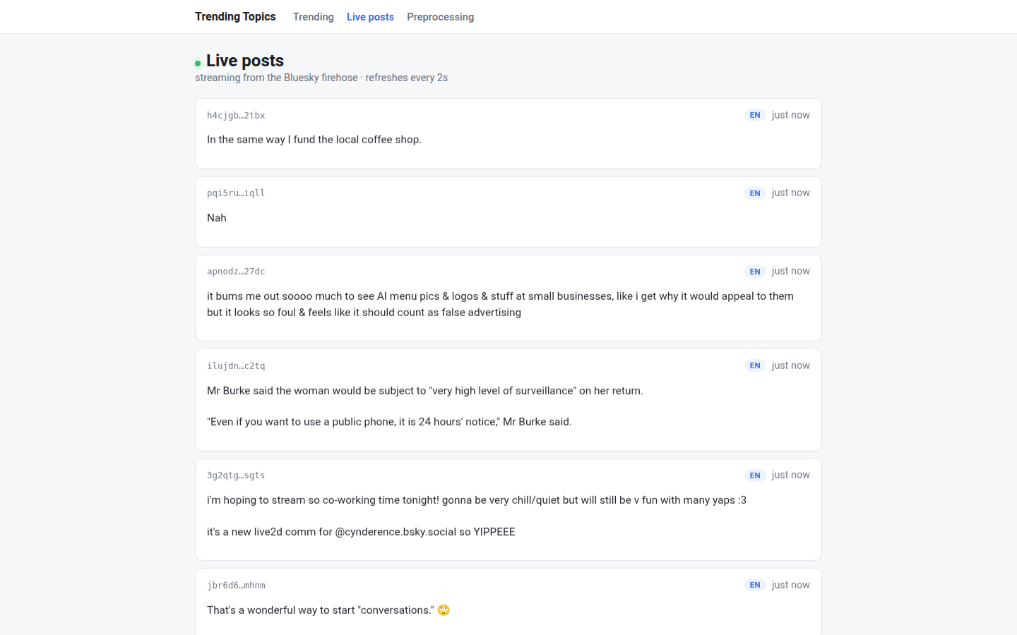
SERVING
REST API & Dashboard
Trending Now
Live Posts
15

Slide 16
04
Search & Exploration
Elasticsearch + Kibana, additive to the trending path
16

Slide 17
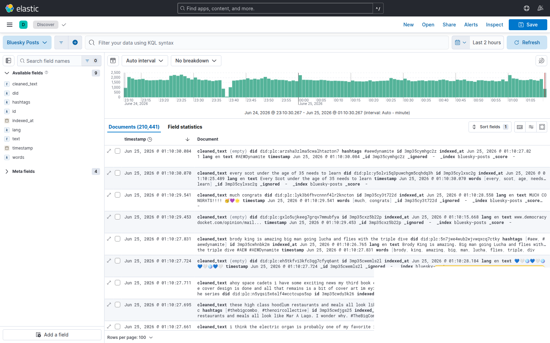
SEARCH & EXPLORATION
Kibana: Full-Text Exploration
Full-text search, faceting on hashtags/words/lang, post-volume histogram
17

Slide 18
05
Engineering Rigor & Results
What broke, what we learned, what we shipped
18

Slide 19
ENGINEERING RIGOR
Real Issues Found & Fixed
Watermark poisoning
HBase pagination bug
Sequential bottleneck
A clock-skewed client posted a timestamp ~6.5h in the future, permanently advancing Spark's watermark and silently dropping all later events.
HBase REST's scanner caps cells per page, not rows — a 5-column row could be split across pages and returned incomplete.
One HTTP call per candidate term made large windows (5000+ terms) fall behind their 30s trigger under real load.
Fixed: reject events whose timestamp is implausibly far in the future.
Fixed: merge cells by row key across pages before truncating to the limit.
Fixed: batched multiget/multi-row PUT — verified at 5241 candidates, zero restarts.
19

Slide 20
RESULTS
Project Implementation
9
3
4
100%
Dockerized services
Independent Kafka consumers
Real bugs found in production-like testing
Configured via .env files
Every service: its own Dockerfile, its own .env, clean separation of concerns
Shared preprocessing module vendored at build time into 3 services from one source file
Verified against the real, live Bluesky firehose throughout — not just unit tests
20

Slide 21
CONCLUSION
Conclusion
Built a complete, real-time trending-detection pipeline on a live public data source
Acceleration-based scoring (ratio to baseline) surfaces real spikes, not just frequent words
Clean separation of services, shared rules vendored from one source, fully containerized
Hardened by real engineering issues found and fixed under real load, not just in theory
Extensible: the same architecture pattern (independent Kafka consumers) added Kibana search without touching the existing trending path
21

Slide 22
Thank You
Questions?
22

