Slide 1
Ansible - Introduction
Inventory, Config Files, Playbooks, Rolls, and Collections

Slide 2
Ansible Introduction & Overview
Ansible – An automation language leveraging modules to be used in one or more tasks on managed systems. Most Ansible automation leverages and Ansible playbook which is a YAML formatted file containing Ansible directives.
Ansible modules – Components used by Ansible tasks and playbooks which are generally implemented and developed in Python. Ansible modules work with certain system utilities and are optimized to be leveraged as a declarative automation language and provide idempotency.
Ansible ad-hoc commands – A way of executing a single Ansible task quickly that relies on a single Ansible module to perform the tests/changes of the task.

Slide 3
Ansible Components & Commands
ansible.cfg – Configuration file for running the ansible and ansible-playbook commands.
Inventory – Inventory file used by the ansible and ansible-playbook commands identifying managed hosts/nodes.
ansible – Command used to perform/execute Ansible ad-hoc commands against a managed node.
ansible-playbook – Command used to execute and run Ansible playbooks
ansible-galaxy – Command to create or utilize Ansible roles. Many of these roles are published on http://galaxy.ansible.com
Playbook – Collection of Ansible tasks organized into one or more Ansible plays.
Task – Collection/list of Ansible modules arranged into instructions. Each task utilizes an Ansible module to perform a given action.
Ansible Module – Specific module (small program generally implemented in Python) which perform the commands and executes the program to get the desired state of a given task.

Slide 4
Ansible (AAP2) Components & Commands
Ansible-navigator.yml – Configuration file for running the ansible-navigator command. The biggest things specified here are the EEI (Execution Environment Image), the Pull Policy, and the mode. Ansible Module – Specific module (small program generally implemented in Python) which perform the commands and executes the program to get the desired state of a given task.
Ansible Collection – Collections of Ansible content. Generally Ansible collections include Ansible modules, Ansible roles, and Ansible plugins. However, it is possible to include Ansible playbooks as part of collections.
ansible-navigator – Command line utility that will execute Ansible playbooks in an execution environment using the defined EEI. The ansible-navigator command replaces all other ansible commands.
Execution Environment Image (EEI) and Execution Environment – The EEI is a container image is a simple container image that contains OS and system packages, Python packages, and most importantly the Ansible runtime libraries and components along with a set of Ansible collections and modules. The Execution Environment (EE) is the container launched by the Ansible navigator command that runs the ansible playbook and essentially functions as the control node. It is important to remember with EEs, that localhost refers to the container running the playbook and not the system running the ansible-navigator command.

Slide 5
Inventory File
The inventory file can contain both Ansible managed hosts/nodes as well as inventory variables to be used for the managed nodes.
Inventory location is generally specified by the ansible.cfg file
./inventory – Common practice to leverage inventory files with playbooks and the ansible.cfg file in the current working directory
/etc/ansible/hosts – Default inventory file deployed with the Ansible package
Important | Inventories must contain exact names and each unique hostname/IP/FQDN included in inventory appears as a separate managed node in Ansible.

Slide 6
Ansible.CFG File
This file defines the configuration directives which apply directly to how the ansible and ansible-playbook command interact with the Ansible application and which configuration items are applied to a given Ansible session.
./ansible.cfg – When located in the current working directory (CWD) this file is the highest precedence.
~/.ansible.cfg – When located in the user’s home directory, this file will have precedence if an ansible.cfg doesn’t exist in the CWD.
/etc/ansible/ansible.cfg – This is the default configuration file and has the lowest precedence. This file is used when no other ansible.cfg file exists.
Important | It is also possible to define the ansible.cfg file with the environment variable ANSIBLE_CONFIG. If this variable is used, it will override all other configuration files.

Slide 7
ANSIBLE-NAVIGATOR.YML File
This file defines the configuration directives which apply directly to how the ansible and ansible-playbook command interact with the Ansible application and which configuration items are applied to a given Ansible session.
./ansible-navigator.yml – When located in the current working directory (CWD) this file is the highest precedence.
~/.ansible-navigator.yml – When located in the user’s home directory, this file will have precedence if an ansible.cfg doesn’t exist in the CWD.
Important | It is also possible to define the ansible-navigator.yml file with the environment variable ANSIBLE_NAVIGATOR_CONFIG. If this variable is used, it will override all other configuration files.

Slide 8
Playbook structure (simple)
---
- name: Ansiblize Managed Hosts
hosts: localhost
tasks:
- name: Create Ansible User
debug:
msg: This will use the USER module

Slide 9
Playbook structure (Complex)
---
- name: Ansiblize Managed Hosts
hosts: localhost
vars_files:
- variables.yml
roles:
- namespace.role_name
pre-tasks:
- name: Pre-Task to login to the API for Ansible Tasks
debug:
msg: This will use a module to login to the API
tasks:
- name: Create Ansible User
debug:
msg: This will use the USER module
post-tasks:
- name: Pre-Task to login to the API for Ansible Tasks
debug:
msg: This will use a module to login to the API
handlers:
- name: Restart SSHD
debug:
msg: This sill use the SERVICE or SYSTEMD

Slide 10
Creating an Ansible ROLE
Use the ansible-galaxy init <RoleName> command to create a Role
Empty directories or unused directories can be deleted to clean up the Role
Populate the various Role structures
Must have the following components (at minimum):
README.md
meta/main.yaml
tasks/main.yaml
[student@workstation ~]$ ansible-galaxy init My_Role
- My_Role was created successfully

Slide 11
Ansible ROLE Structure
[student@workstation ROLES]$ tree My_Role/
My_Role/
├── defaults
│ └── main.yml
├── files
├── handlers
│ └── main.yml
├── meta
│ └── main.yml
├── README.md
├── tasks
│ └── main.yml
├── templates
├── tests
│ ├── inventory
│ └── test.yml
└── vars
└── main.yml
8 directories, 8 files

Slide 12
Ansible ROLE Structure
Subdirectory | Function of Directory
defaults | The main.yml file contains default variable values that are used by the role. These have the lowest precedence and priority.
files | Contains files that are used by the tasks in the role.
handlers | The main.yml file contains handlers that are executed by the role.
meta | The main.yml file contains information about the role. At a minimum you should modify the author, license, platforms, and dependencies.
tasks | The main.yml file contains the tasks being used by the Role.
templates | Contains Jinja2 templates used by tasks in the role.
tests | Contains an inventory and test.yml playbook that can be used to test the role.
vars | The main.yml file contains role variables and values. These are high precedence and not intended to be changed when used in a playbook.

Slide 13
Ansible Content Collections
Use the ansible-galaxy collection install <collection_name> command to install a collection.
You can install multiple collections and use the –r requirements.yml file to provide a list of content collections. You can also use the –p <directory> to specify where to install content collections. Typically, this would be in a folder in the current working directory at the project level called collections.
Sdf
[student@workstation ~]$ ansible-galaxy collection install

Slide 14
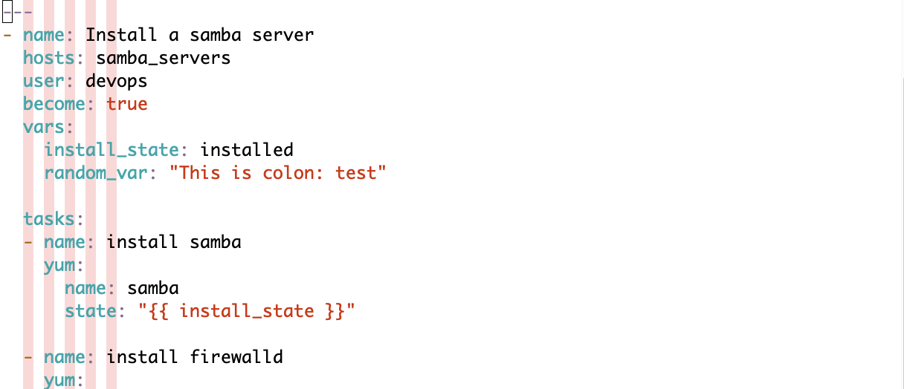
Playbook Troubleshooting
.vimrc | autocmd FileType yaml setlocal ai ts=2 sw=2 et sts=2 colorcolumn=3,5,7,9,11

