Slide 1

TastyTracks
Part I (Design)
RESTAURANT WEBSITE
Notes:
- TastyTracks is a website that represents a virtual restaurant.
Will work on simple stuff at first then gradually build up towards harder concepts and I will try my best to keep things simple and keep the complications to a minimum.
I will show you the designs we will work on then will start coding.

Slide 2







Frontend Tech we will use
React 18
Vscode
Tailwind
Ant Design
AXIOS
React Icons
TypeScript
Notes:
We’ll use React 18 in this project and use hooks and functional components to avoid concepts that are too complicated.
I will use VSCODE but feel free to use whatever you feel comfortable with.
We’ll use tailwind for styling and occasionally some CSS.
We will use Ant design as a UI Library to avoid styling everything which is a nightmare.
We’ll also use AXIOS instead of the native JS fetch because it has a bit more functionalities and easy to configure.
We’ll need react icons.
And finally, we’ll use typescript to reduce errors and stuff.
Feel free to leave a comment If you’d like me to add or remove something from this list.

Slide 3
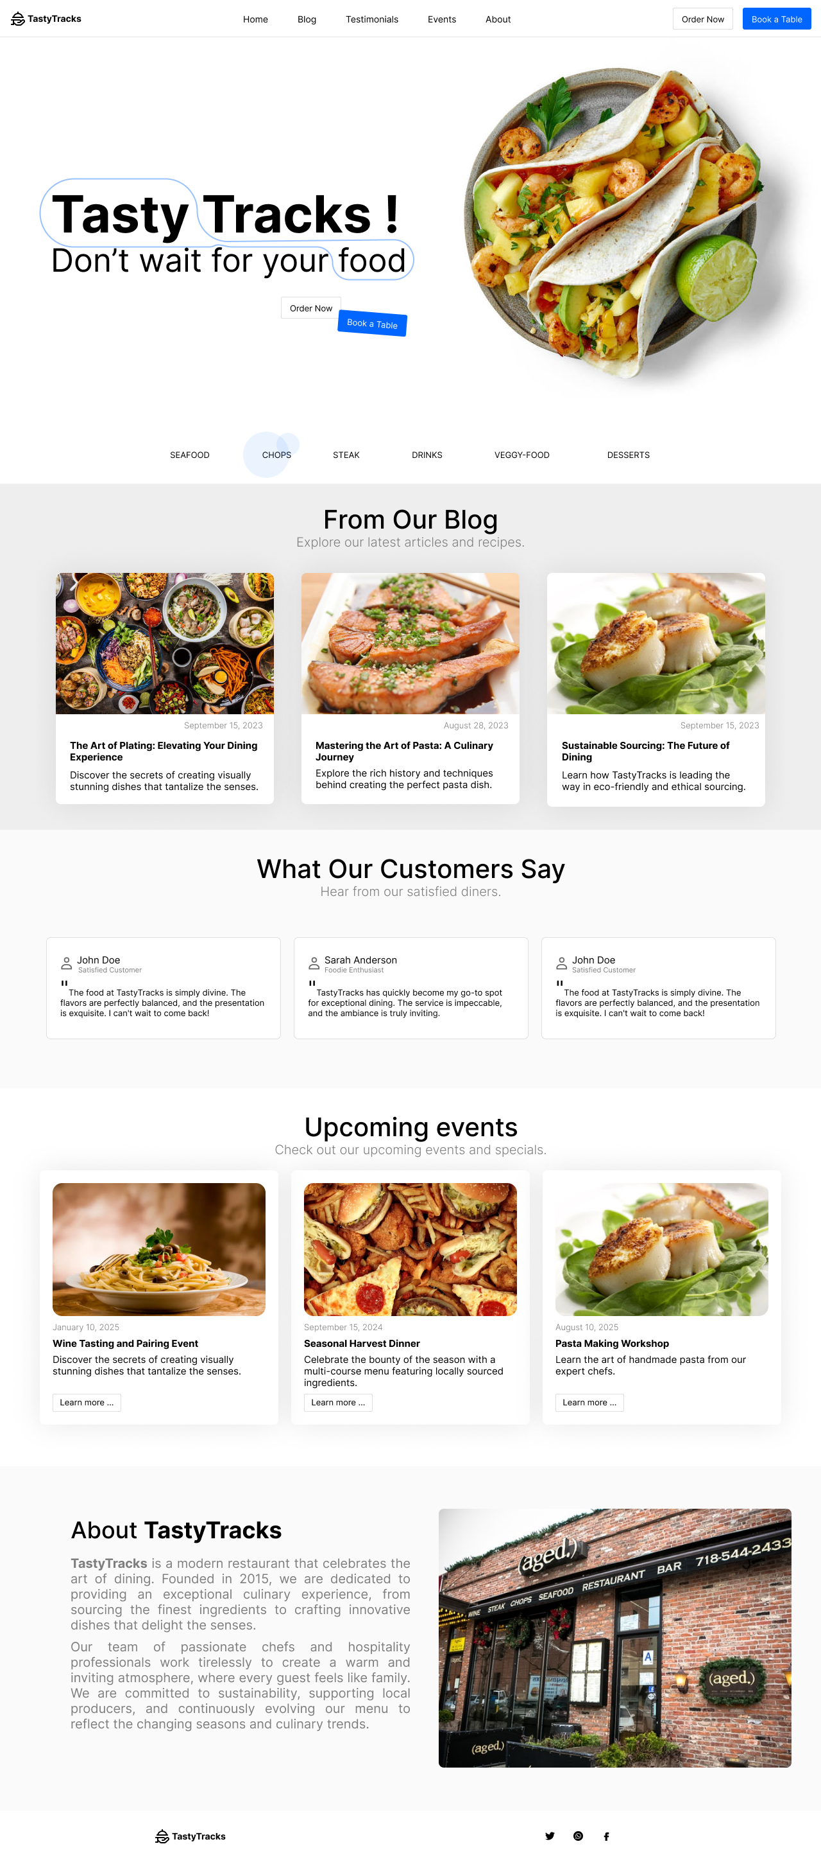
TastyTracks
Landing

Slide 4
TastyTracks
From our blog

Slide 5
TastyTracks
Testimonials

Slide 6
TastyTracks
Events

Slide 7
TastyTracks
About
Footer

Slide 8
Let’s get coding !
Clean & good code.
Focus on good design.
Keep it simple.
coding
coding
Notes:
- Code will get progressively more complicated as we advance, so the most important thing that I will try to keep consistent is clean and good code that has comments and is easy to maintain and understand.

