Slide 1


Flutter Workshop
Inelectronics
Students
Club
Presented by:
- Belkacem BEKKOUR
- Anes SEDDIK
- Abdelhamid RIAHI
- Mohammed BOURAHLA
- Cheikh HASNI

Slide 2


Flutter
Inelectronics
Students
Club
Flutter is framework created by Google.
A cross-platform framework used to develop application for
Android
iOS
Web
Desktop
Dart Programming language

Slide 3









Why Flutter for App Development
Inelectronics
Students
Club
1. Open Source | 2. Faster development Cycle | 3. Super Productive
Flutter is Open-Source framework
Therefore, anyone can use it for any given purpose.
Flutter is so fast that it takes less then 30 sec for first full compilation.
Comes with Hot-Reload & Hot-Restart.
Comes with Hot-Reload & Hot-Restart.
Due to Stateful widget hot-reload feature Flutter is very fast iterative coding style.

Slide 4

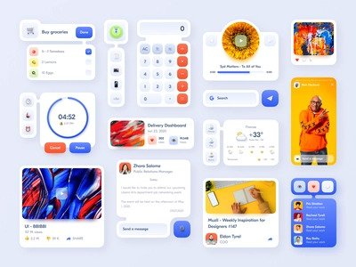

Why Flutter for App Development
Inelectronics
Students
Club
4. Ease to learn & code sharing | 5. Widget Libraries | 6. Community Support
Any one who have basic knowledge of OOPS & UI Designing can easily learn Flutter.
Ready to use widget, Flutter have many widget that you can use to build flutter application. Such as : http, get, share plus, toggle switch etc.
Flutter Community is bit small if we compare with other framework like React.
But Flutter is grow very fast then other framework.

Slide 5
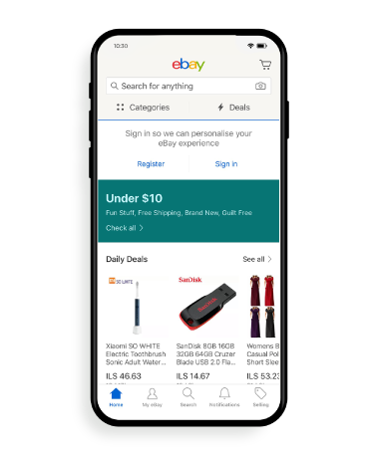
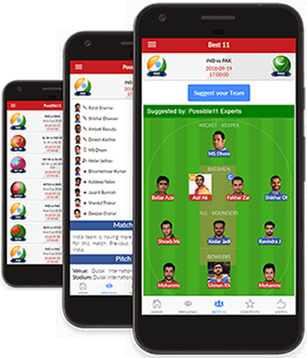
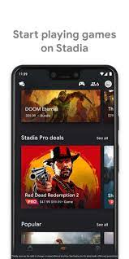
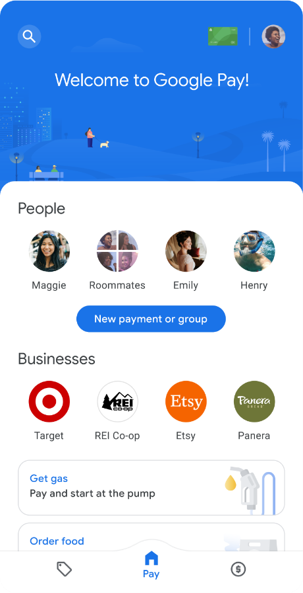
Apps that are build using Flutter
Inelectronics
Students
Club
Stadia gaming platform.
Dream 11
eBay
Google Pay

Slide 6
Outline of the workshop
Inelectronics
Students
Club
WEEK 1
WEEK2
WEEK 3
Introduction to flutter.
Flutter requirement installation.
Runing “Hello World app”.
Introduction to dart programming language.
Object orioted programming concepts.
Flutter Layout/ Basic widgets.
Build a full App page.
Challenge session.
Building a full UI App.

Slide 7
THANK YOU
Inelectronics
Students
Club

