Slide 1
Challenge data analysis
Axelle Paquet, Abdellah El Ghilbzouri, Melvin Leroy.

Slide 2

Introduction
Data cleaning/managing;
Data analysis;
Data interpretation.

Slide 3
Data cleaning/managing

Slide 4
Data cleaning/managing
Rename and drop some columns;
Delete rows with NAN in prices and duplicated rows;
Change type some data and create columns from others;
  Region classification;
  Province classification;
  Get all the cities’ names the same.
Create one hot encode columns.

Slide 5
Data analysis

Slide 6
Data analysis
The target variable:
Price by square meter
Number of data:
shape = (19855, 73)
=> 1 449 415 values
(/!\ one hot encoding)

Slide 7
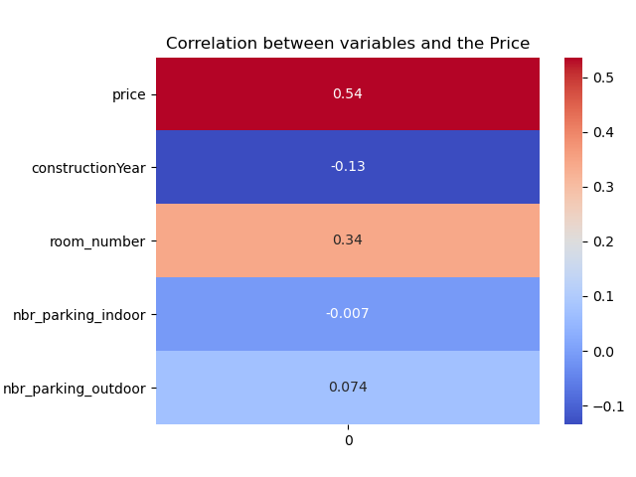
Correlation between the variables and the target.

Slide 8
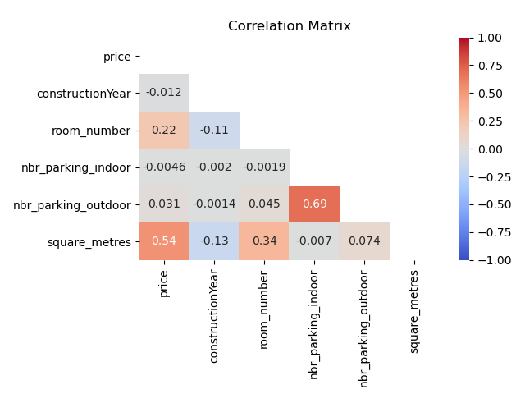
Correlation matrix

Slide 9
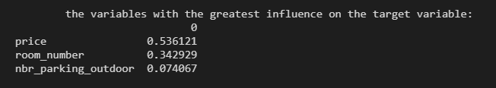
Variables with the greatest influence on the target.

Slide 10

Variables with the least influence on the target

Slide 11

Qualitative variables
Number of qualitative variables:
Qualitative variables transformation:
One hot incoding

Slide 12
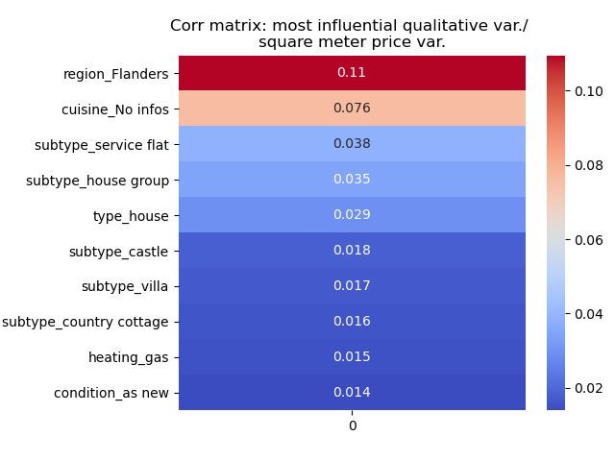
Most influential qualitative variables

Slide 13
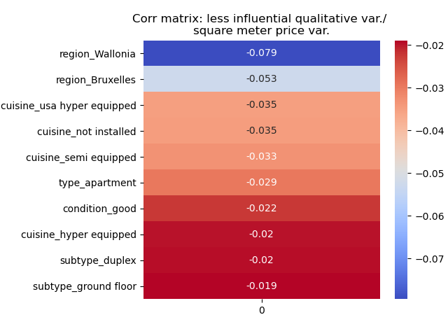
Least influential qualitative variables

Slide 14
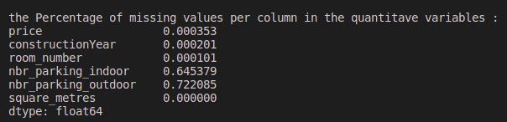
Missing values

Slide 15
Data interpretation

Slide 16
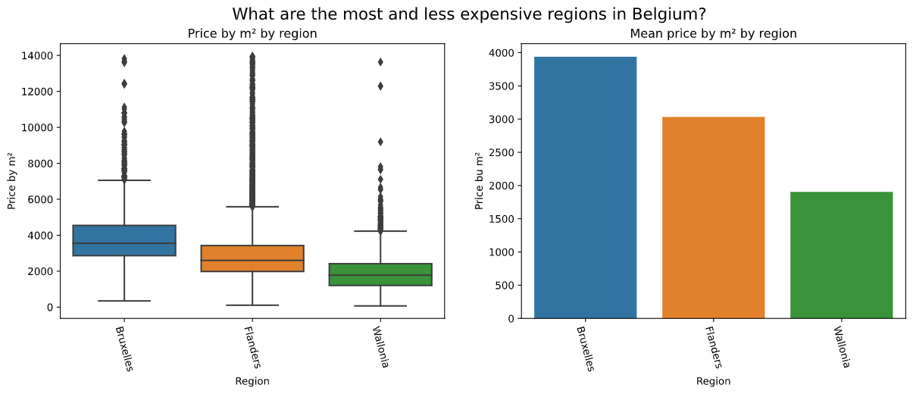
Data interpretation

Slide 17
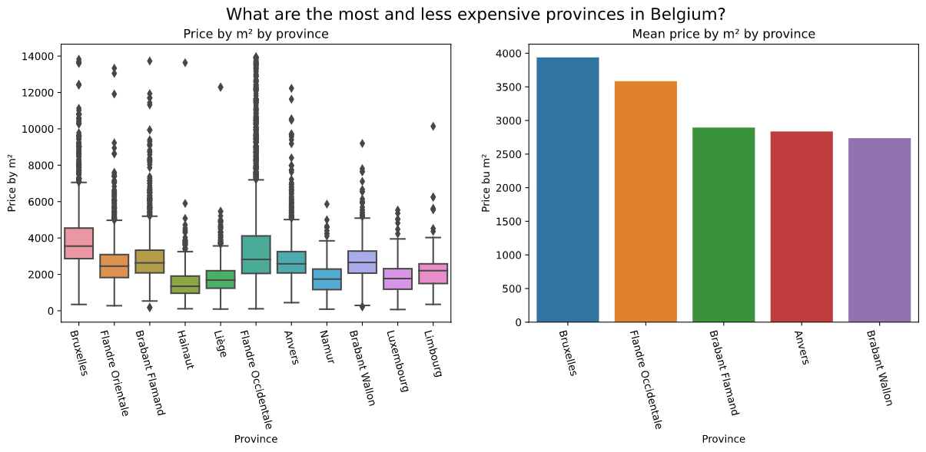
Data interpretation

Slide 18
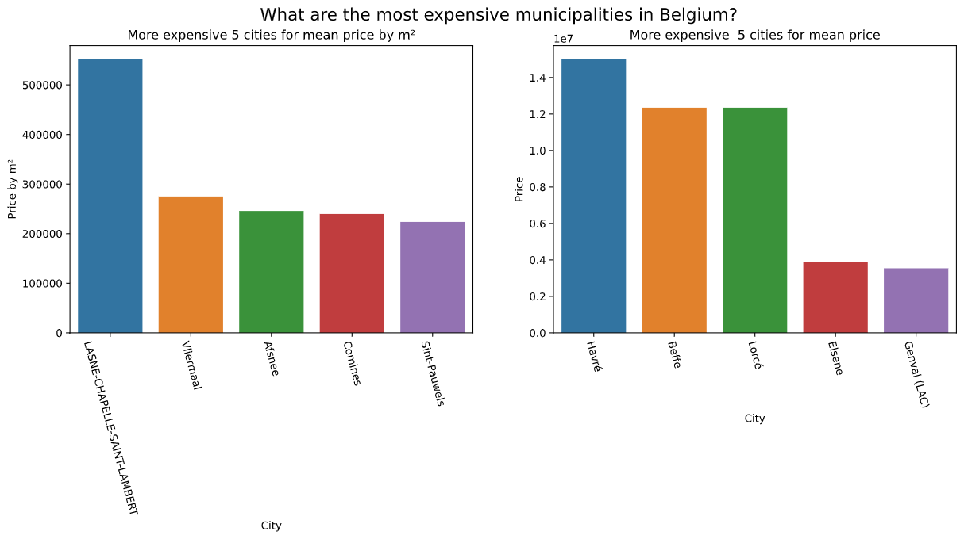
Data interpretation

Slide 19
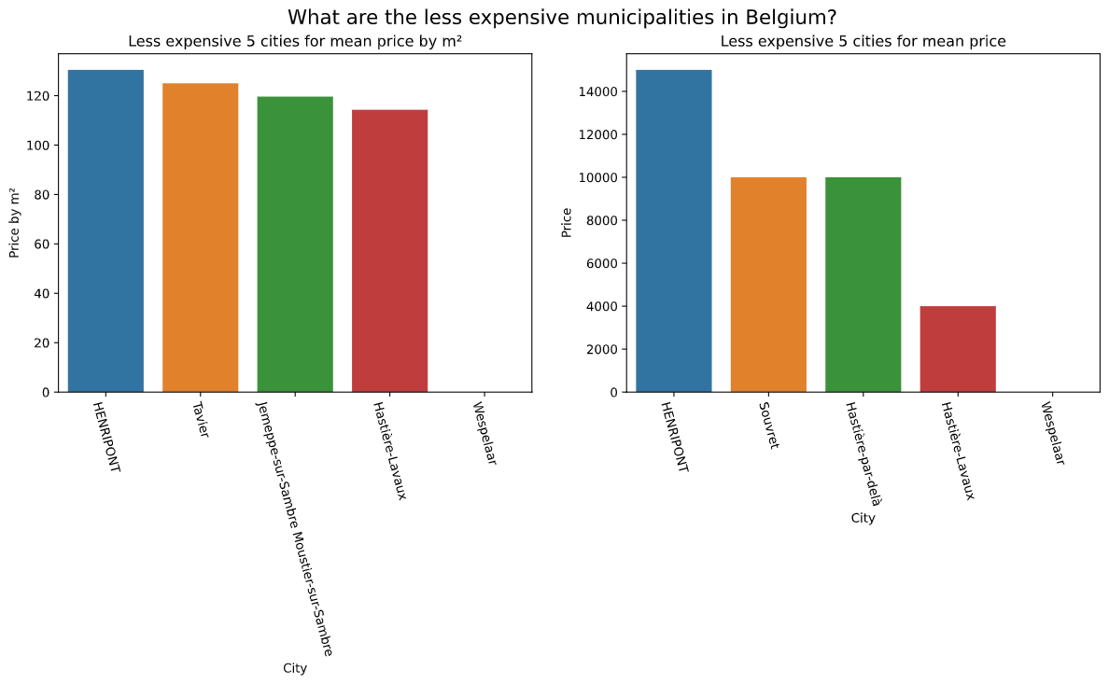
Data interpretation

Slide 20
Thanks for your attention !
Any questions ?

