Slide 1

Chapter 9
Error Detection and Correction
Types of Errors
Detection
Correction

Slide 2

Errors
Single-bit
Multiple-bit
Burst

Slide 3


Single-bit error
0 changed to 1
sent
received

Slide 4


Multiple-bit error
sent
received

Slide 5
Burst error
sent
received

Slide 6
Detection

Slide 7

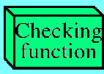



Redundancy
Data
Accept
Reject
redundancy check
sender
Data&redundancy check
receiver

Slide 8
Detection methods
VRC(Parity)
Vertical
LRC(longitudinal)
CRC
Cyclic
CHECKSUM

Slide 9
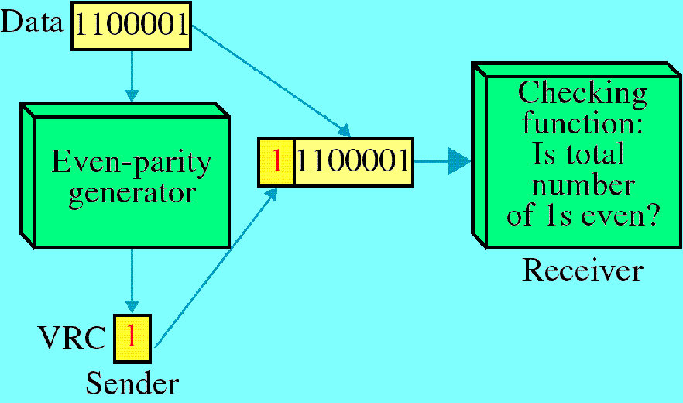
VRC

Slide 10
VRC
A parity bit is added to every data unit such that the total number of ones is even (even parity) or odd (odd parity).
Can detect all single-bit errors and multiple-bit or burst errors only if the total number of errors is odd.

Slide 11
LRC
A redundant unit is added after a number of data units. The bits in the redundant unit are calculated from the corresponding bits in the data units using VRC.
Direction of movement
10101010
10101001
00111001
11011101
11100111
LRC
Data

Slide 12
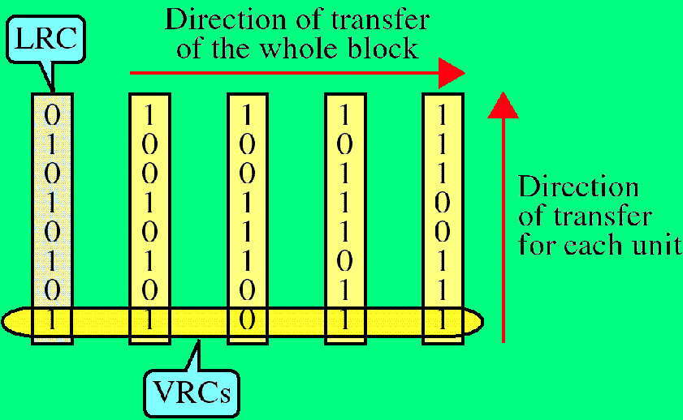
VRC and LRC

Slide 13
Reliability
Can detect all single-bit errors.
Can detect all multiple-bit and burst errors except the case in which an even number of errors occurs in corresponding positions in any even number of data units.

Slide 14
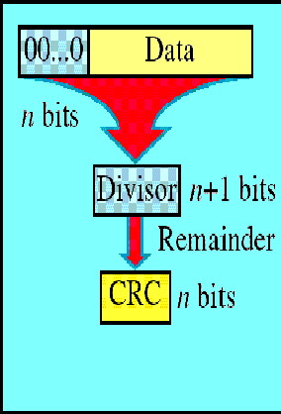
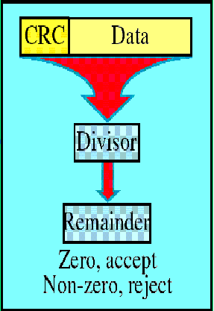
CRC
CRC
DATA

Slide 15
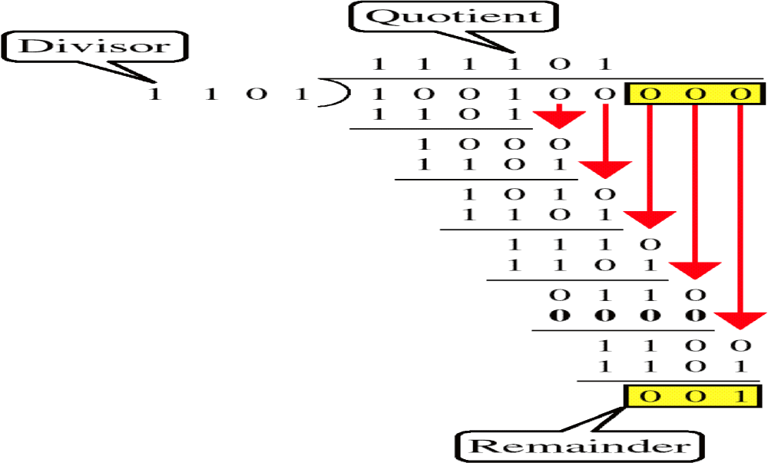
Binary Division

Slide 16
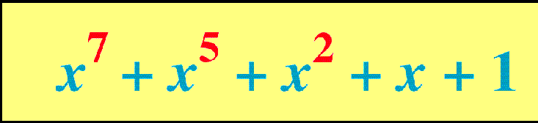
Polynomial

Slide 17
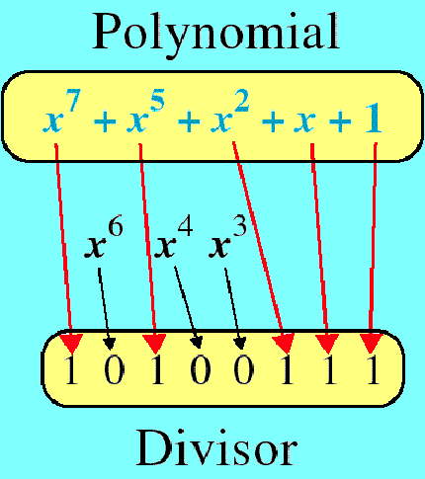
Polynomial and Divisor

Slide 18
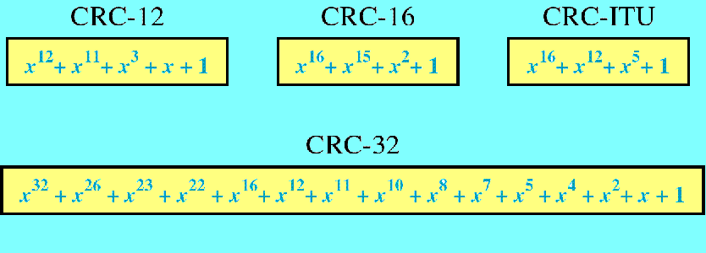
Standard Polynomials

Slide 19
Reliability of CRC
Can detect all single-bit errors (if P(x) has two or more terms).
Can detect all double-bit errors (Make F(x) shorter than the shortest double-bit error P(x) cannot find.)
Can detect all odd errors (If P(x) contains (x+1) as a factor).
Can detect all short burst errors where the burst length is less than n and P(x) has x⁰ term.
Can detect longer bursts that do not match P(x).

Slide 20
P(X) = X³ + X² + X
X²
X⁰
X³
2
1 0
Data In (MSB first)
After k shifts, the CRC is in the shift register

Slide 21
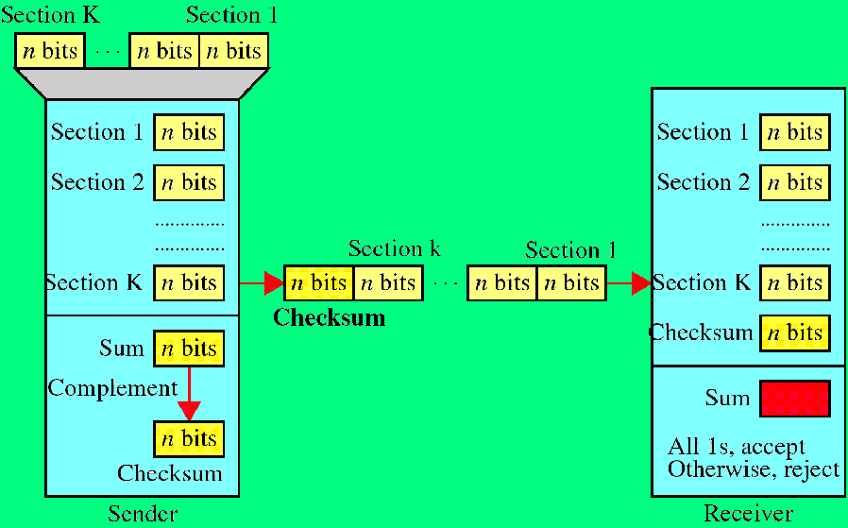
Checksum

Slide 22
Reliability of Checksum
Detects all errors involving odd number of bits.
Detects all errors involving even number of bits.
It cannot detect the cases in which one or more bits of a segment are damaged and corresponding bits of opposite values in a second segment are also damaged.

Slide 23
Data Unit and Checksum
The receiver adds the data unit and the checksum field ,if the result is all 1s,the data unit is accepted,otherwise it is discarded.
sender
Receiver
checksum
Data unit
-T
T

Slide 24
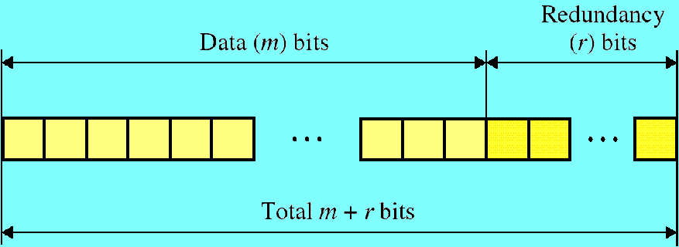
Error Correction

Slide 25
Hamming Code
11 10 9 8 7 6 5 4 3 2 1
d
d
d
r
d
d
d
r
d
r
r
Redundancy bits

Slide 26
Hamming Code
r1 will take care
of these bits
11
9
7
5
3
1
0101
0011
1011
1001
0111
0001
d
d
d
r8
d
d
d
r4
d
r2
r1

Slide 27
r2 will take care
of these bits
10111010
01110110
00110010
11
10
7
6
3
2
d
d
d
r8
d
d
d
r4
d
r2
r1

Slide 28
Hamming Code
r4 will take care
of these bits
0111011001010100
11
9
7
5
3
1
0101
0011
1011
1001
0111
0001
d
d
d
r8
d
d
d
r4
d
r2
r1

Slide 29
r8 will take care
of these bits
1011101010011000
11
9
7
5
3
1
0101
0011
1011
1001
0111
0001
d
d
d
r8
d
d
d
r4
d
r2
r1

Slide 31
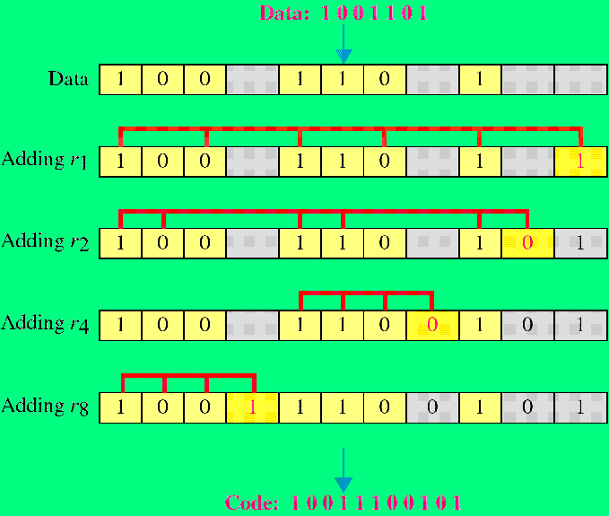
Example of Hamming Code

Slide 32

Single-bit error
sent
received
Error

Slide 33
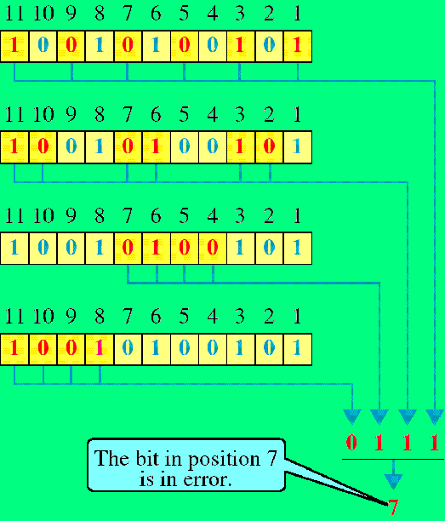
Error Detection

