Slide 1





block cipher
GET STARTED
Teamm :
  miloudi mohammed yassine
  messaoui mohammed larbi

Slide 2


Wardiere Inc.
project plan
01
02
03
04
introduction
modes d’ operation
ECB – Electronic Codebook
CBC – Cipher Block Chaining
05
06
07
08
OFB – Output Feedback
CTR – Counter Mode
Comparison
conclusion

Slide 3
Wardiere Inc.
introduction
  It's an encryption method that divides data into fixed-size blocks—such as 128 bits—and then encrypts each block using an algorithm such as AES or DES. However, encrypting each block individually can cause problems, such as repeating patterns.

Slide 4
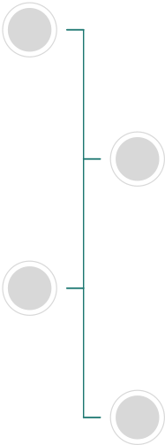
Wardiere Inc.
modes d’ operation
2
CBC – CIPHER BLOCK CHAINING
4
CTR – COUNTER MODE
1
ECB – ELECTRONIC CODEBOOK
3
OFB – OUTPUT FEEDBACK

Slide 5
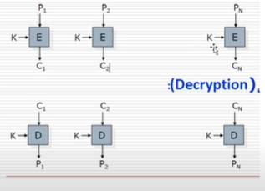
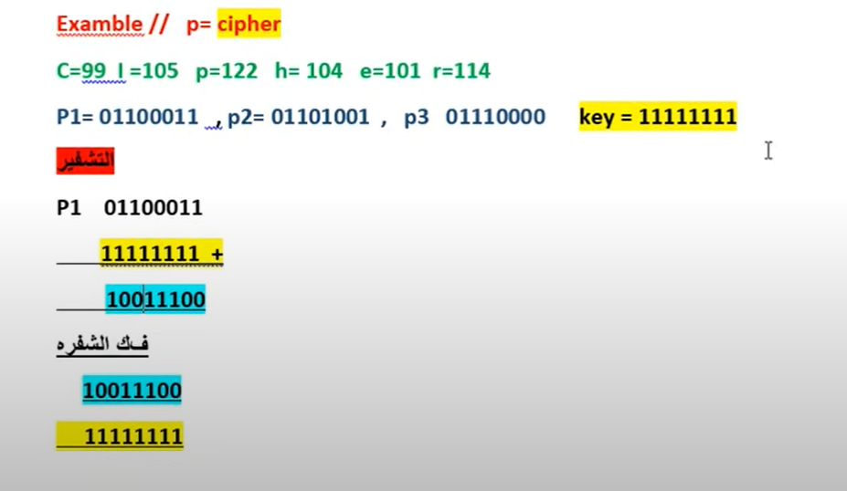
Wardiere Inc.
Electronic Code Book (ECB)
Each plaintext block is encrypted independently using the same key

Slide 6


Wardiere Inc.
ECB – Electronic Codebook
Advantages:
Disadvantages:
  Simple to implement.
  Fast encryption and decryption.
  Allows parallel encryption of blocks.
  Not secure for real data — same plaintext block → same ciphertext.
  Leaks patterns

Slide 7
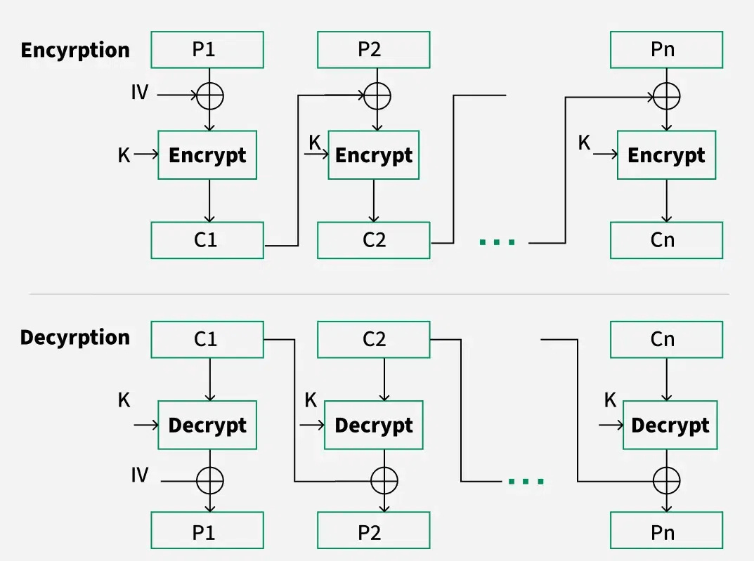
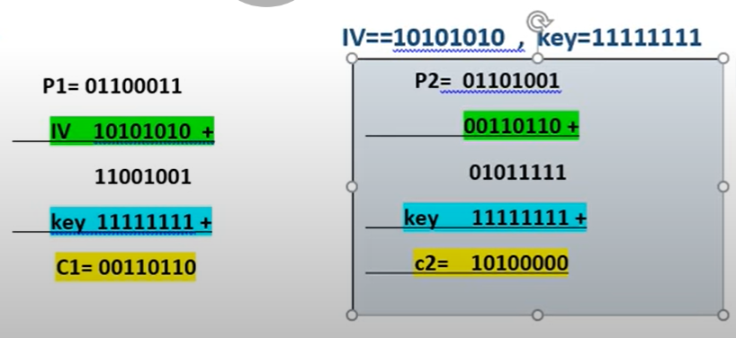
Wardiere Inc.
Cipher Block Chaining
Cipher block chaining or CBC is an advancement made on ECB since ECB compromises some security requirements. In CBC, the previous cipher block is given as input to the next encryption algorithm after XOR with the original plaintext block. In a nutshell here, a cipher block is produced by encrypting an XOR output of the previous cipher block and present plaintext block.

Slide 8
Wardiere Inc.
CBC – Cipher Block Chaining
Advantages:
Disadvantages:
  Much more secure than ECB.
  Hides patterns in the data.
  Resistant to some replay attacks.
  Not parallelizable (slow for large data).
  Requires a unique and unpredictable IV.
  A single-bit error affects two blocks when decrypting

Slide 9
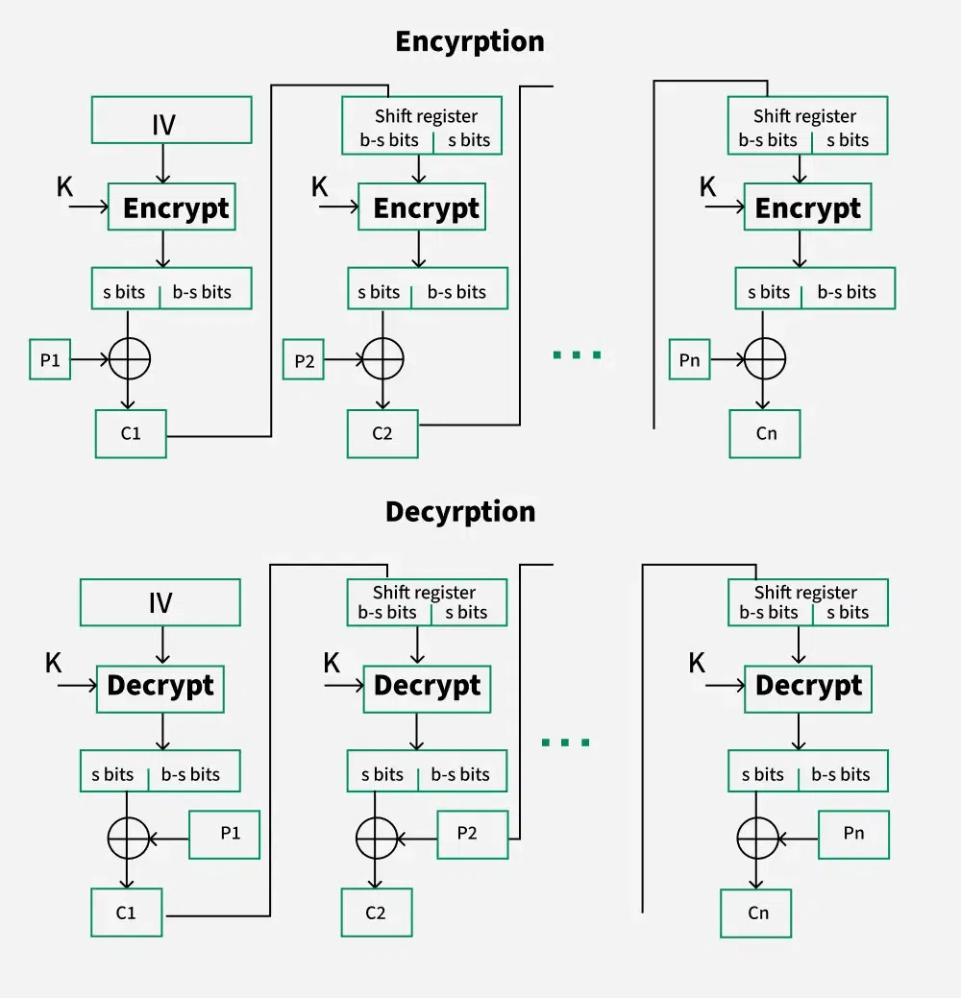
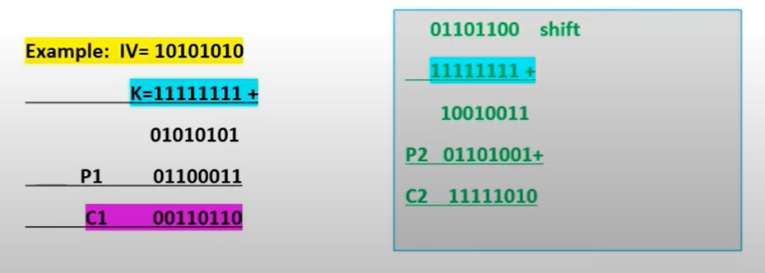
Wardiere Inc.
OFB – Output Feedback
Turns the block cipher into a stream cipher. IV is encrypted repeatedly to produce a keystream that is XORed with plaintext.

Slide 10
Wardiere Inc.
OFB – Output Feedback
Advantages:
Disadvantages:
  Good for streaming data.
  Errors don’t propagate — one bit error only affects that bit.
  Can be precomputed if IV and key are known.
  Needs a unique IV for each encryption session.
  Reusing IV can expose plaintext.

Slide 11
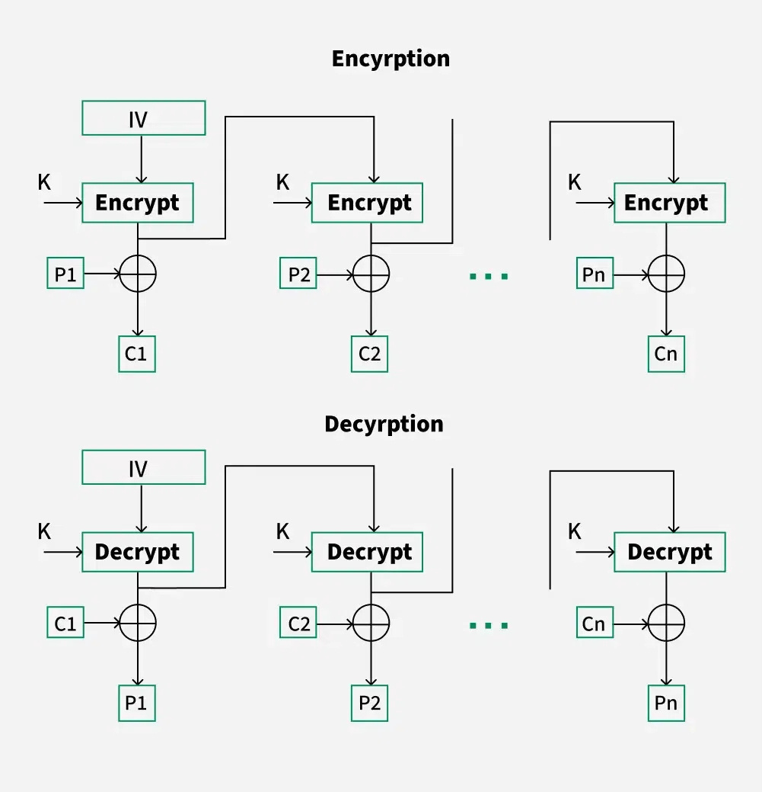
Wardiere Inc.
CTR – Counter Mode
Uses a counter that is encrypted to generate a keystream, which is XORed with the plaintext. The counter is incremented for each block.
Advantages
Disadvantages
  Highly parallelizable — fast for encryption and decryption.
  Works well for streaming and high-performance systems.
  Error in one block doesn’t affect others.
  Counter/nonce must be unique and never repeated.
  Implementation must be careful to avoid nonce reuse.

Slide 12
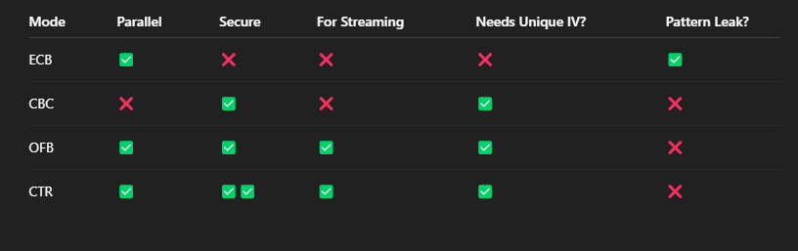
Wardiere Inc.
comprsion

Slide 13
Wardiere Inc.
Conclusion:
Each block cipher mode changes how data is encrypted using the same base algorithm (like AES), but with different behaviors and use cases
Thank You

