Slide 1

Process Synchronization in Operating Systems
Abdelmalek moahmmed riad, 4eme ing coputer security, 21/10/2025

Slide 2
Introduction
What is process synchronization?
Short overview of what will be covered
The coordination of processes to ensure that they execute correctly and share resources efficiently, especially when accessing shared data.
We will explore basic notions, the synchronization problem, critical sections, and common solutions like Peterson's, locks, and semaphores.

Slide 3
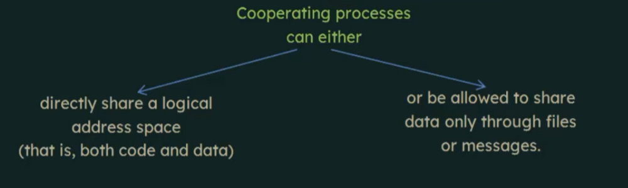
Reminder of Basic Notions
Cooperating Process
A process that can affect or be affected
by other processes executing in the system.

Slide 4

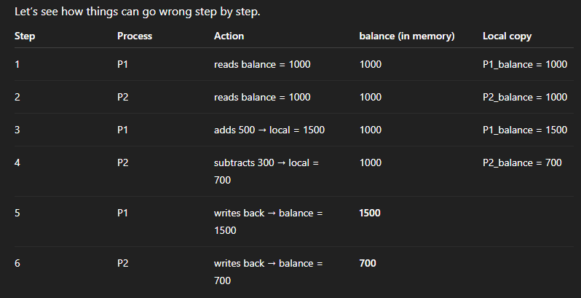
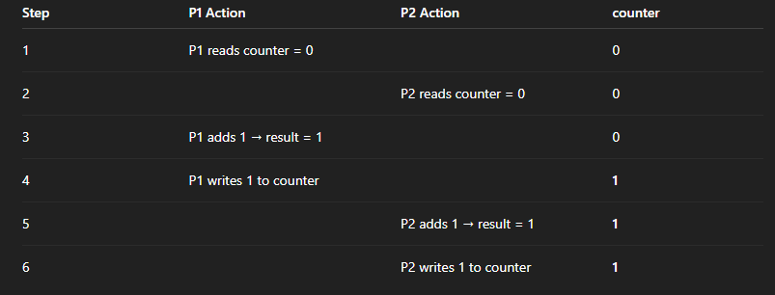
The Problem of Synchronization
When multiple processes access shared data, problems arise if the execution order is not controlled.
data inconsistency
race conditions

Slide 5
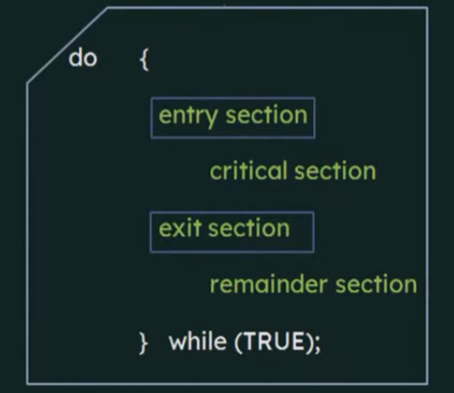
Definition of Critical Section
Critical Section (CS) :
is a segment of code where two or more processes may be changing shared variables (attributes) , code (functions and procedures)
Requirements for a Critical Section
Structure of a Process
Mutual exclusion
If one process is executing in its critical section, then no other processes can be executing in their critical sections.
entry section
Progress
critical section
If no process is executing in its critical section and some processes wish to enter their critical sections, then only those processes that are not executing in their remainder sections can participate in deciding which will enter its critical section next.
exit section
remainder section
bounded waiting
A bound must exist on the number of times that other processes are allowed to enter their critical sections after a process has made a request to enter its critical section and before that request is granted.

Slide 6

Synchronization Solutions
.Peterson's solution
.lock
A software-based solution for two processes that ensures mutual exclusion, progress, and bounded waiting may not work for modern pc.
A simple hardware or software mechanism that protects a critical section. A process must acquire the lock before entering the CS and release it upon exiting.
.semaphores
A synchronization tool that does not require busy waiting. It is an integer variable accessed only through two standard atomic operations: wait() and signal().

Slide 7
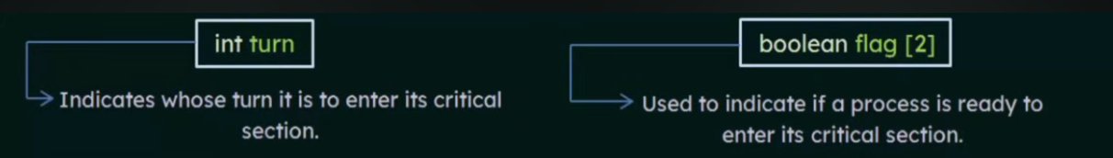
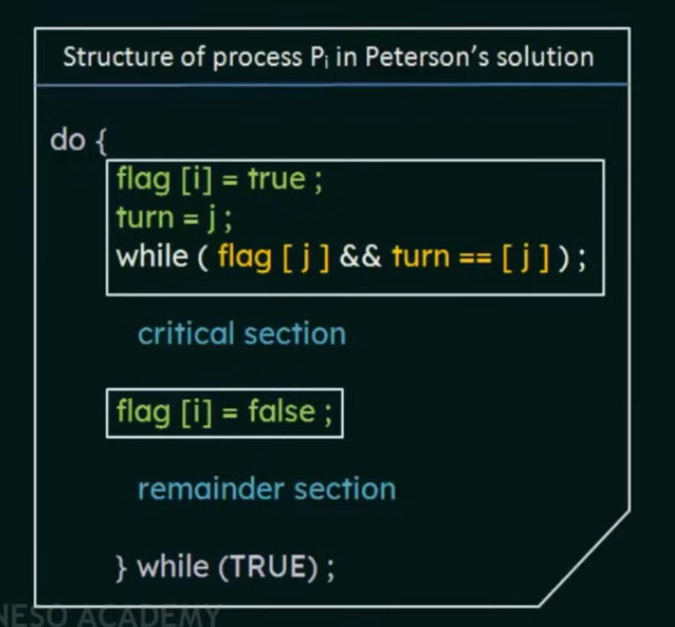
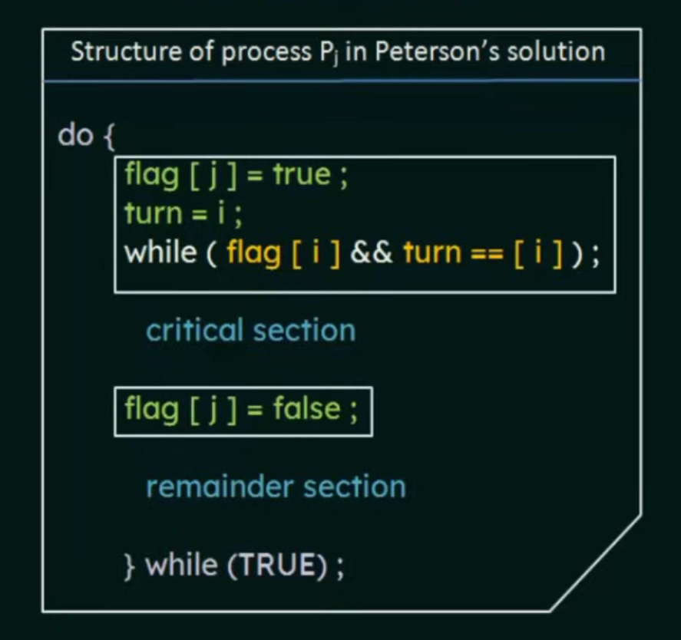
Synchronization Solutions
Peterson's solution

Slide 8
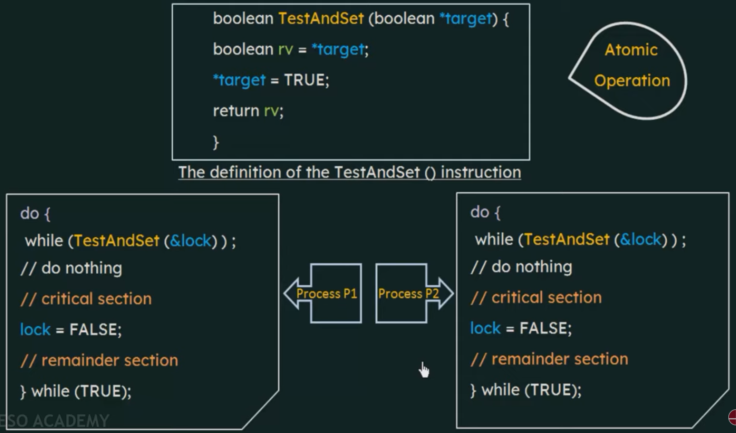
Synchronization Solutions
Lock solution

Slide 9
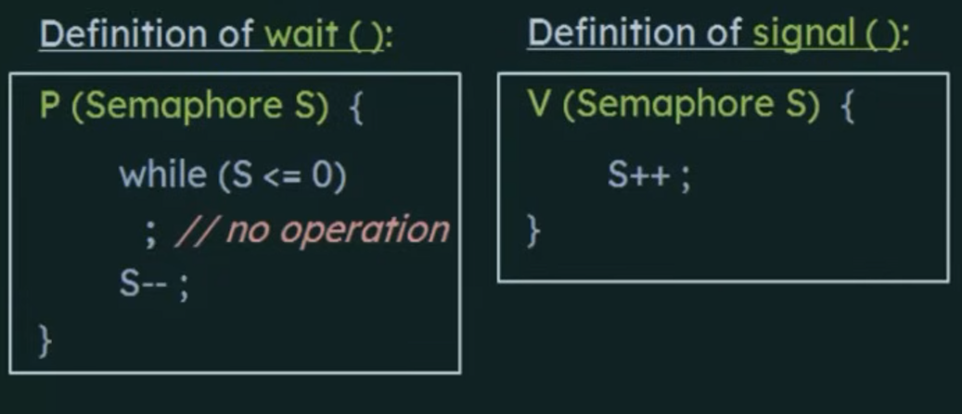
Synchronization Solutions
Semaphores

Slide 10
Comparison & Summary
A quick comparison of the three primary synchronization solutions discussed:
solution
Ease of use
Processes supported
Hardware dependency
Example use
Peterson
Simple, 2 processes
2 only
Software only
Learning
Lock
Simple
Many
Hardware support
Small systems
Semaphore
Powerful
Many
OS-level
Real-world use

Slide 11

Conclusion
Effective process synchronization is fundamental to reliable operating systems.
By understanding and correctly implementing mechanisms like Peterson's solution, locks, and semaphores, we can prevent race conditions and ensure data consistancy in concurrent environments.

