Slide 1
Introduction
Operating Systems Security.
Contenu de la matière :
Introduction to operating system security (Linux, Windows, and Android).
Introduction to operating system administration and access control (Linux, Windows, and Android).
Attacks on Oss.
Operating system protection mechanisms.
Methods for analyzing and evaluating the security of an operating system.
Failure recovery and recovery methods.

Slide 2
Operating Systems Security:
Chapter 01
Computer Security
Computer security is about provisions and policies adopted to protect Hardware, Software, information and property from theft, corruption, or natural disaster
while allowing the information and property to remain accessible and productive to its intended users.
security of computers against intruders (e.g. Hackers) and malicious software (e.g., viruses).

Slide 3
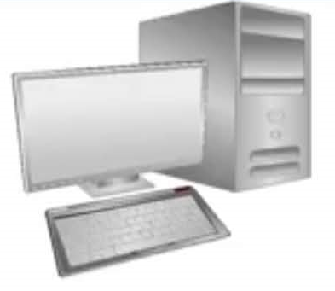
Operating Systems Security
Chapter 01
Computer Security
Assets
Hardware:
Computer
Devices (disk drives, memory, printer)
Network gear
Software:
Operating system
Utilities (antivirus)
Commercial applications (word processing, photo editing)
Individual applications
Data:
Documents
Photos
Music, videos
Email
Class projects

Slide 4
Operating Systems Security
Chapter 01
Why need security at the OS level?
No more standalone computer system environments.
Any system can be globally accessible through a set of vast inter and intra-network connections.
Transition motivated by the need to work remotely,
  convenience in accessing personal records, online shopping etc.
A single security loophole in the OS design and implementation known to a malicious attacker could do serious damage.

Slide 5
Operating Systems Security
Chapter 01
Who are the attackers?
Vandals (Hackers, crackers) driven by intellectual challenge.
Insiders: employees or customers seeking revenge or gain informal benefits
Natural disasters: flooding, fire, storms, earthquake...
Criminals seeking financial gain.
Organized crime seeking gain or hiding criminal activities
Organized terrorist groups or nation states trying to influence national policy.
Foreign agents seeking information (spying) for economic, political, or military purposes.
Tactical countermeasures intended to disrupt military capability.
Large organized terrorist groups
Cyber attacks

Slide 6
Operating Systems Security
Chapter 01
What are the vulnerabilities?
Physical vulnerabilities (Eg. Computer can be stolen)
Natural vulnerabilities (Eg. Earthquake)
Hardware and Software vulnerabilities (Eg. Failures)
Media vulnerabilities (Eg. Hard disks can be stolen)
Communication vulnerabilities (Ex. Wires can be tapped)
Human vulnerabilities (Eg. Insiders)
Poorly chosen passwords
Software bugs (non reliability of software)
- buffer overflow attacks

Slide 7
Operating Systems Security
Chapter 01
What are the vulnerabilities?
Automatically running active content: active-x, scripts, Java programs (applet)
Open ports: telnet, mail
Incorrect configuration
- file permissions
- administrative privileges
Untrained users/system administrators

Slide 8
Operating Systems Security
Chapter 01
Security features in Operating System
An operating system manages and controls access to hardware components
Older operating systems focused on ensuring data confidentiality
Modern operating systems support four basic functions
    Positively identify a user
    Restrict access to authorized resources
    Record user activity
    Ensure proper communications with other computers and devices (sending and receiving data)

Slide 9
Operating Systems Security: Introduction
Chapter 01
Security features in ordinary OS
Authentication of users
    Password comparisan
Protection of memory
    User space, paging, segmentation
File and I/O device access control
    Access contol matrix
  Allocation and access control to general objects

Slide 10
Operating Systems Security: Introduction
Chapter 01
Security features in ordinary OS
Enforcement of sharing resources
  To preserve integrity and consistency (critical section)
Fair service
  no starvation and deadlock
Inter-process communication & synchronization
  Shared variable (e.g, using semaphores)
Protection of data
  encryption, isolation

Slide 11
Operating Systems Security: Introduction
Chapter 01
Security features of Trusted OS
Identification and Authentication
Mandatory (enforce multilevel security by classifying the data and users into various security classes) and
Discretionary Access Control (grant privileges to users)
Object use and reuse protection (Subject and object)
Anti-virus scan .
Accountability and Audit (security log)
Firewall
Intrusion detection (patterns of normal system usages, anomalies)

Slide 12
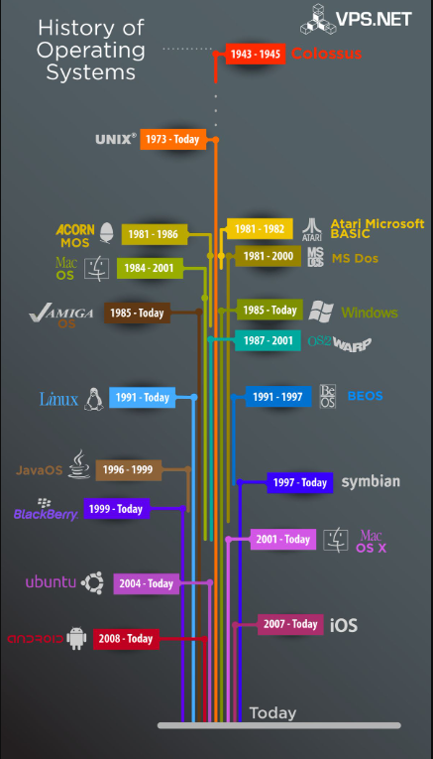
Operating Systems Security
Chapter 01
History of Operating Systems
First, an entire computer was dedicated to one program at a time, but this approach proved wasteful
The first operating systems saved startup, loading, and shutdown time and made much better use of limited resources
The first personal computers took a major step back, as they were dedicated to single users and effectively one program at a time
Multitasking returned to the mainstream in the 1990s, and with it came all the lessons of the early shared computers

Slide 13
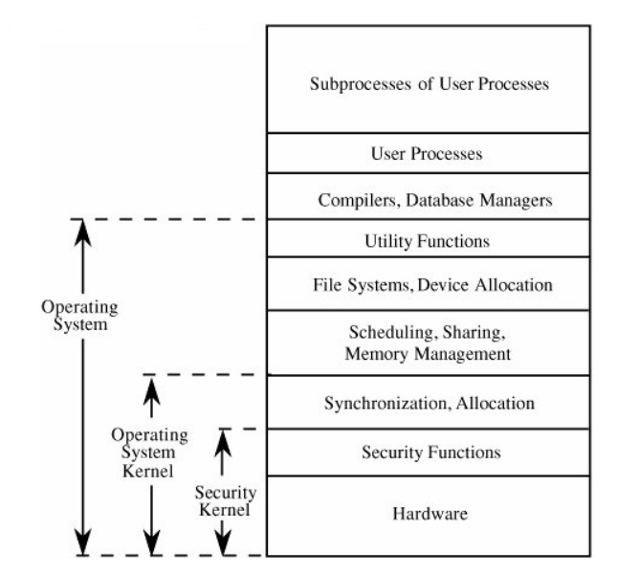
Operating Systems Security
Chapter 01
OS Layered Design
Operating system visualized in layers, from most critical (bottom) to least critical.

Slide 14
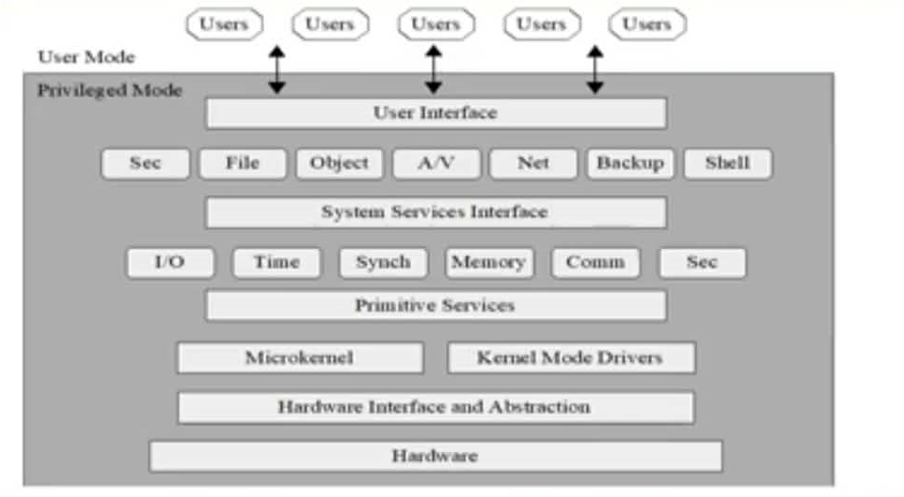
Operating Systems Security
Chapter 01
Modular OS Design
Modern OSs are built from discrete modules. These modules generally come from a variety of sources and are subject to updating/overwriting, so they cannot trust one another.

Slide 15
Operating Systems Security
Chapter 01
Protected Objects
These are some of the common objects that need protection by and in OSs.
Memory
Sharable 1/O devices, such as disks
Serially reusable 1/O devices, such as printers
Sharable programs and sub procedures
Networks
Sharable data

Slide 16
Operating Systems Security
Chapter 01
Operating Systems Hardening
First critical step in securing a system is to secure the base operating system
Basic steps
  Install and patch the operating system
  Harden and configure the operating system to adequately address the identified security needs of the system by:
    Removing unnecessary services, applications, and protocols
    Configuring users, groups, and permissions
    Configuring resource controls
  Install and configure additional security controls, such as anti-virus, host-based firewalls, and intrusion detection system (IDS)
  Test the security of the basic operating system to ensure that the steps taken adequately address its security needs

Slide 17
Operating Systems Security
Chapter 01
Operating Systems Hardening
Systems planning process should consider:
Categories of users on the system
Privileges they have
Types of information they can access
How and where they are defined and authenticated
Default accounts included as part of the system installation should be secured
Those that are not required should be either removed or disabled
Policies that apply to authentication credentials configured

Slide 18
Operating Systems Security
Chapter 01
Application Configuration
• May include:
Creating and specifying appropriate data storage areas for the application .
Making appropriate changes to the application or service default configuration details.
Some applications or services may include:
Default data, Scripts and User accounts Of particular concern with remotely accessed services such as Web and file transfer services.
Risk from this form of attack is reduced by ensuring that most of the files can only be read, but not written, by the server.

Slide 19
Operating Systems Security
Chapter 01
Security Maintenance
Process of maintaining security is continuous
Security maintenance includes:
Monitoring and analyzing logging information.
Performing regular backups.
Regularly testing system security.
Using appropriate software maintenance processes to patch and update all critical software, and to monitor and revise configuration as needed.

Slide 20
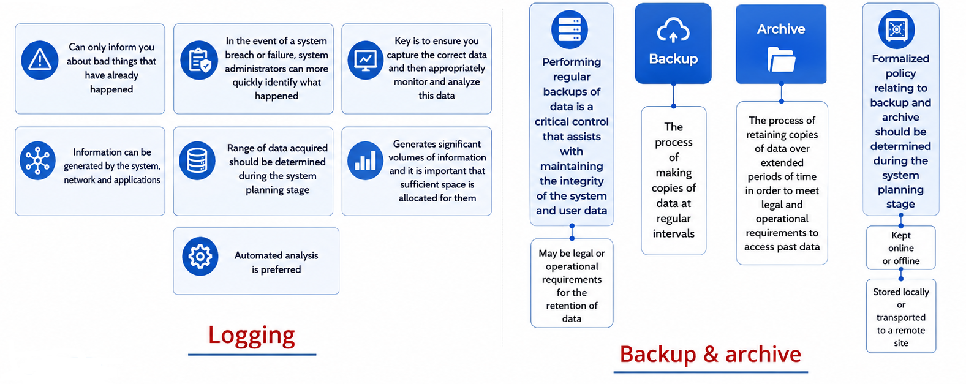
Operating Systems Security
Chapter 01
Security Maintenance

Slide 21
Operating Systems Security
Chapter 01
The Origins of Linux
• 1960s
1964: MIT joins with GE and Bell Labs to create a multiuser, time-sharing operating system
• 1980s
Multiple Unix versions available from AT&T, University of California
1987: Unix-like operating system called MINIX released
• 1990s
1991: Torvalds releases Linux in October
Numerous open-source projects contributed to Linux over past 20 years

Slide 22
Operating Systems Security
Chapter 01
The Origins of Linux
  Linux is a common operating system used for Internet infrastructure.
  With Linux, security is much more than just firewalls and permissions.
As with any operating system, a Linux implementation requires strategies to harden it against attack.

Slide 23
Operating Systems Security
Chapter 01
Linux security
  The reality is that no operating system can be called secure.
  Security results from appropriate controls and processes
  Has evolved into one of the world's most popular operating systems
  Free, Open-sourced
  Available in a wide variety of distributions targeted at almost every usage scenario imaginable

Slide 24
Operating Systems Security
Chapter 01
Linux Security
The traditional Linux security model can be summed up quite succinctly: People or processes with "root" privileges can do anything; other accounts can do much less
From the attacker's perspective the challenge in cracking a Linux system is gaining root privileges
Once an attacker gains root privileges they can:
Erase or edit logs & hide their processes, files, and directories
Basically, redefine the reality of the system as experienced by its administrators and users
Thus, Linux security (and UNIX security in general) is a game of "root takes all"

Slide 25
Operating Systems Security
Chapter 01
Security in an Open-Source World
  • Open source
  Software developed by teams that provide access to the source code and all the programming language text from which the final executable is generated
  Source code is open for anyone to see
  • Closed source
  Commercial software developed by companies that ask you to pay for the program

Slide 26
Operating Systems Security
Chapter 01
Security in an Open-Source World
  Most open-source code is free and can be used without restriction.
  Access to open source enables users to learn from source code, see what it does, and understand how a program operates,
  Open source provides the ability for anyone to pick up source code and fix it.
  Enables speedy resolutions
  Most open-source software is licensed in a way that requires changes to remain open as well.

Slide 27
Operating Systems Security
Chapter 01
Linux Distributions
  RedHat
  Red Hat Enterprise Linux (RHEL)
  Fedora Core
  CentOS was based on released versions of RHEL, now developed as CentOS Stream (non-Red Hat)
  Debian
  Created by lan Murdock years ago
  Debian is a merging of the name lan with the name Debra (lan's girlfriend at the time)
  Mint and Ubuntu are derivatives

Slide 28
Operating Systems Security
Chapter 01
Linux Distributions
  Advantages
  Stable
  Distributions have pre-compiled packages
  Can avoid unnecessary packages by building your own Linux
  Disadvantages
  Distribution determines dependencies; may get packages you don't want or need
  Source-based distributions must be compiled from source each time, can be time-consuming

Slide 29
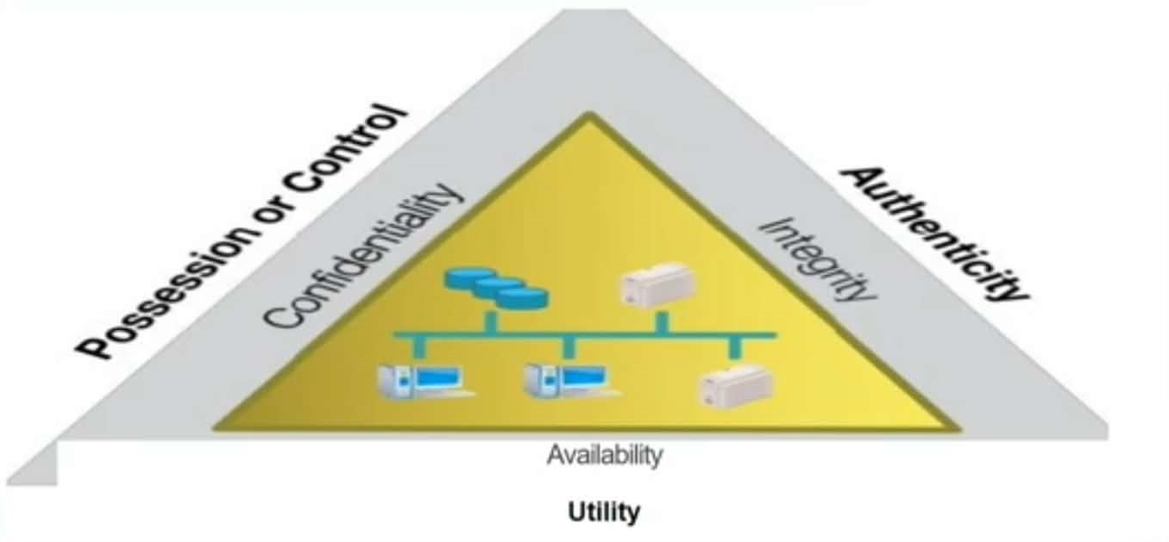
Operating Systems Security
Chapter 01
The C-I-A Triad

Slide 30
Operating Systems Security
Chapter 01
The C-I-A Triad
Confidentiality
    Keeping secrets
Integrity
    Ensuring that the data that are sent are the data that are received
Availability
    Ensuring use of a service, such as a networked application
    Software that is buggy and crashes a lot affects availability
    A denial of service (DoS) attack is a specific and malicious form of a denial of service condition

Slide 31
Operating Systems Security
Chapter 01
The Parkerian Hexad
In the late 1990s, Donn Parker, a security professional proposed an expansion of the C-I-A triad to cover additional concepts he felt were critical to the realm of information security:
Confidentiality
Possession or control Integrity
Authenticity
Availability
Utility

Slide 32
Operating Systems Security
Chapter 01
Linux as a Security Device
Operating system hardening:
  Limit the number of software packages installed.
  Remove all but the most critical users from the system.
  Restrict permissions on files and directories.
  Remove all but necessary system services.
Can deploy a completely hardened operating system as a bastion host
  A bastion host is a system that is presented to the outside world that can be used to protect other systems that are more sensitive.

Slide 33
Operating Systems Security
Chapter 01
Linux as a Security Device
Firewall
Hardware or software capable of blocking networking communications based on established criteria, or rules
Common firewalls available for Linux are iptables and firewalled
You can set up firewall rules to allow, drop, or log specific packets from the network.
If there are multiple network interfaces and a network behind a Linux firewall, you can have it perform network address translation (NAT), effectively hiding all the systems behind your Linux firewall. using
On top of the firewall, you can deploy encryption services using Transport Layer Security (TLS).

Slide 34
Operating Systems Security: Introduction
Chapter 01
Linux in the Enterprise
Web server
  The way customers get access to information, products, and services offered by businesses.
Application server
  Software that provides a framework inside which applications can be written
Security systems
  Firewalls and intrusion-detection systems
Operating systems
  Linux is operating system for many security-based appliances
  You can use Linux as Proxy server or gateway, jump host, or bastion server

Slide 35
Operating Systems Security
Chapter 01
Linux in the Enterprise
Filtering
  Between network segments
Remote Desktop Protocol (RDP) system
  Many packages support functions commonly found on Windows systems
File server / file sharing
  Makes use of Server Message Block (SMB) or Common Internet File System (CIFS) systems, or Network File System (NFS)

Slide 36
Operating Systems Security
Chapter 01
Recent Security Issues
Vulnerabilities
  Addition of more functions to a system increases complexity
  Increased complexity results in more potential for unforeseen problems
  Testing is essential but cannot account for all user behaviors
Increased prevalence of notification laws
Businesses must notify customers of a breach
Customers have the right to know when their personal information is at risk

Slide 37
Operating Systems Security
Chapter 01
Recent Security Issues
Hacker
  Someone who shows great technical skills and creativity in completing specific tasks.
  May or may not be a criminal.
Black-hat hacker
  Someone who performs attacks against victims for malicious purposes.

Slide 38
Operating Systems Security
Chapter 01
Recent Security Issues
White-hat hacker
  May use some of the same techniques as a black-hat hacker but is a good guy
Gray-hat hacker
  Performs a range of actions that a white-hat hacker will not undertake; somewhere in between a white-hat hacker and a black-hat hacker

Slide 39
Operating Systems Security
Chapter 01
Recent Security Issues
The Internet is filled with professional organizations and their skilled employees, running businesses that exist to steal information, extort money, or perform other illegal actions.
They may be related to the military for different countries sometimes called nation-states.
Some attackers look for information, such as intellectual property, that could be sold. They also might engage in corporate espionage or inter-country espionage.

Slide 40
Operating Systems Security
Chapter 01
Recent Security Issues
A malware attack may be launched to get more zombie hosts for a botnet.
    This is also an attack for financial gain because the zombies may be running web server software as a front to an illegal storefront for, say, pharmaceuticals.
    The botnet may also be rented to an attacker for political or financial gain,.

Slide 41
Operating Systems Security
Chapter 01
Summary
Who are the attackers
What are the vulnerabilities
Security features in Operating System
Operating Systems Hardening
Security Maintenance
The origins of Linux
Open-source software security considerations
The confidentiality, integrity, and availability (C-l-A) triad
Linux distributions
Linux security and security threats

Slide 42
Operating Systems Security
Chapter 01
Introduction
In Previous Lecture you learned:
Who are the attackers
What are the vulnerabilities
Security features in Operating System
Operating Systems Hardening
Security Maintenance
The origins of Linux
Open-source software security considerations
The confidentiality, integrity, and availability (C-l-A) triad
Linux distributions
Linux security and security threats

