Slide 1
Operating Systems Security
Chapter 02
CHAPTER 2 TOPICS
This chapter covers the following topics and concepts:
What is the Vulnerabilities
How the Methods of Defense work
What is the Software Controls
What is the Protected Objects and Methods of Protection
What is the Protection Types

Slide 2
Operating Systems Security
Chapter 02
CHAPTER 2 GOALS
When you complete this chapter, you will be able to:
Describe the Security goals
Describe the Vulnerabilities
Explain the Principles of Adequate Protection
Differentiate between the Methods of Securing the Operating Systems
Explain the Protection Types

Slide 3
Operating Systems Security
Security goals
OPERATING SYSTEM
The purpose of computer security is to: Devise ways to prevent the weaknesses from being exploited

Slide 4
Operating Systems Security
Chapter 02
What are the vulnerabilities?
Physical vulnerabilities (Eg. Computer can be stolen)
Natural vulnerabilities (Eg. Earthquake)
Hardware and Software vulnerabilities (Eg. Failures)
Media vulnerabilities (Eg. Hard disks can be stolen)
Communication vulnerabilities (Ex. Wires can be tapped)
Human vulnerabilities (Eg. Insiders)
Poorly chosen passwords
Software bugs (non reliability of software)
- buffer overflow attacks

Slide 5
Operating Systems Security
Vulnerabilities
When we prepare to specify, design, code, or test a secure system, we try to imagine the vulnerabilities that would prevent us from reaching one or more of our three security goals (C-I-A).
The three assets (hardware, software and data) and the connections among them are all potential security weak points.

Slide 6
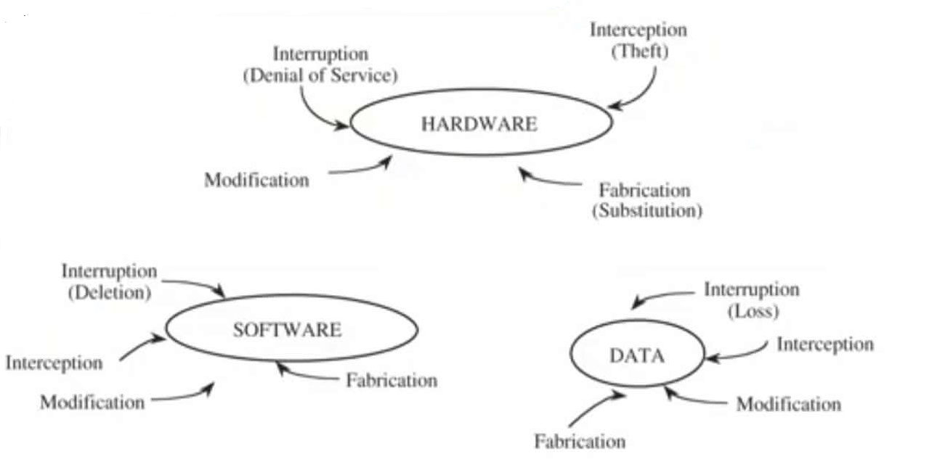
Operating Systems Security
Vulnerabilities

Slide 7
Operating Systems Security
Software Vulnerabilities
Software is surprisingly easy to delete and to copy
Software is vulnerable to modifications that either cause it to fail or cause it to perform an unintended task.

Slide 8
Operating Systems Security
Software Vulnerabilities
Logic bomb: a program that has been maliciously modified to fail when certain conditions are met or when a certain date or time is reached.
Trojan horse: a program that overtly does one thing while covertly doing another.
Virus: a specific type of Trojan horse that can be used to spread its "infection" from one computer to another.

Slide 9
Operating Systems Security
Software Vulnerabilities
Trapdoor: a program that has a secret entry point.
Information leaks in a program: code that makes information accessible to unauthorized people or programs.

Slide 10
Operating Systems Security
Data Vulnerabilities
More people know how to use or interpret data.
Confidential data leaked to a competitor may narrow a competitive edge.
Data incorrectly modified can cost human lives.
Inadequate security may lead to financial liability if certain personal data are made public.

Slide 11
Operating Systems Security
Principle of Adequate Protection
Computer items must be protected only until they lose their value.
They must be protected to a degree consistent with their value.

Slide 12
Operating Systems Security
Methods of Defense
Harm occurs when a threat is realized against a vulnerability
To protect against harm , we can neutralize the threats, close the vulnerability, or both
The possibility for harm to occur is called risk

Slide 13
Operating Systems Security
Methods of Defense
We can deal with harm in several ways.
We can seek to
    Prevent it, by blocking the attack or closing the vulnerability
    Deter it, by making the attack harder
    Deflect it, by making another target more attractive
    Detect it, either as it happens or some time after the fact
    Recover from its effects

Slide 14
Operating Systems Security
Software Controls
Internal program controls: parts of the program that enforce security restrictions, such as access limitations.
Operating system and network system controls: limitations enforced by the operating system or network to protect each user from all other users.

Slide 15
Operating Systems Security
Software Controls
Independent control programs: application programs, such as password checkers, intrusion detection utilities, or virus scanners, that protect against certain types of vulnerabilities
Development controls: quality standards under which a program iS designed, coded, tested, and maintained, to prevent software faults from becoming exploitable vulnerabilities

Slide 16
Operating Systems Security
Principle of Effectiveness
Principle of Effectiveness :
Controls must be used-and used properly--to be effective.
They must be efficient, easy to use, and appropriate.

Slide 17
Operating Systems Security
Operating System
An operating system is the software on a computer that manages the way different programs use their hardware, and regulates the ways that a user controls the computer.
Operating systems are found on almost any device that contains a computer with multiple programs-from cellular phones and video game consoles to supercomputers and web servers. Some popular modern operating systems for personal computers include Microsoft Windows, Mac OS X, and Linux

Slide 18
Operating Systems Security
Operating System
Operating system functions can be categorized as:
  access control.
  identity and credential management.
  information flow.
  audit and integrity protection.
Each of these activities has security implications.

Slide 19
Operating Systems Security
Objects and Methods of Protection
what kinds of things operating systems can protect ?
what methods are available for protecting them?
Once upon a time, there were no operating systems: Users entered their programs directly into the machine in binary.
The first operating systems were simple utilities, designed to assist individual programmers and to smooth the transition from one user to another.

Slide 20
Operating Systems Security
Objects and Methods of Protection
Operating systems took on a much broader role as the notion of multiprogramming was implemented
  two users could interleave access to the resources of a single computing
  researchers developed concepts such as scheduling, sharing, and parallel use.
  protecting one user's programs and data from other users' programs became an important issue in multi-programmed operating systems.

Slide 21
Operating Systems Security
Protected Objects
  memory
  Sharable I/O devices, such as disks
  protecting one user's programs and data from other users' programs became an important issue in multi-programmed operating systems.

Slide 22
Operating Systems Security
Security features in Operating System
An operating system manages and controls access to hardware components
Older operating systems focused on ensuring data confidentiality
Modern operating systems support four basic functions
  Positively identify a user
  Restrict access to authorized resources
  Record user activity
  Ensure proper communications with other computers and devices (sending and receiving data)

Slide 23
Operating Systems Security
Security features in ordinary OS
Authentication of users
password comparison
Protection of memory
user space, paging, segmentations
File and I/O device access control
  access control matrix
Allocation & access control to general objects

Slide 24
Operating Systems Security
Security features in ordinary OS
Enforcement of sharing resources
To preserve integrity and consistency (critical section)
Fair service
no starvation and deadlock
Inter-process communication & synchronization
Shared variable (e.g, using semaphores)
Protection of data
encryption, isolation

Slide 25
Operating Systems Security
Security features of Trusted OS
Identification and Authentication
Mandatory (enforce multilevel security by classifying the data and users into various security classes) and
Discretionary Access Control (grant privileges to users)
Object use and reuse protection (Subject and object)
Anti-virus scan
Accountability and Audit (security log)
Firewall
Intrusion detection (patterns of normal system usages, anomalies)

Slide 26
Operating Systems Security
Protection Types
Do not protect
Isolate
Share all or share nothing
Share via access limitation
Share by capabilities
Limit use of an object

Slide 27
Operating Systems Security
Protection Types(cont.)
Do not protect. Operating systems with no protection are appropriate A when sensitive procedures are being run at separate times.
Isolate. When an operating system provides isolation, different processes running concurrently are unaware of the presence of each other. Each process has its own address space, files, and other objects

Slide 28
Operating Systems Security
Protection Types(cont.)
Share all or share nothing. With this form of protection, the owner of an object declares it to be public or private.
Share via access limitation. With protection by access limitation, the operating system checks the allow ability of each user's potential access to an object.

Slide 29
Operating Systems Security
Protection Types(cont.)
Share by capabilities. An extension of limited access sharing, this of sharing rights for form of protection allows dynamic creation objects, The degree of sharing can depend on the owner or the subject, on the context of the computation, or on the object itself.

Slide 30
Operating Systems Security
Protection Types(cont.)
Limit use of an object. This form of protection limits not just the access to an object but the use made of that object after it has been accessed. For example, a user may be allowed to view a sensitive document, but not to print a copy of it.

Slide 31
Operating Systems Security
Security Methods of Operating Systems
The basis of protection is separation
separation: keeping one user's objects separate from other users
    physical separation
    temporal separation
    logical separation
    cryptographic separation

Slide 32
Operating Systems Security
Security Methods of Operating Systems
• physical separation, in which different processes use different physical objects, such as separate printers for output requiring different levels of security.
• temporal separation, in which processes having different security requirements are executed at different times

Slide 33
Operating Systems Security
Security Methods of Operating Systems
logical separation, in which users operate under the illusion that no other processes exist, as when an operating system constrains a program's accesses so that the program cannot access objects outside its permitted domain.
cryptographic separation in which processes conceal their data and computations in such a way that they are unintelligible to outside processes

Slide 34
Operating Systems Security
Security Methods of Operating Systems
the first two approaches are very stringent and can lead to poor resource utilization
Therefore, we would like to shift the burden of protection to the operating system to allow concurrent execution

Slide 35
Operating Systems Security
Security Methods of Operating Systems
We want to separate users and their objects, but we also want to be able to provide sharing for some of those objects.
An operating system can support separation and sharing in several ways, offering protection at any of several levels,

Slide 36
Operating Systems Security
Basic Terms
The kernel
The core of the operating system
Includes a monolithic core and modular components
The distribution
A unified collection of applications, services, drivers, and libraries configured with the kernel
Managed by either a company or a group of volunteers

Slide 37
Operating Systems Security
Security Relates to the Kernel
Kernel philosophy
Kernel is robust
Includes a core and supplemental modular components
Monolithic part of kernel contains drivers and options essential to the kernel boot process
The modular part of the kernel adds everything else needed for smooth operation
Basic kernels
Development work is managed by the Kernel Organization
Source code for the kernel can be acquired at https://kernel.org
Building a custom kernel requires source code

Slide 38
Operating Systems Security
Security Relates to the Kernel
Distribution-specific kernels
The distribution-specific kernel has been compiled and built with the intended hardware in mind
Name of the kernel file generally includes the version number as well as the hardware architecture
    Example: Debian Linux has a kernel named vmlinuz-5.10.0-8-amd64
    Custom kernels
    kernel is highly customizable
    Different configuration interfaces exist, including a text-based one using the ncurses library

Slide 39
Operating Systems Security
Security Issues Beyond the Basic Operating System
• Security issues with the graphical user interface (GUI)
  Programs written for GUIs have a larger set of libraries that get added during the build; more code that can be broken
  Reduce the number of installed packages to reduce the potential for vulnerabilities

Slide 40
Operating Systems Security
Tracking the Latest Security Updates
O.S security updates for:
  Regular users
  Home hobbyists
  Power users
  administrators
Update administration

Slide 41
Operating Systems Security
Summary
This chapter explained :
Kinds of the Vulnerabilities
How the Methods of Defense work
The Software Controls
The meaning of Protected Objects and Methods of Protection
The Protection Types

