Slide 1
Operating Systems Security
Chapter 03
Introduction
In Previous Lecture you learned:
What is the Vulnerabilities
How the Methods of Defense work
What is the Software Controls
What is the Protected Objects and Methods of Protection .
What is the Protection Types

Slide 2
Operating Systems Security
Chapter 03
CHAPTER 3 TOPICS
This chapter covers the following topics and concepts:
Operating system Security attack types
Principles of Secure OS
Design Protecting an OS from Malicious
Software Memory and Address Protection
Linux Security

Slide 3
Operating Systems Security
Chapter 03
CHAPTER 2 GOALS
When you complete this chapter, you will be able to:
Describe the Protected Objects
Suggest how to secure your computer/OS
Explain the method of Protecting an OS from Malicious Software
Explain the Users, Groups, and file Permissions in Linux

Slide 4
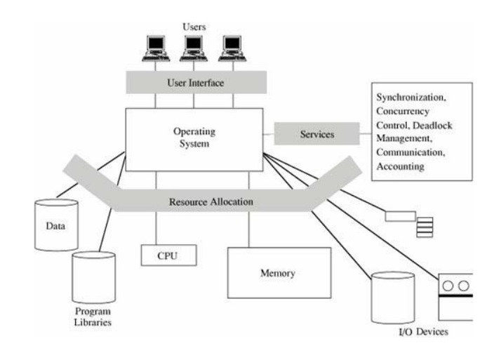
Operating Systems Security
Operating Systems Functions

Slide 5
Operating Systems Security
History of Operating Systems
Single-user systems, no OS
Multiprogramming OS
Multiple users
Multiple programs
Scheduling, sharing, concurrent use
Personal computers

Slide 6
Operating Systems Security
OS Security Services
• Control panel: main component of operating system security environment
• Used to gain access to the OS and its features • Include
User authentication
Remote access
Administration tasks
Password policies

Slide 7
Operating Systems Security
Protected Objects
These are some of the common objects that need protection by and in OSs.
• Memory
• Networks
• Serially reusable I/O devices, such as printers
• Sharable:
programs and sub procedures
I/O devices, such as disks
data

Slide 8
Operating Systems Security
Operating system Security attack types
Malware Attack:
⁃ A generic term for software that has a malicious purpose
⁃ Is software that is intentionally included or inserted in a system for a harmful purpose.
Different forms of malicious software (malware) Intended to
Cause distress to a user
Damage files or systems
Disrupt ordinary computer and network functions
Examples
Viruses, worms
Logic bomb
Trojan horses
Spy-wares
• New ones: Spam/scam, Slammer, Nimda, e-payment frauds, etc...

Slide 9
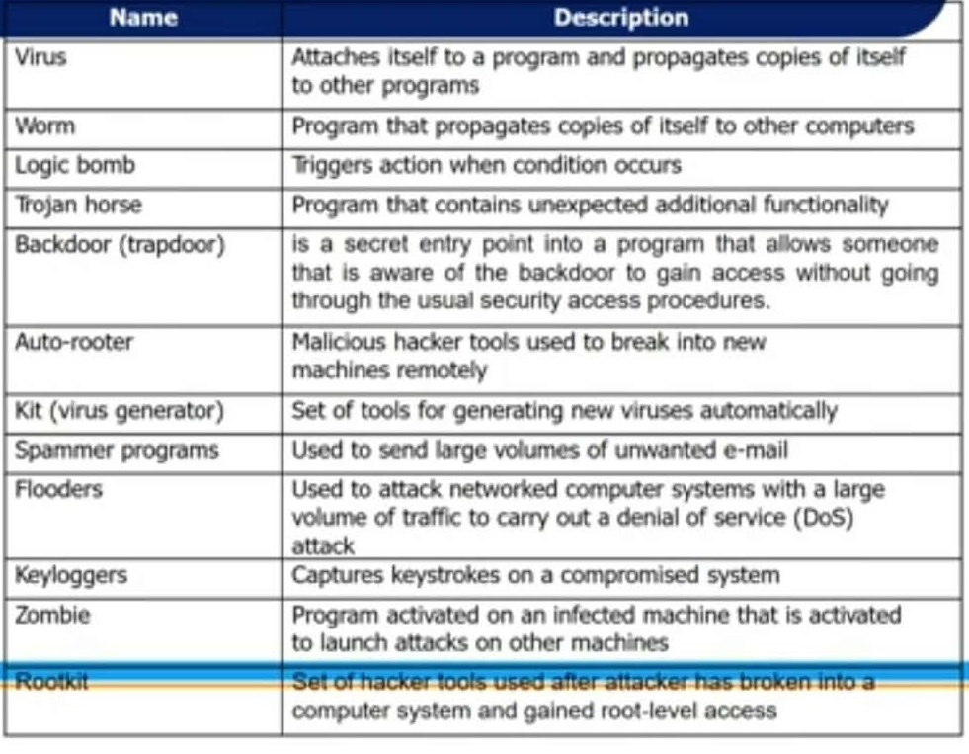
Operating Systems Security
Operating system Security attack types

Slide 10
Operating Systems Security
Malware Attack...
Malicious software can be divided into two categories:
those that need a host program
  fragments of programs that cannot exist independently of some actual application program, utility, or system program.
  Viruses and logic bombs are examples.
those that are independent
  are self-contained programs that can be scheduled and run by the operating system.
  Worms and zombie programs are examples.

Slide 11
Operating Systems Security
Malware Attack.
Viruses
  A malicious code that replicates and hides itself inside other programs usually without your knowledge.
  A virus is a piece of software that can "infect" other programs by modifying them.
  Similar to biological virus: Replicates and Spreads ⁃ Can do serious damage such as erasing file... ⁃
Worms
  A worm is a program that can replicate itself and send copies from computer to computer across network connections.

Slide 12
Operating Systems Security
More on Virus
During its lifetime, a typical virus goes through the following four phases:
Dormant phase: The virus is idle.
⁃ The virus will eventually be activated by some event, such as a date, the presence of another program or file, or the capacity of the disk exceeding some limit.
Propagation phase: The virus places an identical copy of itself into other programs or into certain system areas on the disk.
⁃ Each infected program will now contain a cione of the virus, which will itself enter a propagation phase,
Triggering phase: The virus is activated to perform the function for which it was intended.
⁃ As with the dormant phase, the triggering phase can be caused by a varlety of system events
Execution phase: The function is performed.
⁃ The function may be harmless, such as a message on the screen, or
⁃ damaging, such as the destruction of programs and data files.

Slide 13
Operating Systems Security
More on Virus...
Types of viruses
Parasitic virus: The traditional and still most common form of virus.
- A parasitic virus attaches itself to executable files and replicates
Memory-resident virus: resides in main memory as part of a resident system program.
-From that point on, the virus infects every program that executes.
Boot sector virus: Infects a master boot record or boot record and spreads when a system is booted from the disk containing the virus.
Stealth virus: A form of virus explicitly designed to hide itself from detection by antivirus software,.
- a virus that uses compression so that the infected program is exactly the same length as an uninfected version.

Slide 14
Operating Systems Security
More on Virus...
Types of viruses...
Polymorphic virus: A virus that mutates with every infection, detection by the "signature" of the virus impossible.
Metamorphic virus: As with a polymorphic virus, a metamorphic virus mutates with every infection.
  The difference is that:
  a metamorphic virus rewrites itself completely at each iteration, increasing the difficulty of detection.
  Metamorphic viruses my change their behavior as well as their appearance,

Slide 15
Operating Systems Security
Malware Attack.
Trojan Horse
• Any malicious program which misinterprets itself as useful, interesting in order to convince a victim to install it.
• The program claims to do one thing
- (it may claim to be a game) but instead does damage when you run it (it may erase your Hard Disk).
• Trojan horse programs do not replicate themselves like a virus,
• Such program traps a user login credentials and stores them to send to a malicious user

Slide 16
Operating Systems Security
Rootkits
A rootkit is a malicious software package that attains and takes advantage of root status or effectively becomes part of the OS
Rootkits often go to great length to avoid being discovered or, if discovered and partially removed, to reestablish themselves
  This can include intercepting or modifying basic OS functions

Slide 17
Operating Systems Security
Spyware
Software placed on a computer
  typically without user's knowledge
  reports back information about user's activities
Some operate through monitoring cookies
A software that literally spies on what you do on your computer.
  Example: Simple Cookies, mobile codes , web crawlers, Xerox
  Types of information that is gathered includes the Websites visited, browser and system information, and your computer IP address.

Slide 18
Operating Systems Security
Spam (junk mail)
Filling e-mail inboxes with unwanted junk mail.
Anyone using e-mail is essentially guaranteed to receive spam
How spammers get your mail.
Web search
Sending test emails
Exchange or buy from other spammers

Slide 19
Operating Systems Security
Spam (junk mail)
Filling e-mail inboxes with unwanted junk mail.
Anyone using e-mail is essentially guaranteed to receive spam
How spammers get your mail.
Web search
Sending test emails
Exchange or buy from other spammers

Slide 20
Operating Systems Security
Suggestions to fight spam
Never reply junk emails
Do not open any files or executable attachments
Immediately DELETE the malicious email
Don't post your actual email address in the website.
Norton, McAfee, and many more include spam as one of the threats that they protect against.
Can use spam filtering applications

Slide 21
Operating Systems Security
Malware attacks...
Infection mechanisms
‣ First, the virus should search for and detect objects to infect
‣ Installation into the infectable object .
    Writing on the boot sector .
    Add some code to executable programs
    Add some code to initialization/auto-executable programs
Trigger mechanism
‣ Date
‣ Number of infections
‣ First use
Effects: It can be anything
‣ A message
‣ Deleting files
‣ Formatting disk
‣ Overloading processor/memory
‣ Etc

Slide 22
Operating Systems Security
Threat Monitoring
Check for suspicious patterns of activity
i.e. several incorrect password attempts may signal password guessing.
Audit log - records the time, user, and type of all accesses to an object; useful for recovery from a violation and developing better security measures.
Scan the system periodically for security holes; done when the computer is relatively unused.
02

Slide 23
Operating Systems Security
Threat Monitoring (Cont.)
• Check for:
⁃ Short or easy-to-guess passwords
⁃ Unauthorized set programs
⁃ Unauthorized programs in system directories
⁃ Unexpected long-running processes
⁃ Improper directory protections
⁃ Improper protections on system data files
⁃ Dangerous entries in the program search path (Trojan horse)
⁃ Changes to system programs: monitor checksum values

Slide 24
Operating Systems Security
Suggestions to secure your computer/OS
Use anti-virus software.
Depending on the vendor, the antivirus software may also contain anti-spyware tools, anti-spam filtering, a personal firewall, and more.
Update your computer regularly.
Be careful with the email attachments
Use firewall to protect you from malware attack.

Slide 25
Operating Systems Security
Principles of Secure OS Design
• Simplicity of design
OSs are inherently complex, and any unnecessary complexity only makes them harder to understand and secure
• Layered design
Enables layered trust
• Layered trust
  Layering is both a way to keep a design logical and understandable and a way to limit risk
  Example: very tight access controls on critical OS functions, fewer access controls on important noncritical functions, and few if any access controls on functions that aren't important to the OS

Slide 26
Operating Systems Security
Kernelized Design
• A kernel is the part of the OS that performs the lowest-level functions
Synchronization
Interprocess communication
Message passing
Interrupt handling
• A security kernel is responsible for enforcing the security mechanisms of the entire OS
  Typically contained within the kernel

Slide 27
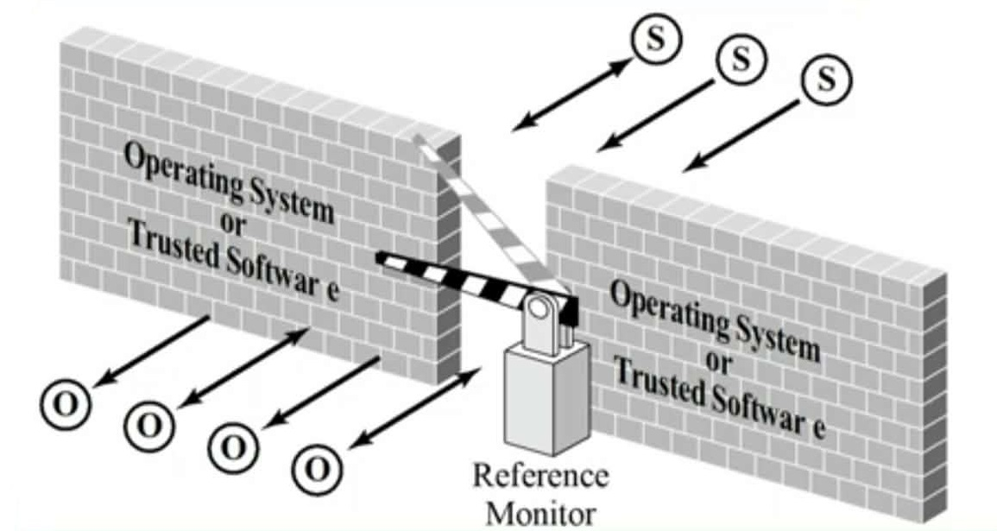
Operating Systems Security
Reference Monitor

Slide 28
Operating Systems Security
Trusted Systems
A trusted system is one that has been shown to warrant some degree of trust that it will perform certain activities faithfully
Characteristics of a trusted system:
  A defined policy that details what security qualities it enforces
  Appropriate measures and mechanisms by which it can enforce security adequately
  Independent scrutiny or evaluation to ensure that the mechanisms have been selected and implemented properly

Slide 29
Operating Systems Security
Other Trusted System Characteristics
Secure startup
System startup is a tricky time for security, as most systems load basic I/O functionality before being able to load security functions
Trusted path
An unforgeable connection by which the user can be confident of communicating directly with the ÓS
Object reuse control
OS clears memory before reassigning it to ensure that leftover data doesn't become compromised
Audit
Trusted systems track security-relevant changes, such as the installation of new programs or OS modification
Audit logs must be protected against tampering and deletion

Slide 30
Operating Systems Security
Protecting an OS from Malicious Software
Install updates
Use malicious software scanners
Back up systems and create repair disks
Create and implement organizational policies

Slide 31
Operating Systems Security
Installing Updates
• Update
  Provides access to patches that are regularly issued/released
• Service packs
  Address security issues and problems affecting stability, performance, or operation of features included with the OS
Patch This fixes something small and is usually quick to download and install, Rollup This might include a group of patches for a program.
Update Updates might add or fix features in your program or fix an earlier patch.

Slide 32
Operating Systems Security
Protecting an OS from Malicious Software
• Install updates
• Use malicious software scanners
• Back up systems and create repair disks
• Create and implement organizational policies

Slide 33
Operating Systems Security
Using Malicious Software Scanners
• Effective way to protect operating system
• Scan systems for virus, worms, and Trojan horses
• Often Called Virus Scanners
• Functions of anti-viruses
⁃ Identification of known viruses
⁃ Detection of suspected viruses
⁃ Blocking of possible viruses
⁃ Disinfection of infected objects
⁃ Deletion and overwriting of infected objects

Slide 34
Operating Systems Security
Memory and Address Protection
The most obvious problem of multiprogramming is preventing one program from affecting the data and programs in the memory space of other users.

Slide 35
Operating Systems Security
Fence
The simplest form of memory protection was introduced in single-user operating systems to prevent a faulty user program from destroying part of the resident portion of the operating system
a fence is a method to confine users to one side of a boundary.

Slide 36
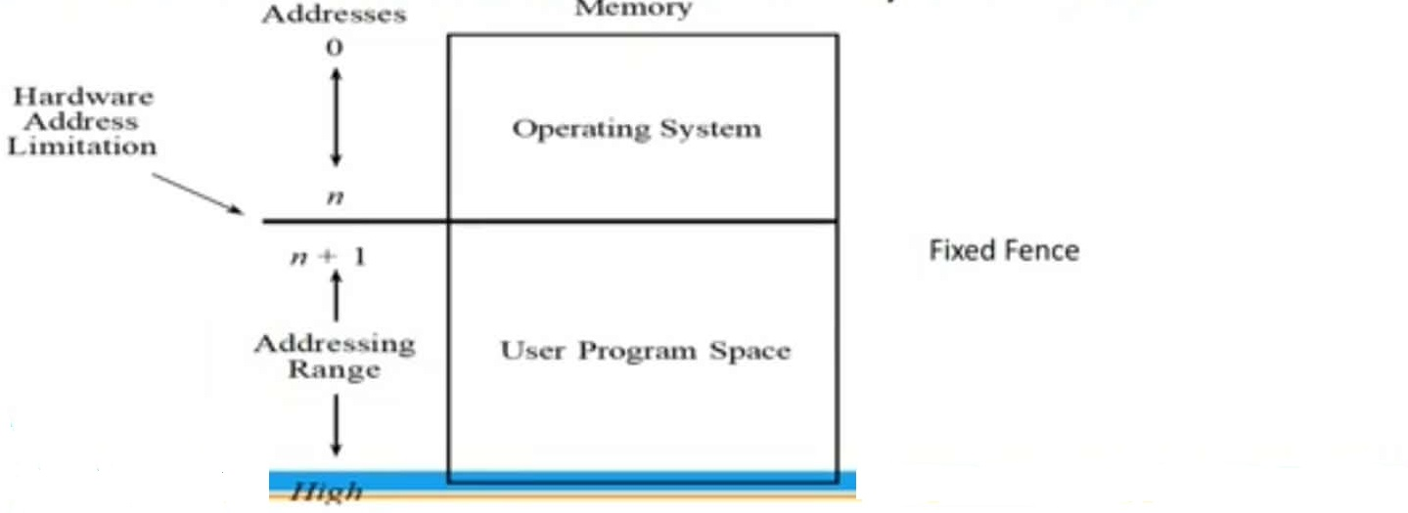
Operating Systems Security
Fence
The fence was a predefined memory address, enabling the operating system to reside on one side and the user to stay on the other.

Slide 37
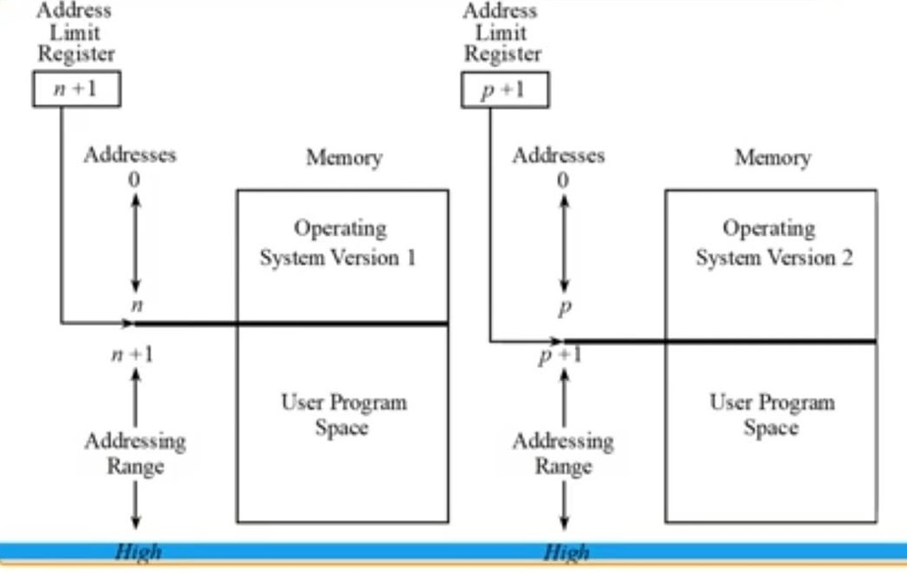
Operating Systems Security
Fence register

Slide 38
Operating Systems Security
Fence register
containing the address of the end of the operating system
the location of the fence could be changed.
Each time a user program generated an address for data modification
If the address was greater than the fence address the instruction was executed
if it was less than the fence address, an error condition was raised
‣>the fence cannot protect one user from another user.

Slide 39
Operating Systems Security
Linux Security
Like other general-purpose operating systems, Linux's wide range of features presents a broad attack surface.
Even so, by leveraging native Linux security controls, carefully configuring Linux applications, and deploying certain add-on security packages, you can create highly secure Linux systems.

Slide 40
Operating Systems Security
Linux/Unix Security
Patch management
◦ Keeping security patches up to date is a widely recognized and critical control for maintaining security
Application and service configuration
Most commonly implemented using separate text files for each application and service
Generally located either in the /etc directory or in the installation tree for a specific application
Individual user configurations that can override the system defaults are located in hidden "dot" files in each user's home directory
Most important changes needed to improve system security are to disable services and applications that are not require

Slide 41
Operating Systems Security
Linux/Unix Security
Users, groups, and permissions
Access is specified as granting read, write, and execute permissions to each of owner, group, and others for each resource
Guides recommend changing the access permissions for critical directories and files
Local exploit - Software vulnerability that can be exploited by an attacker to gain elevated privileges
Remote exploit - Software vulnerability in a network server that could be triggered by a remote attacker
chroot jail
  Restricts the server's view of the file systerm to just a specified portion
  Uses chroot system call to confine a process by mapping the root of the filesystem to some other directory
  File directories outside the chroot jail aren't visible or reachable
  Main disadvantage is added complexity

Slide 42
Operating Systems Security
Users, Groups, and Permissions
There are two things on a Linux/UNIX system that aren't represented by files:
User accounts
Group accounts
User account
  Represents someone or something capable of using files
  Group account
  A list of user accounts
  Each user account is defined with a main group membership, but may belong to as many groups as you need it to

Slide 43
Operating Systems Security
Simple File Permissions
Each file on a UNIX system has two owners (a user & a group)
Each user and group has its own set of permissions that specify what the user or group may do with the file (read it, write to it, delete it, execute it)
Other
User accounts that don't own the file or belong to the group that owns it
Permissions are listed in the order "user permissions group permissions, other permissions."

Slide 44
Operating Systems Security
Summary
Operating System Functions
Protected Objects
Operating system Security attack types
Malware Attacks
Principles of Secure OS Design
Memory and Address Protection
Linux/Unix Security

