Slide 1
Introduction
Secure Software Development
Spécialité : Computer Security.
Semestre : 08.
UE : UEF81.
Titre de la matière : Secure Software Development.
Crédits : 3.
Coefficient : 2.
Objectifs de l’enseignement : This course aims to provide students with an in-depth understanding of the fundamental principles of software security from the design phase. It also allows learners to acquire skills in integrating security throughout the software development lifecycle (DevSecOps). At the end of this subject, the student is expected to be able to implement management practices effective security in software development, deployment and maintenance.
Connaissances préalables recommandées : Software development approaches and basic notions of IT security.
01

Slide 2
Secure Software Development
Part 1: Requirements, Design
Part 1 Chapter Overview
Requirements, and Design
Security Basics
This chapter provides a high-level overview about security, including definitions of security and privacy, requirements, and risk management.
Secure Design Principles
This chapter describes how to design software to be secure, focusing on key secure design principles such as least privilege, complete mediation, and input validation.
02

Slide 3
Secure Software Development
What is Software ?
Software refers to a collection of programs, instructions, and data that enable a computer or electronic device to perform specific tasks or functions . It encompasses all the intangible components that are necessary for a computer system to operate and provide desired functionalities.
Software is a generic term used to refer to applications, scripts and programs that run on a device. It can be thought of as the variable part of a computer, while hardware is the invariable part.
02

Slide 4
Secure Software Development
What is Software ?
The two main categories of software are applications software and system software. An application is software that fulfills a specific need or performs tasks.
Systems software is designed to run a computer's hardware and provides a platform for applications to run on top of.
Other types of software include programming software, which provides the programming tools software developers need; middleware, which sits between system software and applications; and driver software, which operates computer devices and peripherals.
02

Slide 5
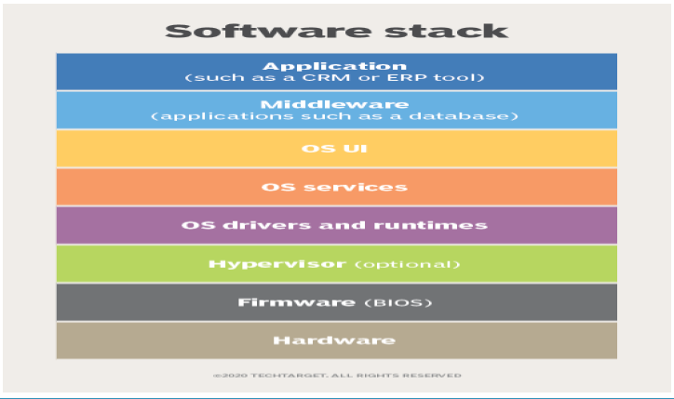
Secure Software Development
Part 1: Requirements, and Design
What is Software ?
02

Slide 6
Secure Software Development: Introduction
What is Software ?
Hardware
Physical components: CPU, RAM, SSD/HDD, network card, GPU, etc.
Firmware (BIOS/UEFI)
Low-level code on the motherboard.
It boots the machine, initializes hardware, and starts loading the OS.
Hypervisor (optional)
The virtualization layer.
Lets you run multiple operating systems (virtual machines) on one physical machine.
OS drivers and runtimes
02

Slide 7
Secure Software Development: Introduction
What is Software ?
Drivers: enable the OS to control hardware devices (network, printer, GPU…).
Runtimes: environments needed to run programs (e.g., JVM, .NET, system libraries).
OS services
Core OS functions: process scheduling, memory management, file system, networking, permissions, logging, etc.
Many run in the background as services/daemons.
OS UI
The user interface: desktop, windows, menus, shell/terminal.
Middleware
Software “between” the OS and the application, providing reusable services.
Examples: databases, web/app servers, message queues, caches (Redis), API gateways.
Application
The end-user software (e.g., CRM, ERP, web/mobile apps).
Key idea: applications don’t talk directly to hardware; they rely on middleware + OS layers to access
02

Slide 8
Secure Software Development: Introduction
Part 1: Requirements and Design
What is Software ?
The Nature of Software
Software lies at the nervecentre of most engineered artifacts and business processes, i.e. from consumer electronics to financial modelling, and from automotives to medical applications
A single defect in millions of lines of code can result in a system failure (safety critical systems)
Typically, more than 35% of project costs are allocated to software design.
02

Slide 9
Secure Software Development
Part 1: Requirements and Design
What is Software ?
The Nature of Software
Software is among the most complex engineered artifacts
Software is flexible, so is expected to conform to standards imposed by other components, e.g. hardware, external agents etc
Flexibility also increases the rate at which software is changed during its lifetime
02

Slide 10
Secure Software Development: Introduction
What Does "Security" Mean?
Security Basics
02

Slide 11
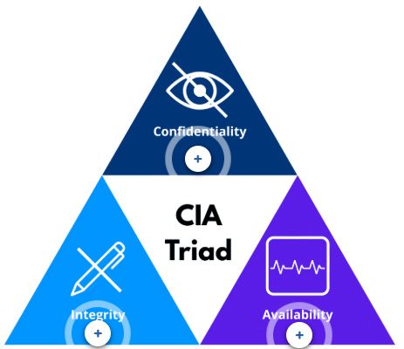
Secure Software Development: Introduction
Security Basics
What Does "Security" Mean?
To get secure software, we first need to understand what security means. Different software has different specific security requirements, but many people divide security requirements into three broad objectives: Confidentiality, Integrity, and Availability.
02

Slide 12
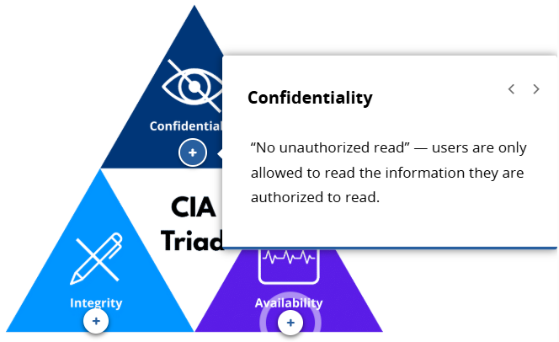
Secure Software Development: Introduction
Security Basics
What Does "Security" Mean?
02

Slide 13
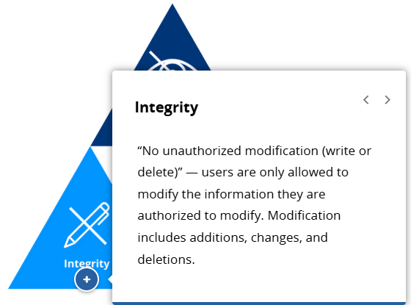
Secure Software Development: Introduction
Security Basics
What Does "Security" Mean?
02

Slide 14
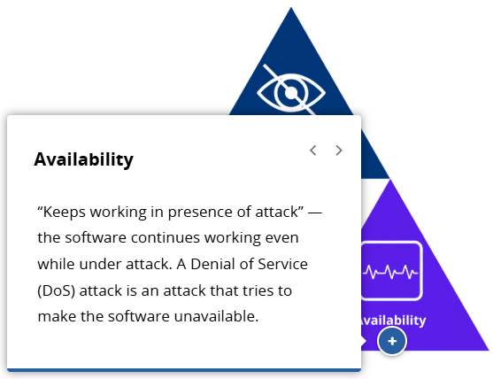
Secure Software Development: Introduction
Security Basics
What Does "Security" Mean?
Together, these three objectives form the CIA Triad, a foundational model for understanding software security.
02

Slide 15
Secure Software Development: Introduction
Security Basics
What Does "Security" Mean?
Beyond the CIA triad (Confidentiality, Integrity, Availability), many add a fourth goal: non-repudiation/accountability.
It ensures the system can prove who did what, even if the person later denies it (e.g., large money transfers, deleting critical data, sending/receiving important messages).
Not every system needs this, and some treat it as part of integrity.
The key is to clearly define the system’s security objectives.
Achieving them requires supporting mechanisms, especially authorization/access control to decide whether actions are allowed.
02

Slide 16
Secure Software Development: Introduction
Security Basics
What Does "Security" Mean?
Supporting Security Functions
Identification & Authentication (I&A)
Goal: identify the user and verify their identity before any protected action
Identity: username / email
Authentication: password
Example: login process
02

Slide 17
Secure Software Development: Introduction
Security Basics
What Does "Security" Mean?
Supporting Security Functions
Authorization (Access Control)
Goal: decide what the user is allowed to do before performing the action
Think of it as: a list of permissions (roles/rights) per user
Key point: if attackers can add permissions, even strong I&A helps little
Critical for: confidentiality + integrity
Auditing / Logging
Goal: record important events to detect and recover from attacks
Typical logs: login/logout, account changes, critical data modifications
Critical for: accountability + non-repudiation
02

Slide 18
Secure Software Development: Introduction
Security Basics
What Does "Security" Mean?
Authentication = “Who are you?”
Verifies identity (e.g., password, MFA, biometrics).
Authorization = “What are you allowed to do?”
Grants or restricts permissions after login (e.g., user vs admin, read vs write).
✅ Key point: You can know who someone is (authenticated) and still limit what they can do (authorized).
02

Slide 19
Secure Software Development: Introduction
Security Basics
What Does "Security" Mean?
What you implement depends on the type of software you’re building.
A low-level library may not implement these security mechanisms directly.
But it must be designed to fit into and support a larger system.
02

Slide 20
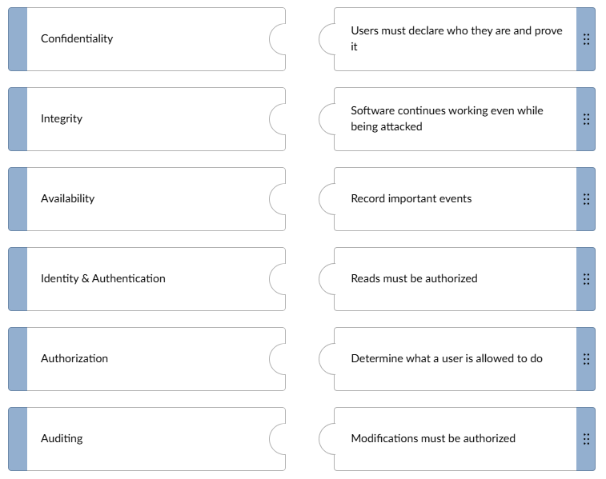
Secure Software Development: Introduction
Security Basics
Test Your Understanding
Match each definition to the correct term.
02

Slide 21
Secure Software Development
Security Basics
Security Requirements
02

Slide 22
Secure Software Development
Security Basics
Security Requirements
To build software, you must know what it should do.
Requirements define what a product/service must do or be.
Include legal/regulatory obligations and what matters to users/customers.
In professional projects, requirements are usually documented.
02

Slide 23
Secure Software Development
Security Basics
Security Requirements
Legal & Regulatory Requirements
Some software must comply with special laws/regulations, especially in high-risk domains (medical, financial, military).
Security vulnerabilities in these systems can cause serious harm.
Selling software across different countries/regions may introduce additional legal requirements.
02

Slide 24
Secure Software Development
Security Basics
Security Requirements
How Laws Become Security Requirements
Laws/regulations often force security controls inside the system.
They translate into concrete requirements:
Confidentiality
“Do not disclose patient/customer data”
⇒ encryption + access control + MFA
Integrity
“Prevent unauthorized changes to medical/financial records”
⇒ fine-grained permissions + audit logs + DB constraints + digital signatures
02

Slide 25
Secure Software Development
Security Basics
Security Requirements
Availability
“Service must remain operational”
⇒ backups + recovery plan + redundancy
Accountability / Non-repudiation
“Track who did what, and when”
⇒ logging & auditing + log retention + tamper-evident logs
Example (Banking)
“Record every transfer and keep it for a period”
⇒ tamper-evident transaction logs
02

Slide 26
Secure Software Development: Introduction
Security Basics
Security Requirements
Where Requirements Live
Requirements aren’t always in one formal document.
New requirements may appear in issue trackers or through user discussions.
Even in small projects, record high-level security requirements in one place.
This keeps everyone aligned on the software’s security goals when building, changing, or using it.
Note: Capturing key security requirements early helps guide design and implementation.
02

Slide 27
Secure Software Development
Security Basics
Common Security Objectives
02

Slide 28
Secure Software Development
Security Basics
Common Security Objectives
How to define security requirements
Revisit common security objectives and supporting functions.
Apply each one to the information your software manages.
Ask: What must be protected, from whom, and how?
02

Slide 29
Secure Software Development
Security Basics
Common Security Objectives
Confidentiality (“No unauthorized read”)
Identify data that must not be public (personal/system info).
Protect secrets (e.g., passwords) using strong password-hashing.
Enforce access controls to prevent unauthorized viewing.
02

Slide 30
Secure Software Development
Security Basics
Common Security Objectives
Integrity (“No unauthorized modification”)
Identify what data must not be changed without permission.
Define who can modify what (roles, responsibilities).
Use controls to prevent and detect tampering.
02

Slide 31
Secure Software Development
Security Basics
Common Security Objectives
Availability (“Keeps working under attack”)
Evaluate the impact of downtime (how serious is it?).
Availability isn’t absolute—online systems can face DDoS.
Design for resilience:
  prevent overload, scale under load, recover quickly
  backups + disaster recovery (including cold storage)
02

Slide 32
Secure Software Development
Security Basics
Common Security Objectives
Non-repudiation (“Prove someone did something”)
Decide if you must later prove an action occurred (not always needed).
Important for high-impact actions (e.g., transfers, deletions, critical messages).
Usually supported by logs + signatures/timestamps (depending on the system).
02

Slide 33
Secure Software Development
Security Basics
Common Security Objectives
Supporting Functions (How you achieve the goals)
Identity & Authentication (I&A)
How users prove who they are; prevent impersonation.
Prefer 2FA (built-in or via trusted identity providers).
Authorization
Who is allowed to do what (permissions/roles).
Central to confidentiality + integrity.
Auditing / Logging
Record key events (login/logout, account creation/deletion, sensitive actions).
Log: when, what, which component, and who triggered it.
02

Slide 34
Secure Software Development
Security Basics
Common Security Objectives
Takeaway
Together, these objectives help you decide:
  What to protect
  How to protect it
  How to respond when something goes wrong
Each objective contributes to your overall security posture.
Together, they help you decide what to protect, how to protect it, and how to respond when something goes wrong.
02

Slide 35
Secure Software Development
Security Basics
Tips for Finding Security Requirements
02

Slide 36
Secure Software Development
Security Basics
Tips for Finding Security Requirements
you may see “subject” and “object” in security:
  Subject: the actor (user, process)
  Object: what is acted on (file, database record, network port)
Mapping who acts on what helps identify access control and protection needs.
— Use Cases vs Abuse/Misuse Cases
Many teams capture requirements using use cases:
  interactions between actors and the system to achieve a goal
Security adds two helpful variants:
  Abuse cases: interactions intended to cause harm to the system, users, or stakeholders
  Misuse cases: deliberate exploitation of the system or its components
02

Slide 37
Secure Software Development
Security Basics
Tips for Finding Security Requirements
Use Cases vs Abuse / Misuse Cases (Definition)
Many teams capture requirements using use cases:
interactions between actors and the system to achieve a goal
Security adds two helpful variants:
Abuse cases: interactions intended to cause harm to the system, users, or stakeholders
Misuse cases: deliberate exploitation of the system or its components
02

Slide 38
Secure Software Development
Security Basics
Tips for Finding Security Requirements
Examples: Use vs Abuse vs Misuse
E-Commerce System (Online Store)
Use Case (normal use)
The user logs in, buys a product, and pays by card.
Goal: complete a purchase normally.
Abuse Case (harmful intent)
An attacker tries to disrupt the website by sending too many requests (flooding / overload).
Goal: stop the service, annoy users, and/or cause loss of sales.
Misuse Case (deliberate exploitation)
An attacker changes the order ID in the URL to view other users’ orders (IDOR).
Goal: access data they are not authorized to see (exploit a vulnerability/weakness).
02

Slide 39
Secure Software Development
Security Basics
Tips for Finding Security Requirements
— Why This Helps
Define abuse/misuse cases to specify how the system must counter attacks.
Thinking about abuse/misuse early prevents many problems later.
Since it’s hard to “think like an attacker,” use structured methods:
  common vulnerability patterns
  systematic threat modeling
NOTE: Defining abuse and misuse cases early helps you understand how your system should respond to malicious behavior and can prevent vulnerabilities before they occur.
02

Slide 40
Secure Software Development
Security Basics
Tips for Finding Security Requirements
Attacker Model (Threat Assumptions)
Defining security requirements includes deciding which attackers your system must counter.
Defending against well-resourced nation-state targeted attacks is extremely difficult and outside this program’s scope.
In this course, we assume a more common scenario: typical commercial-site threats—attackers have limited resources and attacks are often not highly targeted.
02

Slide 41
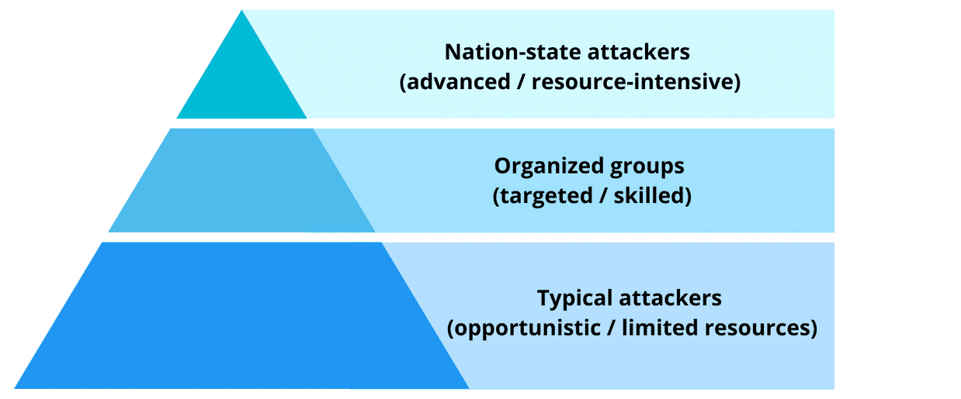
Secure Software Development
Security Basics
Tips for Finding Security Requirements
Security requirements depend on your attacker model.
This program focuses on typical web/commercial attackers, not nation-state adversaries.
Most systems focus on defending against typical and moderately skilled attackers.
02

Slide 42
Secure Software Development
Security Basics
Tips for Finding Security Requirements
Define an attacker model to set realistic security requirements.
This program targets typical commercial-site attackers (limited resources, often not highly targeted), not nation-state adversaries.
Attacker pyramid: typical → organized/skilled → nation-state; most systems focus on the first two layers.
Focus on attackers, not “hackers” (hacker ≠ attacker; per IETF definition).
02

Slide 43
Secure Software Development
Security Basics
Tips for Finding Security Requirements
In security requirements, we must define an attacker model (who attacks, what they want, and what they can do).
A hacker (per IETF definition) is someone who enjoys deep understanding of systems — not necessarily malicious.
An attacker is someone who attempts to harm the system (steal data, take over accounts, disrupt service, etc.).
Therefore, security requirements should be written in terms of attacker behaviors:
  brute-force / credential stuffing → rate limiting, MFA
  unauthorized access (IDOR) → RBAC
  abuse/DoS patterns → throttling, WAF
  suspicious activity → logging + alerts
Takeaway: Use “attacker” to make requirements clear, testable, and realistic.
02

Slide 44
Secure Software Development
Key Terms: Trust, Trustworthy, and Untrusted
Security Basics
02

Slide 45
Secure Software Development
Security Basics
Key Terms: Trust, Trustworthy, and Untrusted
Trustworthy
A component is worthy of trust for a specific purpose.
Trust
A decision to depend on something for a purpose.
Only trust things when there is adequate evidence they are trustworthy.
Many security flaws happen when we trust something that isn’t actually trustworthy.
Untrusted User
A user you do not fully trust.
Treat all data from them carefully, because they may be an attacker.
Takeaway
Every system relies on trust
—secure design comes from knowing where to trust and where to question assumptions.
02

Slide 46
Secure Software Development
Security Basics
Key Terms: Trust, Trustworthy, and Untrusted
Trust = decision to depend on something for a purpose
Trustworthy = worthy of being trusted (with evidence)
Untrusted user = not fully trusted; their data may be malicious
Many vulnerabilities happen when we trust something that is not trustworthy
Secure design = knowing where to trust and where to verify
02

Slide 47
Secure Software Development
Security Basics
Key Terms: Trust, Trustworthy, and Untrusted
Clear examples
1) Login website (HTTPS)
Trustworthy: The site has a valid TLS certificate and the domain name matches (technical evidence).
Trust: You decide to type your password into that site.
Common mistake: You enter your password on a fake look-alike page (you trust it) even though it’s not trustworthy → phishing.
2) Installing a banking app
Trustworthy: The app is from the official store, digitally signed, has reasonable reviews, and a known publisher.
Trust: You decide to install it and grant permissions.
Failure from misplaced trust: You install an APK from a WhatsApp link (you trust it) but it’s not trustworthy → it may steal your data.
02

Slide 48
Secure Software Development
Security Basics
Key Terms: Trust, Trustworthy, and Untrusted
3) “Reset password” flow
Trustworthy: The reset process uses a strong OTP, short expiration time, and attempt limits.
Trust: The system decides that whoever enters the OTP is the account owner.
Problem: If the OTP is weak or there’s no rate limiting, the system may trust the wrong person → account takeover.
4) Untrusted user input
Trustworthy: There is no reason to assume user input is “safe” by default.
Trust: If the program treats user input as safe (a trust decision), e.g., putting it directly into SQL.
Result: SQL injection happens because you trusted data that wasn’t trustworthy.
Simple rule of thumb
Trustworthy = evidence
Trust = a decision
02

Slide 49
Secure Software Development
Security Basics
Test
True or False? A typical Internet-connected service should try to stay available, but this may be difficult to achieve if the service is the target of a highly-resourced distributed denial-of-service (DDoS) attack.
True
False
02

Slide 50
Secure Software Development
Examples — Trust, Trustworthy, Untrusted
Security Basics
Goal
Identify what must be treated as untrusted
Decide what evidence makes something trustworthy
Choose the right security controls before you trust it Instructions
You have 2 scenarios. For each scenario, do the following:
Identify the untrusted inputs/components
Explain why they should not be trusted by default
Propose 2–4 security controls that make relying on them safer
Do a quick risk rating:
  Likelihood (L): 1–5
  Impact (I): 1–5
  Risk = L × I
02

Slide 51
Secure Software Development
Examples — Trust, Trustworthy, Untrusted
Security Basics
Scenarios
Scenario 1 — Login Form
A user enters a username and password in a login page.
Scenario 2 — Password Reset
Password reset is done via an emailed link + a one-time code (OTP).
02

Slide 52
Secure Software Development
Examples — Trust, Trustworthy, Untrusted
Security Basics
Scenarios
Scenario 1 — Login Form
Untrusted: username, password, IP address, request rate
Why: the user may be an attacker (brute force, automated abuse, malicious input)
Controls:
Input validation (format + length limits) and safe error messages
Rate limiting + temporary lockout
MFA for sensitive accounts
Logging and alerting for repeated failures / unusual patterns
Example risk: L=4, I=4 → Risk=16
02

Slide 53
Secure Software Development
Examples — Trust, Trustworthy, Untrusted
Security Basics
Scenarios
Scenario 1 — Login Form
Why L = 4 (Likelihood is high)
A login form is one of the most targeted parts of any internet-facing system : It’s publicly reachable (anyone can try it).
Automated attacks are very common (brute force, credential stuffing, bots).
Attacking it is cheap/easy to scale (many requests quickly).
So the chance of attempted abuse is usually high → 4/5 (not always 5 because some systems are less visible or already have strong protections).
02

Slide 54
Secure Software Development
Examples — Trust, Trustworthy, Untrusted
Security Basics
Scenarios Scenario 1 — Login Form
Why I = 4 (Impact is high)
If the attack succeeds, the consequences can be serious:
Account takeover (attacker logs in as the user).
Data exposure (personal/sensitive info).
Unauthorized actions (changing settings, deleting data, accessing admin features, etc.).
So the harm is typically high → 4/5 (not always 5 unless it’s a critical system).
Important note
These numbers are example ratings, not fixed. They depend on context:
Banking / healthcare / admin accounts → often Impact = 5
Internal/private system (not internet-exposed) → often Likelihood = 2–3
02

Slide 55
Secure Software Development
Examples — Trust, Trustworthy, Untrusted
Security Basics
Scenarios
Key takeaway
Trust = a decision.
Only trust something after you have evidence (verification/controls) that it is trustworthy.
Golden rule: Everything coming from outside your trust boundary is untrusted until proven otherwise.
02

Slide 56
Secure Software Development
The Need for Risk Management
(Software Security)
Security Basics
02

Slide 57
Secure Software Development
Security Basics
The Need for Risk Management (Software Security)
Risks = potential problems: Secure software requires managing security risks before they become incidents.
Risk is unavoidable: developers make mistakes; some become vulnerabilities. Attackers may also insert malicious code during development or via dependencies.
Risk management (Hubbard, 2009): identify, evaluate, prioritize risks, then apply resources to minimize, monitor, and control likelihood and/or impact.
Assume attackers will try: you can’t stop attempts, but you can make attacks harder and reduce damage if they succeed.
Start early: if you wait, it’s no longer a risk—it’s a problem. Early risk thinking is cheaper, improves reliability, reputation, and trust.
02

Slide 58
Secure Software Development
Security Basics
The Need for Risk Management (Software Security)
Takeaway:
Assume attacks will happen. Reduce both the likelihood of success and the impact of harm to an acceptable level.
Mini-example (Risk → Controls)
Risk: Password attacks on the login page (brute force / credential stuffing).
Impact: Unauthorized access → data leakage and/or account modification.
Controls:
  Rate limiting + temporary lockout after repeated failed attempts
  MFA / 2FA
  Secure password storage (hashing with bcrypt/Argon2) + strong password policy
  Logging + alerting to detect and respond to suspicious behavior
02

Slide 59
Secure Software Development
Security Basics
The Need for Risk Management (Software Security)
Notes (very short)
“We don’t aim for zero risk; we aim for acceptable risk.”
“Attack attempts are guaranteed; success is what we prevent.”
“Fixing a risk in design is cheaper than fixing an incident in production.”
02

Slide 60
Secure Software Development
Security Basics
Risk Management Process
Scale matters: small/low-impact projects can be informal; large/high-impact projects should be rigorous.
Risk Planning
Define how you will do risk management (roles, cadence, templates, thresholds).
Risk Identification
List what could go wrong (focus on security risks). Use lessons learned from similar projects and past incidents. Write it down and share it.
Risk Analysis
For each risk estimate:
  Likelihood (how probable?) (probability)
  Severity (how bad if it happens?) (impact)
  Higher likelihood and/or severity ⇒ higher priority.
02

Slide 61
Secure Software Development
Security Basics
Risk Management Process
Risk Handling (choose a response)
  Accept + Monitor: keep it, but track and communicate (ok when low L or low S).
  Avoid: remove the cause/impact (e.g., don’t collect certain data; use a safer language).
  Transfer: shift risk to another party/component (e.g., use a trusted identity provider).
  Control / Mitigate: reduce likelihood and/or severity to acceptable levels (training, secure design, safer languages/APIs, tools & peer review, hardening).
Risk Monitoring
Track how risks evolve over time; “burn down” risk until it’s acceptable.
Key idea: it’s common sense—but easy to forget while building features.
Risk management is common sense, but easy to forget during busy development.
Early attention prevents future incidents.
02

Slide 62
Secure Software Development
Security Basics
Identifying Security Risks

Slide 63
Secure Software Development
Security Basics
Identifying Security Risks
To identify security risks effectively, you need both mindset and method:
Mindset: assume some users are adversaries, and they will try unusual inputs, edge cases, and “weird” sequences of actions.
Method: use structured techniques so you don’t rely only on intuition.
Practical ways to identify security risks
Start from assets (what you must protect)
List your most important assets, such as:
user accounts and identities
personal/medical/financial data
payment records
availability of the service (uptime)
integrity of logs, audit trails, and records
Then ask: What could go wrong to each asset? Who would benefit?

Slide 64
Secure Software Development
Security Basics
Identifying Security Risks
2) Map trust boundaries
Draw a simple diagram of where data crosses boundaries, for example:
browser → web server
web server → database
your system → third-party APIs
internal admin tools → production systems
Risks often appear where trust changes (untrusted → trusted).
3) Think like an attacker (without “hacking”)
Ask questions such as:
  What if the user is not who they claim to be?
  What if inputs are malformed, too long, missing, or unexpected?
  What if actions are repeated quickly (spam/abuse)?
  What if someone tries to access data they shouldn’t?
  What if a dependency/library is vulnerable or malicious?
02

Slide 65
Secure Software Development
Security Basics
Identifying Security Risks
4) Use checklists and known patterns
Checklists help teams consistently notice common risks, such as:
authentication and session management risks
authorization/RBAC mistakes (privilege escalation)
input validation risks
data exposure (in transit / at rest / logs)
insecure defaults and misconfiguration
dependency/supply-chain risks
monitoring gaps (no logs, no alerts)
Well-known catalogs like OWASP/CWE can guide what to look for.
5) Convert “abuse/misuse cases” into risks
Write a few short stories where the goal is harmful, e.g.:
“A user tries to access another user’s record.”
“A bot repeatedly attempts logins.”
“An insider exports sensitive reports.”
Each story becomes a risk statement you can analyze and handle.

Slide 66
Secure Software Development
Security Basics
Identifying Security Risks
6) Review collaboratively
Risk identification improves a lot when done with others:
design reviews (early)
code reviews (ongoing)
“what could go wrong?” sessions
testing/QA feedback loops
Different people notice different failure modes.

Slide 67
Secure Software Development
Security Basics
Identifying Security Risks
What good risk statements look like
A useful risk statement is specific and testable:
Risk: “An attacker may guess passwords and take over accounts.”
Asset harmed: accounts / data
Cause: weak password controls / no rate limiting
Impact: unauthorized access, data leakage
Where: login endpoint
Avoid vague risks like “security might be bad.” Make them concrete.

Slide 68
Secure Software Development
Security Basics
Identifying Security Risks
Mini example (risk → controls)
Risk: Credential stuffing on the login page
Impact: account takeover → data exposure
Controls: rate limiting + lockout, MFA/2FA, strong password policy + secure hashing, logging + alerts
Key takeaway
Security risk identification is a habit supported by structure. A “slightly paranoid” mindset helps you notice what normal users won’t do—but attackers will. Keep identifying risks continuously, not just once at the start.

Slide 69
Secure Software Development
Security Basics
Security Is a Process, Not a Product

Slide 70
Secure Software Development
Security Basics
Security Is a Process, Not a Product
Bruce Schneier famously argued that security is a process, not a product—there is no such thing as perfect security. What matters is keeping risks manageable over time.
Security must continuously adapt because the environment around your software keeps changing:
how users interact with the system evolves,
new vulnerabilities are discovered,
platforms, libraries, and dependencies are updated,
laws, policies, and business goals shift.
As a result, software that was secure one year ago may not be secure today. Security is not “fire and forget.” It requires ongoing attention, monitoring, updates, and improvement.

Slide 71
Secure Software Development
Security Basics
Security Is a Process, Not a Product
No perfect security; the goal is manageable risk.
Security must evolve as conditions change:
  usage changes
  new vulnerabilities appear
  dependencies get updated
  laws/policies/goals shift
“Secure once” is not enough.
Security needs continuous work:
  monitoring
  patching
  reviews and testing
  incident response readiness
Takeaway
Treat security as a continuous lifecycle, not a one-time feature.

Slide 72
Secure Software Development
Security Basics
Security Is a Process, Not a Product
Takeaway + Mini example (Risk → Process)
Takeaway:
Security is ongoing work: reduce risk continuously as the system and threats evolve.
Mini example
Risk: A new vulnerability is found in a library your app uses.
Process actions (controls over time):
  Track dependencies (SBOM / inventory)
  Monitor vulnerability alerts (CVE feeds/tools)
  Patch/upgrade quickly + test + redeploy
  Add detection (logs/alerts) for exploitation attempts
  Post-incident review to prevent repeats

Slide 73
Secure Software Development
Security Basics
Checklists Are Not Security

Slide 74
Secure Software Development
Security Basics
Checklists Are Not Security
Checklists/guidelines/tips are useful aids, not “security itself.”
They help you:
  identify common risks
  choose reasonable mitigations
  review software faster and more consistently
Good checklists are built from real-world experience—don’t ignore them.
But you can follow every checklist and still ship insecure software.
You can also skip irrelevant items and still be secure.
There is no substitute for thinking.
Continuously ask: How would an attacker exploit this?
Treat issues early: before risks become incidents.

Slide 75
Secure Software Development: Introduction
Security Basics
Checklists Are Not Security
Takeaway + Mini example (Risk → Thinking)
Takeaway
Checklists help, but security comes from continuous thinking + verification.
Mini example
Risk: A developer follows a “secure coding checklist” but forgets to enforce authorization on an API endpoint.
Impact: Any logged-in user can access/modify other users’ data (IDOR / privilege escalation).
Process response (beyond checklist):
  Threat model the endpoint: who should access what?
  Add server-side access control checks (RBAC/ABAC).
  Write tests for permission boundaries.
  Log and alert suspicious access patterns.

Slide 76
Secure Software Development
Security Basics
Checklists Are Not Security
Test
True or False? The purpose of developing secure software is to eliminate all possible security risks.
True
False

Slide 77
Secure Software Development
Development Processes/Defense-in-Breadth: Individual Software Development & Deployment Processes
Security Basics

Slide 78
Secure Software Development
Development Processes/Defense-in-Breadth: Individual Software Development & Deployment Processes
Security Basics
Defense-in-Breadth (Across Development & Deployment) — Core Idea
There is no single “magic” mechanism that makes software secure.
Security must be considered continuously throughout software development and deployment.
Defense-in-breadth means:
embedding security into every phase of the process, rather than treating security as a separate “final step.”
Every normal development activity is an opportunity to:
reduce risk early
prevent common vulnerabilities
build more trustworthy software

Slide 79
Secure Software Development
Development Processes/Defense-in-Breadth: Individual Software Development & Deployment Processes
Security Basics
1) Determine Requirements
Goal: define what the software must do.
Security view: identify security requirements from the start.
Examples:
What data must stay confidential (medical, financial, personal)?
Who can do what? (roles/permissions: patient, doctor, admin)
Do we need audit logs (traceability)?
What availability level is required (resistance to abuse/DoS)?
Output: clear, testable security requirements.

Slide 80
Secure Software Development
Development Processes/Defense-in-Breadth: Individual Software Development & Deployment Processes
Security Basics
2) Determine Architectural Design
Goal: split the system into interacting components (UI, API, DB, storage, external services).
Security view: design an architecture that is easier to secure.
Examples:
Define trust boundaries (where untrusted data crosses into trusted parts).
Separate responsibilities (upload service ≠ prescriptions service ≠ admin service).
Enforce security on the server side, not only in the client.
Plan authentication/authorization early (sessions/tokens/roles).
A good architecture reduces attack surface and avoids expensive late “patches.”

Slide 81
Secure Software Development
Development Processes/Defense-in-Breadth: Individual Software Development & Deployment Processes
Security Basics
3) Select Reusable Components (Dependencies)
Goal: choose libraries, packages, frameworks.
Security view: manage dependency risk (software supply chain).
Why it matters:
A vulnerability in a dependency can become your vulnerability.
Your “supply chain” includes where components come from and how updates reach you.
Practices:
Choose well-maintained, reputable components.
Scan dependencies for known vulnerabilities.
Pin versions (lockfiles) and have an update policy.

Slide 82
Secure Software Development
Development Processes/Defense-in-Breadth: Individual Software Development & Deployment Processes
Security Basics
4) Implement the Code
Goal: write the code.
Security view: avoid the most common vulnerability patterns.
Common patterns:
unvalidated input (injection, XSS)
broken access control (IDOR)
weak session/token handling
secrets in code
insecure crypto usage
Once you know these patterns, you can systematically prevent them via secure coding rules, reviews, and checklists.

Slide 83
Secure Software Development
Development Processes/Defense-in-Breadth: Individual Software Development & Deployment Processes
Security Basics
5) Verify the Software
Goal: test and analyze to confirm behavior matches intent.
Security view: test security as well as functionality.
Examples:
unit/integration tests
authorization tests (a user should not access another user’s data)
static/dynamic analysis tools (SAST/DAST)
dependency scanning
testing error paths and unusual inputs
Goal: find vulnerabilities before attackers do.

Slide 84
Secure Software Development
Development Processes/Defense-in-Breadth: Individual Software Development & Deployment Processes
Security Basics
6) Deploy Securely
Goal: deliver the correct software version to users and run it safely.
Security view: use secure defaults and make secure operation easy.
Examples:
TLS/HTTPS enabled
secure-by-default configuration (no debug in production)
least privilege for services and accounts
proper secrets management
monitoring and alerting
Good software should be easy to operate securely.

Slide 85
Secure Software Development
Development Processes/Defense-in-Breadth: Individual Software Development & Deployment Processes
Security Basics
Key takeaway
Every phase is a chance to reduce risk.
Thinking about security across requirements, design, implementation, verification, and deployment is true defense-in-breadth—and leads to more trustworthy software.

Slide 86
Secure Software Development
Development Processes/Defense-in-Breadth: Individual Software Development & Deployment Processes
Security Basics
Summary _Defense-in-Breadth Across the Lifecycle
Title: Defense-in-Breadth: Security Built Into Every Phase
No single “magic” control makes software secure → security must be continuous.
Defense-in-breadth = embed security in requirements → design → build → test → deploy → operate (not a final step).
Lifecycle contributions
Requirements: define security requirements (confidentiality, access control, audit, availability).
Architecture/Design: set trust boundaries, reduce attack surface, plan authn/authz.
Components/Dependencies: evaluate libraries; manage supply-chain risk (scan + pin versions).
Implementation: follow secure coding patterns; avoid common vulnerabilities (injection, IDOR, secrets).
Verification: test security + functionality (SAST/DAST, auth tests, dependency scans).
Secure Deployment/Operations: secure defaults, TLS, least privilege, monitoring + patching.
Takeaway: Every phase is a chance to reduce risk and build more trustworthy software.

Slide 87
Secure Software Development
Development Processes/Defense-in-Breadth: Individual Software Development & Deployment Processes
Security Basics
Key takeaway
Every phase is a chance to reduce risk.
Thinking about security across requirements, design, implementation, verification, and deployment is true defense-in-breadth—and leads to more trustworthy software.

