Slide 1
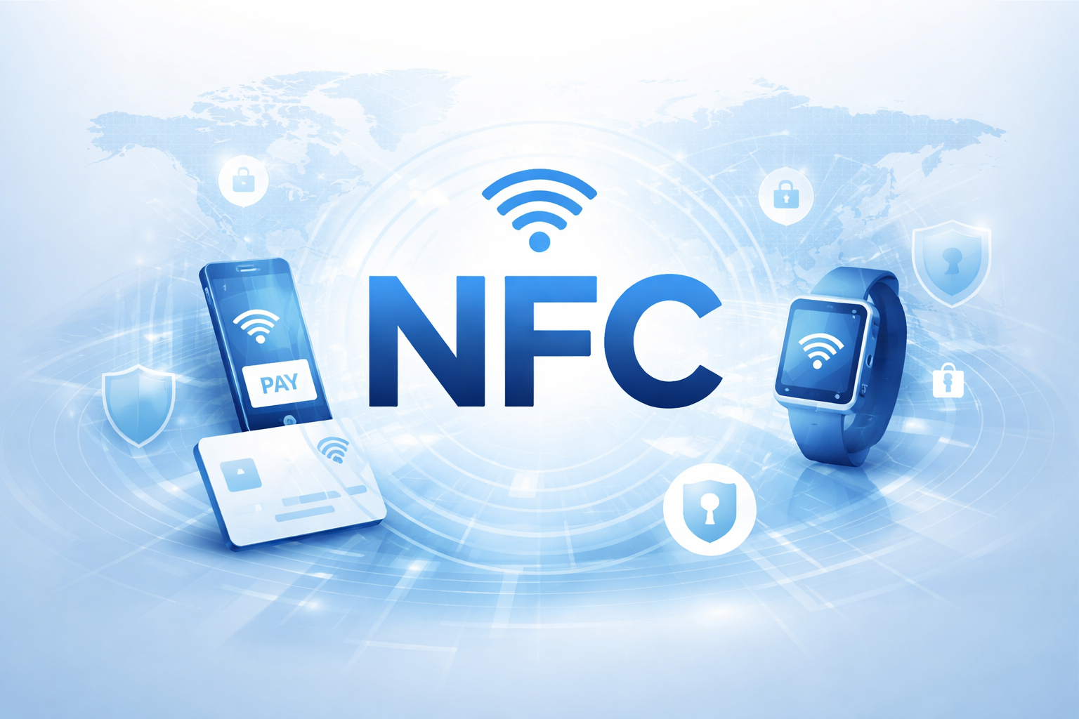
Presented by :
BEKRI DOUAA

Slide 2
Introduction
Near Field Communication (NFC) is a short-range wireless communication technology (typically a few centimeters), operating at 13.56 MHz. It enables fast, simple, and secure data exchange between devices without prior configuration, using RFID technology. Today, NFC is widely used in several fields such as mobile payments, transportation, access control, and interactive marketing.

Slide 3
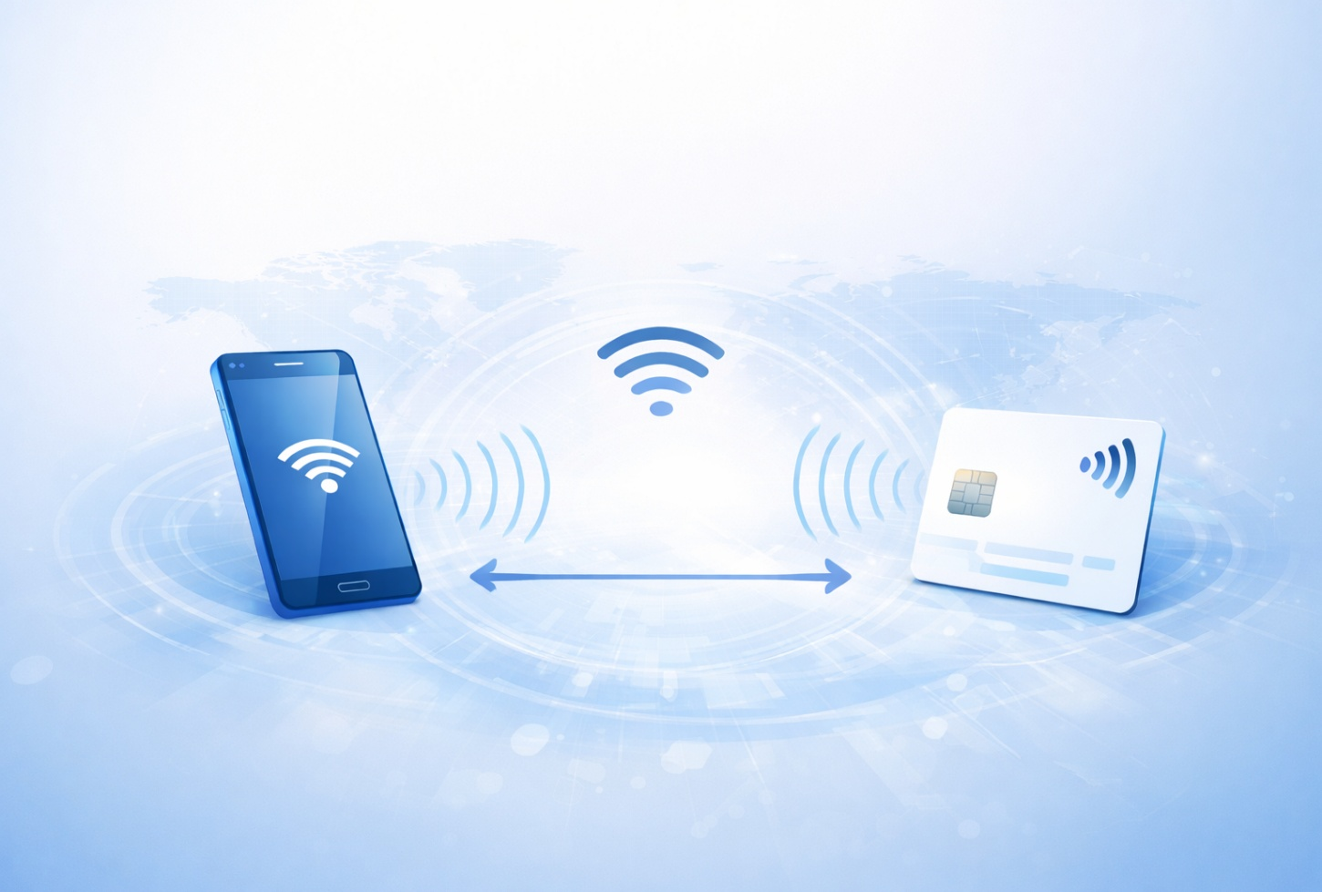
How Does NFC Work?
NFC uses inductive coupling between two devices
It operates at a frequency of 13.56 MHz
Data transfer speed ranges from 106 to 424 kbit/s
NFC enables:
  Contactless payments
  Data exchange
  Easy connection (e.g., Wi-Fi setup)

Slide 4
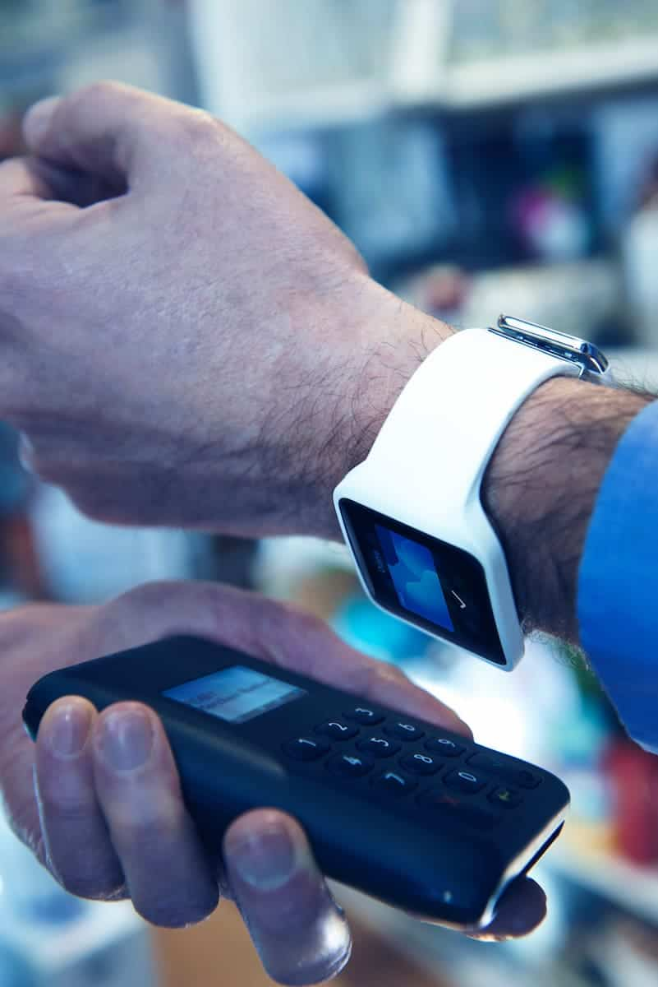
How Does NFC Work?
NFC Modes of Operation
Peer-to-Peer Mode:
Data exchange between two devices (e.g., smartphones)
Read/Write Mode:
One device reads data from another (e.g., NFC tags)
Card Emulation Mode:
Device acts like a smart card (e.g., payments, transport)

Slide 5
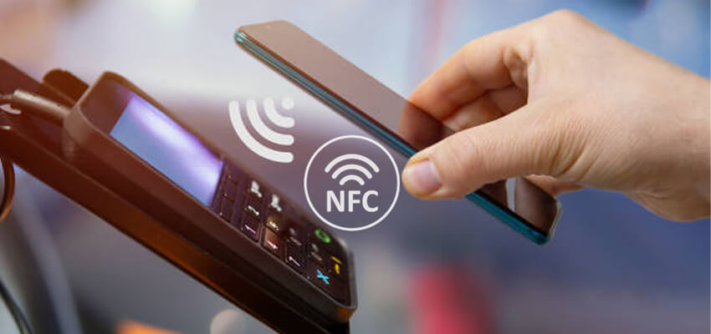
Protocols Used
ISO/IEC 14443
Used for contactless smart cards (e.g., bank cards, transport cards).
Defines communication between NFC devices and cards
ISO/IEC 18092
Defines peer-to-peer communication between NFC devices
Allows data exchange between two smartphones
NDEF
Defines how data is structured and stored
Used for sharing text, URLs, or small data

Slide 6
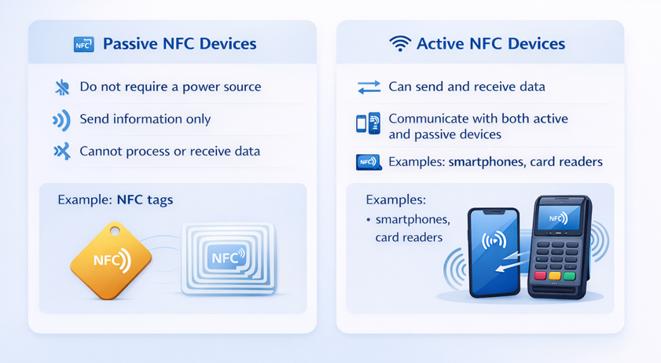
Types of NFC Devices

Slide 7

Countermeasures
Use strong encryption (AES)
Disable NFC when not in use
Enable authentication mechanisms
Use secure elements in devices
Keep devices very close
(short range)

Slide 8
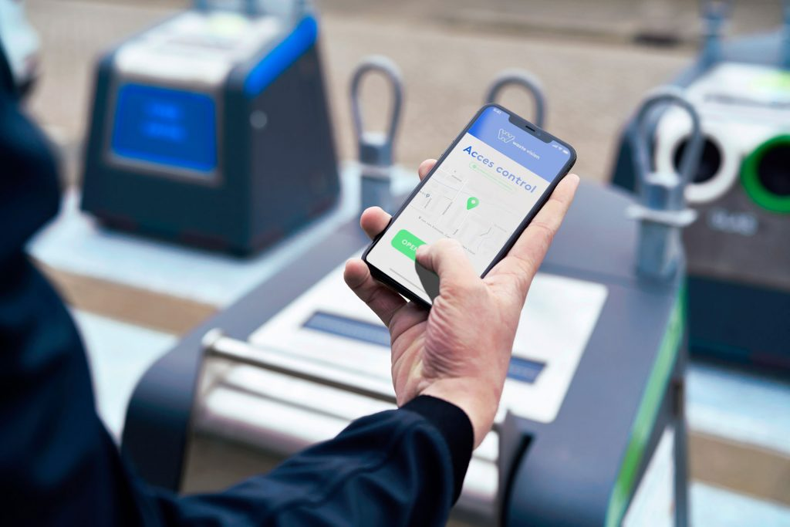
Cryptographic Algorithms
AES (128-bit encryption)
DES (Data Encryption Standard)
3DES (Triple DES)

Slide 9
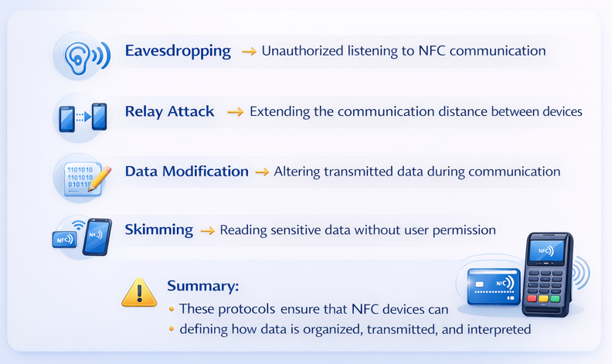
Known Vulnerabilities (Attacks)

Slide 10
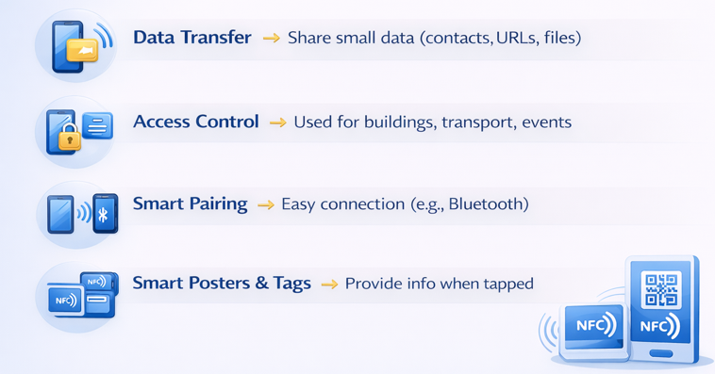
Applications of NFC

Slide 11
Benefits of NFC
Easy payments with smartphones
Used in banking, tickets, and access control
Secure (PIN + encryption)
No pairing required
Works without extra setup
Compatible with RFID systems

Slide 12
Limitations of NFC
Short operating range
Low data transfer rates (106, 212, 424 Kbps)
Costly for companies to adopt
Can be relatively complex to use compared to simpler technologies

Slide 13
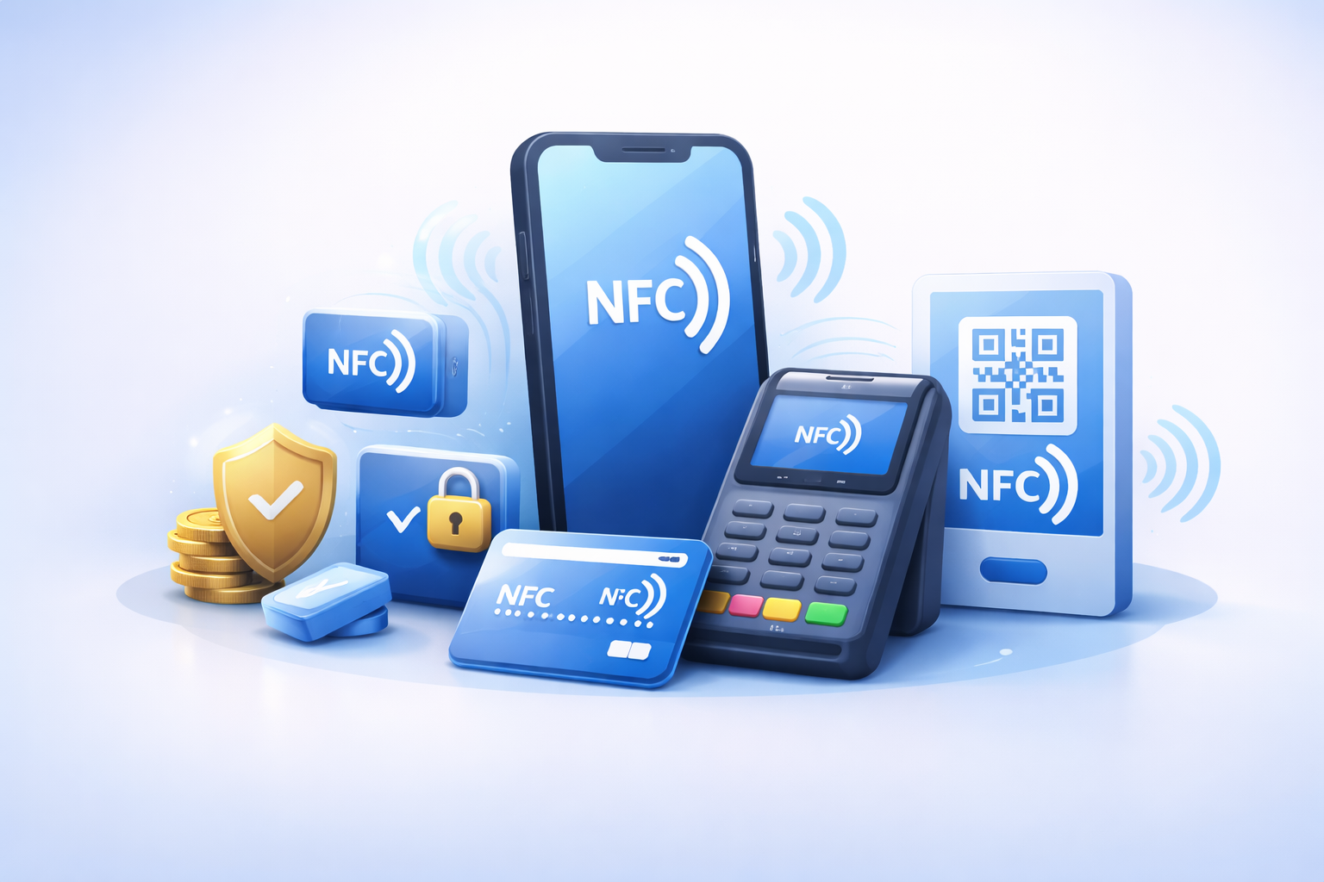
Conclusion
Near Field Communication (NFC) is a short-range wireless technology that enables fast and secure communication. It is widely used in mobile payments and data transfer. Despite its short range and low speed, NFC remains simple, secure, and widely used.

Slide 14
THANK
YOU.

