Slide 1

UAMS - PCI & RHG Security Compliance
Ensuring robust protection and regulatory adherence
Notes:
AI-generated content may be incorrect. ---

Slide 2
Introduction to UAMS and Compliance
Notes:
--- This slide references information from the following file: https://carlsonrezidor-my.sharepoint.com/personal/abdelmanem_samy_radissonblu_com/Documents/Microsoft%20Copilot%20Chat%20Files/PRESENTATION_PCI_RHG_COMPLIANCE.html Overview of UAMS, Importance of PCI & RHG Compliance

Slide 3
Overview of UAMS
Centralized Compliance Tracking
UAMS provides centralized tracking and documentation for compliance across systems like Active Directory, PMS, and POS.
Audit Evidence Documentation
The system documents user account activities and generates reports to demonstrate adherence to security policies for audits.
Compliance with Security Standards
UAMS supports compliance with standards like PCI and RHG by reducing manual effort and enhancing process transparency.
Notes:
--- This slide references information from the following file: https://carlsonrezidor-my.sharepoint.com/personal/abdelmanem_samy_radissonblu_com/Documents/Microsoft%20Copilot%20Chat%20Files/PRESENTATION_PCI_RHG_COMPLIANCE.html The User Access Management System (UAMS) is designed as a compliance tracking and documentation platform that ensures organizations meet stringent security standards. It does not enforce security policies directly but provides a centralized mechanism to track and document compliance across multiple systems such as Active Directory, PMS, and POS. UAMS helps organizations prove to auditors that security policies are being followed by monitoring user accounts, documenting evidence, and generating reports. This system is critical for organizations that need to maintain compliance with PCI and RHG standards, as it reduces manual effort, minimizes errors, and provides transparency in access management processes.

Slide 4
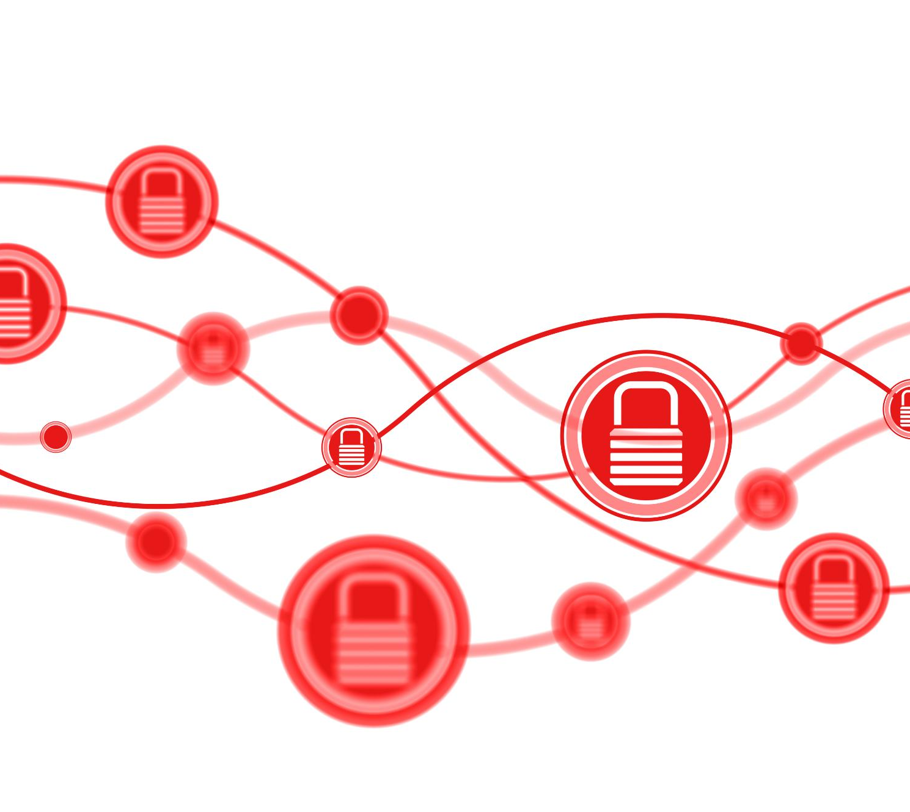
Importance of PCI & RHG Compliance
PCI Security Standards
PCI standards enforce strict security controls to protect credit card data and mandate annual compliance audits.
RHG Access Control Policies
RHG includes seven critical audit requirements focusing on company-specific access control policies and security.
Consequences of Non-Compliance
Failure to comply risks data breaches, reputational damage, financial losses, and legal penalties.
Role of UAMS
UAMS ensures compliance by providing evidence-based tracking and centralized visibility across systems.
Notes:
--- This slide references information from the following file: https://carlsonrezidor-my.sharepoint.com/personal/abdelmanem_samy_radissonblu_com/Documents/Microsoft%20Copilot%20Chat%20Files/PRESENTATION_PCI_RHG_COMPLIANCE.html PCI (Payment Card Industry) standards govern the security of credit card data, requiring strict access controls and annual compliance audits. RHG refers to company-specific access control policies that include seven key audit requirements. Compliance with these standards is essential to protect sensitive data, pass security audits, meet regulatory requirements, and avoid penalties or fines. Organizations that fail to comply risk data breaches, reputational damage, and financial losses. UAMS plays a pivotal role in ensuring compliance by providing evidence-based tracking and centralized visibility across systems.

Slide 5
Audit Requirements and Compliance
Notes:
--- This slide references information from the following file: https://carlsonrezidor-my.sharepoint.com/personal/abdelmanem_samy_radissonblu_com/Documents/Microsoft%20Copilot%20Chat%20Files/PRESENTATION_PCI_RHG_COMPLIANCE.html The Seven RHG Audit Requirements

Slide 6
The Seven RHG Audit Requirements
Requirement | What It Means | Status
4.1 | Unique User IDs - Each person has unique account | ✅ Complete
4.2 | Service Account Passwords - Secure passwords for service accounts | ✅ Complete
4.3 | Admin Access Limits - Only IT admins have admin rights | ✅ Complete
4.4 | Change Management - All access changes are approved | ✅ Complete
4.5 | Permission Reviews - Quarterly reviews of user permissions | ✅ Complete
4.6 | Approved Access Only - Employees only have approved access | ✅ Complete
4.7 | Default Accounts - Factory default accounts are removed/changed | ✅ Complete
Notes:
--- This slide references information from the following file: https://carlsonrezidor-my.sharepoint.com/personal/abdelmanem_samy_radissonblu_com/Documents/Microsoft%20Copilot%20Chat%20Files/PRESENTATION_PCI_RHG_COMPLIANCE.html Auditors check seven critical requirements under RHG policies: unique user IDs, secure service account passwords, limited administrator access, approved change management, quarterly permission reviews, approved access only, and removal of default accounts. Each requirement ensures that user access is controlled, documented, and verified regularly. UAMS addresses these requirements by providing automated tracking, alerts, and comprehensive reporting. By meeting these standards, organizations can demonstrate compliance and maintain a strong security posture.

Slide 7
Detailed Requirements
Notes:
--- This slide references information from the following file: https://carlsonrezidor-my.sharepoint.com/personal/abdelmanem_samy_radissonblu_com/Documents/Microsoft%20Copilot%20Chat%20Files/PRESENTATION_PCI_RHG_COMPLIANCE.html Requirement 4.1: Unique User Accounts, Requirement 4.2: Service Account Security

Slide 8

Requirement 4.1: Unique User Accounts
Risks of Generic Accounts
Generic accounts reduce accountability and traceability, increasing security risks within organizations.
Unique Username Requirement
Auditors require proof that every employee has a unique username across all systems without shared accounts.
UAMS Compliance Features
UAMS tracks usernames, flags generic accounts, verifies uniqueness, and monitors password policy compliance.
Notes:
--- This slide references information from the following file: https://carlsonrezidor-my.sharepoint.com/personal/abdelmanem_samy_radissonblu_com/Documents/Microsoft%20Copilot%20Chat%20Files/PRESENTATION_PCI_RHG_COMPLIANCE.html Generic accounts pose significant security risks because they lack accountability and traceability. Auditors require proof that each employee has a unique username across all systems, no shared accounts exist, and password settings align with RHG policies. UAMS helps by tracking usernames, flagging generic accounts, and documenting remediation. It also provides cross-system views, uniqueness verification, and policy drift monitoring to ensure compliance. For example, an employee like John Doe would have consistent usernames across AD, PMS, and POS, with verified password policies.

Slide 9

Requirement 4.2: Service Account Security
Elevated Privileges Importance
Service accounts have elevated privileges requiring special security measures to prevent unauthorized access.
Audit and Documentation
Auditors require documented service accounts, ownership details, and regular password updates for compliance.
UAMS Features
UAMS offers registry, password tracking, ownership linkage, attestation workflows, and compliance alerts for service accounts.
Example: PMS Backup Account
A PMS backup service account includes owner info, last password change date, and compliance status for auditing.
Notes:
--- This slide references information from the following file: https://carlsonrezidor-my.sharepoint.com/personal/abdelmanem_samy_radissonblu_com/Documents/Microsoft%20Copilot%20Chat%20Files/PRESENTATION_PCI_RHG_COMPLIANCE.html Service accounts require special attention because they often have elevated privileges. Auditors expect documentation of all service accounts, regular password changes, ownership assignment, and proof of compliance. UAMS provides a service account registry, password tracking, ownership linkage, and attestation workflows. It also offers compliance reports and alerts for overdue password changes. For instance, a service account for PMS backup would include details like owner, last password change date, and compliance status.

Slide 10
Key Features and Benefits
Notes:
--- This slide references information from the following file: https://carlsonrezidor-my.sharepoint.com/personal/abdelmanem_samy_radissonblu_com/Documents/Microsoft%20Copilot%20Chat%20Files/PRESENTATION_PCI_RHG_COMPLIANCE.html Core Features of UAMS, Benefits for Stakeholders

Slide 11
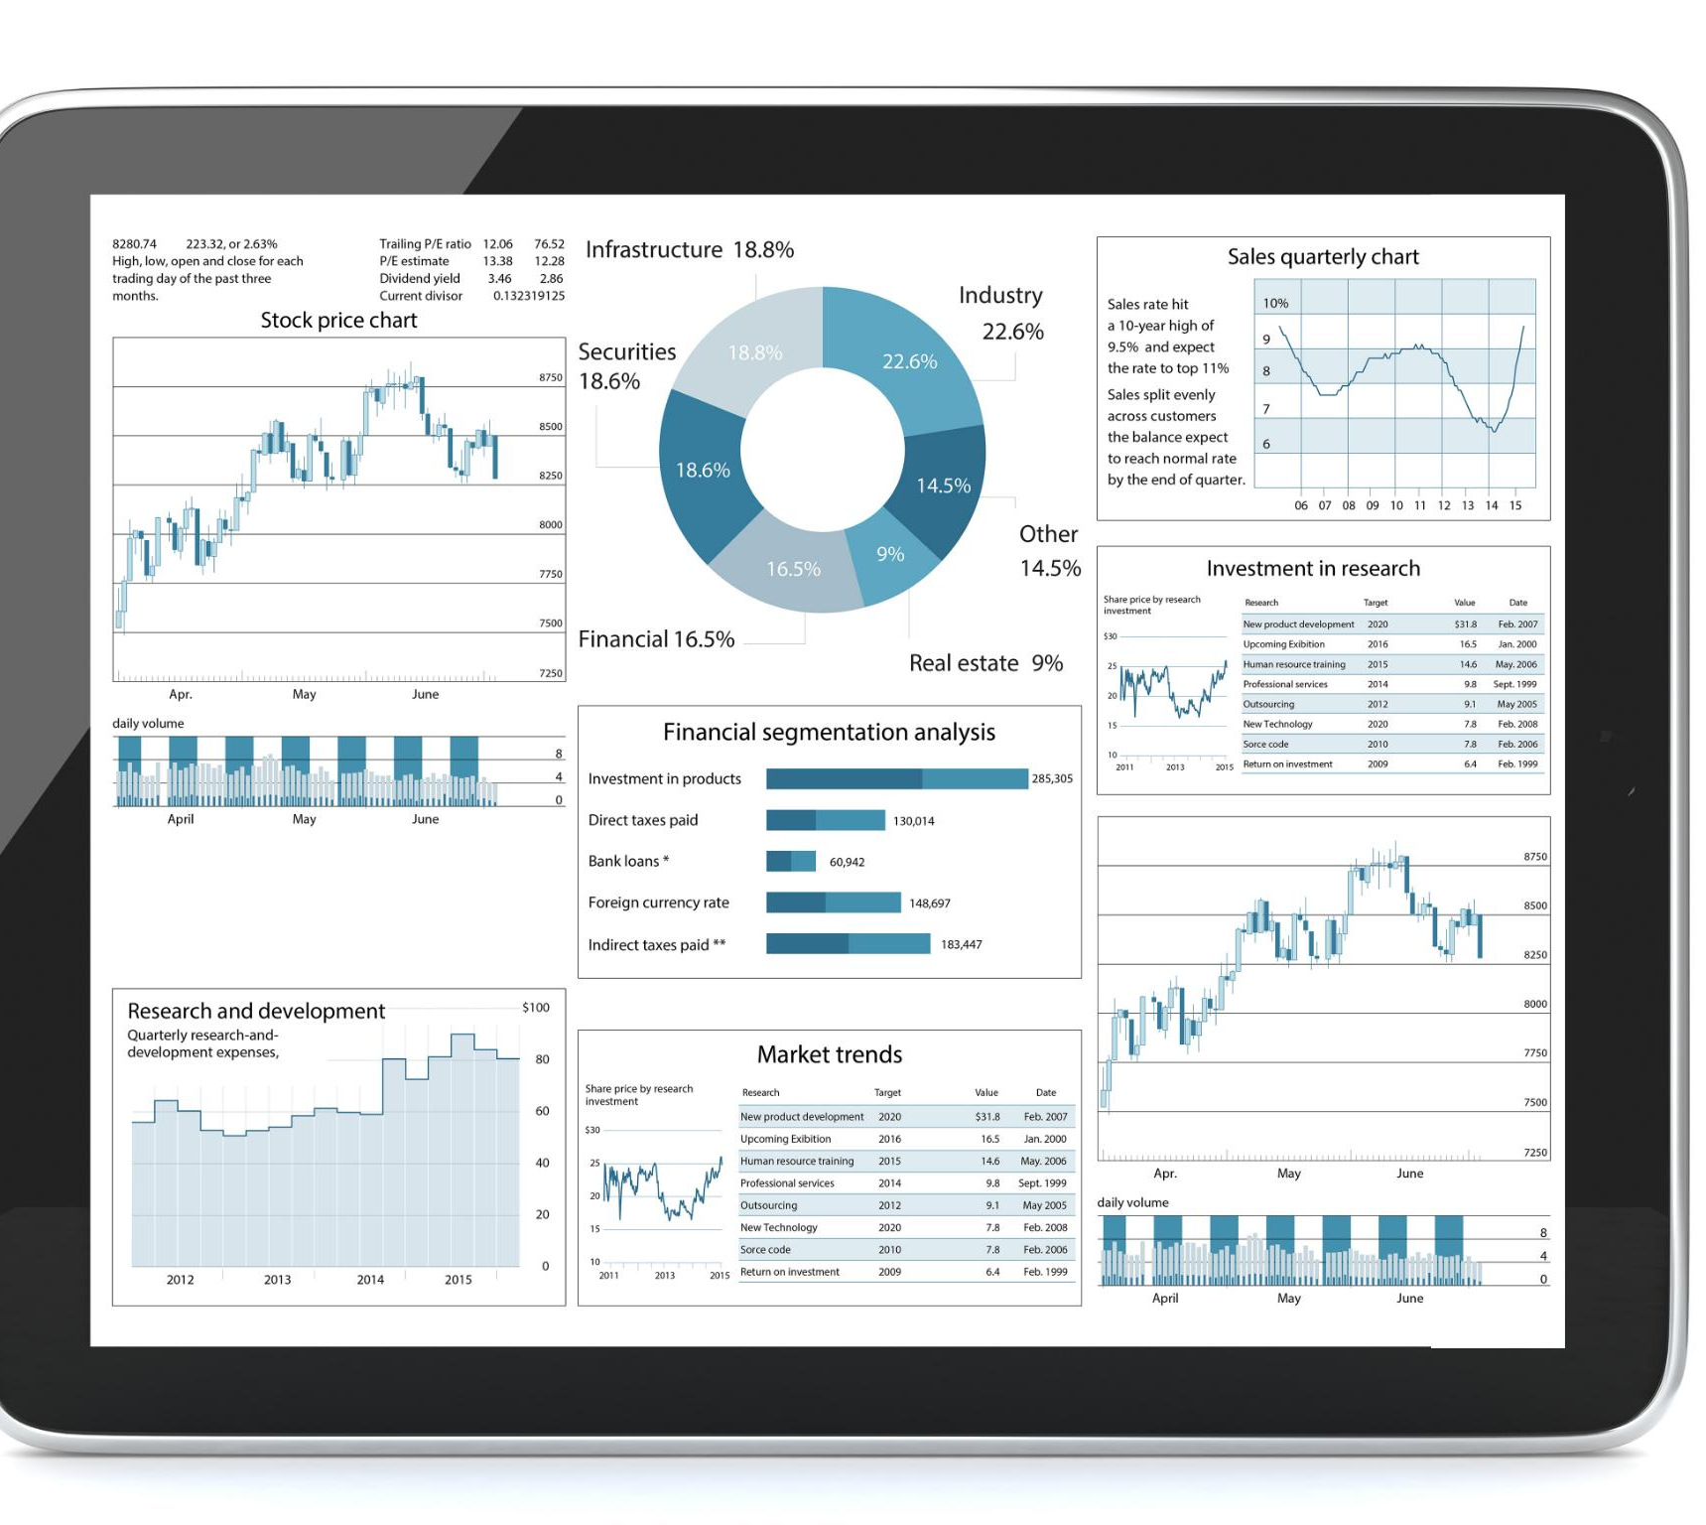
Core Features of UAMS
Centralized Compliance Dashboard
UAMS provides a unified dashboard to track compliance status and gain visibility across systems.
Complete Audit Trails
Complete audit trails allow organizations to detect discrepancies and prepare efficiently for audits.
Automated Alerts
Automated alerts notify users about password rotations and overdue reviews to enhance compliance readiness.
Comprehensive Reporting
Reports can be exported in Excel, PDF, and CSV formats for easy sharing with auditors.
Notes:
--- This slide references information from the following file: https://carlsonrezidor-my.sharepoint.com/personal/abdelmanem_samy_radissonblu_com/Documents/Microsoft%20Copilot%20Chat%20Files/PRESENTATION_PCI_RHG_COMPLIANCE.html UAMS offers a centralized dashboard for compliance tracking, cross-system visibility, complete audit trails, automated alerts, and comprehensive reporting. These features enable organizations to monitor compliance status, detect discrepancies, and prepare for audits efficiently. Reports can be exported in multiple formats, including Excel, PDF, and CSV, making it easy to share evidence with auditors. Automated alerts for password rotations and overdue reviews further enhance compliance readiness.

Slide 12

Benefits for Stakeholders
IT Administrator Efficiency
UAMS streamlines IT tasks with centralized tracking and automated alerts, saving administrators valuable time.
Management Risk Reduction
Management experiences reduced security risks and benefits from simplified audit preparation processes.
Auditor Access and Clarity
Auditors obtain clear, organized evidence and complete audit trails for comprehensive reviews.
Organizational Security and Compliance
Organizations improve security posture, lower data breach risks, and maintain compliance confidence effectively.
Notes:
--- This slide references information from the following file: https://carlsonrezidor-my.sharepoint.com/personal/abdelmanem_samy_radissonblu_com/Documents/Microsoft%20Copilot%20Chat%20Files/PRESENTATION_PCI_RHG_COMPLIANCE.html For IT administrators, UAMS saves time through centralized tracking and automated alerts. Management benefits from reduced security risks and easier audit preparation. Auditors gain access to clear, organized evidence and complete audit trails. Overall, organizations improve their security posture, reduce the risk of data breaches, and maintain compliance confidence. These benefits translate into faster audit preparation, improved review completion rates, and enhanced operational efficiency.

Slide 13
Implementation and Next Steps
Notes:
--- This slide references information from the following file: https://carlsonrezidor-my.sharepoint.com/personal/abdelmanem_samy_radissonblu_com/Documents/Microsoft%20Copilot%20Chat%20Files/PRESENTATION_PCI_RHG_COMPLIANCE.html Getting Started with UAMS, Roadmap for Optimization

Slide 14
Getting Started with UAMS
System Setup and Configuration
Organizations install and configure UAMS, set up user accounts, and define system parameters for initial deployment.
Data Import and Access Documentation
Import existing user and system data, document access rights, and link system approvals to maintain accurate records.
Review Scheduling and Reporting
Schedule quarterly reviews to ensure compliance and generate detailed reports for auditing and accountability.
Notes:
--- This slide references information from the following file: https://carlsonrezidor-my.sharepoint.com/personal/abdelmanem_samy_radissonblu_com/Documents/Microsoft%20Copilot%20Chat%20Files/PRESENTATION_PCI_RHG_COMPLIANCE.html Implementing UAMS involves several steps: system setup, data import, access documentation, review scheduling, and report generation. Organizations begin by installing and configuring UAMS, setting up user accounts, and defining systems. Next, they import existing user and system data, document current access, and link approvals. Quarterly reviews are scheduled to maintain compliance, and reports are generated for auditors. This structured approach ensures smooth adoption and effective compliance tracking.

Slide 15

Roadmap for Optimization
Foundation Phase
This phase focuses on system installation and setting up the foundational infrastructure for optimization.
Data Migration Phase
Data import and migration are carried out to transition existing information into the new system seamlessly.
Integration Phase
This phase involves staff training, workflow integration, and configuring alerts to ensure smooth operations.
Optimization Phase
Continuous refinement of processes, addition of integrations, and enhancement of reporting capabilities occur here.
Notes:
--- This slide references information from the following file: https://carlsonrezidor-my.sharepoint.com/personal/abdelmanem_samy_radissonblu_com/Documents/Microsoft%20Copilot%20Chat%20Files/PRESENTATION_PCI_RHG_COMPLIANCE.html The implementation roadmap includes four phases: foundation, data migration, integration, and optimization. Initial phases focus on system installation and data import, while later phases involve staff training, workflow integration, and alert configuration. Continuous optimization ensures processes are refined, integrations added, and reporting enhanced. This roadmap helps organizations achieve long-term compliance success and adapt to evolving security requirements.

