Slide 1
REGRESSION OPEN CAPSTONE PROJECT
House Price Prediction
A Regression Approach
AI & Data Science Basics — Module Open Capstone
Team Members: Abdelmoghit El Asraoui & Mohamed Ben Mouh Department: MIG — EHTP | Semester S4 Instructor: Dr. Rym Nassih Date: June 2025

Slide 2
AI & DATA SCIENCE BASICS — CAPSTONE PRESENTATION
Problem Framing & AI Context Note
THE PROBLEM & BUSINESS MOTIVATION
AI CONTEXT NOTE (COURSE 2 PARADIGM SHIFT)
• Fair Market Value: Determining residential price is highly consequential. A mispriced listing sits unsold or leaves money on the table. • Appraisal Costs: Traditional methods (manual appraisals or comparative audits) are slow, subjective, and cost hundreds of dollars per report. • Data-Driven Screening: We build a regression model using 79 property features from Ames, Iowa to provide agents with rapid, objective price estimates.
• The Rule-Based Expert System Failure (1970s–1980s): Early AI attempted to model housing markets using hand-crafted if-then rules. These systems failed because they could not adapt to market changes or scale with complex high-dimensional variables. • Shift to Statistical Machine Learning: Instead of programming explicit rules, our Ridge model learns pricing patterns statistically from data. It automatically discovers coefficients for quality ratings and locations across 1,460 examples. This transition from symbol manipulation to data-driven inference marks the modern AI paradigm.
House Price Prediction — Regression Capstone | Slide 2

Slide 3
AI & DATA SCIENCE BASICS — CAPSTONE PRESENTATION
Data Science Project Pipeline
01
02
03
04
05
06
Acquisition & Audit
Data Wrangling
Feature Eng.
Algorithm Selection
Training & Tuning
Final Report
Loaded 1,460 rows × 81 columns. Audited dtypes and identified skewed SalePrice target.
Dropped 4 columns (>80% missing). Imputed median/mode. Ordinal/one-hot encoded.
Created 5 new features (TotalSF, etc.). Filtered features by corr > 0.1. Saved to SQLite db.
Compared 7 regression models. Selected Linear, Ridge, and XGBoost. Chose RMSE.
Log target transform. Split 80/20. GridSearchCV tuned Ridge (alpha=10).
Produced a Model Card outlining limits and redlining risks. Final report & slides.
House Price Prediction — Regression Capstone | Slide 3

Slide 4
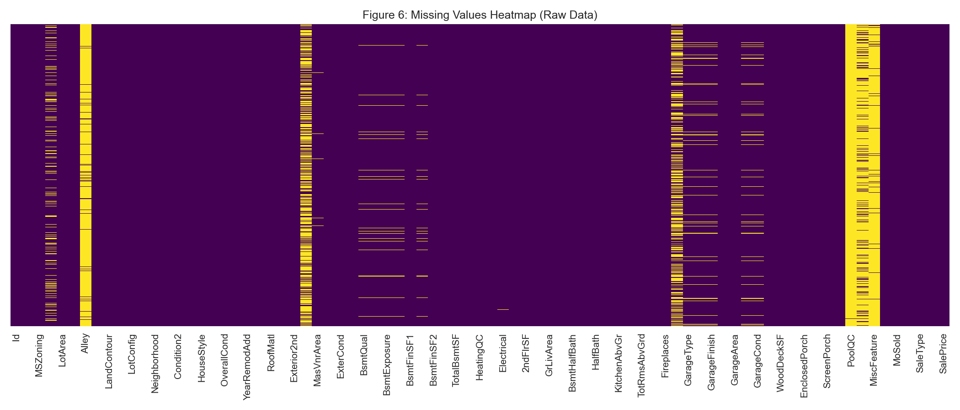
AI & DATA SCIENCE BASICS — CAPSTONE PRESENTATION
Data Ingestion & Inconsistent Null Audit
1,460
81
INGESTED LISTINGS (ROWS)
INITIAL FEATURES (COLUMNS)
• Target Variable: SalePrice ($34,900 – $755,000 | Mean: $180,921). • Feature Breakdowns: 43 object/categorical, 35 int64 features, 3 float64 features. • Drop Threshold (>80% missing): Alley (93.8%), PoolQC (99.5%), Fence (80.8%), and MiscFeature (96.3%) were removed completely. • Indexing Filter: Dropped the unique Id column to prevent database index overfitting.
House Price Prediction — Regression Capstone | Slide 4

Slide 5
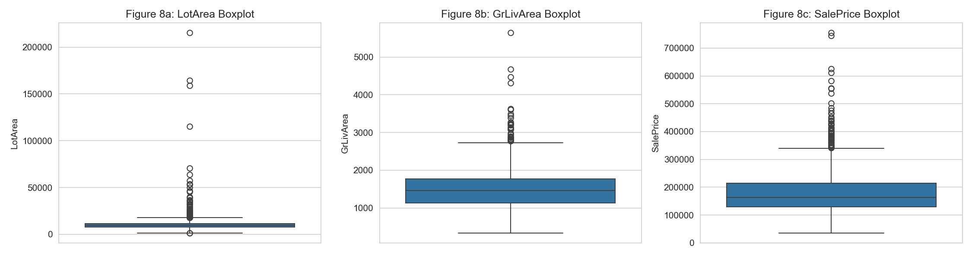
AI & DATA SCIENCE BASICS — CAPSTONE PRESENTATION
Data Wrangling: Imputation & Outliers
IMPUTATION & FEATURE ENCODING
• Imputations: Median for LotFrontage/GarageYrBlt. Mode for BsmtQual/GarageType/FireplaceQu. • Encodings: 9 quality variables mapped ordinally (1 to 5). 30 nominal features one-hot encoded, yielding 213 numeric dimensions.
OUTLIER METHOD METHODOLOGY AUDIT
Feature Name | IQR Outliers (1.5×) | Z-Score Outliers (|z|>3)
SalePrice | 61 rows | 22 rows
LotArea | 69 rows | 13 rows
GrLivArea | 31 rows | 16 rows
Analysis: Right-skewness causes IQR to over-flag. We retained rows to save luxury properties, but applied np.log1p on target to reduce leverage impacts.
House Price Prediction — Regression Capstone | Slide 5

Slide 6
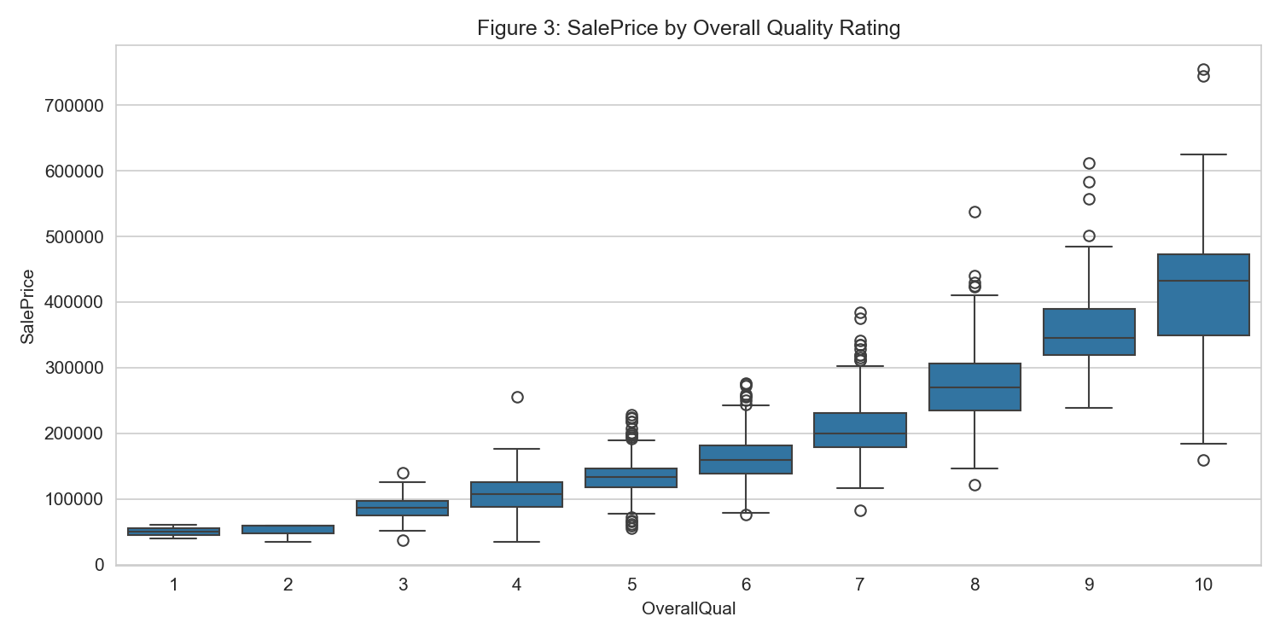
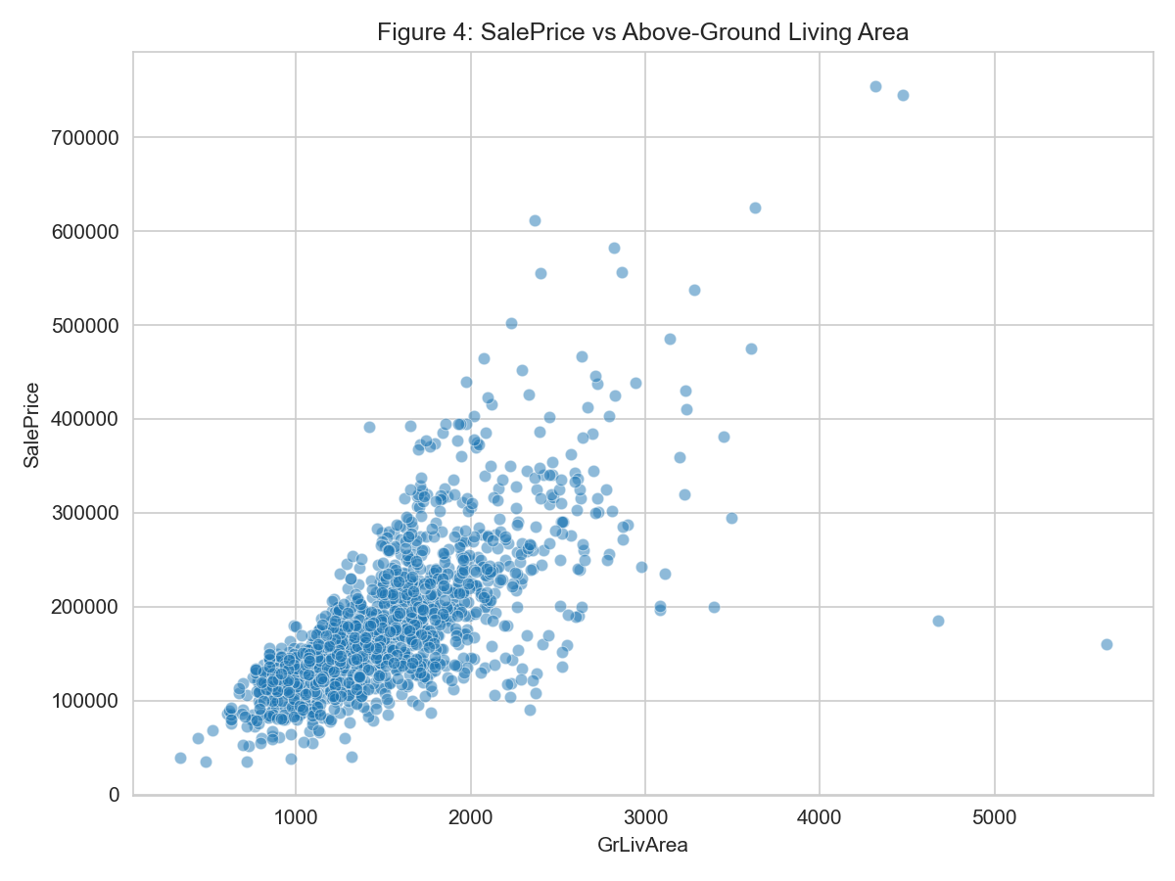
AI & DATA SCIENCE BASICS — CAPSTONE PRESENTATION
EDA — Core Predictors: Quality, Size & Age
Insights: [Left] Overall Quality exhibits monotonic growth with rapid exponential pricing jumps at Quality 7+ (luxury threshold). [Right] Above-grade living area shows strong linear correlation with target (r=0.71), with high-leverage outliers visible above 4,000 sq ft.
House Price Prediction — Regression Capstone | Slide 6

Slide 7
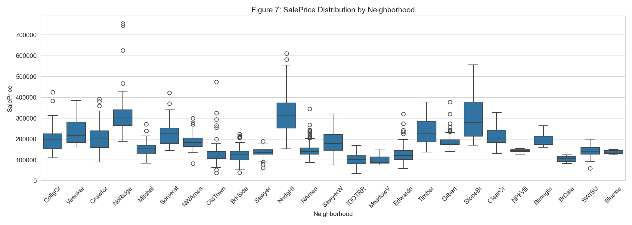
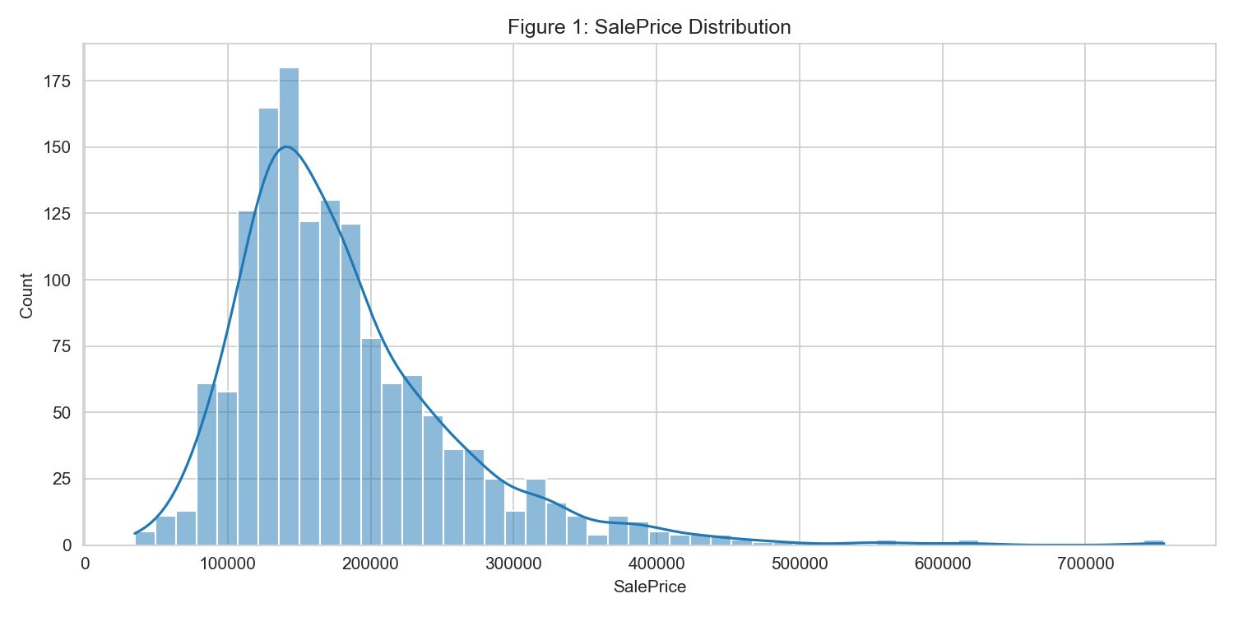
AI & DATA SCIENCE BASICS — CAPSTONE PRESENTATION
EDA — Location Variance & Target Skewness
Insights: [Left] Neighborhood medians span 5x from IDOTRR ($85K) to StoneBr ($438K), indicating massive location variance. [Right] Target variable shows high positive skewness (1.88). Applying a log-transform (np.log1p) normalizes residuals and satisfies linear modeling assumptions.
House Price Prediction — Regression Capstone | Slide 7

Slide 8
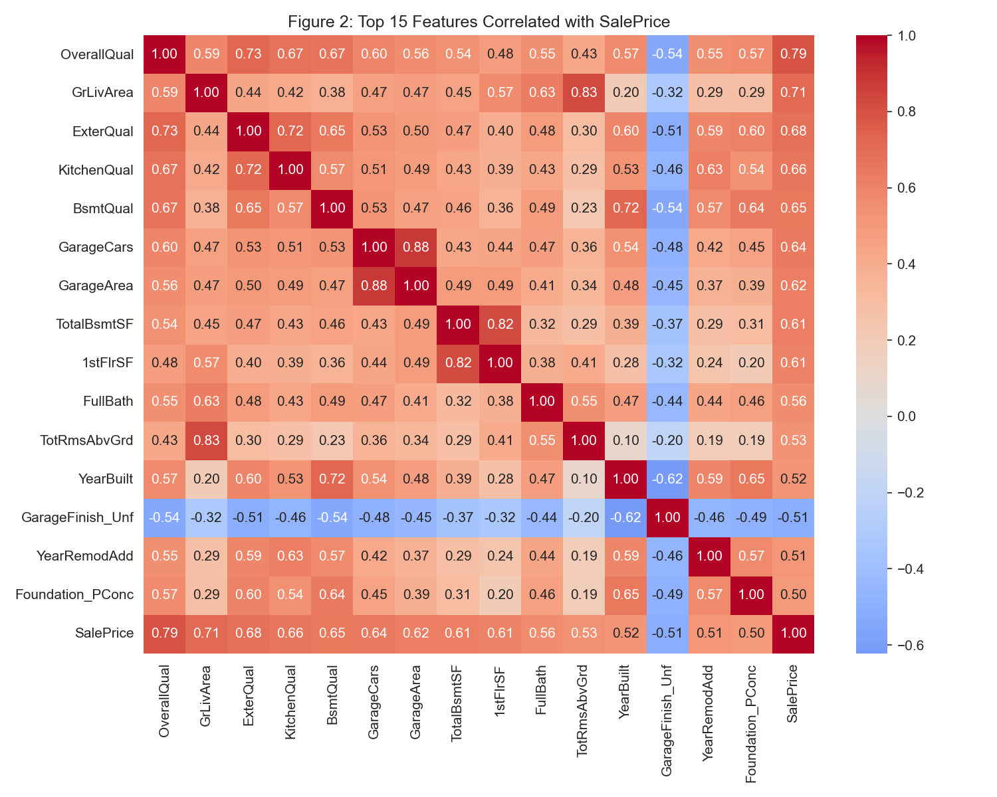
AI & DATA SCIENCE BASICS — CAPSTONE PRESENTATION
Feature Engineering & Selection Heatmap
FEATURE CREATION LOG
Feature | Formula | Pearson r | Rank
TotalSF | GrLivArea + TotalBsmtSF | 0.779 | Rank #2
TotalBath | FullBath + 0.5*HalfBath... | 0.632 | Rank #8
HouseAge | 2010 − YearBuilt | -0.523 | Rank #14
TotalPorchSF | WoodDeck + OpenPorch... | 0.390 | Rank #28
• Engineering Logic: Combined features (e.g. TotalSF) exhibit higher correlation than parent features. HouseAge captures temporal decay patterns. • Dimensionality Reduction: Applied a Pearson correlation filter (|r| >= 0.1) on one-hot features. Dropped 113 non-predictive variables, shrinking the feature space by 55% (from 213 down to 98 key inputs).
House Price Prediction — Regression Capstone | Slide 8

Slide 9
AI & DATA SCIENCE BASICS — CAPSTONE PRESENTATION
Data Management: SQLite & Analytical Queries
SQLITE HOUSING DATABASE SCHEMA
THE 4 TARGETED SQL QUERIES & RESULTS
• Database Table: `housing_data` inside `housing.db` • Processed Dimensions: 98 selected independent features plus 1 target SalePrice column (99 columns total). • Integrity Purpose: Relational storage prevents data corruption. Standardizes the preprocessing pipeline across multiple modeling scripts. • Real Estate SQL API: Allows business analysts to execute rapid diagnostic audits on listing prices, averages, and eras without needing python runtime tools.
Q1: OverallQual Monotonic Trend
Avg price increases strictly from $50,150 (Qual 1) to $438,588 (Qual 10). Jumps rapidly at Qual 7+.
Q2: GarageCars Count Anomalies
3-car garages average $309,636. 4-car garages drop to $192,656, but represent a tiny sample distortion (5 homes).
Q3: Affordable Large Homes
Identified 267 properties (18.3% of data) offering above-average size (TotalSF > 2,568 sq ft) under $200,000.
Q4: Construction Era Premiums
Post-2000 homes average $242,439; 1970–1999 average $188,244; pre-1970 homes average $140,185.
House Price Prediction — Regression Capstone | Slide 9

Slide 10
AI & DATA SCIENCE BASICS — CAPSTONE PRESENTATION
Algorithm Selection & Metric Rationale
Algorithm | Decision | Mechanism & Suitability
OLS Linear Regression | Baseline | Starting reference point. Highly interpretable but fragile to multicollinearity.
Ridge Regression | SELECTED | Adds L2 penalty (α·Σβ²). Prevents instability and handles sparse one-hot sets.
XGBoost | SELECTED | Gradient boosting tree candidate. Explores non-linear interactions.
Random Forest | Benchmark | Standard bagging ensemble. Implemented as an additional comparison baseline.
Support Vector (SVR) | REJECTED | Computationally heavy for 200+ dimensions; offers no benefits here.
Decision Tree | REJECTED | Prone to severe overfitting; redundant when RF and XGBoost are available.
K-Nearest (KNN) | REJECTED | Curse of dimensionality makes Euclidean distance meaningless on sparse inputs.
EVALUATION METRIC RATIONALE
• Root Mean Squared Error (RMSE) — Primary: Penalizes large errors quadratically. In housing, a single $50k error is far worse than ten $5k errors. RMSE ensures our model avoids massive outliers. • Mean Absolute Error (MAE): Calculates average absolute error in original dollars. Highly intuitive for agents and buyers. • Mean Absolute Percentage Error (MAPE): Computes error percentages. A $15k error on a $100k home (15%) is serious, whereas on a $500k home (3%) it is minor.
Why not F1/Accuracy? This is a continuous regression problem. Grouping prices into bins would strip vital listing sensitivity.
House Price Prediction — Regression Capstone | Slide 10

Slide 11
AI & DATA SCIENCE BASICS — CAPSTONE PRESENTATION
Model Training & Hyperparameter Tuning
CROSS-VALIDATION MODEL PERFORMANCE
GRID SEARCH CV HYPERPARAMETER TUNING
Model Type | CV RMSE (log) | CV R²
Linear Regression | 0.205 | 0.775
Random Forest | 0.147 | 0.885
XGBoost (default) | 0.144 | 0.889
Ridge (α=10) — WINNER | 0.135 | 0.902
• Hyperparameter Tuning Strategy: We used GridSearchCV with 3-fold cross-validation exclusively on the training set to prevent data leakage. • Values Tested: Tested L2 regularizer strengths alpha = [0.1, 1, 10, 100]. • Tuning Outcome: Alpha = 10 won, producing an optimal cv-RMSE of 0.1473 (log scale). The model performance is stable around alpha=10, indicating the L2 regularizer is primarily serving to address correlation without over-shrinking parameters. • Model Export: Trained model serialized as best_model.pkl for server deployment.
Applying np.log1p compressed right-skewed prices, reducing skewness from 1.88 to 0.12. Residuals matched standard normal assumptions, yielding high OLS benchmarks.
LOG TRANSFORMATION NORMALIZATION EFFECT
House Price Prediction — Regression Capstone | Slide 11

Slide 12
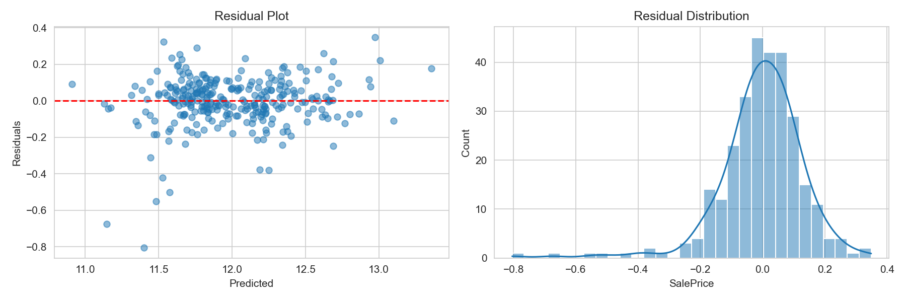
AI & DATA SCIENCE BASICS — CAPSTONE PRESENTATION
Final Test Set Evaluation
0.917 | TEST R² SCORE (Target: ≥ 0.85)
$25,298 | TEST RMSE ERROR (Target: ≤ $30,000)
9.8% | TEST MAPE ERROR (Target: ≤ 15.0%)
VALIDATION SUMMARY
• Validation Summary: Our Ridge model exceeded all target requirements. Exceeded the R² baseline by 6.7% and beat the RMSE ceiling by $4,702. • MAE Score: Mean Absolute Error was minimized to $16,365. • Operational Significance: For a typical $200,000 Ames property, model predictions sit within ±$25,298 about 68% of the time (1 standard deviation), providing a highly reliable algorithmic baseline for agents.
House Price Prediction — Regression Capstone | Slide 12

Slide 13
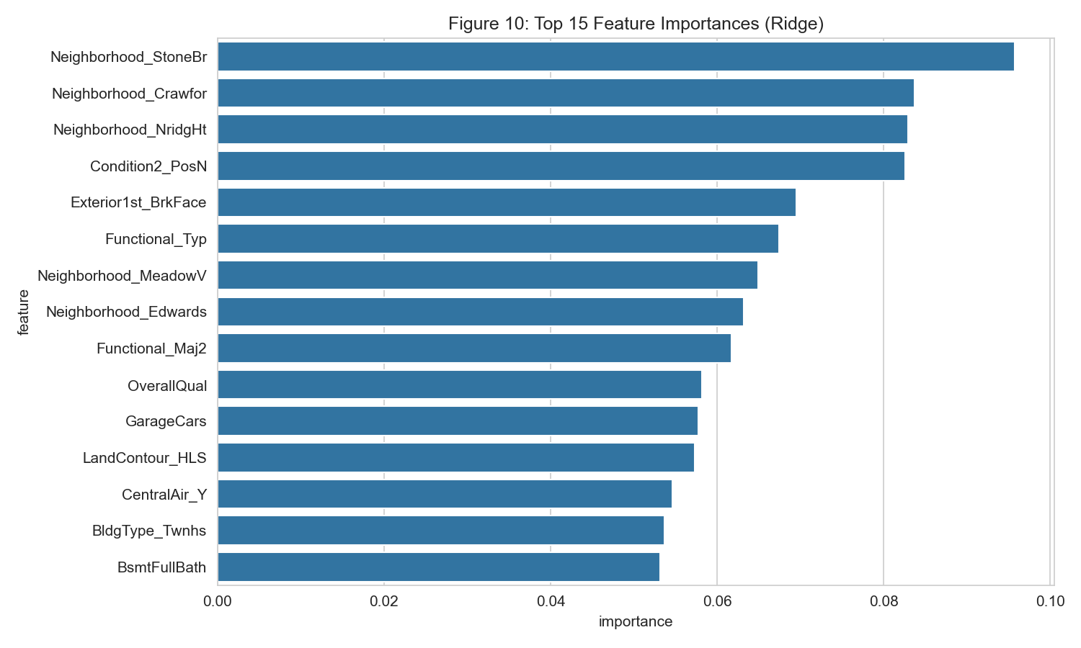
AI & DATA SCIENCE BASICS — CAPSTONE PRESENTATION
Feature Importance & Neighborhood Dominance
TOP RIDGE COEFFICIENTS (LOG IMPACT)
Feature Name | Impact | Details
1. Neighborhood_StoneBr | +0.0957 | Premium location
2. Neighborhood_Crawfor | +0.0838 | Historical appeal
3. Neighborhood_NridgHt | +0.0829 | Luxury area
4. Condition2_PosN | +0.0826 | Near park/nature
5. Exterior1st_BrkFace | +0.0695 | Brick exterior
6. Neighborhood_MeadowV | -0.0649 | MeadowV discount
7. Neighborhood_Edwards | -0.0632 | Edwards discount
• Neighborhood Dominance: 5 of the top 8 coefficients are neighborhoods, indicating location dominates over physical features. • Why Ridge Won: Tabular one-hot expansions create sparse, highly-correlated dimensions where Ridge L2 constraints excel, while XGBoost overfits.
House Price Prediction — Regression Capstone | Slide 13

Slide 14
AI & DATA SCIENCE BASICS — CAPSTONE PRESENTATION
Model Card & Ethical Redlining Reflection
MODEL CARD DOCUMENTATION
ETHICAL REFLECTION: ALGORITHMIC REDLINING
• Intended Use Case: Provides pricing guidelines for real estate agents in Ames, Iowa and assists buyers in drafting purchase proposals. • Out of Scope: Cannot support formal bank appraisals or algorithmic trading systems. • Preprocessing Pipeline: Dropped columns with >80% nulls, median/mode imputation, ordinal/one-hot encoding, and target log-transformation. • Limits: Ames-specific. Restrained to 2006–2010 market dynamics. High-end properties are underrepresented.
• Location as a Proxy: No racial, ethnic, or demographic indicators exist in the training dataset. However, neighborhood dummy variables account for 5 of the top 8 Ridge coefficients. • Redlining Risk: If specific Ames neighborhoods historically suffered from systemic segregation or economic redlining, the model automatically encodes these price suppressions. Deploying it unchecked will perpetuate historical under-valuations, disadvantage sellers, and restrict equity gains in marginalized areas. • Mitigation Recommendation: Never treat estimates as absolute. Present predictions as a ±$25,298 range (1 RMSE) and enforce manual human audits for properties deviating >30% from local baseline averages.
House Price Prediction — Regression Capstone | Slide 14

Slide 15
AI & DATA SCIENCE BASICS — CAPSTONE PRESENTATION
Conclusions & Operational Guidelines
PROJECT CONCLUSION & SUCCESS AUDIT
OPERATIONAL ROADMAP & FUTURE WORK
• Targets Surpassed: The Ridge model met all evaluation goals: R² (0.917 vs. 0.85 target), RMSE ($25,298 vs. $30,000 target), and MAPE (9.8% vs. 15% target). • Ridge Justification: A regularized linear Ridge model beats complex tree structures by L2-constraining highly correlated one-hot feature expansions. • Location Rule: Location remains the dominant coefficient factor, outranking age, basement size, and materials combined.
• Pricing Assistant Deployment: Real estate agents input specifications. Model outputs predicted range. Agents manually adjust based on school quality updates, curb appeal, and local buyer sentiment. • Retraining to Address Drift: The model is trained on 2006–2010 sales. Retraining on 2020–2025 listings is required to address structural market drift. • Coordinates & Spatial Models: Incorporate latitude/longitude and physical proximity to green spaces to replace coarse neighborhood indicator variables. • Geographic Generalizability: Test model generalization capabilities across other Midwestern hubs (Omaha, Des Moines).
House Price Prediction — Regression Capstone | Slide 15

Slide 16
PROJECT SUCCESS AUDIT SUMMARY
• Winner: Ridge Regression (α=10) with log target transform.
• Test Set R² = 0.917 (Met the course threshold of ≥ 0.85).
• Test Set RMSE = $25,298 (Met the course threshold of ≤ $30K).
• Test Set MAPE = 9.8% (Met the course threshold of ≤ 15%).
• Completed SQLite data management and demographic redlining ethical audit.
THANK YOU
GitHub Repository: github.com/abdelmoghit911/data_science_project
House Price Prediction — Regression Capstone | Slide 16

