Slide 1

Activity-Based Travel Demand Modeling
King Fahd University of Petroleum and Minerals · Department of Civil and Environmental Engineering
CE 571 Transportation Planning and Modeling
CE 571 · Group Presentation #2 · Group 10
2 November 2026
Group members: [Member name – ID] · [Member name – ID] · [Member name – ID]
Instructor: [Instructor name]
Notes:
Title slide. Replace the bracketed member and instructor fields with verified details before presenting; nothing has been invented here.
Handoff note on duration: the assignment opening says 20–25 minutes plus 10 minutes of discussion, while the activity-based topic's own requirements say 30–35 minutes plus 10 minutes. The deck is paced for the topic-specific 30–35 minutes. The instructor has not resolved the discrepancy; raise it if needed.

Slide 2





Why Does This Person Travel?
Illustrative household / schedule
20 min
35 min
15 min
25 min
Home
School
Work
Supermarket
Home
Leaves 07:00
Drop-off 07:20–07:25
08:00–16:00
Shop 16:15–16:35
Arrives 17:00
Household constraint: the mother needs the shared car at 17:15. The father's whole day has to fit around school hours, work hours, shopping and that commitment.
Activities come first: school escort, work and shopping are the reasons for the four trips.
Decisions are linked: a longer shop, a different supermarket or a different mode changes the rest of the day.
Notes:
Open with the example, not the definition. Walk the audience along the route: the father leaves home at 07:00, drops the child at school, drives to work, shops on the way back and is home by 17:00. Reveal the constraint last: his wife needs the car at 17:15.
The point is that he travels in order to take part in activities and meet family commitments. A decision about one part of the day (how long to shop, which supermarket, whether to drive) affects the other parts. That whole-day pattern is the motivation for activity-based modeling. If the slide is presented gradually, describe each stop before moving to the next.

Slide 3



Activity-Based Travel Demand Modeling
Definition
Activity-based models represent individuals' daily activity and travel patterns within household circumstances and the constraints represented by the model.
Core principle: travel is a derived demand. People travel to participate in activities.
Short historical note. Activity-based approaches gained attention in the 1970s. Advances in computing later supported their practical implementation.
Activity versus movement. Working from home keeps the work activity but removes the commute. The activity (work, shopping) is distinct from the travel used to reach it.
Sources: [R1] Adnan, course introduction; [R3] SHRP 2 C46 Primer (2014); [R10] Liu et al. (2024) on in-home activity representation.
Notes:
Give the definition and then immediately tie it back to the father: his work, school escort and shopping are activities; the four drives are the travel derived from them.
Stress the distinction between the activity and the movement used to reach it. Working from home retains the work activity while removing the commute. How much in-home activity detail a model represents differs between implementations; recent research (Liu et al. 2024, R10) extends that capability.
Keep the history to one sentence: attention in the 1970s, practical implementation enabled later by computing power. Do not expand into a separate history slide.

Slide 4
Trip, Tour, and Activity-Based Perspectives
Illustrative household / schedule
one movement between two locations
Approach | Main focus
Trip-based | Individual trips between locations
Tour-based | Linked trips that start and end at a base location
Activity-based | Daily activity and travel patterns, including represented time and household constraints
Trip
Home
School
Work
Shop
Home
the complete chain that starts and ends at home
Tour
Home
School
Work
Shop
Home
+ time windows, durations and the shared car
Activity-based
The perspectives overlap: an activity-based model normally contains tours and trips.
Home
School
Work
Shop
Home
Work 08:00–16:00
School 07:20
Shop 20 min
Car back by 17:15
Notes:
Same route, three layers. Layer one highlights a single trip: Home to School, one movement between two locations. Layer two highlights the whole chain starting and ending at home: the tour. Layer three adds what the activity-based perspective brings: work hours, the school commitment, the shopping duration and the shared-car availability.
Be careful with the comparison. These approaches overlap: activity-based models commonly contain tours and trips, and tour-based modeling is not an unrelated competitor. Avoid saying that every trip-based model is completely incapable of links or feedback; the difference is how explicitly the links and constraints are represented.

Slide 5





Key Behavioral Principles
Travel as a derived demand
People travel to participate in activities. The father drives because of school, work and shopping, not for the drive itself.
Interdependent decisions
One decision affects other daily choices. A longer shopping stop changes the time the car is back at home.
Time–space constraints
Schedules and travel times limit choices. Work ends at 16:00 and the car is needed at 17:15, so the shop must fit in between.
Household interactions
Family members coordinate activities and share resources. One car serves the father's tour and the mother's outing.
Behavioral heterogeneity
Travel patterns vary across people and households. A household with two cars or no school-age child would plan differently.
Notes:
Five principles, each with a one-line explanation through the same family. Derived demand: the trips exist because of the activities. Interdependence: the shopping stop affects when the car is back. Time–space constraints: work hours and the 17:15 commitment bound the afternoon. Household interactions: one car, two adults with needs. Heterogeneity: a different household composition changes the pattern entirely.
Keep this short; the examples on the following slides make each principle concrete.

Slide 6
Activity-Based Modeling Overview
Illustrative household / schedule
Inputs
Modeling decisions
Outputs
Household and person data
Activity participation
Daily activity schedules
A working father, his wife, a schoolchild, and one shared car.
Taking the child to school, working, and shopping.
A predicted timetable for school drop-off, work, shopping and returning home.
Land-use and network data
Location, timing and mode choices
Linked trips and tours
Home, school, workplace and supermarket locations, with travel times between them.
Which supermarket to visit and when, while returning the car before his wife needs it.
Home–school–work–supermarket–home, forming one home-based tour.
The wife's time-specific car requirement is an activity-coordination condition; the number of vehicles is a household characteristic.
Notes:
A simple inputs → modeling decisions → outputs picture, every item tied to the household example. Inputs: who the household is and where the activities can take place, with travel times between them. Decisions: whether to take part in each activity, and where, when and how to travel, while respecting the car commitment. Outputs: a predicted timetable and the linked trips forming one home-based tour.
Distinguish two things that both involve the car: the vehicle count is a household characteristic (an input), while the wife needing it at 17:15 is a coordination condition that constrains the schedule.

Slide 7
What Changes If the Father Works from Home?
Illustrative scenario, not estimated results
Office day | Work-from-home day: one possible response
Takes his child to school | Still takes his child to school
Travels to the workplace | Works at home
Shops on the way home from work | Makes a separate shopping trip or postpones shopping
Uses the shared car during the commute | The car may become available to his wife earlier
What the scenario shows
Removing the commute does not remove every other trip. School escort still happens, shopping moves or is postponed, and the car's availability to the rest of the household changes.
Actual car availability also depends on the school and shopping trips, not on the commute alone.
Notes:
Present the scenario before any list of benefits. If the father works from home, the commute disappears, but the child still needs to get to school, shopping still has to happen somewhere, and the car may become free for his wife earlier in the day.
This is an illustrative scenario, not an estimated result. Note that car availability depends on the school and shopping trips too; removing the commute does not logically remove every other activity or trip. That is exactly the kind of whole-day reasoning an activity-based model is built to represent.

Slide 8




Why Use an Activity-Based Model?
Changing one activity can reshape the daily schedule, linked trips, and shared-car use. Working from home removes the commute, but school and shopping trips may still be needed.
Daily activity patterns
Household coordination
Represents activities and travel across the whole day.
Accounts for shared vehicles and linked family decisions where supported.
Linked trips and tours
Time and cost constraints
Connects trips within a consistent daily schedule.
Considers travel time, cost, activity duration and scheduling limits.
Population differences
Policy evaluation
Represents variation across demographic and socioeconomic groups.
Examines responses to transit improvements, pricing, teleworking and land-use changes.
Long-term forecasting
Higher behavioral detail does not by itself guarantee higher predictive accuracy.
Supports future population, land-use and behavioral scenarios.
Notes:
Read the statement at the top first: it summarizes the work-from-home example. Then run quickly through the seven motivations; each needs only a few words. Daily patterns, household coordination where the implementation supports it, linked trips and tours, time and cost constraints, population differences, policy evaluation (transit, pricing, teleworking, land use), and long-term forecasting.
End with the caveat: more behavioral detail does not automatically mean a more accurate forecast. Data quality, estimation and validation still decide that.

Slide 9
Workplace Parking Charges: Comparing Insights
Hypothetical policy scenario
Suppose the father's workplace introduces a daily parking charge. How could he respond while still meeting school, shopping and shared-car commitments?
Traditional four-step model
Trip Generation
Trip Distribution
Mode Choice
Traffic Assignment
feedback of congested times can be included in some conventional systems
Approach | Potential insight on the parking charge
Traditional trip-based model | If parking cost is specified, estimate its effect on mode choice; whole-day and family linkages may be simplified.
Activity-based model | Examine mode choice alongside linked activities, tours, schedules and household constraints represented by the implementation.
Parking charges may change more than the commute mode. They may also affect school drop-off, shopping, and household car use.
Notes:
Example first: a hypothetical workplace parking charge. Ask the audience how the father could respond: pay, switch to transit for the commute, change where or when he shops, or rearrange the school escort with his wife.
Show the four conventional stages explicitly: trip generation, trip distribution, mode choice, traffic assignment, with feedback of congested travel times possible in some systems. A conventional model can take a parking cost as an input and estimate a mode-choice effect; the limitation is not that cost cannot be entered. The difference is behavioral representation: the activity-based model examines the mode decision together with the linked activities, the tour, the schedule and the household constraints that the implementation represents.

Slide 10

Limitations of the Traditional Trip-Based Approach
Limitation | Brief explanation
Limited trip linkage | Connections between trips and complex tours may be weakly represented.
Limited household coordination | Shared vehicles and linked family decisions may not be explicitly modeled.
Limited scheduling detail | Activity duration and time constraints may be simplified.
Interdependent choices | Separately modeled stages may produce inconsistent choices without appropriate constraints or feedback.
Policy sensitivity | Changes in activity timing, locations and trip sequences may be difficult to capture.
When is a trip-based model still appropriate? When its level of detail meets the planning objective, particularly where data, budget or computing resources are limited.
Notes:
Now generalize from the parking example to the limitations. Five points: trip linkage, household coordination, scheduling detail, interdependence between separately modeled stages, and policy sensitivity to changes in timing, location and trip sequence.
Balance the critique: a trip-based model remains appropriate when its detail matches the planning question and when data, budget or computing resources are limited. Many regional studies are still well served by one.

Slide 11




Synthetic Population: An Illustrative Household
Illustrative household / schedule
Synthetic households represent real population characteristics without identifying specific real families.
Attribute | Illustrative value
Household members | Father, mother, and one schoolchild
Employment and education | Father employed; child attending school
Vehicle availability | One shared car
Residential location | Assigned home location within the study area
How it is built
Population synthesis uses sample households and population totals to reproduce selected demographic and household distributions. Synthetic does not mean arbitrary: selected controls are matched, while unobserved attribute combinations remain uncertain.
Sources: [R3]; course material on population synthesis (TMIP webinar slides supplied with the course).
Notes:
The first component: a synthetic population. Our illustrative household is a father, a mother, a schoolchild and one shared car, placed at a home location in the study area. It stands for a type of household that exists in the population; it is not a real family.
Explain that synthesis combines sample households with population totals so that selected distributions (household size, workers, income, vehicles, age groups) are reproduced. Synthetic does not mean arbitrary, but combinations that are not controlled remain uncertain, and that uncertainty carries into the model.

Slide 12
Daily Activity Patterns: Our Household Example
Illustrative household / schedule
Household member | Illustrative activities | Main constraints
Father | School drop-off, work, shopping | School/work schedules; returning the car
Mother | A planned outing requiring the car | Car availability and outing timing
Child | School attendance | School hours and parent coordination
Mandatory activities
Non-mandatory activities
Typically involve more fixed commitments, such as work or school.
Note: classifications vary across models. Label school escort directly rather than forcing it into one universal category. Work can also have flexible hours.
May still be essential, but often allow more flexibility in timing or frequency, such as shopping.
Tour generation decides the number and purposes of tours and how stops are linked. Participation asks whether shopping occurs; destination choice asks where.
Notes:
Second component: the daily activity pattern for each person. The father's pattern contains school escort, work and shopping; the mother's a planned outing that needs the car; the child's school attendance. Each has its own constraints.
Define mandatory and non-mandatory activities visibly, but note that the classification varies across models: school escort is best labelled directly, and work may itself have flexible hours. Then explain tour generation: how many tours, for which purposes, and how stops are linked; several activities can sit in one tour. Keep activity participation (does shopping happen?) separate from destination choice (where?).

Slide 13

Activity Location Choice
Illustrative schematic, not a real Al Khobar map
Supermarket B
requires a detour · wider product selection
Car back home by 17:15
Work
Supermarket A
Home
on the route home · smaller product selection
Location choice balances destination attractiveness with travel time, cost, and daily constraints.
The nearest place need not be chosen. Workplace and school are longer-term location decisions; shopping destinations vary more often. A person does not choose a new workplace every morning.
Notes:
Third component: where each activity takes place. Two supermarkets: A sits on the route home with a smaller selection; B offers more but requires a detour. The 17:15 car commitment makes the detour costly. The model weighs attractiveness against travel time, cost and the day's constraints, so the nearest option is not automatically chosen.
Distinguish time horizons: the usual workplace and school are longer-term location decisions, while shopping destinations can vary from day to day. Do not give the impression that a person re-chooses a workplace every morning. The schematic is a teaching picture, not a map of Al Khobar.

Slide 14

Mode Choice: Alternatives and Constraints
Illustrative household / schedule
Factor | Car | Public transport + walking
Availability | Requires access to the shared car | Requires suitable services and accessible stops
Travel time | Includes driving and parking time | Includes walking, waiting, transfers and in-vehicle time
Travel cost | Includes operating costs and parking charges | Includes fares
Daily constraints | Must accommodate family needs and car return | Must accommodate school, work and shopping schedules
The model evaluates available alternatives within the person's daily schedule and household constraints.
Do not assume the car is always faster or transit always cheaper. Tour consistency requires knowing where the car is; multimodal tours remain possible.
Notes:
Fourth component: mode choice. Compare the two alternatives on availability, time, cost and daily constraints. The car requires access to the one shared vehicle and must be back for the wife; transit requires suitable services and stops and must fit school, work and shopping schedules. Transit time includes walking, waiting and transfers, and cost includes fares; car cost includes operating costs and any parking charge.
Two cautions: do not assume the car is always faster or transit always cheaper, and remember tour consistency: if the father leaves the car at home in the morning, it is not available for the afternoon leg. Multimodal tours are still possible.

Slide 15
Time-of-Day Choice and Activity Scheduling
Illustrative schedule, teaching calculation
Morning
Drive 20
Drive 35
Work 08:00 → 16:00
…
07:00
07:20 drop-off
08:00
17:15 car needed
Afternoon, normal
Drive 15
Shop 20
Drive 25
15-min buffer
16:00
17:00 home
17:15 car needed
Afternoon, +20 min shopping
Drive 15
Shop 40
Drive 25
17:20 arrival
20 extra shopping minutes → arrival at 17:20 → shared-car conflict. A feasible schedule must accommodate activity durations, travel times, and household commitments.
Activity duration (20 min shopping) and travel duration (15 + 25 min) are separate time requirements. Shortening, relocating or postponing shopping are possible responses; none has been estimated.
Notes:
Fifth component: timing and scheduling. Use the fixed timeline: 20-minute drive to school, 5-minute drop-off, 35-minute drive to work, work 08:00 to 16:00, 15 minutes to the supermarket, 20 minutes shopping, 25 minutes home, arriving 17:00 with a 15-minute buffer before the 17:15 commitment.
Then the teaching calculation: 20 extra minutes of shopping, everything else unchanged, gives a 17:20 arrival, five minutes after the car is needed. Separate activity duration (20 minutes in the shop) from travel duration (40 minutes of driving around it). The model's job is to find a feasible schedule; possible responses are to shop faster, elsewhere or later, but no particular response has been estimated here.

Slide 16
Network Integration and Feedback
Network skims
(times and costs)
Activity-based
demand model
Traffic assignment
or simulation
feedback of updated times and costs, where supported
Component | Brief explanation
Network skims | Travel times and costs by origin–destination pair, mode and time period
Activity-based demand model | Uses network conditions to generate activity and travel patterns
Traffic assignment / simulation | Loads demand onto the network to estimate flows and travel conditions
Feedback, where supported | Returns updated times and costs to the demand model
Skims describe travel conditions, not the number of trips. Demand generation and assignment have distinct functions. The parking application discussed later does not require a detailed dynamic network model to have been built.
Notes:
Sixth component: the network side. Skims are matrices of travel time and cost by origin–destination pair, mode and time period; they describe conditions, not demand. The demand model uses them to generate schedules; assignment or simulation loads the resulting trips onto the network to estimate flows and congested conditions; where the architecture supports it, the updated conditions feed back to the demand model.
Make the distinction clear: demand generation and assignment are different functions and often different software. Our later parking application is a behavioral analysis with suitable network conditions supplied; we are not claiming a detailed dynamic network model.

Slide 17
Complete Activity-Based Modeling Workflow
1 Survey, population, land-use and network data
2 Synthetic households and persons
3 Longer-term conditions and vehicle availability
4 Daily activity participation and patterns
8 Trips, tours and travel-demand outputs
7 Consistent person schedules and household coordination
6 Mode, time-of-day, duration and scheduling
5 Tour generation, destinations and stops
9 Network assignment or simulation
updated skims, where supported
Network times and costs (skims)
skims feed destination, mode and timing choices
Conceptual organization: actual model ordering and nesting vary by implementation. Household coordination and time constraints operate across several components, not only at step 7.
Notes:
The comprehensive flowchart the assignment asks for. Data (1) feed population synthesis (2); longer-term conditions such as workplace, school and vehicle availability (3); daily activity participation and patterns (4); tour generation with destinations and stops (5); mode, time-of-day, duration and scheduling (6); consistent person schedules with household coordination (7); and the demand outputs, trips and tours (8), which go to network assignment or simulation (9). Skims feed the destination, mode and timing components, and where supported, assignment returns updated skims.
This is a conceptual organization. Real implementations nest and order components differently, and household coordination and time constraints act in several places, not only at step 7.

Slide 18

Proposed Household Travel Survey: Al Khobar
Proposed Al Khobar survey
Item | Proposal
Objective | Collect household, person, activity and travel data to support ABM development
Study area | A clearly defined and verified Al Khobar study boundary
Target population | Residents of eligible private households inside that boundary
Reporting | Parent or household representative enters all members' data after consulting them
Diary | One assigned weekday and one assigned weekend day, same dates for all members
Main method | Guided electronic questionnaire with telephone or face-to-face assistance when needed
Coverage note
Residents' trips outside the boundary are recorded. Non-resident through traffic is not measured by a resident survey and needs supplementary sources.
Notes:
Topic 5 begins. This is a proposed design for Al Khobar; no fieldwork has been carried out. Objective, study area (a boundary that still has to be verified), target population (residents of eligible private households), reporting by a household representative after consulting every member, a two-day diary with the same assigned weekday and weekend day for all members, and a web-first guided questionnaire with telephone or face-to-face help.
Residents' trips that leave the boundary are still recorded; through traffic by non-residents needs other sources such as counts.

Slide 19
Sampling and Initial Sample-Size Benchmark
Proposed Al Khobar survey
Simple random sampling
Chosen main design
Select households at random from the complete eligible frame.
Stratified random sampling with simple random selection within each geographic stratum. One survey, not two; other attributes only if known in the frame.
n₀ = z²·p·(1−p) / e²
= 1.96² × 0.5 × 0.5 / 0.05² = 384.16 → 385
Initial benchmark for completed households; 95% confidence, ±5 percentage points, one household proportion.
Hypothetical completion rate | Invite for 385 complete
40% | 963 eligible households
60% | 642 eligible households
80% | 482 eligible households
Essential caveat: final sample requirements must also consider sampling design, behavioral-model estimation, subgroup coverage, available resources and non-response. 385 is not automatically sufficient for a full city ABM.
No completion rate has been observed in Al Khobar. Household members and repeated diary days are not independent household samples.
Notes:
Two sampling concepts, then the chosen design: geographic stratification followed by simple random selection within each stratum. It is one survey; do not describe it as two independent samples.
The benchmark calculation is for a single household proportion under simple random sampling with a large-population approximation: 1.96 squared times 0.25 divided by 0.05 squared gives 384.16, rounded up to 385 completed households at 95% confidence and plus or minus five percentage points. The invitation table shows how many eligible households would be invited under hypothetical completion rates of 40, 60 and 80 percent; no rate has been observed locally.
The caveat matters: model estimation, subgroup coverage, resources and non-response all affect the final requirement, and 385 households is a starting benchmark, not proof of adequacy for a city-wide ABM.

Slide 20
Survey Implementation and Quality Assurance
Proposed Al Khobar survey
Field process →
Invitation
Consent
Household profile
Assigned dates
Reminders
Diaries
Review / callback
Completion record
Pilot
Main campaign
Round 1 → revise → Round 2 with different households. Test clarity, burden, location entry, skip logic, shared trips and diary completion.
Eight weeks after piloting, in an ordinary school-term period. Recruitment and assigned dates spread across the period; each household records only two days. Holidays and unusual events logged; no claim of seasonal representativeness.
Training
Quality checks
Standard instructions, neutral assistance, activity/trip/stage distinctions, all-member coverage, shared travel, handling unknowns, consent and privacy, practice interviews and callbacks.
Missing activities or trips, time gaps and overlaps, location continuity, implausible travel times, inconsistent shared trips, vehicle conflicts. Confirmed no-travel days and atypical-day flags are retained; no invented answers.
Method comparison (verbal): face-to-face gives assistance but costs staff time; telephone supports remote follow-up; web gives flexible entry but may exclude some users; smartphone/GPS helps timing and routes with consent and inference limits. Mixed-mode assistance supports inclusion.
Notes:
How the survey would be run. Field process: invitation, consent, household profile, assigned dates, reminders, diaries, timely review with callbacks, and a disposition record for every household.
Pilot in two rounds with different households. Main campaign over eight weeks in a normal school-term period, with dates spread across the calendar; each household still records only two days, and holidays or unusual events are logged rather than claiming annual representativeness. Staff training covers the definitions, neutral assistance, covering all members, shared travel, unknowns and privacy. Quality checks catch missing records, gaps, overlaps, location discontinuities, implausible times, inconsistent shared trips and vehicle conflicts; confirmed no-travel days are kept, and nothing is invented to fill a gap.
Briefly compare administration methods verbally: face-to-face, telephone, web and smartphone/GPS each trade assistance against cost and coverage; the mixed-mode design is chosen for inclusion.

Slide 21
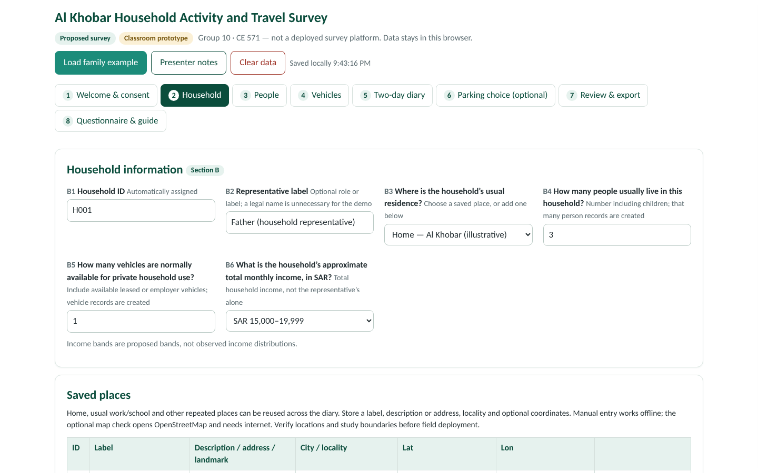
Questionnaire Excerpts: Household, People, Vehicles
Proposed Al Khobar survey · in respondent order
1 Household
2 People
3 Vehicles
Usual residence (saved place)
Household size
Vehicles available
Monthly income band (7 bands incl. Prefer not to answer)
Age, gender (Male / Female), education, licence
Work or student status
Conditional: workplace, schedule, home-working, parking
Conditional: school, transit-stop walking time
Vehicle ID (V01, V02 …) and type
Provision: owned / leased / employer
Permitted drivers
Availability restrictions
Household section of the prototype questionnaire (Al_Khobar_Household_Survey.html)
Burden-reduction choices built into the questionnaire
Household representative · income bands · saved places · conditional questions · save and resume · reused shared trips. Employed members give their own stated preferences through the representative.
Notes:
Show the questionnaire in the order a respondent meets it. Household first: residence, size, vehicles and a total household income band with a prefer-not-to-answer option. Then each person: age, gender (male or female), education, licence, work or student status, and conditional questions on workplace, schedule, home-working, parking availability and who pays for it, school, and walking time to a usable transit stop. Then each vehicle: ID, type, how it is provided, who may drive it and any availability restrictions.
Point out the burden-reduction decisions: one representative, income bands rather than exact amounts, saved places, conditional questions, save-and-resume, and reuse of shared trips. The full questionnaire with every response option is in the appendix.

Slide 22
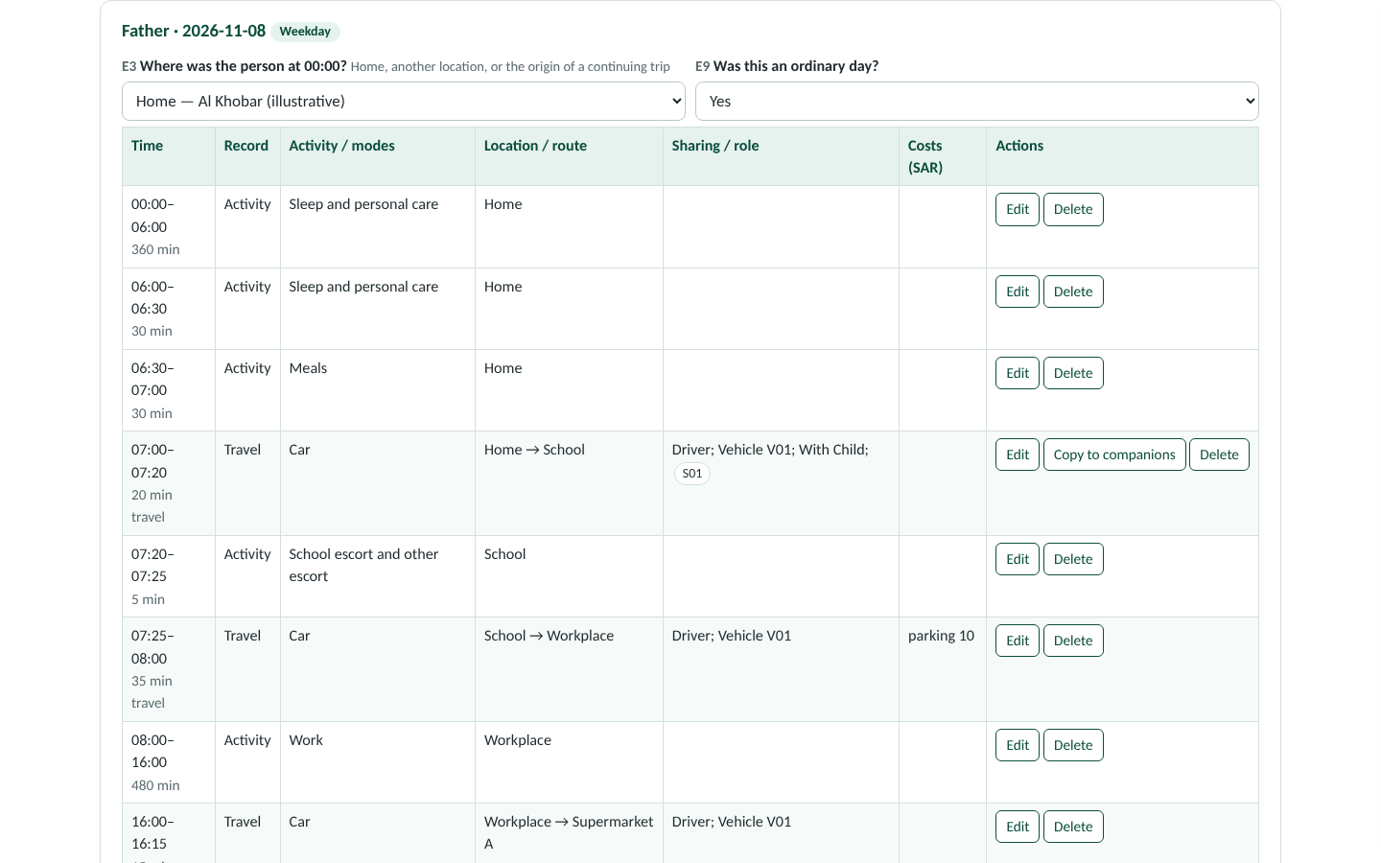
Two-Day Diary: Guided Entry and Live Demonstration
Proposed Al Khobar survey
Activity
Location
Start / end
Travel if location changes
Next activity
Full-day review
Live demonstration (about two minutes)
1 Open the HTML file → Load family example
2 Household → People → Vehicles
3 Two-day diary: Father, assigned weekday
4 Edit the 07:00–07:20 Home–School trip: Child as companion, vehicle V01; cancel
5 Child: passenger copy, different destination activity
6 Review & export · Questionnaire & guide
▶ Open Al_Khobar_Household_Survey.html (beside this deck)
Includes at-home activities, all modes, short walks, out-of-area trips, transfer stages, vehicle sharing and no-travel days. Activities and trips have separate durations. Fallback: appendix diary tables.
Local prototype: no server submission, continuous GPS, live geocoder or verified household-access system.
Notes:
Explain the diary logic on the slide: the respondent records an activity, its location and times; if the next activity is somewhere else, a trip is recorded; and the whole day is reviewed at the end. At-home activities, short walks, transfers, shared vehicles and days with no travel are all captured, and activities and trips carry separate durations.
Then run the live demonstration from the hyperlink (test it on the classroom computer beforehand; the HTML must sit beside the deck). Load the family example, show Household, People and Vehicles in order, open the father's weekday diary, open the 07:00–07:20 Home–School trip to show the child as companion and vehicle V01, cancel, switch to the child to show the passenger copy with a different destination activity, then glance at Review & export and the questionnaire guide. If the browser fails, use the father's schedule table in the appendix as the static fallback.
Be honest about the prototype: it is local, with no server submission, GPS tracking, live geocoding or institutional access control.

Slide 23
Optional Workplace-Parking Choice Questions
Proposed supplement · hypothetical attributes, not measured Al Khobar values
“For this workday, which option would you choose, considering your work schedule, household commitments, and travel budget?”
Attribute | Option A: Car | Option B: Public transport + walking
Total outward-and-return daily travel time | 70 min | 100 min
Other daily travel costs | SAR 12 | SAR 8
Daily workplace parking charge | SAR 10 | SAR 0
Total daily cost | SAR 22 | SAR 8
Design notes
Public transport time includes walking, waiting and transfers.
Two short cards per relevant employee as a pilot starting point; final experimental design, versions, burden and sample needs still to be assessed.
These fixed cards alone do not identify or validate a full ABM. Link future tasks to feasible alternatives and observed context [R9].
Choices: Option A / Option B / Neither option is feasible — explain
The employee answers personally; the representative only records the answer. Both cards and the rationale are in the appendix.
Notes:
An optional stated-preference supplement tied to the parking application. One illustrative card is shown: the car takes 70 minutes a day and costs 22 riyals including a 10-riyal parking charge; transit with walking takes 100 minutes and costs 8 riyals. The respondent chooses A, B, or says neither is feasible and explains why.
Stress the limits: the attributes are hypothetical, not measured Al Khobar prices or times; two cards per employee are a pilot starting point; and these fixed cards alone cannot identify or validate a full activity-based model. Future field tasks should be linked to the respondent's feasible alternatives and observed context, as in the SP-off-RP approach (Rudloff and Straub 2021, R9). Keep it short: this is a supplement, not a separate research project.

Slide 24

Weighting, Representation, and Privacy
Proposed procedure · illustrative numbers
Step | Illustrative calculation
Households in one stratum | 1,000
Randomly selected | 100
Base weight | 1,000 / 100 = 10
Completed | 80
Simplified non-response-adjusted weight | 10 × 100 / 80 = 12.5
1 Selection probability
2 Non-response adjustment in suitable cells
3 Calibration to verified controls
Compare achieved with available geographic, household-size, demographic and vehicle controls. Review undercoverage and extreme weights. Apply day-type weights: one weekday plus one weekend day are not equally important in a weekly mean.
The example assumes a suitable adjustment cell; it does not establish that non-response bias disappears.
Privacy: inform participants; separate contact details from analytical IDs in deployment; restrict detailed-location access; report aggregates; finalize retention and withdrawal procedures before fieldwork. GPS decision: no continuous tracking in the core design; locations are entered and reused manually; GPS is a separately consented future extension.
Notes:
Weighting with one approved numeric illustration: a stratum of 1,000 households, 100 selected, base weight 10; 80 complete, so the simplified non-response-adjusted weight is 10 times 100 over 80, or 12.5. The sequence is selection probability, non-response adjustment within suitable cells, then calibration to verified population controls. The example assumes a sensible adjustment cell; it does not prove that non-response bias disappears.
Representativeness: compare achieved and target distributions where controls exist, look for undercoverage and extreme weights, and weight day types properly, because one weekday and one weekend day are not equally important in a weekly average.
Privacy: informed participants, contact data separated from analytical IDs, restricted access to detailed locations, aggregate reporting, and retention and withdrawal rules settled before fieldwork. No continuous GPS in the core design.

Slide 25

Data Roles: Inputs, Estimation, Calibration, Validation
Role | Meaning | Example
Model inputs | Represent population and travel environment | Household attributes, activity locations, skims
Estimation data | Estimate behavioral relationships | Observed choices and attributes of available alternatives
Calibration data | Adjust outputs to appropriate observed patterns | Trip rates, tours, mode distributions, departure-time patterns
Independent validation data | Test performance using evidence not used to fit or tune | Held-out survey observations or independent counts and time observations
Separation matters. A dataset may serve different roles with proper separation. Matching the same counts used for calibration is not independent validation. Household members and repeated SP responses need appropriate handling when creating training and validation splits.
Notes:
Topic 6 starts with the distinction the assignment asks for. Inputs describe the population and the travel environment. Estimation data are the observed choices, together with the attributes of the alternatives that were available, used to estimate behavioral parameters. Calibration data are the patterns the model is adjusted to reproduce. Independent validation data are evidence not used in fitting or tuning.
The same dataset can play more than one role only with clean separation. Reproducing the counts you calibrated to is not validation. Members of the same household and repeated stated-preference answers are correlated, so splits must respect that structure.

Slide 26
Data Requirements and Potential Sources
Dataset | Required fields | Model use | Potential source | Availability status
Household / person | Composition, income, age, work/education, vehicles | Population and behavioral representation | Proposed household survey | To be collected
Activity / travel diaries | Purposes, locations, times, modes, stages, shared trips, payments | Behavioral estimation and schedule reconstruction | Proposed two-day diary | To be collected
Population controls | Household and population totals, demographic distributions | Synthesis and weighting | GASTAT / Census / DataSaudi [R13] | Public aggregates identified; boundary detail requires checking
Land use and activity opportunities | Type, density, jobs, enrolment, shops and services | Activity and destination opportunities | Municipal GIS and administrative agencies [R15] | Detailed access and coverage unverified
Networks and skims | Roads, capacity, speeds, restrictions; transit stops, routes, fares, frequencies, timetables, transfers; walking and cycling; OD time/cost matrices | Available alternatives and travel impedance | Road and municipal agencies; transit operator [R14] | Machine-readable access needs confirmation
Supporting observations | Traffic and congestion, passenger and smart-card data, travel times, external and through flows | Calibration and independent validation | Authorities, operator, field measurements; legally available GPS or mobile data | Access and independence need confirmation
Future scenarios | Population, employment, land use, network and service changes | Forecasting | Planning agencies | Official projections or transparent assumptions needed
Governorate-level totals are not the city boundary; a transit information page and a municipal GIS portal are potential sources, not verified modeling datasets.
Notes:
The data table covers every dataset the assignment lists, including cycling networks, transit frequencies and transfers, network restrictions, external and through travel, and future scenarios, with a potential source and an honest availability status for each.
Two datasets would come from the proposed survey. Population controls exist as public aggregates (GASTAT, DataSaudi) but boundary detail must be checked. Land use would come from municipal GIS, whose detailed access is unverified. Networks and skims need machine-readable road and transit data, which has not been confirmed. Supporting observations for calibration and validation need both access and independence. Future scenarios need official projections or transparent assumptions. Do not quote local statistics that have not been checked for the chosen boundary and reference date.

Slide 27
Software Comparison and Recommendation
A demand model predicts activities and travel choices; a transport simulation represents interactions on a network. They overlap in some systems but are not interchangeable just because both use agents.
Criterion | ActivitySim | FEATHERS | MATSim
Primary role | Activity-based demand modeling | Activity-based modeling framework | Agent-based transport simulation
Approach | Discrete-choice components | Decision-tree implementations; extensible framework | Plans, network simulation, iterative replanning
Main data | Synthetic persons and households, land use, skims, behavioral data | Activity, household and spatial data; framework-specific inputs | Activity plans, networks, policy parameters
Skills | Python, GIS and data preparation, behavioral estimation | Framework-specific modeling and local development | Simulation and network expertise; programming for customization
Access / cost | Open source; distributed without charge | Access and implementation terms require confirmation | Open source; staff and computing costs remain
Fit to our purpose | Strong candidate for cost-sensitive tour and mode analysis | Candidate after local adaptation and cost-sensitivity assessment | Relevant if detailed network effects become a priority
Recommendation: ActivitySim for the proposed Al Khobar application, subject to local data preparation, behavioral estimation, and verification of the required parking and household-coordination components.
Sources: [R4] ActivitySim documentation; [R5] Hasselt University IMOB, FEATHERS; [R6] MATSim; [R7] Bao et al. (2016). Separate skimming/assignment tools may be needed.
Notes:
First the distinction: a demand model such as ActivitySim predicts activity and travel choices; a transport simulation such as MATSim represents agents interacting on a network; FEATHERS is an activity-based framework built on decision trees. They overlap in places but are not interchangeable.
Walk the matrix by criterion: role, approach, data, skills, access and cost, and fit to our purpose, which is a cost-sensitive analysis of tours and mode choice under a workplace parking charge. ActivitySim is recommended because it is open source, built from discrete-choice components, documented, and matches the objective and the Python and GIS skills a local team would need; FEATHERS is a candidate after local adaptation and confirmation of access terms; MATSim becomes relevant if detailed network effects become the priority.
The recommendation is conditional: a suitably skilled team is a requirement, not a fact; separate skimming and assignment tools may be needed; and the parking-cost, escort and time-specific car-allocation components must be verified in the chosen release rather than assumed from the platform name.

Slide 28
Estimation, Calibration, and Validation
1 Estimation
2 Calibration
3 Validation
Estimate behavioral parameters from observed or stated choices
Adjust model components to reproduce relevant observed patterns
Test against independent observations where available
Teaching specification
Vₘ = ASCₘ + βT·Tₘ + βC·Cₘ
Utility of mode m: an alternative-specific constant plus estimated coefficients on travel time T and cost C. Parameters are estimated, not assigned by opinion.
Choice set: unchosen but available alternatives need attributes too; chosen trips alone cannot describe the choice set.
Compare distributions: activity and trip rates, tours and stops, destinations, mode shares and departure times. Traffic-volume totals alone are insufficient.
Limited data: document transferred parameters, sparse segments, missing alternatives and limited independent validation.
The simple expression is a teaching example, not a claim that ActivitySim is one binary model.
Notes:
Topic 7. Three stages: estimation of behavioral parameters from observed or stated choices; calibration, adjusting components so that the model reproduces relevant observed patterns; and validation against independent observations where they exist.
The small specification shows a mode's utility as an alternative-specific constant plus coefficients on time and cost. The coefficients are estimated from data, not set by opinion. To estimate them you need the attributes of the alternatives the person did not choose, so observed chosen trips alone are not enough. It is a teaching expression; ActivitySim is a system of many linked components, not one binary model.
Calibrate and validate on distributions, not just aggregate volumes: trip and activity rates, tours and stops, destinations, mode shares and departure times. In a limited-data setting such as a first Al Khobar model, document any transferred parameters, sparse segments, missing alternatives and the limits of independent validation.

Slide 29

Model Testing and Reliability
Check | Purpose
Sensitivity | Test responses to changes in policy variables, e.g. the workplace parking charge
Uncertainty | Assess effects of uncertain inputs and parameters
Convergence | Check stability of iterative components where used
Computational efficiency | Monitor runtime and memory needs
Reproducibility | Document data, settings, versions and random seeds
Two cautions
Convergence is not proof of predictive accuracy.
Repeated stochastic runs are not independent observational validation.
No parking response magnitude has been estimated for Al Khobar.
Notes:
Five checks that make a model trustworthy to use. Sensitivity: does the model respond sensibly when the parking charge changes? Uncertainty: how do uncertain inputs and parameters propagate to results? Convergence: are iterative components stable? Efficiency: runtime and memory. Reproducibility: data, settings, software versions and random seeds documented so a run can be repeated.
Two cautions: a converged model is not thereby accurate, and repeating stochastic runs tells you about the model's own variability, not about agreement with the real world. We have not estimated any parking response magnitude for Al Khobar.

Slide 30




Evaluating Workplace Parking Charges in Al Khobar
Hypothetical policy scenario · proposed analysis, no forecast carried out
Scenario | Definition
Baseline | Existing documented parking charges and travel conditions
Policy | One explicitly specified workplace-parking charge change
Indicators the model would report
Commute mode shares · tours and stops · departure times where the specification supports a response · represented household vehicle use · differences by income, car access and commitments. Examine who actually pays, including employer support. Hold other assumptions constant; report forecast uncertainty.
Do not set baseline parking to zero without evidence. No fee amount is approved or measured; the SAR 10 and SAR 20 survey-card values do not define the policy simulation.
Scope: behavioral response analysis with suitable network conditions supplied; no completed dynamic congestion study is claimed.
Broader applications
Transit investments
Road and congestion pricing
New development, TOD
Flexible work
Vehicle-ownership scenarios
Shared and on-demand mobility
Environmental and TDM policies
Environmental outputs need additional emissions or energy models and data; activity detail alone is not an emissions calculation.
Notes:
Topic 8: the focused application. Two scenarios: a baseline with the existing, documented parking charges and conditions, and one explicitly specified change in the workplace parking charge. The baseline must not be assumed to be free parking, and no fee has been approved; the survey-card values are not the policy.
The model would report commute mode shares, tours and stops, departure times where the specification allows a response, represented household car use, and differences by income, car access and commitments. Check who actually pays the charge, including employer support, hold other assumptions constant for a first comparison, and report uncertainty. The scope is a behavioral response analysis with network conditions supplied, not a dynamic congestion study.
Then the broader application families in one breath: transit, pricing, development and TOD, flexible work, vehicle-ownership scenarios, shared mobility, and environmental and TDM policies, noting that emissions need additional models and data.

Slide 31
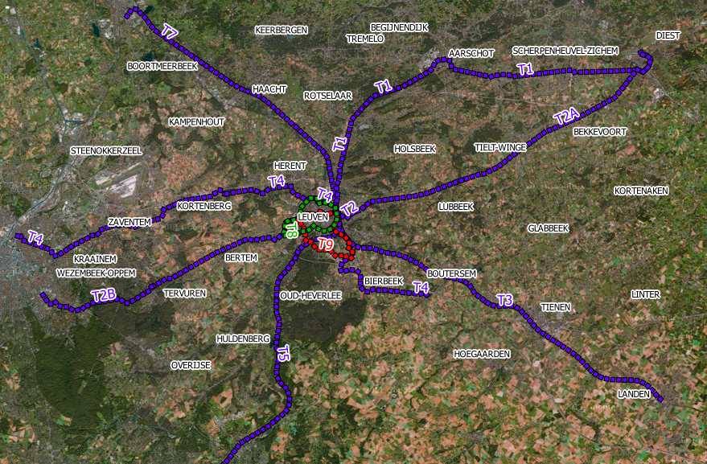
Case Study: Leuven, Belgium
Published study · Bao et al. (2018), Applied Sciences 8(2), 211, CC BY
Objectives
Travel-demand effects of a light rail proposal; spatial and study-area requirements; runtime and randomness.
Context and data
Proposed rail: 10 lines, about 250 km. OVG travel survey: 8,800 persons, random register sample, mainly face-to-face.
Model and method
FEATHERS: 26 CHAID decision trees, ALBATROSS-derived scheduler; updated spatial inputs, relearned trees and TransCAD skims.
Figure 1 of Bao et al. (2018): the proposed regional light rail network surrounding Leuven. Reproduced with attribution under the article's CC BY license [R2].
Notes:
Topic 9: a published application of FEATHERS to the Leuven region in Flanders. The planning question was the travel-demand effect of a proposed regional light rail network of ten lines and about 250 kilometres. The paper also studied how fine the zoning should be, how small the study area could be to save runtime, and how many runs are needed to tame randomness.
Data: the OVG Flemish travel survey of 8,800 persons drawn at random from the national register, mainly face-to-face. Model: FEATHERS, built on 26 CHAID decision trees and a scheduler derived from ALBATROSS, with updated spatial inputs, relearned trees and skims from TransCAD.
The map is Figure 1 of the paper, used with attribution under its CC BY license.

Slide 32
Published Model Results
Published model prediction · not an observed post-project outcome
Mode | Relative change in mean daily trips
Car driver | +0.18%
Car passenger | +0.03%
Non-motorized | −4.54%
Public transport | +7.86%
Comparison design
Without and with the proposed rail; seven runs each; 50% synthetic population. Authors considered the car changes negligible relative to run variability.
Higher public transport use does not automatically imply fewer car trips.
Source: [R2] Bao et al. (2018), Table 3, percentage change between the average values of seven runs per scenario.
Notes:
The headline results, from Table 3 of the paper: comparing the light rail scenario with the null scenario, each averaged over seven runs on a 50% synthetic population, predicted daily trips by car driver changed by +0.18%, car passenger +0.03%, non-motorized modes −4.54%, and public transport +7.86%.
Read the chart carefully: these are relative changes in predicted trip counts, not percentage-point changes in mode share, and not observed outcomes after a project was built. The authors judged the small car changes negligible against the variability between runs. The takeaway: more public transport use came mainly at the expense of walking and cycling, not of car trips.

Slide 33
Critical Assessment and Lessons for Al Khobar
Assessment of the study
Our transfer recommendations
Detailed zones require data; the building-block zoning needed updated spatial inputs.
Smaller study areas trade coverage for runtime.
Estimated network inputs limit confidence in results.
Repetition addresses randomness; seven runs were needed.
Independent observational validation is not fully documented in the article.
Re-estimate locally; Flemish trees and parameters do not describe Al Khobar households.
Represent external interactions at the study-area boundary.
Obtain independent evidence for validation before policy use.
Test mode-specific outcomes, not only totals: gains for transit may come from walking and cycling.
Transfer the methodology, not the numerical forecasts.
Model-to-model agreement is not the same as real-world accuracy.
Evidence: [R2], Sections 2, 4–6 and Table 3.
Notes:
Critical assessment first. Finer zones demand more data; shrinking the study area reduces runtime but loses coverage; some network inputs were estimated, which limits confidence; randomness had to be handled by repeating runs; and the article does not fully document validation against independent observations, which we disclose rather than infer.
Lessons for Al Khobar: re-estimate the behavioral components locally, represent interactions across the study boundary, obtain independent evidence before using the model for policy, and look at mode-specific outcomes rather than totals, because the Belgian gain in transit came largely from walking and cycling. What transfers is the methodology, not the numbers. Agreement between two model runs is not the same as agreement with reality.

Slide 34
Challenges and Future Directions
Challenge | Development or research direction
Survey cost and declining response | Complement surveys with GPS, mobile-device and smart-card data [R11]
Privacy and consent | Responsible access, consent and protection procedures
Behavioral differences and changing preferences | Better representation of diverse households and evolving behavior; in-home schedule enrichment [R10]
Uncertain future conditions | Alternative population, land-use and behavioral scenarios
Computational demands | Efficiency improvements; selective dynamic assignment and agent-simulation integration
Explainability and reproducibility | Document assumptions; test transparent uses of AI and machine learning
Saudi implementation needs | Local data, technical expertise and institutional coordination
GPS does not directly explain every activity purpose; smart cards do not cover a person's entire day. New components must be explained and validated.
Notes:
Topic 10 in one table. Survey cost and falling response rates push toward GPS, mobile-device and smart-card data; Vo et al. (2026, R11) show how survey and smart-card data can be combined to generate transit users' schedules. Privacy and consent need responsible procedures. Behavioral diversity and changing preferences call for better representation, including in-home activities (Liu et al. 2024, R10). Uncertain futures need alternative scenarios. Computation drives efficiency work and selective integration with dynamic assignment and agent simulation. Explainability and reproducibility demand documented assumptions and transparent, tested uses of machine learning. In Saudi Arabia, the practical needs are local data, technical expertise and institutional coordination.
Two cautions on the new data: GPS traces do not tell you the purpose of every activity, and a smart card covers only the transit part of a day. These are future directions, not additional case studies.

Slide 35

Key Takeaways
Activity-based models connect daily activities, linked trips, and household constraints.
Reliable policy evaluation requires suitable data, local estimation, and independent validation.
For Al Khobar, ActivitySim is the proposed platform, subject to local adaptation and verification.
The value of an activity-based model depends on its behavioral relevance, data quality, validation, and suitability for the planning decision.
Notes:
Close with three messages: activity-based models connect activities, linked trips and household constraints; reliable policy evaluation needs suitable data, local estimation and independent validation; and for Al Khobar we propose ActivitySim, conditional on local adaptation and verification of the components we need.
Final statement: the value of an activity-based model depends on its behavioral relevance, data quality, validation and suitability for the planning decision. Then invite questions. Every group member should be ready to answer on any part of the topic, not only their own slides.

Slide 36
References (1 of 2)
[R1] Adnan, M. Activity-Based Models: Introduction. Supplied KFUPM course presentation (10 slides; date not stated). Cited as course material.
[R2] Bao, Q., Kochan, B., Shen, Y., Creemers, L., Bellemans, T., Janssens, D., & Wets, G. (2018). Applying FEATHERS for Travel Demand Analysis: Model Considerations. Applied Sciences, 8(2), 211. https://doi.org/10.3390/app8020211 (CC BY; Figure 1 p. 4, Table 3 p. 9)
[R3] National Academies of Sciences, Engineering, and Medicine (2014). Activity-Based Travel Demand Models: A Primer. SHRP 2 Report S2-C46-RR-1. Washington, DC: The National Academies Press. https://doi.org/10.17226/22357
[R4] ActivitySim project. Project repository and model documentation (users-guide: example models, model anatomy, model setup; dev-guide: tour mode choice, parking location choice). https://github.com/ActivitySim/activitysim · https://activitysim.github.io/activitysim/ (consulted 1–2 November 2026)
[R5] Hasselt University, Transportation Research Institute (IMOB). Technology platforms: FEATHERS. https://www.uhasselt.be/en/instituten-en/transportation-research-institute-imob/tools/technology-platforms (consulted 1–2 November 2026)
[R6] MATSim project. Official website, documentation and source repository. https://www.matsim.org/ · https://matsim.org/docs/ · https://github.com/matsim-org/matsim-libs (consulted 1–2 November 2026)
[R7] Bao, Q., Kochan, B., Shen, Y., Bellemans, T., Janssens, D., & Wets, G. (2016). Activity-Based Travel Demand Modeling Framework FEATHERS: Sensitivity Analysis with Decision Trees. Transportation Research Record, 2564, 89–98. https://doi.org/10.3141/2564-10
[R8] UK Department for Transport. National Travel Survey 2024 technical report: Chapter 1, Introduction and background. https://www.gov.uk/government/statistics/national-travel-survey-2024-technical-report/chapter-1-introduction-and-background
Notes:
Course and theoretical sources, the Belgian case-study paper, and primary software documentation. Keep the links for verification. The Bao et al. (2018) article is CC BY, which is why its Figure 1 map is reproduced with attribution.

Slide 37
References (2 of 2)
[R9] Rudloff, C., & Straub, M. (2021). Mobility surveys beyond stated preference: introducing MyTrips, an SP-off-RP survey tool, and results of two case studies. European Transport Research Review, 13, 49. https://doi.org/10.1186/s12544-021-00510-5
[R10] Liu, F., Bellemans, T., Janssens, D., Wets, G., & Adnan, M. (2024). A Methodological Approach for Enriching Activity–Travel Schedules with In-Home Activities. Sustainability, 16(22), 10086. https://doi.org/10.3390/su162210086
[R11] Vo, K. D., Kim, E.-J., Lee, H., & Bansal, P. (2026). Harnessing household travel survey with smart card data to generate spatiotemporally-diverse activity schedules for transit users. Transportation Research Part B: Methodological, 205, 103388. https://doi.org/10.1016/j.trb.2025.103388
[R12] Aschauer, F., Hössinger, R., Jara-Díaz, S., Schmid, B., Axhausen, K., & Gerike, R. (2021). Comprehensive data validation of a combined weekly time use and travel survey. Transportation Research Part A, 153, 66–82. https://doi.org/10.1016/j.tra.2021.08.011
[R13] DataSaudi. Data explorer database structure. https://datasaudi.sa/en/data-explorer/datasets (potential source of public aggregates; not an acquired model dataset)
[R14] SAPTCO. Eastern Region public buses. https://saptco.com.sa/qr-eastern-bus (service information page; not operational modeling files)
[R15] Eastern Province Municipality. Geographic information portal (candidate administrative source; access and suitability not verified). https://webgis.eamana.gov.sa/home/
Also TF Resource. Household travel surveys. https://tfresource.org/topics/Household_travel_surveys.html · Course material: TMIP activity-based modeling webinar slides (CT-RAMP, population synthesis, scheduling) supplied with the course.
Notes:
Survey and recent research sources, plus Saudi data sources listed as potential access rather than acquired datasets. Note the bibliographic correction: Vo et al. is a 2026 journal volume although the DOI string contains 2025.

Slide 38
Appendix: Complete Questionnaire and Survey Methodology
Reference material for questions and discussion. Not presented in the main talk.
A Participation · B Household · C People · D Vehicles · E Diary · F Trips · G Parking choice supplement · H Review · Methodology rationale · Prototype capabilities · Example diaries
Notes:
Divider for the appendix. The main slides showed excerpts in respondent order; the appendix preserves the whole questionnaire and the reasoning behind the design decisions.

Slide 39
A. Participation and Reporting Instructions
Participant introduction
This survey collects information about household characteristics and daily activities and travel to support transportation planning research. Participation is voluntary. Please record the activities and trips of all household members on the two assigned diary days.
ID | Question / instruction | Response / behavior
A1 | Do you agree to participate? | Yes — continue / No — end response
A2 | Explain the survey to participating adult household members. | Representative confirms they have done so
A3 | Who completes the response? | Parent or household representative enters everyone's information after consulting them; assists children
A4 | Confirm known information with each member. | Do not guess missing details
Before actual fieldwork, supply the responsible organization, contact details, approved data handling, retention and withdrawal procedures. Local demonstration notice: data stays in the browser; use fictional information; export or clear locally; no continuous GPS or institutional submission.
Notes:
Section A of the questionnaire: consent and the reporting rule. One representative completes the response after consulting every member and must not guess.

Slide 40
B. Household Information
ID | Field / question | Response format
B1 | Household ID | Automatically assigned
B2 | Representative label | Optional role or label; a legal name is unnecessary for the demo
B3 | Where is the household's usual residence? | Saved place, address or landmark, city/locality; coordinates if known
B4 | How many people usually live in this household? | Number including children; creates that many person records
B5 | How many vehicles are normally available for private household use? | Number; include available leased or employer vehicles; creates vehicle records
B6 | What is the household's approximate total monthly income, in SAR? | Bands at right
Income choices, exactly
1 Less than SAR 5,000
2 SAR 5,000–9,999
3 SAR 10,000–14,999
4 SAR 15,000–19,999
5 SAR 20,000–29,999
6 SAR 30,000 or more
7 Prefer not to answer
Proposed bands, not observed income distributions. Ask total household income, not the representative's income alone.
Saved places: Home, usual work/school and other repeated places can be reused. Store label, description or address, locality and optional latitude/longitude. The offline demo has manual entry and an optional external map check, not a live geocoding service. Verify locations and study boundaries before field deployment.
Notes:
Section B. Household-level fields and the exact income bands. The bands are a design proposal; they are not observed distributions.

Slide 41
C. Each Household Member (1 of 2)
ID | Question | Response / routing
C1 | Person ID and member label | Assigned ID plus label such as Father, Mother, Child
C2 | Age in completed years | Number; 0 for a child under one year
C3 | Gender | Male / Female
C4 | Highest education completed | No formal education yet / Primary / Intermediate / Secondary / Diploma / Bachelor's / Postgraduate / Other
C5 | Nationality group | Optional: Saudi / Non-Saudi
C6 | Current employment and education status | Employed or self-employed; Student; both can apply; neither if both unchecked
C7 | Driving-licence status | Holds valid licence / Does not hold valid licence / Not applicable
C8 | Usual workplace | If employed: saved place
C9 | Work schedule | If employed: fixed / flexible / shifts-variable / no usual schedule
Notes:
Section C, first half: identity, age, gender, education, nationality group, status, licence and the first conditional work questions.

Slide 42
C. Each Household Member (2 of 2)
ID | Question | Response / routing
C10 | Usual work start and end | If applicable: 24-hour times
C11 | Working from home | If employed: never / some workdays / all workdays / varies
C12 | Workplace parking availability | Free available / paid available / no parking available / unknown
C13 | Who normally pays workplace parking charges? | If paid: employee / employer / shared payment / unknown
C14 | Typical total daily parking charge | If paid: SAR; leave unknown blank
C15 | Usual school/college/university | If a student: saved place
C16 | Usual education start and end | If applicable: 24-hour times
C17 | Usual walking time from home to a usable transit stop | Under 5 / 5–10 / 11–20 / over 20 minutes / no usable service known / unknown
C18 | Mobility, access, escort or other travel constraints | Optional short text
Skip irrelevant work or student questions. 'Prefer not to answer' was removed from Gender, not from income. Keep choices consistent with the approved prototype.
Notes:
Section C, second half: the conditional work, parking, education and transit-access questions. These parking fields are what links the survey to the parking-charge application.

Slide 43
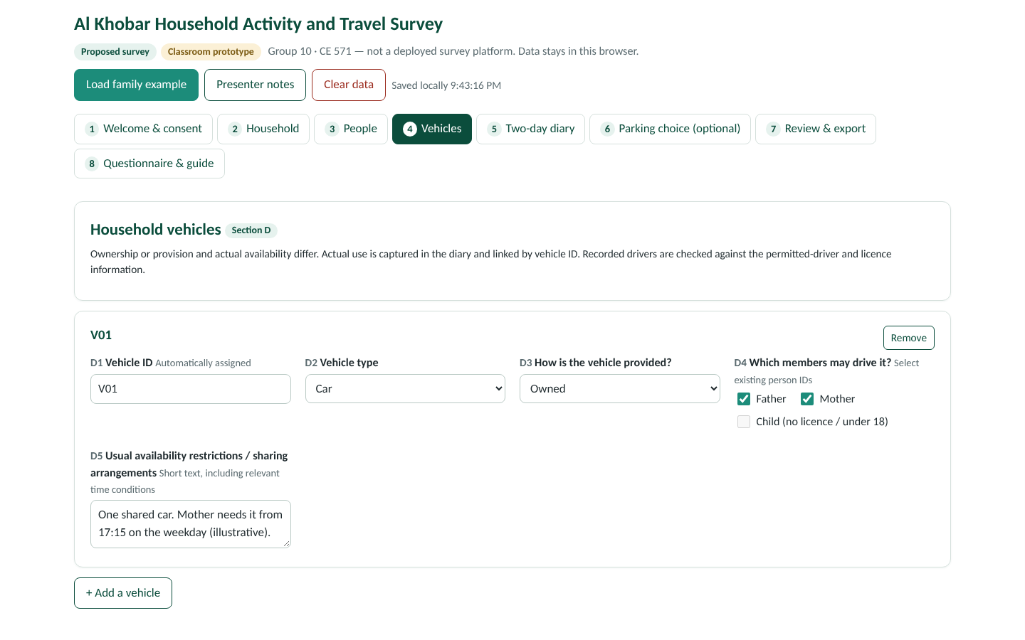
D. Each Vehicle
ID | Question | Response
D1 | Vehicle ID | Automatically assigned V01, V02, etc.
D2 | Vehicle type | Car / SUV / Van / Pickup / Motorcycle / Other
D3 | How is the vehicle provided? | Owned / leased-rented / employer-provided / other
D4 | Which members may drive it? | Select existing person IDs
D5 | Usual availability restrictions or sharing arrangements | Short text, including relevant time conditions
Design note
Ownership or provision and actual availability differ. Actual use is captured in diary records and linked by vehicle ID. Flag inconsistencies between recorded drivers and the permitted-driver or licence information.
Notes:
Section D. Vehicle records are linked to diary trips by vehicle ID, which is what makes shared-car conflicts detectable.

Slide 44
E. Assigned Diary Dates and Activity Records
ID | Field / question | Response / logic
E1 | Assigned weekday and weekend dates | Same two dates for all members; assigned across the fieldwork calendar
E2 | Member and diary day | Select person ID and assigned date
E3 | Where was the person at 00:00? | Home / another location / travelling; identify location or continuing-trip record
E4 | Main activity | List at right
E5 | Activity location | Saved or new place
E6 | Activity start and end | HH:MM; begin at 00:00 and finish the complete diary at 24:00
E7 | Activity detail | Optional text; duration calculated from times
E8 | Did the next activity occur at the same location? | Same location: next activity; changed location: record the trip
E9–E10 | Was this an ordinary day? If not, explain | Yes / No — unusual circumstances / Unknown; short text; retain the day with its flag
E11 | No travel on this day? | Explicit confirmation; still record the activities
E12 | Confirm review with the member | Representative confirms all known activities and trips included
Activity choices
Sleep and personal care · Meals · Work · Education · Shopping and services · School escort and other escort · Household and family care · Leisure and social activities · Healthcare · Waiting / other activity · Other
Record the main activity in a period. Include at-home work and education. A day with no trips is a valid observation. Travel across midnight is flagged as a continuation. Calendar grouping proposed as Sunday–Thursday and Friday–Saturday; record actual work circumstances.
Notes:
Section E. The diary is activity-first: every period of the day is an activity, and a trip is recorded only when the location changes. The full day from 00:00 to 24:00 must be covered.

Slide 45
F. Each Trip and Its Stages
ID | Question | Response / logic
F1 | Trip origin | Previous location prefilled for confirmation
F2 | Trip destination | Saved or new place
F3 | Departure and arrival | HH:MM; travel duration calculated
F4 | Modes used | Car / public transport / walking / cycling / ride-hailing-taxi / motorcycle / other; select all used
F5 | Driver or passenger? | If car used
F6 | Vehicle used | Household vehicle ID / other vehicle
F7 | Household companions for the shared segment | Select person IDs
F8 | Additional non-household companions | Number
F9 | Public transport stages | Ordered walking, waiting/transfer, bus, rail/metro or other stages; line if known; start and end times
F10–F12 | Fare, parking and toll paid | Where applicable: SAR; 0 if confirmed free; blank if unknown
F13 | Payment or uncertainty note | Optional explanation
Shared-trip reuse
Copy common movement details to companions for review. Copy only the relevant travel segment. Do not copy the destination activity, assume personal fare payments, or make a child a driver. Shared parking and toll payments are recorded once. Copies are linked by a shared-trip ID. Person-trip counts differ from vehicle movements. Tours and chains are derived from the ordered records; respondents do not enter them twice.
Notes:
Section F. Trips carry modes, roles, vehicle, companions, ordered public-transport stages and payments. Transfers are stages within one trip; a new destination activity starts a new trip. Fuel use is not asked per trip; operating costs are estimated later.

Slide 46
G. Stated-Preference Supplement: Both Cards
Illustrative pilot cards · not a final optimized statistical design
Attribute | Card 1: Car | Card 1: Transit + walk | Card 2: Car | Card 2: Transit + walk
Total daily outward/return travel time | 70 min | 100 min | 70 min | 90 min
Other daily travel costs | SAR 12 | SAR 8 | SAR 12 | SAR 8
Workplace parking charge | SAR 10 | SAR 0 | SAR 20 | SAR 0
Total daily cost | SAR 22 | SAR 8 | SAR 32 | SAR 8
Eligibility: relevant employed member with workplace travel; skip where not relevant. The employee answers personally; the representative records it.
Question: which option would the employee choose for this workday considering schedule, household commitments and budget? Choices: Option A / Option B / Neither feasible (record the constraint).
Stated public transport time includes walking, waiting and transfers.
Final field design needs realistic alternatives, planned attribute variation and versions, burden testing, and sample and identification checks. RP/SP estimation requires appropriate methodological treatment; hypothetical choices can differ from real behavior [R9].
Notes:
Section G, both pilot cards. Card 2 raises the parking charge to 20 riyals and shortens the transit time to 90 minutes. The cards illustrate the interface and the concept; they are not an optimized experimental design.

Slide 47
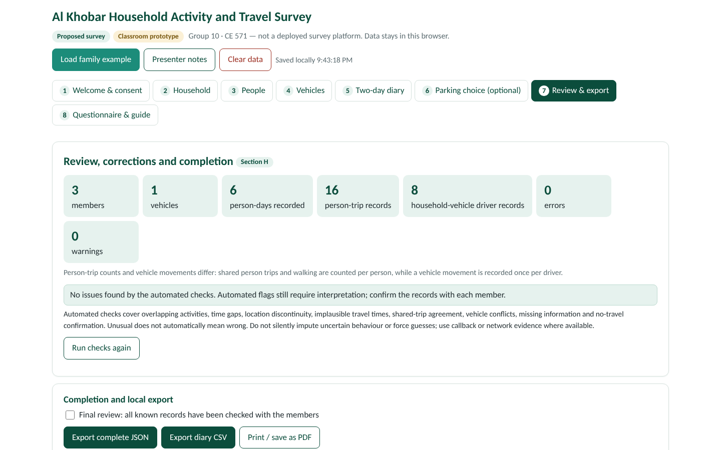
H. Review, Corrections and Completion
Check | Example prompt or action
Overlapping activities | Two records overlap; check their times.
Time gaps | What was the person doing during the missing interval?
Location discontinuity | The next location differs; was a trip missed?
Shared-trip agreement | Confirm the companions shared this entire segment.
Vehicle conflicts | The same car appears in separate overlapping driver trips.
Missing or implausible information | Review with the member; use callback or network evidence where available.
No-travel confirmation | Confirm the person stayed without trips; retain their activities.
Final review | Confirm all known records have been checked with the members.
Automated flags require interpretation; unusual does not mean wrong. Do not impute uncertain behavior or force guesses. Export linked records, preserve quality flags and keep a disposition log in fieldwork. The prototype exports JSON and a diary CSV and prints the guide; a production service would need secure hosting, access control, contact management, geocoding and approved data handling, none of which the classroom file claims.
Notes:
Section H. The automated checks in the prototype mirror these rows. Flags are prompts for review, not automatic corrections.

Slide 48
Methodology: Sampling Frame and Sample Size
Sampling frame and coverage
Sample-size assumptions and non-response
Define and verify the study polygon and eligible private-household population first.
Seek an authorized, current household or residential-unit frame including apartments and compounds; multi-household buildings need a within-address selection stage.
Availability of a suitable Al Khobar frame has not been verified.
Strata must be clear, mutually exclusive and cover the eligible area; start with proportional allocation; document any oversampling with probabilities and weights.
Use household type, income or car availability only if known in the frame.
Select randomly inside strata; keep selection records; never substitute a cooperative neighbour for a refusal.
Institutional or collective accommodation coverage remains an explicit unresolved decision.
n₀ = z²p(1−p)/e² with z = 1.96, p = 0.50, e = 0.05 gives 384.16 → 385 completed households, for one household proportion.
A finite-population correction needs the verified eligible-household total; do not invent it. Do not impose an unsupported design effect.
Review the stratification, clustering, weighting and model-oriented requirements; two diaries from one household do not double the sample.
Invited eligible households = ⌈n_completed / r_completion⌉: 963, 642 and 482 at hypothetical 40%, 60% and 80% completion.
Ineligible addresses need separate treatment if the frame is imperfect.
Budget, staffing, pilot size, subgroup targets and expected completion need an operational assessment; no city-wide ABM adequacy is asserted.
Notes:
Rationale for the sampling design and the benchmark sample size, with every number that has not been established stated as unverified.

Slide 49
Methodology: Burden, Administration, Fieldwork
Method | Useful feature | Limitation to discuss
Face-to-face | Explanation and guided reconstruction | Staff time and cost; interviewer standardization
Telephone | Recruitment, clarification, timely callbacks | Detailed locations and long diaries are difficult
Web | Flexible completion, saved fields and logic checks | Access, digital literacy and abandonment
Smartphone / GPS assistance | Route and time support | Consent, device coverage, inference errors, purpose confirmation
Selected approach | Web-first with assistance as needed | Monitor response and completion by mode and group
Reporting responsibility and burden
Pilot and eight-week fieldwork
One representative coordinates one household response. Recognize proxy-reporting limits; use short follow-up. Employees give their own SP answers. Income bands with refusal option; conditional questions; reused locations and shared movements; save and resume; children with adult help. Field versions should have equivalent Arabic and English wording.
1 Test with varied households. 2 Measure completion time, misunderstandings, missing records, shared-trip handling, abandonment. 3 Revise. 4 Re-test with different households. 5 Finalize frame, allocations, contact protocol, staffing, data handling. 6 Run eight weeks with dates spread across the calendar. 7 Review promptly and call back. No agreed numeric pilot size yet; seasonal coverage remains a limitation.
Notes:
Administration options compared, the selected web-first mixed-mode approach, the burden-reduction reasoning and the pilot-to-fieldwork sequence. The prototype does not implement GPS, phone recruitment or secured invitations; these are proposed procedures.

Slide 50
Methodology: Training, Weighting, Privacy
Recruitment, training, follow-up
Weighting and representativeness
Consent and privacy
Invite only selected households, explaining purpose, burden, voluntariness and privacy. Record contact attempts, refusals, non-contacts, ineligibility, partial and complete responses (attempt schedule not finalized). Assign diary dates; remind before, review soon after. Train staff in definitions, neutral explanation, consent, all-member coverage, shared trips, unknowns, time and location checks and privacy; use a standard script and practice households; review early work. Retain corrections and quality flags; a logical check is not proof of truth.
1 Base weights from documented inclusion probabilities. 2 Non-response adjustment in supported cells or models. 3 Calibration to verified population controls. 4 Compare achieved and target distributions; investigate missing groups, undercoverage and extreme weights. 5 Treat household, person and day structure and unequal day-type representation in analysis and uncertainty estimation.
Only the approved 1,000 / 100 / 80 illustration is used; it is not an Al Khobar expansion and does not prove unbiased estimates. Never substitute administrative-region totals for an inconsistent city boundary.
Explain the study to participating members; representative coordination does not replace informing adults. Use analytical household, person and vehicle IDs; separate contact data from responses in a deployed service. Restrict detailed-location access; publish aggregated maps. Finalize responsible contacts, access controls, retention, deletion and withdrawal before recruitment. No continuous GPS in the core design; passive data need separate consent. The prototype's local storage and export are distinct from secure institutional infrastructure.
Notes:
The remaining methodology rationale: staff and follow-up procedures, the weighting sequence with its single illustrative calculation, and the consent and privacy commitments.

Slide 51
Companion Prototype: Capabilities and Limitations
What Al_Khobar_Household_Survey.html contains
Important limitations
Welcome and consent, household, person, vehicle, diary, SP, review and export, and full questionnaire and guide sections.
Conditional work, student and transport-mode questions.
Two person-day selectors with editable time and location records.
Ordered public transport stages, shared-trip copies and vehicle-ID links.
Full fictional three-person, two-day example; local save and resume; JSON and CSV export; print support.
Core checks for completeness, overlaps and gaps, locations, shared trips and simultaneous vehicle use.
Presenter notes and a printable methodology guide.
A classroom prototype, not a deployed data-collection platform.
No backend, institutional submission, continuous tracking, live geocoder, verified sampling frame or city-boundary validation.
Manual location entry works offline; optional online map links need internet.
Fictional values are examples, not calibration evidence or real participant records.
A local demonstration does not perform ActivitySim estimation or forecast the parking policy.
The two SP cards demonstrate interface and concepts; the final experimental design is not complete.
Notes:
An honest statement of what the companion HTML file does and does not do, so that nobody mistakes it for a published website or a working survey service.

Slide 52
Example Diary: Father (P01), Weekday 2026-11-08
Illustrative records from the prototype · static fallback for the live demonstration
Time | Record | Activity / mode | Location / route | Sharing / role
00:00–06:30 | Activity | Sleep and personal care (two records) | Home
06:30–07:00 | Activity | Meals | Home
07:00–07:20 | Travel | Car | Home → School | Driver; V01; with Child
07:20–07:25 | Activity | School escort and other escort | School
07:25–08:00 | Travel | Car | School → Workplace | Driver; V01
08:00–16:00 | Activity | Work | Workplace
16:00–16:15 | Travel | Car | Workplace → Supermarket A | Driver; V01
16:15–16:35 | Activity | Shopping and services | Supermarket A
16:35–17:00 | Travel | Car | Supermarket A → Home | Driver; V01
17:00–18:00 | Activity | Household and family care | Home
18:00–19:00 | Activity | Meals | Home
19:00–23:00 | Activity | Leisure and social activities | Home
23:00–24:00 | Activity | Sleep and personal care | Home
Consistency check across all six person-days: 16 person-trip records and 8 household-vehicle driver records; each person-day covers 1,440 minutes. Different counts reflect shared person trips and walking, not duplicated vehicle movements.
Notes:
Static fallback for the live demonstration: the father's weekday diary exactly as loaded by the prototype. The mother's and child's records, and the weekend day, are in the prototype's example data.

Slide 53
Example Diary: Mother (P02) and Child (P03), Weekday
Illustrative household / schedule
Mother · time | Record | Activity / mode · location
00:00–07:30 | Activity | Sleep, household care, meals · Home
07:30–13:40 | Activity | Household and family care · Home
13:40–14:00 | Travel | Walking · Home → School
14:00–14:05 | Activity | School escort · School
14:05–14:25 | Travel | Walking · School → Home · with Child
14:25–17:15 | Activity | Household and family care · Home
17:15–17:30 | Travel | Car · Home → Community centre · Driver; V01
17:30–18:30 | Activity | Leisure and social · Community centre
18:30–18:45 | Travel | Car · Community centre → Home · Driver; V01
18:45–24:00 | Activity | Meals, leisure, sleep · Home
Child · time | Record | Activity / mode · location
00:00–07:00 | Activity | Sleep, meals · Home
07:00–07:20 | Travel | Car · Home → School · Passenger; V01; with Father
07:20–14:00 | Activity | Education · School
14:00–14:05 | Activity | Waiting / other · School
14:05–14:25 | Travel | Walking · School → Home · with Mother
14:25–16:00 | Activity | Leisure and social · Home
16:00–17:00 | Activity | Education (homework) · Home
17:00–21:00 | Activity | Leisure, meals · Home
21:00–24:00 | Activity | Sleep and personal care · Home
Weekend day (2026-11-13) for all three: one joint car tour Home → Park → Home (10:00–10:20 and 12:00–12:20), father driving, mother and child passengers. The mother's 17:15 car trip is the commitment that constrains the father's weekday afternoon.
Notes:
Compact view of the other two weekday diaries and a note on the shared weekend tour. Several consecutive at-home activity records are summarized in one row here; the prototype holds them separately.

