Slide 1
Model Structure
Developed by LChilds, JGlasser, ZFeng, JHeffernan, JLi, GRost
(greater severity of disease) (lower level of susceptibility)
From left to right
mild moderate severe
Non- neutralizing
S – susceptible E- infected, no symptoms, not infectious
V – vaccinated I – infected, infectious, symptoms – mild (asymp), moderate, severe)
1

Slide 2
Model Structure
Developed by LChilds, JGlasser, ZFeng, JHeffernan, JLi, GRost
(greater severity of disease) (lower level of susceptibility)
From left to right
These infections are reported only through contact tracing
Some of these infections are reported since they have some mild symptoms, also, contact tracing
These infections are reported, will need to see doctor and/or have a hospital stay
S – susceptible E- infected, no symptoms, not infectious
V – vaccinated I – infected, infectious, symptoms – mild (asymp), moderate, severe)
2

Slide 3
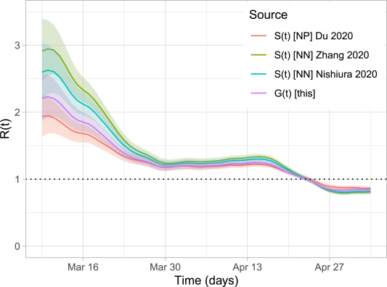
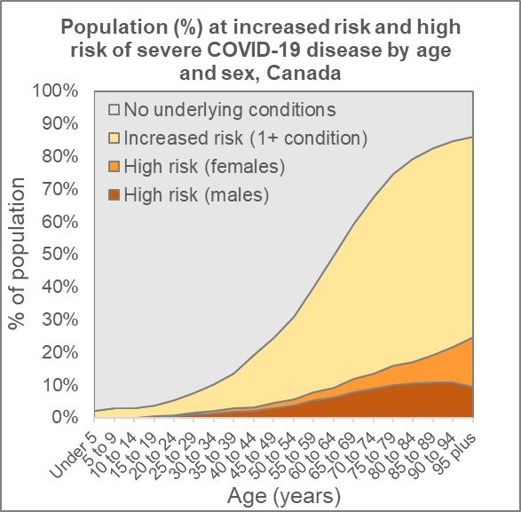
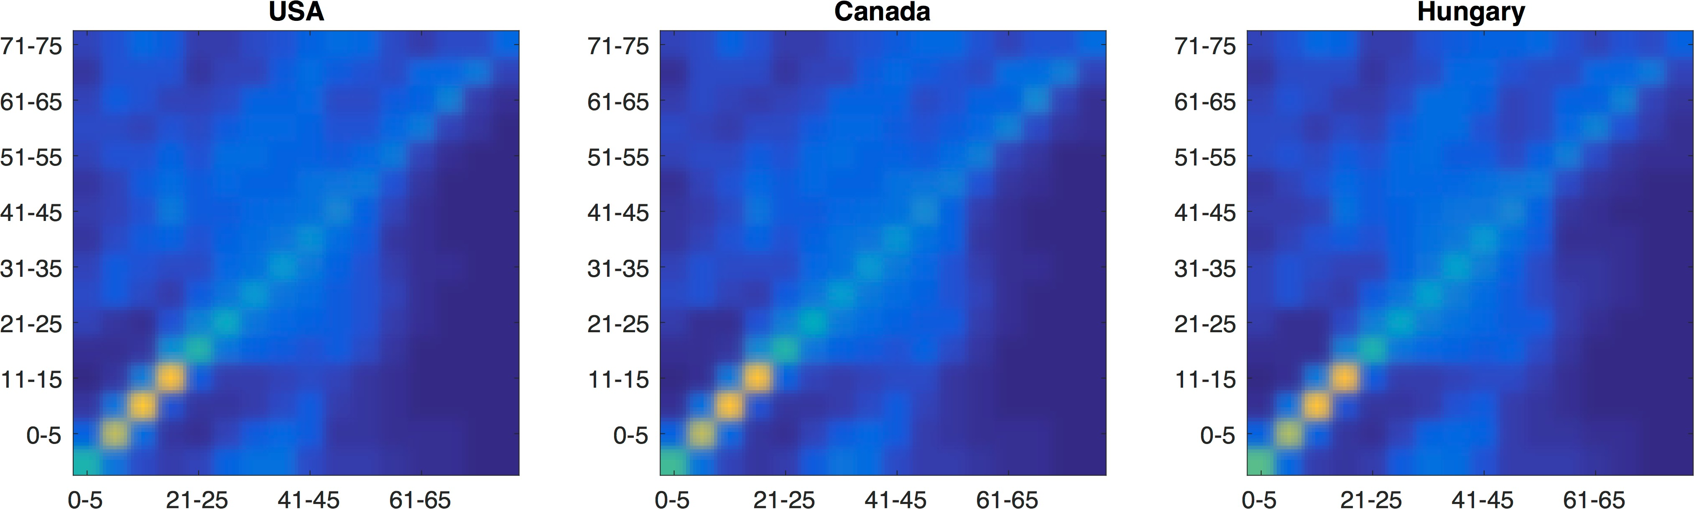
Parameters
Developed by LChilds, JGlasser, ZFeng, JHeffernan, JLi, GRost
Knowledge-based (Values or trends taken from the literature)
Assumed/expertise (Trends consistent w immunity/vaccination knowledge)
Fit to data (Restricted by identifiability)
Knight & Mishra, Infectious Disease Modelling, https://doi.org/10.1016/j.idm.2020.10.009. Clark, Andrew, et al. The Lancet Global Health 8.8 (2020): e1003-e1017. Prem, Cook, Jit. PLoS computational biology 13.9 (2017): e1005697.
3

Slide 4
Parameters
Developed by LChilds, JGlasser, ZFeng, JHeffernan, JLi, GRost
Knowledge-based (Values or trends taken from the literature)
Assumed/expertise (Trends consistent w immunity/vaccination knowledge)
Fit to data (Restricted by identifiability)
Fit β to R₀ = 2.6
Comorbidities in each age group determine the probability of mild, moderate and severe infection
Contact matrices from Prem et al.
Modify for different mitigation periods
Knight & Mishra, Infectious Disease Modelling, https://doi.org/10.1016/j.idm.2020.10.009. Clark, Andrew, et al. The Lancet Global Health 8.8 (2020): e1003-e1017. Prem, Cook, Jit. PLoS computational biology 13.9 (2017): e1005697.
4

Slide 5
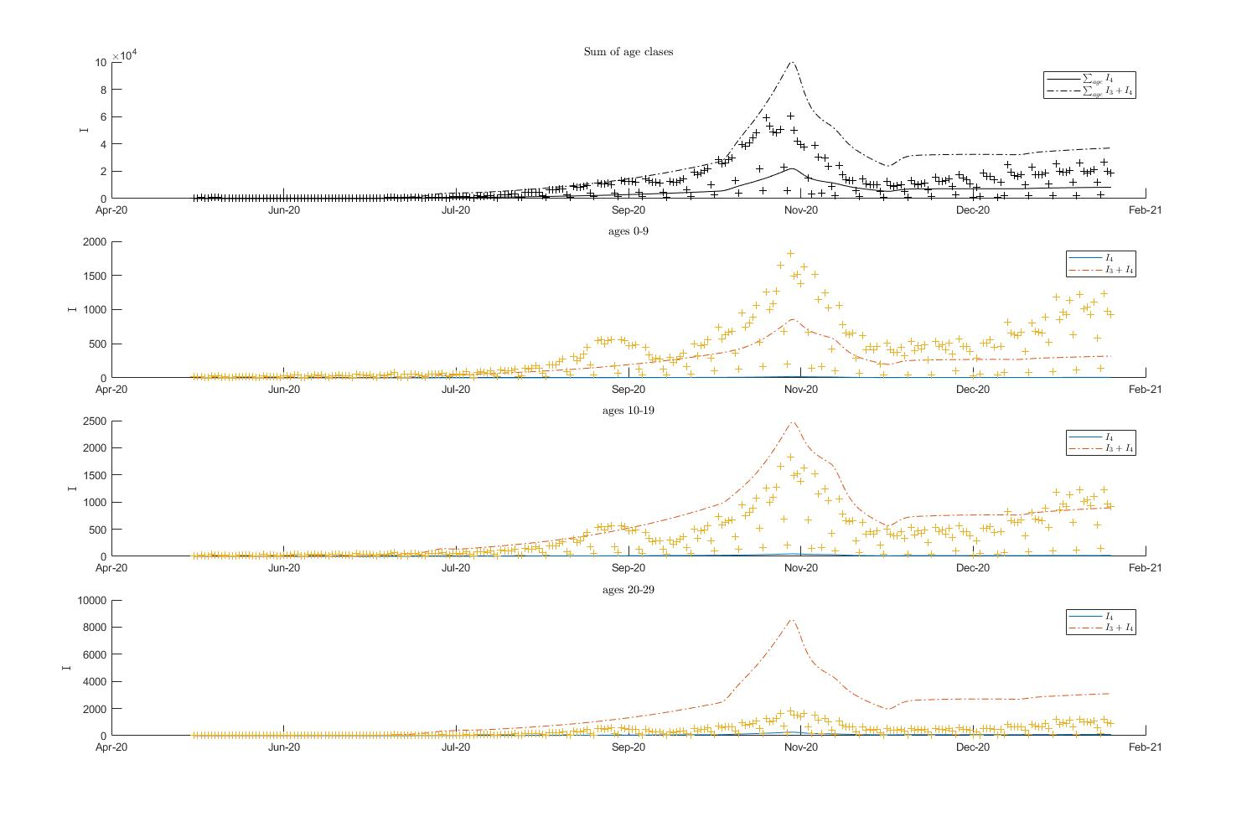
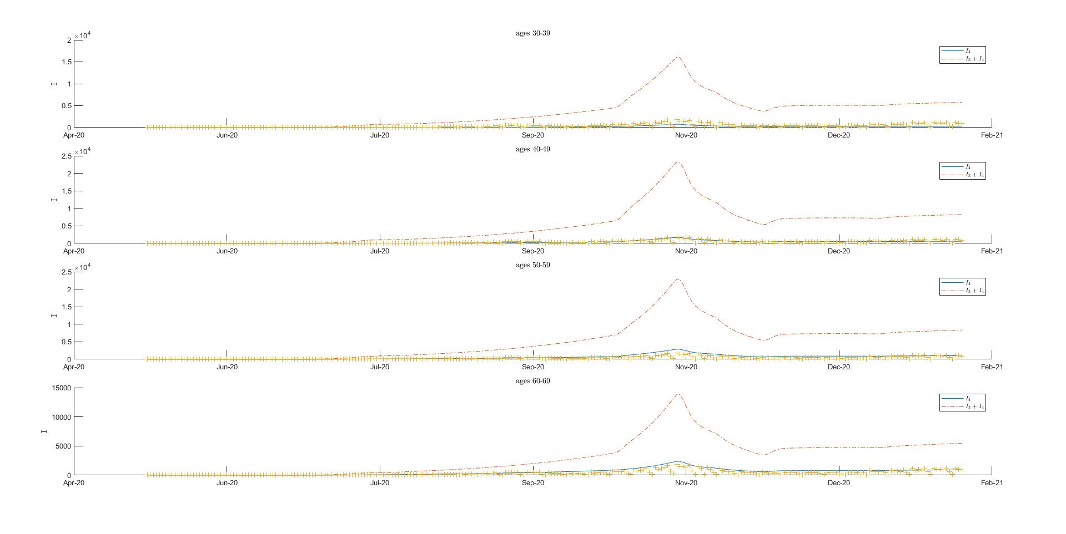
Preliminary (not great) Results
All ages
30-39
0-9
40-49
10-19
50-59
20-29
60-69
With LChilds, JGlasser, ZFeng, JHeffernan, JLi, GRost, DDick, MPrague, LWittkop, CVignals
Other age group not shown

Slide 6
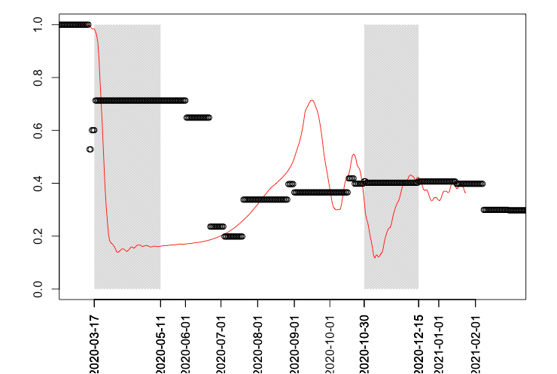
Scaling contact rate with fitted infectivity

