Slide 1
Answer Machine System

Slide 2
Acknowledgements
Thanks to my ALLAH for all of his gifts.
Then, thanks to Dr.\ Khaled F. Hussien.
Last I want to thank my dear friends for their support & help:
  Mahmoud abdel-sabour.
  Mahmoud hosny.

Slide 3
Project Description
Developing An Answering Machine System to Store Student’s opinions about faculty Courses

Slide 4
Brief History
If you call any large cinema looking for times for films, you will undoubtedly be forwarded to an automated system that tells you when each film is on.
This system is made possible by digital telephony.
Computer Telephony Integration, or CTI, systems routinely cost $10,000 and upward for enterprise-scale systems.
The high cost is largely a result of the misconceived idea that any telephony system requires loads of specialized hardware and, thus, is out of reach for the humble developer.
In fact, you can put a simple system together using no more than a cheap modem.

Slide 5
Features
Automatically answer the phone.
Playing audio back through a voice modem.
Responds to digits pressed by the user (DTMF Tones).
Store Student Opinions upon their choices.
Some other feature…

Slide 6
Requirements
Visual C#.Net
Microsoft Telephony Application Programming Interface (TAPI 2.2)
Windows Multimedia API Methods (Waveform Audio Methods)
Database Management System (DBMS)
A voice modem, system tested successfully on:
  SoftK56 Data Fax Voice Speakerphone modem
  Conexant Soft Voice SoftRing Modem
  But failed on: Motorola modems

Slide 7
Background

Slide 8
TAPI
TAPI stands for Telephony Application Programming Interface that is a set of API's designed by Intel and Microsoft jointly to make it easy to write application for telephony communication devices (like modems). With their help we no longer need to know a lot of hardware and their relative protocol details (like AT commands for modems).

Slide 9
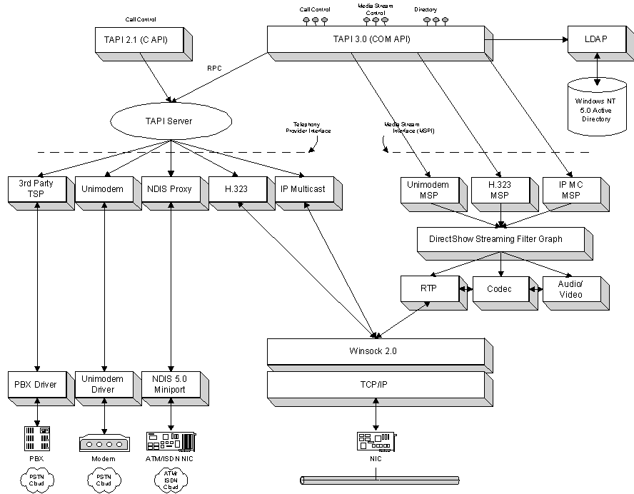

Slide 10
Tapi 2.2 VS. Tapi 3.1
Tapi 3.1 is newer version than tapi 2.2
But, this version is very simplified so we can’t understand the big picture
But in tapi 2.2, we define all structures, methods, event handlers & using of multimedia methods (waveform audio, MCI Interface & so on,,,)

Slide 11
TSP
There is a mechanism inside TAPI that makes it possible for different hardware manufacturer to give the developer a single interface to work with. While our application works with the set of APIs there is another side which is modem driver. manufacturer of the modem should write a driver capable of doing main TAPI functions. Look at Figure in next page

Slide 12
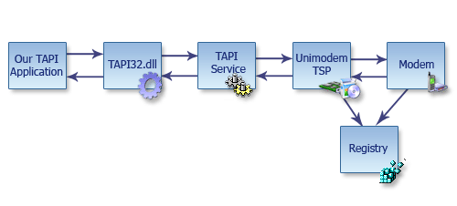
TSP

Slide 13

Line and Phone, Mic/SPK jacks
Look at your modem carefully, you'll see two big sockets (Like RJ45) at the bottom of it, one of them named Line and the other named Phone. Many people use them every day.
There is also, in some modems, two jacks marked as Mic and Speaker. you can use them to connect a line to a Headphone, if modem supports

Slide 14
Program Sequence
Tapi Initialization
Listen For Events
Find Voice Modem
& Register on it
Tapi Shutdown
Event Arrived
Call Disconnect
Digit
Pressed
Handle Event
Accept Call
Call Arrived
Store In DB
Audio Playback

Slide 15
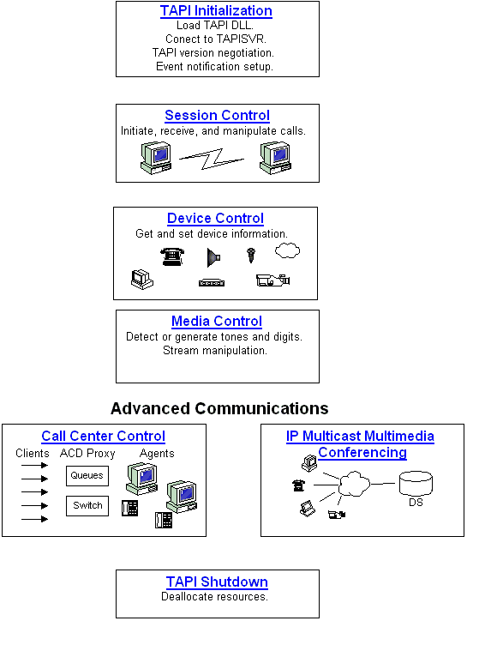
The Same Sequence

Slide 16
TAPI Call sequence
To write a TAPI application, we should start by finding out what's going on in the real world. What happens when we make a call, or when telephone rings, when the user presses a button, caller id comes,....
A simple sequence for an answering machine would be like this:
- Init a line/phone. (Now you know what a line/phone is!)
- Open a line/phone.
- Create an event receiving mechanism. Run a thread for example, to receive events)
- Do Telephony interactions.
- Shutdown and clean up.
each sequence has it's own details (subsequences) and calls to TAPI functions. Main calls listed Next:

Slide 17
TAPI Call sequence
Init:
- lineInitializeEx
- lineNegotiateAPIVersion
- lineGetDevCaps
Open:
- lineOpen
- lineSetNumRings
- lineSetStatusMessages
Creating an event thread
does not need any more calls to TAPI functions
Shutdown & Cleanup
- lineDrop
- lineClose
- lineDeallocateCall
- lineShutdown

Slide 18
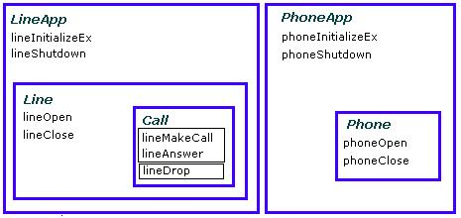
TAPI Call sequence

Slide 19
What a simple interface!!!!!
Seems to be easy? well, it's not that easy! Each call needs it's true inputs, beside, all outputs must be checked.
However a true output does not show a job well done (Asynchronous calls), but a wrong one shows an unsupported operation. There are other more important things either, like:
  handling memory allocation and de allocation,
  handling events and giving true responses
  And managing sound playback
  & ....

Slide 20
Using the code
Finally we are here. What do I offer?
-Finds appropriate Hardware (If exists at all!).
- Inits, opens and listens for messages relative to answering machine.
- Detects CallerID and DTMF and Inform you.
- Do any thing then…

Slide 21
Project Resources
Header Files: (Namespaces)
  Audio_Class.cs
  Tapi_Class.cs
Forms:
  Main form (has all controls on it).

Slide 22
TAPI Class Overview
This class contain declaration & Definitions of:
  Tapi Structures,
  Tapi Constants,
  Tapi Events And
  Tapi Methods.

Slide 23
TAPI Events
The core element of every TAPI application is the callback function LineCallBack. This is used to detect changes in the phone line, such as incoming calls, dropped calls, or key presses on the remote telephone keypad.
This is message handler returned from modem hardware.
public delegate int LineCallBackDelegate(int dwDevice,int dwMessage,int dwInstance,int dwParam1,int dwParam2,int dwParam3);
The purpose of this delegate is to ensure that the underlying telephony processes have something to call back to even after the program closes. This prevents Windows from crashing if your application does not shut down cleanly.

Slide 24
TAPI Events
The parameter dwMessage indicates broadly what has happened on the line, and
dwParam1 defines the event more concisely.

Slide 25
TAPI Events
Event (dwMessage ) | wParam(1/2) | How to process
LINE_APPNEWCALL |  | A handle to a call is available
LINE_LINEDEVSTATE | LINEDEVSTATE_RINGING | Ringing, please pick up the phone!
LINE_CALLINFO | LINECALLINFOSTATE_CALLERID | CallerID
LINE_CALLSTATE | LINECALLSTATE_CONNECTED | A connection established
LINE_MONITORDIGITS | Type of DTMF | The other party pressed a digit
LINE_REPLY |  | sent to report the results of function calls that completed asynchronously
LINE_CALLSTATE | LINECALLSTATE_DISCONNECTED | The remote party has disconnected from the call

Slide 26
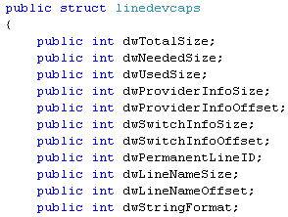
Tapi Structures
  LINEDEVCAPS Structure:-
    describes the capabilities of a line device.
Total size allocated to this data structure, in bytes.
Size needed for this data structure to hold all the returned information, in bytes.
Size of the portion of this data structure that contains useful information, in bytes.
Size of the variably sized field containing service provider information, in bytes.
Offset from the beginning of the structure to the service provider information, in bytes.
Size of the variably sized device field containing switch information, in bytes.
Offset from the beginning of the structure to the switch information, in bytes.
  Size & Offset of the variably sized device field containing a user configurable name for this line device, in bytes.
Permanent identifier by which the line device is known in the system's configuration.

Slide 27

Tapi Structures
  LINEDEVCAPS Structure:-
    describes the capabilities of a line device.
Flag array that indicates the different media types the address is able to support.
Digit modes than can be detected on this line (DTMF, Pulse).
Minimum value that can be specified for both the first digit and inter-digit timeout values.
Maximum value that can be specified for both the first digit and inter-digit timeout values used by lineGatherDigits, in milliseconds .
Different line status components for which the application may be notified in a LINE_LINEDEVSTATE message on this line (CONNECTED , OPEN , CLOSE ).
Pointer to null terminated string contain all description of modem devices such as their names, extensions,...

Slide 28
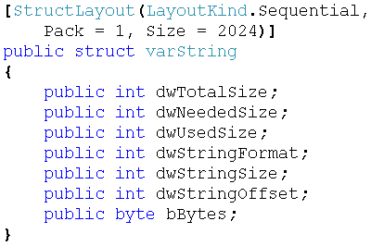
Tapi Structures
VarString Structure:-
  used for returning variably sized strings.
Total size allocated to this data structure, in bytes
Size for this data structure that is needed to hold all the returned information.
Size of the portion of this data structure that contains useful information.
Size of the string information.
Offset from the beginning of the structure to the variably sized device field containing the string information.
Array Contain all info.

Slide 29
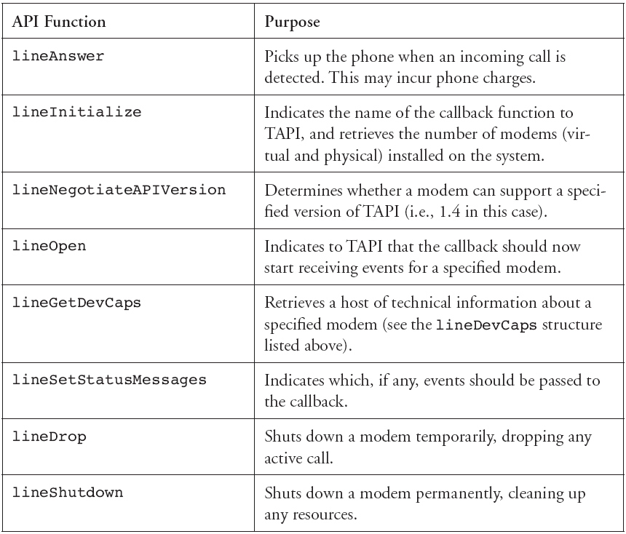
Tapi Methods Again

Slide 30

Tapi Methods Parameters
Pointer to a location that is filled with the application's usage handle for TAPI
Instance handle of the client application or DLL
Address of a callback function that is invoked to determine status and events on the line device
Pointer to a null-terminated text string that contains only displayable characters,
Unused
the number of line devices available to the application.

Slide 31
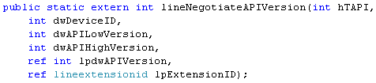
Tapi Methods Parameters
Pointer to a location that is filled with the application's usage handle for TAPI
Identifier of the line device to be queried.
Earliest TAPI version with which the application is compliant.
Latest TAPI version with which the application is compliant.
Pointer to a variable that contains the TAPI version number that was negotiated.
Pointer to a structure of type LINEEXTENSIONID.

Slide 32
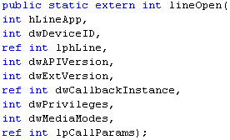
Tapi Methods Parameters
Handle to the application's registration with TAPI.
Returns zero if the request succeeds or a negative error number if an error occurs
line identifier to be opened. It can either be a valid device identifier or the value:LINEMAPPER
  This value is used to open a line device in the system that supports the properties specified in lpCallParams.
Pointer to an HLINE handle that is then loaded with the handle representing the opened line device. (Line Handle)
API version number under which the application and Telephony API have agreed to operate.
Extension version number under which the application and the service provider agree to operate.
This parameter is not interpreted by the Telephony API.
Privilege the application wants when notified of a call
The media type or modes of interest to the application, Shown Next.
This pointer is only used if LINEMAPPER is used; otherwise it is ignored. It describes the call parameter that the line device should be able to provide.

Slide 33
What Are media types!!!
LINEMEDIAMODE_AUTOMATEDVOICE
  Voice energy was detected on the call, and the voice is locally handled by an automated application such as with an answering machine application. When a service provider cannot distinguish between interactive and automated voice on an incoming call, it will report the call as interactive voice.
LINEMEDIAMODE_DATAMODEM
  A data modem session on the call. Current modem protocols require the called station to initiate the handshake. For an incoming data modem call, the application can typically make no positive detection. How the service provider makes this determination is its choice. For example, a period of silence just after answering an incoming call can be used as a heuristic to decide that this might be a data modem call.
LINEMEDIAMODE_INTERACTIVEVOICE
  Voice energy was detected on the call, and the call is handled as an interactive voice call with humans on both ends.
& More …

Slide 34
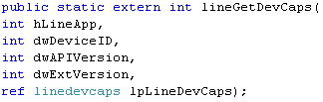
Tapi Methods Parameters
Returns zero if the request succeeds or a negative error number if an error occurs
Line Handle
Line Device Identifier
Version number of the Telephony API to be used
Version number of the service provider-specific extensions to be used.
Pointer to a variably sized structure of type LINEDEVCAPS. Upon successful completion of the request, this structure is filled with line device capabilities information.

Slide 35



Tapi Methods Parameters
Line Handle
Bit array that identifies for which line-device status changes a message is to be sent to the application.
Bit array that identifies for which address status changes a message is to be sent to the application.
But Unused.
Handle to the call to be answered.
Pointer to a null-terminated string containing user-user information to be sent to the remote party at the time the call is answered.
Size of the user-user information in lpsUserUserInfo, in bytes
What Difference with above, No ref because here we pass parameter to get not to set

Slide 36

Tapi Methods Parameters
Handle to the call on which digits are to be detected.
Digit mode or modes that are to be monitored. If zero, digit monitoring is canceled.
LINEDIGITMODE_DTMF
Uses DTMF tones to signal digits. Valid digits are 0 through 9, '*', '#', 'A', 'B', 'C', and 'D'.
  LINEDIGITMODE_PULSE
        Uses rotary pulse sequences to signal digits. Valid digits are 0 through 9.
Which Modes

Slide 37
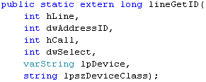
Tapi Methods Parameters
Handle to an open line device.
Address on the given open line device. An address identifier is permanently associated with an address; the identifier remains constant across operating system upgrades.
ref
Handle to a call.
Specifies whether the requested device identifier is associated with the line, address or a single call.
Pointer to varString where the device identifier is returned.
Pointer to a null-terminated string that specifies the device class of the device whose identifier is requested.
(wave/out), (wave/in),…
Application's usage handle for the line API.

Slide 38
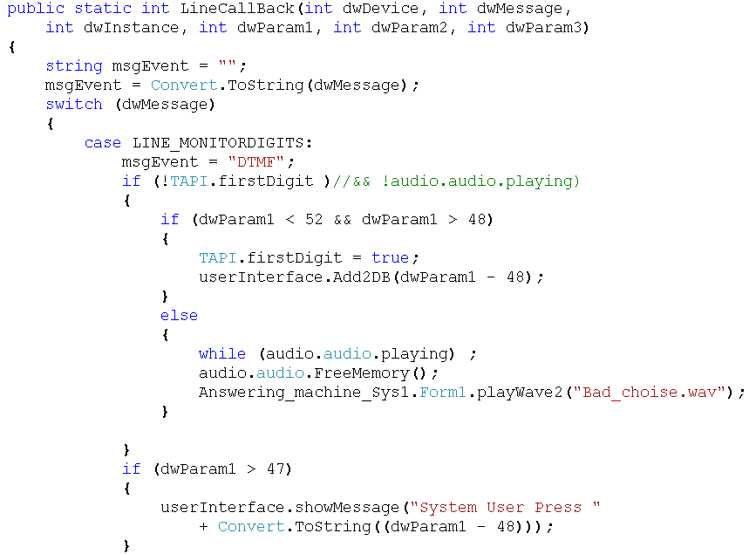
Tapi Class Code

Slide 39
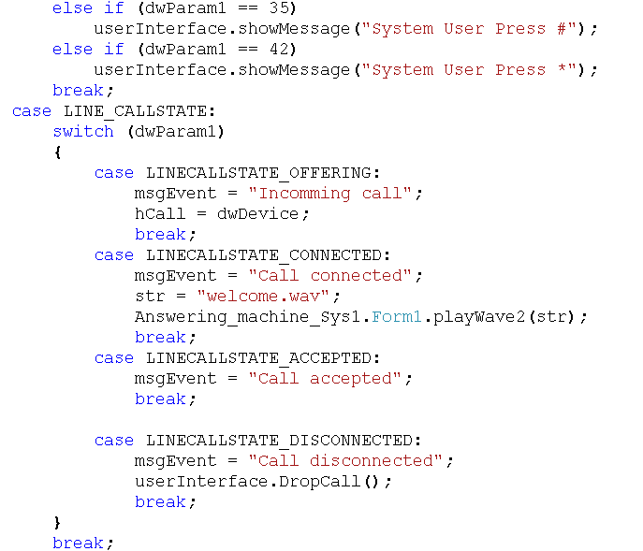
Tapi Class Code

Slide 40
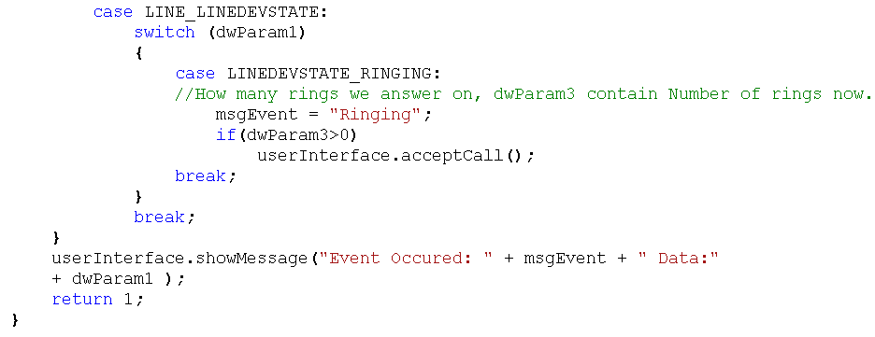
Tapi Class Code

Slide 41
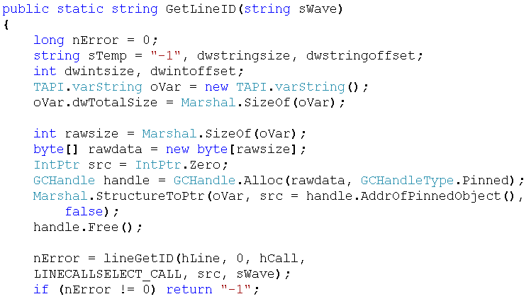
Tapi Class Code

Slide 42
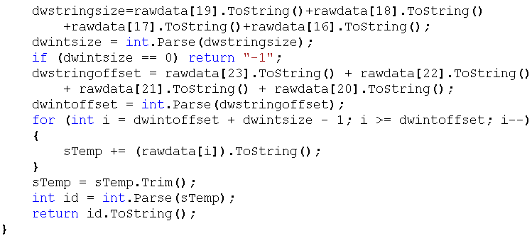
Tapi Class Code

Slide 43
Oh No Wait, what about sounds?!!

Slide 44
Sound playback
Sound playback is one of the points you would be very careful using it. Some critical errors might occur here. There are a lot of considerations like sound format, quality, buffering and unbuffering truly and on time
There are some considerations:
Selecting a sound quality depends on your modem capabilities. Today almost all types of voice modems support 'Wave PCM 8.000 KHz; 16 bit; Mono', which is the best possible format! because this is the best quality(8 KHz voice) that real phone lines and cables and communication tools (at least in my country), are capable to transform. But this quality is almost bad! Volume is low, so we'll have to record our voice a bit louder, so that at the other side it turns to an acceptable one. Try it yourself. perhaps for a rest!
However Microsoft says the true format is 8.000KHZ 8 bit mono CCITT u-law (Microsoft Knowledge Base Article ID: Q142745).
Buffering is another issue.

Slide 45
Audio Class Overview
This class Contain definitions of structures & methods using to play Wave form audio files (streams)

Slide 46
Resource Interchange File Format Services (RIFF)
The preferred format for multimedia files is resource interchange file format (RIFF). The RIFF file I/O functions work with the basic buffered and unbuffered file I/O services. You can open, read, and write RIFF files in the same way as other file types.
RIFF files use four-character codes to identify file elements. These codes are 32-bit quantities representing a sequence of one to four ASCII alphanumeric characters, padded on the right with space characters. The data type for four-character codes is FOURCC. Use the mmioFOURCC macro to convert four characters into a four-character code. To convert a null-terminated string into a four-character code, use the mmioStringToFOURCC function.
The basic building block of a RIFF file is a chunk. A chunk is a logical unit of multimedia data, such as a single frame in a video clip. Each chunk contains the following fields:
  A four-character code specifying the chunk identifier
  A doubleword value specifying the size of the data member in the chunk
  A data field, The following illustration shows a "RIFF" chunk that contains two subchunks.

Slide 47
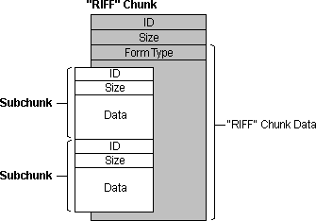
Resource Interchange File Format Services (RIFF)
The following illustration shows a "RIFF" chunk that contains two subchunks.

Slide 48
Resource Interchange File Format Services (RIFF)
A chunk contained in another chunk is a subchunk. The only chunks allowed to contain subchunks are those with a chunk identifier of "RIFF" or "LIST". A chunk that contains another chunk is called a parent chunk. The first chunk in a RIFF file must be a "RIFF" chunk. All other chunks in the file are subchunks of the "RIFF" chunk.
"RIFF" chunks include an additional field in the first four bytes of the data field. This additional field provides the form type of the field. The form type is a four-character code identifying the format of the data stored in the file. For example, Microsoft waveform-audio files have a form type of "WAVE".

Slide 49
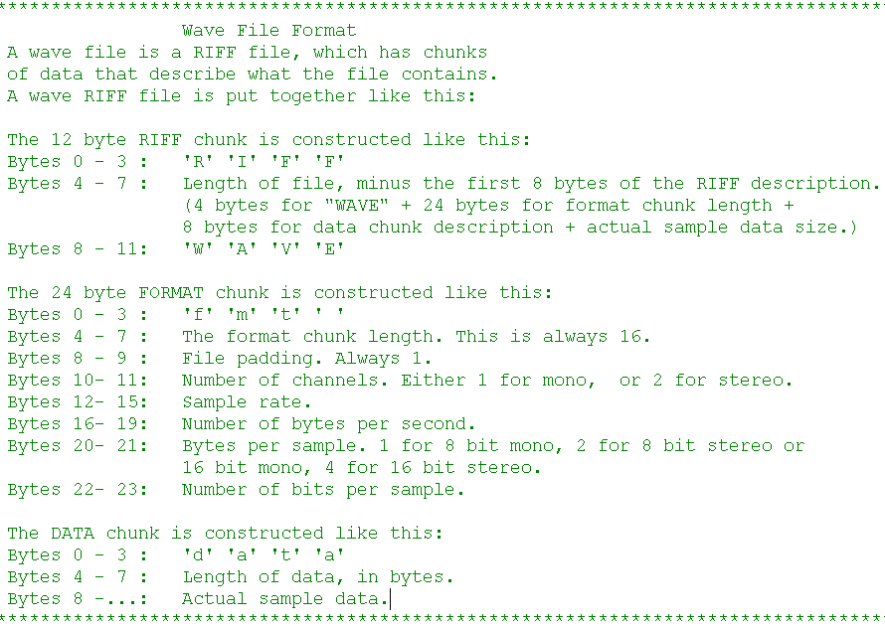

Slide 50
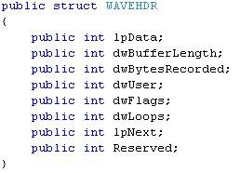
Waveform Audio Structures
WAVEHDR Structure
  defines the header used to identify a waveform-audio buffer.
Pointer to the waveform buffer.
Length, in bytes, of the buffer.
When the header is used in input, this member specifies how much data is in the buffer
User data ,like what?!!!
Flags supplying information about the buffer, Specified in next Slide
Number of times to play the loop. This member is used only with output buffers.
Reserved.

Slide 51
dwFlags Flags
WHDR_BEGINLOOP
  This buffer is the first buffer in a loop. This flag is used only with output buffers.
WHDR_DONE
  Set by the device driver to indicate that it is finished with the buffer and is returning it to the application.
WHDR_ENDLOOP
  This buffer is the last buffer in a loop. This flag is used only with output buffers.
WHDR_INQUEUE
  Set by Windows to indicate that the buffer is queued for playback.
WHDR_PREPARED
  Set by Windows to indicate that the buffer has been prepared with the waveInPrepareHeader or waveOutPrepareHeader function.

Slide 52
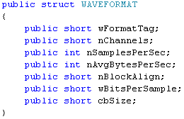
Waveform Audio Structures
WAVEFORMAT Structure
  describes the format of waveform-audio data, This structure has been superseded by the WAVEFORMATEX structure.
Format type. The following type is defined:
WAVE_FORMAT_PCM: Waveform-audio data is PCM.
Number of channels in the waveform-audio data. Mono data uses one channel and stereo data uses two channels.
Sample rate, in samples per second.
Required average data transfer rate, in bytes per second. For example, 16-bit stereo at 44.1 kHz has an average data rate of 176,400 bytes per second (2 channels — 2 bytes per sample per channel — 44,100 samples per second).
Block alignment, in bytes. The block alignment is the minimum atomic unit of data.
Size, in bytes, of extra format information appended to the end of the WAVEFORMATEX structure.
Bits per sample for the wFormatTag format type. If wFormatTag is WAVE_FORMAT_PCM, then wBitsPerSample should be equal to 8 or 16.

Slide 53
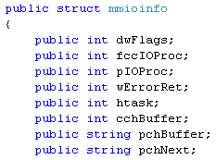
Waveform Audio Structures
MMIOINFO Structure
  contains the current state of a file opened by using the mmioOpen function.
Flags specifying how a file was opened.
Four-character code identifying the file's I/O procedure. If the I/O procedure is not an installed I/O procedure, this member is NULL.
Pointer to file's IO procedure.
Extended error value from the mmioOpen function if it returns NULL. This member is not used to return extended error information from any other functions.
Handle to a local I/O procedure. Media Control Interface (MCI) devices that perform file I/O in the background and need an I/O procedure can locate a local I/O procedure with this handle.
Size, in bytes, of the file's I/O buffer.
Pointer to the next location in the I/O buffer to be read or written.
Pointer to the file's I/O buffer.

Slide 54
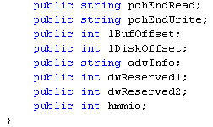
Waveform Audio Structures
MMIOINFO Structure
  contains the current state of a file opened by using the mmioOpen function.
Pointer to the location that is 1 byte past the last location in the buffer that can be read.
Pointer to the location that is 1 byte past the last location in the buffer that can be written.
Reserved.
Current file position, which is an offset, in bytes, from the beginning of the file.
State information maintained by the I/O procedure. I/O procedures can also use these members to transfer information from the application to the I/O procedure when the application opens a file.
Reserved.
Handle to the open file, as returned by the mmioOpen function. I/O procedures can use this handle when calling other multimedia file I/O functions.

Slide 55
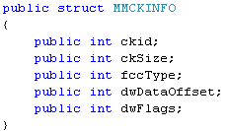
Waveform Audio Structures
MMCKINFO Structure
  contains information about a chunk in a RIFF file.
Chunk identifier.
Size, in bytes, of the data member of the chunk. The size of the data member does not include the 4-byte chunk identifier, the 4-byte chunk size, or the optional pad byte at the end of the data member.
Form type for "RIFF" chunks or the list type for "LIST" chunks.
File offset of the beginning of the chunk's data member, relative to the beginning of the file.
Flags specifying additional information about the chunk. It can be zero or the following flag:
MMIO_DIRTY
The length of the chunk might have changed and should be updated by the mmioAscend function. This flag is set when a chunk is created by using the mmioCreateChunk function.

Slide 56
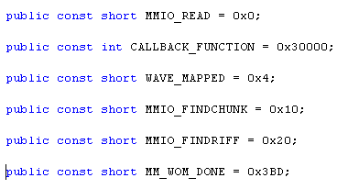
Waveform Audio Constants
Buffer is filled from the file.
Determine that this value is the call back function to be called when an event occurred
The function selects a waveform-audio output device capable of playing the given format.
Searches for a chunk with the specified chunk identifier.
Searches for a chunk with the chunk identifier "RIFF" and with the specified form type.
sent to a window when the given output buffer is being returned to the application.

Slide 57
Multimedia Methods Used
GlobalAlloc | Allocates a block of memory of a specified size
GlobalLock | Prevents other processes from using a specified block of memory
GlobalFree | Releases a block of memory
mmioOpen | Opens an audio source (e.g., a wave file)
mmioReadFormat | Retrieves the format of an audio source and details including bit rate, stereo/mono, quality, etc.

Slide 58
Multimedia Methods Used
mioStringToFOURCC | Converts a null-terminated string to a four-character code
mmioRead | Reads data from an audio source into memory
mmioDescend | Descends into a chunk of a RIFF file that was opened by using the mmioOpen function; can also search for a given chunk
mmioAscend | Ascends out of a chunk in a RIFF file descended into with the mmioDescend function or created with the mmioCreateChunk function
mmioClose | Closes an audio input or output device

Slide 59
Multimedia Methods Used
waveOutOpen | Opens an audio output device
waveOutPrepareHeader | Indicates the format of the raw audio data to the wave-out device, so that it can play the sound at the correct speed and knows its format
waveOutWrite | Tells the audio output device to begin playing the sound
waveOutPause | pauses playback on the given waveform-audio output device. The current position is saved.
waveOutRestart | resume playback from the current position.
waveOutReset | stops playback on the given waveform-audio output device and resets the current position to zero.

Slide 60
Multimedia Methods Parameters
mmioOpen
  Parameters
    szFilename
    Pointer to a string containing the filename of the file to open.
    lpmmioinfo
    Pointer to an MMIOINFO structure containing extra parameters
    dwOpenFlags
    Flags for the open operation.
  Return Values
    Returns a handle of the opened file. If the file cannot be opened, the return value is NULL.

Slide 61
Multimedia Methods Parameters
mmioRead
  Parameters
    hmmio
    File handle of the file to be read.
    pch
    Pointer to a buffer to contain the data read from the file.
    cch
    Number of bytes to read from the file.
  Return Values
    Returns the number of bytes actually read. If the end of the file has been reached and no more bytes can be read, the return value is 0. If there is an error reading from the file, the return value is - 1.

Slide 62
Multimedia Methods Parameters
mmioClose
  Parameters
    hmmio
    File handle of the file to close.
    wFlags
    Flags for the close operation.
  Return Values
    Returns zero if successful or an error otherwise.

Slide 63
Multimedia Methods Parameters
mmioDescend
  Parameters
    hmmio
    File handle of an open RIFF file.
    lpck
    Pointer to a buffer that receives an MMCKINFO structure.
    lpckParent
    Pointer to an optional application-defined MMCKINFO structure identifying the parent of the chunk being searched for
    wFlags
    Search flags.
      MMIO_FINDCHUNK: Searches for a chunk with the specified chunk identifier.
      MMIO_FINDLIST: Searches for a chunk with the chunk identifier "LIST" and with the specified form type.
      MMIO_FINDRIFF: Searches for a chunk with the chunk identifier "RIFF" and with the specified form type.
  Return Values
    Returns MMSYSERR_NOERROR if successful or an error otherwise.

Slide 64
Multimedia Methods Parameters
mmioAscend
  Parameters
    hmmio
    File handle of an open RIFF file.
    lpck
    Pointer to an application-defined MMCKINFO structure previously filled by the mmioDescend or mmioCreateChunk function.
    wFlags
    Reserved; must be zero.
  Return Values
    Returns MMSYSERR_NOERROR if successful or an error otherwise.

Slide 65
Multimedia Methods Parameters
mmioStringToFOURCC
  Parameters
    sz
    Pointer to a null-terminated string to convert to a four-character code.
    wFlags
    Flags for the conversion. The following value is defined:
      MMIO_TOUPPER:
      Converts all characters to uppercase.
  Return Values
    Returns the four-character code created from the given string.

Slide 66
Multimedia Methods Parameters
waveOutOpen
  Parameters
    phwo
    Pointer to a buffer that receives a handle identifying the open waveform-audio output device.
    uDeviceID
    Identifier of the waveform-audio output device to open. It can be either a device identifier or a handle of an open waveform-audio input device. You can use the following flag instead of a device identifier.
      WAVE_MAPPER: The function selects a waveform-audio output device capable of playing the given format.
    pwfx
    Pointer to a WAVEFORMATEX structure that identifies the format of the waveform-audio data to be sent to the device.
    dwCallback
    Pointer to a fixed callback function, an event handle, a handle to a window, or the identifier of a thread to be called during waveform-audio playback to process messages related to the progress of the playback. If no callback function is required, this value can be zero.
    dwCallbackInstance
    User-instance data passed to the callback mechanism. This parameter is not used with the window callback mechanism.
    fdwOpen
    Flags for opening the device.
  Return Values: Returns MMSYSERR_NOERROR if successful or an error otherwise.

Slide 67
Multimedia Methods Parameters
waveOutPrepareHeader
  Parameters
    hwo
    Handle to the waveform-audio output device.
    pwh
    Pointer to a WAVEHDR structure that identifies the data block to be prepared.
    cbwh
    Size, in bytes, of the WAVEHDR structure.
  Return Values
    Returns MMSYSERR_NOERROR if successful or an error otherwise.

Slide 68
Multimedia Methods Parameters
waveOutWrite
  Parameters
    hwo
    Handle to the waveform-audio output device.
    pwh
    Pointer to a WAVEHDR structure containing information about the data block.
    cbwh
    Size, in bytes, of the WAVEHDR structure.
  Return Values
    Returns MMSYSERR_NOERROR if successful or an error otherwise.

Slide 69
Multimedia Methods Parameters
waveOutPause
  Parameters
    hwo
    Handle to the waveform-audio output device.
  Return Values
    Returns MMSYSERR_NOERROR if successful or an error otherwise.

Slide 70
Multimedia Methods Parameters
waveOutRestart
  Parameters
    hwo
    Handle to the waveform-audio output device.
  Return Values
    Returns MMSYSERR_NOERROR if successful or an error otherwise.

Slide 71
Multimedia Methods Parameters
waveOutReset
  Parameters
    hwo
    Handle to the waveform-audio output device.
  Return Values
    Returns MMSYSERR_NOERROR if successful or an error otherwise.

Slide 72
Multimedia Methods Parameters
GlobalAlloc
  Parameters
  uFlags
    [in] Memory allocation attributes. If zero is specified, the default is GMEM_FIXED. This parameter can be one or more of the following values, except for the incompatible combinations that are specifically noted.
    0x0000 Allocates fixed memory.
    0x0002 Allocates movable memory. Memory blocks are never moved in physical memory, but they can be moved within the default heap.
    0x0040 Initializes memory contents to zero.
  dwBytes
    [in] Number of bytes to allocate.
  Return Values
    If the function succeeds, the return value is a handle to the newly allocated memory object.
    If the function fails, the return value is NULL.

Slide 73
Multimedia Methods Parameters
GlobalLock
  Parameters
  hMem
    [in] Handle to the global memory object. This handle is returned by the GlobalAlloc function.
  Return Values
    If the function succeeds, the return value is a pointer to the first byte of the memory block.
    If the function fails, the return value is NULL.

Slide 74
Multimedia Methods Parameters
GlobalFree
  Parameters
  hMem
    [in] Handle to the global memory object. This handle is returned by the GlobalAlloc function.
  Return Values
    If the function succeeds, the return value is NULL.
    If the function fails, the return value is equal to a handle to the global memory object.

Slide 75
Audio play Back steps
Open file & load it into memory
Lock memory segments
Play segments
Stop playback
Free resources

Slide 76
Load Method
This Method will load a wave file from disk into memory and then play it through the sound card (any device) on request.
Loading a wave file into memory is done in two stages.
  The first is where the format of the audio is extracted from the wave file. The audio format includes details about the quality (16-bit or 8-bit), bit rate (44 kbps for CD quality), and whether the audio is mono or stereo.
  The audio format is stored in a public variable named format_wave.
  The next step is to pull the data segment of the wave file into memory. A wave file can be several megabytes in size, so for better performance, the memory is allocated directly from the heap using GlobalAlloc.
The wave file is then read into this memory using mmioRead. Once the operation is complete, the file is closed.

Slide 77
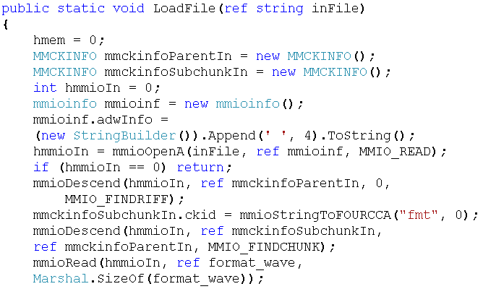
Load Method

Slide 78
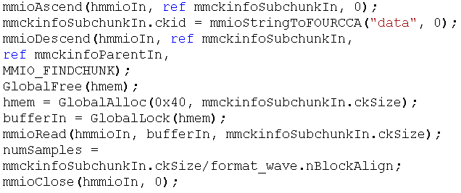
Load Method

Slide 79
Play Method
Once the wave file is in memory, the sound card (or Device) can be instructed to play the audio with a call to this next function, named Play.
This function is asynchronous and can be called more than once during the playing of a sound clip, provided the hardware supports it. The sound card will fetch the audio from memory as required using a process known as direct memory access (DMA).
Because the audio format is stored in public variables, that data needs to be transferred to the sound card such that it can correctly play back the sounds at the right speed and quality. Once waveOutPrepareHeader has set the sound card up, waveOutWrite then starts the sound playing.
The parameter that method take is of type short which conclude for the device id to play sound within it.

Slide 80
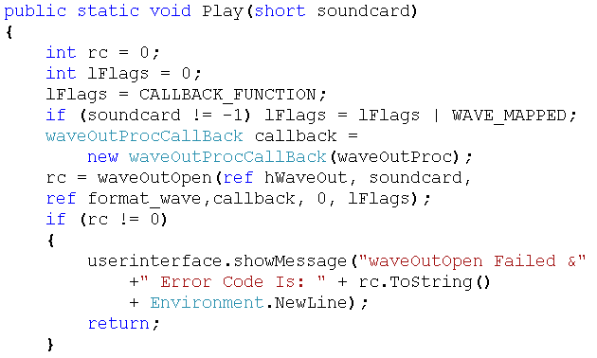
Play Method

Slide 81
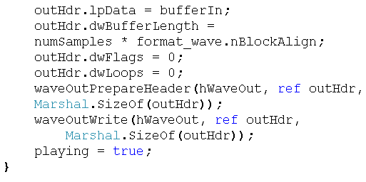
Play Method

Slide 82
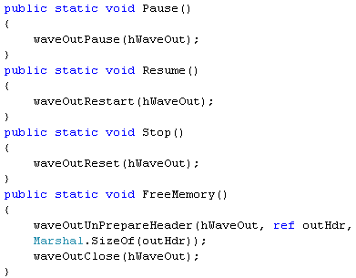
Other Methods

Slide 83
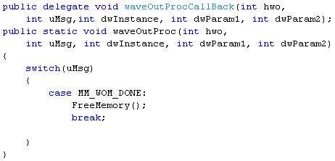
PlayBack Event Handler

Slide 84
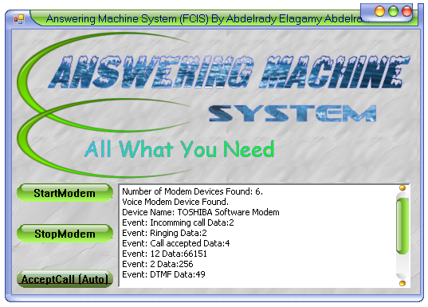
What About Interface?!!!

Slide 85
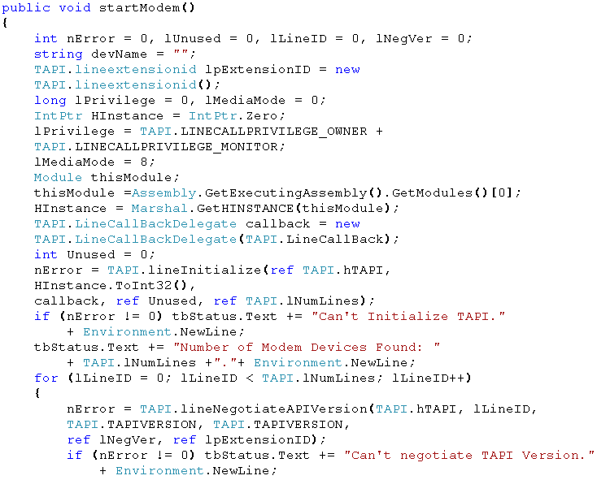
User Interface Code

Slide 86
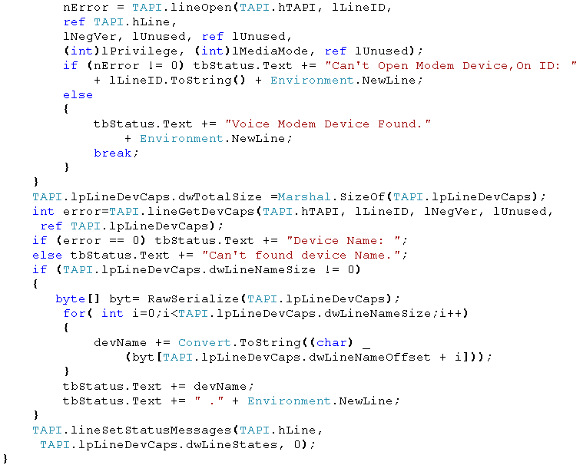
User Interface Code

Slide 87
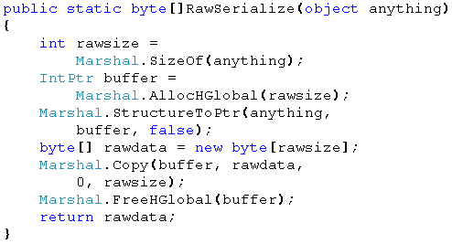
User Interface Code

Slide 88
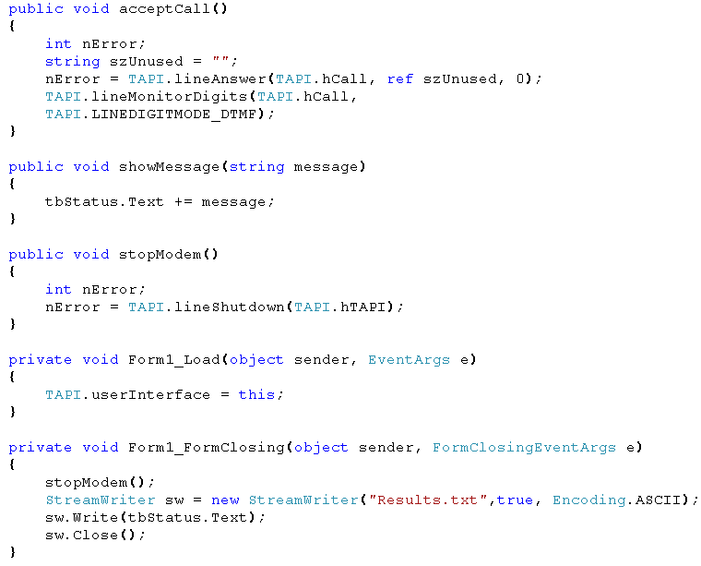
User Interface Code

Slide 89
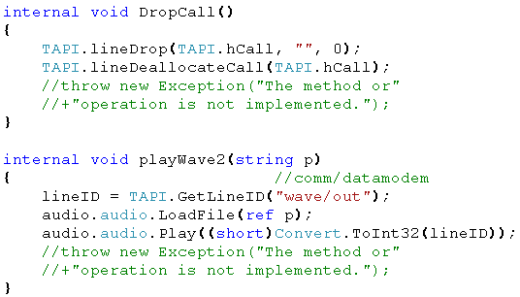
User Interface Code

Slide 90
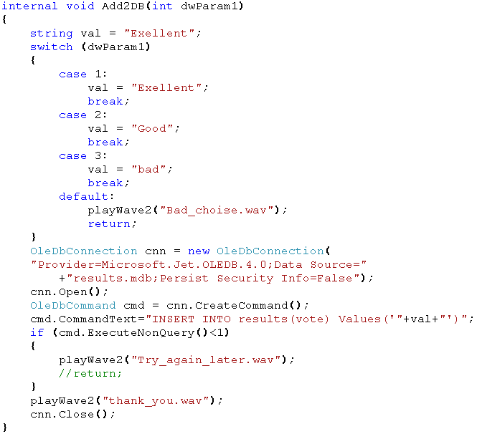
User Interface Code

Slide 91

Are there more slides?!!!

Slide 92
References
Digital.Press.Network.programming.in.dot.NET.C.Sharp.and.Visual.Basic.dot.NET E-book
Mapi Sapi And Tapi Developers Guide E-book
Samples on http://www.codeproject.com
Microsoft Developer Network (MSDN)
Tapi 2.2 Software Development Kit (SDK).
Samples on http://www.exceletel.com

Slide 93
With My Best Wishes
Good Bye

