Slide 1
OpenAL “Play Stream” sample
By
sadawy kamel sadawy

Slide 2
Why streaming?
Playing stream used in case of big audio files that is based initially in dividing source file into streams in memory not loading the entire big file into memory and play it “buffer by buffer”.
we need two or more buffers ,one to be loaded into memory and played other to be in the same time being “Recharged” from the next part of audio file

Slide 3
Implementation details
Once the C++ solution is opened two folders appeared the “Framwork” and “Source Files”
Source Files Contains the “PlayStream.cpp” which contains code to run program that uses Framework files

Slide 4
Framwork files
Which contains OpenAL Utilities
  “aldlist.h” responsible for processing audio devices such as Getting device name , count and the default device.
  “CWaves.h” for wave files manipulation
  such as open, load or even read wave
  file.

Slide 5
Framwork files cont.
  “Framework.h” which provides an easy interface for device initialization and closing such as “ALFWInit();” that allocates the CWaves Object.

Slide 6
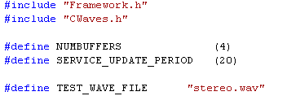
Code
Number of buffers that the wave file will be loaded into
The amount of milliseconds needed to reload buffers
Target File name to be played

Slide 7
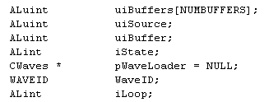
Used to generate al buffers “the 4 Buffers”
The source only one
An in variable that is used to identify device state
Pointer to the object that will hold wave file attributes and specification
Index To loop over buffers

Slide 8
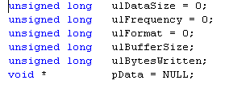
Wave file attributes kept here

Slide 9


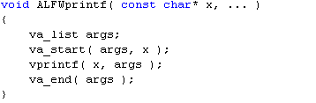

Slide 10
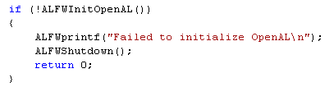
Responsible for:-
  Enumerating device list
  Getting the default device
  Prompt user to select device
  Processing user input
  Returns Null if fail or no devices in machine

Slide 11

Inside ALFWInitOpenAL()
Allocating new device list object.
If enough memory to hold retrieve number of currently installed devices.

Slide 12
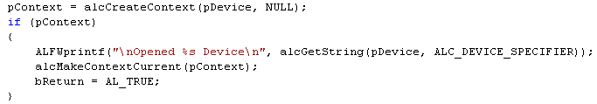
Inside ALFWInitOpenAL() cont.
Choosed device are retrieved by name .
If successfully opened create the suitable context and make it the current.

Slide 13
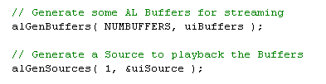
Back to playStream.cpp
Generate 4 buffers and one source for the sound.

Slide 14
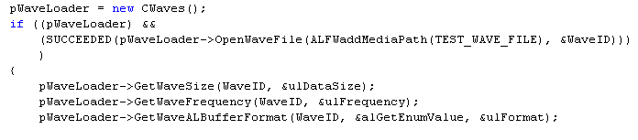
Load the file and assign to it an ID if so initialize
  Size
  Frequency
  And format
Cont.

Slide 15
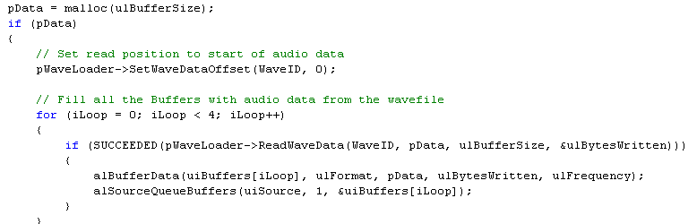
Allocate the space to buffer
Begin read in charge the four buffers

Slide 16

finally
Thanks

